Slide 1
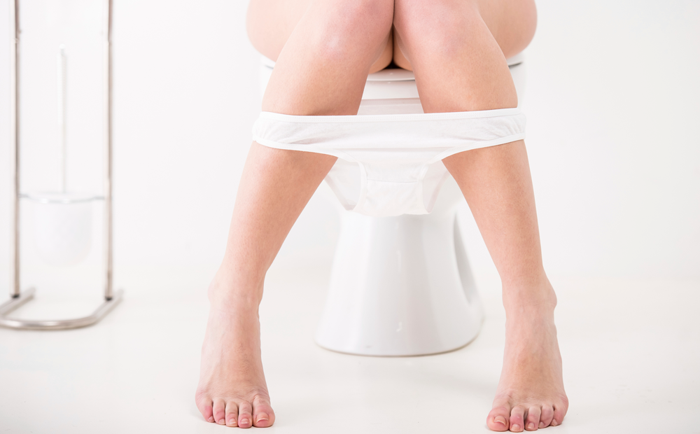



Hormonal treatment in postmenopausal women with nocturia:
Bladder, kidney or sleep?
Kim Pauwaert

Slide 2

Menopause and nocturia: What’s the link?
FLUID INTAKE
SLEEP
Dry mouth
Hot flushes
Isomnia
UROGENITAL
RENAL
Vaginal atrophy
Higher prevalance of OAB
Nocturnal polyuria ↑ as ADH ↓ and RAAS ↓
Pauwaert K, Goessaert AS, Ghijselings L, Monaghan TF, Depypere H, Everaert K. 2021. Nocturia through the menopausal transition and beyond: a narrative review [Internet]. International Urogynecology Journal. doi: 10.1007/s00192-020-04640-7

Slide 3



Menopause and NP: Aim of research
Need for research in women with nocturnal polyuria

Slide 4
Menopause and NP
INCLUSION
INTERVENTION
Groups
PARAMETERS
Prospective, observational study
Systemic hormonal treatment during 3 months
Women with NP
Women without NP
Frequency Volume Chart during 72 hours
Renal function profile

Slide 5
Menopause and NP: Results
N = 32 → NP in 17/32 women
Median age 52 years
Median BMI 25,5 kg/m2

Slide 6
Menopause and NP: Results
 | No nocturnal polyuria N = 15 |  |  | Nocturnal Polyuria N = 17
 | Before | After | P – Value* | Before | After | P – Value*
Total fluid intake (ml) | 2200 (1885 – 2700) | 2000 (1228.3 – 2193.3) | 0.005 | 1891 (1575 – 2687) | 1549.5 (1354 – 2127.3) | 0.008
Total urine volume (ml) | 2385 (2100 -2988) | 2257.5 (1625.8 – 2832.5) | 0.5 | 1771 (1286 – 2379) | 1855 (1528.3 -2235.3) | 0.7
Nocturnal urine volume (ml) | 600 (500 – 783) | 509.2 (422 – 792.5) | 0.5 | 607 (493- 800) | 581.5 (413.8 -712.5) | 0.2
NP Index (%) | 25 | 25 | 0.8 | 33 | 31 | 0.5
Nighttime frequency | 1 ( 0.7 – 1.7) | 0.8 (0.0 – 1.4) | 0.1 | 1.0 (0.7 – 1.2) | 1.0 (0.3 – 1.0) | 0.3
Daytime frequency | 8.7 ( 7.0 – 9.3) | 7.2 (6.5 – 8.1) | 0.002 | 7.7 (7.0 – 8.7) | 7.0 (6.4 – 8.9) | 0.7

Slide 7
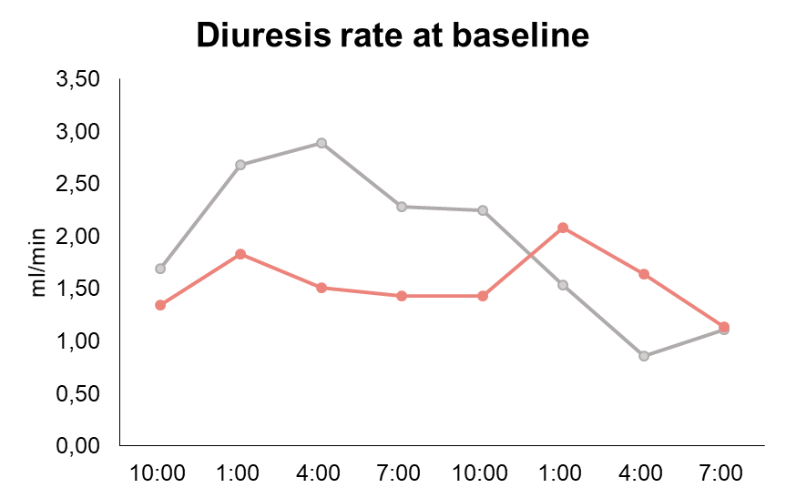
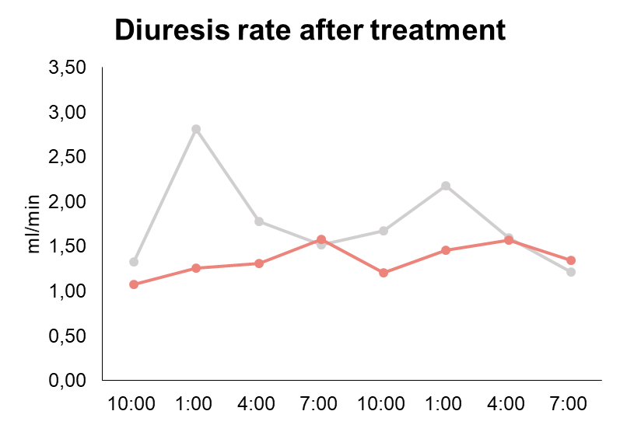
Menopause and NP: Results
NP = circadian rhythm stays present
No NP = circadian rhythm disappears

Slide 8
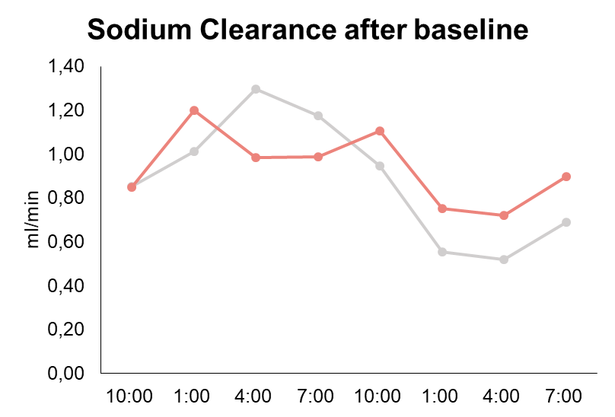
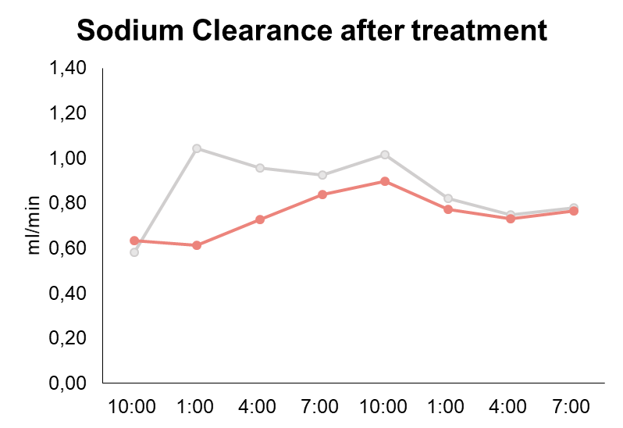
Menopause and NP: Results
NP = circadian rhythm stays present
No NP = circadian rhythm disappears

Slide 9
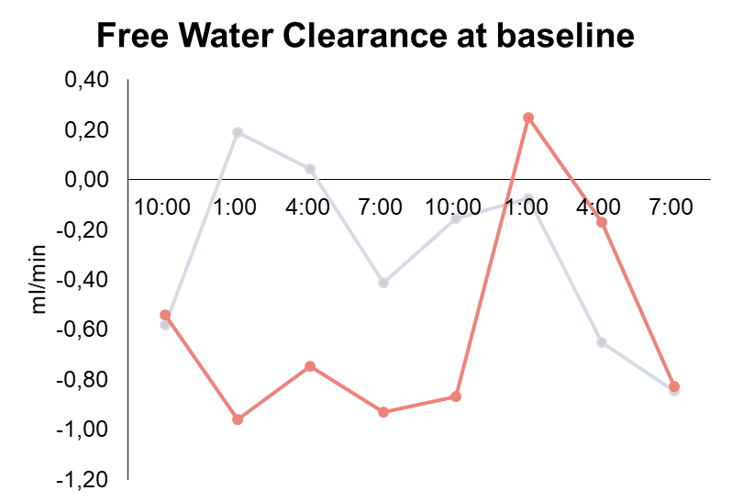
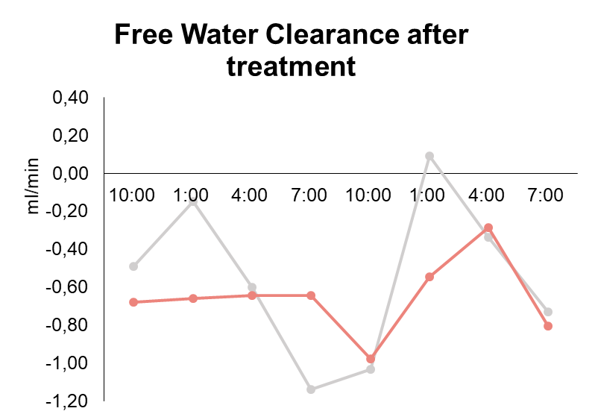
Menopause and NP: Results
NP = circadian rhythm stays absent
Geen NP = circadian rhythm stays absent

Slide 10

Implications on general practice
Systemic hormonal treatment induces a decrease in nocturia prevalence
Systemic hormonal treatment is only indicated if nocturia is induced by sleep disorders

Slide 11

THANKS
Kim Pauwaert
Kim.Pauwaert@ugent.be
@KPauwaert

