Slide 1
Measurable serum estradiol and estrone in women 36-56 years during adjuvant treatment with aromatase inhibitors for a hormone receptor-positive breast cancer. Case studies and Cross-Sectional study using an ultra-sensitive LC-MS/MS-method. Van Houdt M, Han S.N., Pauwels S, Billen J, Neven P
BMS meeting 19.11.2022

Slide 2
Introduction
Definition of menopause in patients with ER positive breast cancer?
A combination of menstrual history (amenorrhea), age, serum gonadotrophin and estrogen levels
→ chemotherapy and tamoxifen pose specific problems like inducing amenorrhea
The assessment of permanent menopausal status in ER positive breast cancer patients is challenging
→ Suitable for AI treatment?
Recent studies showed an ovarian function recovery (OFR) rate of 12,4-39% in patients with chemo-induced amenorrhea (CIA) receiving adjuvant AI treatment
AI are pharmacologically ineffective and contraindicated in PREmenopausal patients
Stimulation of the gonadotropin secretion with an increase of serum E2 levels → abolishes the expected anticancer effect
AI stimulation → unexpected ovulation→ risk of unplanned pregnancy

Slide 3
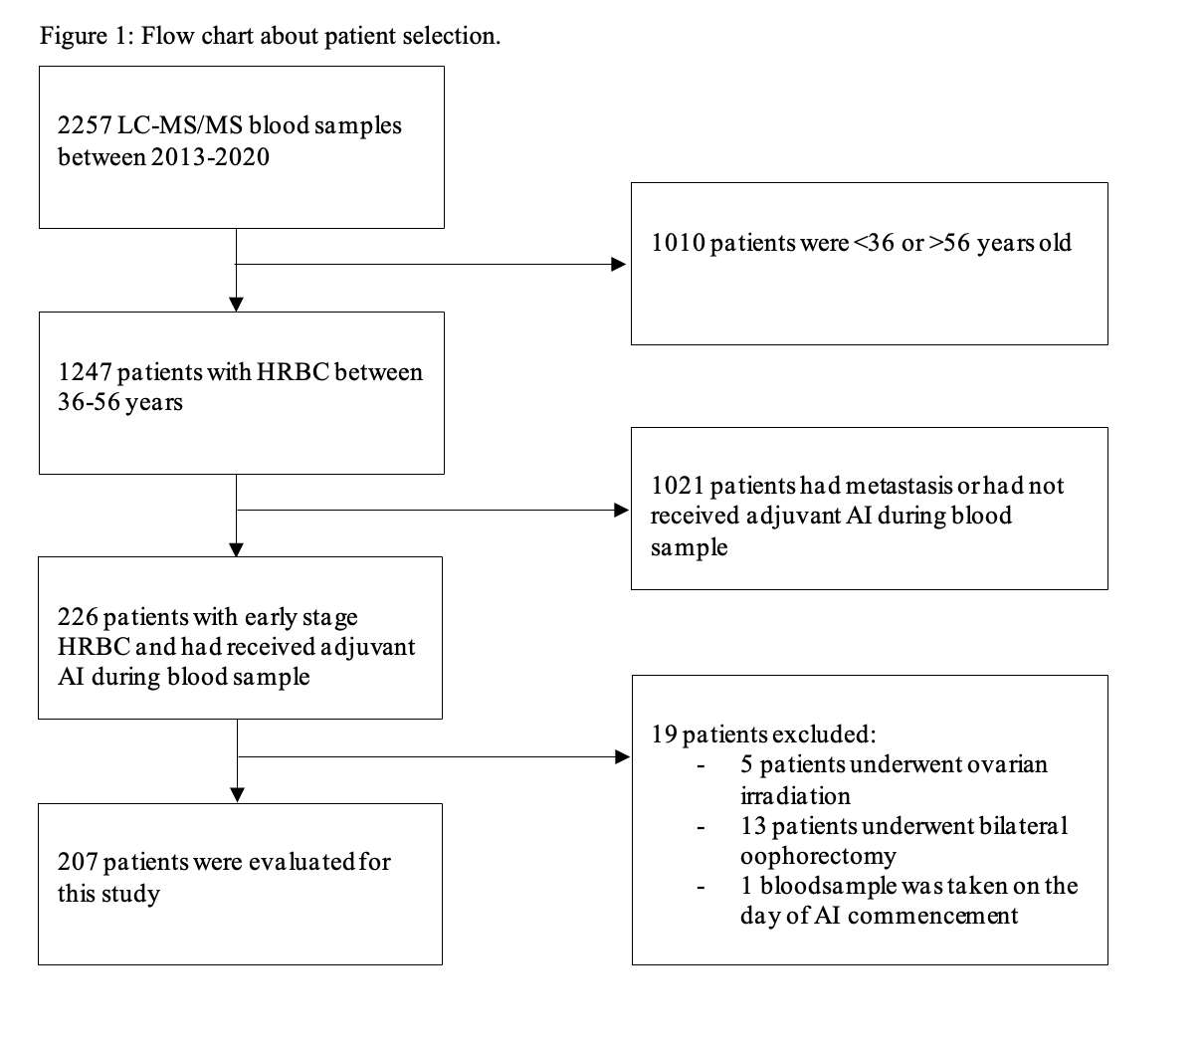
Methods
Cross-sectional retrospective study of 207 patients with estrogen receptor-positive breast cancer (age 36-56 y)
Estradiol (E2) and Estriol (E1) were measured during AI treatment with LC-MS/MS.
The primary end point = prevalence of OFR during adjuvant therapy of AI in our population.
OFR was considered when
1) return of vaginal bleeding with premenopausal E2 levels or
2) premenopausal E2 levels only (E2 value > 10 ng/l (LC-MS/MS)
The secondary end point → identifying baseline risk factors for OFR
age,
BMI,
type of chemotherapy and
time of AI use.

Slide 4
Results: AI group
OFR rate was 10,7% (n=17)
9/17 (52,9%) were > 50 years
Median duration of AI use was 9 months.
Median FSH level was 29,6 IU/l in the OFR group vs 70,8 IU/l in the no-OFR group.
10/17 patients (58,8%) reported vaginal bleeding.
Adjuvant endocrine therapy was adjusted in 13 patients (76,5%): In 4 patients' endocrine therapy was not adjusted
Notes:
159 patients received adjuvant AI only therapy. (Table 1)
For the AI-only group, median age at the time of the blood sample was 52 years (range=39-56).
121/159 patients (76,1%) had received (neo-) adjuvant chemotherapy prior to starting AI therapy.
Verandering van ET: 4 patients underwent a bilateral oophorectomy, 4 patients received additional LHRH agonist therapy and 5 patients switched to tamoxifen.
Niet veranderde ET:as 3 patients had a control blood sample after 3 months showing postmenopausal levels. And 1 patient had E2 10,7 ng/l and FSH 74 IU/l, which was defined as ‘menopausal’.

Slide 5
Results: AI group
Younger women (<50 y) were more likely to experience OFR
Previous chemotherapy decreased the likelihood of OFR
BMI and duration of AI use were not statistically significant.

Slide 6
Results: AI+OFS group
OFR rate was 6,3 % (n=3).
Median duration of AI use was 13 months.
Median FSH level was 3,3 IU/l in the OFR group vs 7,5 IU/l in the no OFR group.
Only 1/3 patients reported vaginal blood loss.
One patient switched to tamoxifen. No changes in endocrine therapy were made for the two other patients, as a control blood sample 3 months later showed postmenopausal levels.
Notes:
48 patients received AI and LHRH agonist. (Table 2)
Median age at the time of the blood sample was 43 years (range 36-53). 33 patients (68%) received prior (neo)adjuvant chemotherapy.
One patient had a local hematoma after LHRH agonist injection, control blood sample showed postmenopausal values for E2, no treatment adjustments were made.

Slide 7
Conclusion and guidelines
As definition of OFR ‘vaginal bleeding confirmed by premenopausal E2 levels’ or ‘premenopausal E2/FSH levels alone’ with E2 >10 ng/l (LC-MS/MS)
If patients develop OFR they should be advised to start LHRH agonist, undergo bilateral oophorectomy, or switch to tamoxifen.
Guidelines
Serial E2/E1 and FSH monitoring with LC-MS/MS in patients (<57 years) with uncertain menopausal status taking AI
AND in patients already under ovarian suppression with LHRH agonists
First year: every 3 months
2nd and 3rd year: every 6 months
Notes:
In 4/17 patients (23,5%) no treatment changes were made,
this stresses the importance of a clear definition of OFR in our institution and guidelines for monitoring.

