Slide 1



Why we should use tools to evaluate osteoporosis risk ?
Olivier Bruyère, PhD
Université de Liège

Slide 2
Competing interests
None for this lecture
General CI
  Grant research: Biophytis, IBSA, MEDA, SMB.
  Consulting or lecture fees: Amgen, Aptissen, Biophytis, IBSA, MEDA, Mylan, Novartis, Sanofi, SMB, TRB Chemedica, UCB, Viatris.

Slide 3
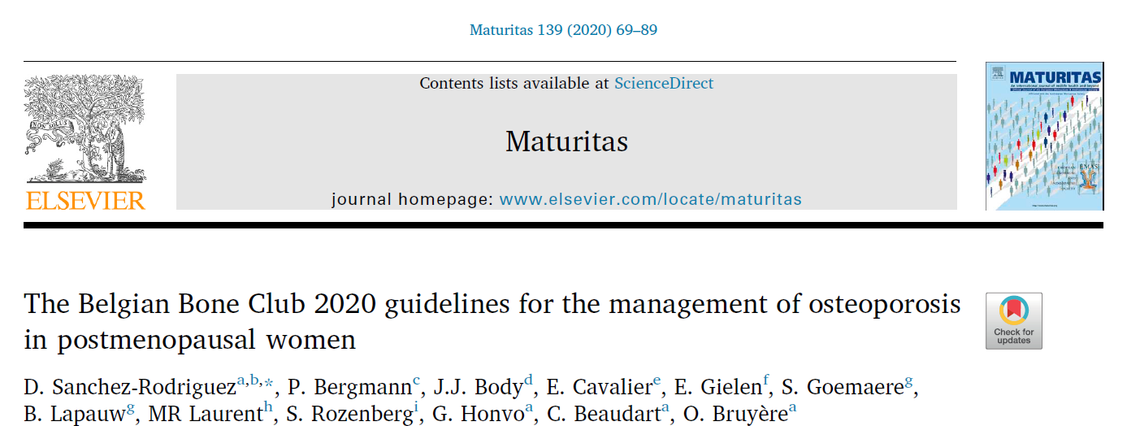

Slide 4
Questions
Q1. HOW should osteoporosis be screened in postmenopausal women?
Q2. WHEN and HOW OFTEN should postmenopausal women be screened for osteoporosis?
Q3: WHICH TOOLS should be used to diagnose osteoporosis and assess fracture risk in postmenopausal women?
Q4. WHICH THRESHOLDS should be used to diagnose and assess the severity of osteoporosis in postmenopausal women?

Slide 5
Q1. HOW should osteoporosis be screened in postmenopausal women?
Q2. WHEN and HOW OFTEN should postmenopausal women be screened for osteoporosis?
Q3: WHICH TOOLS should be used to diagnose osteoporosis and assess fracture risk in postmenopausal women?
Q4. WHICH THRESHOLDS should be used to diagnose and assess the severity of osteoporosis in postmenopausal women?

Slide 6
15 screening questionnaires composed of a varying number of clinical risk factors have been published.
The diagnostic accuracy (i.e., sensitivity and specificity) of the screening tools for osteoporosis varied depending on the target populations assessed.

Slide 7
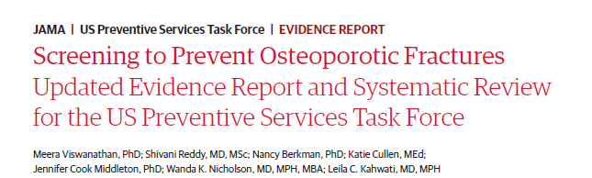
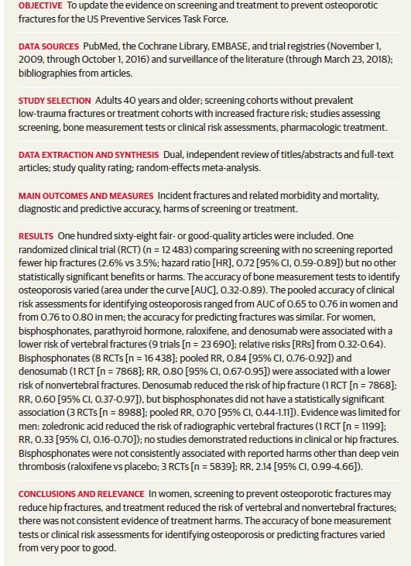

Slide 8
Postmenopausal women with ≥1 major risk factor or ≥2 additional risk factors should receive a formal fracture risk evaluation (Q3-Q4).
Major risk factors
Age (≥65 years)
Low body mass index (<20 kg/m²)
Prior fragility fractures
Hip fracture history in a first-degree relative
Frequent falls (≥1/year)
Measured height loss ≥4 cm
Secondary osteoporosis
Early menopause (<45 years)
Diabetes mellitus
Glucocorticoid therapy
Rheumatic inflammatory diseases
Excessive alcohol (≥3 units of alcohol/day)
Current tobacco use
Additional risk factors
Family history of osteoporosis
Absence of a healthy balanced diet
Diseases involving clinical nutrition and metabolism
Thyroid and parathyroid diseases
Psychiatric, mental, and eating disorders
Drugs: Antidepressants, antiepileptic drugs, benzodiazepines, loop diuretics, opioids, proton-pump inhibitors, zolpidem, etc.

Slide 9
Q1. HOW should osteoporosis be screened in postmenopausal women?
Q2. WHEN and HOW OFTEN should postmenopausal women be screened for osteoporosis?
Q3: WHICH TOOLS should be used to diagnose osteoporosis and assess fracture risk in postmenopausal women?
Q4. WHICH THRESHOLDS should be used to diagnose and assess the severity of osteoporosis in postmenopausal women?

Slide 10
When
Most of the studies included in two SR that assessed the performance of risk assessment instruments to predict fracture risk included participants ≥50 years
Individual studies have suggested that screening at an age of 65 or over could be more relevant
Screening at the age of 50 years, or at the age of menopause if it occurs earlier, should be considered.

Slide 11
How often
Screening policy is an unmet need. But:
  Two years is generally taken as the timeframe to consider a fracture as recent.
  It leads to the emerging concept of “imminent fracture risk”.
    During this 2-year period of time following a fracture, individuals have the highest risk for a new fracture
    Detection and early treatment might involve the highest benefits.

Slide 12
Q1. HOW should osteoporosis be screened in postmenopausal women?
Q2. WHEN and HOW OFTEN should postmenopausal women be screened for osteoporosis?
Q3: WHICH TOOLS should be used to diagnose osteoporosis and assess fracture risk in postmenopausal women?
Q4. WHICH THRESHOLDS should be used to diagnose and assess the severity of osteoporosis in postmenopausal women?

Slide 13
WHICH TOOLS
Existing tools for the identification of previous fragility fractures
Existing tools for BMD assessment
Existing fracture risk assessment tools

Slide 14
WHICH TOOLS
Existing tools for the identification of previous fragility fractures
Existing tools for BMD assessment
Existing fracture risk assessment tools

Slide 15
X-ray radiography is the recommended imaging technique to confirm a fracture.
Vertebral, pelvis, hip, femur, humerus, and forearm are considered major osteoporotic fractures (MOFs).
  However, persons aged ≥75 years with a previous recent forearm fracture should be considered at very high risk, but this is not correct for younger persons, as their imminent risk after an index forearm fracture is lower

Slide 16
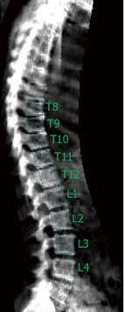
The use of VFA in patients with low clinical suspicion of vertebral fractures could be considered.
  VFA can be performed simultaneously with DXA
  Compared to X-ray spinal radiography, VFA presented moderate sensitivity 0.84 and high specificity 0.90

Slide 17
WHICH TOOLS
Existing tools for the identification of previous fragility fractures
Existing tools for BMD assessment
Existing fracture risk assessment tools

Slide 18
BMD measured by DXA has been the international gold standard to diagnose osteoporosis since 1994.
Other techniques not recommended
  Ultrasound
  computed tomography (CT) imaging
  Trabecular bone score
Emerging tools
  central and peripheral (high-resolution) quantitative CT
  nanoindentation
  Radiofrequency echographic multi spectrometry (REMS)

Slide 19
WHICH TOOLS
Existing tools for the identification of previous fragility fractures
Existing tools for BMD assessment
Existing fracture risk assessment tools

Slide 20
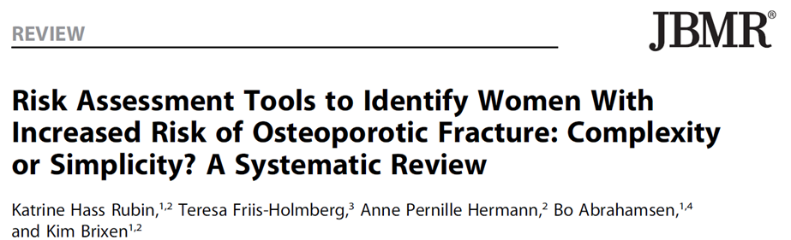
A total of 48 tools were identified
  20 had been externally validated,
  6 had been tested more than once in a population‐based setting with acceptable methodological quality.
    3 for BMD
    3 for fracture

Slide 21
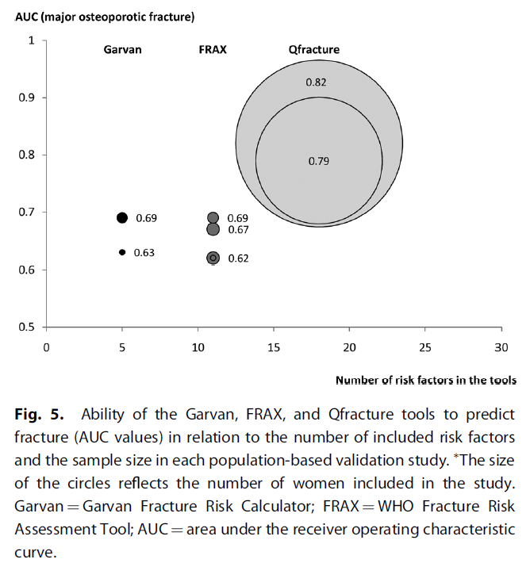

Slide 22
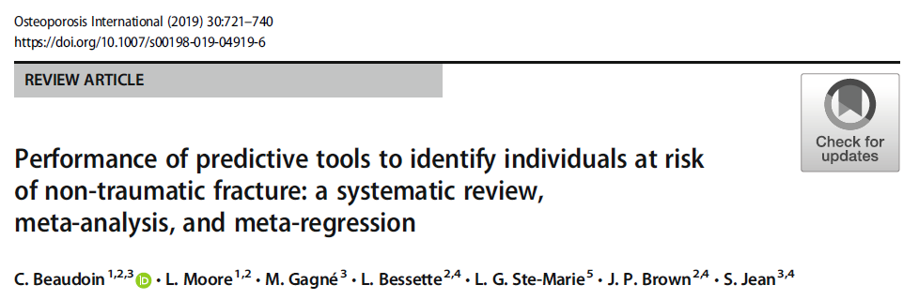
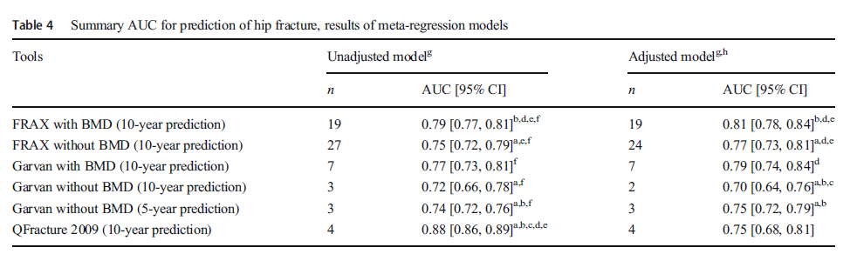

Slide 23
10-year fracture risk
Q-fracture is validated only in the UK and recommended only in the UK and Scottish guidelines
FRAX® and Garvan could be considered in Belgium.

Slide 24
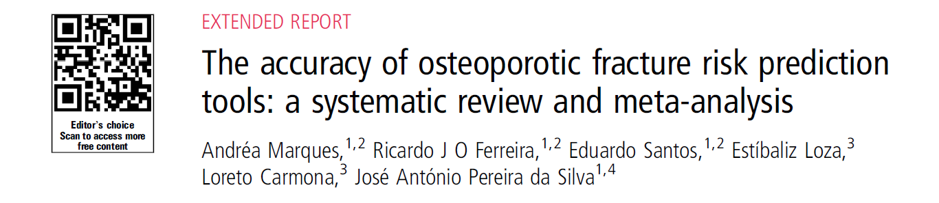
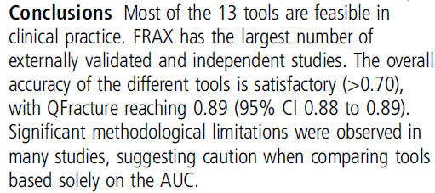

Slide 25
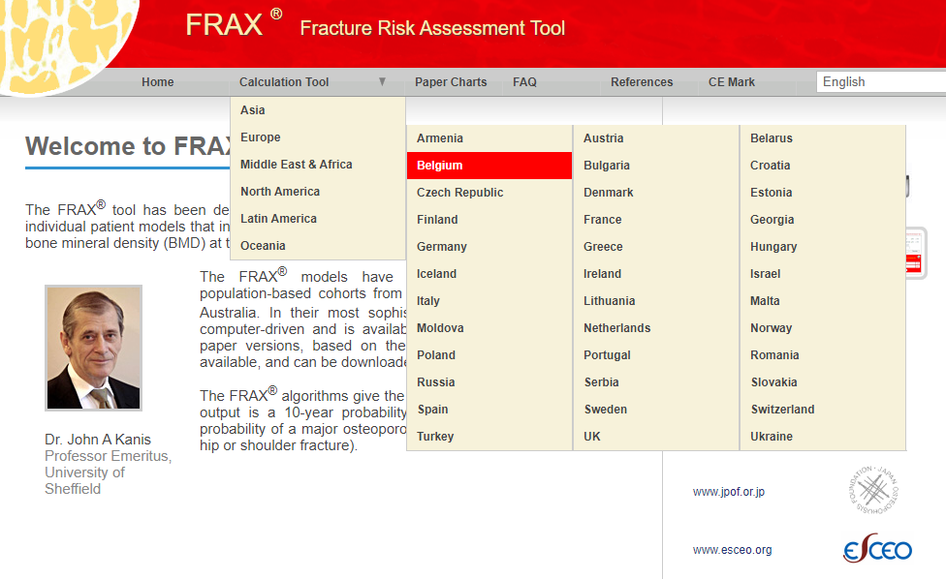

Slide 26
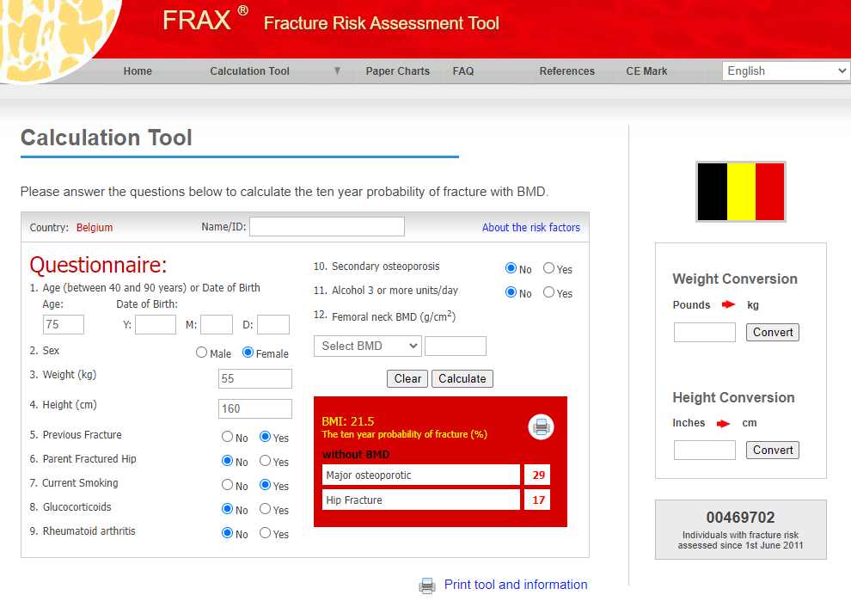

Slide 27
Q1. HOW should osteoporosis be screened in postmenopausal women?
Q2. WHEN and HOW OFTEN should postmenopausal women be screened for osteoporosis?
Q3: WHICH TOOLS should be used to diagnose osteoporosis and assess fracture risk in postmenopausal women?
Q4. WHICH THRESHOLDS should be used to diagnose and assess the severity of osteoporosis in postmenopausal women?

Slide 28
WHICH THRESHOLDS
Identification of fragility fracture
BMD
Fracture risk assessment tools

Slide 29
WHICH THRESHOLDS
Identification of fragility fracture
BMD
Fracture risk assessment tools

Slide 30
Vertebral fracture is defined as at least a 20 % reduction in vertebral height on X-ray spinal radiography using the Genant semi-quantitative method
It confers a 2.5-fold greater risk of subsequent vertebral fractures

Slide 31
WHICH THRESHOLDS
Identification of fragility fracture
BMD
Fracture risk assessment tools

Slide 32
The threshold considered in the majority of references is a BMD (assessed by DXA) of at least 2.5 SDs (i.e., T score ≤−2.5) below the reference population
Patients with a T-score ≤-3.5 should be considered at “very high risk”.
Low bone mass (osteopenia) should not be considered a disease category BUT
  DXA has great specificity (when other metabolic bone diseases have been excluded) but low sensitivity
  The majority of osteoporotic fractures occur in patients with a T-score >-2.5

Slide 33
WHICH THRESHOLDS
Identification of fragility fracture
BMD
Fracture risk assessment tools

Slide 34
120 guidelines used FRAX® worldwide, of which 38 did not provide intervention thresholds.
There are no randomized trials specifically designed to validate FRAX® thresholds.
Belgian country-specific fracture risk assessment tools are available

Slide 35
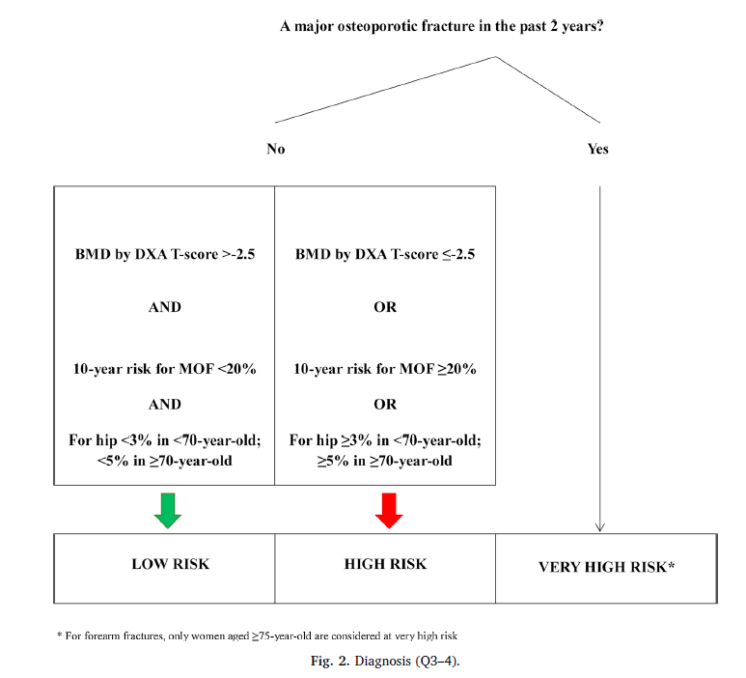

Slide 36
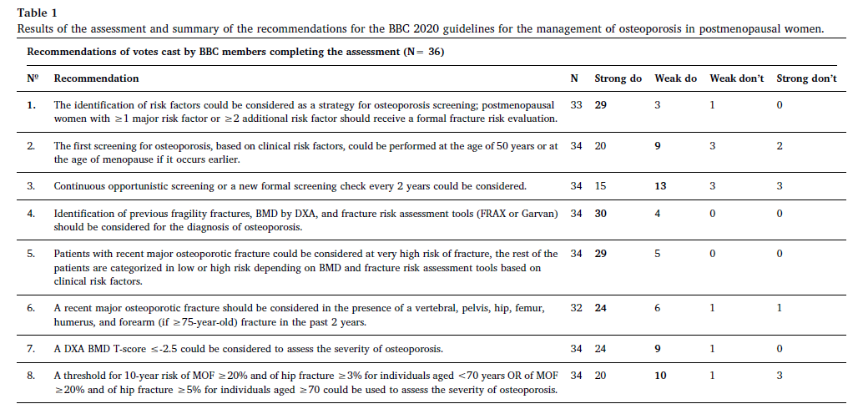

Slide 37


