Slide 1

Bisphosphonates vs. denosumab:
Advantages and risks
Charlotte Verroken
Department of Endocrinology
UZ Gent

Slide 2
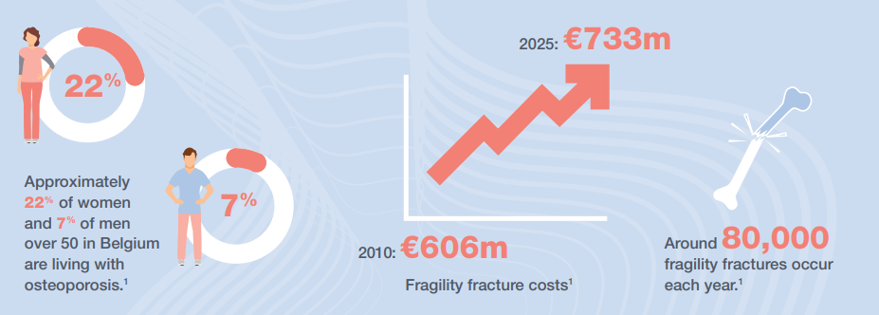
Osteoporosis in Belgium
Importance of timely diagnosis and treatment of women with high fracture risk ↔ life expectancy ± 80y
Need for antiosteoporotic agents that can be administered for prolonged periods with both efficacy and safety
Figure from osteopolicynetwork.org

Slide 3
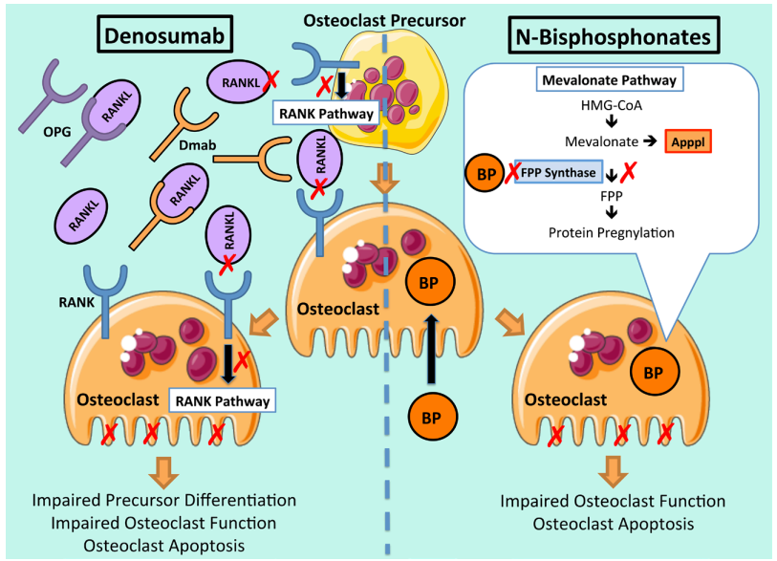
Antiresorptives
Anastasilakis et al., 2018

Slide 4
Bisphosphonates
Alendronate 70mg / week (ALN - Fosamax®)
Risedronate 35mg / week (RIS - Bonviva®)
Ibandronate 150mg / month (IBN - Actonel®)
Zoledronate 5mg / year (ZOL - Aclasta®)
Potency ~ degree of bone remodeling inhibition
New bone turnover equilibrium after 3-6 months (IV faster)

Slide 5
Bisphosphonates
Relative fracture risk reduction
BMD increase
  Greater BMD gain in those with high baseline bone remodeling
  Plateau after 2-3 years (esp. at hip)
 | ALN | RIS | IBN | ZOL
24-48 months
Vertebral fracture | 49% | 41-43% | 36-51% | 63-72%
Non-vertebral fracture | 17-20% | 21% |  | 26-31%
Hip fracture | 38-40% | 26-37% |  | 39-41%
Hopkins et al., 2011. Zhou et al., 2016

Slide 6
Antiresorptives
Anastasilakis et al., 2018

Slide 7
Denosumab
Denosumab 60mg / 6 months (Dmab - Prolia®)
Rapid decline in bone resorption (nadir after 1 month)
Relative fracture risk reduction
  Vertebral fracture: - 68%
  Non-vertebral fracture: - 20%
  Hip fracture: - 40%
BMD increase
  No plateau
  Greater than with bisphosphonates

Slide 8
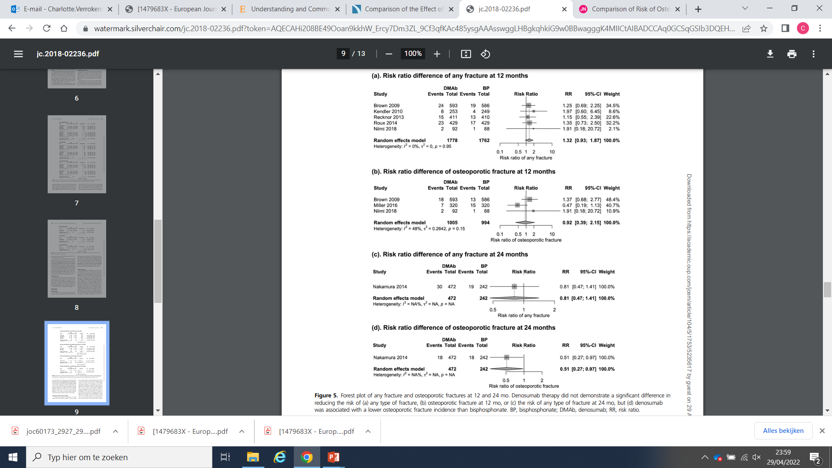
Dmab vs. BP: fracture risk reduction
Lyu et al., 2019

Slide 9
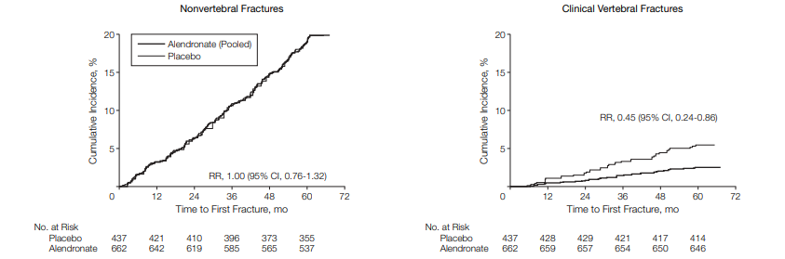
Bisphosphonates: residual effect
After initial binding in bone → inactive state
Reactivation when burial site is subjected to remodeling again
Elimination half-time of the skeleton up to 8-10 years
Possibility of drug holiday
Black et al., 2006

Slide 10
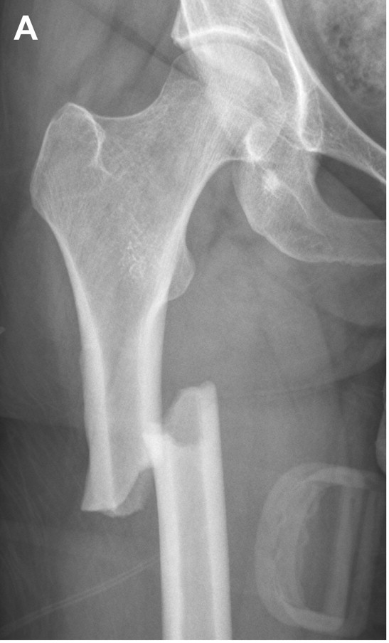
Risks: atypical femoral fracture (AFF)
3.2–50 / 100.000 patient years for bisphosphonates, similar for denosumab
Risk factors:
  Prolonged antiresorptive use
  Glucocorticoid treatment
  Chemotherapy
  Older age
  For denosumab: previous BP use

Slide 11
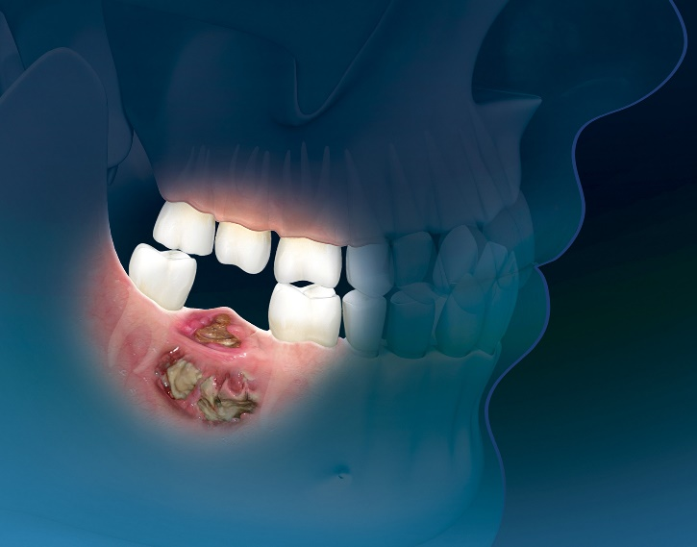
Risks: osteonecrosis of the jaw (ONJ)
In doses used for osteoporosis: 1-10 / 100.000 patient years for bisphosphonates, similar for denosumab
  Only marginally higher than general population!
Risk factors:
  Potency of antiresorptive
  Prolonged antiresorptive use
  Glucocorticoid use
  Chemotherapy
  Older age
  Pre-existing oral infection
  Invasive dental procedures
  Smoking

Slide 12
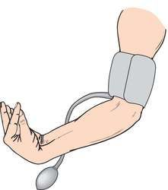
Risks: hypocalcemia
More frequent with denosumab
  Risk factor: CKD
  Most frequent in first 1 – 2 months after injection
  Ensure adequate calcium and vitamin D suppletion

Slide 13
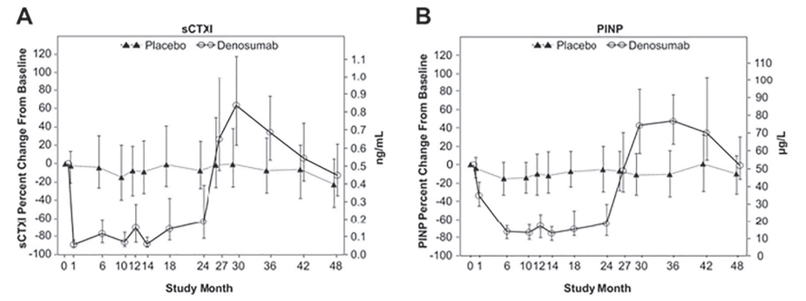
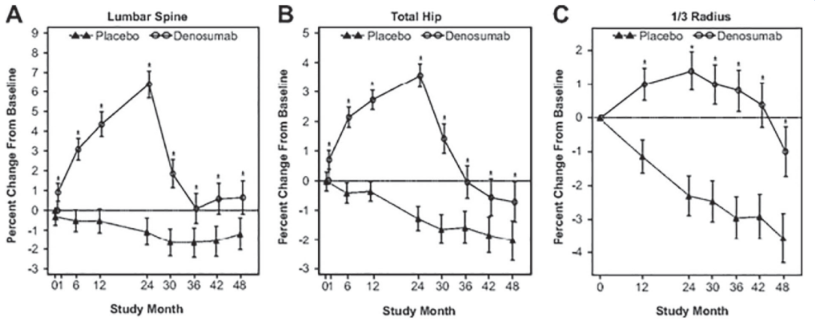
Denosumab: rebound phenomenon
Bone turnover
BMD
Tsourdi et al., 2017

Slide 14
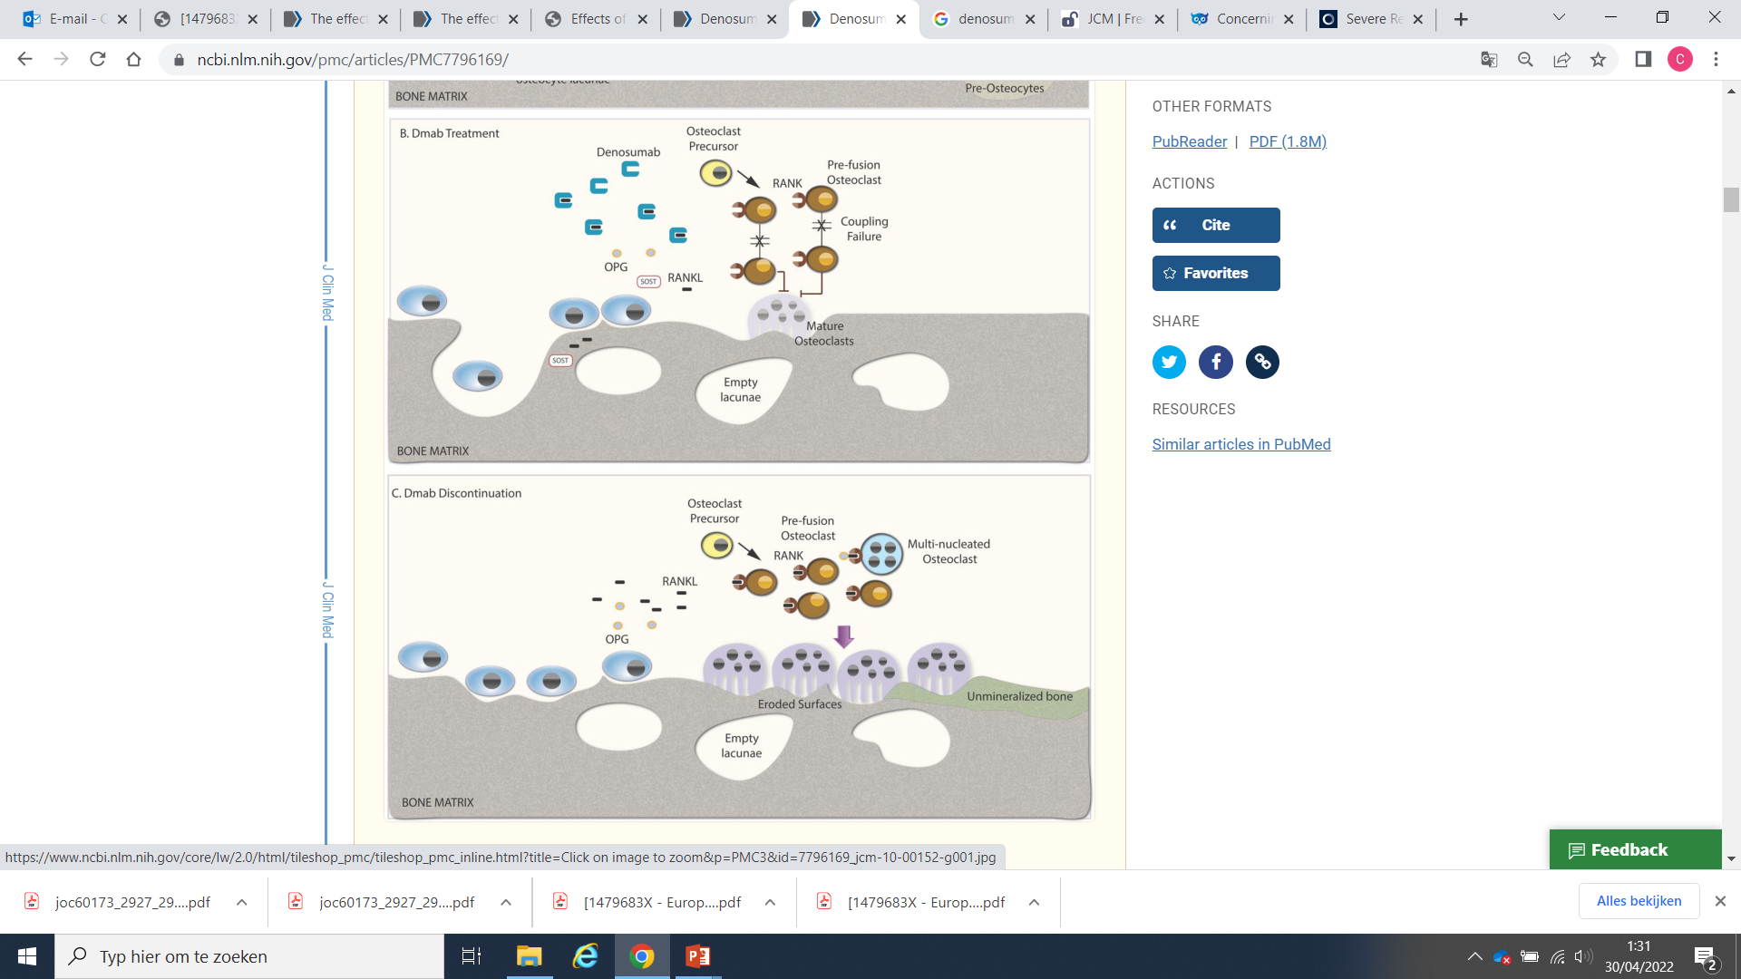
Denosumab: rebound phenomenon
Anastasilakis et al., 2020

Slide 15
Denosumab: rebound phenomenon
Increase in bone turnover and loss of bone mineral density early after denosumab discontinuation
Risk of multiple clinical vertebral fractures
  1.2 - 7.1 / 100.000 patient years for single VF, much higher risk for multiple VF
  Low thoracic and high lumbar spine
  Even in those at ‘low risk’ in terms of BMD and absence of previous fractures
Risk factors:
  Long duration of treatment
  Prevalent VFs
  No other treatment before denosumab
  BMD loss upon discontinuation

Slide 16
Denosumab: rebound phenomenon
Increase in bone turnover and loss of bone mineral density early after denosumab discontinuation
Risk of multiple clinical vertebral fractures
  1.2 - 7.1 / 100.000 patient years for single VF, much higher risk for multiple VF
  Low thoracic and high lumbar spine
  Even in those at ‘low risk’ in terms of BMD and absence of previous fractures
Risk factors:
  Long duration of treatment
  Prevalent VFs
  No other treatment before denosumab
  BMD loss upon discontinuation
Denosumab should not be stopped without considering alternative treatment

Slide 17
Reimbursement criteria – postmenopausal osteoporosis
Zoledronate
  1 of the following:
  VF (≥25% and ≥4mm)
  Hip fracture
  T-score < -2.5 at LS / hip / femoral neck
Denosumab
  Previous treatment with bisphosphonate or contra-indication for bisphosphonate
  AND 1 of the following:
  VF (≥25% and ≥4mm)
  T-score < -2.5 at LS / hip / femoral neck on DXA < 6 months old

Slide 18
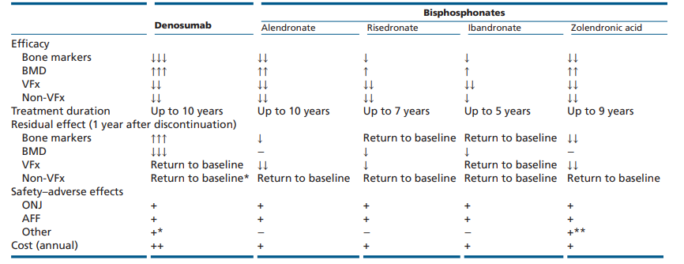
Summary
VFx after discontinuation
(AF)
Other advantages
Can be used in CKD
No reimbursement restrictions
Anastasilakis et al., 2018

Slide 19

Questions?

