Slide 1
Could elucidating the genetics of POI be just around the corner?
Alix SENTERRE
Uliege – CHR of Huy 1 year intern
Introduction
POI: reminder
Conclusion
Method and results of research

Slide 2
?
Primary or secondary amenorrhea
Puberty delay
Stop of growth
Infertility
Patients below the age of 40
Mood swings
Dyspareunia
Loss of sex drive
Primary ovarian
insufficancy
(POI)
Which diagnosis ?
Anamnesis
Heat waves
Hypogonadotropic
hypogonadism
PCOS
Hypergonadotropic hypogonadism
Pregnancy

Slide 3
Hormonal dosage
FSH
Œstradiol
bHCG
AMH
Prolactine
Hypergonadotropic
hypogonadism
Definition from ESHRE
Follicular pool impairement during embryonic development,
Accelerated follicular atresia,
Blocage of follicule maturation
Methods of investigation
Amenorrhea of at least 4 months
Elevated FSH levels: above 25 UI/L on two dosages 4 weeks apart
Pelvis US study
Etiologies
Genetic ?
Chromosomal ?
Autoimmune
?
Chimio-/Radio-toxicity ?
Surgical ?

Slide 4
Why the interest in genetics regarding POI ?
10-30%
1D° family members
70 % idiopathic
1%
women <40 yo
Understanding the genetics of POI
Understanding of the pathogenic mechanisms
Prevention ?
Screening ?
Cure ?
20-25% genetic
Major clinical implications:
New opportunities of treatment
Optimization of patient care

Slide 5
Infertility
Oocyte bank. Adoption. Cryopreservation impossible: too few follicules
Indeed: actuel treatment ….
Impaired bone mineralisation
CV imparement
ONLY SYMPTOMATIC
HST
HST
Sexual functions
Treatment of the oestrogen deprivation
HST
Depression
HST
Infertility treatment
Today:
PREVENTION
CURE

Slide 6
Research goal:
Understanding the genetics of POI
Why ?
Pronostic et fertility potential
Better genetic counceling + fertility treatment
Key steps in the ovarian function’s developement
New targeted therapy
Implication of genetic variants
Different treatment for different phenotypes
Family screening
Prevention ?
Cryopreservation ?

Slide 7
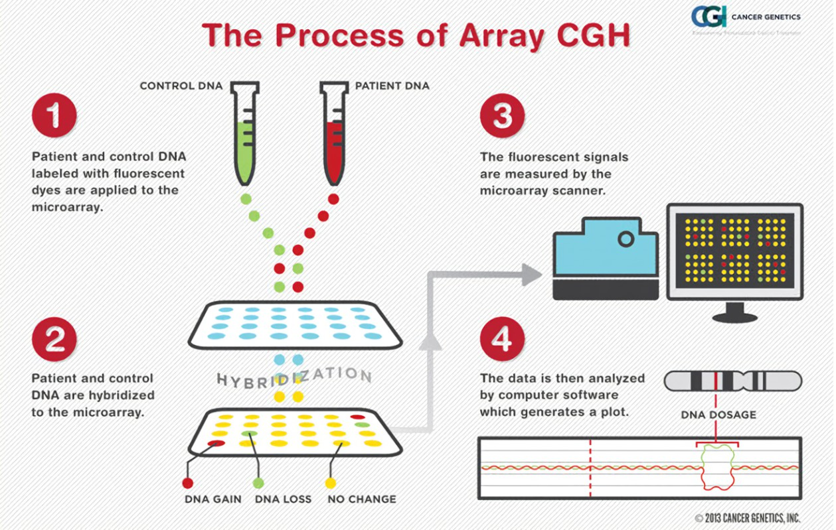
17 patients: array-CHG analyses
Research method
Deletions - Duplications
Prospective study, patients selected between 2014 et 2021
Initial cohort of 42 patients, other causes of POI excluded
Fragile X premutations and caryotype abnormalities were ruled out: 40 patients remaining
15 patients: gene pannel analysis
Nucleotidic variation
Panel BRIGHTcore évaluant 32 gènes d’interet

Slide 8
Results
7 genes of interest
27 genes => 9 protein coding
TUSC3 | Tumor Suppressor Candidate 3
MSR1 | Macrophage Scavenger Receptor 1
NRXN1 | Neurexin 1
AKR1C2 | Aldo-keto reductase family 1 member C2
AC007682.1 | Long intergenic noncoding ARN
AC092578.1 | Long intergenic noncoding ARN
MIR4733 | microRNA 4733
PALB2 | Partner and localizer of BRCA2

Slide 9
Conclusion
The genetic approach is essential to the understanding of the pathogenesis of heterogeneous disease such as POI
Cytogenomics and next generation sequencing are the most efficient methods to unveil genetics of POI.
Limitation: these study NEED replication, rendomization and case control population for reliable results.

Slide 10
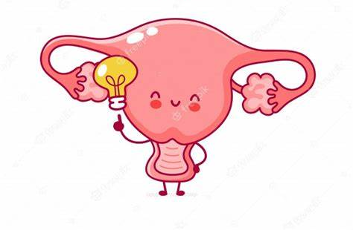
Thank you !

