Slide 1
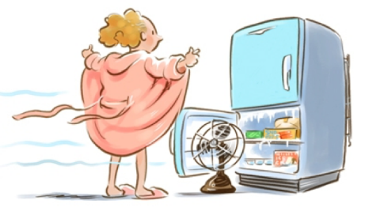
Menopause and Work
Project Vitaliteit op het Werk funded byWOMEN Inc., ProudWoman (ZonMw)
Dr. P. Verdonk, dpt. Ethics, Law & Humanities, Amsterdam UMC-VUmc, p.verdonk@amsterdamumc.nl
https://dedietisten.nl/vrouwen-en-hormonen/voeding-en-de-overgang/

Slide 2
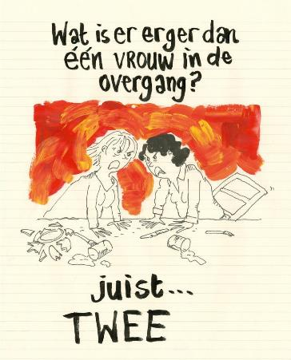
Introduction
“Vitality at work” funded WOMEN Inc., 2018-2019
Proud Woman (ZonMw) – intervention
Women in the military police (2021-)
Female specific-lifestages and work
  Literaturestudies, knowledge gaps
  Qualitative research project
    Interviews nurses and physicians
    Interviews supervisors/stakeholders HRM
    Focusgroups
Uit: Oomen, F. Oomen stroomt over.
Hoe overleef ik de overgang,
2017

Slide 3
Literature study Menopause & Work
In Nl ~ 1,8 million women in lifestage of menopause
Labour market participation of women in NL ~63% (>12 uur p.w.)
Increase
  fulltime work among women
  retirement age
  older women in the labour market
  migrant background/cultural diversity

Slide 4
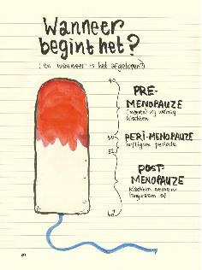
Menopause: menopauze & overgang
Uit: Oomen, F. Oomen stroomt over.
Hoe overleef ik de overgang,
2017
Menopause as a biomedical concept
  Three phases: pre-, peri-, postmenopause
  Hard to distinguish
  Hot flashes and nightsweat, vaginal dryness -> hormonal changes
  Sleeping problems, mood swings, irritability, anxiety, heart palpitations, concentration- and memoryproblems, loss of libido, etc…
Overgang/menopause as a (bio)psychosocial concept
  Transitional phase: fertility, adolescent children, ageing parents, relationships, health, stigma on ageing (especially women), leisure time, renewed focus, renewed ambitions…

Slide 5
Results 2 studies: literature study, interview study
Bendien, E., Van Gemert, I., Heijsman, A., Verdonk, P. (2019). Zwoegen, zweten en zwijgen in de zorg. Een kwalitatieve empirische studie naar ervaringen met vrouwspecifieke levensfasen van verpleegkundigen en artsen in een academisch ziekenhuis. In opdracht van WOMEN Inc. Amsterdam: Amsterdam UMC-VUmc, mei 2019. DOI: 10.13140/RG.2.2.18172.49284. Download https://www.vitaliteit-op-de-werkvloer.nl/over-vitaliteit-op-de-werkvloer/empirisch-onderzoek-amsterdam-umc-vrouwspecifieke-levensfasen/
Bendien, E., Van Gemert, I., Appelman, Y., Verdonk, P. (2019). Werken aan de overgang. Een uitgebreide literatuurstudie naar overgang, menopauze, gezondheid, en werk. In opdracht van WOMEN Inc. Amsterdam: Amsterdam UMC-VUmc, maart 2019. DOI: 10.13140/RG.2.2.17688.03841. Download https://www.vitaliteit-op-de-werkvloer.nl/overgang-en-werk/literatuurstudie-amsterdam-umc/
Verdonk, P., Bendien, E., Appelman, Y. (2021). Menopause and work. A narrative literature review about menopause, work and health. Work, 77(2), 483-496.

Slide 6
1. Lack of recognition for menopause
Phenomena not recognized and acknowledged by women and the work environment
Lack of education (allover)
Menopause not discussed, barriers and facilitators:
  Gender of the supervisor, dominance of men on the workfloor, stigmatization
  (Lack of) communicationskills, humor, understanding
“If you’ve got a manager and head of department who are female, who perhaps have been there or who are sharing their experience with you, then naturally there’s more acceptance and understanding of it. Whereas if you’ve got a male head of department and perhaps male manager, I think you’d suffer more in silence and you wouldn’t share as much.” (Beth, 40–50, Professional, Pre-Menopausal).
https://www.menopause.org.au/hp/studies-published/856-women-work-and-the-menopause-project

Slide 7
2. Costs and sickness abence
Hardly studied!
Women 45-65 years higher sick leave percentages than men
Lower productivity, short term sickness absence
Presenteeism
Costs possibly underestimated

Slide 8
3. Menopause and work ability
Work ability: individual assessment of work performance, physically and mentally (Ilmarinen et al., 1997), Work Ability Index (WAI)
Negative association work ability and age, adapting work
Dutch studies Marije Geukes, MD: association menopausal complaints and work ability in particular for women with severe menopausal complaints (VMS, somatic and psychological)
Recent study on work(Oude Hengel et al., 2022)
  80% of perimenopausal women 45-55 yrs has menopausal complaints that bother them at work, 2/3 lower performance

Slide 9
4. Menopause and working conditions
Hardly any studies
Psychosocial job characteristics such as job demands, social support, autonomy
In particular autonomy an important predictor for health outcomes in women (cholesterol, cardiovascular risk, mental health) and work-related health outcomes (sickness absenteeism, turnover, job performance)
Quality of work for women

Slide 10
5. Other psychosocial & cultural factors
Menopausal complaints as a source of shame, insecurity, fear, in particular hot flashes at work, and in particular women at higher hierarchical levels
Complaints as a stress factor themselves
Perceptions of women about how social and work environment views menopausal complaints are not always in line with the environment’s perceptions…
‘Felt-stigma’ – self-stigmatization

Slide 11
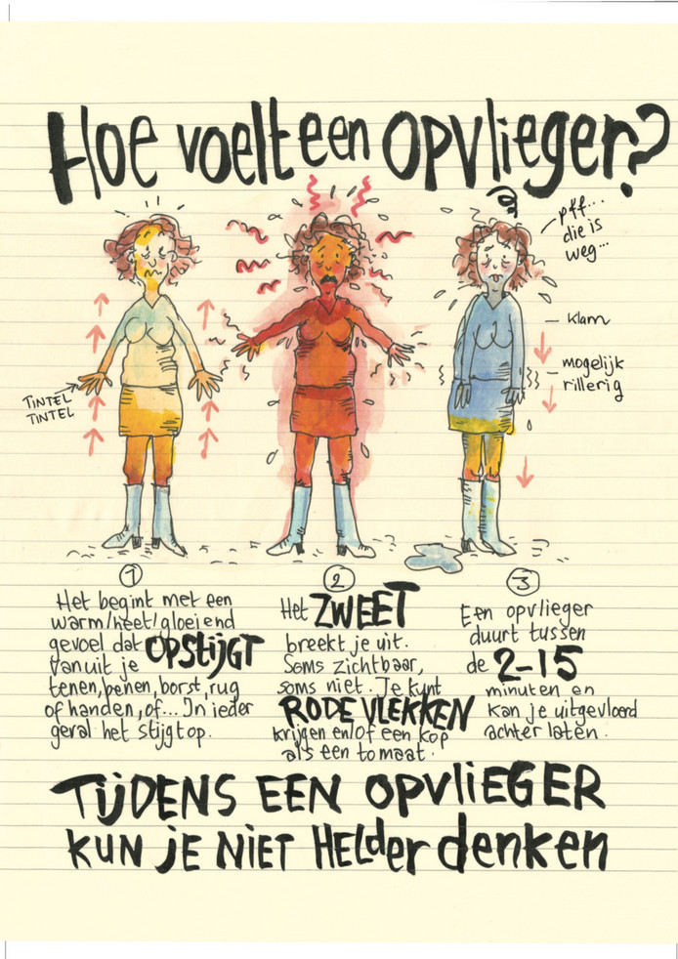
6. Health and menopause
Unclear
VMS and depression, sleeping disorders, anxiety, panic
Menopause and cardiovascular risk profile – early menopause!
Uit: Oomen, F. Oomen stroomt over.
Hoe overleef ik de overgang,
2017

Slide 12
7. Stress, fatigue, exhaustion during menopausal transition
Few studies, relationship unclear
Confusion menopausal complaints and work-related psychological complaints
Long-term work-related fatigue associated with adverse working conditions and worse health outcomes

Slide 13
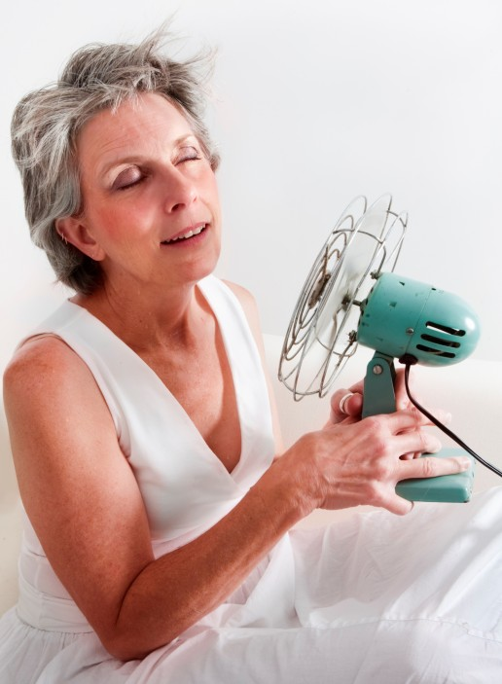
8. Coping with menopausal complaints (I)
https://gezondidee.mumc.nl/hoe-overleef-je-de-overgang-menopauze
Individual coping strategies
  Favorable: acceptation, openness
    Hot flashes: extra layers clothing, ventilators, temperature
    Concentration: to do lists, extra check
    Lifestyle: nutrition/alcohol, exercise, sleep
    Communication: humor, sharing
  Unfavorable: extra work, hiding, sick leave, taking holiday off

Slide 14
Coping with menopause II
Interventions for women
  Hormonal therapy – HRT!
  Lifestyle e.g. sports/exercise
  Cognitive- & behavioral therapy, mindfulness-based
  Coaching personalized
Interventions for work organization
  Awareness among supervisors: knowledge, openness, open culture
  Flexible start (of day)
  Access to information and support from employer
  Temperature, ventilation

Slide 15
Concluding from the literature study
Epistemological gap, increasing interest
State of the art, cautious conclusion
  Menopause and decreased work ability/performance seems likely
  Could explain higher sickness absence
  Presenteeism, taboo, individual solutions
Knowledge gaps
  Mechanisms behind lack of research
  Physical and psychological working conditions in relation to menopause
  Organization and policy

Slide 16
Knowledge agenda
Awareness of menopause in relation to work in occupational health
  Guideline menopause and work (NVAB)
  Sickness absence in relation to female-specific lifestages
  Awareness raising programmes for employers, employees, public
Women’s health and menopause
  Across diverse professions and sectors
  Cross-cultural comparative research, international
Methodological and theoretical frameworks
  Multi- and transdisciplinary research

Slide 17
Qualitative study pregnancy and menopause: lifecourse perspective
Embodied lifecourse (Bendien et al., 2019c)
  ‘The maternal body’ and possible reproductive role of women vs the ‘one-dimensional employee’
    Lifecourse and career not always aligned
    Neither are the body and the work schedule
  Bodily politics of the unexpected
    Unpredictable and uncontrollable
    Body has to to bodily work
Female physicians and nurses, supervisors, HRM in Amsterdam UMC
21 semi-structured interviews, 2 focusgroups, 3 dialogue sessions

Slide 18
1. Disembodiment of the maternal body

Slide 19
1a. Work ethos above selfcare, work above private life
Ignoring own physical signals
“You cannot just say: let the patient down, I am leaving” (nurse)
Individual responsibility for setting boundaries internalized
Simultaneously, the organization claims on crossing these boundaries
Questions about sustainability in long term, work-life balance, patient safety

Slide 20
1b. Coping and surviving in health care
Fulfillment, inspiration, pride, self-esteem, autonomy
Demanding context: staff shortages, job demands, intensification, increasing retirement age
Decoupling from the body, shame, continuing to work exhausting reserves:
  “And I had such a heavy menstruation I was doing surgery here once, …. And they said geez [name]. You should not make such a mess, because there was blood everywhere on the floor and that happened to be mine. I had not noticed it.” (Physician)

Slide 21
1c. Flexibility and collegiality
Flexibility as norm – for employees, not the organization
Collegiality under pressure, a moral issue to report sick
Efficiency, cost reduction, staff shortages
“Yes, you notice that people lose credit,… It happens in every workplace, I think, I know someone who is valued less.” (FG: supervisor)

Slide 22
1d. Legitimacy of the body
Pregnancy is also positive - but tension within teams because of high job demands
“And in the meantime everybody thinks: shit! And that makes sense because…. That ‘shit’ means that someone is not available on the workfloor while the work continues.” (Physician)
Lack of knowledge and insight in what pregnancy means for a woman
Pregnancy complications legitimize absence or job accommodations, but not health complaints – and also not menopausal complaints

Slide 23
Theme 2 The maternal body silenced

Slide 24
2a. Laughing away the discomfort
Sometimes funny, often crossing limits and disqualifying
  “In fact menopause is being used as some sort of disqualification. That is how I experienced it, like, you do not adhere to, what is expected. Actually it is being held against you, in fact. That is how I experienced it.” (Physician)
Symbolizes ageing
  “Yes, and that you should just say it when you’re having a hot flash. Because you see, the point is you do not want to be seen as an old woman, like an old tart with problems. You want to be taken seriously, and that the transition should be visible and that there is time and space for it.” (Physician)

Slide 25
2b. Lacking knowledge
Female-specific lifestage in relation to work: unknown and uncomfortable, also for medically trained women
Especially but not only menopause
Even women themselves seem surprised by menopause – acknowledging the life stage
“Yes, and every once in a while a conversation with other and then you hear oh God, oh those and those complaints I have them myself. Only that’s when the penny drops.” (Physician)
Distinguishing other (health) problems: life-events, cardiovascular problems, stress/burnout

Slide 26
2c. Talking about the changing body
Lack of knowledge among supervisors, need for tools to have a conversation
Impact of menopause seems to be especially hard to understand for male and/or younger supervisors

Slide 27
2c. Asking for support, or asking for trouble?!
It is hard for women to assess when to start the conversation
But when they do, there is a next hurdle, also with the occupational health physician
  Referral to GP, lack of protocols/guidelines, not familiar with menopausal care/coaching
  Need for guidelines
  And when they are not there, the perspective is ‘psychological complaints’
Both pregancy and menopause risk of losing jobs

Slide 28
2d. Life stages: expectation vs. experience
A woman’s body is trouble, pregnancy is acceptable, menopause not so much
Menopause is associated with ageing and being sidelined
But has attractive sides: taking space, work experiences, maturity
Pregnancy is difficult but also a phase of hope, natural, part of life
  Absence of the desire to have children, miscarriage, or being unhappy is taboo
  “Everyone says you are on this pink cloud after pregnancy. I thought: where is this pink cloud? Because this is not a pink cloud, because I don’t know what to do. I am not sleeping, I do not know that child, where is that feeling?” (nurse)

Slide 29
2d. Sustainable employment in policy
Lifecourse perspective – the same bodies go through pregnancy and through menopause…!
Sufficient recovery time, breaks, adaptations
Education and tools for supervisors
Shared responsibility and protection of female workers
“Hire good supervisors”: knowledge, openness, involving men and women, time to supervise
Understanding for the difficult position in-between for supervisors/managers
Training, flexible schedules (start/end of the day), professional health advice, financial means to support healthy lifestyle, relaxation…

Slide 30
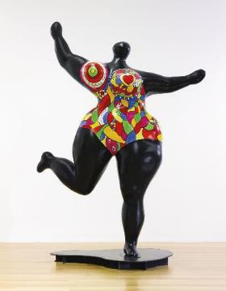
Discussion
Working women’s bodies are neglected bodies
  In health care and in research
Organizations have no framework to provide sufficient room, rest, and meaning to bodies
Openness requires awareness and action
Space for selfcare – the body has its own temporalities
Women in female specific lifestages deserve more, not less, attention
Black Standing Nana, Niki de Saint-Phalle

Slide 31
Literature
Bendien, E., Van Gemert, I., Appelman, Y., Verdonk, P. (2019). Werken aan de overgang. Een uitgebreide literatuurstudie naar overgang, menopauze, gezondheid, en werk. In opdracht van WOMEN Inc. Amsterdam: Amsterdam UMC-VUmc, maart 2019.
Bendien, E., Oosten, A., Van Gemert, I., Verdonk, P. (2019). Vol verwachting. Een uitgebreide literatuurstudie naar zwangerschap, gezondheid en werk. In opdracht van WOMEN Inc. Amsterdam: Amsterdam UMC-VUmc, april 2019.
Bendien, E., Van Gemert, I., Heijsman, A., Verdonk, P. (2019). Zwoegen, zweten en zwijgen in de zorg. Een kwalitatieve empirische studie naar ervaringen met vrouwspecifieke levensfasen van verpleegkundigen en artsen in een academisch ziekenhuis. In opdracht van WOMEN Inc. Amsterdam: Amsterdam UMC-VUmc, mei 2019.
Oude Hengel, K., et al. (2022). De overgang: klachten en de invloed op het werk. Verdiepend onderzoek van de Nationale Enquête Arbeidsomstandigheden (NEA). Leiden: TNO.
Verburgh, M.J., Verdonk, P., Appelman, Y., Brood-van Zanten, M., Nieuwenhuijsen, K. (2020). “I Get That Spirit in Me”— Mentally Empowering Workplace Health Promotion for Female Workers in Low-Paid Jobs During Menopause and Midlife. International Journal of Environmental Research and Public Health, 17(18), 6462. Https://doi.org/10.3390/ijerph17186462
Verdonk, P. (2019). Gender en arbeid. Werkstress, overspannenheid en burnout. Hoofdstuk 30 in: Handboek Psychopathologie bij Vrouwen en Mannen. Red T. van Amelsvoort, M. Bekker, J. van Mens-Verhulst, M. Olff. Amsterdam: BOOM Uitgeverij, pp. 379-390.
Verdonk, P., Bendien, E., Appelman, Y. (2021). Menopause and work. A narrative literature review about menopause, work and health. Work, 77(2), 483-496.

