Slide 1
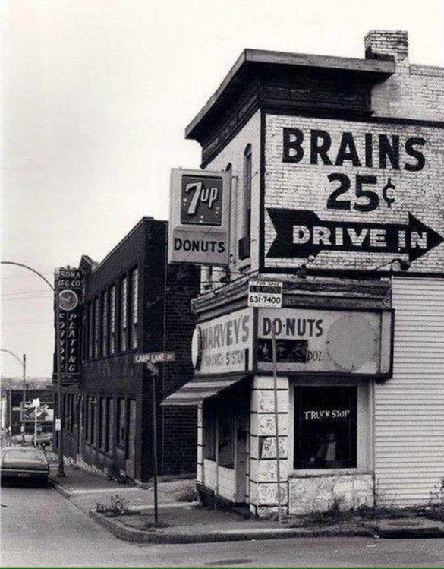

When to refer a patient to a memory clinic?
Dr. K. Segers
Memory Clinic
Neurology Dept
CHU Brugmann

Slide 2

Dementia is not a diagnosis
We have found out why you can’t walk anymore: it is because you’re in a wheelchair.
Acquired
Progressive
Cognitive decline (not always memory)
Loss of autonomy
Never explained by age
early on: difficulties with
administration
drug compliance
appointments
electronic devices
use of public transport
Who would have thought?

Slide 3

Médicaments pouvant entrainer une confusion par leurs effets anticholinergiques
Neurologie | Antiparkinsoniens anticholinergiques | Trihexyphénidyle (Artane) Bipirédène (Akineton) Procyclidine (Kemadrin)
Psychiatrie | Antidépresseur 3C | Clomipramine (Anafranil) Amytryptiline (Redomex)
 | Neuroleptique phénothiazinique/thioxanthène | Prothipendil (Dominal) Lévomépromazine (Nozinan) Flupenthixol (Deanxit)
 | ISRS | Paroxetine (Seroxat)
 | Neuroleptique atypique | Clozapine (Leponex) Olanzapine (Zyprexa)
 | Myorelaxant | Tizanidine (Sirdalud)
Gastroentérologie | Antiémétiques (neuroleptiques) | Metoclopramide (Primperan)
Urologie | Antispasmodiques dans l’instabilité vésicale | Oxybutinine (Ditropan) Tolterodine (Detrusitol) Solifenacine (Vesicare) Darifénacine (Emselex) Fesoterodine (Toviaz) Flavoxat (Urispass) Tous : strong anticholinergic properties (BEERS)
Immuno-allergologie | Antihistaminiques phénothiaziniques | Prométhazine (Phenergan) Alimémazine (Theralène)
 | Antihistaminiques H1 | Cétirizine (Zyrtec) Desloratadine (Aerius) Dimetendène (Fenistil) Hydroxyzine (Atarax)
Pneumologie | Antitussifs antihistaminiques H1 | Oxomémazine (Toplexil sirop)
 | Bronchodilatateurs anticholinergiques | Ipratopium (Atrovent) Tioptropium (Spiriva)
Cardiologie | Troubles du rythme | Dysopiramide (Rythmodan)
Divers | Antispasmodiques anticholinergiques | Atropine Scopolamine

Slide 4
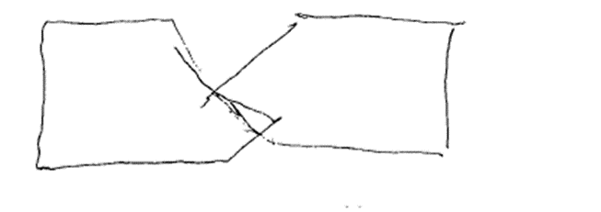
Loss of autonomy implies knowledge about past autonomy

Slide 5
Most common dementias
Alzheimer’s disease: accumulation of amyloid β42
Vascular dementia
Dementia with Lewy bodies: accumulation of α-synuclein
Frontotemporal dementias: many different rare diseases, language and behavioral difficulties
Many patients, even the young, have multiple pathologies (+ alcohol, drugs, SAS...)

Slide 6
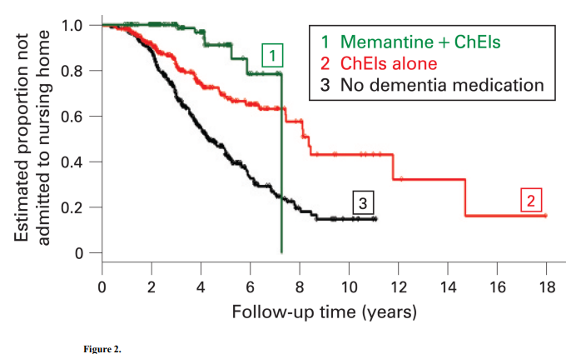
Alzheimer’s disease is not curable, but treatable
Lopez OL et al, JNNP 2009

Slide 7
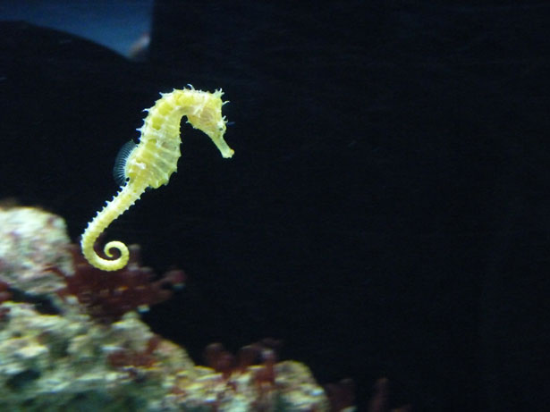
Alzheimer is not a disease of short time memory but of encoding of new memories in the episodic long term memory
No help of semantic
cueing = hippocampus problem:
AD
Anticholinergics: not rare
Stroke in hippocampus: rare
Banana
Taxi
Sheep
Banana
Taxi
…
The third word was an animal
Short term memory
Long term memory
Cat?

Slide 8
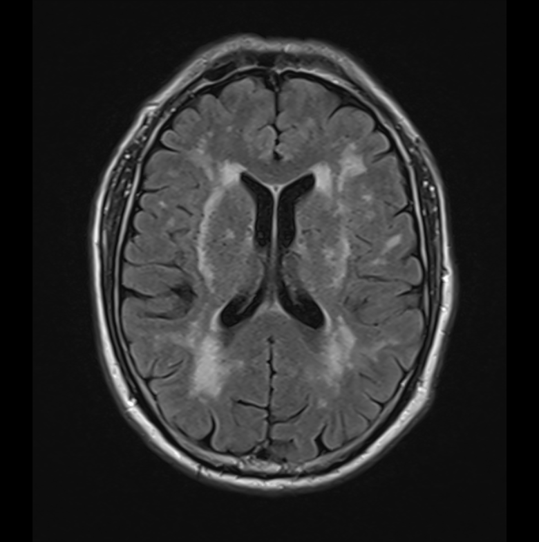
Vascular dementia
Small subcortical infarcts
Dysexecutive functioning, frontal behavior, early urinary incontinence and walking difficulties
Memory is spared (MMSE often high)
Choose MRI, not CT: you might
miss things

Slide 9
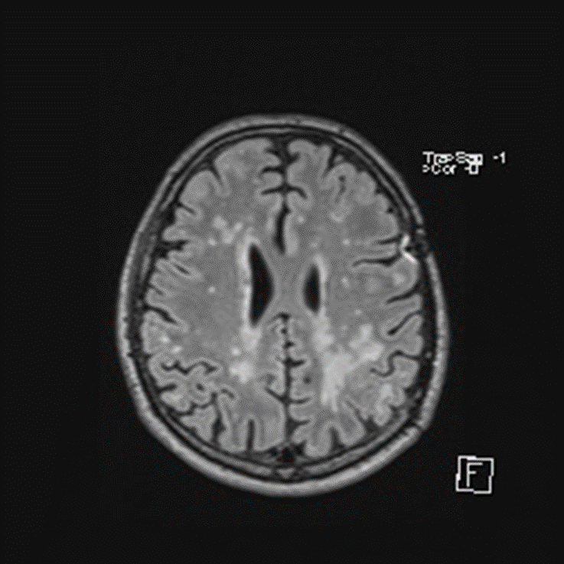

Slide 10
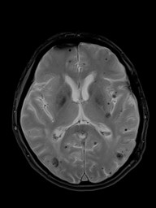
Cerebral amyloid angiopathy: absolute contra-indication for anticoagulation and even anti-aggregation

Slide 11
Dementia with Lewy bodies
Inversed Parkinson disease: cognitive and behavioral changes before extrapyramidal signs
Younger patients -> often mistaken for depression and other psychiatric disorders
Think LBD when
    (Visual) hallucinations
    Cognitive fluctuation
    Parkinsonism
    Parasomnia
    Hypophonia
    Anxiety needing medical care
    Intolerance to neuroleptics (if necessary: clozapine)
    Orthostatic hypotension
    Constipation
    Delusions (pregnancy delusion: ¼ are men)
    Cognitive slowing
    Early spatial disorientation
Core criteria

Slide 12
Frontal lobe behavior
Not specific: AD, vasc, LBD, FTD, alcohol, trauma
Inappropriate behavior during consultation: intolerance to waiting, misplaced familiarity, jocularity (Witzensucht), hypersexuality, need to touch objects on your desk (utilization behavior)
Imitation (test visual fields)
Head turning sign: AD
“Emotional incontinence”

Slide 13

Albanian construction worker, 48 y, cries since recently when he sees a romantic film

Slide 14
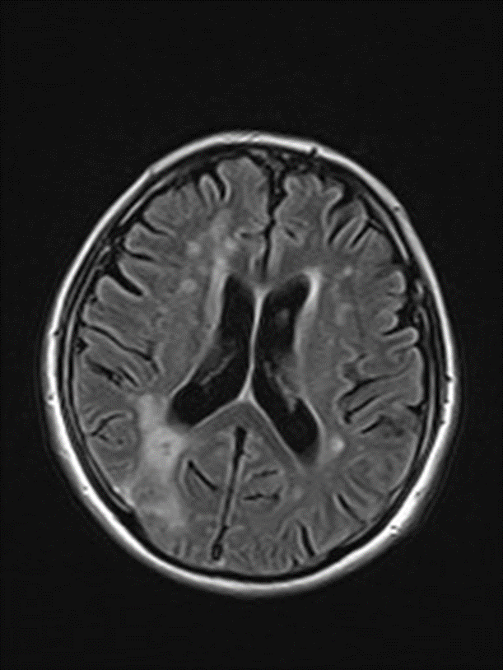

Slide 15
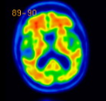
Anosognosia
Inability to perceive one’s own cognitive dysfunctioning
NOT a psychological defense mechanism
It will not disappear with reasoning
Always pathological (frontal lobe dysfunction)
Even present in prodromal Alzheimer’s disease (40%)
Interferes with treatment compliance +++

Slide 16
Observe the patient in the waiting room
Extrapyramidal walking difficulties are not exclusively a motor problem
  Improves with attention
  Might deteriorate when thinking about other things (risk falls)
  Might deteriorate when passing a door
Sleep apnea syndrome?

Slide 17
Cognitive function and treatment compliance
Call the pharmacist, not the GP.
Temporal disorientation? A pillbox for the week won’t help
Avoid polypharmacy and multiple intakes a day
Avoid cascades (amlodipine -> furosemide -> anticholinergics)

Slide 18
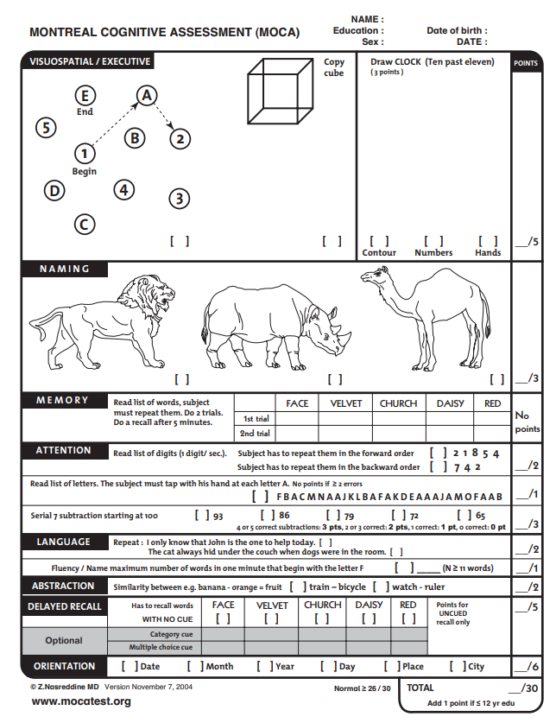
Careful with screening tools (MMSE)
Underdiagnosis (high MMSE)
- highly educated patients
- vascular cognitive disorder: use MoCA
Overdiagnosis (low MMSE)
- unschooled patients (Ardilla effect)

Slide 19
When you refer a patient
Exact treatment?
Consider asking MRI to speed up workout
No neuropsychological tests
  During use of anticholinergics
  For advanced dementia
  In the acute phase of a disease
  Untreated but treatable SAS
Ask someone to come with them

Slide 20


Slide 21

So when should you refer?

Slide 22
Suggested reading:
Johnson JCS, McWhirter L, Hardy CJD, et al. Suspecting dementia: canaries, chameleons and zebras. Practical Neurology 2021;21:300-312.

