Slide 1
Background
The use of menopause hormone therapy has dramatically decreased in all countries since the initial findings of the Women’s Health Initiative (WHI) were published in 2002.
Physicians’ advices and women’s decisions regarding such therapy have been surrounded by anxiety and confusion for the last decades.
Moreover two generations of physicians have not been trained about menopause management.

Slide 2
Background
Reanalyses and long follow-up of WHI data and new evidence emerging from other high quality studies are globally reassuring.
This concensus aims to update these date.

Slide 3
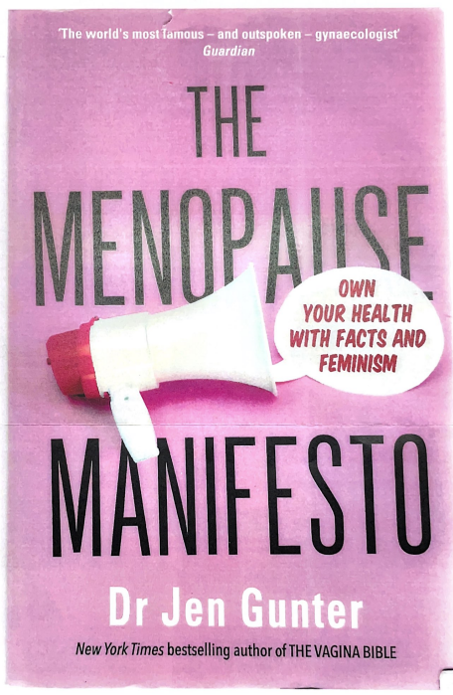
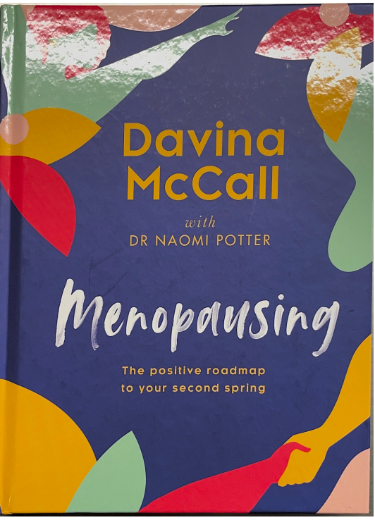
NY times

Slide 4
Definitions
By estrogen therapy (ET), we mean all systemic estrogen provided orally or parenterally (transdermal, percutaneous, spray). The Estrogen-progestin therapy (EPT) includes regimens combining estrogens and progestins. Hormone (replacement) therapy (HRT or HT), or menopause hormone therapy (MHT) includes all regimens containing steroids for the treatment of menopausal symptoms with inclusion of ET, EPT and tibolone. TSEC consists in the combination of CEE and a SERM. (Bazedoxifene).
Other routes of administration of estrogens and progestins (vaginal forms, and Intra Uterine delivery Systems) will be discussed separately.
Other drugs such as SERMS (selective estrogen receptor modulators) also called estrogen agonists-antagonists, SPRM (selective progestin receptors modulators), bone drugs, lipid lowering drugs, androgens, vitamin D, calcium etc. will be discussed separately.

Slide 5
Definitions
New drugs might emerge soon, but are not marketed yet and will, therefore, be discussed later separately (Estetrol, NK3 Antagonists).

