Slide 1
Climacteric symptoms
Symptoms directly or indirectly related to menopause include :
Vasomotor symptoms (hot flushes and night sweats and their consequences)
Insomnia,
Mood changes, psychological symptoms
Impaired concentration and memory
Some patients suffer from a fog, resulting in impaired work capacity
Sexual dysfunction
Urogenital symptoms
Arthralgia

Slide 2
Climacteric symptoms
Moderate to severe symptoms disturb women’s health-related quality of life for variable (short to very long) durations.
In women suffering from such symptoms, MHT is the most effective treatment. In these women, it improves their quality of life.
(Level of evidence Ia )

Slide 3
Climacteric symptoms
Some symptoms are attributed to the climacteric but may result from other etiologies (such as iatrogenic causes).
In asymptomatic women, MHT usually does not ameliorate objectively the overall quality of life.
(level 1b of evidence)

Slide 4
Hot flushes
In some patients other etiologies of Hot flushes should be excluded
Thyroid disease
Hypo/hyper-glycemia
Obesity
Cancers
High / low blood pressure

Slide 5
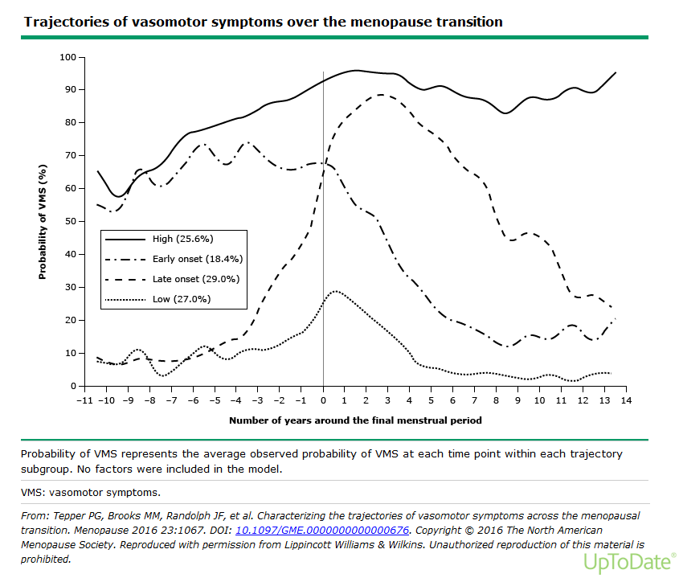
Notes:
Longitudinals studies indicate that women follow distinct patterns of VMS
Both the SWAN study (US° and an Australian study ( Aus Longit Study of women’s health) found that VMS follow 4 trajectories in approx. equal proportions across 4 groups
4 types:
Mild : mild/ no HF
Late onset : start na laatste menstruatie → blijven tot late MP
Early onset : start reeds vroeg in de overgang maar↓ na laatste menses
Super flushers : start vroeg in de overgang → blijven tot late MP
RF voor HF vroege flushers
↑ BMI
Centrale obesitas
↓ slaapkwaliteit
↓ Quality of life

Slide 6
Is a hot flush trivial ??
Increasing amount of studies show that ↑ HF //
↑ Cardio vascular disease (CVD)
The strongest predictor of underlying CVD are early flushers/ superflushers
↑ other precursors v CVD
Abnormal endothelial function
↑ coronary / Aorta calcification = arteriosclerosis
↑ carotid intima media thickness
↑ central obesity en BMI
↑ hypertension
↑LDL cholesterol en Triglicerides
↑ insulin resistentance en (pre)diabetes
↑orthosympatic activity
↑ hypothalamic – hypofyse- adrenal axis : ↑cortisol
↑inflammation en cytokines
Notes:
VMS are among the strongest predictors of subclinical CVD
VMS are associated with a more adverse CVD risk profile
Endotheeldysfunctie: endotheel: 3 lagen: buitenste BW/middenste gl spierweefsel/ binnenste 1 laag endotheel
Endotheel : behoud lage vasc tonus
bron v NO (!! VD, verminderd OX stress, inflamm, WBC adhesive, Plaatjes aggregatie en gl spiercelprolif
endotheline, prostacycline (ox stress mediatoren)
Endotheeldysfunctie agv: verminderde NO(!!), meer ox stress, AHT, inflamm, obesitas, tabak
gevolg: dalen flow mediated dilatation: behouden v flow dmv VD/VC
is belangrijke voorloper v arteriosclerose ontwikkeling: onder beschadigd endotheel nestelen zich LDL+ WBC→ ox/inflamm → plaque
IMT (intima media thickness): meting v binnenste/middenste lag carotis: ! Marker voor cor plaque en CVD !!

Slide 7
Sleep and HRT
Improves sleep esp in women with nighttime VMS by reducing awakenings
ET or PT may improve chronic insomnia in MP women, independant of VMS
Oral progesterone has mild sedating effects (GABA agonistic effect).
Oral progesterone improves sleep onset latency but not sleep duration efficiency in RCT in post MP ( syst RV, meta analysis)

Slide 8
Cognitive complaints
Frequent in midlife women and across MP transition
Role of E2
Role of VMS, sleep disturbances and mood changes
Notes:
- studies show a role for E2 in mediating MP related changes in cognition
removal of ovaries or suppression of E2 leads to declines in verbal learning which is reversed by E treatment
E receptors are replete in brain areas subserving memory and other cognitive functions (hippocampus and prefrontal cortex)
In addition: MP related sympt : VMS, sleep disturbances and mood changes contribute to cognitive difficulties
Mp sympt also appear to contribute tot memory difficulties
Brain imaging studies link VMS to adverse changes in brain structure and function
A study done by Rebecca thurstona and Pauline Maki showed
That more frequent physiologically detected VMS were associated with greater white matter hyperintensities, a measure of small vessel disease in the brain. They also found greater default network connectivity with more frequent VMS

Slide 9
Mood disturbances
Menopause transition as well as early menopause may increase vulnerability for some women.
Women who have experienced previous periods of depression associated with PMS or postpartum, are more susceptible to depression at the menopause. These women should probably be treated with MHT first before using anti-depressant drugs (grade IIC)
Mood disturbances and depression as such are not an indication of MHT. However, it may help women who have mood disturbances associated with climacteric symptoms.
Notes:
Estrogen lowers serotonine and endorphines

Slide 10
Urogenital atrophy or Genito-urninary syndrome of the menopause (GSM)
Vulvo-Vaginal (Urogenital) atrophy occurs (VVA) in up to 70-90% of women. One should systematically inquire whether these symptoms are present. Treatment should be encouraged.
MHT and regular sexual activity improves genital atrophy and its symptoms.
Local (topical) treatments with estradiol, estriol and DHEAS may be used in the absence of other indications, For these treatments, there is no age or time limit.
Local treatments should be administered for long periods of time (Level 1a) and does not require generally concomitant administration of a progestin.
Local treatment reduces the incidence of recurrent urinary tract infections and nycturia. (Level 1b of evidence)
Urinary incontinence is not an indication for MHT, although data reported improved urgency using topical estrogen (Level 1b).
Notes:
Studies have not found a signif effect on sexual interest, arousal and orgasmic response
If systemic HRT is indicated in women with low libido, TD ET is preferred given increased SHBG and reduced bioavailability of testost with oral ET

Slide 11
Urogenital atrophy or Genito-urninary syndrom of the menopause (GSM)
Although, Laser and radiofrequency have gained popularity, clinical evidence on efficacy and long-term safety is lacking (2C).

