Slide 1
MENOPAUSE
Sénat 5.6.23
Serge Rozenberg
CHU St Pierre
ULB-VUB Belgium
serge_rozenberg@stpierre-bru.be

Slide 2
Conflict of interest & Disclosure
No conflict of interest declared
Disclosures SR
Research funding IRIS- King Baudouin Fondation, Vesale research Foundation, Amgen, MSD
Speakers bureau &/or Advisory Boards/ & or research grants obtained
Viatris, Abbott, Pfizer, Gedeon Richter, MSD, Amgen, Bayer, Theramex

Slide 3
Agenda
Clinical situation
WHI impact on MHT
Menopause nowadays
Early menopause
  Consequences
Unmet needs

Slide 4
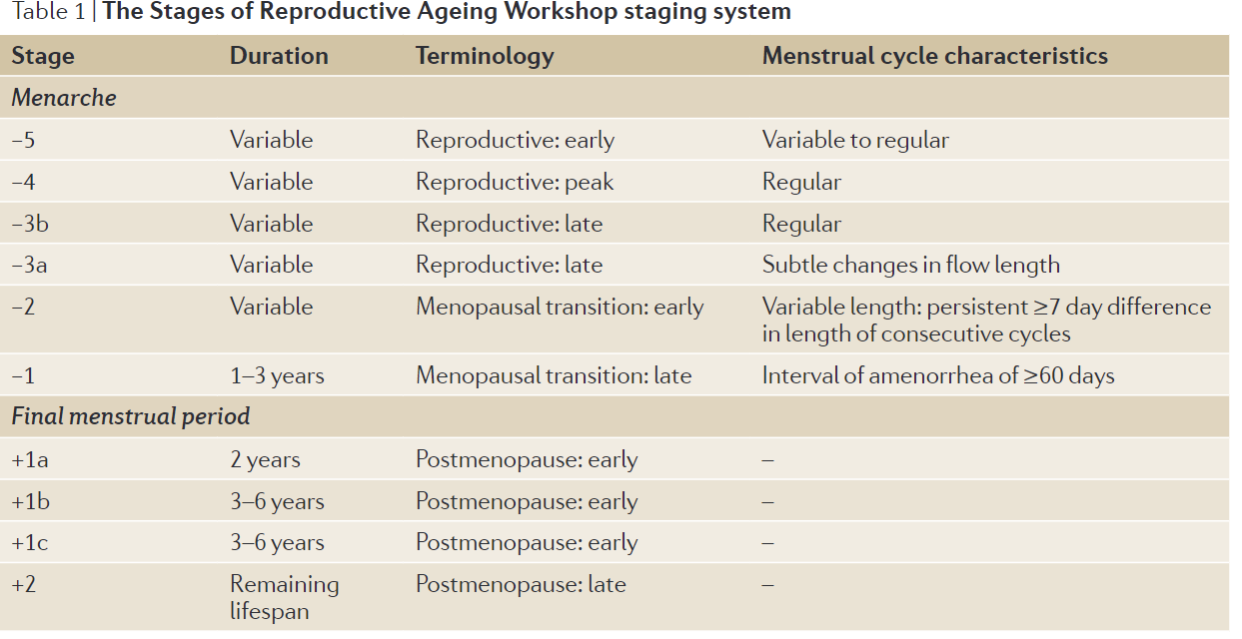

Slide 5
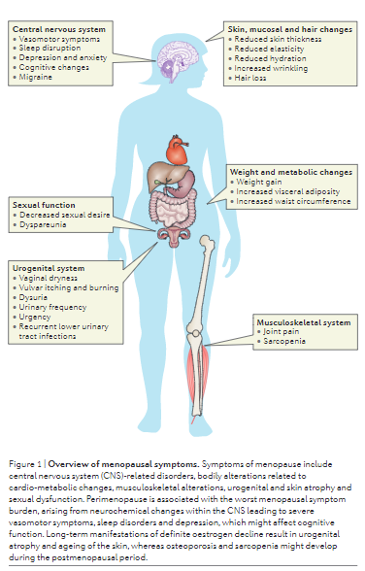
VMS
HF
Mood
Cognition
Cardiovascular
Osteoporosis

Slide 6
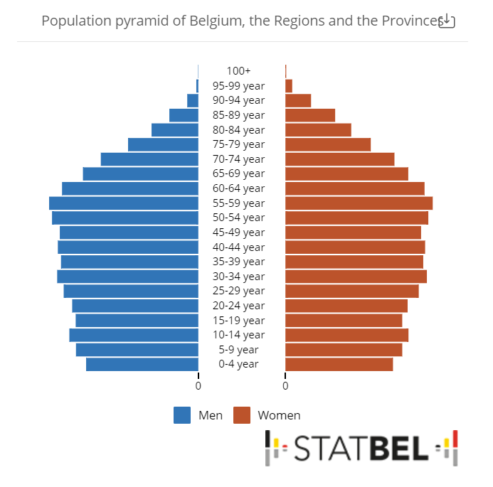
1.5 Million women aged 45-60 yrs

Slide 7
WHI ≠ Real life
Older patients ( + 65 yrs in WHI; + 50 real life)
Presumably asymptomatic in WHI <> VMS
Unfavourable MHT regimen
  Unfavourable benefit-risk ratio
  Breast cancer

Slide 8
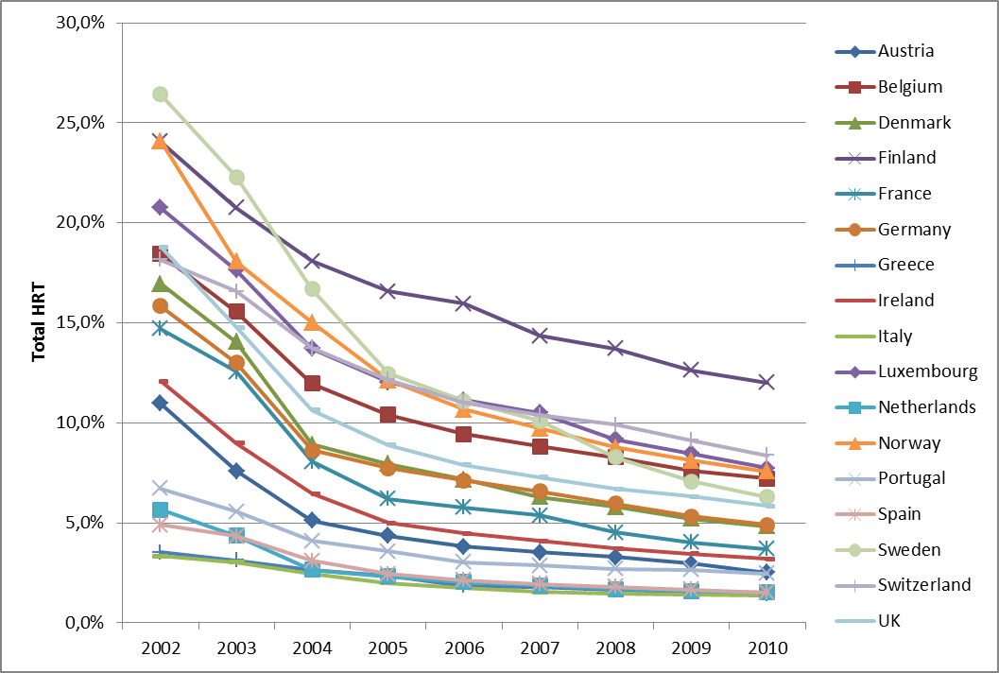
Antoine, Ameye, Paesmans Rozenberg Maturitas 2016

Slide 9
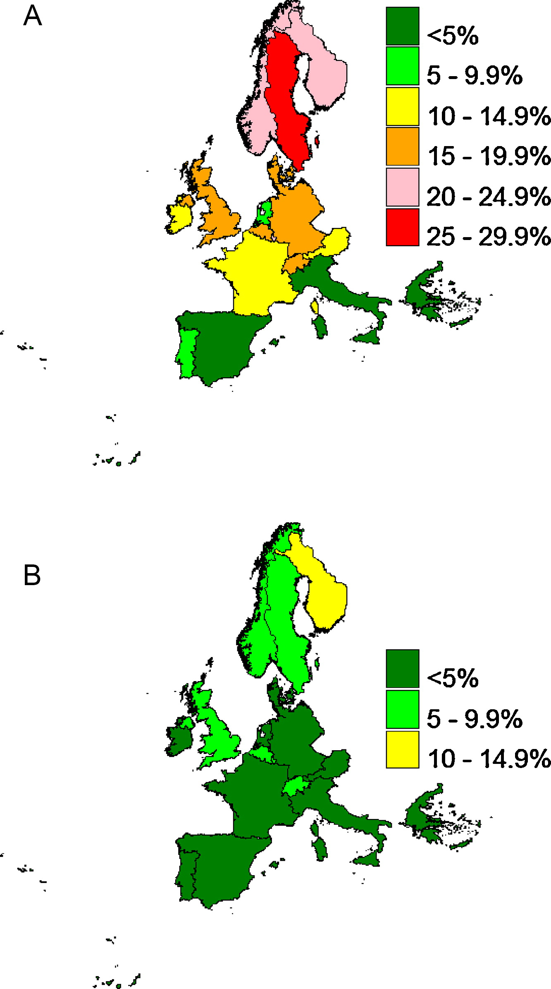
Fig. 2Map of Europe indicating the proportion of women 45–69 years old using MHT in the years 2002 and 2010. (A) MHT in 2002. (B) MHT in 2010.
Ameye, Antoine, Paesmans Rozenberg Maturitas 2014

Slide 10
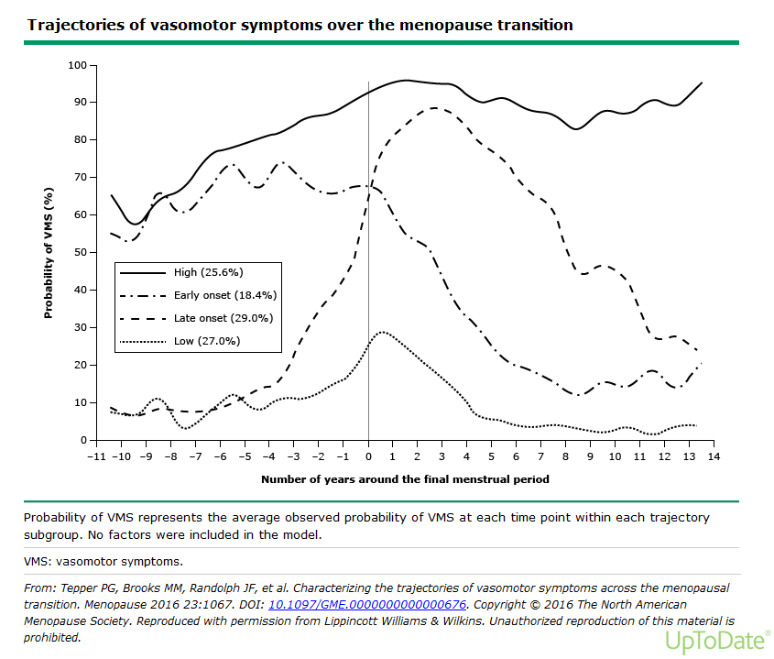

Slide 11
Global cross-sectional survey of women with vasomotor symptoms associated with menopause: prevalence and quality of life burden.
Prevalence of moderate-to-severe VMS
  Europe : 40%
  US 34%,
  Japan 16%
Which symptoms
  Tired or worn out (75%)
  Aching muscles & joints (60-70%)
  Sleeping difficulty (60%-70%)
  Hot flashes (60Europe 67%, US 68%, Japan 62%).
  Weight gain.
  Impact on daily & working activities
Nappi RE, et al Menopause. 2021;28(8):875. Epub 2021 May 24.

Slide 12
Clinical indications
Women with mild symptoms do not typically seek hormonal therapy.
Between 25-50% have moderate and severe symptoms affecting their quality of life
Concerns between 325.000 and 750.000 Belgian women
Women underestimate VMS
Only + 25 % women with moderate to severe symptoms seek treatment.

Slide 13
Menopausal symptoms might serve as markers for future health;
  severe vasomotor symptoms and sleep disorders might increase cardiovascular risk,
  whereas severe vasomotor symptoms and depression might affect cognitive function
  Rozenberg et al Nature Endocrinology 2013,
  Monteleone, et al Nature Endocrinology 2018

Slide 14
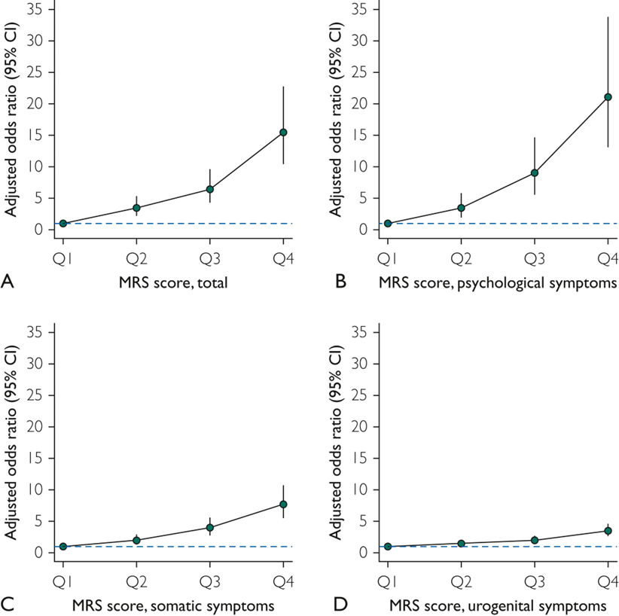
Impact of Menopause Symptoms on Women in the Workplace
Faubion SS et al Impact of Menopause Symptoms on Women in the Workplace. Mayo Clin Proc. 2023 Apr 20:S0025-6196(23)00112-X.

Slide 15
Impact of Menopause Symptoms on Women in the Workplace
Work days missed due to menopause symptoms
Annual loss of $1.8 billion in US
Faubion SS et al Impact of Menopause Symptoms on Women in the Workplace. Mayo Clin Proc. 2023 Apr 20:S0025-6196(23)00112-X. ​

Slide 16
News from the WHI Study
15/02/2023
WHI Response to NYT article "Women have been misled about menopause"
….. Therefore, we agree that the benefit of symptom relief may well outweigh any small risks in perimenopausal women. This is especially so for estrogen alone, but even for combined hormone therapy, the short-term risks are low. Of course, treatment decisions should consider a woman’s individual profile, such as severity of symptoms and presence of risk factors for heart disease, stroke, breast cancer, and bone fractures......

Slide 17
POSITION STATEMENTS
….. For women aged younger than 60 years or who are within 10 years of menopause onset and have no contraindications, the benefit-risk ratio is favorable for treatment of bothersome VMS and prevention of bone loss.....
IMS, EMAS, NAMS, Endo Soc, Nice,
Most recent HMT position statements

Slide 18
Lifetime fracture risk
A 50-year-old white woman has a 15 - 20% of hip fracture and a 50% risk of any osteoporotic fracture.
Black & Rosen NEJM 2016

Slide 19
Is there a role for menopausal hormone therapy in the management of postmenopausal osteoporosis?
We provide an evidence …for the use of MHT for the maintenance of skeletal health and prevention of future fractures in recently menopausal women. ….
Potential role for MHT soon after menopause in the management of postmenopausal osteoporosis is increasingly recognized.
Overall, the benefit-risk profile supports MHT …in women recently (< 10 years) menopaused, who have menopausal symptoms and who are less than 60 years old, with a low baseline risk for adverse events.
MHT should be considered as an option for the maintenance of skeletal health in women, specifically as an additional benefit in the context of treatment of menopausal symptoms, when commenced at the menopause, or shortly thereafter, in the context of a personalized benefit-risk evaluation.
S Rozenberg , N Al-Daghri, M Aubertin-Leheudre , M-L Brandi, A Cano, P Collins, C Cooper, A R Genazzani, T Hillard, J A Kanis, J-M Kaufman, I Lambrinoudaki, A Laslop, E McCloskey, S Palacios, D Prieto-Alhambra, J-Y Reginster, R Rizzoli, G Rosano, F Trémollieres, N C Harvey Osteoporosis Int 2020

Slide 20
Early menopause : < 45 years
Premature menopause : < 40 years
  Dramatic reproduction consequences
  Psychosocial support
Higher mortality

Slide 21
Timing hypothesis & window of opportunity

Slide 22
Early menopause & CVD meta-analysis
Menopause before age 45 have a 50% higher risk of coronary heart disease, cardiovascular mortality, and overall mortality compared with women who experienced menopause after age 50
T. Muka, et al.Association of age at onset of menopause and time since onset of menopause with cardiovascular outcomes, intermediate vascular traits, and all-cause mortality: a systematic review and meta-analysis JAMA Cardiol (2016)

Slide 23
Take home messages
Each patient is different
Menopause is an opportunity for correcting risk factors
Indications for MHT and individual risk assessment and should be evaluated
Early menopause is a risk factor for other health issues
For most patients with moderate-severe VMS < 60 years of age, MHT is indicated
For most patients < 40 years, MHT is indicated
Favor regimens with a low risk profile

Slide 24
Unmet needs
Create a favourable work environment

Slide 25
Unmet needs
A registry of women with POI
  According to etiologies
  Add psychological support
  Collaboration
    Menopause consultation
    Fertility
    Oncology

Slide 26
Unmet needs
Cohort studies menopause consequences
  Menopause consultations
  Obgyn
  Familly planning
  GP

