Slide 1
Methodology
These experts came together and proposed the following consensus based on recent and updated publications.
They essentially considered meta-analyses, randomised trials and large epidemiological observational studies.
The experts hope that this document will facilitate practical menopausal management. The proposed consensus represent the shared view of these experts. In some cases no consensus was reached and these points will be mentioned also.

Slide 2
Levels of evidence I = randomised controlled trials, II= prospective observational robust cohorts, III=animal, experimental or retrospective data).
We also use the Grade recommendations.
In opposition to previous consensus, we define now « as high estrogen dose » as the equivalent of 2 mg E2, or 0.625 CEE; « standard» dose as 1 mg E2 or equivalent and « low dose » as 0.5 mg or lower and CEE 0.4mg. Currently, low dose are preferred therapies. For transdermal therapy, the equivalent of 25 µg/d per patch or 1mg/d gel and 3 mg (2 sprays) is considered as low

Slide 3
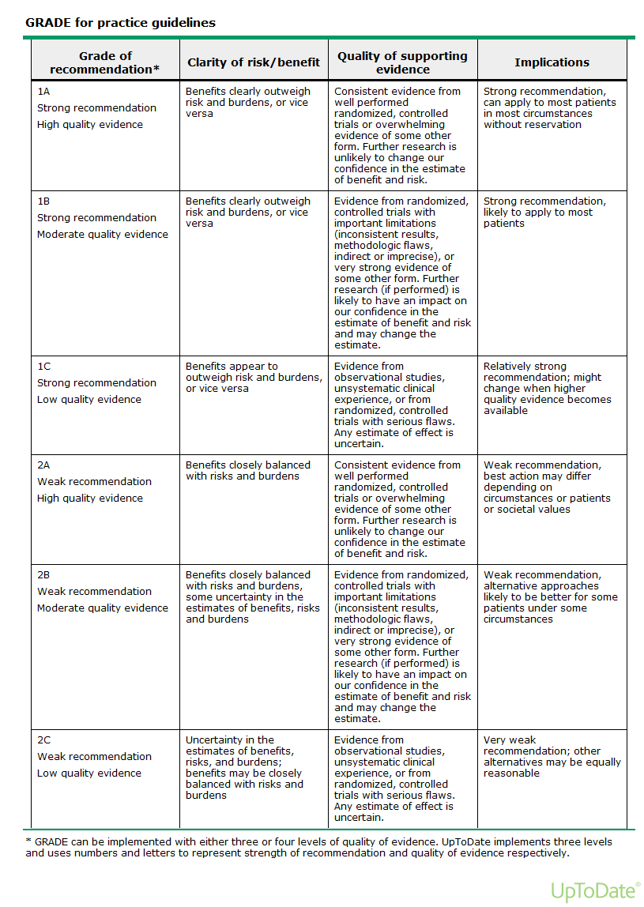

Slide 4
Patient information
Individualised advice is needed. Risks and benefits need to be explained preferably using absolute risk and attribuable estimations.
Women should also be informed about other health strategies.
Therapeutic management should be reviewed regularly.
Shared decision taking should be seeked.

Slide 5
The use of MHT in the following topics have been reviewed
Premature menopause, ovarian insufficiency or failure
Climacteric symptoms, perimenopausal transition symptoms
Quality of life
Loss of work performance and missed job opportunities
Urogenital atrophy
Sexual wellbeing
Osteoporosis (prevention and treatment)
Breast cancer risk
Other cancer risks : Colon cancer, Endometrial cancer, Ovarian cancer, lung cancer, others
Cardio & Vascular
Coronary heart-, stroke, venous thrombo-embolic diseases
Cognitive function, Alzheimer Disease, Parkinson Disease
Miscellaneous

