Slide 1
Osteoporosis
Life style counseling (exercise, banishing smoking and alcohol excess, …) is mandatory in all women.
In vitamin D deprived women (vitamin D < 30 ng/ml) adequate intake vitamin D should be supplied.
MHT (ET, EPT and Tibolone, TSEC) is efficacious in preventing menopause-related bone loss (level 1a).

Slide 2
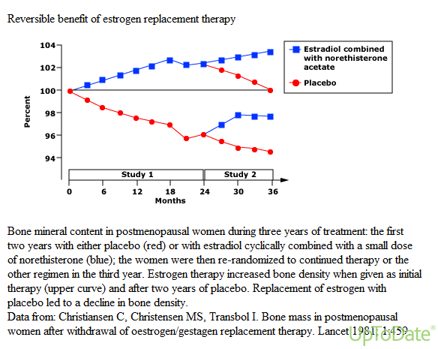

Slide 3
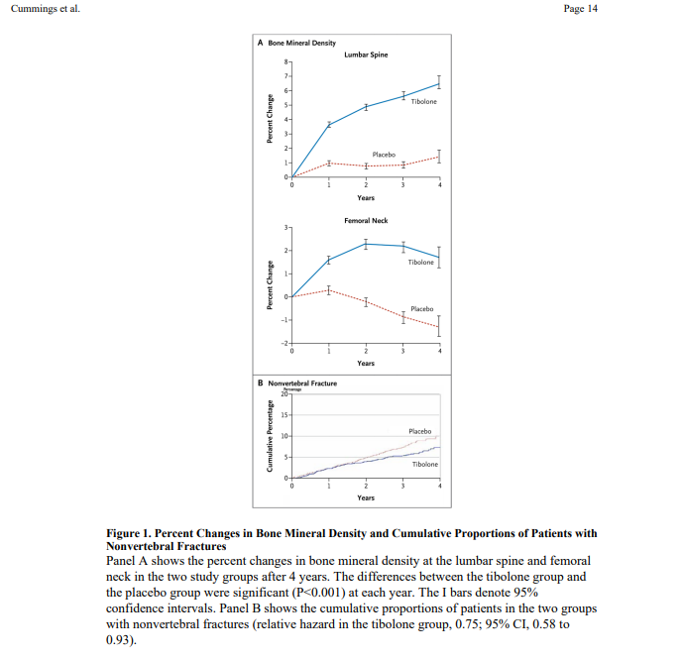
Cummings, et al NEJM 2008​

Slide 4
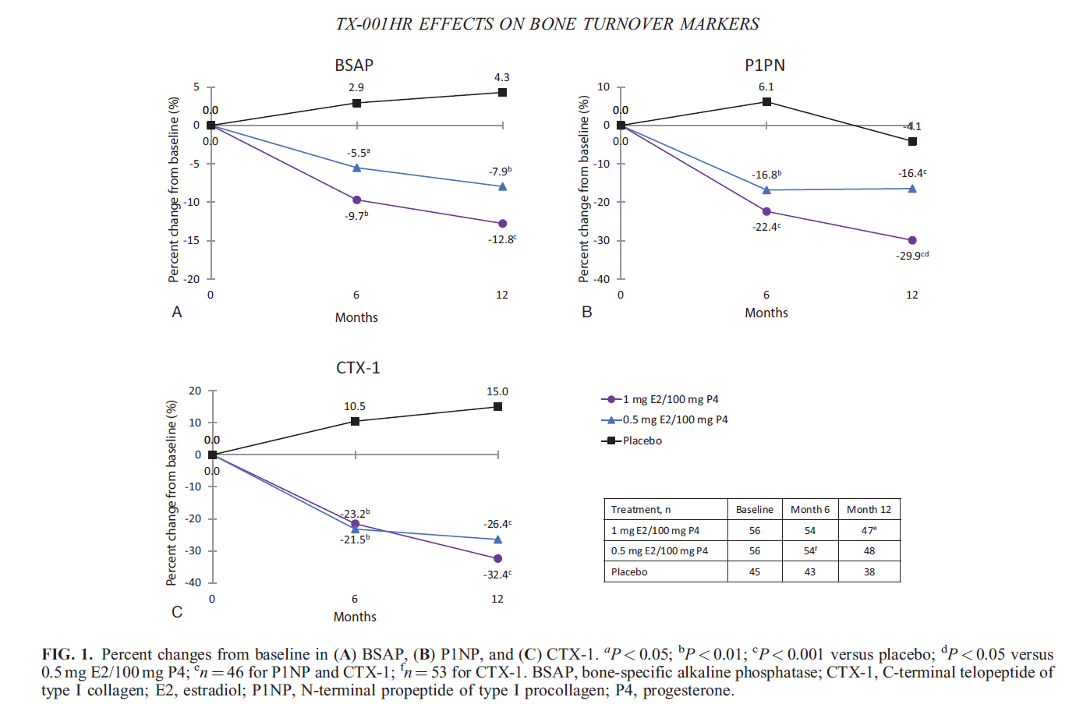
Effects of E2/P4 oral capsules on bone turnover in women with vasomotor symptoms
McClung et al Menopause Feb 2022
. 2022 Feb 14;29(3):304-308.Cliquez pour ajouter du texte

Slide 5
Osteoporosis
Tibolone and Raloxifene and Basedoxifene prevent vertebral fractures (level 1a) and EPT or ET both hip and vertebral fractures (Level 1a of evidence)

Slide 6
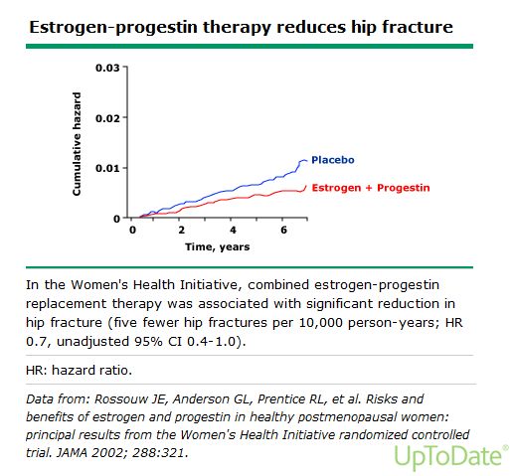

Slide 7
Perspective Menopause Management —
Getting Clinical Care Back on Track
JE Manson, AM Kaunitz
N Engl J Med
March 3, 2016

Slide 8
Osteoporosis
Therefore, MHT may be used in women less than 60 years of age,with high risk of- or with osteoporosis, as a first line treatment.

Slide 9
Osteoporosis
Nevertheless, since these regimens need to be used for long periods of time, potential long term risks should also be weighed against benefits in elderly women.
Osteoporosis risk can be evaluated by FRAX and by BMD. BMD measurement should be prescribed in the presence of risk factors of osteoporosis or at the menopause in patients hesitant to take MHT.

Slide 10
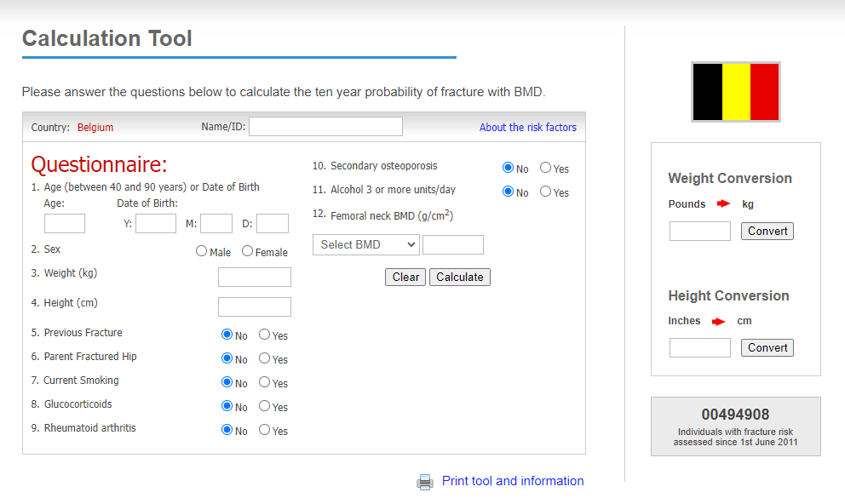
FRAX: WHO Fracture Risk Assessment Tool¹
http://www.shef.ac.uk/FRAX
Threshold of 15%
& 3% hip fractures
1. WHO FRAX tool. Available from http://www.shef.ac.uk/FRAX/tool.jsp

Slide 11
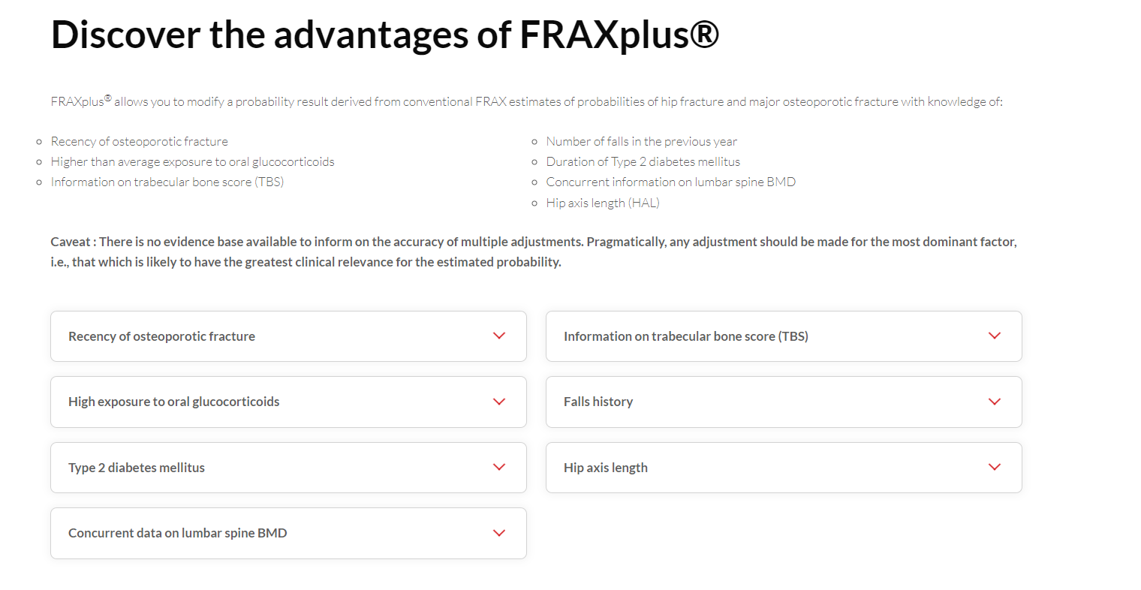
https://www.fraxplus.org/frax-plus

Slide 12
Osteoporosis
In established osteoporosis, there is more evidence for using other drugs in the absence of climacteric symptoms (level 2b).

Slide 13
Osteoporosis
Raloxifene (a SERM) may be used in preventing spinal osteoporosis and fractures as well as invasive breast cancer. It has no proven effect on hip fracture prevention. It increases the incidence of thrombosis (stroke and DVT) and may induce or enhance climacteric symptoms (level 1b).
In 1000 women above the age of 65 years of age, Raloxifene will reduce the incidence of breast cancer per year from 2.7 cases to 1.5 cases (reduction : 1.2 cases). The number of fracture will be reduced from 3.7 to 2.4 fractures per 1000 women per year. The number of thrombosis will increase from 2.7 to 3.9 per 1000 and the number of strokes by 0.7 cases per year. The number of strokes was limited to women with a high 'Framingham Stroke Risk Score'.
Other SERMS, like Bazedoxifene may have different profiles: preventing vertebral osteoporosis and having a neutral effect on breast and endometrium, but increasing probably similarly to other SERMS the thrombosis risk (level 2b) .

Slide 14
Effect of Raloxifene in Women With or Without Existing Fractures
MORE Trial - 3 Years
25
RR 0.70
(95% CI = 0.56, 0.86)
20
30%
Placebo
15
% of Women with
Incident Vertebral Fracture
Raloxifene 60 mg/d
10
RR 0.50%
(95% CI = 0.29, 0.71)
5
50%
0
Without Prevalent
Vertebral Fractures
With Prevalent
Vertebral Fractures
Ettinger et al. JAMA 1999; 282:637-45.

Slide 15
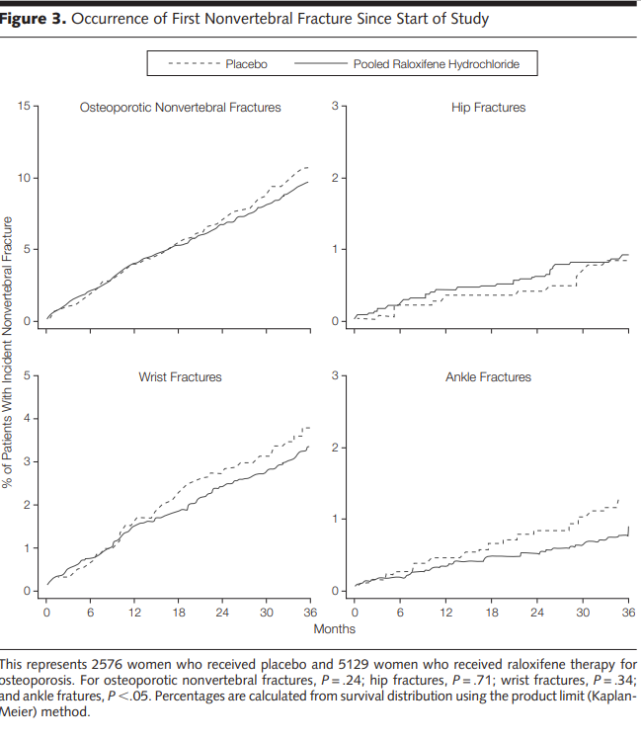
Ettinger et al JAMA 1999 MORE study

Slide 16
Incidence of Invasive Breast Cancer
8 Years of MORE and CORE (N=7705)
Source:
4.0
Review:
Placebo
4.2 per 1000 Women-Yrs
3.0
HR 0.34 (95% CI = 0.22, 0.50)
p <0.001
Cumulative Incidence (%)
66%
Reviewer Memo:
2.0
1.0
Raloxifene
1.4 per 1000 Women-Yrs
0.0
0
1
2
3
4
5
6
7
8
Years in Study
*Women in the raloxifene arm received rlx 60 or 120 mg/d in MORE and rlx 60 mg/d in CORE
Martino S et al. J Natl Cancer Inst 2004;96(23):1751-1761
Slide Modified:
Memo:
Feb 2006 – new slide from ms slide kit.
Notes:
8-year MORE plus CORE Results N=7705
This slide shows the Kaplan-Meier curve for the cumulative breast cancer incidence plotted against time over the 8 years of the MORE plus CORE trials beginning at randomization in MORE to the end of CORE. A total of 98 cases of invasive breast cancer (58 in the placebo group and 40 in the raloxifene group) were reported and confirmed by adjudication.
Over the 8-year period, raloxifene reduced the incidence of invasive breast cancer by 66% (p value < 0.001) compared with placebo. Absolute risk in the placebo group was 4.2 cases per 1000 woman-years and 1.4 cases for the raloxifene group. Thus, in the raloxifene group there was an absolute risk reduction of 2.8 cases per 1000 women-years.
Over the 4 years of CORE (N=5213), 52 cases of invasive breast cancer (28 in the placebo group and 24 in the raloxifene group) were reported and confirmed by adjudication. During the 4 years of the CORE trial, the incidence of invasive breast cancer was reduced in the raloxifene treated group by 59%, compared to the group of women randomized to placebo (p<0.001). The absolute risk for the placebo groups is 5.2 cases per 1000 women-years and 2.1 for the raloxifene group. Thus, the absolute risk reduction for the raloxifene group was 3.1 cases per 1000 women-years.

Slide 17
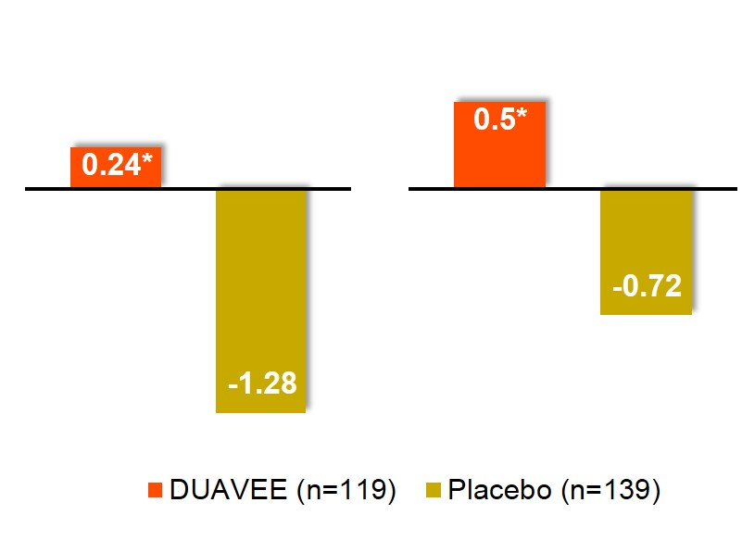
CE/BZA Significantly Increased Lumbar Spine and Total Hip BMD vs Placebo at 12 Months
Lumbar Spine
Total Hip
1.51%
1.21%
% Mean change from baseline
Treatment difference
Treatment difference
CE/BZA
*P<.001 vs placebo.
Adjusted mean changes and P-values based on an ANCOVA model with treatment and region (US or non-US) as factors and baseline BMD value and years since menopause as covariates using the modified intention to treat population with last observation carried forward.
In EU CE/BZA is not indicated for the prevention of postmenopausal osteoporosis
Pinkerton JV, et al . J Clin Endocrinol Metab. 2014 Feb;99(2):E189-98.
Notes:
In Study 2, treatment with DUAVEE significantly increased mean lumbar spine BMD at 12 months, compared with placebo, in women who had been postmenopausal for less than 5 years.
The mean percent change from baseline for lumbar spine BMD was a 0.24% increase for DUAVEE and a 1.28% decrease for placebo at 12 months. This resulted in a statistically significant treatment difference from placebo of 1.51%.
DUAVEE also significantly increased mean total hip BMD at 12 months, compared with placebo.
The mean percent change from baseline for total hip BMD was a 0.50% increase for DUAVEE and a 0.72% decrease for placebo at 12 months. This resulted in a statistically significant treatment difference from placebo of 1.21%.
In summary, based on the two studies we have just reviewed, treatment with DUAVEE demonstrated significant increases in lumbar spine and total hip BMD vs placebo in postmenopausal women.
Reference
Data on file. CSR-81040. Protocol 3115A1-3307. Pfizer Inc; New York, NY.

Slide 18
Biphosphonates, denosumab and romososumab are used in established osteoporosis usually after 60 years old. They have a proven effect also on hip fracture prevention (level 1a).
These medications need to be combined with adequate calcium and vitamin D intake.
As for all long term treatments, compliance is essential.
The long term risk of all used drugs should also be evaluated : a potential concern exists about atrial fibrillation, jaw osteonecrosis and atypical fractures.
In women using bisphosphonates, without fractures a drug holiday is generally advised after a few years of treatment. During this time preventive measures and calcium and vitamin D should be maintained (level 1a)

Slide 19
When Denosumab is stopped, however, bone loss recurr and patients should therefore use another osteoporosis antiresorptive therapy.
Romososumab may be prescribed in women with osteoporosis and major osteoporosis fracture history for one year only.

