Slide 1
Other cancers risks
Randomized trials report a reduced risk of colon cancer in EPT and tibolone users (but not in the ET users) (level 1 of evidence). Currently, colon cancer prevention is not a recognized indication for HRT.
Endometrial cancer : ET use is associated with substantially increased risk. Observational data are conflicting as to whether sequential EPT reverses this risk to the baseline risk (level 2 of evidence). However, continuous combined EPT is not associated with increased risk and even decreased risk in obese women (level 1 of evidence).
TSEC (CEE + Bazedoxifene) has not been associating with an increased endometrium cancer risk.

Slide 2
Other cancer risks
Some observational data, but not all reported an increased risk of some ovarian cancer in HRT users, but the attributable risk is in the range of 0.5 case/ 1000 women/ year.
In smokers older than 60 years, EPT does not increase lung cancer incidence but may increase the related mortality.

Slide 3
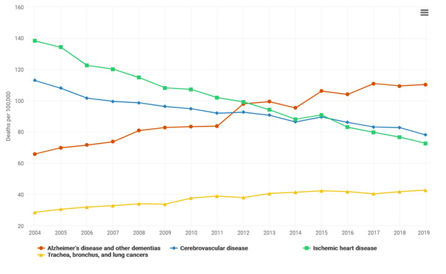
3
Notes:
3

Slide 4
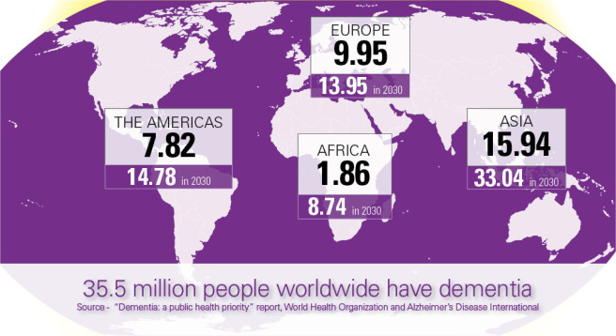
Ziekte van Alzheimer is de belangrijkste oorzaak van dementie, verantwoordelijk voor 60% to 80% tot van patiënten met dementie
AD patients worldwide
65%
35%
Alzheimer’s Disease Facts and Figures, Alzheimer’s & Dementia 2018
Notes:
TO DATE THERE ARE 35 MILION OF PEOPLE LIVING WITH DEMENTIA WORDLWIDE – 9 MILION ONLY IN EUROPE AND THIS NUMBER IS EXPECTED TO INCREAS TO 70 MILION WITHITN 15 YEARS

Slide 5
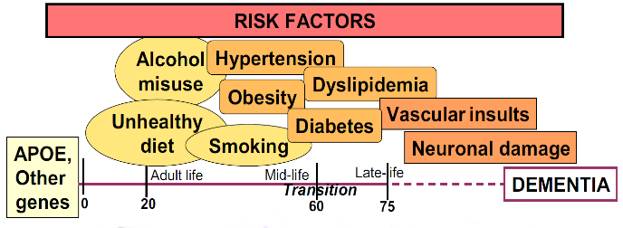
Alzheimer’s dementia: risc factors
CMC
Depressie
Sleeping disorder
Adapted from Kivipelto et al. (2013) Alzheimer’s & Dementia
Notes:
THE DEVELOPÒMENT OF AD DEMENTIA MIGHT BE INFLUENCED BY SOME GENETIC AND ENVIROMENTAL RISK FACTORS
THE MAIN KNOWN GENTIC RISK FACTOR FOR AD IS THE PRESENCE OF E4 ALLELE OF APOLIPOPROTEIN PLUS OTHER CANDIDATES GENES.
MOREOVER DURING THE WHOLE LIFESPAN WE KNOW FROM SEVERAL EVIDENCE THAT THERE ARE ENVIROMENTAL RISK FACTORS THAT MIGHT INFLUENCE THE INCIDENCE OF AD SUCH AS
Kivipelto M, Solomon A, Ahtiluoto S, Ngandu T, Lehtisalo J, Antikainen R, Bäckman L, Hänninen T, Jula A, Laatikainen T, Lindström J, Mangialasche F, Nissinen A, Paajanen T, Pajala S, Peltonen M, Rauramaa R, Stigsdotter-Neely A, Strandberg T, Tuomilehto J, Soininen H.
The Finnish Geriatric Intervention Study to Prevent Cognitive Impairment and Disability (FINGER): study design and progress.
Alzheimers Dement. 2013 Nov;9(6):657-65. doi: 10.1016/j.jalz.2012.09.012.
Cognitive impairment is one of the most frequent chronic conditions in the elderly, and the worldwide costs of dementia have been estimated to exceed those of other chronic diseases such as diabetes. Alzheimer’s disease (AD), the major cause of dementia, has reached epidemic proportions, with a large human, social, and economic burden. However, postponing AD onset by only 5 years may halve the projected AD prevalence in the future.
The importance of finding methods to delay onset and/or modify progression of cognitive impairment/dementia was recently emphasized in a report of the National Institutes of Health (NIH) in USA. Formulated by an independent panel of health professionals and public representatives from outside the AD research field, the report highlighted the need for high-quality, randomized, controlled trials (RCTs). As cognitive impairment/dementia has a multifactorial etiology, resulting from interactions between both genetic and environmental factors (Figure), the report recommended conducting RCTs with multidimensional interventions, combining interventions for multiple risk factors, and controlling for many other factors. Conducting trials initially in individuals at high risk was also recommended as a more efficient approach.
Within the AD/dementia research field, a consensus has emerged that intervention strategies must be initiated as early as possible, even before significant symptoms begin to appear. This goal can be achieved, for example, by incorporating the classical clinical trial approach to disease into a public health model, with long-term longitudinal databases including large populations. Establishing comprehensive databases for studies on aging can create the opportunity to formulate and validate tools for early detection of people who are at increased risk of late-life cognitive impairment, to identify important targets (risk factors) for preventive interventions, and to test such interventions in RCTs.

Slide 6
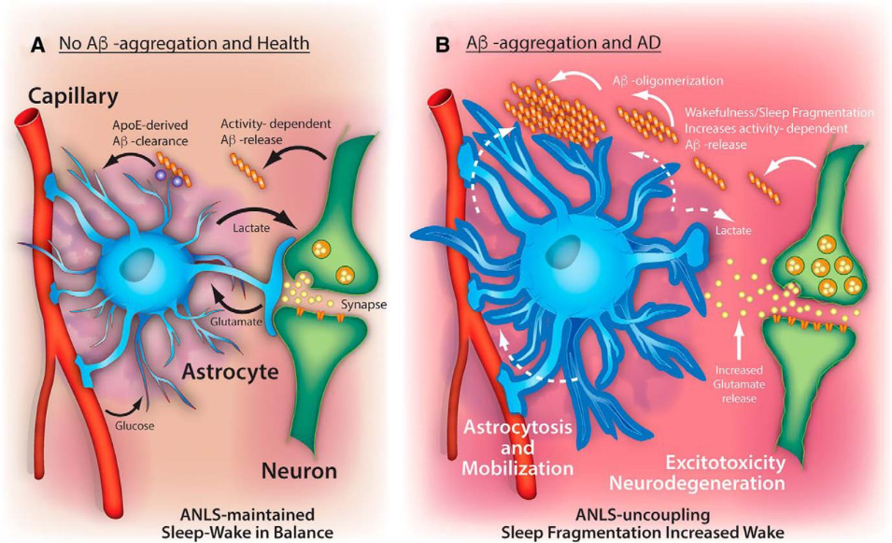
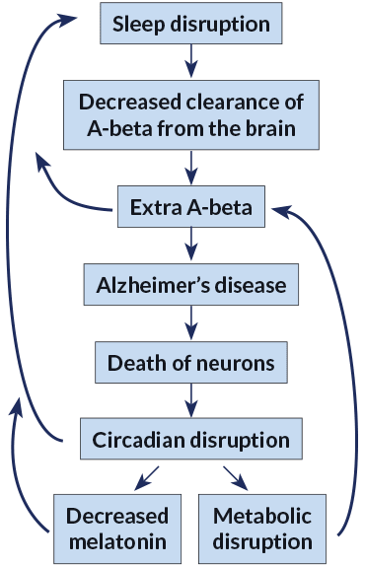
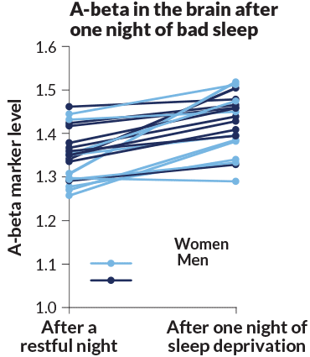
Y. Saeed and S.M. Abbott/Current Neurology and Neuroscience Reports 2017
Notes:
SEVERAL STUDIES HAS HIGHLIGHETHED THE ASSOCIATON BETWEEN SLEEP DISRUPTION AND AD. WHAT WE KNOW IS THAT THE LOSS OF MIGHT ENCOURAGE ALZHEIMER’S BY DECREASING CLEARANCE OF BETA AMYLOID IN THE BRAIN THATA LEAD TO AN ACCOMULATION OF THIS PROTEIN THAT IS AS I PREVIOUSLY SAID ONE OG THE MAIN PATHOPHYSIOLOGICAL PROCESS OF AD.
THIS CYCLE OF SLEEP DEPRIVATION CAN ALSO AFFECT LEVELS OF THE HORMONE MELATONIN, WHICH HELPS THE BODY TO SLEEP, AND CAN INTERFERE WITH METABOLISM, A DISRUPTION THAT IS ALSO A RISK FACTOR FOR ALZHEIMER’S.
THE FLOWCHART ON THE RIGHT DESCRIBES THE EFFECT OF SLEEP DISRUPTION IN OUR BRAIN
Alzheimer’s disease disrupts sleep. And disrupted sleep itself might encourage Alzheimer’s by allowing buildup of amyloid-beta, or A-beta, which is thought to lead to the death of neurons. This cycle of sleep deprivation can also affect levels of the hormone melatonin, which helps the body to sleep, and can interfere with metabolism, a disruption that is also a risk factor for Alzheimer’s.
Using PET scans to measure amyloid-beta markers, researchers compared levels of A-beta in the brains of 20 healthy volunteers after one restful night and after one night of sleep deprivation. Levels of the plaque-forming A-beta rose in most people tested.

Slide 7
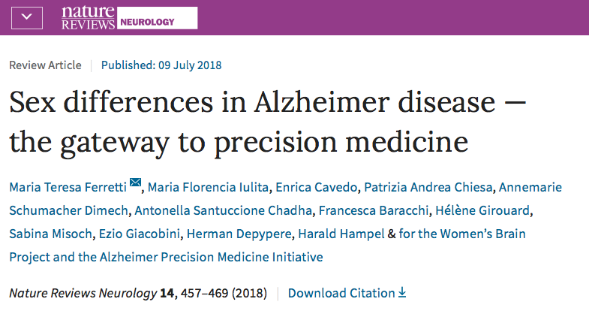
Are there sex-differences in...?
Notes:
DURNG THE LAST 2 YEARS THE APMI AND THE WBP HAD WORKED TOGHETHER IN ORDER TO ANSWER THIS QUESTION AND IN PARTICULA TO UNDERSTAD WHETHER THIS ETEROGENEITY MIGHT BE INFLUENCED BY BIOLOGICAL SEX
TO SEE WHTHER SEX DIFFERENCE THAT WE ARE NOT CURRENTLY CONSIDERING IN OUR RESEARCH MIGHT BE THE GATWAY TO A PRECISION MEDICINE APPROACH TO AD

Slide 8
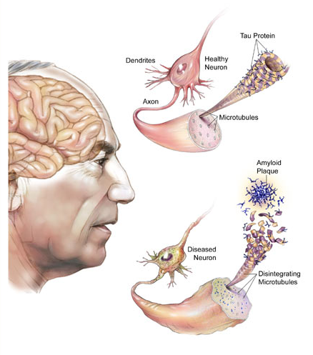
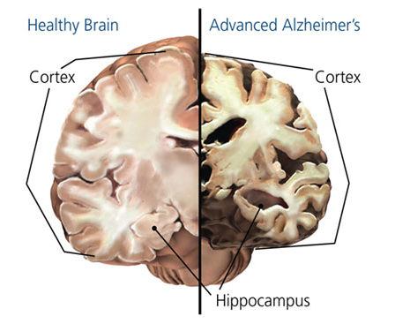
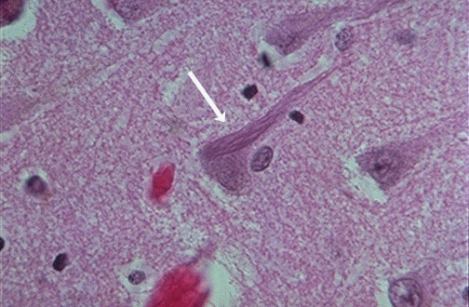
Kenmerken van de ziekte van alzheimer
CMC
Neurodegeneratie
Amyloid Plaques
Neurofibrillaire kluwenvorming
Notes:
THIS CARTOON DESCRIBES THE MAIN PATHOPHYSIOLOGICAL HALLMARKS OF AD.
AT THE TOP WE HAVE THE IMAGE OF AN HEALTHY NEURON, WHLE AT THE BOTTOM WE HAVE A DISEASED NEAURON CARACTERIZED BY MISFOLDING OF BETA-AMYLOID AND TAU PROTEINS THAT LEAD TO THE FORMATION OF THE SO CALL AMYLOID PLAQUES AND NEUROFRBRILLARY TANGLES ACCUMULATION
THE 2 EVENTS AR CONSIDERED THE MAIN CAUSES OF THE NEURODEGENERATION THAT WE OBSERVE IN AD.
THE POST-MORTEN BRAIN ON TOP RIGHT HAND CORNER OF THE SLIDE SHOWS ON THE RIGHT THE BRAIN OF A PATIENTS WITH AD AND ON THE LEFT AN HEALTHY BRAIN. AS WE CAN SEE IN THE PATIENTS WITH AD WE OBSERVE A SHRINKAGE OF NEURONO OF BRAIN CORTEX AND IN PARTICULAR OF TEMPORAL CORTEX AND IN THE HIPPO. THESE ARE THEBRAIN REGIONS MAINLY INVOLVED IN MEMORY PROCESSE
Misfolding of beta amyloid and tau protein follow by the formation of amyloid plaques and neurfibrillary tangles accumulation

Slide 9
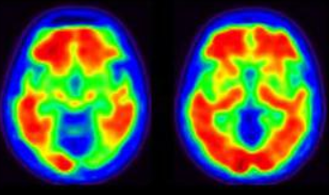
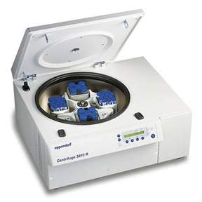
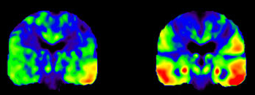
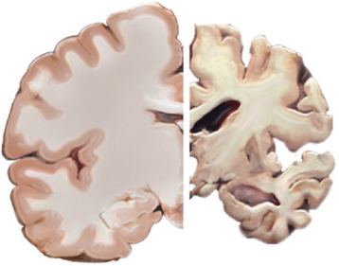
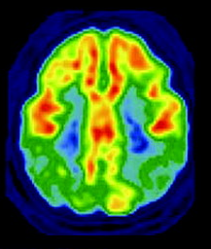
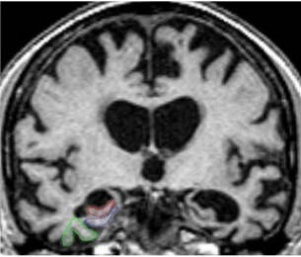
Ziekte van Alzheimer
In vivo Detectie
SURROGAAT MERKERS
Amyloid Plaques
Amyloid PET
CSF/Plasma Aβ1-42
of
Neurofibrillaire kluwen
Tau PET
CSF/Plasma T-tau P-tau
of
Neurodegeneratie
18-FDG PET
Brain Atrophy (MRI)
or

Slide 10
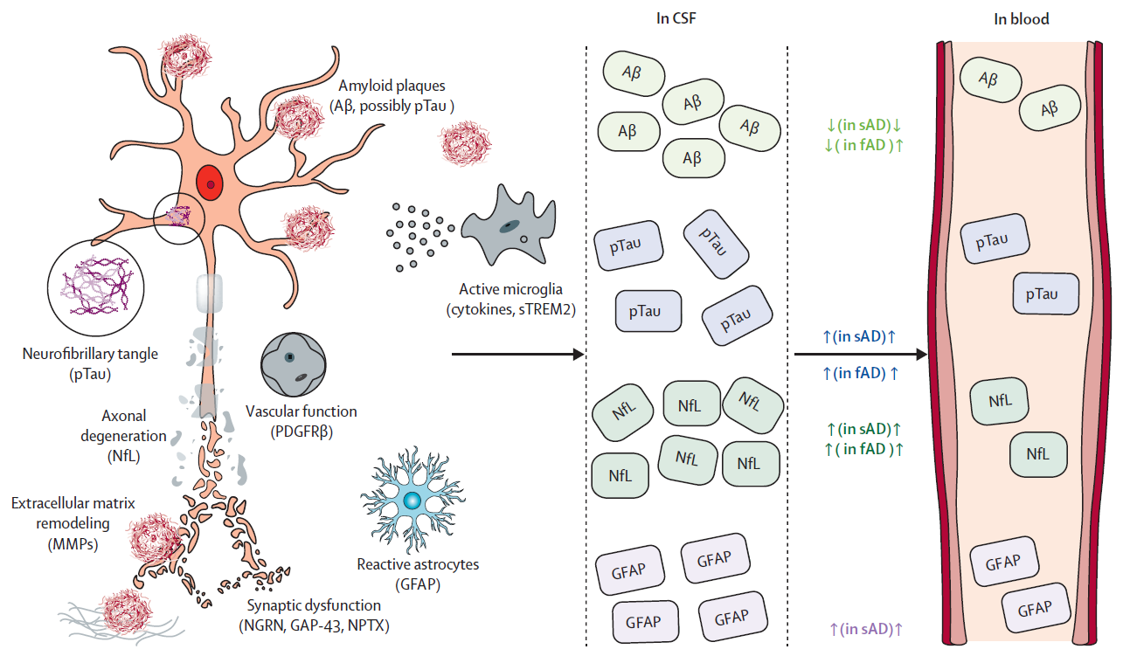

Slide 11
Depypere H¹, Vergallo A^{2*}, Lemercier P^{2*}, Lista S², Benedet AL³ Ashton NJ^{3,4,5,6}, Cavedo E, Zetterberg H^{3, 7, 8, 9, 10}, Blennow K^{3,7}, Vanmechelen E¹¹, Hampel H²; the Neurodegeneration Precision Medicine Initiative (NPMI).
Menopause Hormone Therapy significantly alters
Pathophysiological Biomarkers of Alzheimer’s Disease
Alzheimer’s and dementia: 2022 sept
11

Slide 12
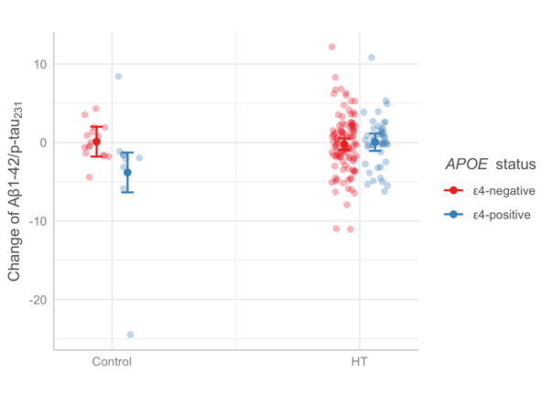
Neurale serum parameters
12

Slide 13
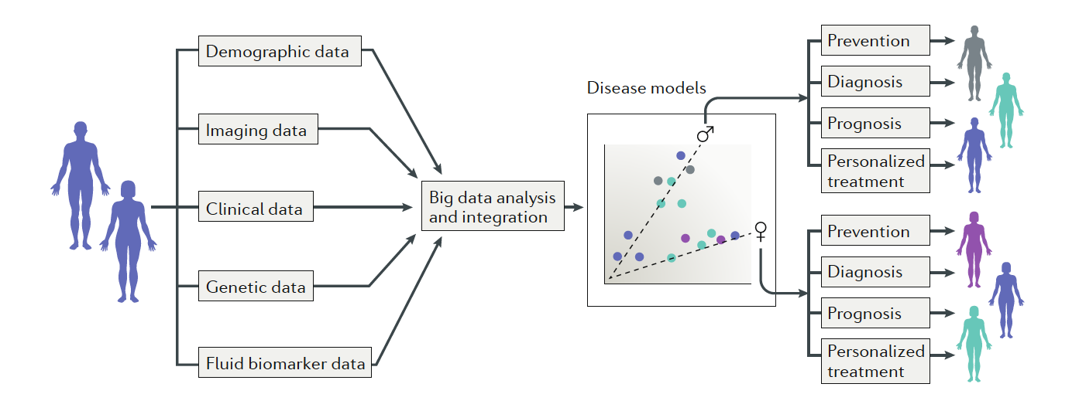
Meer gepersonaliseerde precisie geneeskunde
Notes:
We propose that large-scale, population-based screenings — including compre- hensive AD risk assessment, biomarker collection and genetic stratification — should be performed. This screening would enable disease models to be generated on the basis of big data analysis that takes into account individual variability, including sex as well as genetic, epigenetic, biomarker, phenotypic, lifestyle and psycho- social characteristics, leading to the identification of sub- groups of individuals at risk and patients150,151 (fig. 2). In 2017, the APMI and the APMI cohort programme were launched to stimulate such a paradigm shift towards precision medicine and precision pharmacology in AD, highlighting the need for tailored interventions that take into consideration the individual’s specific biological make-up, including sex17,152,153.

Slide 14
Article | Study population | Type of study | Follow-up | Outcome
Burkhardt 2004 | 181 postmenopausal women Mean age: Estrogen users: 65.40 +/- 6.34 Non-users: 67.03 +/- 6.80 ApoE4 allele present in 64 women | Observational: Cross-sectional | Single administration of the California Verbal Learning Test. | The women with the best performance were the Ɛ4- women on ERT. The Ɛ4+ women had no positive effect of ERT. They had no better results than Ɛ4- women without ERT.
Yaffe 2000 | 2716 postmenopausal women ≥65 years ApoE4 allele present in 677 women | Observational: Prospective cohort | The MMSE was administered annually for 6 years. | Estrogen use was associated with less cognitive decline among Ɛ4- women but not among Ɛ4+ women.
Rippon 2006 | 1498 postmenopausal women mean age: - Dementia present: 73.3 years - Dementia absent: 62.4 years ApoE4 allele present in 736 women | Observational: Cross-sectional | Single administration of neuropsychological tests. | Compared with Ɛ4- women who had no history of ERT, Ɛ4- women who took ERT had an 80% reduction in AD risk. Ɛ4+ women without a history of ERT had a two-fold increased risk of AD, while Ɛ4+ women with a history of ERT had no increased risk.
Ryan 2009 (the 3C city study) | 3130 postmenopausal women ≥65 years ApoE4 allele present in 597 women | Observational: Prospective cohort | Testing of general cognition, verbal fluency, verbal and visual memory, psychomotor speed and executive functions was done 3 times in 6 years | Current use of ERT was associated with better performance in certain cognitive domains, and this association was stronger the longer the duration of ERT. Current use of ERT may decrease AD risk associated with the presence of ApoE4+.
Zandi 2002 (the cache county study) | 1889 women Mean age: - Estrogen users: 76.2 +/- 7.0 - Non-users: 73.1 +/- 5,8 ApoE4 allele present in 569 women | Observational: Prospective cohort | Screening at the beginning of the study and after 3 years with the modified MMSE. A clinical assessment was done in case of a positive screening. | ERT users had a reduced risk of AD compared with non-users. This effect appeared to be stronger for Ɛ4+ women, but this hypothesis did not reached statistical significance because of the small numbers available.
Tang 1996 | 1124 non-demented women Mean age: 74,2 years 156 estrogen users APOE genotypes were available for 53·7% of the women | Observational: Prospective cohort | Standard annual clinical assessments and criterion-based diagnoses were used in follow-up (range 1–5 years) | The age at onset of Alzheimer’s disease was significantly later and the relative risk of AD was significantly reduced in ERT users in comparison with the non-users. ERT use was associated with a reduction in the risk of AD for the heterozygote Ɛ4+ women. An evaluation for the homozygote Ɛ4+ women was not possible.
Yue 2007 | 182 postmenopausal women Mean age - Estrogen users: 66,3 +/- 8,3 - Non-users: 67,1 +/- 7,6 ApoE4 allele present in 32 women | Observational: Cross-sectional | Measuring of the volume of the brain hippocampus with MRI. Single administration of 6 cognitive tests. | The volume of the hippocampus of the Ɛ4+ women was significantly larger in the HRT group in comparison with the control group. The cognitive tests showed no significant improvement of cognitive function in ERT users when compared to non-users.
Sundermann 2008 | 51 postmenopausal women age Ɛ4- women (n=32) - estrogen users: 73.18 ± 4.22 - non-users: 73.77 ± 2.43 Ɛ4+ women (n=19) - estrogen users: 70.41 ± 4.22 - non-users: 69.70 ± 3.60 | Observational: Cross-sectional | Single testing of the odour threshold | ERT use may offer protection against loss of olfactory function in Ɛ4+ women who may be in the early stages of AD. The ERT users who are Ɛ4+ had a significantly higher odour threshold sensitivity in comparison with the non-users. No significant differences were seen between the ERT users and non-users of the Ɛ4- women.
Kang and grodstein (2012) | 3697 postmenopausal women Mean age 72 years ApoE4 allele present in 948 women | Observational: Prospective cohort | Telephonic testing of cognitive functions was done 3 times in 6 years | Compared with ‘never users’, past or current ERT users showed modest but statistically significant worse rates of decline in the cognitive function. A suggestive interaction with Ɛ4 status was found: for Ɛ4- there was no difference in decline between women using ERT and those not using it; for Ɛ4+, women using ERT experienced a decline in cognitive function.
Gleason 2015 Keeps | 693 young healthy menopausal women - 220 allocated to o-CEE low dose + m-P - 211 allocated to t-E2 + m-P - 262 allocated to placeboApoE4 present 25.9 %//Duration : 4 years | Randomized, double-blinded, placebo-controlled clinical trial | Different cognition and mood tests | No influence on cognition was seen. The o-CEE group (not t- E2) had better results on anxiety and depression.

Slide 15
Alzheimer’s disease and cognitive function
80% of dementia in women, is due to Alzheimer.
Obesity, smoking, alcohol, sedentarily, insomnia are risk factors. Apo E4 is a strong driver for Alzheimer.
Observational data showed an impairment of the cognitive function after castration.
MHT initiated early after menopause may reduce the risk of Alzheimer (level 2).
It is not proven that MHT prevents/delays Alzheimer’s dementia.
MHT initiated after the age of 65 years increases the risk of dementia (level 1), probably due to vascular dementia incidence.
Therefore MHT should currently not be used for this indication.

