Slide 1
Premature and early menopause
Ovarian insufficiency (before 40 years) and early menopause (before 45 years), whether natural or induced, is associated with increased morbidity & mortality, when women are untreated with MHT.
Several recent meta-analyses reported in particular increased cardiovascular morbi-mortality (Grade 1C)
Several observational studies reported increased neuro-degenaretive diseases in these women also, while MHT reduces these risks.(Grade IC)
Muka T, et al JAMA Cardiol. 2016.
Rocca JAMA Netw Open 2022

Slide 2
Premature and early menopause
Data gathered from studies in postmenopausal women aged 50 or more can not necessarily be extrapolated to younger postmenopausal women.
It is generally recommended to treat these women at least till the normal age of menopause.
Dosage should be adapted according to symptomatology (Level 3)
Higher doses might be necessary for adequate osteoporosis treatment (Level 3)

Slide 3
Etiologies for POI
Spontaneous 46,XX POI (sPOI) karyotype)
  90% : no cause identified.
  4% of sPOI: lymphocytic autoimmune oophoritis
  2-5% : premutation in the Fragile X Mental Retardation 1 (FMR1) gene
  14% of familial sPOI cases
  Turner syndrome ∼1 in 2,500 girls.
  Devos, Lancet 2010

Slide 4
POI & Infertility
“devastated,” “shocked,” “confused”
adoption
donor embryo
egg donation
Spontaneous pregnancy occurs in ∼5%–10% of women with 46,XX sPOI
van Kasteren & Schoemaker Premature ovarian failure: a systematic review on therapeutic interventions to restore ovarian function and achieve pregnancy
Hum Reprod Update, 5 (1999), pp. 483–492

Slide 5
POI & Emotional Health
Increased risk of depression and anxiety,
Decreased perceived social support and self-esteem.
Regardless of a woman's marital status, whether or not she had children, or the length of time since her diagnosis of sPOI
Orshan, Women with spontaneous 46,XX primary ovarian insufficiency (hypergonadotropic hypogonadism) have lower perceived social support than control women Fertil Steril, 92 (2009), pp. 688–693

Slide 6
Indications for HRT
HRT is indicated for the treatment of symptoms of low estrogen in women with POI (C)
Women should be advised that HRT may have a role in primary prevention of diseases of the cardiovascular system and for bone protection (C)
Untreated POI is associated with reduced life expectancy, largely due to CVD (C)
ESHRE Guideline Group on POI, Webber et al Hum Reprod. 2016 May;31(5):926-37.
Endorsed by EMAS, IMS, NAMS

Slide 7
Rocca et al Survival patterns after oophorectomy in premenopausal women: a population-based cohort study. Lancet Oncol. 2006 Oct;7(10):821-8.

Slide 8
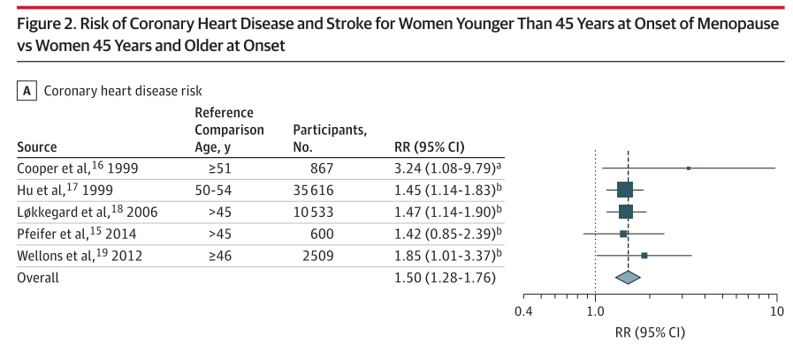
Association of Age at Onset of Menopause and Time Since Onset of Menopause With Cardiovascular Outcomes, Intermediate Vascular Traits, and All-Cause Mortality: A Systematic Review and Meta-analysis
Muka et al JAMA 2016

Slide 9
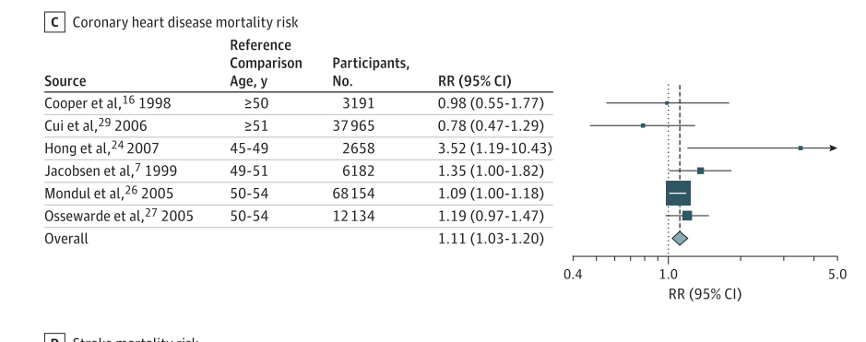
Association of Age at Onset of Menopause and Time Since Onset of Menopause With Cardiovascular Outcomes, Intermediate Vascular Traits, and All-Cause Mortality: A Systematic Review and Meta-analysis
Muka et al JAMA 2016

Slide 10
Osteoporosis
Evaluate risk factors and correct them when possible
Measure BMD (use Z-score)
Frax is not validated in POI
Prevention:
-Physiologic MHT is superior to OCPs in protecting and improving BMD
-MHT 1-2 mg E2 or 100–150 μg/d transdermal E2 plus cyclic progestin
-Paucity of data on fractures in POI
S. Rozenberg et al Maturitas 2020

Slide 11
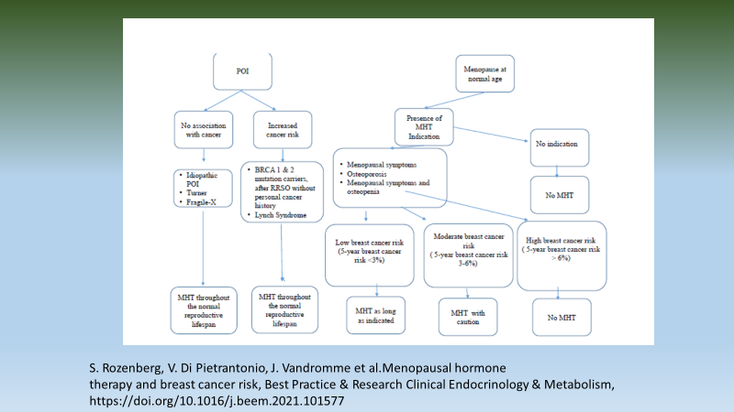
Take home message

