Slide 1

Consensus of the Belgian Menopause Society regarding therapy and strategies after the menopause
Guidelines from the Belgian Menopause Society

Slide 2
Background
The use of menopause hormone therapy has dramatically decreased in all countries since the initial findings of the Women’s Health Initiative (WHI) were published in 2002.
Physicians’ advices and women’s decisions regarding such therapy have been surrounded by anxiety and confusion for the last decades.
Moreover two generations of physicians have not been trained about menopause management.

Slide 3
Background
Reanalyses and long follow-up of WHI data and new evidence emerging from other high quality studies are globally reassuring.
This concensus aims to update these date.

Slide 4




NY times

Slide 5
Definitions
By estrogen therapy (ET), we mean all systemic estrogen provided orally or parenterally (transdermal, percutaneous, spray). The Estrogen-progestin therapy (EPT) includes regimens combining estrogens and progestins. Hormone (replacement) therapy (HRT or HT), or menopause hormone therapy (MHT) includes all regimens containing steroids for the treatment of menopausal symptoms with inclusion of ET, EPT and tibolone. TSEC consists in the combination of CEE and a SERM. (Bazedoxifene).
Other routes of administration of estrogens and progestins (vaginal forms, and Intra Uterine delivery Systems) will be discussed separately.
Other drugs such as SERMS (selective estrogen receptor modulators) also called estrogen agonists-antagonists, SPRM (selective progestin receptors modulators), bone drugs, lipid lowering drugs, androgens, vitamin D, calcium etc. will be discussed separately.

Slide 6
Definitions
New drugs might emerge soon, but are not marketed yet and will, therefore, be discussed later separately (Estetrol, NK3 Antagonists).

Slide 7
Methodology
These experts came together and proposed the following consensus based on recent and updated publications.
They essentially considered meta-analyses, randomised trials and large epidemiological observational studies.
The experts hope that this document will facilitate practical menopausal management. The proposed consensus represent the shared view of these experts. In some cases no consensus was reached and these points will be mentioned also.

Slide 8
Levels of evidence I = randomised controlled trials, II= prospective observational robust cohorts, III=animal, experimental or retrospective data).
We also use the Grade recommendations.
In opposition to previous consensus, we define now « as high estrogen dose » as the equivalent of 2 mg E2, or 0.625 CEE; « standard» dose as 1 mg E2 or equivalent and « low dose » as 0.5 mg or lower and CEE 0.4mg. Currently, low dose are preferred therapies. For transdermal therapy, the equivalent of 25 µg/d per patch or 1mg/d gel and 3 mg (2 sprays) is considered as low

Slide 9
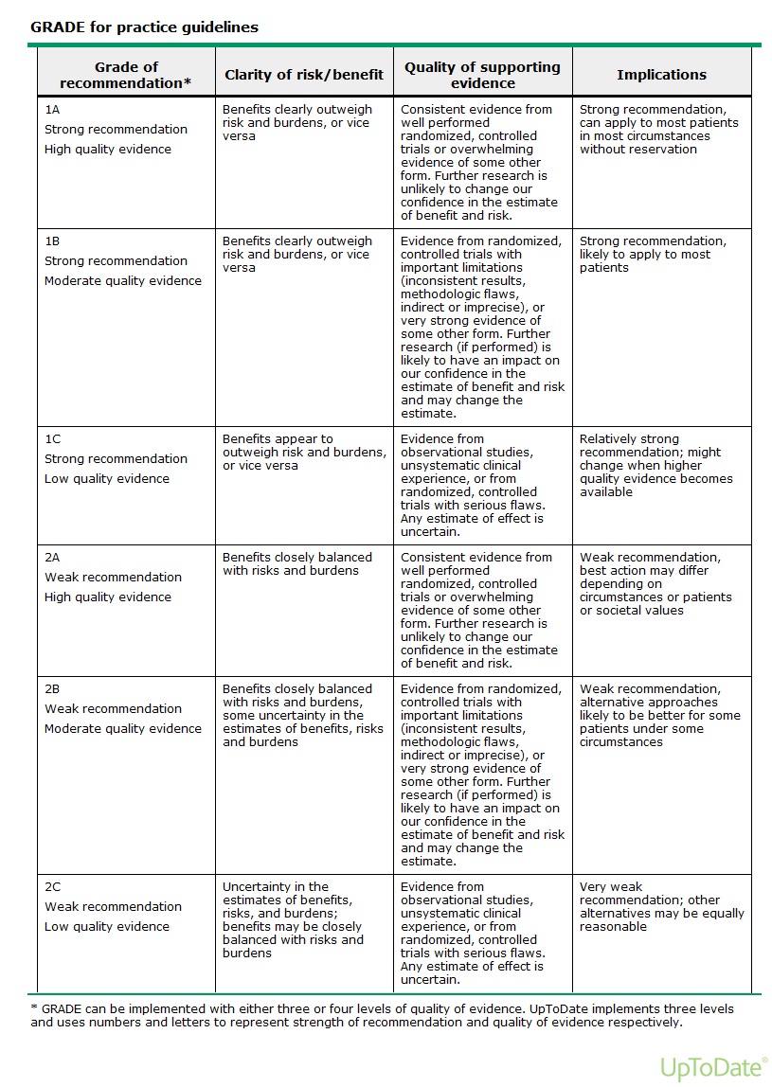

Slide 10
Patient information
Individualised advice is needed. Risks and benefits need to be explained preferably using absolute risk and attribuable estimations.
Women should also be informed about other health strategies.
Therapeutic management should be reviewed regularly.
Shared decision taking should be seeked.

Slide 11
The use of MHT in the following topics have been reviewed
Premature menopause, ovarian insufficiency or failure
Climacteric symptoms, perimenopausal transition symptoms
Quality of life
Loss of work performance and missed job opportunities
Urogenital atrophy
Sexual wellbeing
Osteoporosis (prevention and treatment)
Breast cancer risk
Other cancer risks : Colon cancer, Endometrial cancer, Ovarian cancer, lung cancer, others
Cardio & Vascular
  Coronary heart-, stroke, venous thrombo-embolic diseases
Cognitive function, Alzheimer Disease, Parkinson Disease
Miscellaneous

Slide 12
Premature and early menopause
Ovarian insufficiency (before 40 years) and early menopause (before 45 years), whether natural or induced, is associated with increased morbidity & mortality, when women are untreated with MHT.
Several recent meta-analyses reported in particular increased cardiovascular morbi-mortality (Grade 1C)
Several observational studies reported increased neuro-degenaretive diseases in these women also, while MHT reduces these risks.(Grade IC)
Muka T, et al JAMA Cardiol. 2016.
Rocca JAMA Netw Open 2022

Slide 13
Premature and early menopause
Data gathered from studies in postmenopausal women aged 50 or more can not necessarily be extrapolated to younger postmenopausal women.
It is generally recommended to treat these women at least till the normal age of menopause.
Dosage should be adapted according to symptomatology (Level 3)
Higher doses might be necessary for adequate osteoporosis treatment (Level 3)

Slide 14
Etiologies for POI
Spontaneous 46,XX POI (sPOI) karyotype)
  90% : no cause identified.
  4% of sPOI: lymphocytic autoimmune oophoritis
  2-5% : premutation in the Fragile X Mental Retardation 1 (FMR1) gene
  14% of familial sPOI cases
  Turner syndrome ∼1 in 2,500 girls.
  Devos, Lancet 2010

Slide 15
POI & Infertility
“devastated,” “shocked,” “confused”
adoption
donor embryo
egg donation
Spontaneous pregnancy occurs in ∼5%–10% of women with 46,XX sPOI
van Kasteren & Schoemaker Premature ovarian failure: a systematic review on therapeutic interventions to restore ovarian function and achieve pregnancy
Hum Reprod Update, 5 (1999), pp. 483–492

Slide 16
POI & Emotional Health
Increased risk of depression and anxiety,
Decreased perceived social support and self-esteem.
Regardless of a woman's marital status, whether or not she had children, or the length of time since her diagnosis of sPOI
Orshan, Women with spontaneous 46,XX primary ovarian insufficiency (hypergonadotropic hypogonadism) have lower perceived social support than control women Fertil Steril, 92 (2009), pp. 688–693

Slide 17
Indications for HRT
HRT is indicated for the treatment of symptoms of low estrogen in women with POI (C)
Women should be advised that HRT may have a role in primary prevention of diseases of the cardiovascular system and for bone protection (C)
Untreated POI is associated with reduced life expectancy, largely due to CVD (C)
ESHRE Guideline Group on POI, Webber et al Hum Reprod. 2016 May;31(5):926-37.
Endorsed by EMAS, IMS, NAMS

Slide 18
Rocca et al Survival patterns after oophorectomy in premenopausal women: a population-based cohort study. Lancet Oncol. 2006 Oct;7(10):821-8.

Slide 19
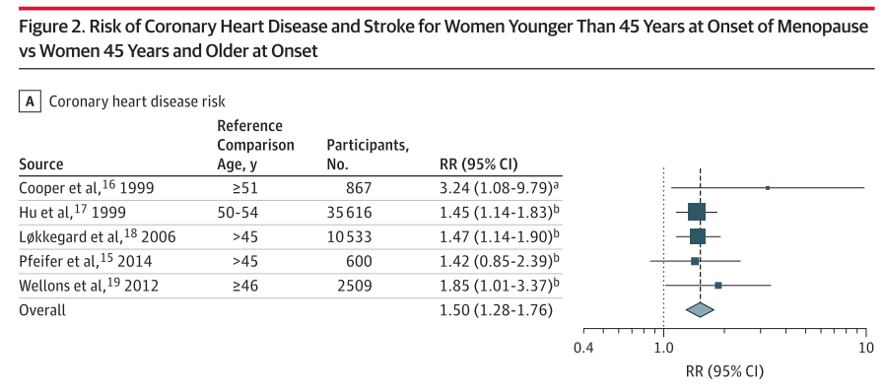
Association of Age at Onset of Menopause and Time Since Onset of Menopause With Cardiovascular Outcomes, Intermediate Vascular Traits, and All-Cause Mortality: A Systematic Review and Meta-analysis
Muka et al JAMA 2016

Slide 20
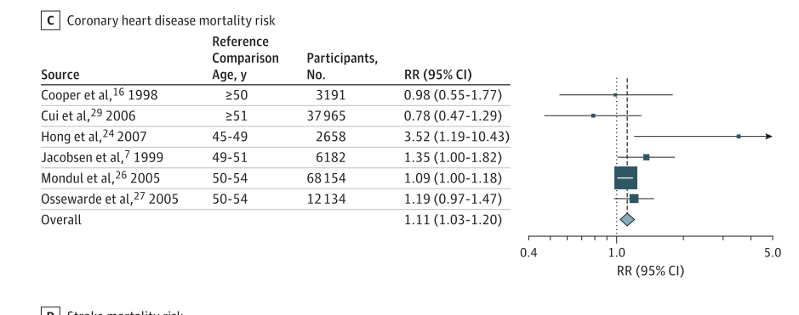
Association of Age at Onset of Menopause and Time Since Onset of Menopause With Cardiovascular Outcomes, Intermediate Vascular Traits, and All-Cause Mortality: A Systematic Review and Meta-analysis
Muka et al JAMA 2016

Slide 21
Osteoporosis
Evaluate risk factors and correct them when possible
Measure BMD (use Z-score)
Frax is not validated in POI
Prevention:
-Physiologic MHT is superior to OCPs in protecting and improving BMD
-MHT 1-2 mg E2 or 100–150 μg/d transdermal E2 plus cyclic progestin
-Paucity of data on fractures in POI
S. Rozenberg et al Maturitas 2020

Slide 22
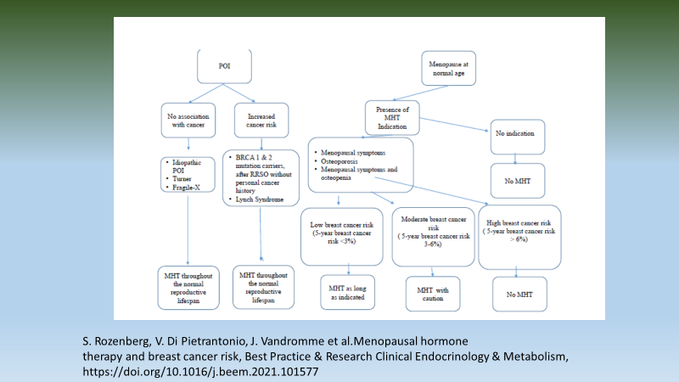
Take home message

Slide 23
Climacteric symptoms
Symptoms directly or indirectly related to menopause include :
  Vasomotor symptoms (hot flushes and night sweats and their consequences)
  Insomnia,
  Mood changes, psychological symptoms
  Impaired concentration and memory
  Some patients suffer from a fog, resulting in impaired work capacity
  Sexual dysfunction
  Urogenital symptoms
  Arthralgia

Slide 24
Climacteric symptoms
Moderate to severe symptoms disturb women’s health-related quality of life for variable (short to very long) durations.
In women suffering from such symptoms, MHT is the most effective treatment. In these women, it improves their quality of life.
(Level of evidence Ia )

Slide 25
Climacteric symptoms
Some symptoms are attributed to the climacteric but may result from other etiologies (such as iatrogenic causes).
In asymptomatic women, MHT usually does not ameliorate objectively the overall quality of life.
(level 1b of evidence)

Slide 26
Hot flushes
In some patients other etiologies of Hot flushes should be excluded
  Thyroid disease
  Hypo/hyper-glycemia
  Obesity
  Cancers
  High / low blood pressure

Slide 27
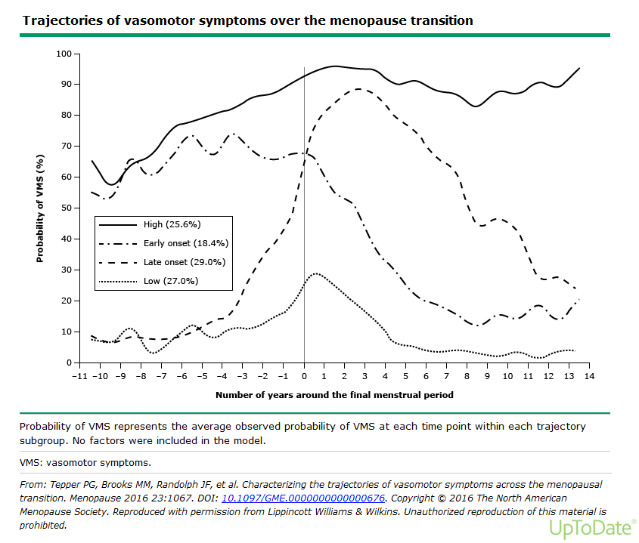
Notes:
Longitudinals studies indicate that women follow distinct patterns of VMS
Both the SWAN study (US° and an Australian study ( Aus Longit Study of women’s health) found that VMS follow 4 trajectories in approx. equal proportions across 4 groups
4 types:
Mild : mild/ no HF
Late onset : start na laatste menstruatie → blijven tot late MP
Early onset : start reeds vroeg in de overgang maar↓ na laatste menses
Super flushers : start vroeg in de overgang → blijven tot late MP
RF voor HF vroege flushers
↑ BMI
Centrale obesitas
↓ slaapkwaliteit
↓ Quality of life

Slide 28

Is a hot flush trivial ??
Increasing amount of studies show that ↑ HF //
  ↑ Cardio vascular disease (CVD)
  The strongest predictor of underlying CVD are early flushers/ superflushers
  ↑ other precursors v CVD
    Abnormal endothelial function
    ↑ coronary / Aorta calcification = arteriosclerosis
    ↑ carotid intima media thickness
    ↑ central obesity en BMI
    ↑ hypertension
    ↑LDL cholesterol en Triglicerides
    ↑ insulin resistentance en (pre)diabetes
    ↑orthosympatic activity
    ↑ hypothalamic – hypofyse- adrenal axis : ↑cortisol
    ↑inflammation en cytokines
Notes:
VMS are among the strongest predictors of subclinical CVD
VMS are associated with a more adverse CVD risk profile
Endotheeldysfunctie: endotheel: 3 lagen: buitenste BW/middenste gl spierweefsel/ binnenste 1 laag endotheel
Endotheel : behoud lage vasc tonus
bron v NO (!! VD, verminderd OX stress, inflamm, WBC adhesive, Plaatjes aggregatie en gl spiercelprolif
endotheline, prostacycline (ox stress mediatoren)
Endotheeldysfunctie agv: verminderde NO(!!), meer ox stress, AHT, inflamm, obesitas, tabak
gevolg: dalen flow mediated dilatation: behouden v flow dmv VD/VC
is belangrijke voorloper v arteriosclerose ontwikkeling: onder beschadigd endotheel nestelen zich LDL+ WBC→ ox/inflamm → plaque
IMT (intima media thickness): meting v binnenste/middenste lag carotis: ! Marker voor cor plaque en CVD !!

Slide 29
Sleep and HRT
Improves sleep esp in women with nighttime VMS by reducing awakenings
ET or PT may improve chronic insomnia in MP women, independant of VMS
Oral progesterone has mild sedating effects (GABA agonistic effect).
Oral progesterone improves sleep onset latency but not sleep duration efficiency in RCT in post MP ( syst RV, meta analysis)

Slide 30
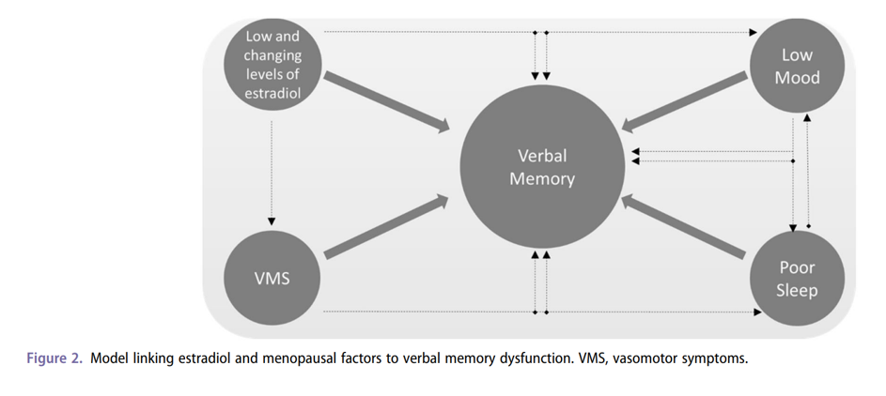
Cognitive complaints
Frequent in midlife women and across MP transition
Role of E2
Role of VMS, sleep disturbances and mood changes
Notes:
- studies show a role for E2 in mediating MP related changes in cognition
removal of ovaries or suppression of E2 leads to declines in verbal learning which is reversed by E treatment
E receptors are replete in brain areas subserving memory and other cognitive functions (hippocampus and prefrontal cortex)
In addition: MP related sympt : VMS, sleep disturbances and mood changes contribute to cognitive difficulties
Mp sympt also appear to contribute tot memory difficulties
Brain imaging studies link VMS to adverse changes in brain structure and function
A study done by Rebecca thurstona and Pauline Maki showed
That more frequent physiologically detected VMS were associated with greater white matter hyperintensities, a measure of small vessel disease in the brain. They also found greater default network connectivity with more frequent VMS

Slide 31
Mood disturbances
Menopause transition as well as early menopause may increase vulnerability for some women.
Women who have experienced previous periods of depression associated with PMS or postpartum, are more susceptible to depression at the menopause. These women should probably be treated with MHT first before using anti-depressant drugs (grade IIC)
Mood disturbances and depression as such are not an indication of MHT. However, it may help women who have mood disturbances associated with climacteric symptoms.
Notes:
Estrogen lowers serotonine and endorphines

Slide 32
Urogenital atrophy or Genito-urninary syndrome of the menopause (GSM)
Vulvo-Vaginal (Urogenital) atrophy occurs (VVA) in up to 70-90% of women. One should systematically inquire whether these symptoms are present. Treatment should be encouraged.
MHT and regular sexual activity improves genital atrophy and its symptoms.
Local (topical) treatments with estradiol, estriol and DHEAS may be used in the absence of other indications, For these treatments, there is no age or time limit.
Local treatments should be administered for long periods of time (Level 1a) and does not require generally concomitant administration of a progestin.
Local treatment reduces the incidence of recurrent urinary tract infections and nycturia. (Level 1b of evidence)
Urinary incontinence is not an indication for MHT, although data reported improved urgency using topical estrogen (Level 1b).
Notes:
Studies have not found a signif effect on sexual interest, arousal and orgasmic response
If systemic HRT is indicated in women with low libido, TD ET is preferred given increased SHBG and reduced bioavailability of testost with oral ET

Slide 33
Urogenital atrophy or Genito-urninary syndrom of the menopause (GSM)
Although, Laser and radiofrequency have gained popularity, clinical evidence on efficacy and long-term safety is lacking (2C).

Slide 34
Osteoporosis
Life style counseling (exercise, banishing smoking and alcohol excess, …) is mandatory in all women.
In vitamin D deprived women (vitamin D < 30 ng/ml) adequate intake vitamin D should be supplied.
MHT (ET, EPT and Tibolone, TSEC) is efficacious in preventing menopause-related bone loss (level 1a).

Slide 35
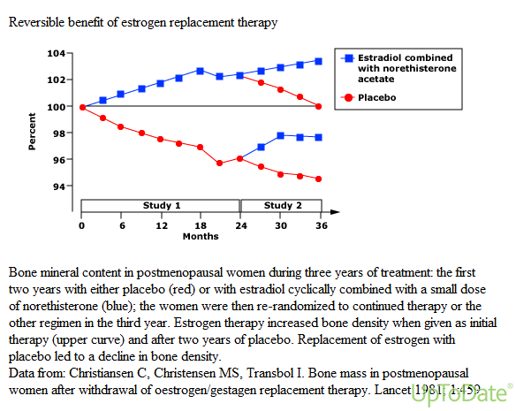

Slide 36
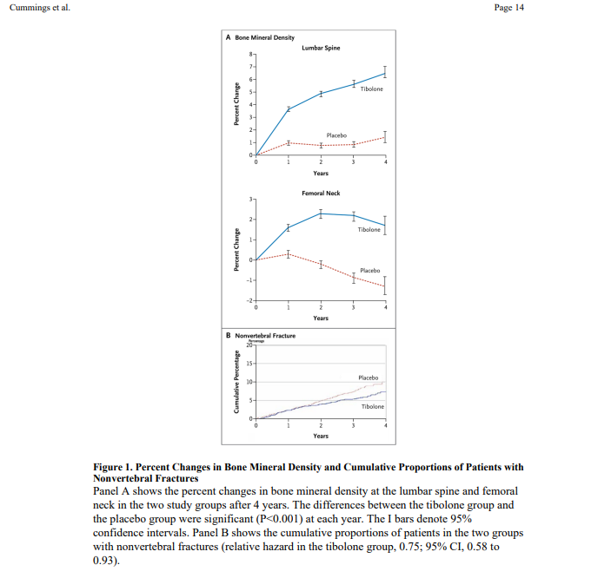
Cummings, et al NEJM 2008​

Slide 37
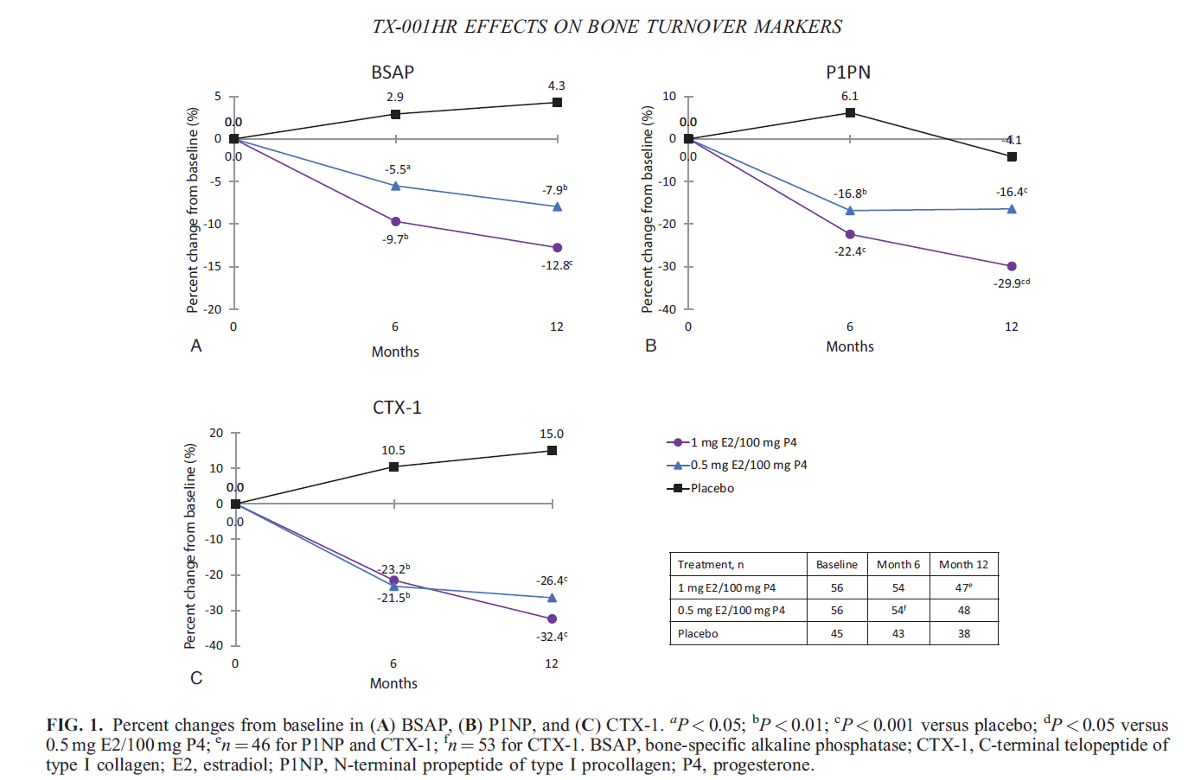
Effects of E2/P4 oral capsules on bone turnover in women with vasomotor symptoms
McClung et al Menopause Feb 2022
. 2022 Feb 14;29(3):304-308.Cliquez pour ajouter du texte

Slide 38
Osteoporosis
Tibolone and Raloxifene and Basedoxifene prevent vertebral fractures (level 1a) and EPT or ET both hip and vertebral fractures (Level 1a of evidence)

Slide 39
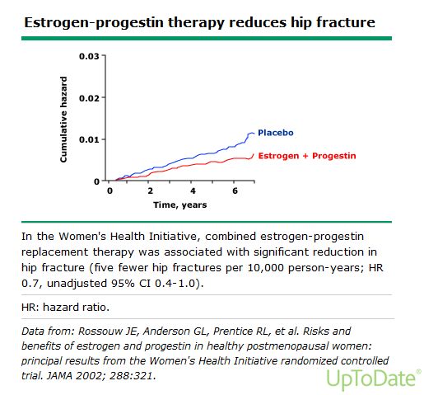

Slide 40
Perspective Menopause Management —
Getting Clinical Care Back on Track
JE Manson, AM Kaunitz
N Engl J Med
March 3, 2016

Slide 41
Osteoporosis
Therefore, MHT may be used in women less than 60 years of age,with high risk of- or with osteoporosis, as a first line treatment.

Slide 42
Osteoporosis
Nevertheless, since these regimens need to be used for long periods of time, potential long term risks should also be weighed against benefits in elderly women.
Osteoporosis risk can be evaluated by FRAX and by BMD. BMD measurement should be prescribed in the presence of risk factors of osteoporosis or at the menopause in patients hesitant to take MHT.

Slide 43
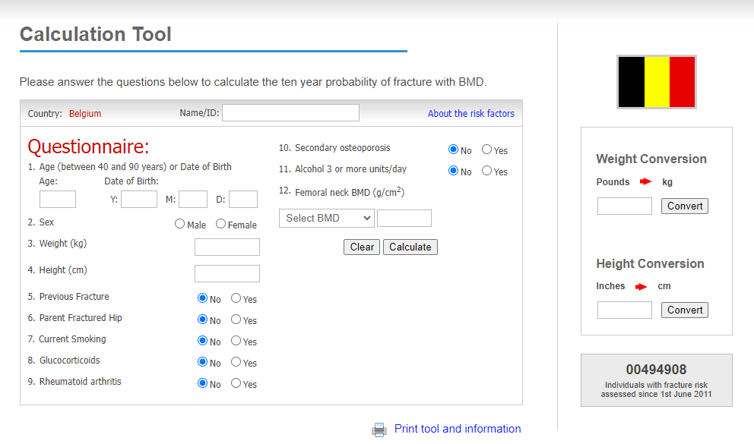
FRAX: WHO Fracture Risk Assessment Tool¹
http://www.shef.ac.uk/FRAX
Threshold of 15%
& 3% hip fractures
1. WHO FRAX tool. Available from http://www.shef.ac.uk/FRAX/tool.jsp

Slide 44
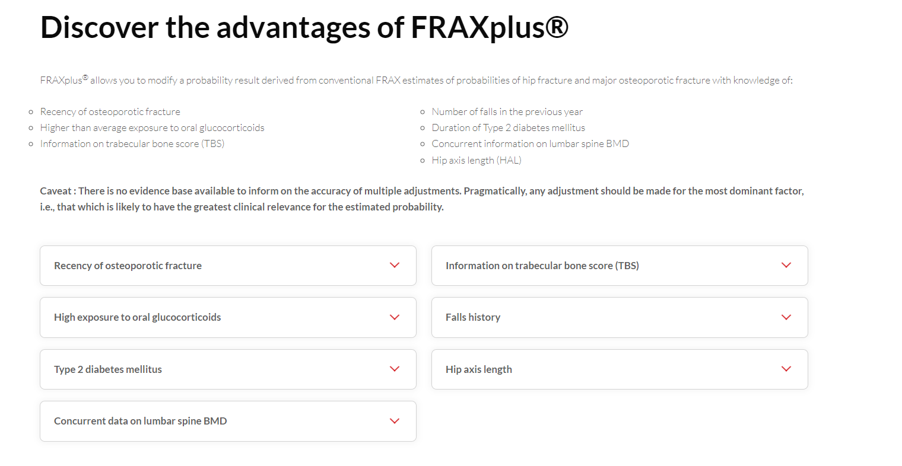
https://www.fraxplus.org/frax-plus

Slide 45
Osteoporosis
In established osteoporosis, there is more evidence for using other drugs in the absence of climacteric symptoms (level 2b).

Slide 46
Osteoporosis
Raloxifene (a SERM) may be used in preventing spinal osteoporosis and fractures as well as invasive breast cancer. It has no proven effect on hip fracture prevention. It increases the incidence of thrombosis (stroke and DVT) and may induce or enhance climacteric symptoms (level 1b).
In 1000 women above the age of 65 years of age, Raloxifene will reduce the incidence of breast cancer per year from 2.7 cases to 1.5 cases (reduction : 1.2 cases). The number of fracture will be reduced from 3.7 to 2.4 fractures per 1000 women per year. The number of thrombosis will increase from 2.7 to 3.9 per 1000 and the number of strokes by 0.7 cases per year. The number of strokes was limited to women with a high 'Framingham Stroke Risk Score'.
Other SERMS, like Bazedoxifene may have different profiles: preventing vertebral osteoporosis and having a neutral effect on breast and endometrium, but increasing probably similarly to other SERMS the thrombosis risk (level 2b) .

Slide 47
Effect of Raloxifene in Women With or Without Existing Fractures
MORE Trial - 3 Years
25
RR 0.70
(95% CI = 0.56, 0.86)
20
30%
Placebo
15
% of Women with
Incident Vertebral Fracture
Raloxifene 60 mg/d
10
RR 0.50%
(95% CI = 0.29, 0.71)
5
50%
0
Without Prevalent
Vertebral Fractures
With Prevalent
Vertebral Fractures
Ettinger et al. JAMA 1999; 282:637-45.

Slide 48
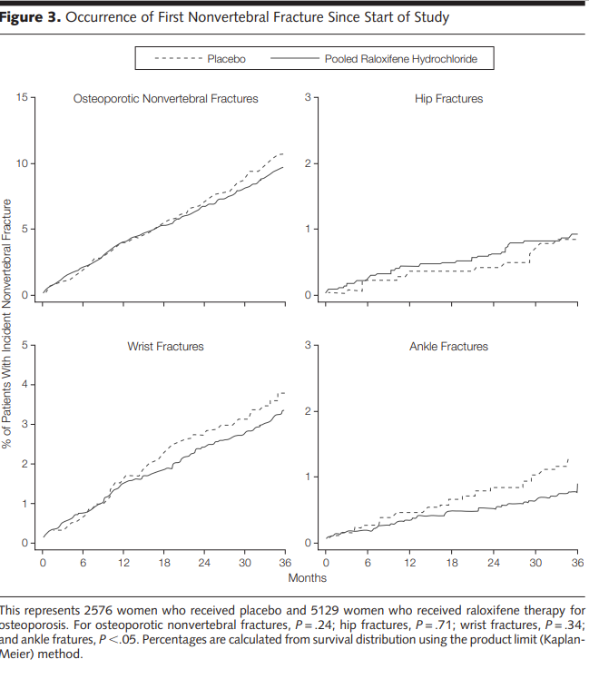
Ettinger et al JAMA 1999 MORE study

Slide 49
Incidence of Invasive Breast Cancer
8 Years of MORE and CORE (N=7705)
Source:
4.0
Review:
Placebo
4.2 per 1000 Women-Yrs
3.0
HR 0.34 (95% CI = 0.22, 0.50)
p <0.001
Cumulative Incidence (%)
66%
Reviewer Memo:
2.0
1.0
Raloxifene
1.4 per 1000 Women-Yrs
0.0
0
1
2
3
4
5
6
7
8
Years in Study
*Women in the raloxifene arm received rlx 60 or 120 mg/d in MORE and rlx 60 mg/d in CORE
Martino S et al. J Natl Cancer Inst 2004;96(23):1751-1761
Slide Modified:
Memo:
Feb 2006 – new slide from ms slide kit.
Notes:
8-year MORE plus CORE Results N=7705
This slide shows the Kaplan-Meier curve for the cumulative breast cancer incidence plotted against time over the 8 years of the MORE plus CORE trials beginning at randomization in MORE to the end of CORE. A total of 98 cases of invasive breast cancer (58 in the placebo group and 40 in the raloxifene group) were reported and confirmed by adjudication.
Over the 8-year period, raloxifene reduced the incidence of invasive breast cancer by 66% (p value < 0.001) compared with placebo. Absolute risk in the placebo group was 4.2 cases per 1000 woman-years and 1.4 cases for the raloxifene group. Thus, in the raloxifene group there was an absolute risk reduction of 2.8 cases per 1000 women-years.
Over the 4 years of CORE (N=5213), 52 cases of invasive breast cancer (28 in the placebo group and 24 in the raloxifene group) were reported and confirmed by adjudication. During the 4 years of the CORE trial, the incidence of invasive breast cancer was reduced in the raloxifene treated group by 59%, compared to the group of women randomized to placebo (p<0.001). The absolute risk for the placebo groups is 5.2 cases per 1000 women-years and 2.1 for the raloxifene group. Thus, the absolute risk reduction for the raloxifene group was 3.1 cases per 1000 women-years.

Slide 50
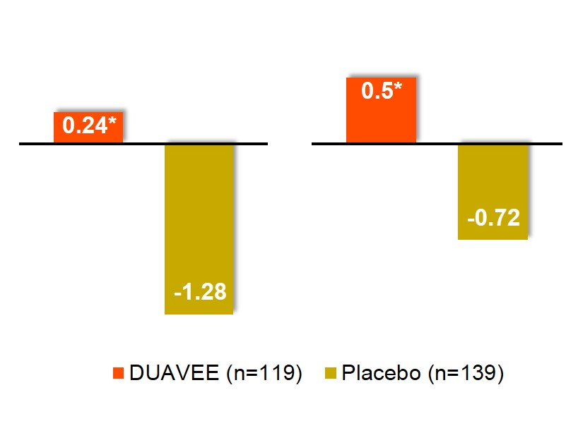
CE/BZA Significantly Increased Lumbar Spine and Total Hip BMD vs Placebo at 12 Months
Lumbar Spine
Total Hip
1.51%
1.21%
% Mean change from baseline
Treatment difference
Treatment difference
CE/BZA
*P<.001 vs placebo.
Adjusted mean changes and P-values based on an ANCOVA model with treatment and region (US or non-US) as factors and baseline BMD value and years since menopause as covariates using the modified intention to treat population with last observation carried forward.
In EU CE/BZA is not indicated for the prevention of postmenopausal osteoporosis
Pinkerton JV, et al . J Clin Endocrinol Metab. 2014 Feb;99(2):E189-98.
Notes:
In Study 2, treatment with DUAVEE significantly increased mean lumbar spine BMD at 12 months, compared with placebo, in women who had been postmenopausal for less than 5 years.
The mean percent change from baseline for lumbar spine BMD was a 0.24% increase for DUAVEE and a 1.28% decrease for placebo at 12 months. This resulted in a statistically significant treatment difference from placebo of 1.51%.
DUAVEE also significantly increased mean total hip BMD at 12 months, compared with placebo.
The mean percent change from baseline for total hip BMD was a 0.50% increase for DUAVEE and a 0.72% decrease for placebo at 12 months. This resulted in a statistically significant treatment difference from placebo of 1.21%.
In summary, based on the two studies we have just reviewed, treatment with DUAVEE demonstrated significant increases in lumbar spine and total hip BMD vs placebo in postmenopausal women.
Reference
Data on file. CSR-81040. Protocol 3115A1-3307. Pfizer Inc; New York, NY.

Slide 51
Biphosphonates, denosumab and romososumab are used in established osteoporosis usually after 60 years old. They have a proven effect also on hip fracture prevention (level 1a).
These medications need to be combined with adequate calcium and vitamin D intake.
As for all long term treatments, compliance is essential.
The long term risk of all used drugs should also be evaluated : a potential concern exists about atrial fibrillation, jaw osteonecrosis and atypical fractures.
In women using bisphosphonates, without fractures a drug holiday is generally advised after a few years of treatment. During this time preventive measures and calcium and vitamin D should be maintained (level 1a)

Slide 52
When Denosumab is stopped, however, bone loss recurr and patients should therefore use another osteoporosis antiresorptive therapy.
Romososumab may be prescribed in women with osteoporosis and major osteoporosis fracture history for one year only.

Slide 53



Slide 54



Cardiovascular and Venous Thomboembolic Diseases and Menopause
A Pintiaux, MD –PhD, CHULg

Slide 55
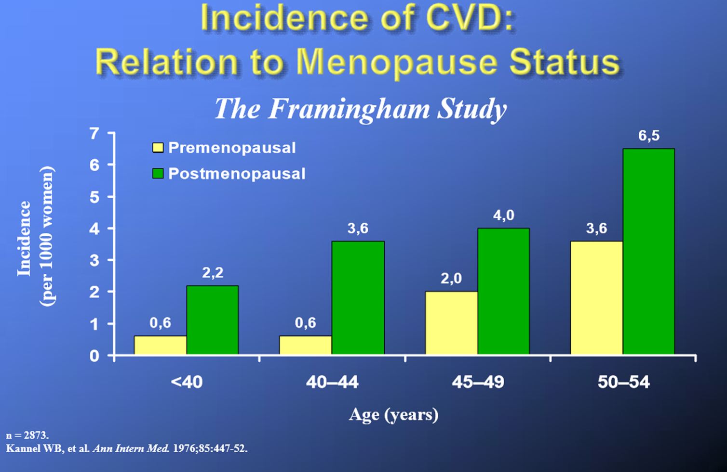

Slide 56

Coronary artery atherosclerosis of cynomolgus monkeys was about 70% when estrogen replacement begins at onset of surgical menopause
THOMAS B. CLARKSON AND MARGARET H. MEHAFFEY American Journal of Primatology 71:785–793 (2009)

Slide 57
Diagram of sex hormone metabolism and signaling through sex hormone receptors. Androgen signaling pathways and receptors are shown in blue, estrogen
pathways and receptors in dark pink, and progesterone pathways and receptors in purple. Names of enzymes (italicized) and receptors (round blocks) are color-coded
based on confirmed expression in cells of the cerebrovasculature (see key). Schematic of the structure and cells of the cerebrovasculature are also shown. 5α-R,
5alpha-reductase; AR, androgen receptor; Astro, astrocyte; EC, endothelial cell; ER, estrogen receptor; HSD, Hydroxysteroid dehydrogenase; PR, progesterone
receptor; VSM, vascular smooth muscle cell.
Lisa S. Robison, Brain Research 1710 (2019) 43–60

Slide 58


In the pre- Women Health Initiative era
MHT was widely prescribed for symptom management and increasingly for chronic disease prevention, in part because multiple observational studies had demonstrated reduced incidence of cardiovascular disease (CVD) in symptomatic menopausal women who initiated MHT in early menopause

Slide 59
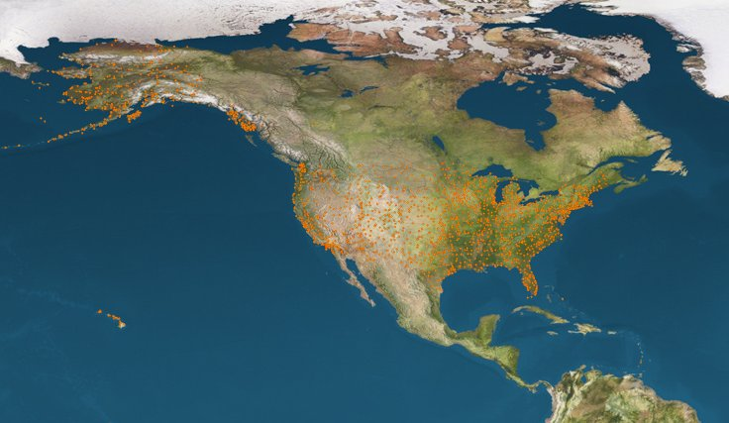

W . H . I . STUDY
RESULTS
CHD RR 1.29
Breast Cancer 1.26
Stroke 1.41
PE 2.13
Colorectal Cancer 0.63
Endometrial Cancer 0.83
Hip Fractures 0.66
TOTAL MORTALITY 0.98

Slide 60

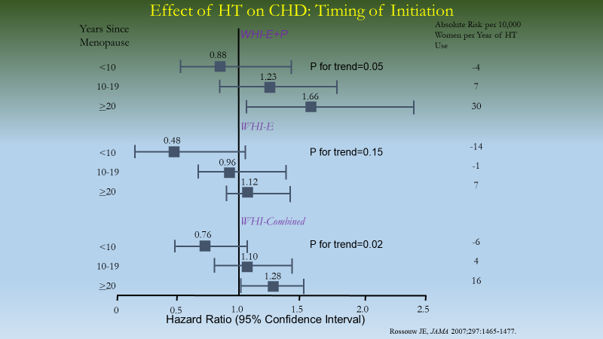
THE WOMEN'S HEALTH INITIATIVE

Slide 61
Relative Risk of CHD: Observational Studies and Randomized Controlled Trials
Epidemiologic Studies
Age=30-55 y
Time Since Menopause <6 y
Randomized Trials
Age <60 y
Time Since Menopause <10 y
0.64
0.68
0.5
1.0
Risk Estimate
Grodstein F, et al. Prog Cardiovasc Dis 1995;38:199-210.
Salpeter S, et al. J Gen Intern Med 2006;21:363-366.

Slide 62



Cardiovascular health after menopause transition, pregnancy disorders, and other gynaecologic conditions: a consensus document from European cardiologists, gynaecologists, and endocrinologists
• MHT is indicated to alleviate menopausal symptoms
• MHT may be of potential prophylactic benefit in depression
• Doses and types of MHT regimens, and age at initiation are crucial for its safety
• Before starting MHT, assessment of cardiovascular risk factors should be performed
• Consider measuring CAC with CT when there is uncertainty on individual cardiovascular risk
• MHT is not recommended in women at high cardiovascular risk and after a CVD event
• Initiation of MHT is generally not advised in asymptomatic women
A.H.E.M. Maas et al. European Heart Journal (2021) 42, 967–984

Slide 65
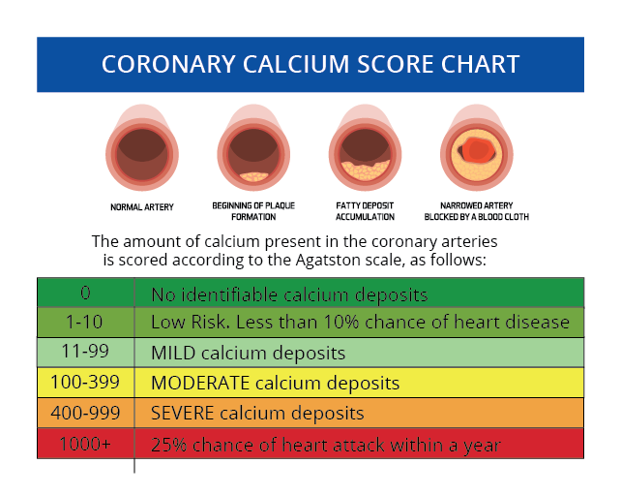

Slide 66
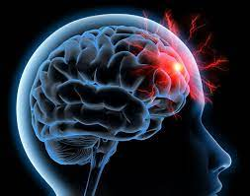

Slide 67
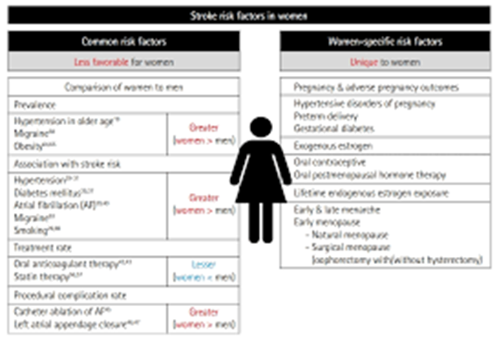
Stroke in Women: A Review Focused on Epidemiology,
Risk Factors, and Outcomes
Cindy W. Yoon, Cheryl D. Bushnell Journal of Stroke 2023;25(1):2-15 https://doi.org/10.5853/jos.2022.03468

Slide 68
Estrogen doses and stroke in the Nurses'Health Study (1)
E-use | Women-Years of follow up | Multivariate-adjusted (2) RR (95% Ci)
Never 0.3mg CEE 0.625 ≥ 1.25 | 313,661 19,964 116,150 39,026 | 1.0 (ref) 0.54 (0.28 – 1.06) NS 1.35 ( 1.08 – 1.68) 1.63 (1.18 – 2.26)
Grodstein F et al, Ann Intern Med 2000;133:933
Adjusted for age, BMI, Diabetes, hypertension, age at menopause, hypercholesterolemia, smoking, parental CHD

Slide 69
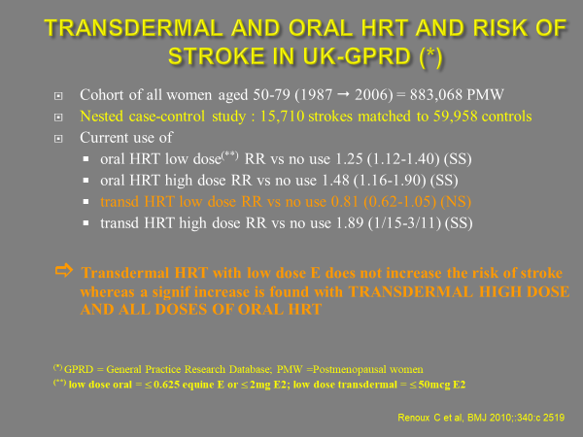
Transdermal and oral hormone replacement therapy and the risk of stroke: a nested case-control study
WHAT IS ALREADY KNOWN ON THIS TOPIC
Oestrogen replacement therapy with or without progestogen is associated with an increased
risk of stroke in postmenopausal women
WHAT THIS STUDY ADDS
The use of transdermal hormone replacement therapy containing low doses of oestrogen was not associated with an increased risk of stroke, in contrast to the oral route of oestrogen alone or combined with a progestogen
Transdermal administration of hormone replacement therapy may be a safer alternative to the oral route of administration
Renoux C et al, BMJ 2010

Slide 70
Cardiovascular diseases :
CHD
Some studies reported that severe vasomotors symptoms, repeated miscarriages, or hypertensive disorders in pregnancy, increase cardiovascular risk.
Experimental and observational studies reported in the past reduced risk of atherosclerosis and CHD in MHT users (level 2, 3 of evidence).
Observational (NHS) and randomised (WHI) data reported a reduced risk in early menopause (at least before the age of 60 and or less than 10 years after menopause) (level 1a). Women older than 60 years can continue using.
On the other hand, benefit of treatment seems to be lost on CHD risk in women in whom the treatment has been initiated at older age (above the age of 70) (WHI) (level 1a of evidence).

Slide 71
Cardiovascular diseases :
CHD
Standard ET doses, used during an average period of 6.8 years, lowered the incidence of CHD in women less than 10 years after menopause (WHI) (level 1a of evidence).
A reduced risk of atherosclerosis has been reported in women starting ET at an early age or soon after menopause (level 1a)
Whether MHT should currently be used for this indication only is currently still debated .

Slide 72
Cardiovascular diseases :
CHD
Standard ET doses, used during an average period of 6.8 years, lowers the incidence of CHD in women 50-59 years of age (WHI) (level 1a of evidence).
Some progestins may reduce the beneficial effects of ET (proven for MPA) (level 1b of evidence).
On the other hand, other risk factors should be considered, such as hypertension, lipids and cholesterol, …. In complex situations, Score systems may be used to calculate the patient’s risk (SCORE 2). Coronary Artery Calcium Score (CAC) can be measured also.
In women with a 10 year risk higher than 10%, MHT is not indicated.

Slide 73
Cerebrovascular diseases :
Stroke
Cerebrovascular disease are prevalent in elderly women.
Prevention should be aimed controlling risk factors. MHT treated women at young age, may develop less atherosclerosis, although it has not been proved that they have a decreased risk of developing cardio & cerebrovascular disease at old age.
MHT (EPT, ET and Tibolone) and SERMS, initiated at old age increase the risk of stroke (level 1b of evidence).
In the absence of risk factors, the attributable risks are however negligible in women before the age of 60 years.
At standard dose after 60, there is an excess of 8 to 11 cases /10 000 women- year on a baseline incidence of 26/10 000 women -year.
Observational studies suggest that low doses MHT confer a lower risk of stroke (level 2a of evidence).
MHT is contraindicated in women with a past history of transient ischemic attack or stroke.
Individual cardio-vascular risk can be evaluated by risks models.

Slide 74
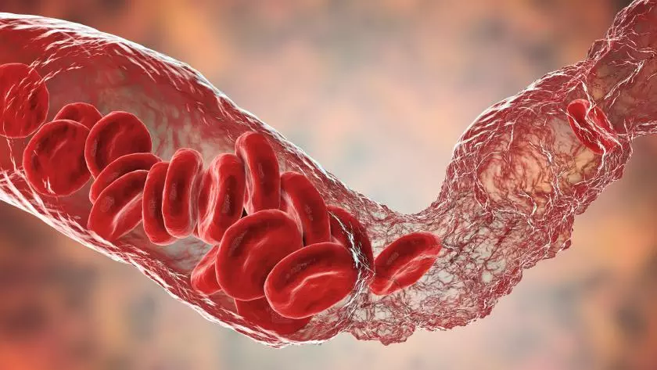

Slide 75
Risk of venous thrombosis by route
of estrogen administration : ESTHER Study
Cases/Controls
Odds Ratio (IC 95%)*
ET non-users
93/261
Current transdermal
ET users
32/27
Current oral
ET users
30/93
* Adjusted for BMI, family history
of venous thrombosis and varicose veins
Scarabin et al, Lancet, 2003

Slide 76
Postmenopausal Hormone Therapy and Risk of Idiopathic Venous Thromboembolism :Results From the E3N Cohort Study
Canonico et al Arterioscler Thromb Vasc Biol. 2010;30:340-345

Slide 77
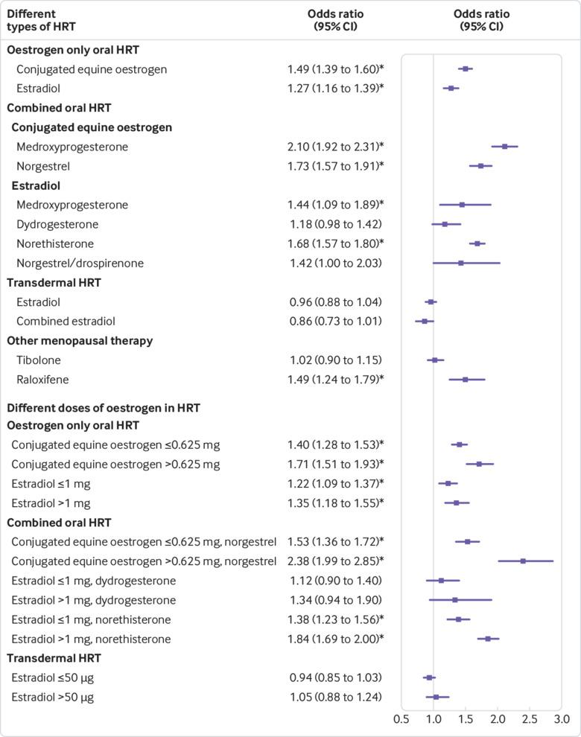
Use of hormone replacement therapy and risk of venous thromboembolism : nested case-control studies using the QResearch and CPRD databases
Adj OR for different types of HRT & different doses of oestrogen.
Yana Vinogradova et al. BMJ 2019;364:bmj.k4810
Notes:
Adjusted odds ratios for different types of hormone replacement therapy (HRT) and different doses of oestrogen. Odds ratios are adjusted for current use of conjugated equine oestrogen cream, estradiol pessaries, oral progestogen, progesterone cream or vaginal preparations, past use of HRT, smoking status, alcohol consumption, Townsend deprivation fifth (QResearch only), body mass index, comorbidities, recent events, current and past use of antidepressants, antipsychotics, aspirin, oral contraceptives, tamoxifen, and years of data. Cases are matched to controls by age, general practice, and index date. *P<0.01

Slide 78
Venous Thromboembolic diseases (VTE)
Randomized and observational studies reported that MHT increases the risk of VTE (2 to 3 fold) (level 1b evidence). This means that in a cohort of 1000 women using MHT, an additional 2 cases occur per year of use on a typical baseline risk of 1 per 1000 woman-years.
Standard ET doses were associated with a rare, but significant increase in VTE (WHI) (0.8 excess/ 1000 women-year). Major identified risk factors are age, overweight, sedentarity and thrombophilia. The risk is highest during the first year of use.

Slide 79
Venous Thromboembolic diseases (VTE)
This risk may be lower using low oral doses of MHT or using MHT regimens with transdermal/percutaneous estrogens (level 2a of evidence).
Administration of TSEC may be associated with a similar increased risk as MHT.
The risk may also vary according to type of progestin (lower risk with progesterone and dihydrogesterone)(level 2a)
In women who have a past history of VTE, one should exclude thrombophylia and check whether the risk is still present. If not, MHT may be used (rather transdermal, low dose).

Slide 80
Breast cancer risk factors
A number of risk factors for breast cancer have been identified:
Age: the main risk factor since the incidence of this cancer has an age-dependent curve, increasing steadily from the age of 45.
Family history of breast cancer: second main risk factor.
3 questions to ask: how many, who, when?
In the 2 branches of the family, as genetic mutations are transmitted in an autosomal
dominant fashion.
Personal history of thoracic irradiation before the age of 30: the level of risk after thoracic irradiation is equivalent to that of a woman with BRCA1 mutation.
Personal history of borderline lesions: Atypical ductal hyperplasia, atypical lobular hyperplasia, lobular carcinoma in situ.

Slide 81
Breast cancer risk factors
Breast density:
  Multifactorial: genetic, biological, hormonal and societal (lifestyle).
  Independent and significant breast cancer risk factor.
  All mammography reports must specify the degree of breast density and clearly inform women with dense breast of the benefits of additional screening tests (1).
  Mac Cormack et al in 2006: the average relative risk (RR) of the density category above 75p. 100(ACR’s type D) is 4.64 (95% CI: 3.64-5.91).
  Cummings et al meta-analysis (2009): RR=4.20 (95% CI: 3.61-4.89) compared with a density category of less than 5p. 100.
  Difficult to quantify precisely breast density. To harmonize the language used by radiologists, the American College of Radiology (ACR) has proposed a classification of breast density which includes 4 types:
    A: 25% of glandular tissue
    B: 25 to 50% of glandular tissue
    C: 50 to 75% of glandular tissue
    D: >75% of glandular tissue
Mac Cormac VA, Dos Santos Silva I et al ,Cancer Epidemiol Biomarkers Prev 2006
Cummngs SR et al: J Natl Cancer Inst, 2009

Slide 82
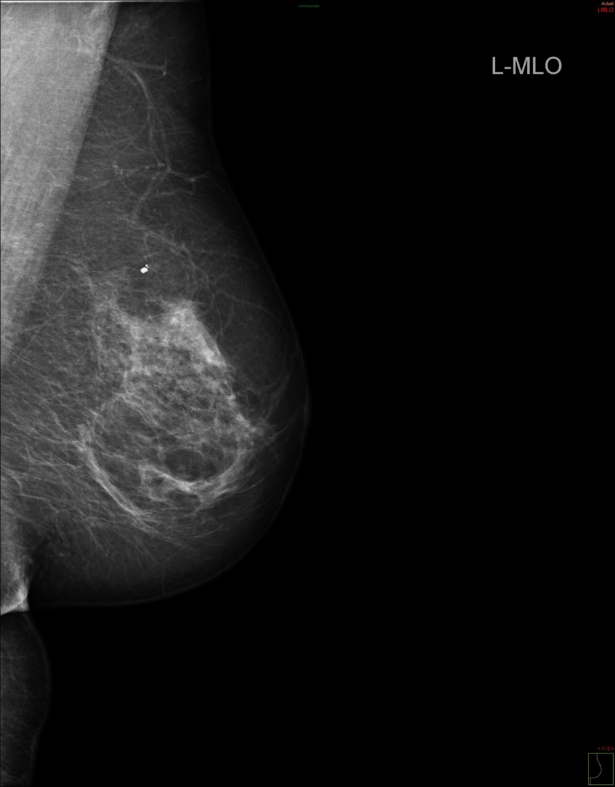
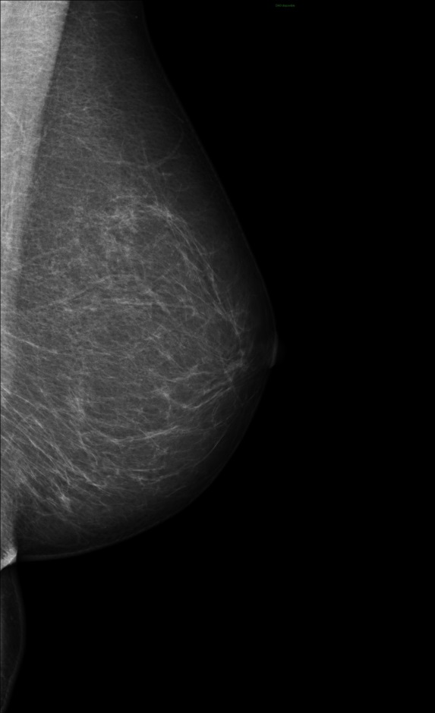
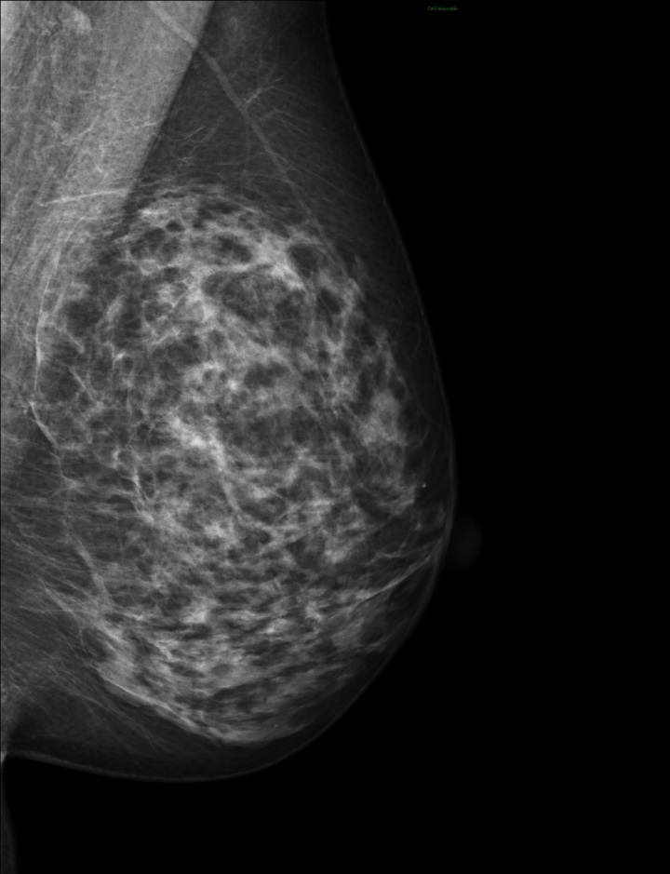
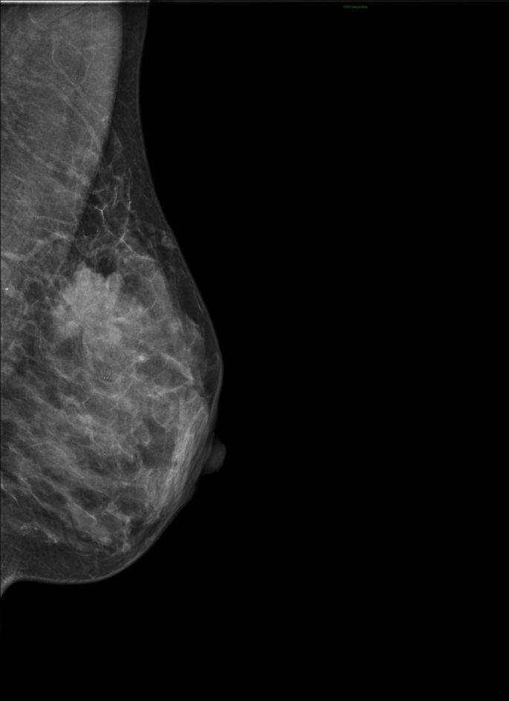
A
B
C
D
Almost entirely fatty
Scattered area of fibroglanular tissue
Heterogenously dense
Dense
BI-RADS (Breast Imaging Reporting and Data System) classification of breast density of the ACR

Slide 83
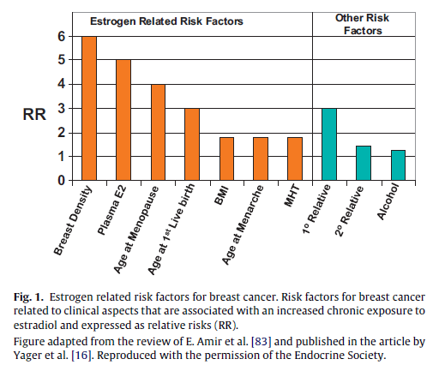

Slide 84
Breast cancer risk
Women should be counseled that life style factors influence the breast cancer risk (post-menopausal obesity and alcohol intake increase it and physical exercise decreases it) (level 1b evidence).
Screening for breast cancer should occur, at the same frequency, whether or not women are using MHT after informed consent considering pro and con’s of screening.
Some regimens (EPT) increase mammographic density. In women with a high baseline mammographic density, regimens not increasing mammographic density should be favoured such as (TSEC, SERMS, ET, tibolone, and low dose EPT).
.

Slide 85
Breast cancer risk factors
Menopausal hormone therapy (MHT)
  Most effective treatment for vasomotor symptoms in menopausal women.
  The influence of menopause hormone therapy (MHT) on breast cancer incidence is still controversial.
  The first Women’s Health Initiative (WHI) publication (2002) has considerably modified the prescription of oestrogens and progesterone in menopausal women.
  Discordant findings between results of prospective observationnal studies and randomized clinical trials.
  Long-term follow-up study of 2 randomized trials have shown:.
    Prior randomized use of CEE alone, compared with placebo, among women who had a previous hysterectomy, was significantly associated with lower breast cancer incidence and lower breast cancer mortality.
    Whereas prior randomized use of CEE plus MPA, compared with placebo, among women who had an intact uterus, was significantly associated with a higher breast cancer incidence but no significant difference in breast cancer mortality.
Chlebowski et al JAMA July 2020

Slide 86
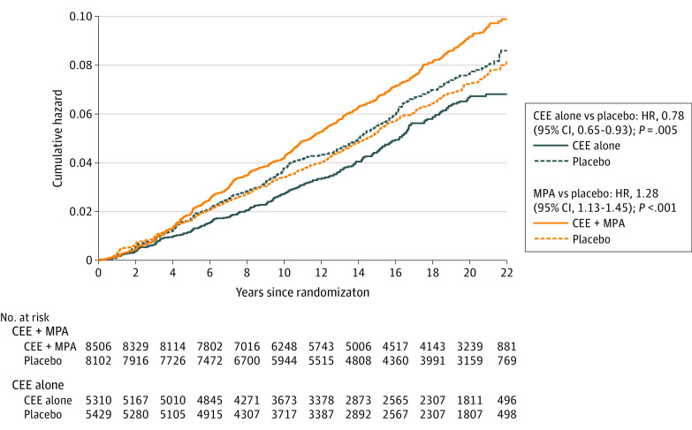
Breast cancer risk factors
Association of Menopausal Hormone Therapy With Breast Cancer Incidence and Mortality During Long-term Follow-up of the Women's Health Initiative Randomized Clinical Trials
Statistically significant lower breast cancer incidence
No significant difference in breast cancer mortality
Association with lower breast cancer incidence greater among women without first degree relative and no previous breast biopsy
Association with lower risk strongest for ER+, PR- cancers
Stronger associations with CEE-alone and breast cancer incidence seen for HER2+ and negative lymph node
Chlebowski et al JAMA July 2020

Slide 87
Breast cancer risk factors
Association of Menopausal Hormone Therapy With Breast Cancer Incidence and Mortality During Long-term Follow-up of the Women's Health Initiative Randomized Clinical Trials
Higher incidence became statiscally significant in year 6 and remains significant
Cancer diagnosed at higher stage with lymph node involvement
No significant difference in breast cancer mortality
Chlebowski et al JAMA July 2020

Slide 88
Breast cancer risk factors
JE Manson, AM Kaunitz N Engl J Med 2016

Slide 89
Breast cancer risk
EPT: Randomized data using one regimen (CEE+MPA) of EPT show an increased risk of breast cancer beyond 5 years of use (WHI) (level 1b of evidence).
This means for example using the WHI data, that in a cohort of 1000 postmenopausal women aged 50-59 years, using EPT the calculated attributable risk of BC is 0.6 cases / 1000 women-year, without increased mortality. This is likely, associated with a proliferation of already preexisting tumors, rather than an induction of tumors. This additional risk is comparable to that of some life style factors.
Sequential EPT as well as tibolone, and TSEC may entail lower risk than continuous combined regimens (LIFT) (level 1b evidence).

Slide 90
Breast cancer risk
ET: Standard ET doses, decreased breast cancer incidence in some prospective randomised studies, as well as breast cancer related mortality (WHI, DOPS) (level 2a of evidence),but not in all.
The addition of a progestin is not indicated in hysterectomised women.

Slide 91
Breast cancer risk factors
Studies have found that MHT with estrogen in combination with synthetic progestins (medroxyprogesteroneacetat, norethisterone, levonorgestrel and norgestrel) is associated with a greater risk of breast cancer.
In contrast, MHT consisting of estrogen in combination with micronized progesterone may have a lower risk of breast cancer.
Estrogen, either bioidentical or animal-derived does not appear to be independently associated with an increase risk of breast cancer.
Fournier A et alInt J Cancer 2005
Asi net al Syst Rev 2016
Haim AA et al Obstet Gynecol 2022

Slide 92
Menopause management of breast cancer patients
MHT and tibolone are contra-indicated in breast cancer patients (level 1b).
Hot flushes can be relieved in some patients with clonidine, venlafaxin and GABA-pentin (level 2a). Some SSRIs lower tamoxifen/endoxifen levels but whether it interferes with its efficacy is controversial. Oxybutidine and other anti-cholinergica have been also used, although these drugs may increase cognitive problems. NK3 –antagonists may be a future alternative for such patients.
In hormone-dependent breast cancer patients suffering from vaginal atrophy on aromatase inhibitors, topical non hormonal products should be administered before using topical hormone therapy. If needed, estriol should be preferred (Level 3).

Slide 93
Other cancers risks
Randomized trials report a reduced risk of colon cancer in EPT and tibolone users (but not in the ET users) (level 1 of evidence). Currently, colon cancer prevention is not a recognized indication for HRT.
Endometrial cancer : ET use is associated with substantially increased risk. Observational data are conflicting as to whether sequential EPT reverses this risk to the baseline risk (level 2 of evidence). However, continuous combined EPT is not associated with increased risk and even decreased risk in obese women (level 1 of evidence).
TSEC (CEE + Bazedoxifene) has not been associating with an increased endometrium cancer risk.

Slide 94
Other cancer risks
Some observational data, but not all reported an increased risk of some ovarian cancer in HRT users, but the attributable risk is in the range of 0.5 case/ 1000 women/ year.
In smokers older than 60 years, EPT does not increase lung cancer incidence but may increase the related mortality.

Slide 95
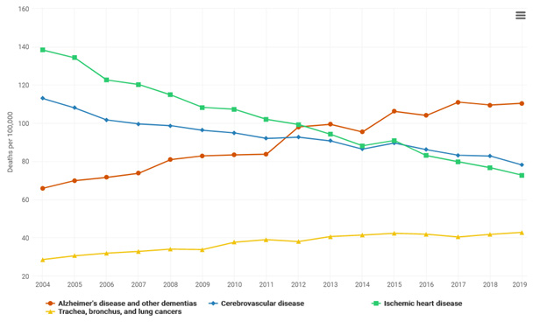
95
Notes:
95

Slide 96
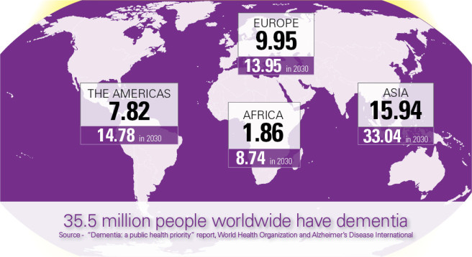


Ziekte van Alzheimer is de belangrijkste oorzaak van dementie, verantwoordelijk voor 60% to 80% tot van patiënten met dementie
AD patients worldwide
65%
35%
Alzheimer’s Disease Facts and Figures, Alzheimer’s & Dementia 2018
Notes:
TO DATE THERE ARE 35 MILION OF PEOPLE LIVING WITH DEMENTIA WORDLWIDE – 9 MILION ONLY IN EUROPE AND THIS NUMBER IS EXPECTED TO INCREAS TO 70 MILION WITHITN 15 YEARS

Slide 97



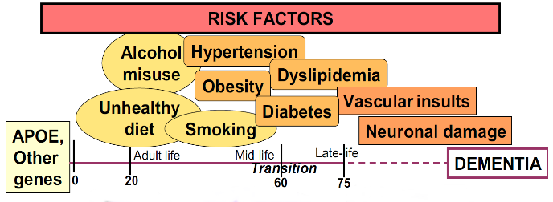
Alzheimer’s dementia: risc factors
CMC
Depressie
Sleeping disorder
Adapted from Kivipelto et al. (2013) Alzheimer’s & Dementia
Notes:
THE DEVELOPÒMENT OF AD DEMENTIA MIGHT BE INFLUENCED BY SOME GENETIC AND ENVIROMENTAL RISK FACTORS
THE MAIN KNOWN GENTIC RISK FACTOR FOR AD IS THE PRESENCE OF E4 ALLELE OF APOLIPOPROTEIN PLUS OTHER CANDIDATES GENES.
MOREOVER DURING THE WHOLE LIFESPAN WE KNOW FROM SEVERAL EVIDENCE THAT THERE ARE ENVIROMENTAL RISK FACTORS THAT MIGHT INFLUENCE THE INCIDENCE OF AD SUCH AS
Kivipelto M, Solomon A, Ahtiluoto S, Ngandu T, Lehtisalo J, Antikainen R, Bäckman L, Hänninen T, Jula A, Laatikainen T, Lindström J, Mangialasche F, Nissinen A, Paajanen T, Pajala S, Peltonen M, Rauramaa R, Stigsdotter-Neely A, Strandberg T, Tuomilehto J, Soininen H.
The Finnish Geriatric Intervention Study to Prevent Cognitive Impairment and Disability (FINGER): study design and progress.
Alzheimers Dement. 2013 Nov;9(6):657-65. doi: 10.1016/j.jalz.2012.09.012.
Cognitive impairment is one of the most frequent chronic conditions in the elderly, and the worldwide costs of dementia have been estimated to exceed those of other chronic diseases such as diabetes. Alzheimer’s disease (AD), the major cause of dementia, has reached epidemic proportions, with a large human, social, and economic burden. However, postponing AD onset by only 5 years may halve the projected AD prevalence in the future.
The importance of finding methods to delay onset and/or modify progression of cognitive impairment/dementia was recently emphasized in a report of the National Institutes of Health (NIH) in USA. Formulated by an independent panel of health professionals and public representatives from outside the AD research field, the report highlighted the need for high-quality, randomized, controlled trials (RCTs). As cognitive impairment/dementia has a multifactorial etiology, resulting from interactions between both genetic and environmental factors (Figure), the report recommended conducting RCTs with multidimensional interventions, combining interventions for multiple risk factors, and controlling for many other factors. Conducting trials initially in individuals at high risk was also recommended as a more efficient approach.
Within the AD/dementia research field, a consensus has emerged that intervention strategies must be initiated as early as possible, even before significant symptoms begin to appear. This goal can be achieved, for example, by incorporating the classical clinical trial approach to disease into a public health model, with long-term longitudinal databases including large populations. Establishing comprehensive databases for studies on aging can create the opportunity to formulate and validate tools for early detection of people who are at increased risk of late-life cognitive impairment, to identify important targets (risk factors) for preventive interventions, and to test such interventions in RCTs.

Slide 98
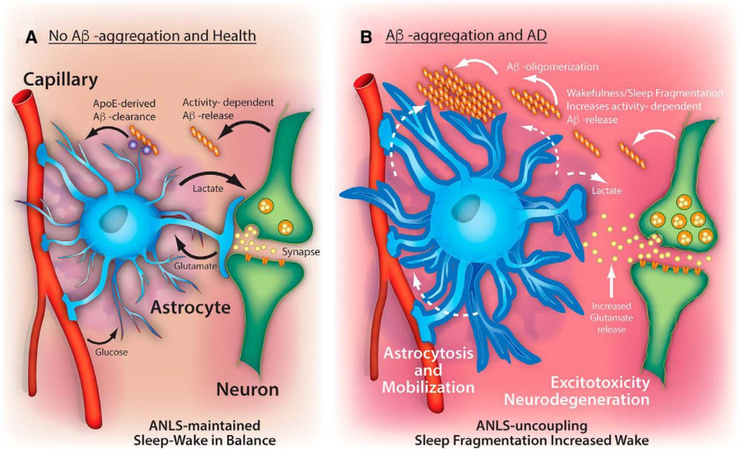
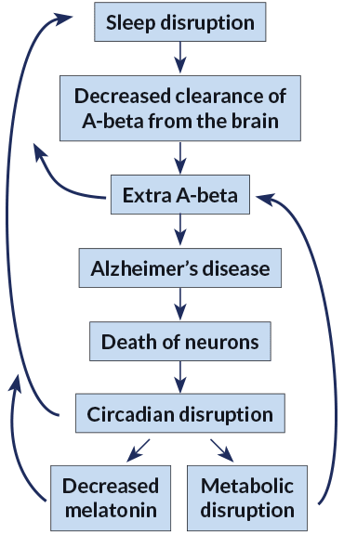
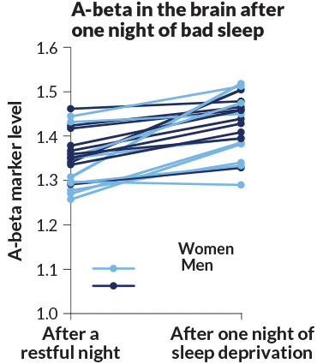
Y. Saeed and S.M. Abbott/Current Neurology and Neuroscience Reports 2017
Notes:
SEVERAL STUDIES HAS HIGHLIGHETHED THE ASSOCIATON BETWEEN SLEEP DISRUPTION AND AD. WHAT WE KNOW IS THAT THE LOSS OF MIGHT ENCOURAGE ALZHEIMER’S BY DECREASING CLEARANCE OF BETA AMYLOID IN THE BRAIN THATA LEAD TO AN ACCOMULATION OF THIS PROTEIN THAT IS AS I PREVIOUSLY SAID ONE OG THE MAIN PATHOPHYSIOLOGICAL PROCESS OF AD.
THIS CYCLE OF SLEEP DEPRIVATION CAN ALSO AFFECT LEVELS OF THE HORMONE MELATONIN, WHICH HELPS THE BODY TO SLEEP, AND CAN INTERFERE WITH METABOLISM, A DISRUPTION THAT IS ALSO A RISK FACTOR FOR ALZHEIMER’S.
THE FLOWCHART ON THE RIGHT DESCRIBES THE EFFECT OF SLEEP DISRUPTION IN OUR BRAIN
Alzheimer’s disease disrupts sleep. And disrupted sleep itself might encourage Alzheimer’s by allowing buildup of amyloid-beta, or A-beta, which is thought to lead to the death of neurons. This cycle of sleep deprivation can also affect levels of the hormone melatonin, which helps the body to sleep, and can interfere with metabolism, a disruption that is also a risk factor for Alzheimer’s.
Using PET scans to measure amyloid-beta markers, researchers compared levels of A-beta in the brains of 20 healthy volunteers after one restful night and after one night of sleep deprivation. Levels of the plaque-forming A-beta rose in most people tested.

Slide 99
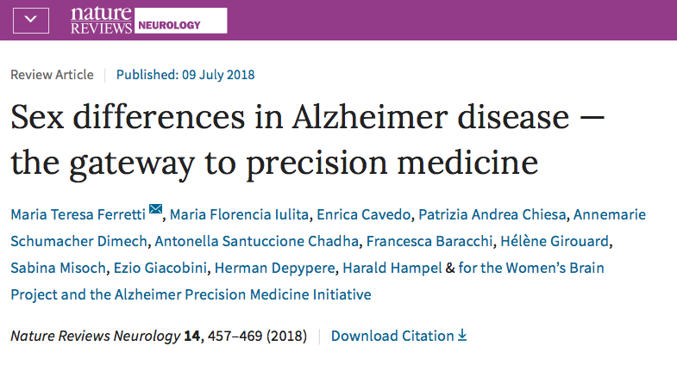
Are there sex-differences in...?
Notes:
DURNG THE LAST 2 YEARS THE APMI AND THE WBP HAD WORKED TOGHETHER IN ORDER TO ANSWER THIS QUESTION AND IN PARTICULA TO UNDERSTAD WHETHER THIS ETEROGENEITY MIGHT BE INFLUENCED BY BIOLOGICAL SEX
TO SEE WHTHER SEX DIFFERENCE THAT WE ARE NOT CURRENTLY CONSIDERING IN OUR RESEARCH MIGHT BE THE GATWAY TO A PRECISION MEDICINE APPROACH TO AD

Slide 100


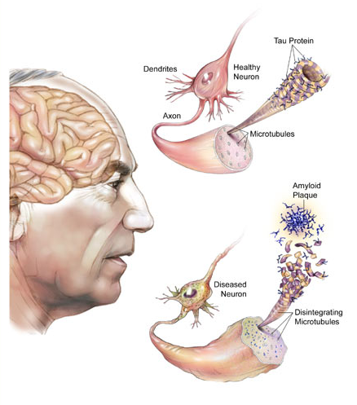
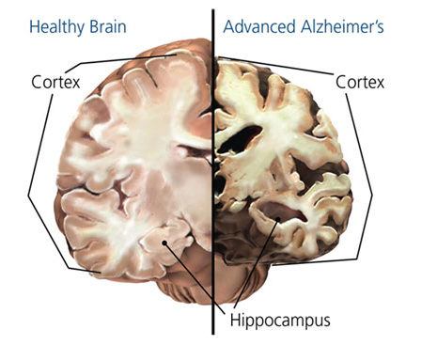

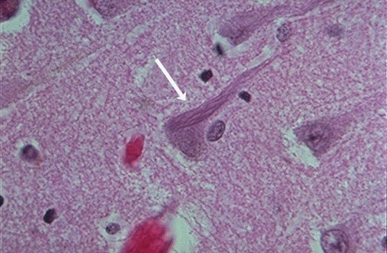
Kenmerken van de ziekte van alzheimer
CMC
Neurodegeneratie
Amyloid Plaques
Neurofibrillaire kluwenvorming
Notes:
THIS CARTOON DESCRIBES THE MAIN PATHOPHYSIOLOGICAL HALLMARKS OF AD.
AT THE TOP WE HAVE THE IMAGE OF AN HEALTHY NEURON, WHLE AT THE BOTTOM WE HAVE A DISEASED NEAURON CARACTERIZED BY MISFOLDING OF BETA-AMYLOID AND TAU PROTEINS THAT LEAD TO THE FORMATION OF THE SO CALL AMYLOID PLAQUES AND NEUROFRBRILLARY TANGLES ACCUMULATION
THE 2 EVENTS AR CONSIDERED THE MAIN CAUSES OF THE NEURODEGENERATION THAT WE OBSERVE IN AD.
THE POST-MORTEN BRAIN ON TOP RIGHT HAND CORNER OF THE SLIDE SHOWS ON THE RIGHT THE BRAIN OF A PATIENTS WITH AD AND ON THE LEFT AN HEALTHY BRAIN. AS WE CAN SEE IN THE PATIENTS WITH AD WE OBSERVE A SHRINKAGE OF NEURONO OF BRAIN CORTEX AND IN PARTICULAR OF TEMPORAL CORTEX AND IN THE HIPPO. THESE ARE THEBRAIN REGIONS MAINLY INVOLVED IN MEMORY PROCESSE
Misfolding of beta amyloid and tau protein follow by the formation of amyloid plaques and neurfibrillary tangles accumulation

Slide 101
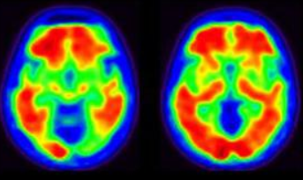
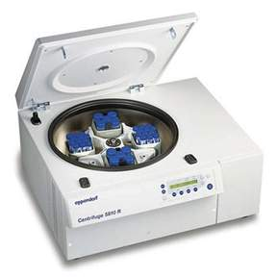


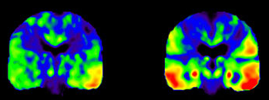
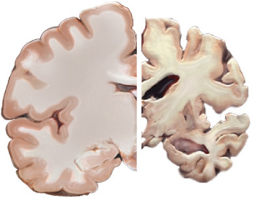
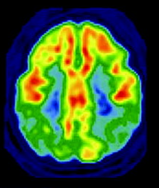
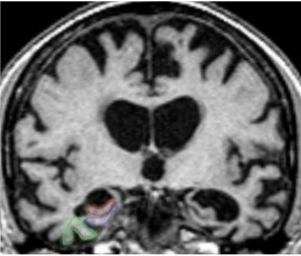
Ziekte van Alzheimer
In vivo Detectie
SURROGAAT MERKERS
Amyloid Plaques
Amyloid PET
CSF/Plasma Aβ1-42
of
Neurofibrillaire kluwen
Tau PET
CSF/Plasma T-tau P-tau
of
Neurodegeneratie
18-FDG PET
Brain Atrophy (MRI)
or

Slide 102
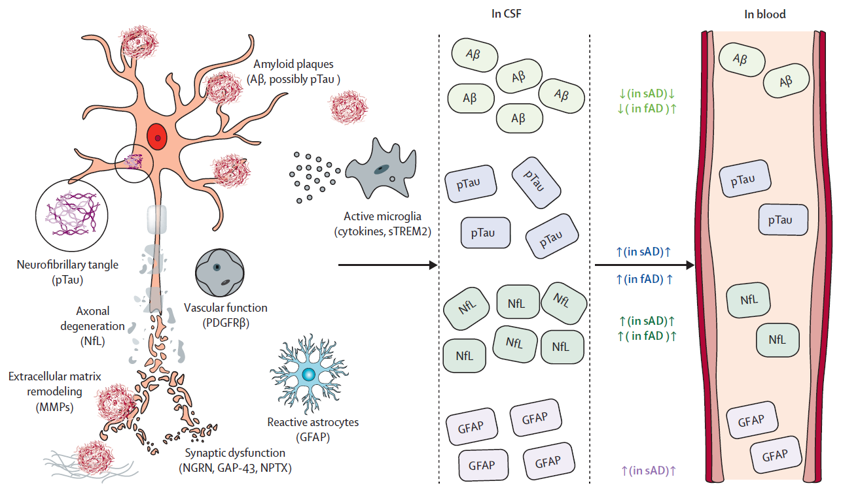

Slide 103

Depypere H¹, Vergallo A^{2*}, Lemercier P^{2*}, Lista S², Benedet AL³ Ashton NJ^{3,4,5,6}, Cavedo E, Zetterberg H^{3, 7, 8, 9, 10}, Blennow K^{3,7}, Vanmechelen E¹¹, Hampel H²; the Neurodegeneration Precision Medicine Initiative (NPMI).
Menopause Hormone Therapy significantly alters
Pathophysiological Biomarkers of Alzheimer’s Disease
Alzheimer’s and dementia: 2022 sept
103

Slide 104
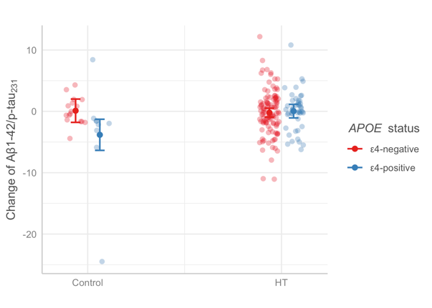
Neurale serum parameters
104

Slide 105
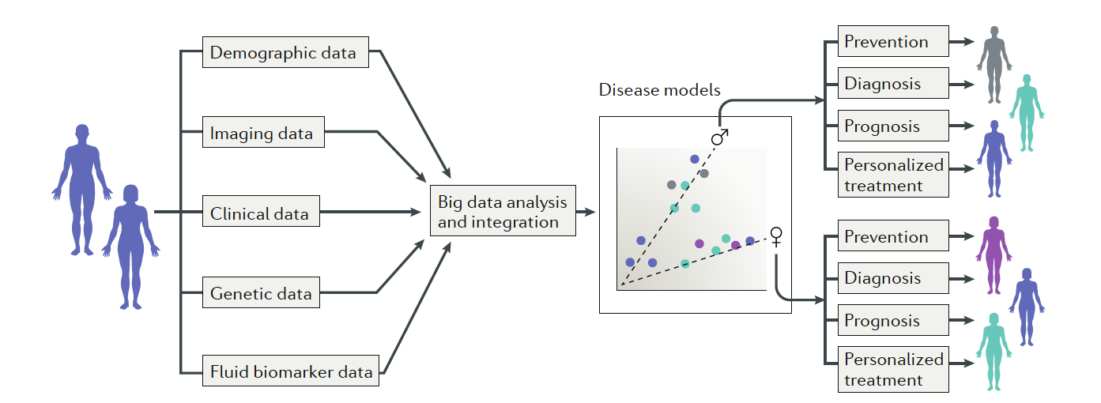
Meer gepersonaliseerde precisie geneeskunde
Notes:
We propose that large-scale, population-based screenings — including compre- hensive AD risk assessment, biomarker collection and genetic stratification — should be performed. This screening would enable disease models to be generated on the basis of big data analysis that takes into account individual variability, including sex as well as genetic, epigenetic, biomarker, phenotypic, lifestyle and psycho- social characteristics, leading to the identification of sub- groups of individuals at risk and patients150,151 (fig. 2). In 2017, the APMI and the APMI cohort programme were launched to stimulate such a paradigm shift towards precision medicine and precision pharmacology in AD, highlighting the need for tailored interventions that take into consideration the individual’s specific biological make-up, including sex17,152,153.

Slide 106
Article | Study population | Type of study | Follow-up | Outcome
Burkhardt 2004 | 181 postmenopausal women Mean age: Estrogen users: 65.40 +/- 6.34 Non-users: 67.03 +/- 6.80 ApoE4 allele present in 64 women | Observational: Cross-sectional | Single administration of the California Verbal Learning Test. | The women with the best performance were the Ɛ4- women on ERT. The Ɛ4+ women had no positive effect of ERT. They had no better results than Ɛ4- women without ERT.
Yaffe 2000 | 2716 postmenopausal women ≥65 years ApoE4 allele present in 677 women | Observational: Prospective cohort | The MMSE was administered annually for 6 years. | Estrogen use was associated with less cognitive decline among Ɛ4- women but not among Ɛ4+ women.
Rippon 2006 | 1498 postmenopausal women mean age: - Dementia present: 73.3 years - Dementia absent: 62.4 years ApoE4 allele present in 736 women | Observational: Cross-sectional | Single administration of neuropsychological tests. | Compared with Ɛ4- women who had no history of ERT, Ɛ4- women who took ERT had an 80% reduction in AD risk. Ɛ4+ women without a history of ERT had a two-fold increased risk of AD, while Ɛ4+ women with a history of ERT had no increased risk.
Ryan 2009 (the 3C city study) | 3130 postmenopausal women ≥65 years ApoE4 allele present in 597 women | Observational: Prospective cohort | Testing of general cognition, verbal fluency, verbal and visual memory, psychomotor speed and executive functions was done 3 times in 6 years | Current use of ERT was associated with better performance in certain cognitive domains, and this association was stronger the longer the duration of ERT. Current use of ERT may decrease AD risk associated with the presence of ApoE4+.
Zandi 2002 (the cache county study) | 1889 women Mean age: - Estrogen users: 76.2 +/- 7.0 - Non-users: 73.1 +/- 5,8 ApoE4 allele present in 569 women | Observational: Prospective cohort | Screening at the beginning of the study and after 3 years with the modified MMSE. A clinical assessment was done in case of a positive screening. | ERT users had a reduced risk of AD compared with non-users. This effect appeared to be stronger for Ɛ4+ women, but this hypothesis did not reached statistical significance because of the small numbers available.
Tang 1996 | 1124 non-demented women Mean age: 74,2 years 156 estrogen users APOE genotypes were available for 53·7% of the women | Observational: Prospective cohort | Standard annual clinical assessments and criterion-based diagnoses were used in follow-up (range 1–5 years) | The age at onset of Alzheimer’s disease was significantly later and the relative risk of AD was significantly reduced in ERT users in comparison with the non-users. ERT use was associated with a reduction in the risk of AD for the heterozygote Ɛ4+ women. An evaluation for the homozygote Ɛ4+ women was not possible.
Yue 2007 | 182 postmenopausal women Mean age - Estrogen users: 66,3 +/- 8,3 - Non-users: 67,1 +/- 7,6 ApoE4 allele present in 32 women | Observational: Cross-sectional | Measuring of the volume of the brain hippocampus with MRI. Single administration of 6 cognitive tests. | The volume of the hippocampus of the Ɛ4+ women was significantly larger in the HRT group in comparison with the control group. The cognitive tests showed no significant improvement of cognitive function in ERT users when compared to non-users.
Sundermann 2008 | 51 postmenopausal women age Ɛ4- women (n=32) - estrogen users: 73.18 ± 4.22 - non-users: 73.77 ± 2.43 Ɛ4+ women (n=19) - estrogen users: 70.41 ± 4.22 - non-users: 69.70 ± 3.60 | Observational: Cross-sectional | Single testing of the odour threshold | ERT use may offer protection against loss of olfactory function in Ɛ4+ women who may be in the early stages of AD. The ERT users who are Ɛ4+ had a significantly higher odour threshold sensitivity in comparison with the non-users. No significant differences were seen between the ERT users and non-users of the Ɛ4- women.
Kang and grodstein (2012) | 3697 postmenopausal women Mean age 72 years ApoE4 allele present in 948 women | Observational: Prospective cohort | Telephonic testing of cognitive functions was done 3 times in 6 years | Compared with ‘never users’, past or current ERT users showed modest but statistically significant worse rates of decline in the cognitive function. A suggestive interaction with Ɛ4 status was found: for Ɛ4- there was no difference in decline between women using ERT and those not using it; for Ɛ4+, women using ERT experienced a decline in cognitive function.
Gleason 2015 Keeps | 693 young healthy menopausal women - 220 allocated to o-CEE low dose + m-P - 211 allocated to t-E2 + m-P - 262 allocated to placeboApoE4 present 25.9 %//Duration : 4 years | Randomized, double-blinded, placebo-controlled clinical trial | Different cognition and mood tests | No influence on cognition was seen. The o-CEE group (not t- E2) had better results on anxiety and depression.

Slide 107
Alzheimer’s disease and cognitive function
80% of dementia in women, is due to Alzheimer.
Obesity, smoking, alcohol, sedentarily, insomnia are risk factors. Apo E4 is a strong driver for Alzheimer.
Observational data showed an impairment of the cognitive function after castration.
MHT initiated early after menopause may reduce the risk of Alzheimer (level 2).
It is not proven that MHT prevents/delays Alzheimer’s dementia.
MHT initiated after the age of 65 years increases the risk of dementia (level 1), probably due to vascular dementia incidence.
Therefore MHT should currently not be used for this indication.

Slide 108
Good clinical practice
Life style counselling is essential for preventing and treating cardiovascular diseases, metabolic disorders, breast cancer and osteoporosis.
Although, in women before 60 years, posthoc analyses of WHI and one meta-analysis report a significant reduced global mortality (level 1 of evidence), the main indication of MHT is climacteric symptoms. In this case, the necessity to alleviate symptoms and the lowest effective dose regimen should be re-evaluated regularly on an individual base. In case of recurrence of symptoms, restarting may be considered, keeping in mind that the absolute risk of MHT related to BC and CVD increases steadily with age.

Slide 109
Good clinical practice
MHT remains a priori, contraindicated in women with a history of stroke and /or BC (level 1 of evidence)
Some experts consider in situ BC and atypical hyperplasia, and triple negative breast cancer as an absolute contra indication, others as a relative one,
Similarly, some consider that transdermal, percutaneous and spray ET may be used in women with a history of VTE/ or known thombophilia, but others do not.

Slide 110
Additional remarks
In case of Hysterectomy, only ET should be used, except in patients with severe or residual endometriosis.
More studies are needed evaluating other regimens, different routes of administration and the use of (micronised) estradiol, progesterone and other progestins, and tibolone which are currently more often used in Europe.

Slide 111
Additional remarks
In women younger than 60 years, there was a significant decrease in total mortality when data from the ET and EPT (WHI) were combined (level 1)

Slide 112
References
Anderson GL, Anderson GL, Chlebowski RT, et al. Prior hormone therapy and breast cancer risk in the Women’s Health Initiative randomized trial of estrogen plus progestin. Maturitas 2006;55:103–15.
Bath P, Gray LJ. Association between hormone replacement therapy and subsequent stroke: a meta analysis. BMJ 2005;330:342.
Beral V on behalf on the Million Women Study Collaborators. Endometrial cancer and hormone-replacement therapy in the Million Women Study. Lancet 2005; 365: 1543–51.
Beral V, Bull D, Green J, Reeves G. Ovarian cancer and hormone replacement therapy in the Million Women Study. Lancet 2007;369:1703-1710
Beral V, Million Women Study Collaborators .Breast cancer and hormone-replacement therapy in the Million Women Study.Lancet. 2003 Aug 9;362(9382):419-27.
Boyd NF, Guo H, Martin LJ, Sun L, Stone J, Fishell E, Jong RA, Hislop G, Chiarelli A, Minkin S, Yaffe MJ. Mammographic density and the risk and detection of breast cancer. N Engl J Med. 2007 Jan 18;356(3):227-36.
Chlebowski RT, Hendrix SL, Langer RD, Stefanick ML, Gass M, Lane D, Rodabough RJ, Gilligan MA, Cyr MG, Thomson CA, Khandekar J, Petrovitch H, McTiernan A; WHI Investigators. Influence of estrogen plus progestin on breast cancer and mammography in healthy postmenopausal women: the Women's Health Initiative Randomized Trial. JAMA. 2003 Jun 25;289(24):3243-53.
Cummings SR, Ettinger B, Delmas PD, et al. The effects of tibolone in older postmenopausal women. The New England journal of medicine 2008;359:697-708
Danforth KN, Tworoger SS, Hecht JL, et al. A prospective study of postmenopausal hormone use and ovarian cancer risk. British journal of cancer 2007;96:151-156

Slide 113
References
Fournier A, Fabre A, Mesrine S, et al. Use of different postmenopausal hormone therapies and risk of histology- and hormone receptor-defined invasive breast cancer. J Clin Oncol 2008;26:1260-1268
Glass AG, Lacey JV, Jr., Carreon JD, Hoover RN. Breast cancer incidence, 1980-2006: combined roles of menopausal hormone therapy, screening mammography, and estrogen receptor status. Journal of the National Cancer Institute 2007;99:1152-1161
Grodstein F, Clarkson TB, Manson JE Understanding the divergent data on postmenopausal hormone therapy. N Engl J Med. 2003 Feb 13;348(7):645-50.
Grodstein F, Manson JAE, Stampfer MJ, Rexrode K. Postmenopausal Hormone Therapy and Stroke. Role of Time Since Menopause and Age at Initiation of Hormone Therapy. Arch Intern Med. 2008;168(8):861-866.
Grodstein F, Manson JE, Colditz GA, Willett WC, Speizer FE, Stampfer MJ A prospective, observational study of postmenopausal hormone therapy and primary prevention of cardiovascular disease. Ann Intern Med. 2000 Dec 19;133(12):933-41
Heiss G, Wallace R, Anderson GL, et al. Health risks and benefits 3 years after stopping randomized treatment with estrogen and progestin. Jama 2008;299:1036-1045
Hendrix SL, Wassertheil-Smoller S, Johnson KC, et al. Effects of conjugated equine estrogen on stroke in the Women’s Health Initiative. Circulation. 2006;113 (20):2425-2434.

Slide 114
References
Hodis HN, Mack WJ, Lobo RA, Shoupe D, Sevanian A, Mahrer PR, Selzer RH, Liu Cr CR, Liu Ch CH, Azen SP; Estrogen in the Prevention of Atherosclerosis Trial Research Group Estrogen in the prevention of atherosclerosis. A randomized, double-blind, placebo-controlled trial. Ann Intern Med. 2001 Dec 4;135(11):939-53.
Hsia J, Criqui MH, Herrington DM, Manson JE, Wu L, Heckbert SR, Allison M, McDermott MM, Robinson J, Masaki K; Women's Health Initiative Research Group. Conjugated equine estrogens and peripheral arterial disease risk: the Women's Health Initiative. Am Heart J. 2006 Jul;152(1):170-6.
Hsia J, Langer RD, Manson JE, Kuller L, Johnson KC, Hendrix SL, Pettinger M, Heckbert SR, Greep N, Crawford S, Eaton CB, Kostis JB, Caralis P, Prentice R; Women's Health Initiative Investigators. Conjugated equine estrogens and coronary heart disease: the Women's Health Initiative. Arch Intern Med. 2006 Feb 13;166(3):357-65. Erratum in: Arch Intern Med. 2006 Apr 10;166(7):759.
Magliano DJ, Rogers SL, Abramson MJ, et al. Hormone therapy and cardiovascular disease: a systematic review and meta-analysis. BJOG. 2006;113:5–14.
Manson JE, Allison MA, Rossouw JE, Carr JJ, Langer RD, Hsia J, Kuller LH, Cochrane BB, Hunt JR, Ludlam SE,. Pettinger MB, Gass M, Margolis KL, Nathan L, Ockene JK, Prentice RL, Robbins J, Stefanick ML, for the WHI and WHI-CACS Investigators. Estrogen Therapy and Coronary-Artery Calcification. N Engl J Med 356:2591, June 21, 2007
Manson JE, Allison MA, Rossouw JE, et al. Estrogen therapy and coronary-artery calcification. The New England journal of medicine 2007;356:2591-2602

Slide 115
References
Mendelsohn ME, Karas RH. HRT and the young at heart. N Engl J Med. 2007 Jun 21;356(25):2639-41.
Nasir K, Budoff MJ, Wong ND, Scheuner M, Herrington D, Arnett DK, Szklo M, Greenland P, Blumenthal RS Family history of premature coronary heart disease and coronary artery calcification: Multi-Ethnic Study of Atherosclerosis (MESA). Circulation. 2007 Aug 7;116(6):619-26. Epub 2007 Jul 23
Prentice RL, Chlebowski RT, Stefanick ML, et al. Conjugated equine estrogens and breast cancer risk in the Women's Health Initiative clinical trial and observational study. American journal of epidemiology 2008;167:1407-1415
Prentice RL, Chlebowski RT, Stefanick ML, et al. Estrogen plus progestin therapy and breast cancer in recently postmenopausal women. American journal of epidemiology 2008;167:1207-1216
Rossouw JE, Anderson GL, Prentice RL, et al. Risks and benefits of estrogen plus progestin in healthy postmenopausal women: principal results from the Women's Health Initiative randomized controlled trial. JAMA 2002;288:321-333.
Rossouw JE, Prentice RL, Manson JE, et al. Postmenopausal hormone therapy and risk of cardiovascular disease by age and years since menopause. Jama 2007;297:1465-1477

Slide 116
References
.Hodis HN, Mack WJ, Henderson VW, Shoupe D, Budoff MJ, Hwang-Levine J, Li Y, Feng M, Dustin L, Kono N, Stanczyk FZ, Selzer RH, Azen SP; ELITE Research Group. Vascular Effects of Early versus Late Postmenopausal Treatment with Estradiol N Engl J Med. 2016 Mar 31;374(13):1221-31. doi: 10.1056/NEJMoa1505241.
TRANSDERMAL AND ORAL HRT AND RISK OF STROKE IN UK-GPRD (*)Transdermal HRT with low dose E does not increase the risk of stroke whereas a significant increase is found with TRANSDERMAL HIGH DOSE AND ALL DOSES OF ORAL HRT Renoux C et al, BMJ 2010;:
JAMA Cardiol. 2016 Oct 1;1(7):767-776. doi: 10.1001/jamacardio.2016.2415. Association of Age at Onset of Menopause and Time Since Onset of Menopause With Cardiovascular Outcomes, Intermediate Vascular Traits, and All-Cause Mortality: A Systematic Review and Meta-analysis. Muka T, et al JAMA Cardiol. 2016
J Clin Oncol. 2010 Aug 20;28(24):3830-7. doi: 10.1200/JCO.2009.26.4770. Epub 2010 Jul 19. Breast cancer risk by breast density, menopause, and postmenopausal hormone therapy use. Kerlikowske K¹, Cook AJ, Buist DS, Cummings SR, Vachon C, Vacek P, Miglioretti DL.

Slide 117
References
.Hodis HN, Mack WJ, Henderson VW, Shoupe D, Budoff MJ, Hwang-Levine J, Li Y, Feng M, Dustin L, Kono N, Stanczyk FZ, Selzer RH, Azen SP; ELITE Research Group. Vascular Effects of Early versus Late Postmenopausal Treatment with Estradiol N Engl J Med. 2016 Mar 31;374(13):1221-31. doi: 10.1056/NEJMoa1505241.
TRANSDERMAL AND ORAL HRT AND RISK OF STROKE IN UK-GPRD (*)Transdermal HRT with low dose E does not increase the risk of stroke whereas a significant increase is found with TRANSDERMAL HIGH DOSE AND ALL DOSES OF ORAL HRT Renoux C et al, BMJ 2010;:

Slide 118
Conflict of interest declaration
The Belgian Menopause Society wishes to thank the following companies who support us with unrestricted educational grants allowing us to fulfill our missions but exercise no control over the content of the consensus: BESINS, Theramex, Gedeon Richter, Viatris, Pfizer, Astellas, Mylan.

