Slide 1

Treatment of osteoporosis
Dr. Charlotte Verroken
Department of Endocrinology
Unit for Osteoporosis and Metabolic Bone Diseases
Ghent University Hospital
BMS Workshop on Menopause Care – 21-03-2025

Slide 2
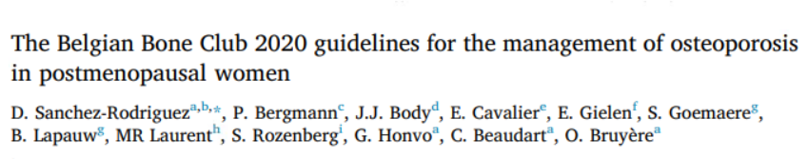
Outline
Diagnosis of osteoporosis
Risk stratification
Treatment options
  Non-pharmacological
  Calcium & vitamin D
  Pharmacological
Treatment adherence
Maturitas, 2020

Slide 3
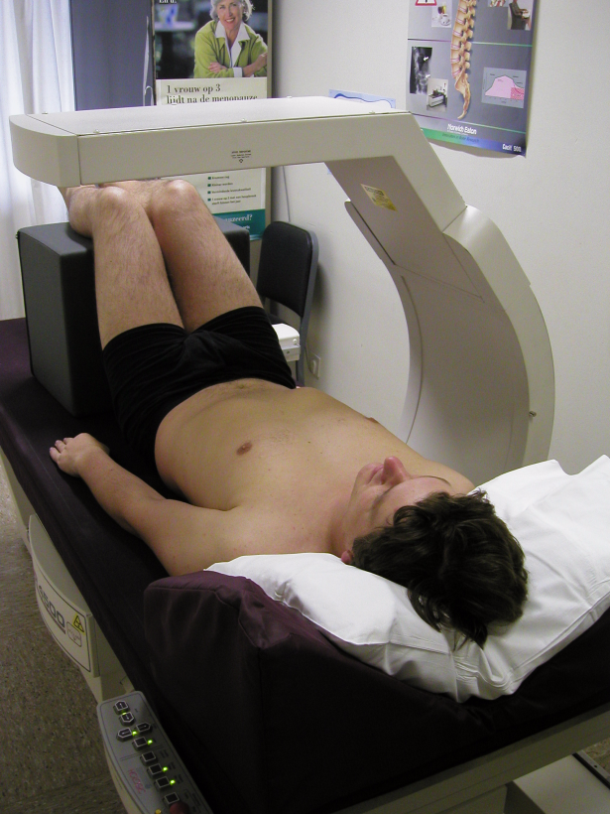
Diagnosis of osteoporosis
Dual-energy X-ray absorptiometry (DXA)
  Lumbar spine (L1-L4) + femoral neck + total hip
  T-score ≤ -2.5 = osteoporosis
Notes:
Reimbursed in women > 65 with hip fracture in first or 2nd degree relative, patients with nontraumatic vertebral or peripheral fractures, secondary osteoporosis (including early menopause)

Slide 4
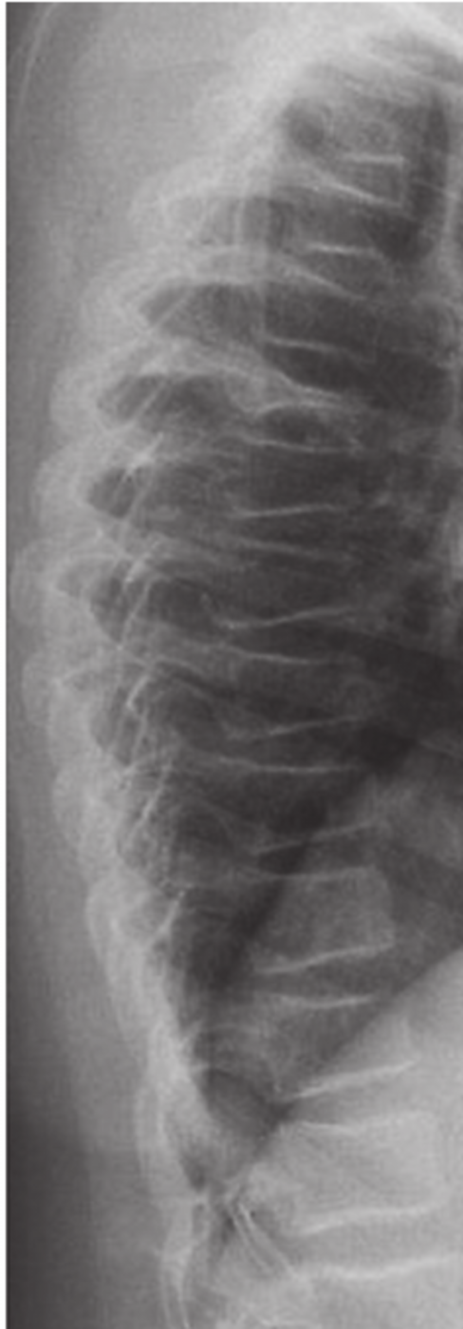
Diagnosis of osteoporosis
Dual-energy X-ray absorptiometry (DXA)
Prevalent fragility fractures?
  Clinical history
  VFA
Fig¹: Risk per 100 000 (95% CI) of a second major osteoporotic fracture (MOF) after a first MOF for a woman at the age of 75 years at her first fracture. Knots for the spline function are set at 0.5, 2.5 and 15 years of follow up after the first fracture. The dashed line is the risk of first MOF in whole population (n=18,872) for a woman 75 years at baseline.
4 /
¹Johansson H et al. Imminent risk of fracture after fracture. Osteoporos. Int. 2017. 28:775 780.
Notes:
MOF: vertebral, pelvis, hip, femur, humerus, wrist, radius/ulna
Rib, tibia/fibula and/or ankle fractures, for example, can also be osteoporotic fractures and qualify as “previous fractures” for use in fracture risk assessment tools, but they are not MOFs [159].
Er bestaan 48 fracture risk assessment tools, slechts enkele zijn gevalideerd in externe cohorts (Garvan, Qfracture)

Slide 5
Diagnosis of osteoporosis
Dual-energy X-ray absorptiometry (DXA)
Prevalent fragility fractures?
Fracture risk calculation (FRAX)
Notes:
vertebral, pelvis, hip, femur, humerus, wrist, radius/ulna

Slide 6
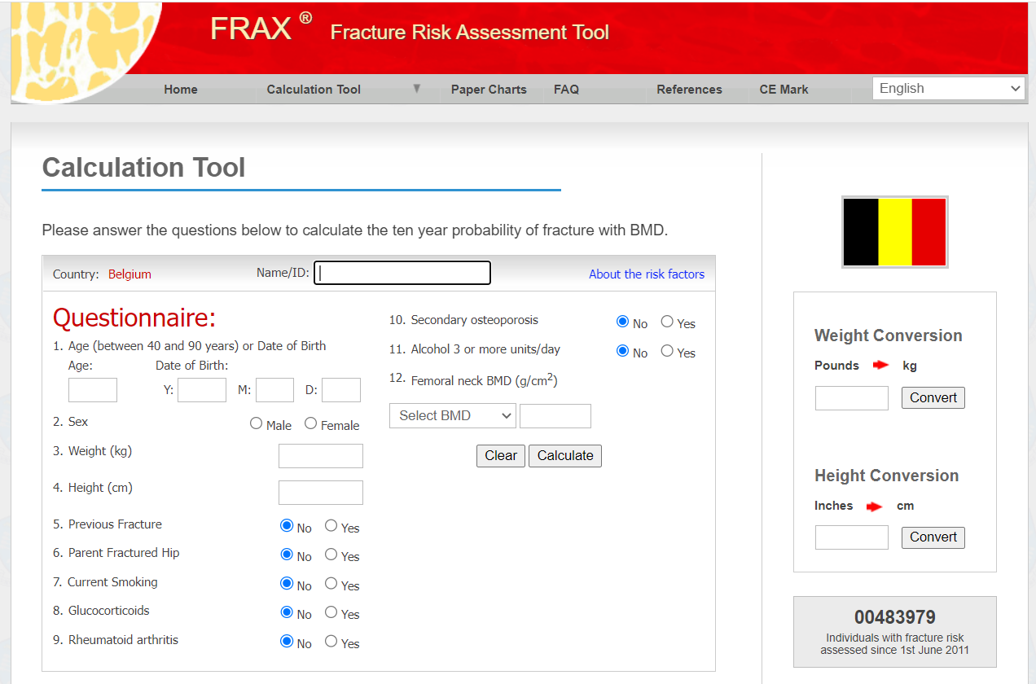
Fracture risk calculation
Wanneer screenen?
  FRAX / andere vragenlijsten
IDDM
OI
Hypogonadism/early menopauze
Longstanding thyrotoxicosis
Malnutrition/malabsorption
Chronic liver disease
Limit 90y
> 3 months > 5mg predni equivalent
https://www.sheffield.ac.uk/FRAX/
Notes:
ROL APOTHEKER

Slide 7
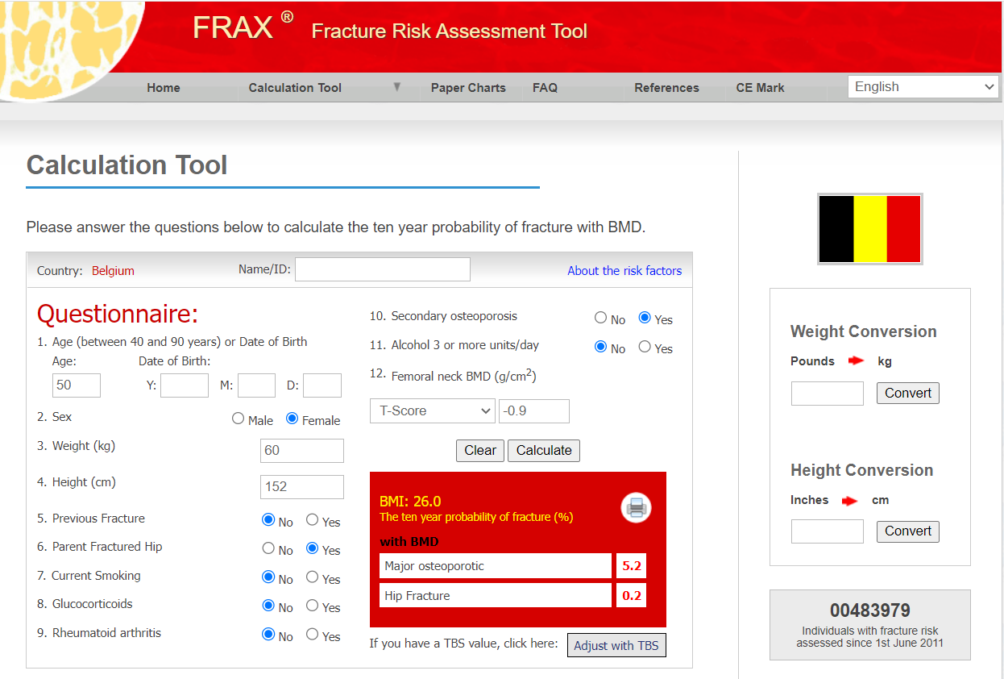
Fracture risk calculation
Wanneer screenen?
  FRAX / andere vragenlijsten
https://www.sheffield.ac.uk/FRAX/

Slide 8
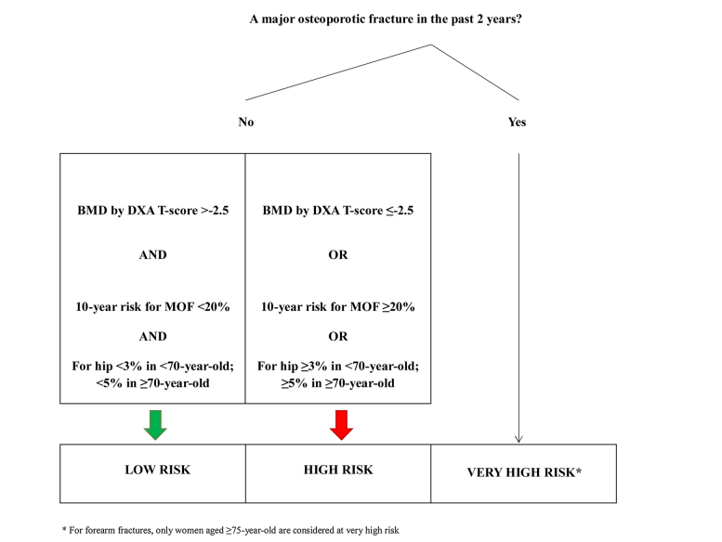
Risk stratification

Slide 9
Principles of treatment
Goal = prevention of fractures
Non-pharmacological
Calcium and vitamin D
Pharmacological
Notes:
Ethyl: vnl. overmatig gebruik

Slide 10
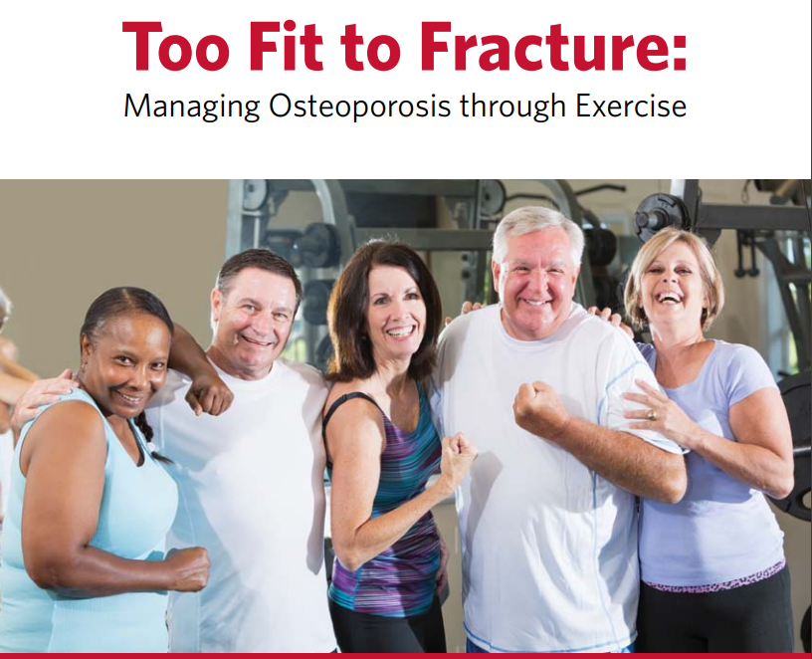
Non-pharmacological measures
Education!
Address risk factors
  Smoking, alcohol, secondary causes, …
Fall prevention
  Intrinsic & extrinsic risk factors
Physical activity
Notes:
Intrinsieke risicofactoren
Fysiek: verminderd evenwicht / spierkracht / mobiliteit / pijn / leeftijd
Medisch: visusverlies / orthostatische hypotensie, urinaire incontinentie
Cognitief: cognitieve stoornissen / valangst / gedrag
Valgeschiedenis (1 per jaar is te veel !)
Extrinsieke risicofactoren
Onveilige omgeving
Onaangepaste schoenen
Medicatie:
O. a. sederende medicatie, antidepressiva, neuroleptica, antihypertensiva
Polyfarmacie (≥ 4 geneesmiddelen)

Slide 11
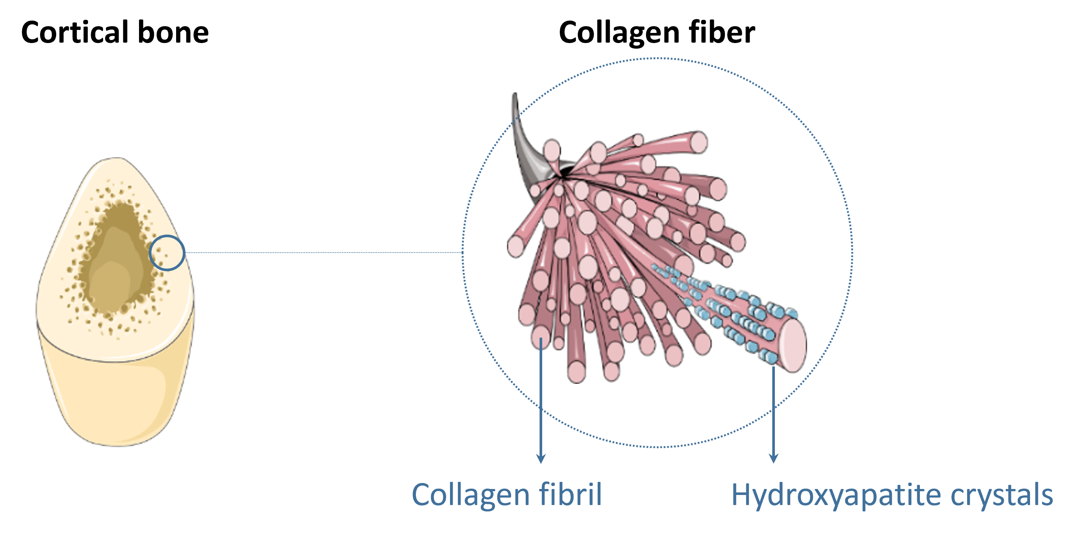
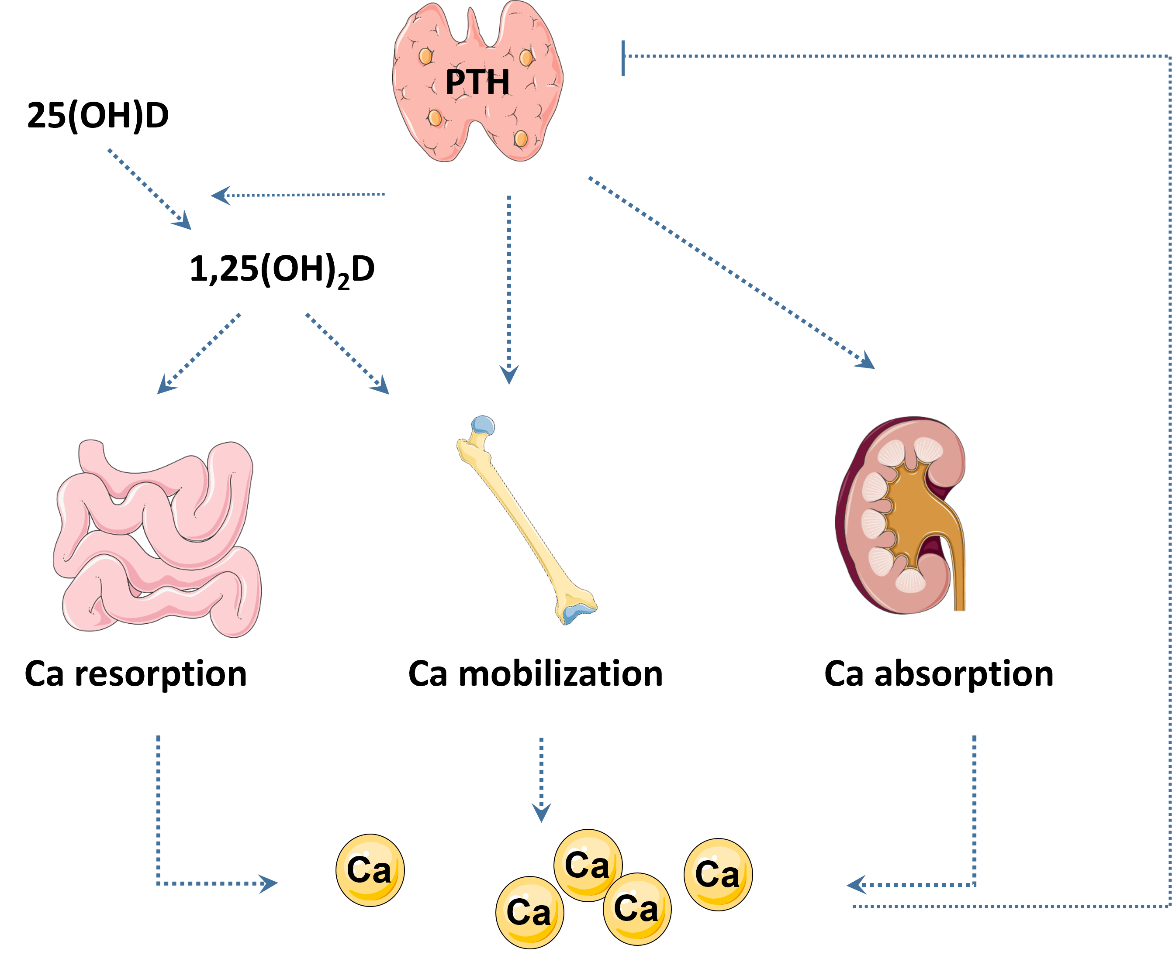
Calcium & vitamin D
Calcium
1200 mg / day
Preferably from diet, supplements if daily intake insufficient
Higher doses in specific populations
Vitamin D
Aim at serum level ≥20 ng/mL (50 nmol/L)
If pharmacological treatment for osteoporosis: always add 800 – 1000 U / day or equivalent
Ca absorption
Ca resorption

Slide 12
Pharmacological treatment
Antiresorptive therapy
  Estrogens (menopausal hormone therapy)
  SERM (raloxifene, bazedoxifene)
  Bisphosphonates
  Denosumab
Anabolic therapy
  Romosozumab
  Teriparatide

Slide 13
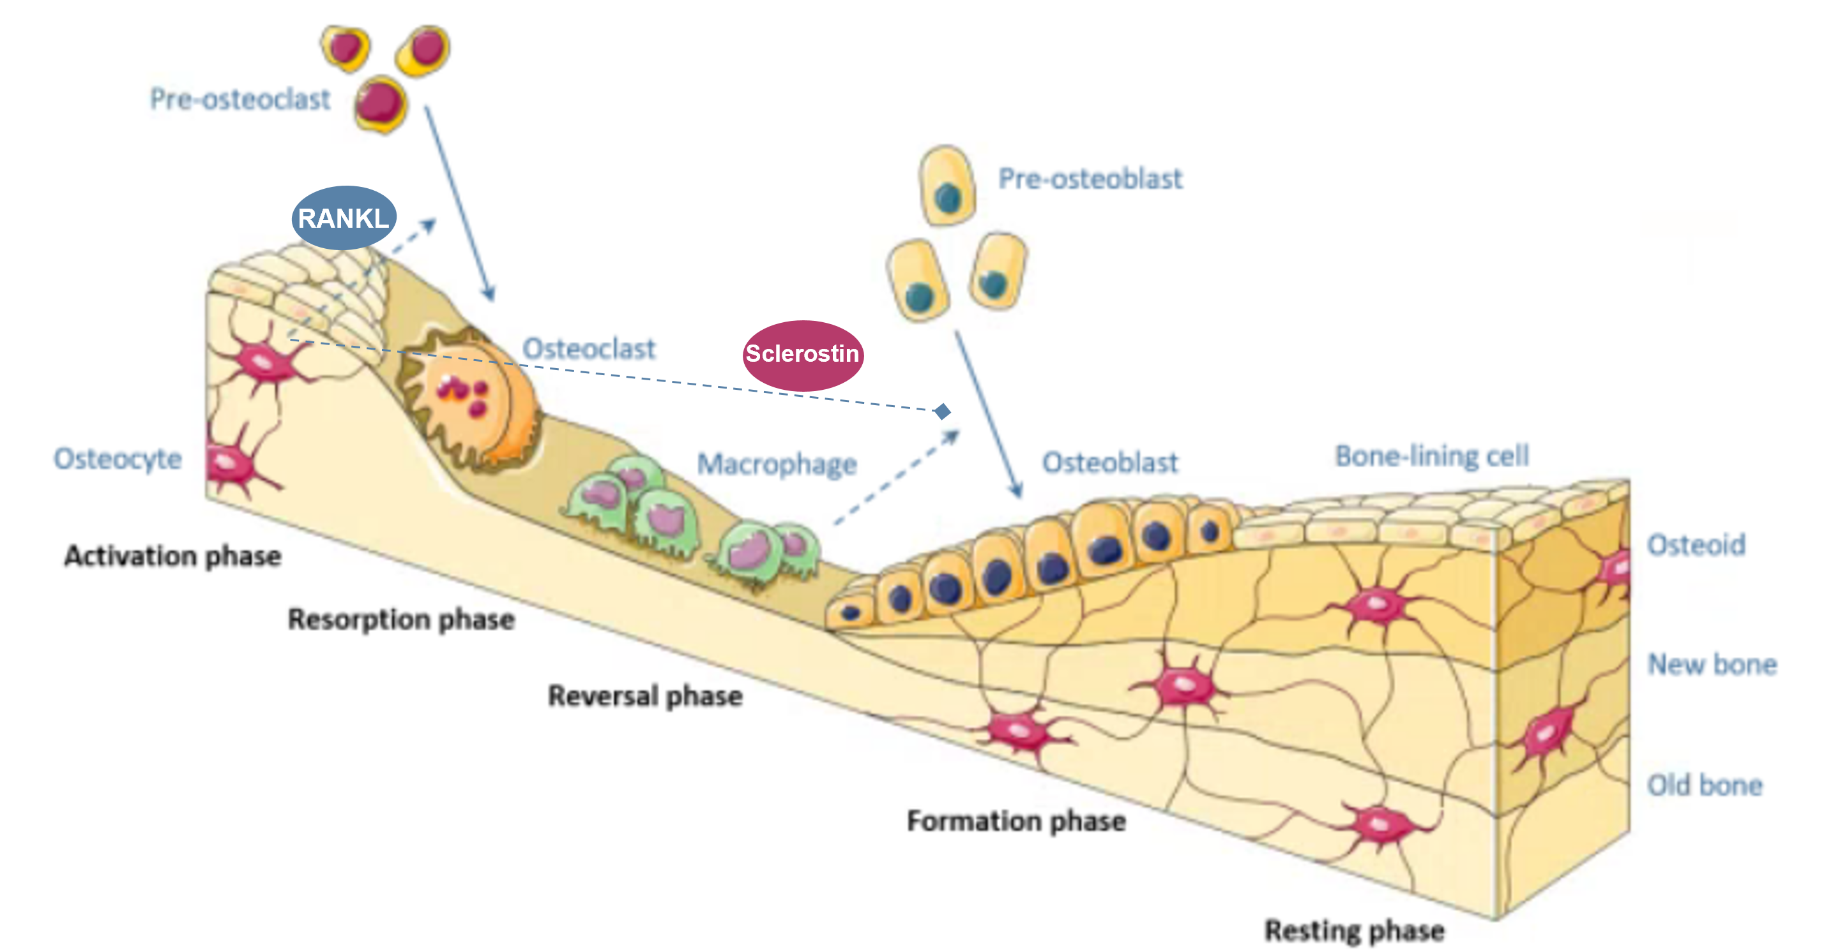
Bone turnover
Notes:
RANKL en sclerostine uitleggen

Slide 14
Pharmacological treatment
DMAB
E2
ROMO
TPD
BP

Slide 15
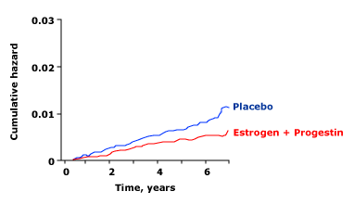
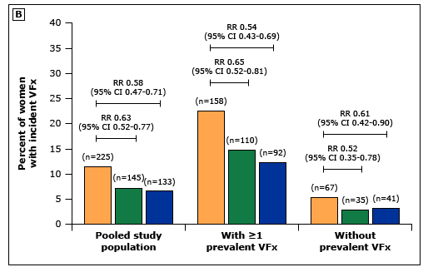
E2 / SERMs
Menopausal hormone therapy / E2
  Prevents bone loss even in low doses
  Reduces fracture risk (WHI: HR 0.66 for hip fx, 0.66 for vertebral fx, 0.77 for other fx)
  Most studies not in specific osteoporosis populations
  No first-line therapy for osteoporosis but may be effective in women taking MHT for menopausal symptoms
SERMs
  Raloxifene / (bazedoxifene)
  Increase bone mineral density (~2% over 2y)
  Reduce vertebral fracture risk (HR 0.63) but not nonvertebral fractures
  May be considered in women ≤ 65y with vertebral osteoporisis and no increased hip fracture risk, or in case of contraindication for other treatment options
Hip fracture risk
Rossouw JE et al. Risks and benefits of estrogen and progestin in healthy postmenopausal women: principal results from the WHI RCT. JAMA 2002;288:321. Figure from UpToDate.
Delmas PD et al. Efficacy of raloxifene on vertebral fracture risk reduction in postmenopausal women with osteoporosis: 4y results from an RCT. JCEM 2002;87:3609. Figure from UpToDate.
Notes:
In postmenopausal women with estrogen-dependent breast cancer, tamoxifen provides some protection against postmenopausal bone loss, presumably due to its partial agonist activity. But more endometrial side effects (bleeding, hyperplasia, cancer) so no first choice if merely for osteoporosis!
In premenopausal women, tamoxifen, like raloxifene, blocks estrogen action on bone and causes a decrease in bone density. Thus, premenopausal women who are taking tamoxifen for the prevention or treatment of breast cancer require monitoring of bone mineral density (BMD).

Slide 16
Bisphosphonates and denosumab
Alendronate PO 70mg 1x/w Zoledronate IV 5mg 1x/y
Risedronate PO 35mg 1x/w Denosumab SC 1x/6m
Ibandronate PO 150mg 1x/m
Increase BMD (6-8% over 2y with ALN, 6-9% over 3y with DMAB )
Reduce fracture risk:
Contraindications:
  Hypocalcemia
  eGFR < 30-35 mL/min for BP
  Esophageal disorders for PO BP
 | ALN | RIS | IBN | ZOL | DMAB
Vertebral fracture | ~50% | ~40% | ~45% | ~70% | ~70%
Non-vertebral fracture | ~20% | ~25% | - | ~30% | ~20%
Hip fracture | ~40% | ~40% | - | ~40% | ~40%
Notes:
NB ZOL also decreases all-cause mortality after hip fracture

Slide 17
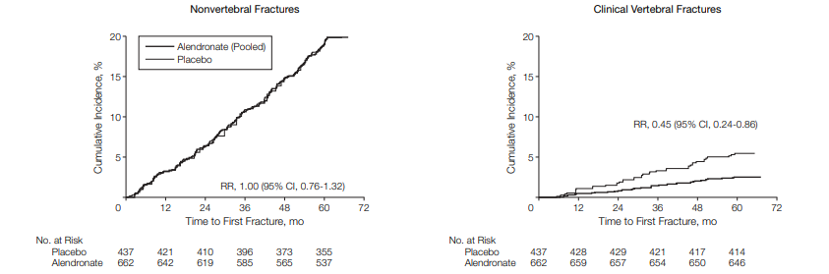
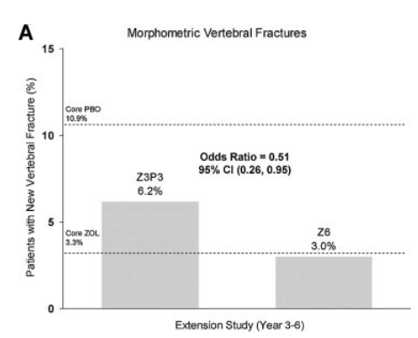
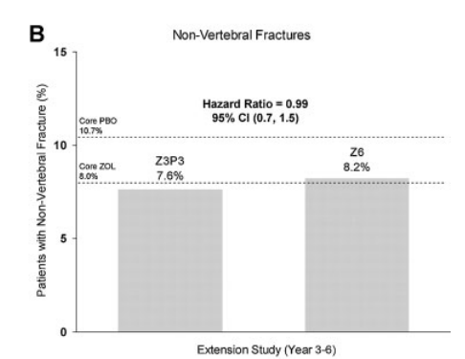
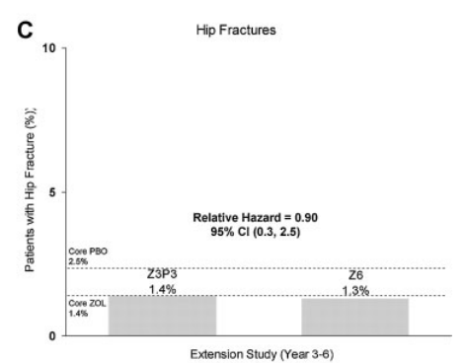
Bisphosphonates and denosumab: specific issues
Sustained effect of alendronate, (risedronate), zoledronate after discontinuation of treatment
ALN
Black et al. Effects of continuing or stopping alendronate after 5 years of treatment: FLEX trial, JAMA 2006;296:2972-2938
ZOL
Black et al. The effect of 3 vs 6 years of zoledronic acid treatment of osteoporosis: Extension of the HORIZON-PFT. JBMR 2012;27:243-245.

Slide 18
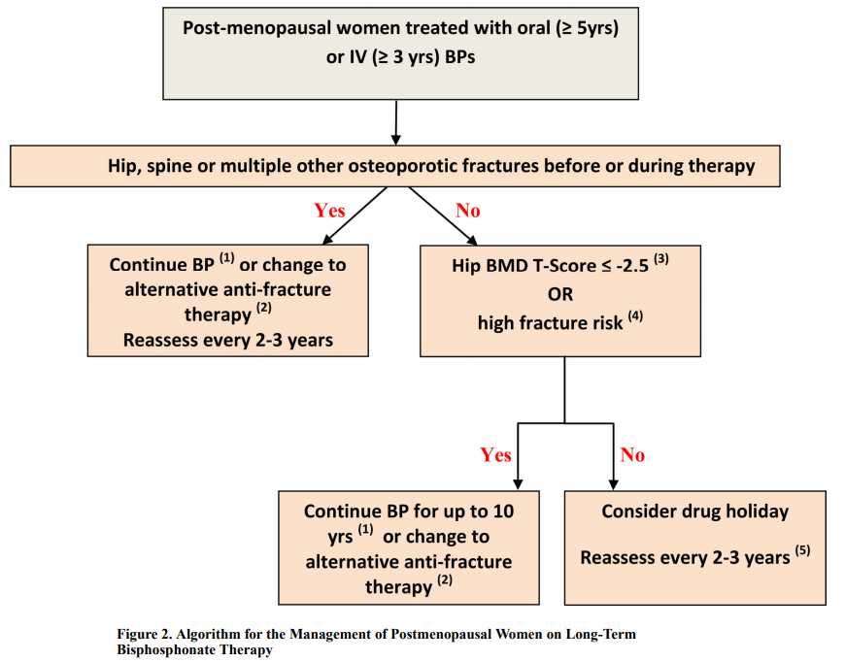
Bisphosphonates and denosumab: specific issues
Consider drug holiday after 5 years of alendronate/risedronate or after 3 years of zoledronate
Adler, JBMR 2016

Slide 19
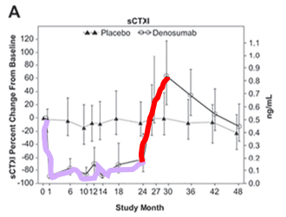
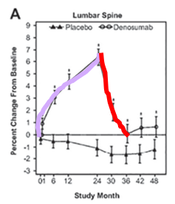
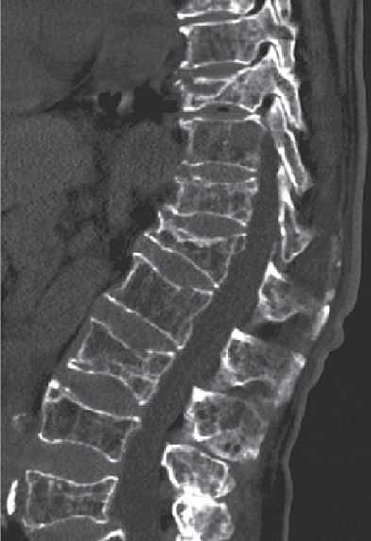
Bisphosphonates and denosumab: specific issues
Rebound increase in vertebral fracture risk upon discontinuation of denosumab
↑ bone turnover
↓ bone mineral density
° of (multiple) vertebral fractures
No drug holiday
No discontinuation without considering change to BP !
Tsourdi et al. 2017
Notes:
Risicofactoren:
Behandelingsduur
Preëxistente wervelfractuur (odds x4)
Geen andere voorafgaande behandeling
Verlies van botdensiteit bij stoppen
Studies dmab gaan tot 10 jaar

Slide 20
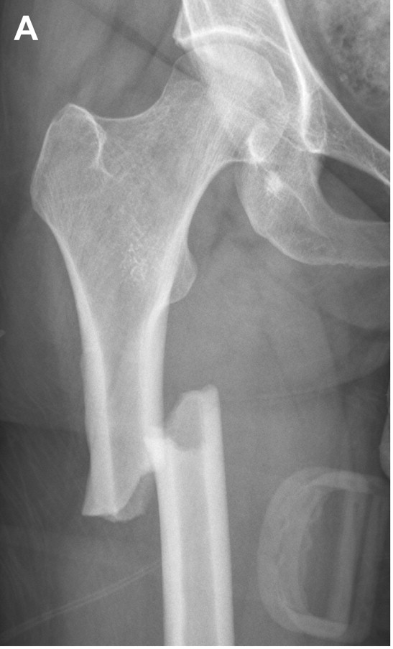
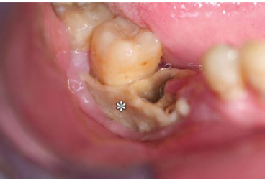
Bisphosphonates and denosumab: specific issues
Atypical femoral fractures
Osteonecrosis of the jaw
1,8/100.000 py after 2y
113/100.000 py after 8-10y
5 years of treatment in 100.000 pt:
2590 fragility fractures prevented, 16 AFF
1-10/100.000 py in osteoporosis
Comparable to general population
Notes:
Risicofactoren: cumulatieve dosis / langdurig gebruik, glucocorticoiden, chemotherapie, leeftijd, mondhygiëne en roken voor ONJ

Slide 21
Anabolic therapy
Romosozumab SC 1x/m Teriparatide SC 1x/d
Strongly increase BMD (~15% over 1y)
Reduce fracture risk:
Contraindications:
  History of AMI or stroke for romosozumab
  Hypercalcemia, prior EBRT involving the skeleton, history of skeletal malignancy for teriparatide
 | ALN | ZOL | DMAB | ROMO | TPD
Vertebral fracture | ~50% | ~70% | ~70% | ~75% | ~75%
Non-vertebral fracture | ~20% | ~30% | ~20% | ~25% | ~50%
Hip fracture | ~40% | ~40% | ~40% | ~50% | ~55%?
Adapted from Cosman et al. 2016,
Saag et al. N Engl J Med 2017.
Notes:
Relatieve fractuurrisico reductie vs. alendronaat (24 maanden):
48% voor wervelfracturen
19% voor niet-wervelfracturen
38% voor heupfractuur

Slide 22
Anabolic therapy: specific issues
Reimbursement
  Romo: first line if recent MOF (pelvis, hip, femur, humerus, (wrist) < 24 months)
  TPD: second line if vertebral fractures of which at least one after 12m BP treatment
  Romo: 1 year
  TPD: 18 months (2x9)
  Always consolidate treatment effect with antiresorptive therapy!
  Response to romosozumab affected by previous therapy
  No TPD immediately after dmab
  Ideal regimen when switching from dmab to romosozumab?
Treatment duration
Post-treatment
Treatment sequence

Slide 23
Choice of treatment
Antiresorptive therapy
Anabolic therapie

Slide 24
Treatment adherence
Problems:
Often asymptomatic disease
Never 100% of fracture risk reduction
Side effects of therapy and practical issues
Solutions:
Education
Patient-centered approach
Regular follow-up

Slide 25
Take home messages
Osteoporosis is more than just BMD
Pay attention to fracture history
Don’t forget non-pharmacological measures
Bisphosphonate: re-evaluate treatment indication after 3 – 5 years
Never stop denosumab without a plan
In patients with very high fracture risk, first line = anabolic therapy

Slide 26

Questions?
charlotte.verroken@uzgent.be

