Slide 1




Cardiovascular Risk & Menopause
Menopause Care : A comprehensive 2 day workshop
22.03.2025
Bharati Shivalkar MD, PhD, FESC, Clin. Pharm/Pharm. Med

Slide 2
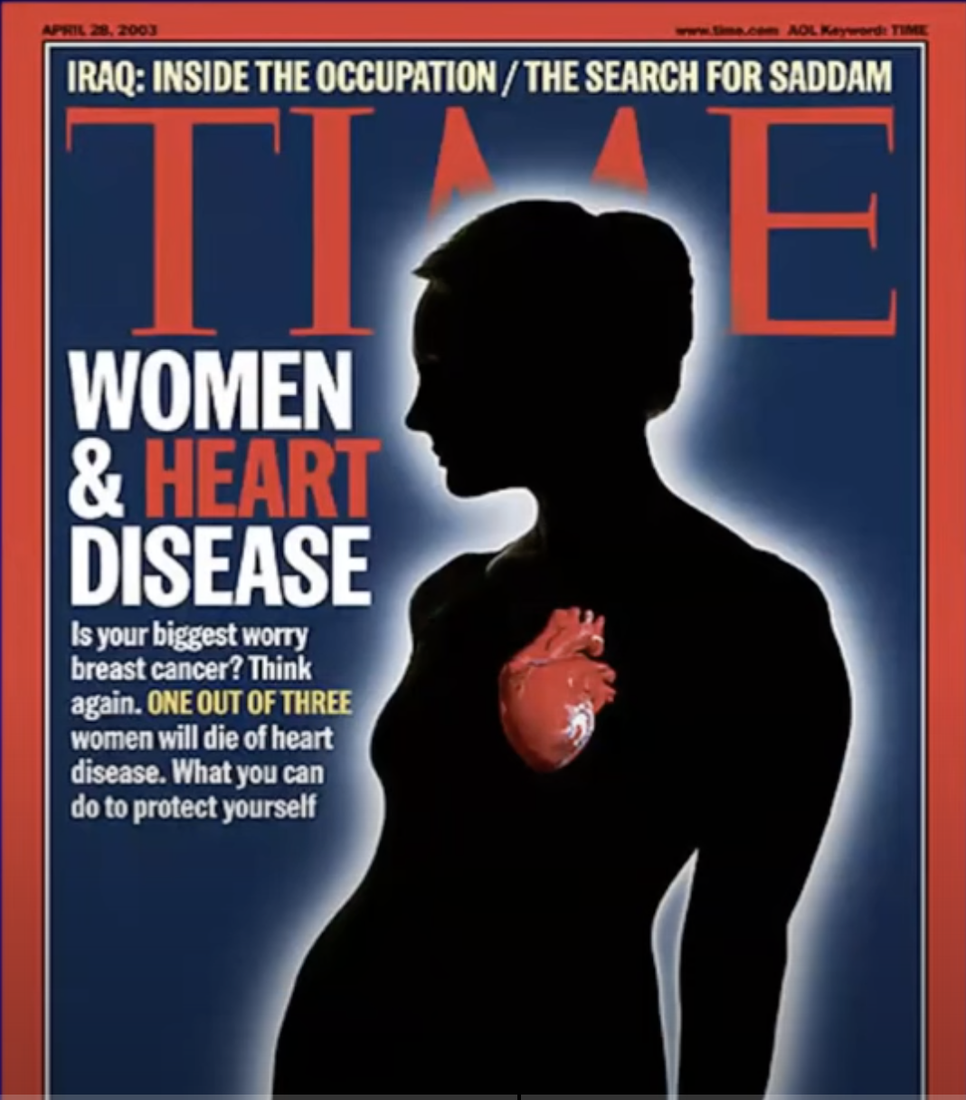

Slide 3
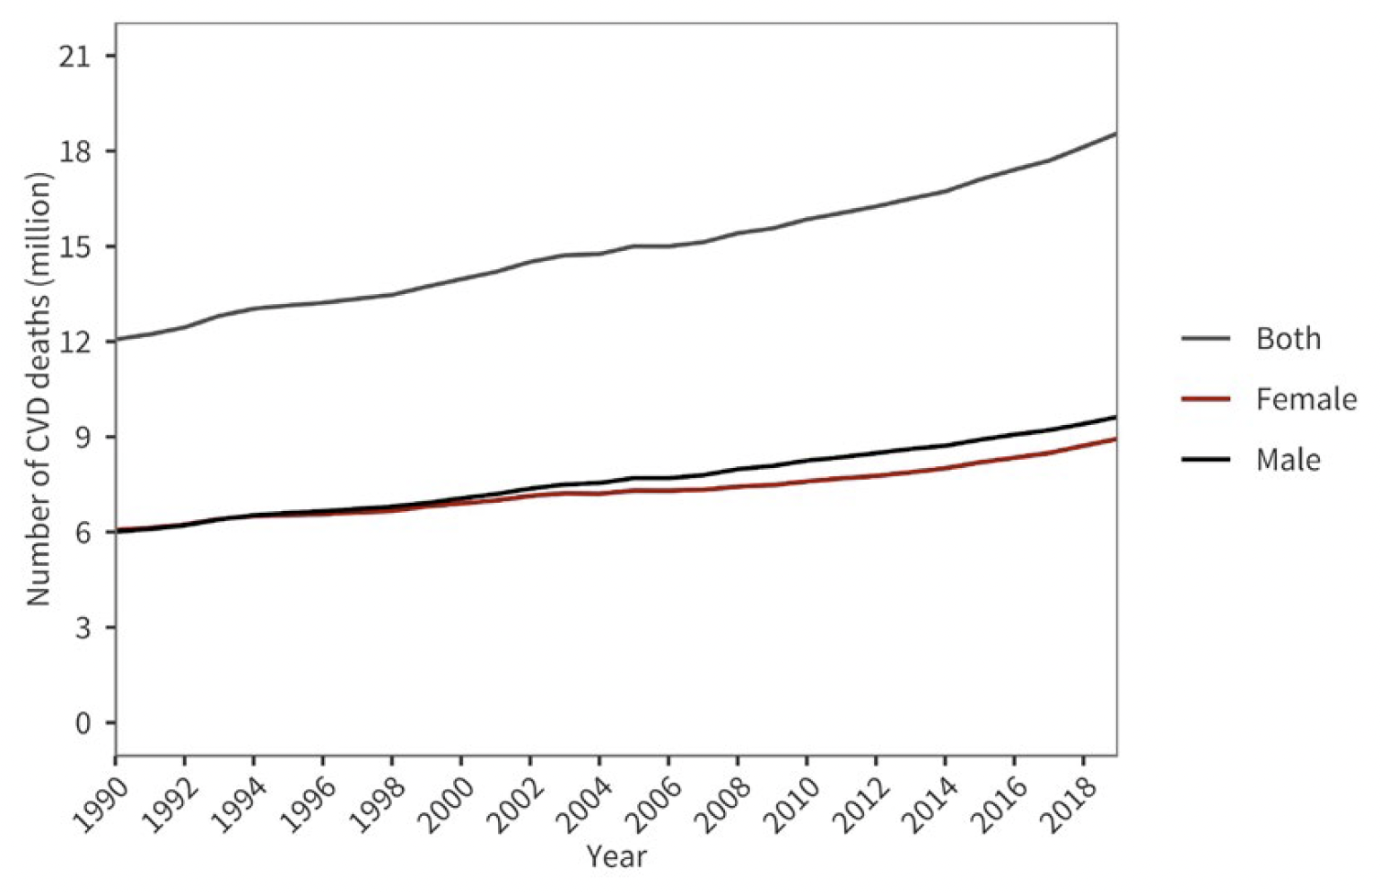
Global trends in deaths due to CVD
18.6 m
=> 1.6 x Belgian population
World heart report 2023. Confronting the world’s nr. one killer

Slide 4
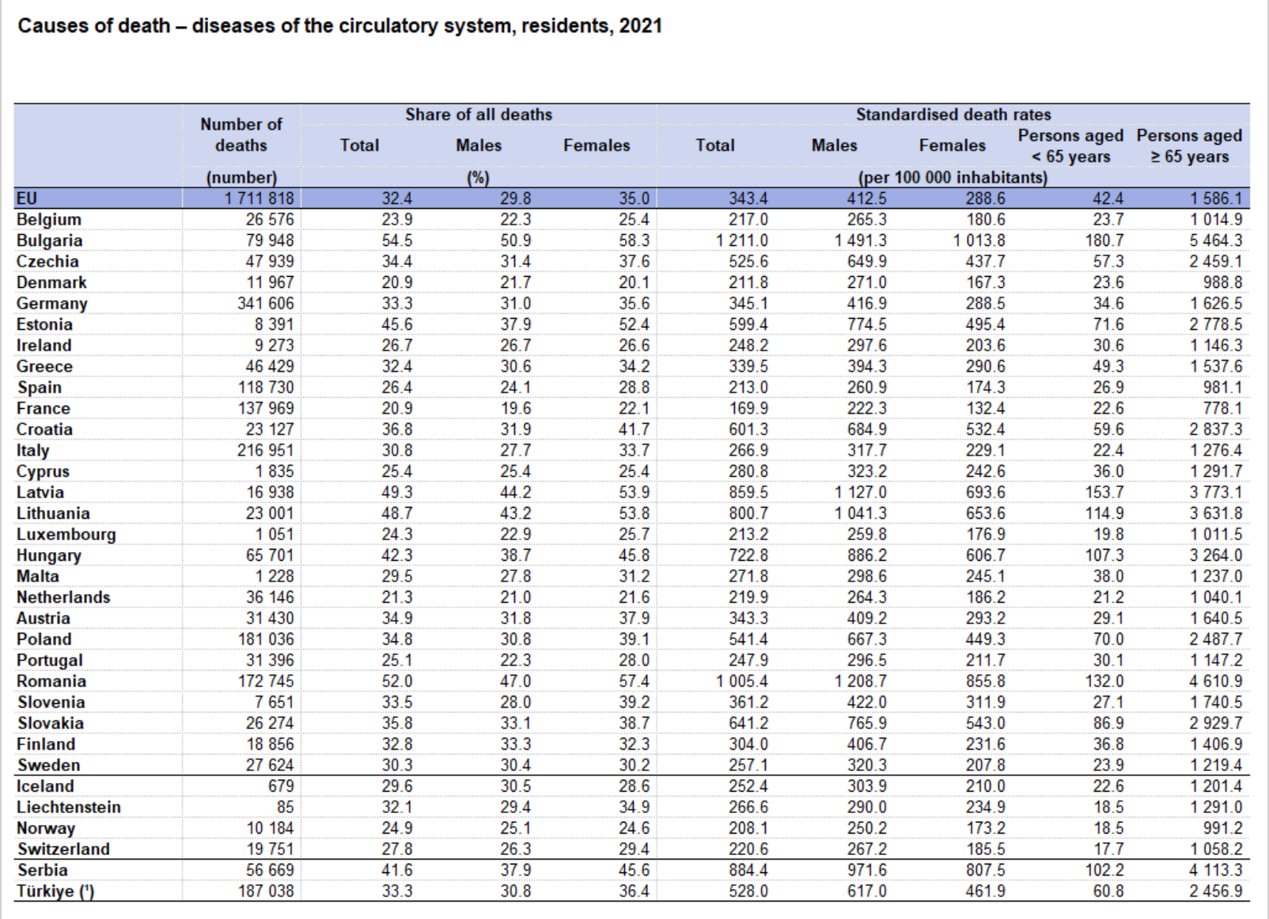
EU Cardiovascular Diseases Statistics
Eurostat July 2024

Slide 5
Women’s health gap⬄ women living in
poor health for 25% more of their lives than men
Conditions that affect life span:
* Ischemic heart disease (> 4 M deaths annually)
* Cervical cancer (350,000 deaths)
* Breast cancer (670,000 deaths)
* Maternal hypertensive disorder (70,000 deaths)
* Postpartum hemorrhage (70,000 deaths)
Conditions that affect health span:
* Menopause (450 M at any point in time; PMN /MN can last up to a decade)
* Premenstrual syndrome (1.8 BN menstruating women every month, 20 – 40% experience PMS)
* Migraine (21% of women)
* Endometriosis (1 in 10 women)
Mckinsey, January 2025. Closing women’s health gap

Slide 6
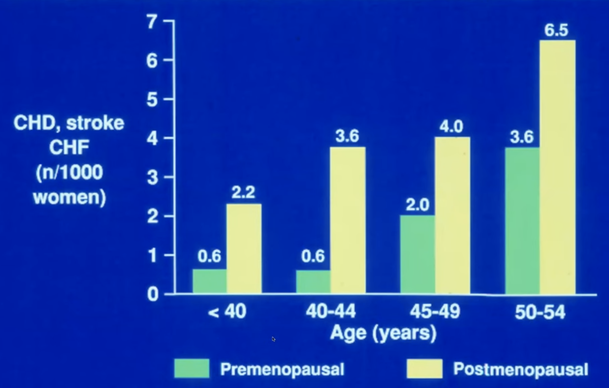
Menopause confers a higher CV risk at every age
Framingham Study : 18 y follow-up (Dhew, 1974, NIH 74-599
Notes:
Doubling risk in women older than 45y, is almost 4 – 6 x higher in younger women.

Slide 7
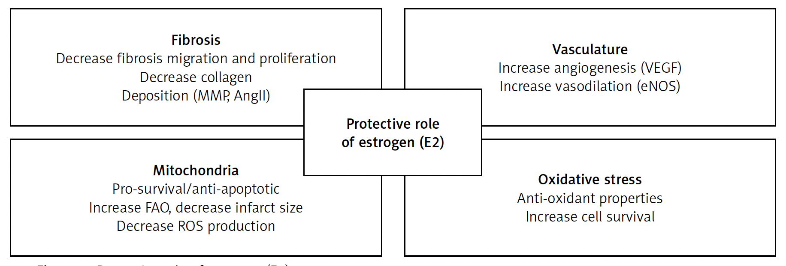
Protective role of estrogen (E2)
Arch Med Sci 2023; 19 (2): 458–466
Notes:
Figure 1
2023 ARS Menopause and women’s cardiovascular health: is it really an obvious relationship?

Slide 8
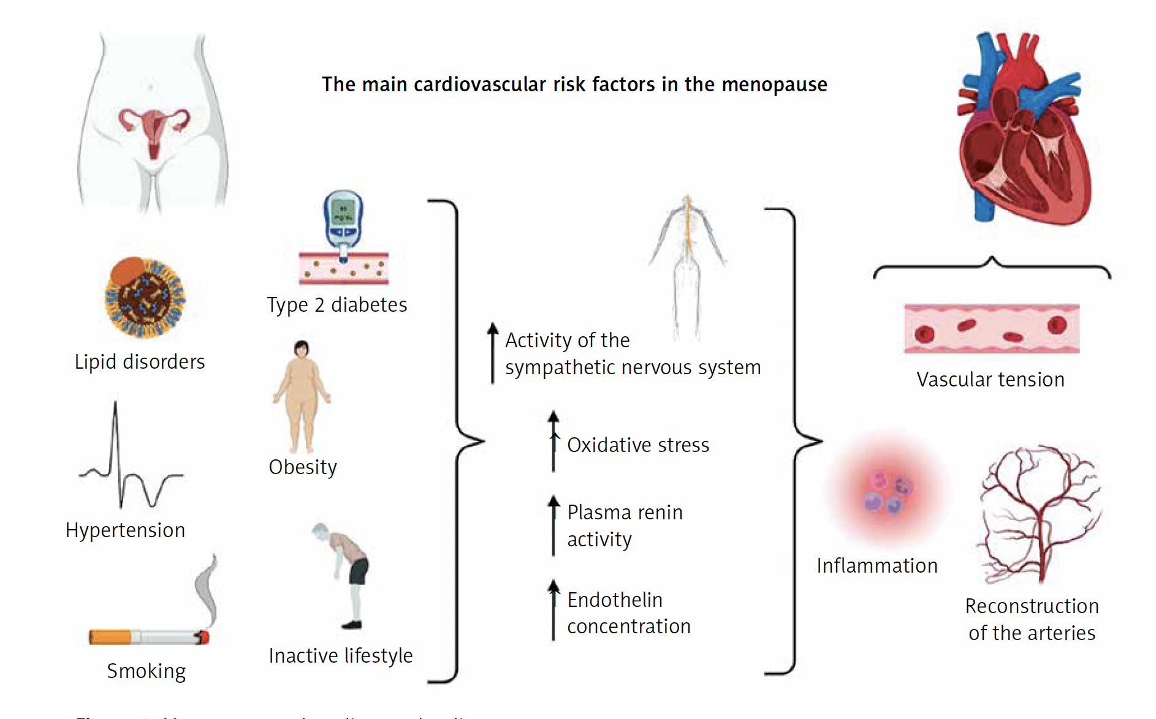
Menopause and Cardiovascular Disease
Ryczkowska et al. Arch Med Sci 2023; 19 (2): 458–466
Notes:
Figure 2. Menopause and cardiovascular disease
Ref 2. 2023 ARS

Slide 9
Early MN => increased CV Risk Factors
Oestrogen drop ⬄ ↑endothelin, angiotensinogen
Parameter | Women with surgical MN age < 40y | Women with natural MN age 40 – 45 y | Women with MN age ≥ 45y | MN hormone therapy (MHT)
Hypertension | ↑↑↑ | ↑↑ | ↑ | ↓
CAD | ↑↑ | ↑ | ↑ | ↓
HF | ↑↑ | ↑ | ↑ | ↓
Lipid disorders | ↑↑ | ↑ | ↑ | ↓
DM-II | ↑↑ | ↑ | ↑ | ↓
Obesity | ↑ | ↑ | ↑ | ↓
Ryczkowska et al. Arch Med Sci 2023; 19 (2): 458–466

Slide 10
Traditional RFs have a greater
impact in women
Risk of death from CAD
RF | Men | Women
Smoking + hypertension
DM
Total chol. + LDL
HDL < 50mg/dL
Peri/post-menopausal women =
Oestrogen
Physical functioning
Sarcopenia, Osteoporosis
The WISE Investigators

Slide 11
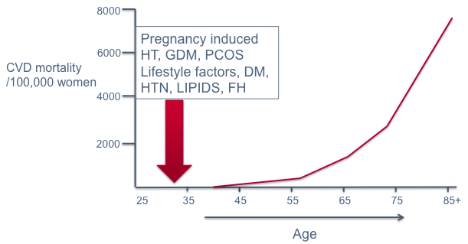
Cumulative causes of increased CV mortality in women during different “life phases”
menopause
Peri-menopause
CMAJ 2017

Slide 12
Cardiovascular Risk in Menopause:
How to assess it and eventually refer
your patient to the cardiologist

Slide 13
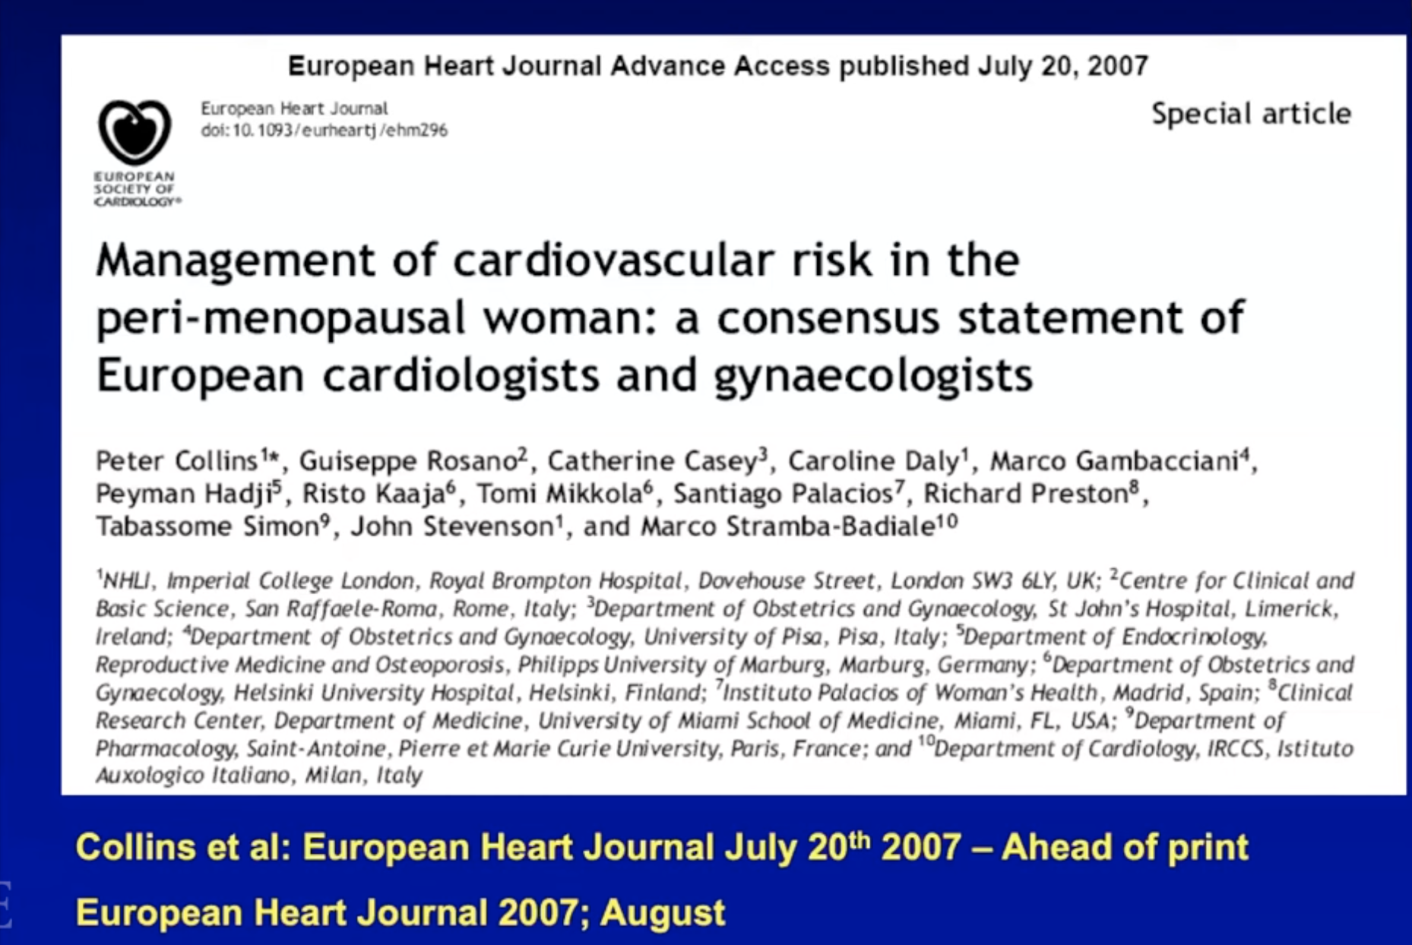

Slide 14
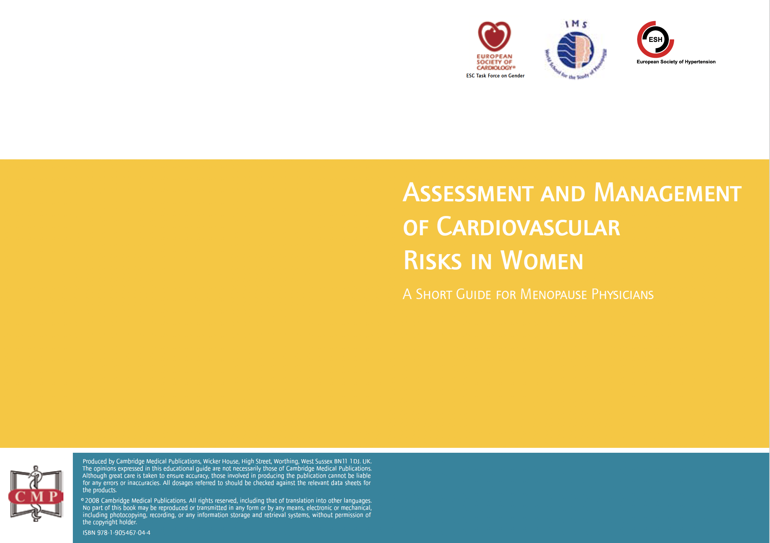

Slide 15
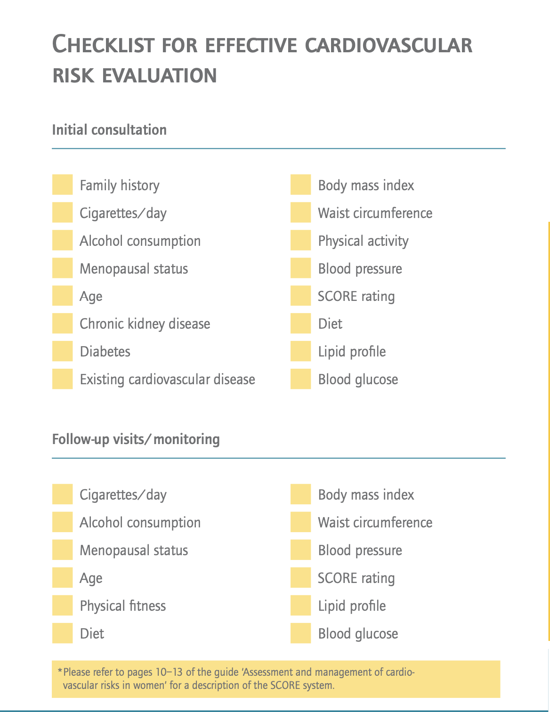
MN symptoms are classic but there is no classic MN patient
Collins et al. Eur Heart J.2007

Slide 16
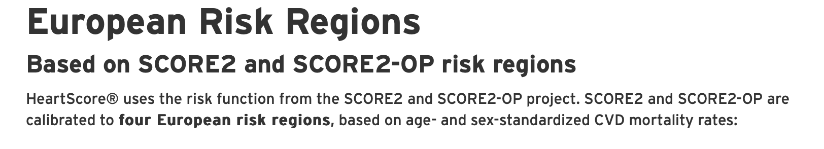
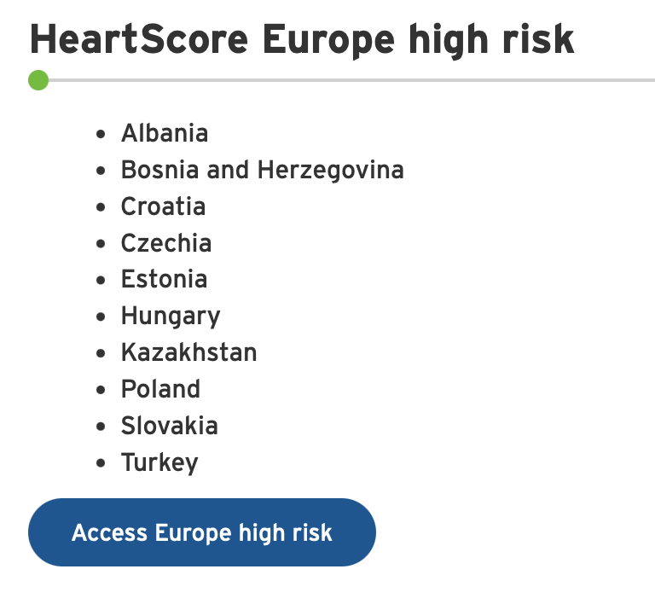
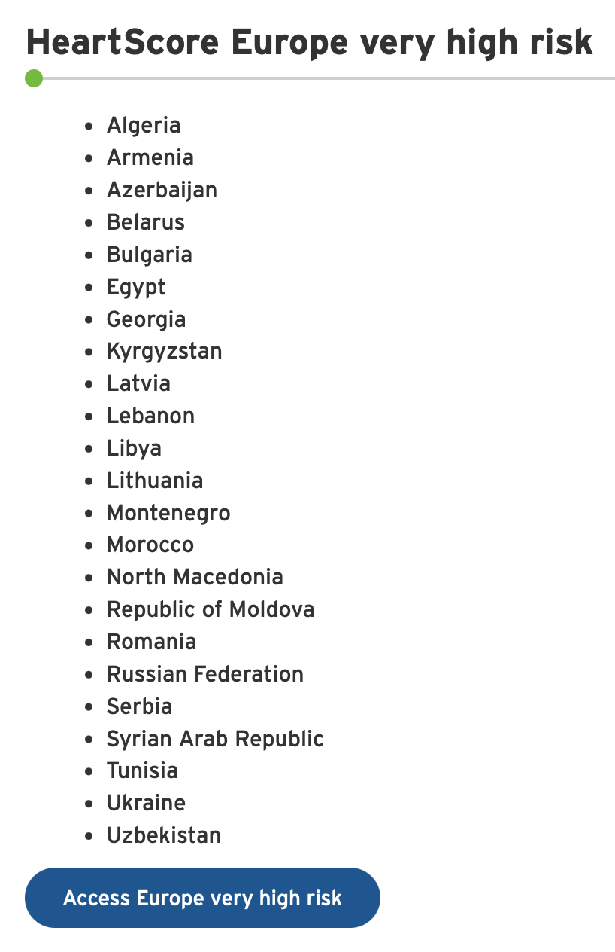
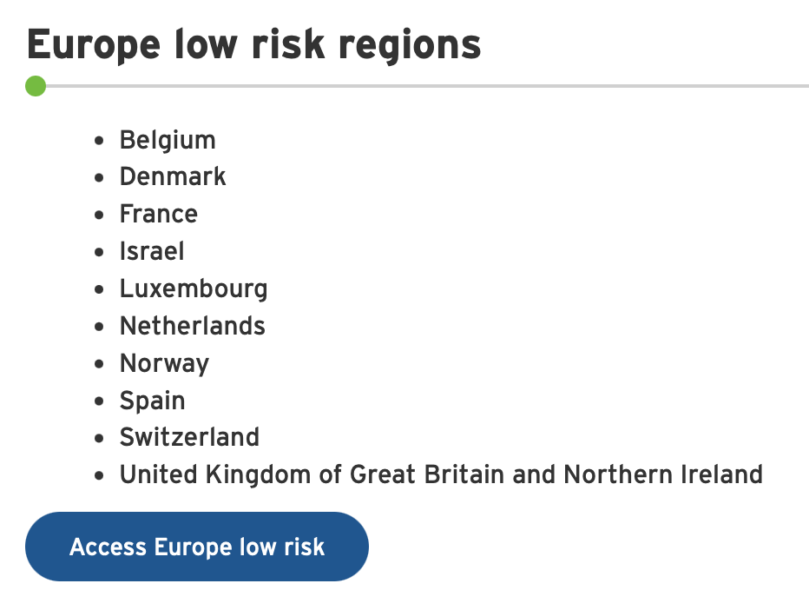
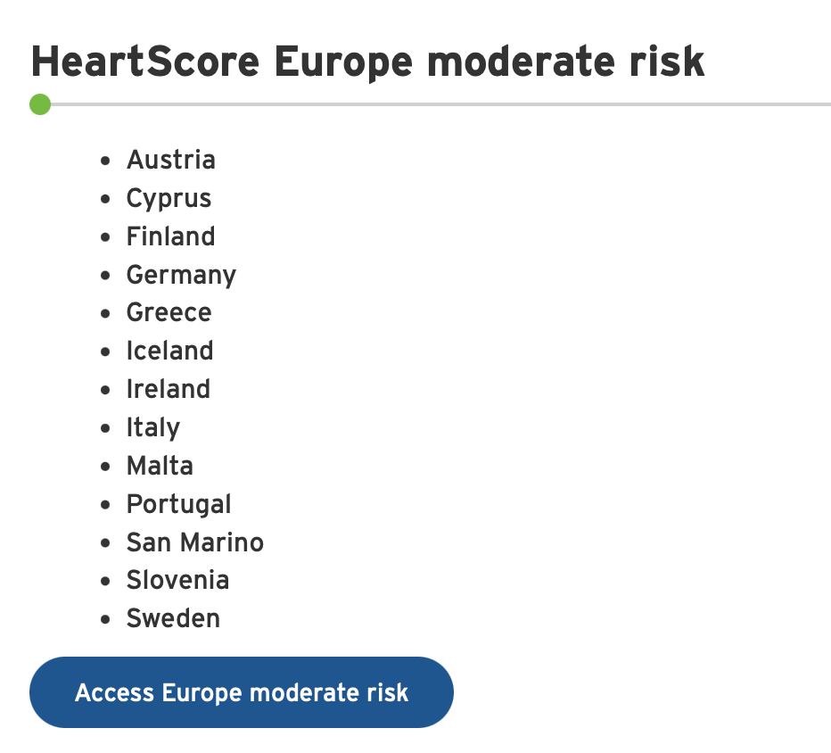

Slide 17
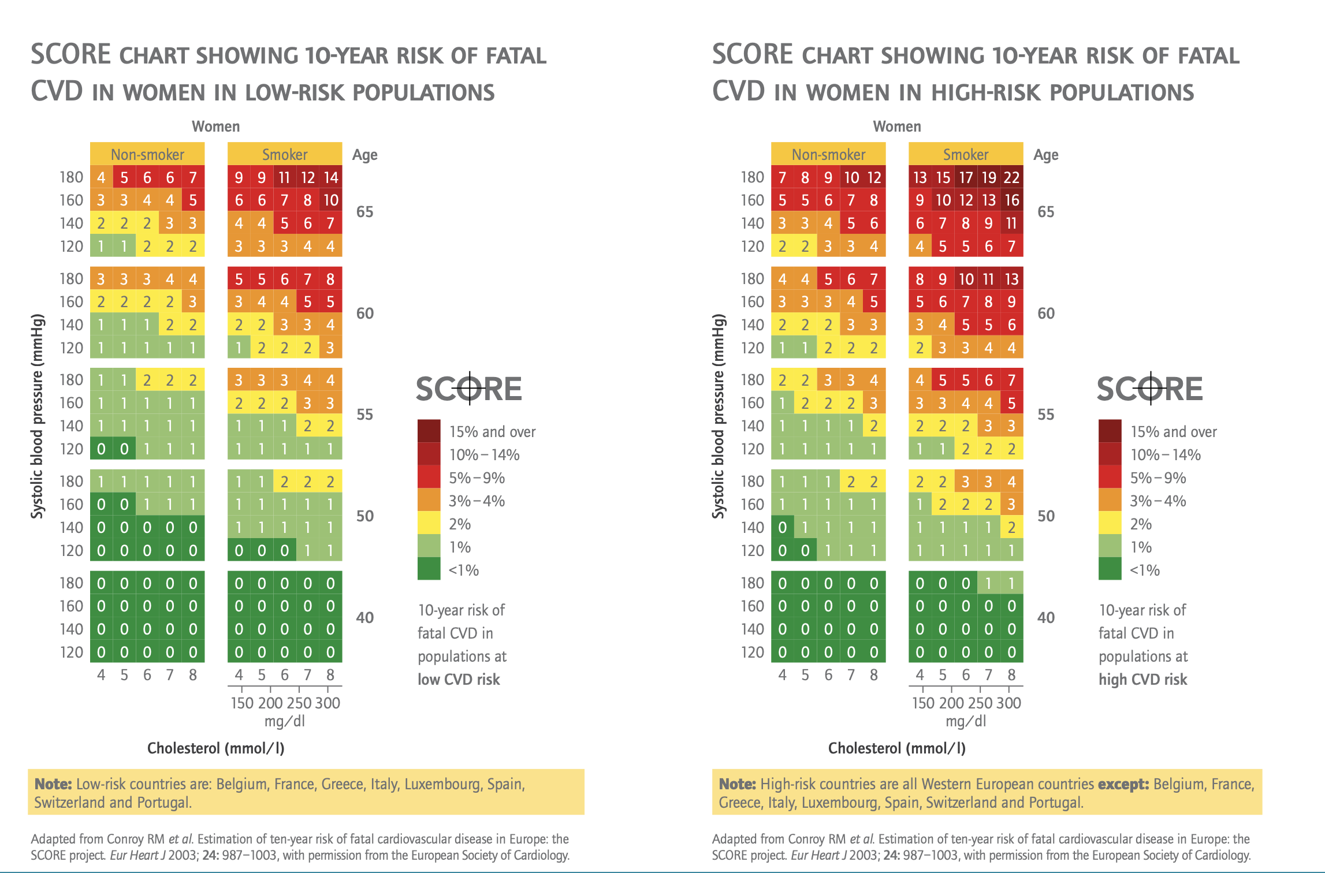
Notes:
Age, gender, SBP, smoking status, cholesterol level, high and low risk countries

Slide 18
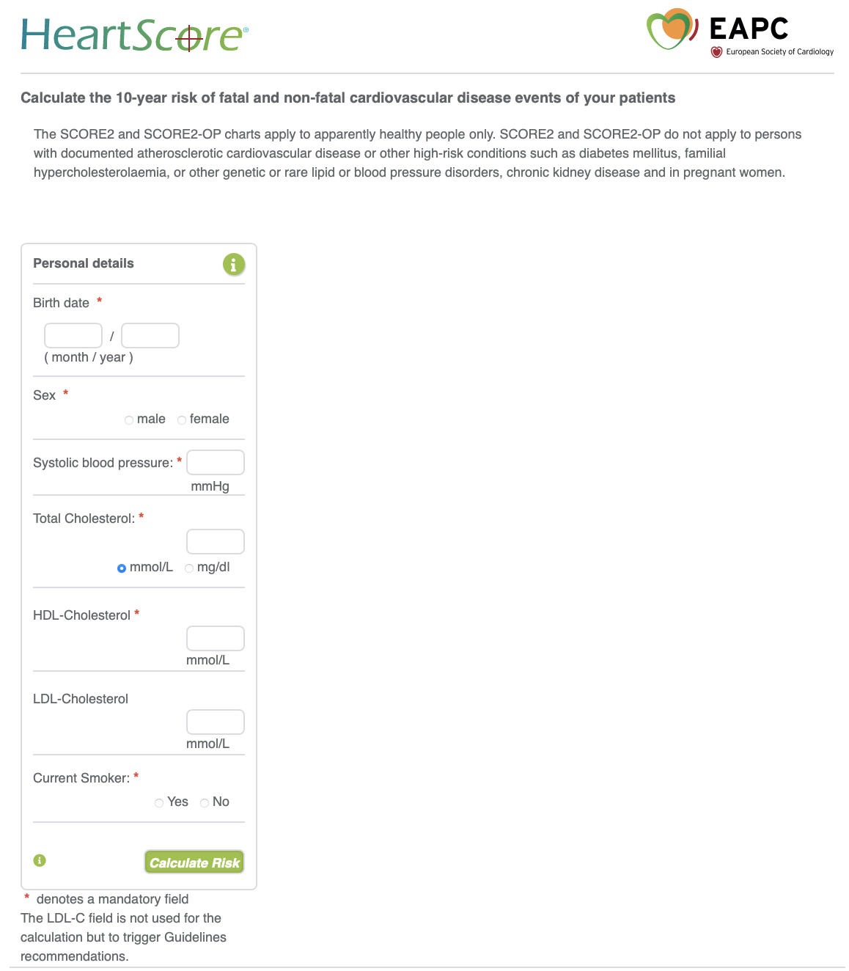

Slide 19
KH, M : 42 y; Ghana; homemaker; GP referral
Medical History:
Menarch 11y, dysmenorrhoea
Migraine in early years
G5P2A3 : PE during full term term pregnancies, children 15y, 17y
AHT, hypothyroidism
Family History:
Father : sudden + at 45y
Mother: 64y, presumably PE; DM-II, PVD
2 Sisters : PE, AHT
R/
Amlor 5 mg
L-Thyroxine 100 mcg
Seroxat
No smoking, alcohol sporadically
Presenting complaints:
Palpitations, 2 x syncope
Regular chest pain without exertion; no sports due to fear of pain
Night sweats, poor sleep, fatigue ++
Irregular menstruation since several months; oedema, fluid retention
Home BP 120-130/80 mmHg
Irritable, depressed
Notes:
Sleep apnea increases on post menopausal women,

Slide 20
Clinical exam:
164 cm; 85 kg, BMI 31.6; centripetal obesity
BP 134/80 mmHg, systolic murmur, mild pedal oedema
ECG: sinus rhythm 90/min, normal repol., isolated ventricular extrasystole
Cardiac Ultrasound:
Borderline LVH, non-dilated, normal function LVEF 62%; DF Grade I
Mild mitral valve prolapse with MR grade 2/4 ; MAD (8 mm)
Bicycle test:
Submaximal test, reduced exercise capacity, ST-T abnormality inferolateral
Sporadic monomorph VESSEN, chest pain; Max. BP 210/116 mmHg
24 h Holter monitoring:
Regular episodes of sinus tachycardia. No arrhythmias, no pauses;
384 VESSEN, 220 SVES
Labs:
TC 240 (<200); TG 264 (< 200); HDL 75 (> 65); LDL 168 (< 100); Glucose 82 (< 100)
Vit D 21 ng/ml (> 30); CRP 6,5 (<5); Fibrinogen 446 (200 - 393) mg/dL; TSH,T4 : nl
Notes:
MAD is associated with sudden death. Given the sudden death of father at early age, and her own 2 syncopes

Slide 21
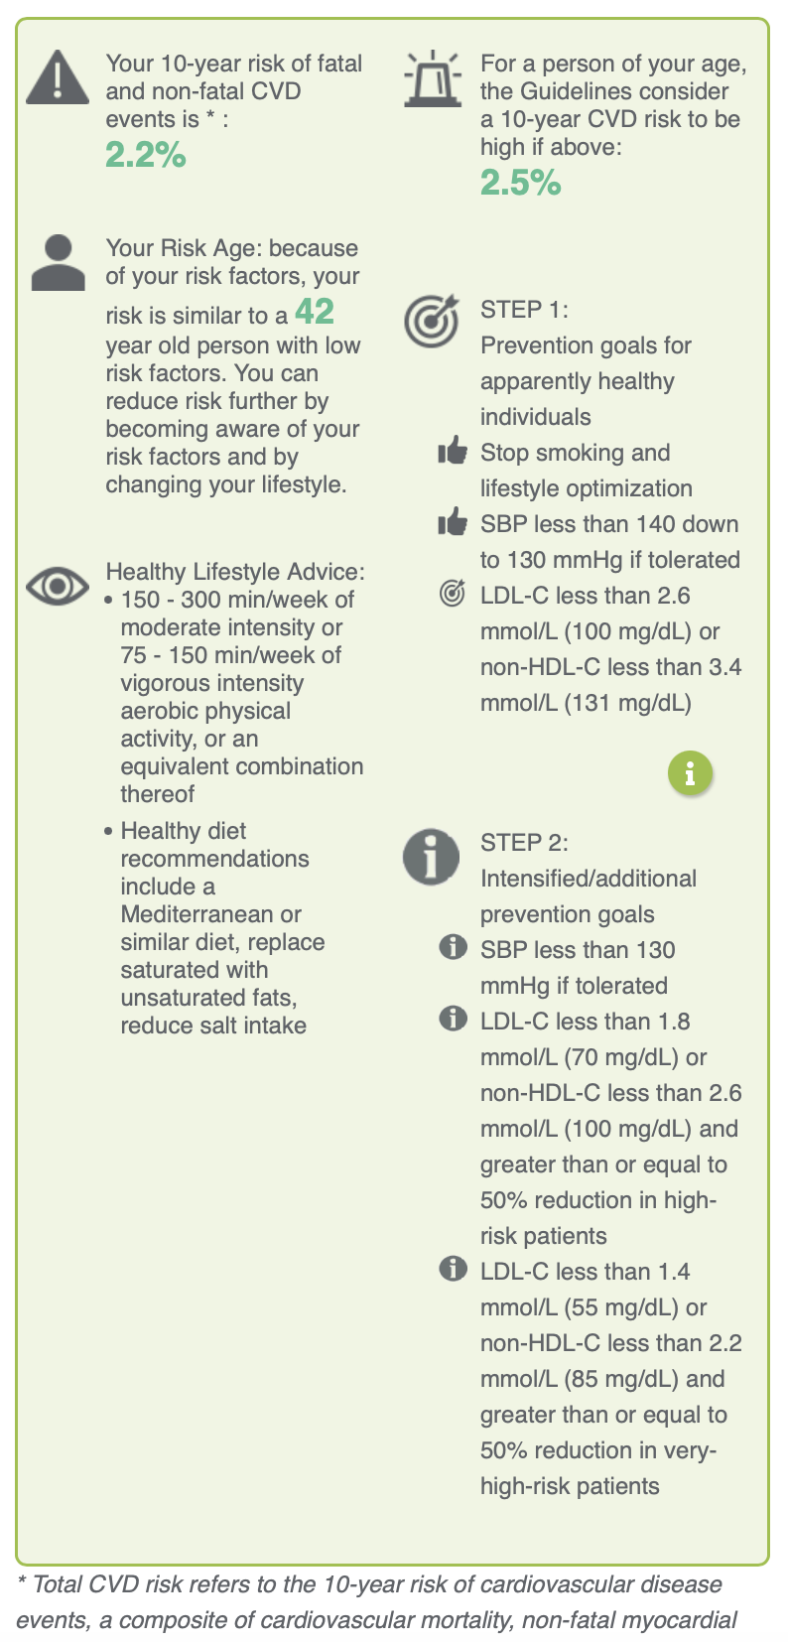
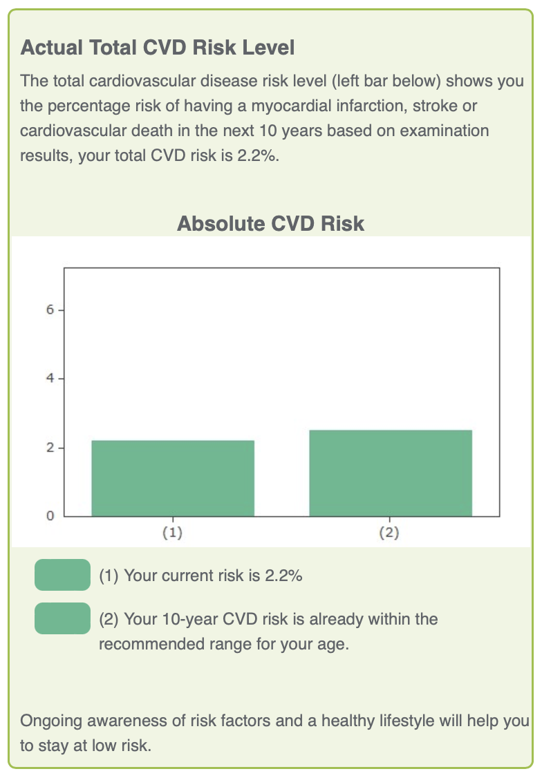
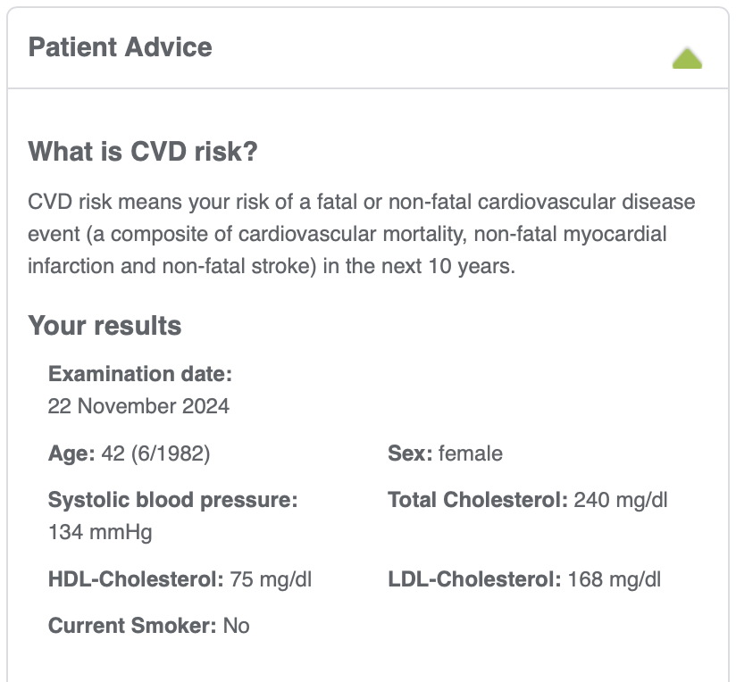
KH, M
HeartSCORE Europe
Very high risk
SCORE 2 CVD risk calculator

Slide 22
Risk modifiers such as psychosocial stressors or individual ethnic background and if available, coronary artery calcium score or plaque characteristics on carotid ultrasound should be considered for further finetuning.

Slide 23
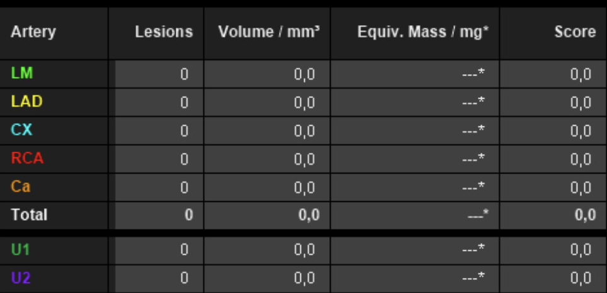
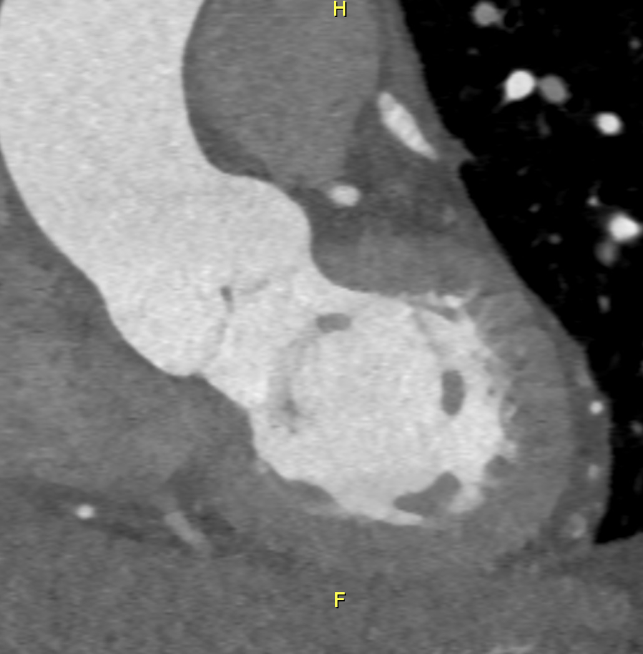
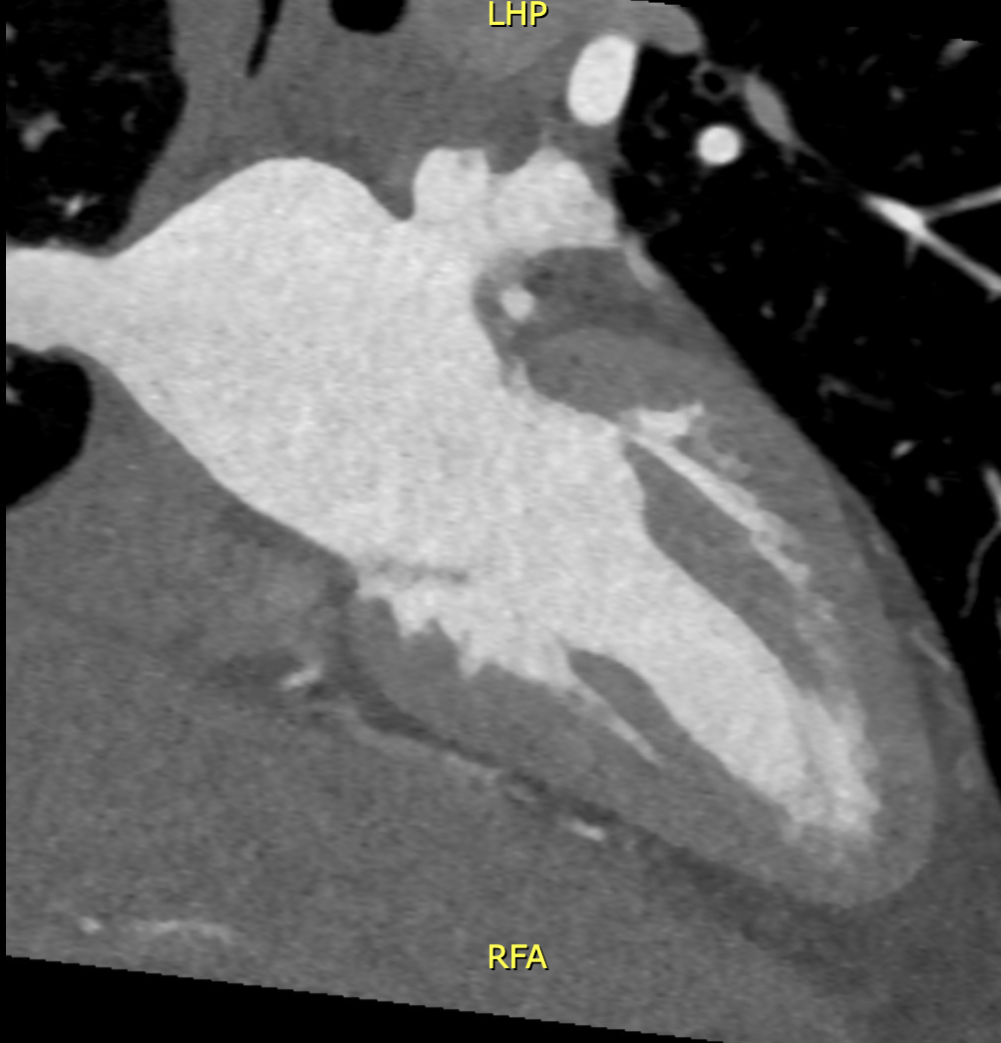
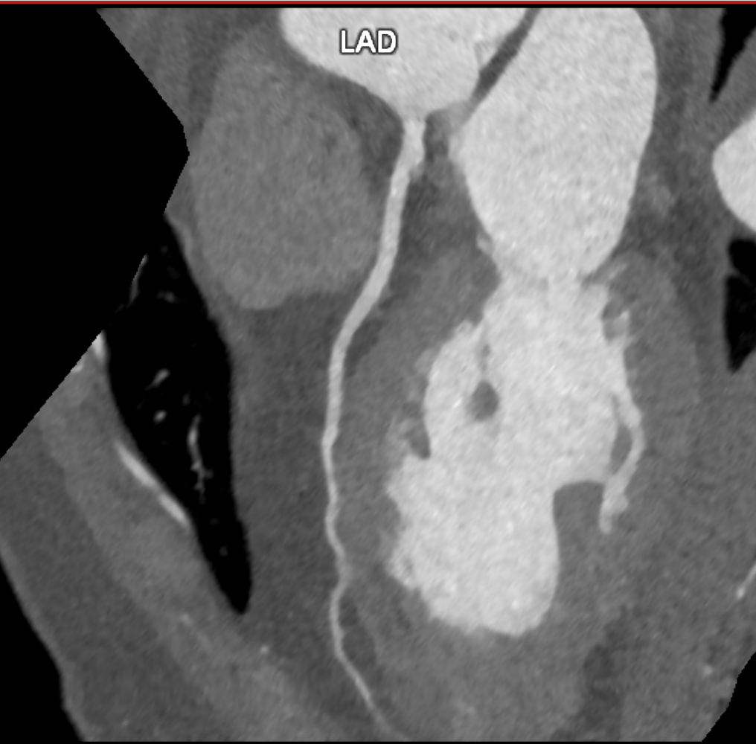
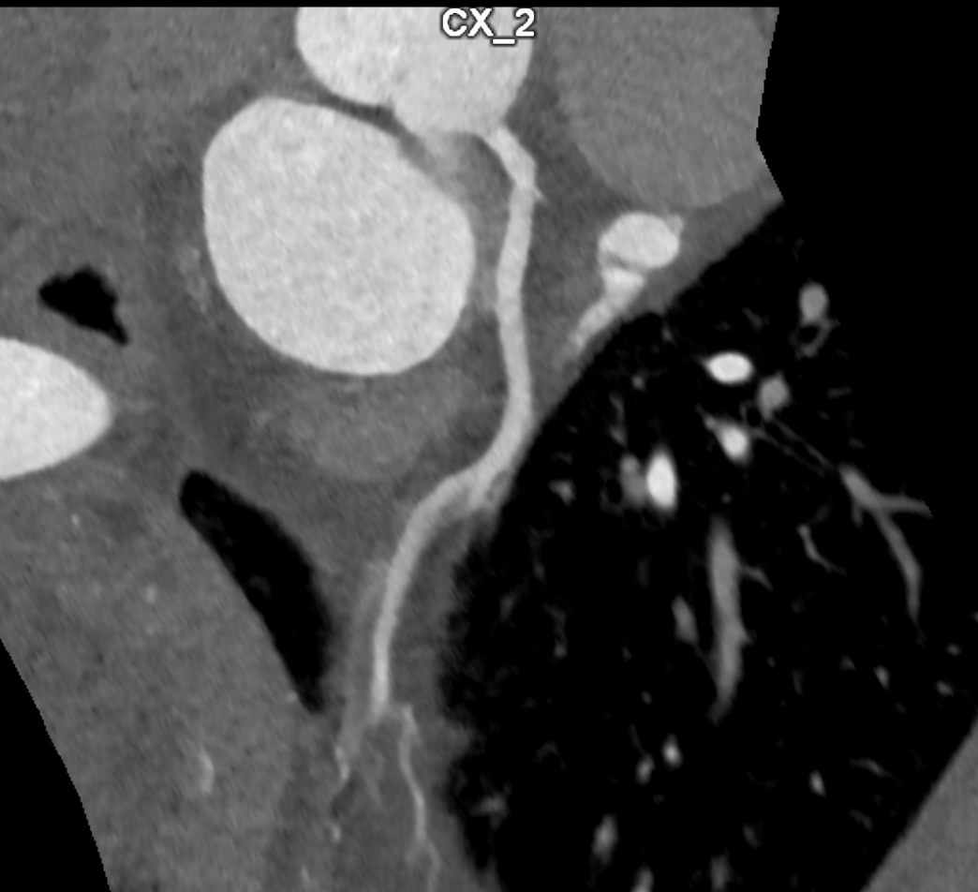
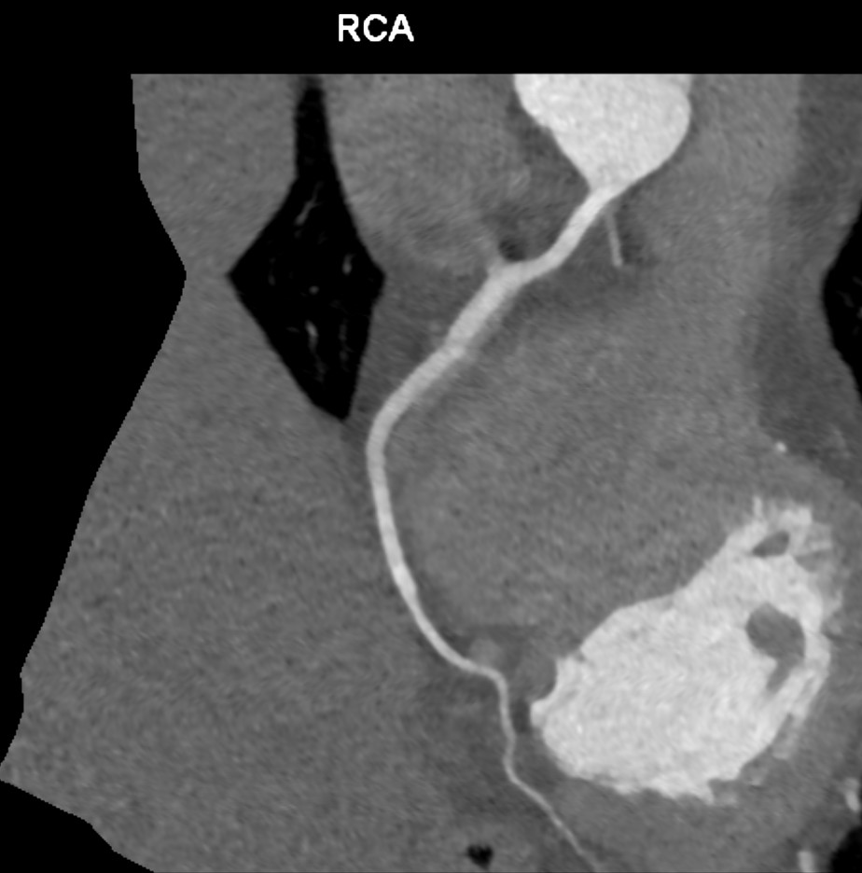
Coronary CTA
KH, M

Slide 24
Advice :
Replace Amlodipine by beta-blocker, Nebivolol*
Maintainence muscle mass, bone health, brain health, treat VM symptoms
Lifestyle : drop weight (15 kg), diet advice (dietician), exercise, relaxation therapy
Vit D supplementation
Follow-up for : BP (24 hr BP monitoring given hypertensive response
during stress test); initiation of lipid lowering treatment after weightloss;
FU given MAD and history of sudden death in the family
=> HRT : referral to Gynaecologist, R/Velbienne
=> FU after 3 months, doing much better with HRT, lost 4 kgs
* stimulates NO, does not affect insulin sensitivity/lipid metabolism, reduces intensity of anxiety sympotms
Notes:
Nebivolol: Nebivolol does not affect insulin sensitivity or lipid metabolism compared with traditional beta-blockers; reduces the intensity of your anxiety symptoms, stimulates the release of nitric oxide, which dilates blood vessels, relaxing them naturally.
“Hormone therapy may be generally safe in women with a coronary artery calcium score of 0 if indicated,” Michos said during the presentation. “On the other hand, I tend to recommend avoiding hormone therapy, particularly systemic hormone therapy, in women with significantly elevated calcium scores of 100 or 300 because they have higher event rates and I consider them more like a secondary prevention population. A CAC score is a very good prognostic marker of risk because it integrates a lifetime of risk exposure of both traditional risk factors and novel and unmeasured risk factors because you’re measuring the atherosclerosis burden itself.”

Slide 25
Risk Assessment at Menopause
Parameter | Women with surgical MN age < 40y | Women with natural MN age 40-45 y | Women with MN age ≥ 45y | MN hormone therapy (MHT)
Hypertension | ↑↑↑ | ↑↑ | ↑ | ↓
CAD | ↑↑ | ↑ | ↑ | ↓
HF | ↑↑ | ↑ | ↑ | ↓
Lipid disorders | ↑↑ | ↑ | ↑ | ↓
DM-II | ↑↑ | ↑ | ↑ | ↓
Obesity | ↑ | ↑ | ↑ | ↓
Ryczkowska et al. Arch Med Sci 2023; 19 (2): 458–466

Slide 26
Whether or not to take HRT is essentially an individual choice, but one that should be offered or recommended unless clinically inappropriate

Slide 27
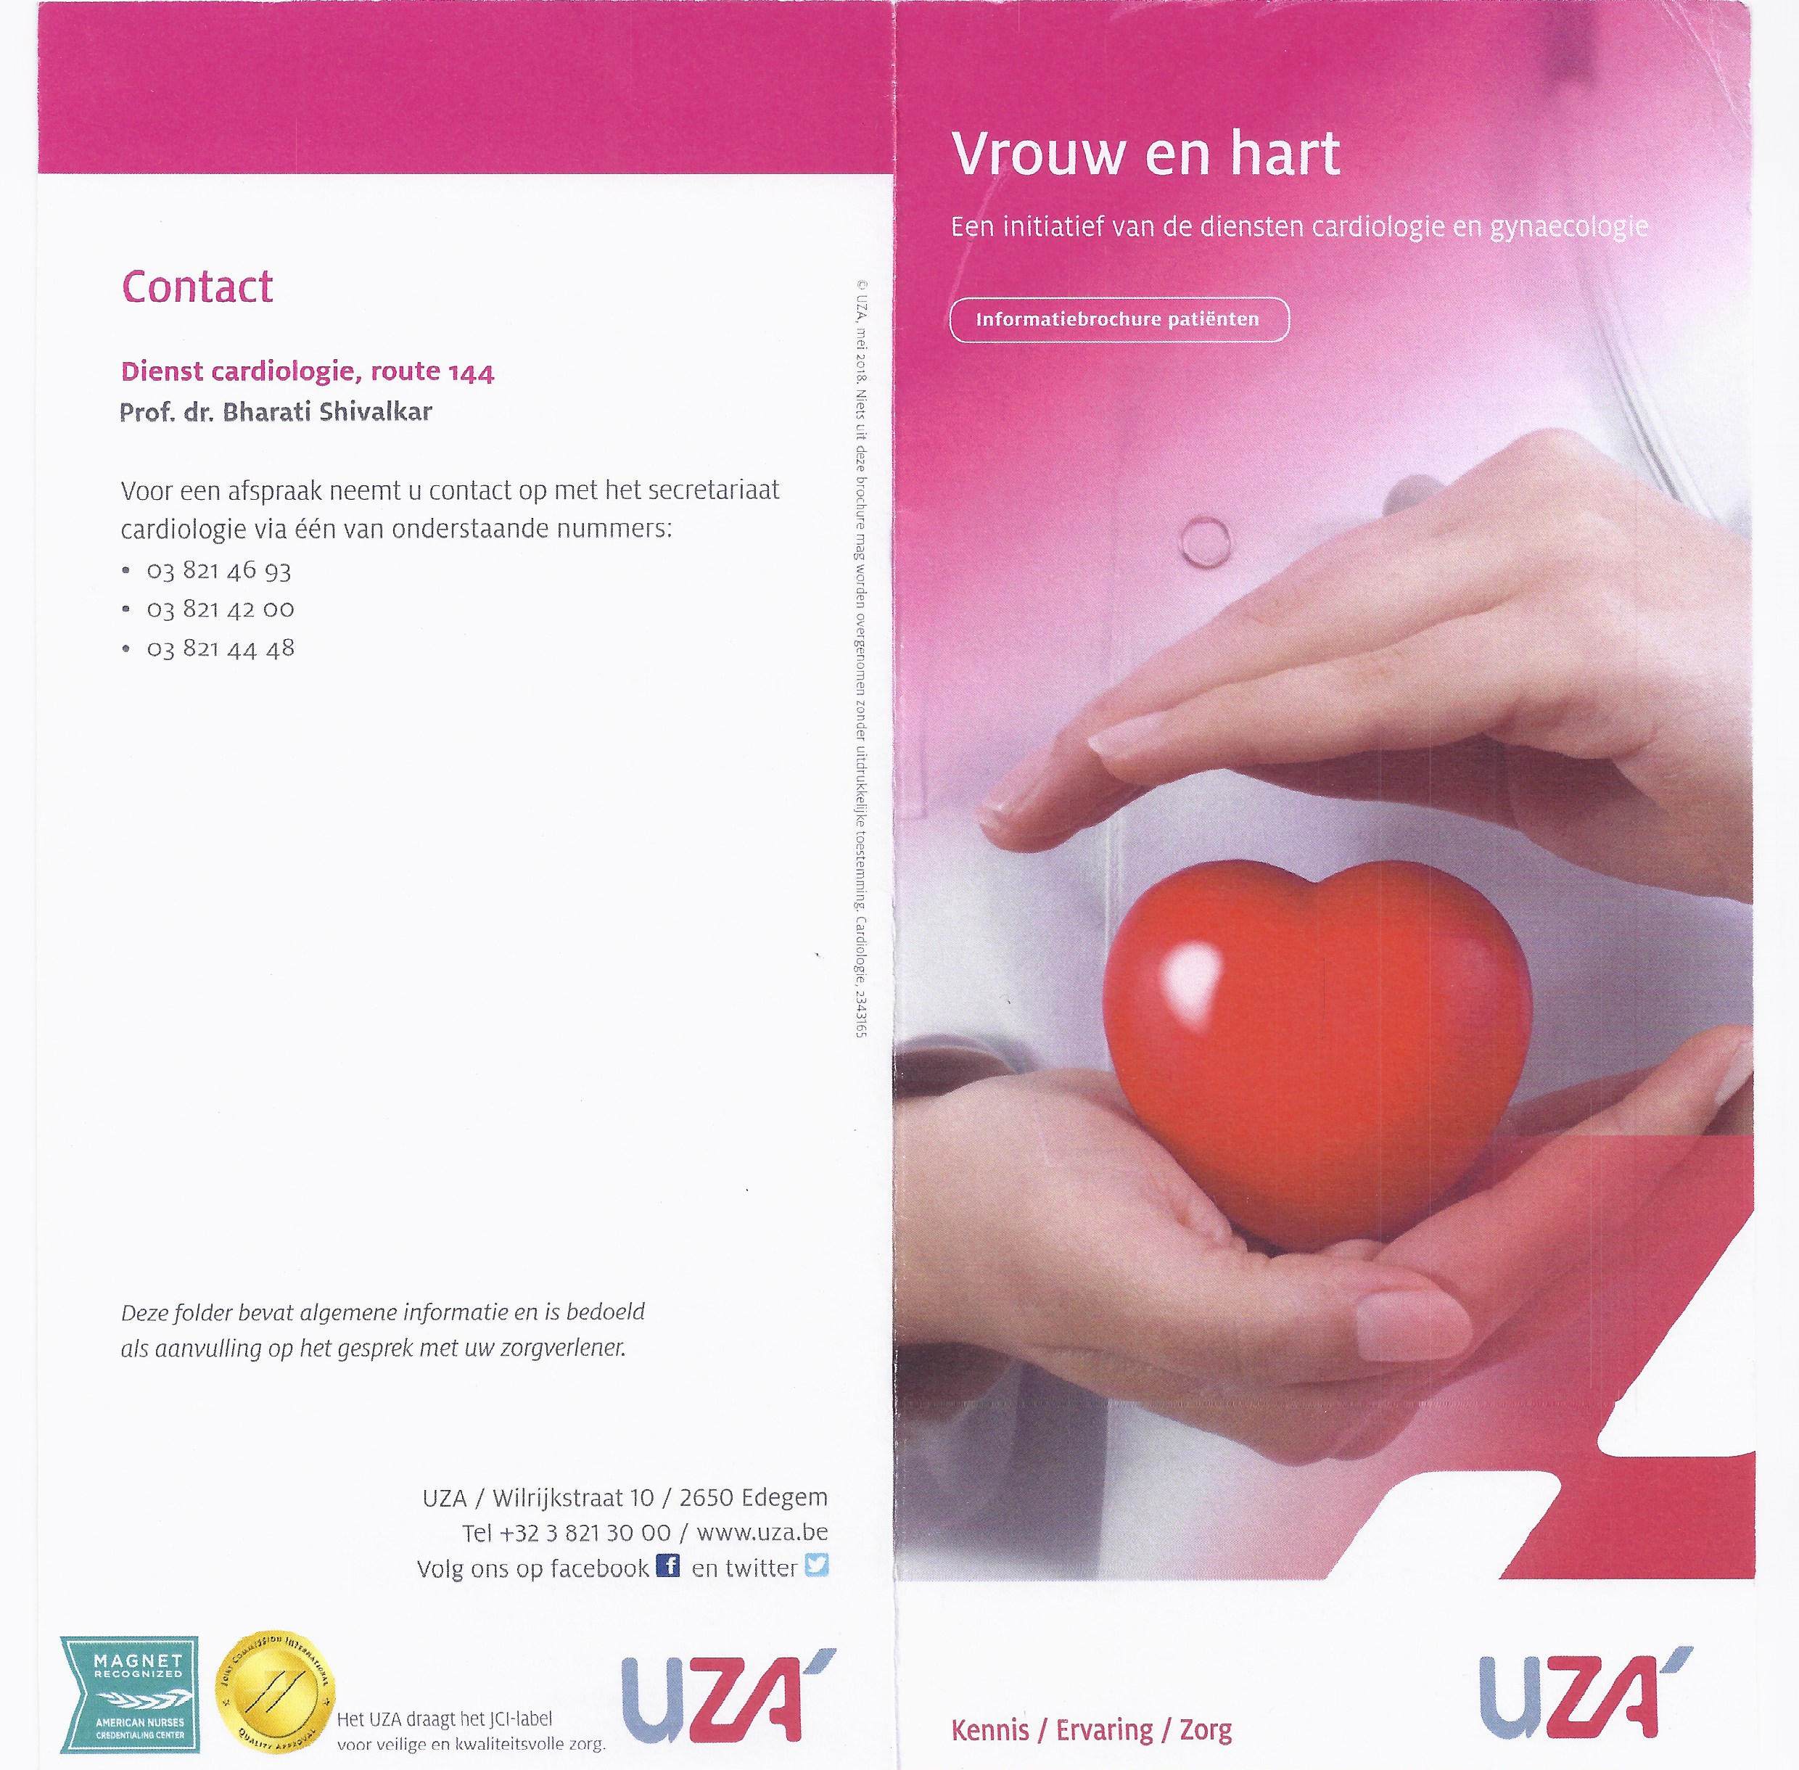

Slide 28
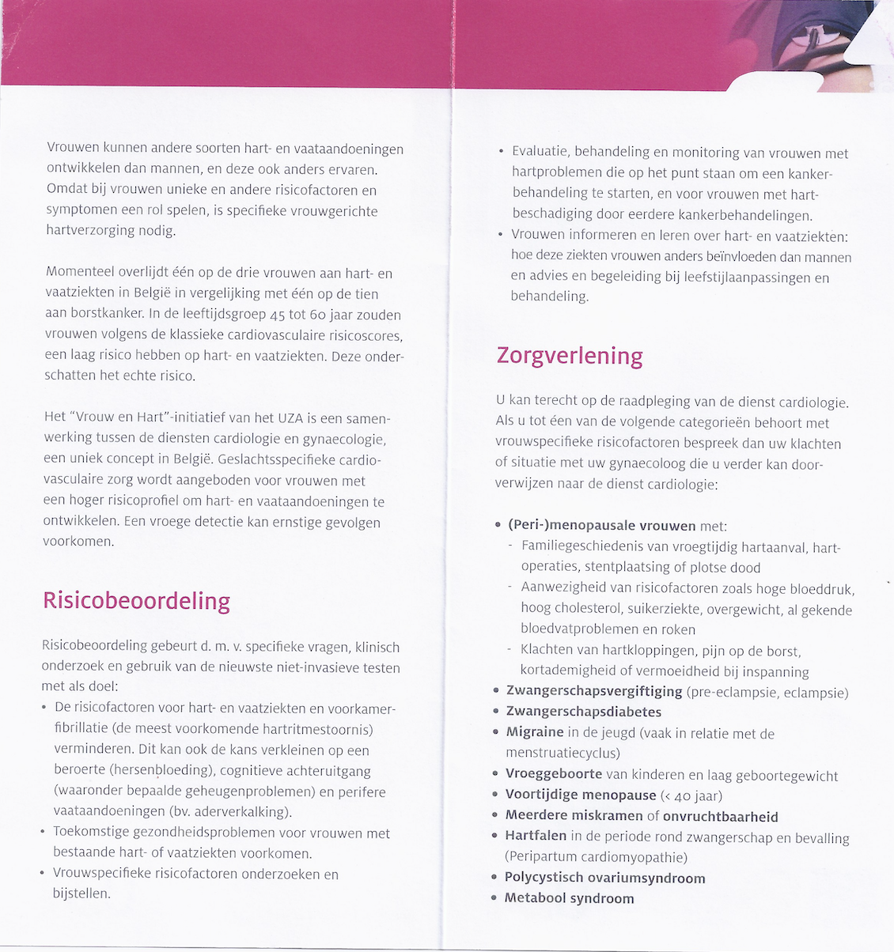

Slide 29
Gender specific approach
designing life course clinical care pathways
Young pregnant women
PE,GD, AHT, DM
Young nonpregnant women
PCOS, infertility, RA, endometriosis, SLE
Endothelial dysfunction
Increased inflammation
Biomarkers ?
BNP, CRP, PAI-1
ICAM, VCAM,IL-6
IL-10, fibrinogen
Early vascular dysfunction, vascular ageing
Non-invasive tests:
Echocardiography
Stress-testing (US, NUC)
Cor. CTA; IMT, ABI,PWV
RF : AHT, DM, Obesity, lack of physical
Activity, smoking, family history of premature CVD
High Risk of CVD
Middle aged (peri-) menopausal women : classic RF, RA, IHD, Thyroid, Metabolic syndrome. HFpEF
CV assessment important
before initiation of HRT
Bharati Shivalkar, UZA 2017

Slide 30
Multidisciplinary life course approach
with easy referral patterns
Rheumato-immuno
Gynae/Obs
General Practitioner
LIFE
Multidisciplinary Approach
Effective
co-ordination of
Care to provide
specialty care
if needed
Integrating services:
Sharing staff (NP, lifestyle advice),locations, tools, strategies
APPROACH
Task Shifting
Broadening healthcare roles
Nurses, community healthcare
Workers for simple screening
e.g. blood pressure
Measurements; advice on
Lifestyle…
COURSE
Cardiologist/Neurologist
Bharati Shivalkar, UZA 2017

