Slide 1
Menopause care : a comprehensive
2 day workshop
Fertility issues in premature ovarian insufficiency
Dr Sassi Asma
Université libre de Bruxelles (ULB)
Hôpital Universitaire de Bruxelles (H.U.B)- CUB Hôpital Erasme Fertility Clinic, Department of Obstetrics and Gynecology
Route de Lennik 808, 1070 Bruxelles – Belgium
22 March 2025

Slide 2
Presentation Content
Introduction on premature ovarian insufficiency (POI) :
  Definition/Nomenclature
  Diagnosis/Prevalence
  Clinical presentation
  Etiologies
Fertility issues in POI :
  Chances of spontaneous pregnancy
  Treatments to increase natural pregnancy
  Oocyte donation
  Fertility preservation
Belgian legislation and reimbursement
Conclusions

Slide 3
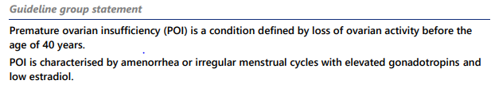
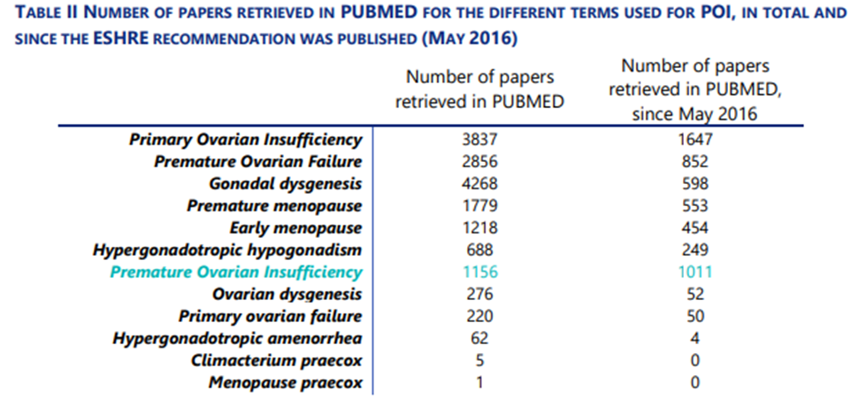

DEFINITION AND NOMENCLATURE
more accurate to describe the fluctuating nature of POI
Less negative connotation
ESHRE-ASRM guidelines on POI 2024
https://www.eshre.eu/Guidelines-and-Legal/Guidelines/Premature-ovarian-insufficiency

Slide 4
DIAGNOSIS
Amenorrhea or irregular menstrual cycle for at least 4 months
+
↑ FSH (> 25UI/L) and ↓ E2 (<20 pg/mL)
ESHRE-ASRM guidelines on POI 2024

Slide 5
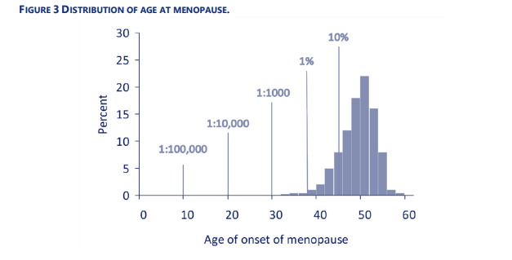
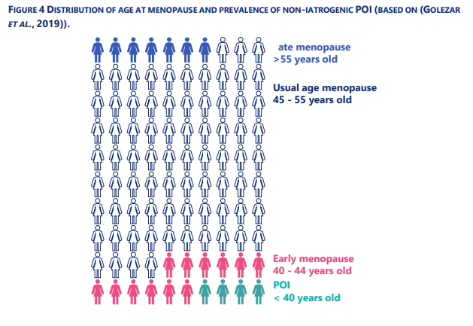
PREVALENCE
1 % to 3.7% non iatrogenic POI
Beck-Peccos and Persani., 2006; Golezar et al., 2019; Li et al., 2023; ESHRE-ASRM guidelines on POI 2024
Notes:
11.2% in women with iatrogenic etiologies

Slide 6
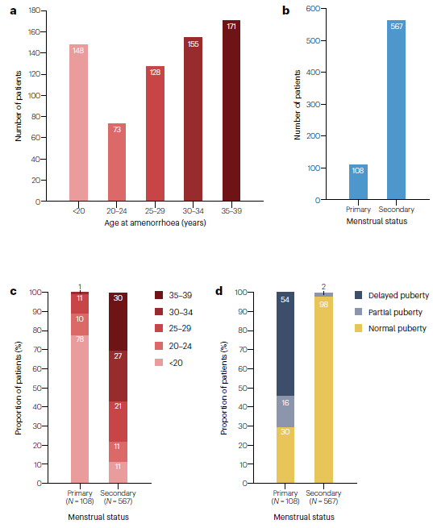
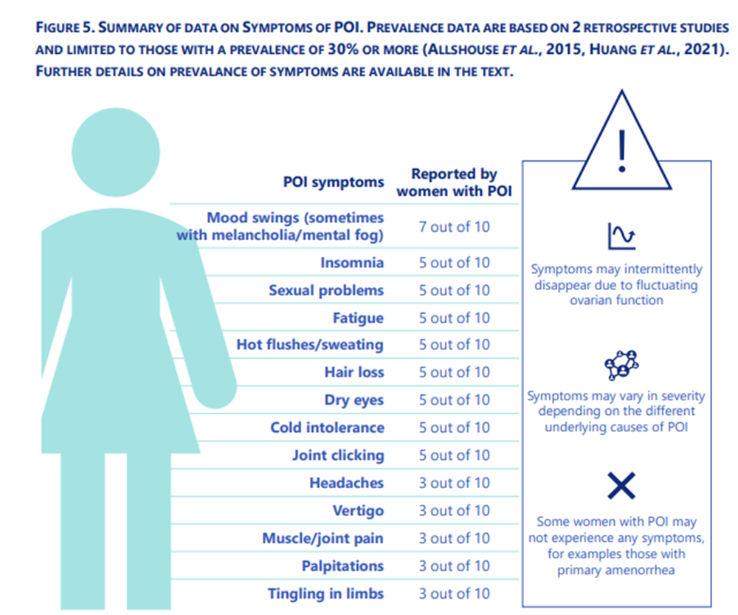
CLINICAL PRESENTATION
Symptoms of estrogen deficiency intermittent + variable severity :
Nelson., 2009; Tucker et al., 2016; Touraine et al., 2024; ESHRE-ASRM guidelines on POI 2024
Notes:
Sporadic in most cases
vasomotor symptoms (hot flashes and night sweats), sleep disturbance, dyspareunia …

Slide 7
ETIOLOGIES
Iatrogenic, Infectious
Chemotherapy, Radiotherapy, Surgery, Mumps …
Associations to other auto-immune diseases (10-55%)
Lymphocytic oophoritis (4-11%)
Auto-immune
Genetic
Isolated
Syndromic
Chromosomal abnormalities : 10→21% (ex/Turner 45X)
FMR1 premutation : 55-199 CGG repeats =>20% to develop POI
Monogenic : 9% 29% to 43% in case of consanguinity
Undetermined ≥ 50 %
Genetic, epigenetic, toxic, polygenic, multifactorial …..?
Ebrahimi et al., 2015; Qin et al., 2015; Dutta et al., 2017; Vabre B et al., 2017; Sassi et al., 2021-2022; Franca et al., 2022; Van Der Kelen et al., 2023

Slide 8
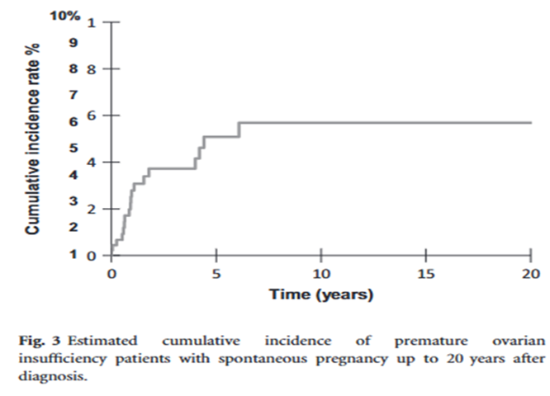
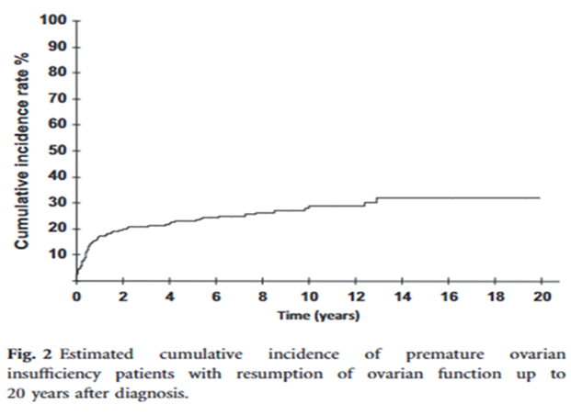
Fertility issues in poi :
CHANCEs OF spontaneous pregnancy
Cumulative incidence of spontaneous pregnancy
  2,2% -10%
Features of ovarian function resumption (Fluctuating POI) : 23-50%
  at least one of three criteria
  Spontaneous pregnancy (15% up to 17,5% )
  Restoration of menstruation in at least two following cycles
  Reduction of FSH within the normal range without any HRT
Ovarian function resumption associated to lower FSH levels at initial evaluation and younger age
Spontaneous resumption of ovarian function is not rare nor a brief phenomenon
507 POI patients, 30,1 ± 6,4 years, 98% SA
  Cumulative incidence 23% at 4 years, 28% at 10 years and 32% at 20 years
  Majority under HRT
  Nelson et al., 2009; Bachelot et al., 2009-2017; Tucker et al ., 2017
Notes:
75% continued to have signs of ovarian function 1 year later /Our study has some bias: POI time of onset, the recovery ofovarian function and its duration were sometimes difﬁcult to establish in our study. Indeed, hormone replacement therapye clipses the ability to diagnose spontaneous normalization o fFSH. Moreover, the most frequent criterion was the resumption of menstrual cycles (87%), but most of the POI patients were receiving HRT and a resumption of ovarian activity could not be detected in these women.

Slide 9
Review
Fertility issues in poi :
CHANCEs OF spontaneous pregnancy
Follicle-like structures in 41-60% of POI patients
Poor correlation between estradiol levels and follicular size
Follicles at various stages of maturation/involution in 29%-48% of POI patients (Biopsy)
    Atretic changes
    Premature luteinization of granulosa and theca cells of antral follicles ˂ tonic elevation in serum LH
    Down-regulation of granulosa cell FSH receptors ˂ elevated FSH levels
  Reduced chances for spontaneous ovulation, response to ovarian stimulation and pregnancies
Van Kasteren et al., 1999; Bidet et al., 2008; bachelot et al., 2009; Kawamura et al., 2013; Fraison et al., 2019; Sullivan et al., 2015; ESHRE-ASRM guidelines on POI 2024
Notes:
Ultrasonography It has been reported that in 41–60% of patients with POF
together with the observation that 50% of POI patients maintain Pfs in their ovaries, has guided research in investigating novel, biological strategies of ovarian rejuvenation. These include PRP, exos therapy, IVA, SC therapy, microRNAs, and mitochondrial targeting therapies.

Slide 10
TREATMENTS TO INCREASE NATURAL PREGNANCY
Gonadotrophin suppression pre-treatments :
Theoretical benefit using either estrogen or gonadotropin releasing hormone agonists (GnRHa)
pre-treatment and/or hormone replacement therapy with or without ovarian stimulation
Corticosteroids :
Theorical benefit in auto-immune POI (Lymphocytic oophoritis )
Dehydroepiandrosterone (DHEA)
Important for folliculogenesis, promising results from animal studies
Little or no benefit in practice
Van Kasteren et al., 1999; Fraison et al ., 2019; Sullivan et al., 2015; Osuka et al., 2023; ESHRE- ASRM guidelines on POI 2024
Notes:
Thus, at present none of the approaches can be recommended for women with POI.
Therefore, experimental biological therapies, such as Platelet-Rich Plasma (PRP), Exosomes (exos) therapy, In vitro Activation (IVA), Stem Cell therapy, MicroRNAs and Mitochondrial Targeting Therapies are experimental treatment strategies that focus on activating oogenesis and folliculogenesis, by upregulating natural biochemical pathways (neo-folliculogenesis) and improving ovarian microenvironment. This mini-review aims at identifying the main advantages of these approaches and exploring whether they can underpin existing assisted reproductive technologies

Slide 11
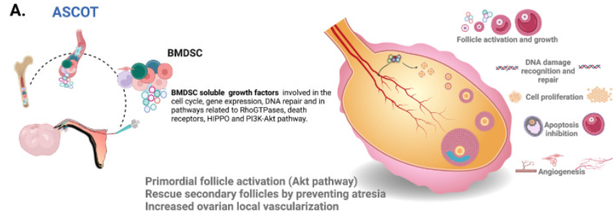
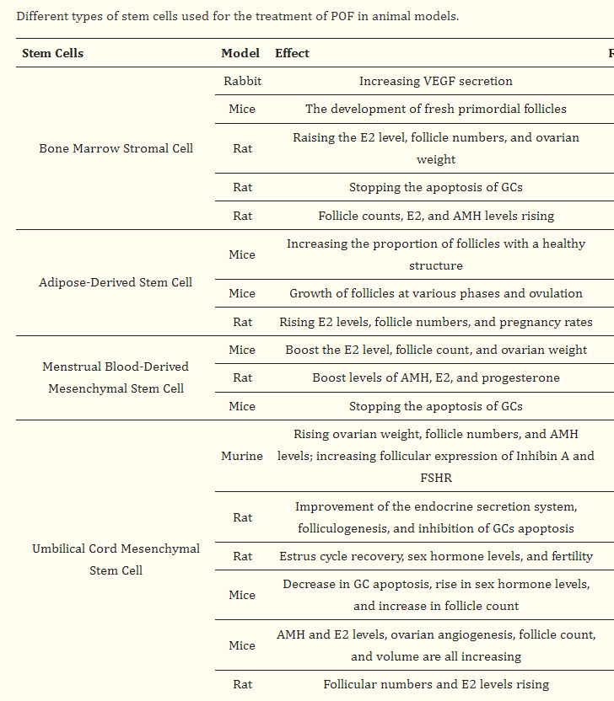
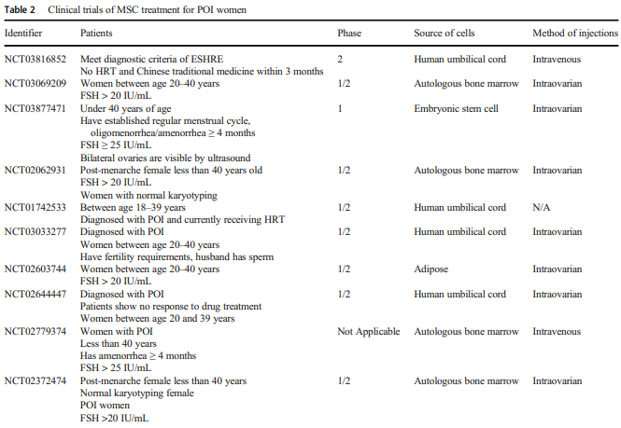
PERSPECTIVES : STEM CELL THERAPY
Takahashi et al., 2021; Ilyas et al Cells 2022; Pellicer et al., 2023
Notes:
Considering the lifelong health of POI patients, development of treatments to restore ovarian function earlier is essential to improve quality of life. Recent development of regenerative medicine allowed transplantation of various types of human MSCs improving the ovarian function in POI mice.
Stem cell-based treatments have used mesenchymal stem cells derived from bone marrow, placenta, and umbilical cord.
In summary, multiple mechanisms are involved in MSCs-driven treatment of POI. Following the migration of MSCs to the injured ovary, the proliferation, apoptosis, immunization, autophagy, oxidative stress, and fibrosis of ovarian cells are modulated by the paracrine effects of MSCs The basic mechanisms may be more significant and complex.

Slide 12
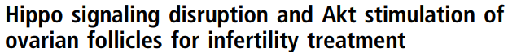
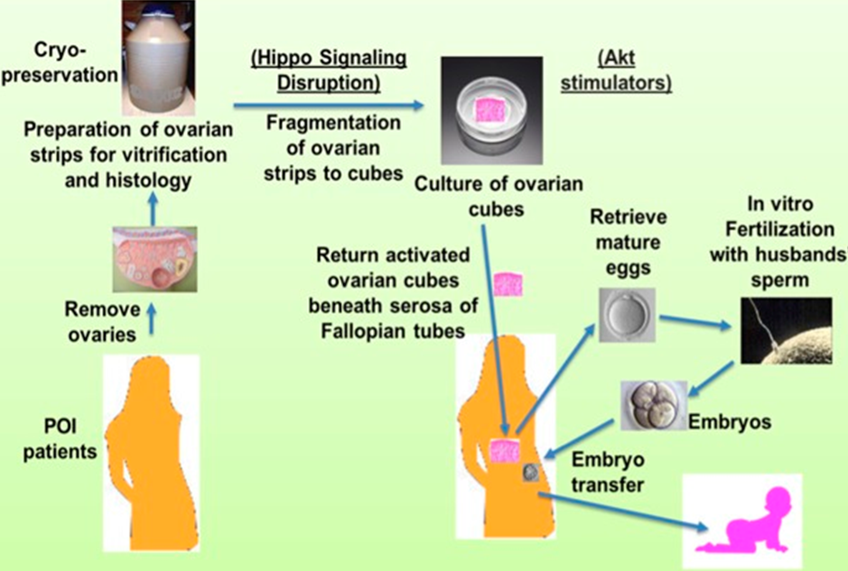
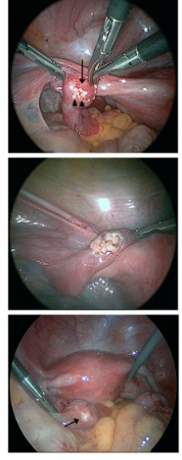
PERSPECTIVES : IN VITRO FOLLICULAR ACTIVATION
+ AUTO-TRANSPLANTATION
27 patients
37.3 ± 5.8 y of age; 6.8 ± 2.1 y of amenorrhea
Laparoscopic ovarian removal
Fragmentation +Treatment with Akt stimulating drug
Autografted in the serosa of Fallopian tubes
IVF–embryo transfer
Residual follicles in 13 patients (48%)
Mature oocytes in 5patients
Embryo transfer in 3 patients
3 pregnancies /2 Live births
11% whole cohort
23% women with residual follicles
Kawamura et al., 2013; Pellicer et al., 2023
Notes:
Akt signalling promoted the development of primordial follicles while also stimulating secondary follicles

Slide 13
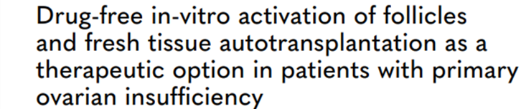
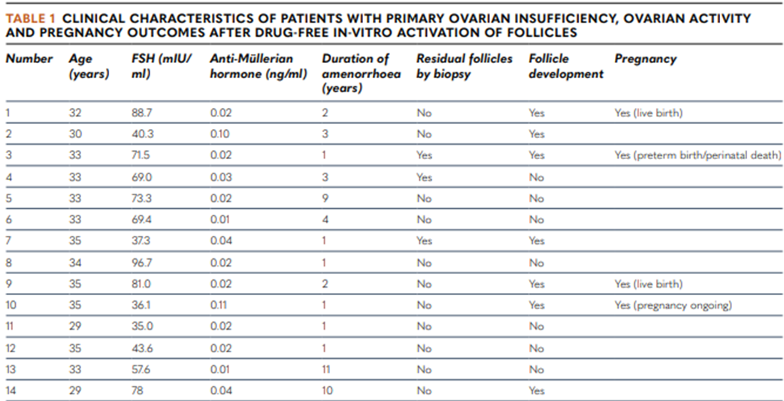
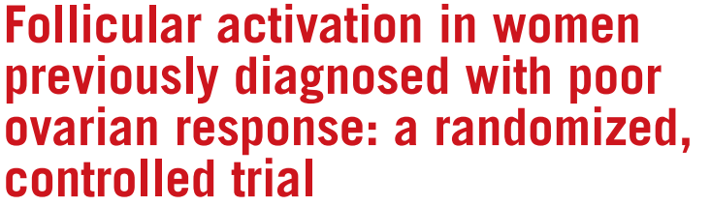
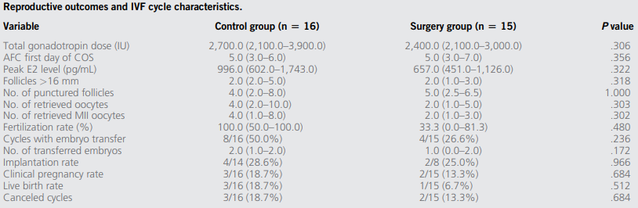
4/14 pregnancies (28,5%)
Ovarian fragmentation for follicular activation
in women with POR resulted in an increase in
AFC but did not modify IVF outcomes when
compared with controls.
Ferrari et al., 2020; Díaz-García., 2022

Slide 14
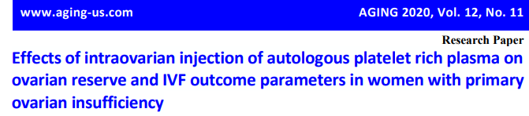
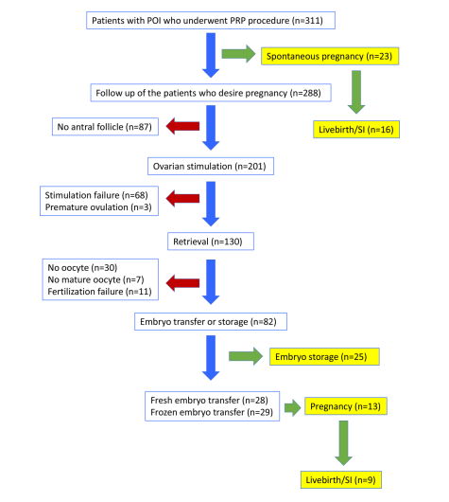
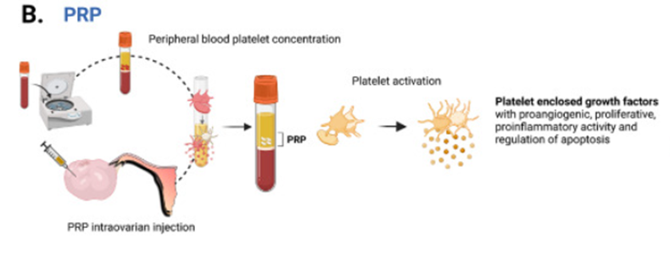

PERSPECTIVES :
INJECTION OF AUTOLOGOUS PLATELET RICH PLASMA INTO OVARY
7,4%
4,18%
Cakiroglu et al., 2020; Pellicer et al., 2023
Notes:
Injection of platelet rich plasma has also been used in several studies, including one of 311 women (Cakiroglu et al., 2020), generally without adequate control groups.

Slide 15
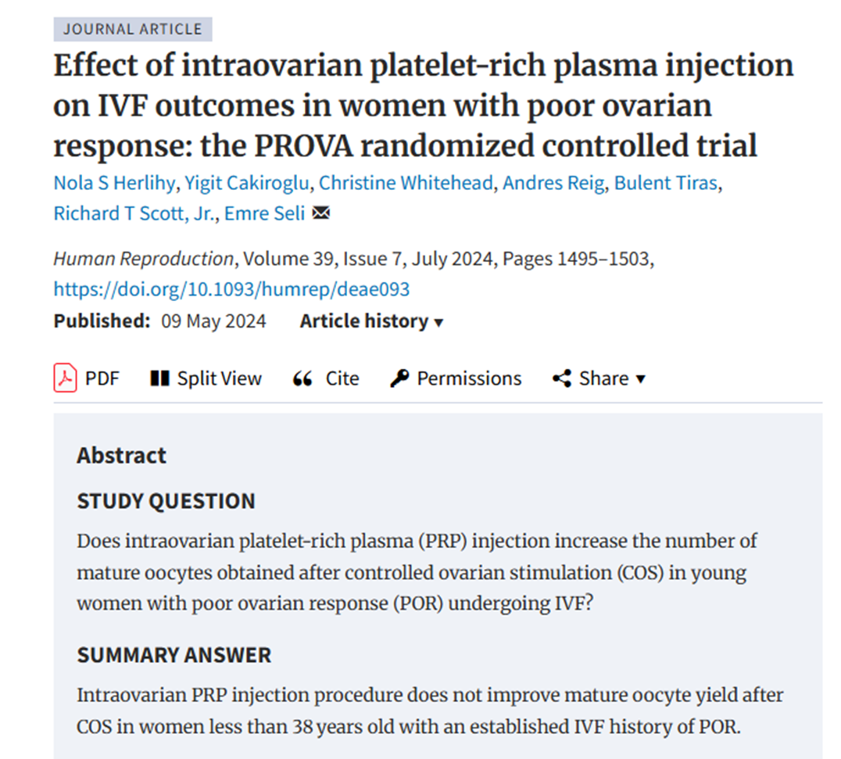
No significant differences in :
Number of MII oocytes retrieved/cycle
Blastocysts - Euploid blastocysts
Implantation rates
Post-treatment AFC and AMH
Notes:
<38 years old, two or more prior cycles with <3 oocytes retrieved previous cycle

Slide 16
Fertility issues in poi :
Women with non surgical POI should be advised to use contraception if they wish to avoid pregnancy
Patients with incipient POI should be encouraged to conceive as soon as possible or consider egg or embryo cryopreservation
If pregnancy is desired, women should be informed that :
  Ovarian activity may occur in women with non-surgical POI. This is associated with a chance of natural conception :
      Regular intercourse is advised
      Monitoring and support of follicular growth and ovulation, inseminations, In vitro fertilization (IVF/ICSI) could be discussed /tried in presence of residual ovarian activity and other infertility factors
  Sequential combined HRT should be used when spontaneous pregnancy is desired in non surgical POI
  Oocyte donation is a well established and the most successful treatment for women with POI
Tucker EJ et al., 2017; ESHRE-ASRM guidelines on POI 2024

Slide 17
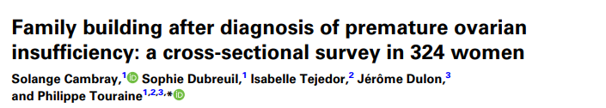
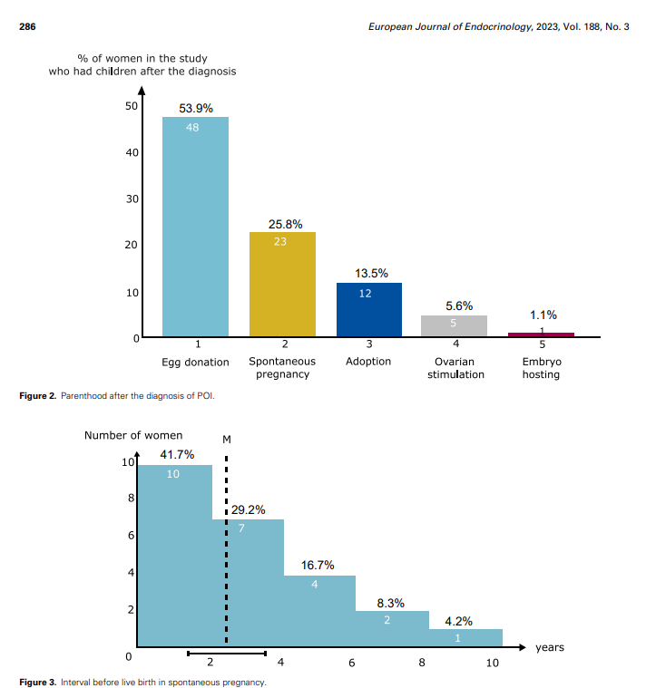
Spontaneous pregnancy rate was 8.6% in the whole cohort
217 women wanted to build a family after the diagnosis
.
10,6 %
2,3%
Notes:
Oocyte donation to achieve pregnancy It is clear that oocyte donation is the most successful treatment for women with POI desiring pregnancy. Successful pregnancy was first reported in 1984 (Lutjen et al., 1984) and since then it has become a ‘routine’ treatment. The pregnancy rate from oocyte donation is not greatly affected by the recipient’s age (Sauer et al., 1994, Templeton et al., 1996, Hogan et al., 2019).
Currently, the treatment of POI-related infertility involves oocyte donation. However, many women with POI desire to conceive with their own ova

Slide 18
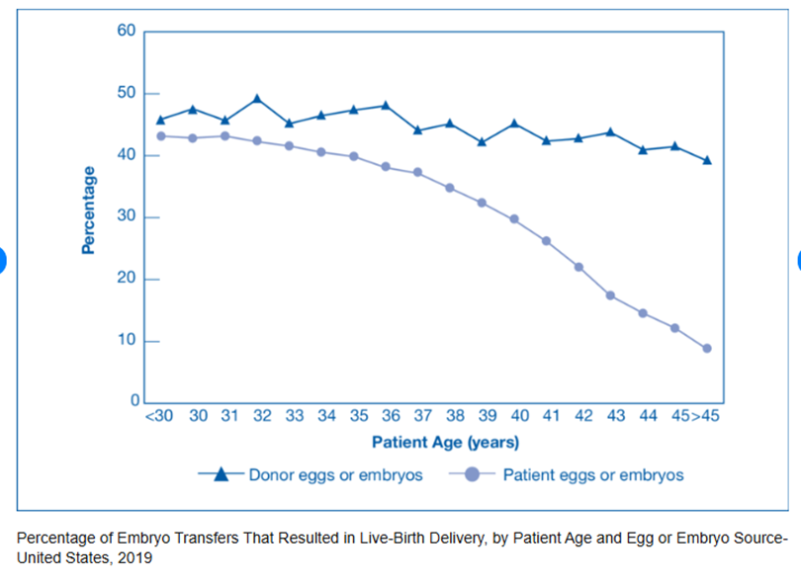
OOCYTE DONATION
Treatment of choice in POI women wishing to conceive
Altruistic oocyte donor versus known donor
Higher risk of cycle cancellation in sisters (X5)
Pregnancy rate from oocyte donation is not
affected by the recipient’s age
ESHRE-ASRM guidelines 2024

Slide 19

PREGNANCIES AFTER OOCYTE DONATION
Increased risk for obstetrical and neonatal complications :
  Hypertensive disorders of pregnancy
  Caesarean section, postpartum haemorrhage, preterm birth, low birth weight
Highest risk situations :
  Turner syndrome patients
  Cardiotoxic treatments
  Prior cardiovascular screening for cardiomyopathy/Aortic dissection
  Pelvic radiation for cancers
Pregnancy should be managed in an appropriate obstetric unit
Delbaere and Englert., 2002; Alvaro Mercadal et al., 2011; Storgaard et al., 2017; Glujovsky et al., 2020, ESHRE-ASRM guidelines 2024
Notes:
Pre-eclampsia 13.5 to 18% in OD pregnancies compared to 5.9% in autologous IVF
Turner syndrome patients ( Risk of aortic dissection (2-5X), over all pregnancy mortality 1%)
Pelvic radiation for cancers (Increased pregnancy loss, preterm birth, and low birth weight, placental attachment disorders)

Slide 20

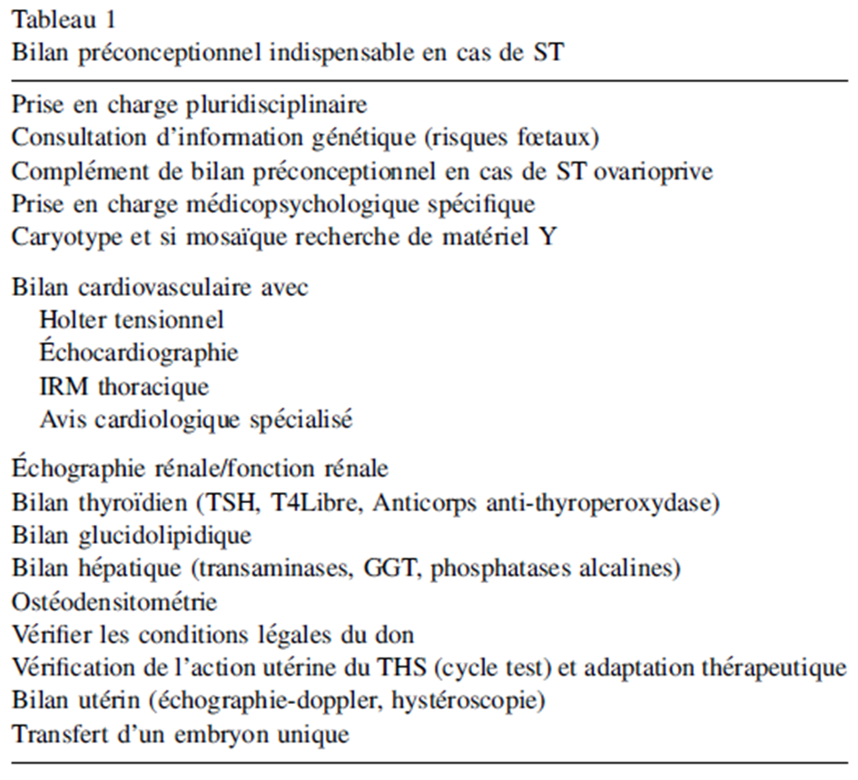
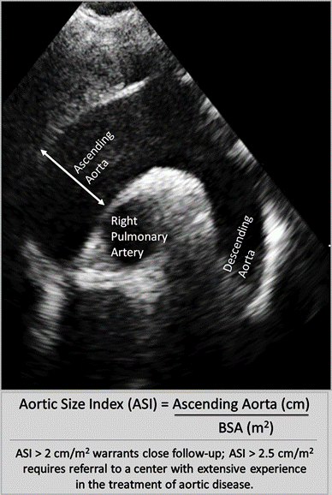
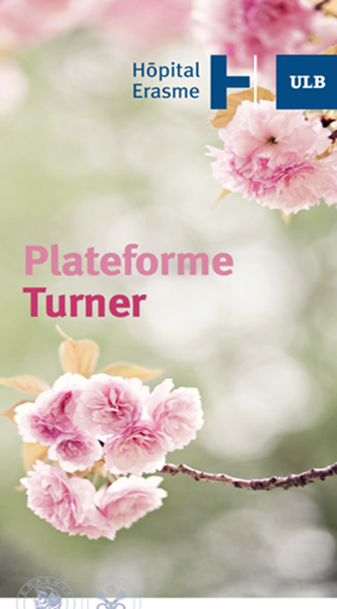

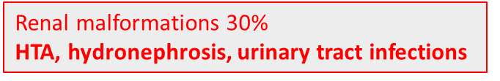
Aortic coarteration 10%
Bicuspide Ao valve 16%
Ao root delation 5%
AORTIC DISSECTION !!
Fénichel and Letur., 2008

Slide 21
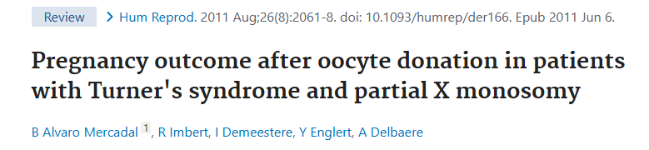
24 TS patients
23 included patients
1 excluded patient
(Aortic dilation 38,7mm)
55 embryo transfers
81 transferred embryos
Mean embryos per transfer: 1,5 ± 0,7
18 pregnancies
Miscarriage rate: 23%
5 biochemical pregnancies
13 clinical pregnancies
SINGLE EMBRYO TRANSFER!!
Clinical pregnancy rate/ET: Fresh 24,4%
Frozen 20%
3 miscarriages
10 ongoing pregnancies
10 deliveries
(2 vaginal,
8 cesarian sections)
11 live-births
9 singletons
1 twin couple
Complications of pregnancy: 50%
4 Preeclampsia
1 Gestational hypertension and intrahepatic cholestasis of pregnancy
4 preterm healthy babies
(34, 35, 36 gw)
7 term healthy babies
Low birth weight
< Preterm deliveries
< SGA babies
Mean birth weight singletons: 2728g ± 577
Birth weight twins: 2110g and 2560g
Four babies below p10 for weight and age
Notes:
Inherent risk factors: CV and renal malformations, endometrial abnormality and increased uterine artery pulsatility index that alter placental development
Pregnancy rates after oocyte donation in patients with TS are comparable with those previously published but a high risk of pregnancy hypertensive disorders and a high risk of low birthweight can be highlighted from our study. Strict inclusion criteria and single embryo transfer are necessary to minimize complications during pregnancy in this high-risk group.

Slide 22

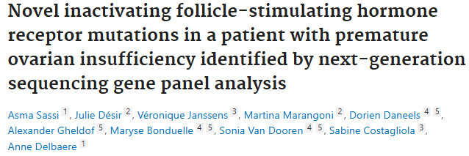
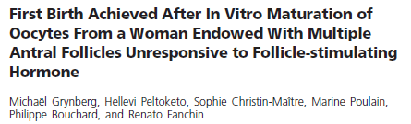
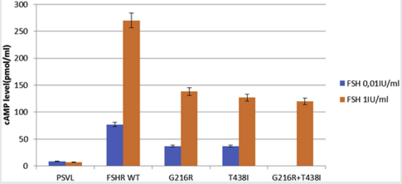

FERTILITY PRESERVATION IN POI WOMEN
= Oocyte, embryo or ovarian tissue cryopreservation (IVM or Autografting)
In most cases there is no opportunity as the follicle pool is depleted
Variable course of the condition (early course ) Potential window of opportunity
Autoimmune oophoritis Possibility of IVM in early stage
FSHR mutations - Gonadotropin-Resistant Ovary Syndrome (IVF/IVM ) :
2 POI Sisters (PA) / FSH levels >74 IU/L / AMH 1.4 and 5.8 ug/L
Targeted NGS : HZC FSHR mutation (VUS)---> Altered function in Vitro (P)
Grynberg et al.,2013-2020; Sassi et al., 2020; ESHRE guidelines on female fertility preservation 2020
Notes:
Lymphocytic infiltration of the theca of an antral and preantral follicle luteinized granulosa cells. Earlier stage follicles free of lymphocytic infiltration
Some preservation of antral follicle growth in the early stages Possibility of aspiration of immature oocytes

Slide 23
Situations AT risK OF POI : ex iatrogEnIC, RELATIVES OF poi women, X fragile premutation , galactosemia, Turner Syndrome…
Ovarian reserve evaluation
Spontaneous pregnancy
Functional ovaries
Oocyte or embryos cryopreservation
±PGD FMR1 premutation, BRCA1/BRCA2
Ovarian tissue cryopreservation
IVM or Autografting
POI or at risk of POI
Oocyte donation
Non functioning ovaries
Oocyte donation

Slide 24
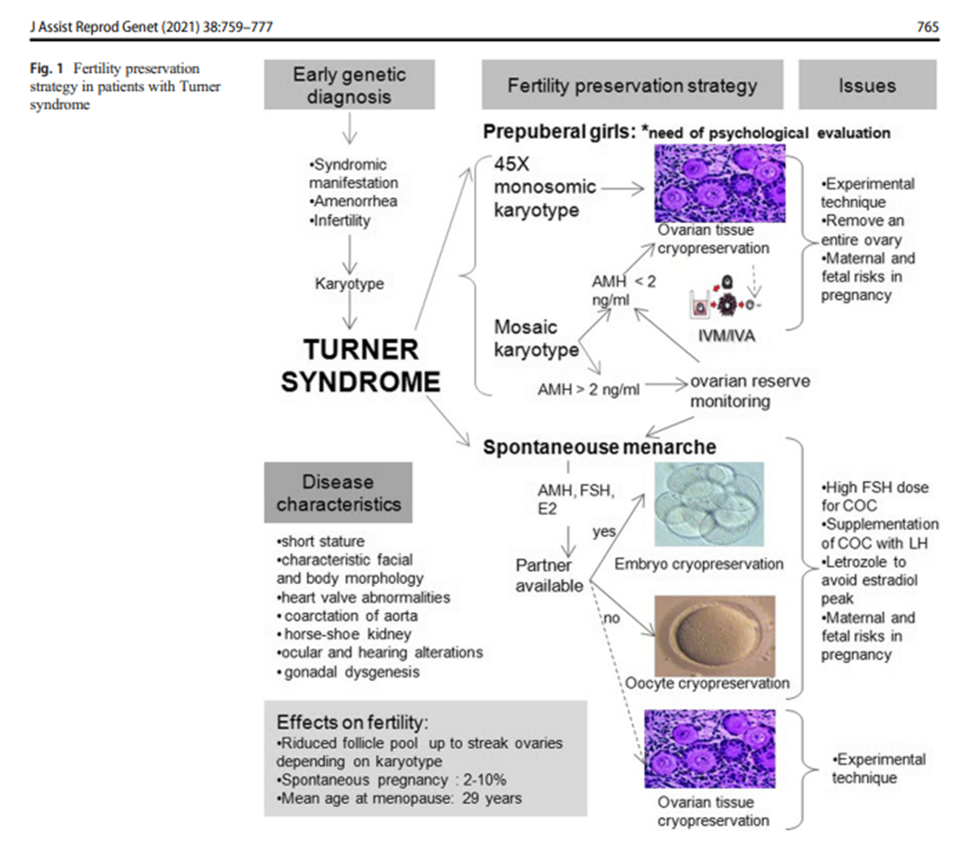
FERTILITY PRESERVATION : TURNER SYNDROME
Hreinsson et al, 2002; Borgstrom et al., 2009; Lamarca and Mastellari., 2021; ESHRE-ASRM guidelines in POI 2024
Notes:
Pregnancies in women with TS are high risk due to the underlying morbidity and mortality of the condition. Although not common, spontaneous pregnancies can occur, especially in women with a mosaic karyotype rather than 45,X, and these may be lower risk than oocyte donated pregnancies (Hadnott et al., 2011).

Slide 25
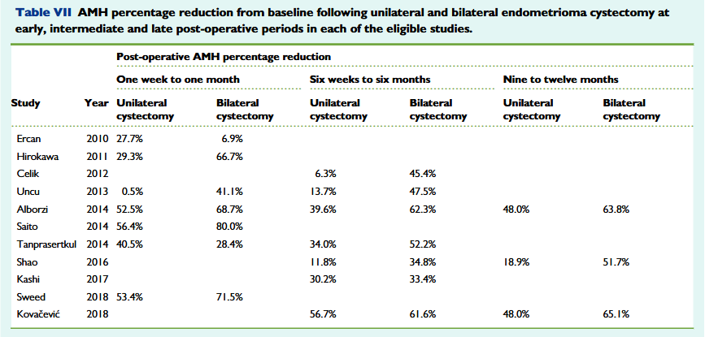
Insuffisance ovarienne prématurée iatrogène
FERTILITY PRESERVATION
IATROGENIC POI : OVARIAN SURGERY
endomETRIOSIS
Younis et al., 2019
Notes:
Some will have low AMH levels after such treatment: the limited evidence suggests that such low AMH levels can be maintained over many years, indicating ongoing ovarian function and thus the potential for conception (Cameron et al., 2019, Su et al., 2020)./

Slide 26
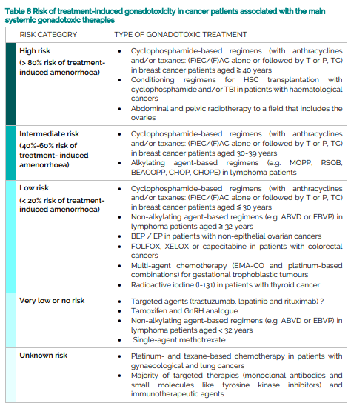

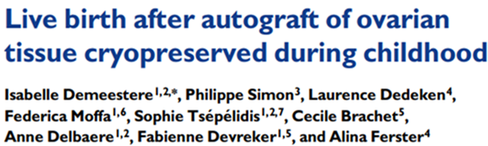
FERTILITY PRESERVATION
IATROGENIC POI : CHEMOTHERAPY AND RADIOTHERAPY
ESHRE guideline: female fertility preservation., 2020
Notes:
Abbreviations: (F)EC/(F)AC = 5-fluoruracil, epirubicin, doxorubicin, cyclophosphamide; T = docetaxel; P = paclitaxel; GnRH analogue = gonadotropin releasing hormone analogue; HSC = hematopoietic stem cell; TBI = total body irradiation; MOPP = mechlorethamine, vincristine, procarbazine, prednisone; RSQB or MOPP/ABV hybrid, = MOPP/doxorubicin, bleomycin, vinblastine; BEACOPP = cyclophosphamide, doxorubicin, vincristine, bleomycin, etoposide, procarbazine, prednisone; ABVD = doxorubicin, bleomycin, vinblastine, dacarbazine; EBVP = epirubicin, bleomycin, vinblastine, prednisone; CHOP = cyclophosphamide, doxorubicin, vincristine, prednisone; CHOPE = CHOP plus etoposide; BEP = etoposide, cisplatin, bleomycine; EP = etoposide, cisplatin; FOLFOX = 5-fluoruracil, oxaliplatin; XELOX = capecitabine, oxaliplatin; EMA-CO = etoposide, actinomycin D, methotrexate followed by cyclophosphamide and vincristine;
The risk of gonadotoxicity in patients with benign diseases is mainly due to treatments with high cumulative doses of alkylating agents given as immunosuppressive therapy
Benign haematological diseases Haematopoietic stem cell transplantation (HSCT) remains the only curative option for several benign haematological diseases such as thalassemia, sickle cell disease, aplastic anaemia, Fanconi anaemia or myeloproliferative syndromes. Although it is usually proposed during childhood, adults may also benefit from this treatment.
A conditioning regimen for HSCT includes high dose alkylating agents and is associated with high risk of permanent amenorrhoea

Slide 27
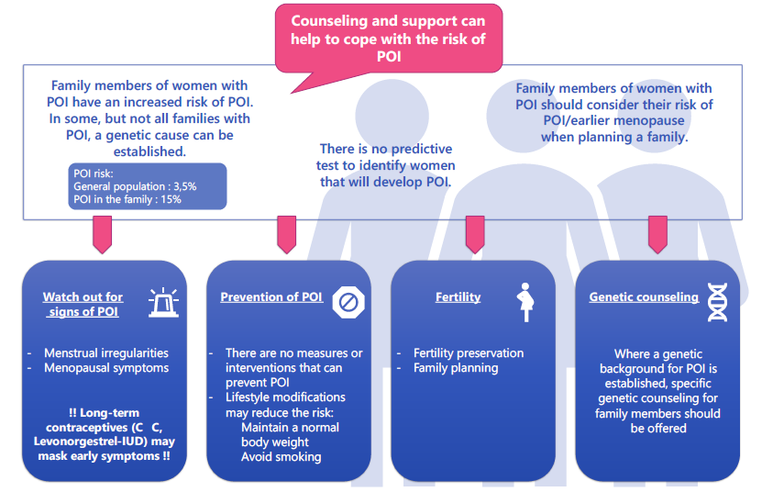
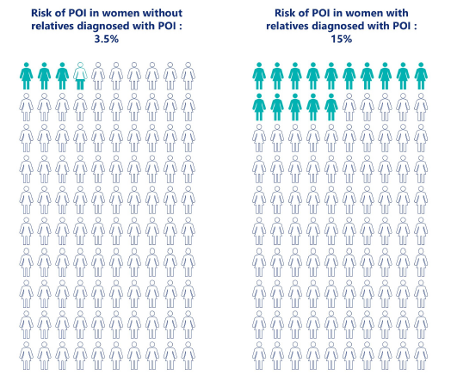
RELATIVES : IMPLICATIONS
ESHRE ASRM guidelines 2024

Slide 28
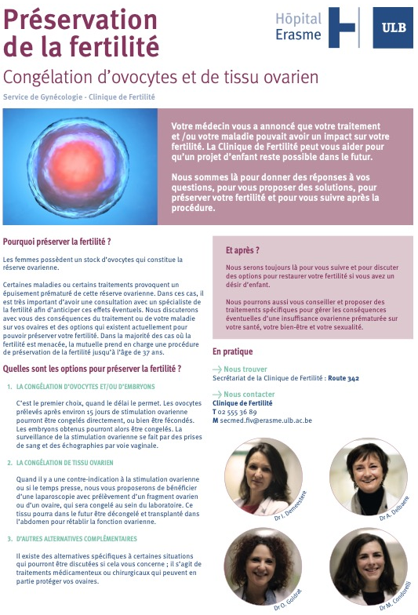
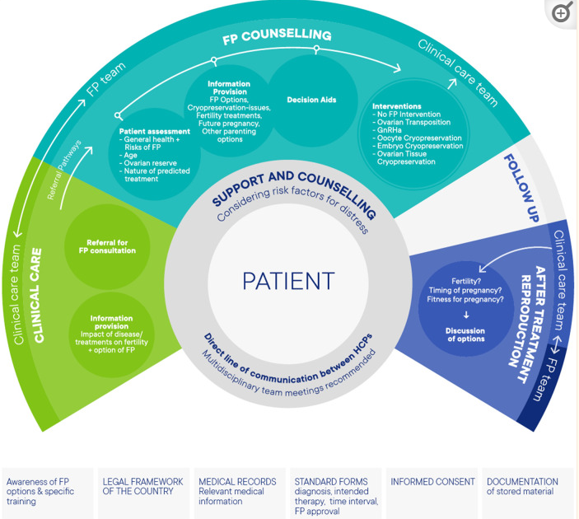
FERTILITY PRESERVATION : MULTIDISCIPLINARITY
ESHRE guideline: female fertility preservation, Human Reprod Open 2020
Notes:
Outlining a Team Approach to Care Women eligible for FP interventions will be managed by different clinical care teams. The clinical care team consists of the oncology team for cancer patients, a rheumatologist, gynaecologist, endocrinologist, haematologist, or another specialist physician for women with benign diseases, and the gender assignment team for transgender men. Women requesting oocyte cryopreservation for age-related fertility loss may directly approach the FP team, or be referred by their general practitioner or gynaecologist. The FP team should consist of fertility specialists, and embryologists, but should also include a psychologist or counsellor. A dedicated psychologist or counsellor improves communication between doctors and patients

Slide 29
BELGIAN LEGISLATION AND REIMBOUSMENT
Convention INAMI freezing – critères élargis le 1er juin 2023
Pour qui? < 38 ans femmes et < 45 ans pour hommes
Conservation de 10 ans (20 ans si < 16 ans)
Patients devant subir un schéma thérapeutique potentiellement gonadotoxique :
  tumeur solide cancéreuse et/ou affection maligne hématopoïétique ou ganglionnaire (leucémie, lymphome, myélome multiple…)
Patients subissant un schéma thérapeutique potentiellement gonadotoxique pour ces mêmes indications
Patients ayant subi un schéma thérapeutique gonadotoxique ayant eu un impact démontré sur leur fertilité, pour ces mêmes indications
Patients avec un cancer testiculaire ne nécessitant pas de chimio- ou radiothérapie
Patientes avec tumeur(s) borderline ovarienne(s)
Patientes porteuses d’une mutation génétique devant subir une ovariectomie préventive à cause d’un haut risque de cancer mammaire ou de cancer ovarien
Patients avec une maladie hématopoïétique nécessitant une greffe de cellules souches
Patients devant subir une orchidectomie bilatérale ou unilatérale dans le cadre où il ne dispose déjà que d’un seul testicule restant (antécédents d’orchidectomie unilatérale controlatérale, agénésie unilatérale d’un testicule, ...)
Patientes présentant une endométriose ovarienne bilatérale ou des kystes ovariens dermoïdes bénins bilatéraux nécessitant un traitement chirurgical impactant la fertilité
Notes:
3 first oncologic situations/ extended recently to other indications at risk of developing POIr

Slide 30
CONCLUSION
Reduction of chances of natural conception
Spontaneous resumption of ovarian function is not rare
  Contraception should be taken if pregnancy is not desired
  Sequential HRT regimen is recommended in women desiring natural pregnancy, and do not impact chances of natural conception
No interventions reliably increase ovarian activity and natural conception rates
Oocyte donation is an established option to achieve pregnancy after a diagnosis of POI
POI etiology should be investigated prior to pregnancy-oocyte donation
Women with risk factors for POI are identified and counselled regarding POI risk and fertility preservation
Genetic counselling and testing should be offered (Genetic etiology-FMR1)
Oocyte donation pregnancies are high risk and should be managed in an appropriate obstetric unit

Slide 31
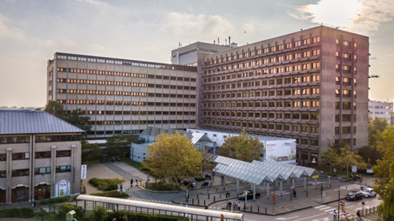
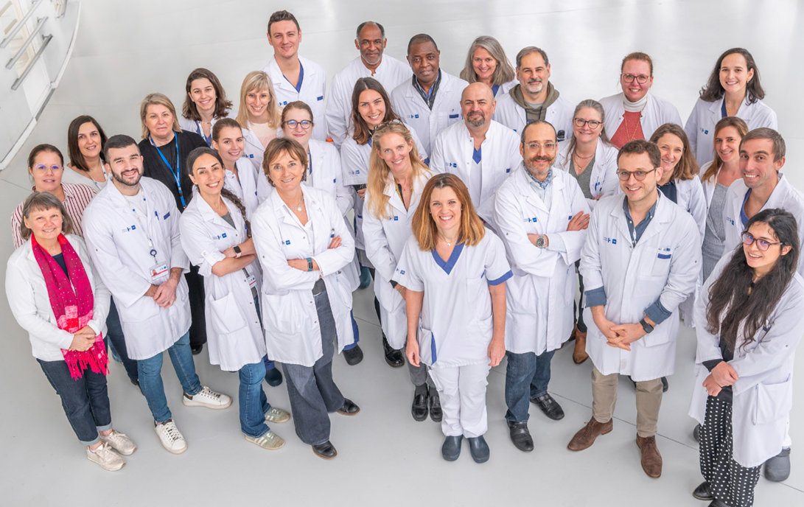

THANK YOU FOR YOUR ATTENTION

