Slide 1
Genitourinary syndrome of menopause : physiopathology, differential diagnosis and measurements
Aurélie Joris
Département de gynécologie-obstétrique
CHU Saint-Pierre
21/03/2025

Slide 2
No conflict of interest

Slide 3
Introduction
Genitourinary syndrome of menopause : GSM
  vaginal atrophy, vulvovaginal atrophy, urogenital atrophy
  defined as a collection of symptoms and signs < hypoE2 changes
    labia majora/minora, clitoris, introitus, vagina, urethra, and bladder
    genital symptoms of dryness, burning, and irritation;
    sexual symptoms of lack of lubrication, discomfort or pain, and impaired function
    urinary symptoms of urgency, dysuria, and recurrent UTI
    patients may present with some or all of the signs and symptoms,
  generally occurs in post-menopausal patients
  women of any age with a decrease in E2
    in the post-partum period or during breast-feeding
Notes:
is a new term that describes various menopausal symptoms and signs associated with physical changes of the vulva, vagina, and lower urinary tract.

Slide 4
Introduction
Epidemiological impact
  affects 50-70% of postmenopausal women
  underdiagnosed due to embarrassement or lack of awareness
  consequences on quality of life
    chronic pain
    urinary disorders
    sexual dysfunction
    psychological distress, self-esteem reduced and depression
  unlike vasomotor symptoms which improve over time
    GSM persist and worsen without treatment

Slide 5
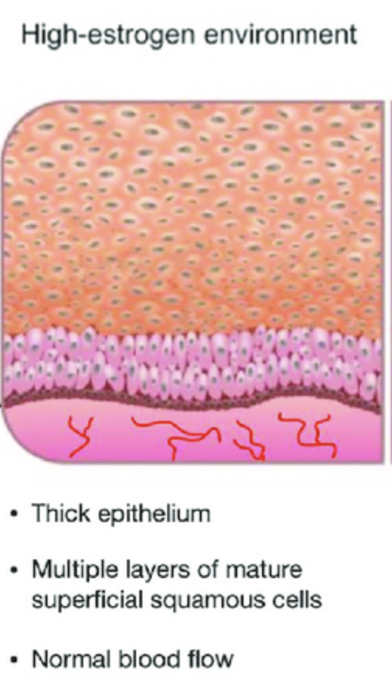
Pathophysiology
E2 acts on its R in the vagina, vulva, urethra, and the bladder
  Maintain the collagen content of epithelium,
    which affects its thickness and elasticity
  Maintain acid mucopolysaccharides and hyaluronic acid,
    which keep epithelial surfaces moist
  Maintain optimal genital blood flow
  Maintain a healthy vaginal microbiome
  the nonkeratinized stratified squamous epithelium of the vagina in response to E2 is
    thick, rugated, and rich in glycogen (> acid)
    maintaining a well-epithelialized vaginal vault during the reproductive years
Notes:
The female genital tract and lower urinary tract share a common embryonic origin,

Slide 6
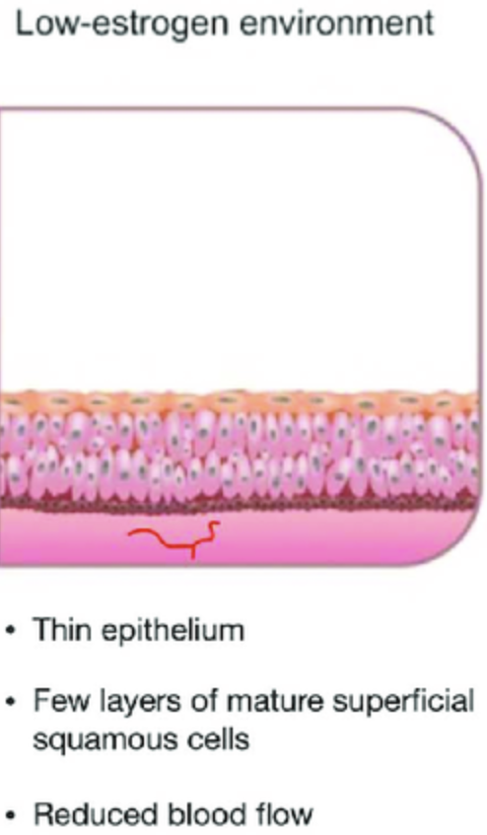
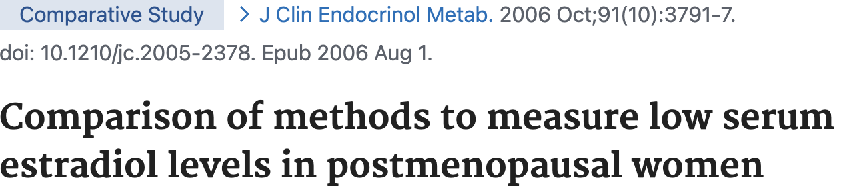
Pathophysiology
At menopause
  estrogen (< 5 pg/ml)
  most E2 assays are not sufficiently sensitive
  measurement of E2 levels
    should not be a routine aspect of clinical care
  changes in the mucosa
    usually develop gradually over a period of years
Notes:
to detect postmenopausal estradiol levels accurately,

Slide 7
Pathophysiology
vaginal atrophy
  Thinning of the top layer of superficial epithelial cells
    increase fragility, inflammation and microabrasions
    this layer may be completely absent in patients with severe atrophy
  Loss of rugae
  Loss of elasticity of the vaginal epithelium
  Shortening and narrowing of the vaginal canal, with loss of distensibility
  Increased subepithelial connective tissue
  Reduction in vaginal secretions from 3 to 4 g/4 hours to 1.7 g/4 hours
    less lubrication, worsening vaginal dryness
  Dyspareunia

Slide 8
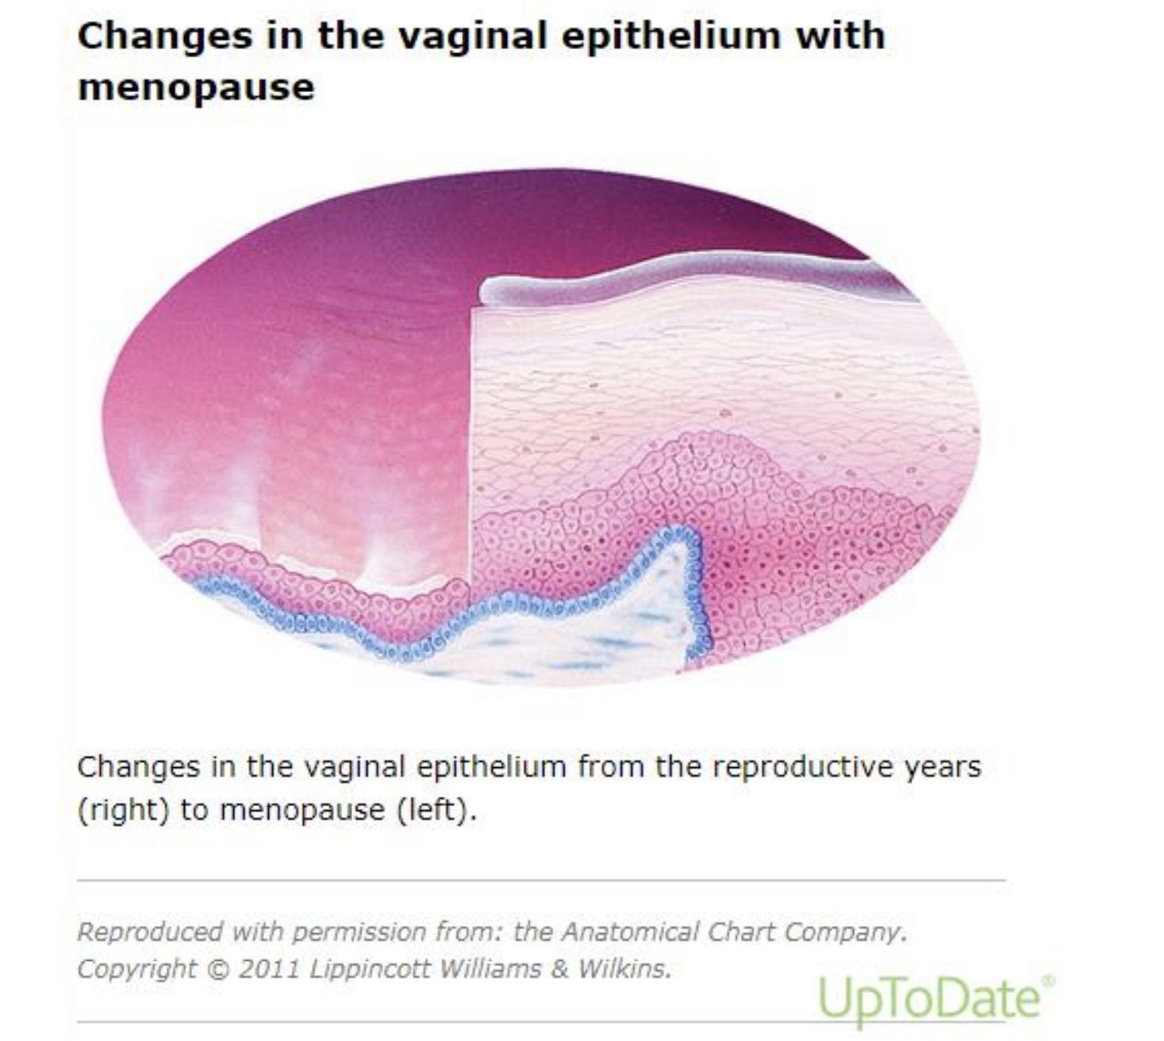
Recurrent urinary tract infection (UTI)
Discharge and odour
Decrease in blood flow
Decrease in lubrication
Loss of elasticity
Atrophic vaginitis
Pain
Sexual dissatisfaction
Notes:
casser ce cercle vicieux, en parler

Slide 9
Pathophysiology
Alteration of vaginal microbiota
  The low glycogen content of the thinned epithelium leads to
  lactic acid production by lactobacilli in vaginal pH > 5
  These changes encourage predisposing affected patients to infection
    by skin and rectal flora
    Gardnerella vaginalis, streptococci, staphylococci, coliforms, diphtheroids as well as trichomonas species.
    vaginitis and UTIs
Lactobacilli Dominance and Vaginal pH: Why Is the Human Vaginal Microbiome Unique? Miller EA et al. Front Microbiol. 2016;7:1936. Epub 2016 Dec 8.
Notes:
These changes in the vaginal environment encourage the overgrowth of nonacidophilic coliforms and the reduction of lactobacillus species, thereby predisposing affected patients to infection by skin and rectal flora
structures are derived from the same embryologic origin as the genital tract and
are affected by a hypoestrogenic state

Slide 10
Deprivation glycogen content
Inhibits lactic acid production in the vagina
Increases vaginal pH 5-6
Low Estrogen
Vaginitis

Slide 11
Pathophysiology
Urinary tract
  the bladder, urethra, pelvic floor musculature, and endopelvic fascia
  also contain estrogen receptors
  consequences
    urethral atrophy
      decreased resistance
        stress urinary incontinence
        hematuria
    weakened bladder support
      risk of urgency, nocturia, recurrent UTIs and urethral prolapse
    loss of urethral seal
      predisposes to urinary leakage

Slide 12
Recurrent urinary tract infection (UTI)
Discharge and odour
Decrease in blood flow
Decrease in lubrication
Loss of elasticity
Atrophic vaginitis
Pain
Sexual dissatisfaction
Notes:
casser ce cercle vicieux, en parler

Slide 13
Pathophysiology
emerging data suggest that androgens also play a role
  AR have been reported in the mucosa, muscularis, and adventitial layers of the vagina
  androgens are precursors to the synthesis of estrogens
    indirect effect on this tissue through the aromatization pathway
    direct effect on this tissue as testosterone
The role of androgens in the treatment of genitourinary syndrome of menopause (GSM): International Society for the Study of Women's Sexual Health (ISSWSH) expert consensus panel review. Simon JA et al. Menopause. 2018;25(7):837.
Notes:
the effects of E2 loss on urogenital tissue have been well described,
some data available suggest androgens, such as testosteron may have

Slide 14
Pathophysiology
long-term consequences if untreated
  progessive worsening of symptoms
  they rarely resolve spontaneously and, in most cases,
    deteriorate if left untreated
    >negatively affecting patients confidence and intimacy with their partners
  increased risk of pelvic organ prolapse
  recurrent UTIs
    chronic bladder irritation
    antobiotic overuse

Slide 15
Epidemiology
urogenital disorders
  a frequent problem
    rarely mentioned by patients during consultations
  patients do not spontaneously mention their problems
    55% suffer from urinary incontinence at least once a week
    70% with vaginal dryness
    40% reporting pain during intercourse
impact ++ on quality of life
Notes:
some believe their symptoms are an expected and necessary part of the aging process
Cultural, religious, and societal beliefs, as well as embarrassment, may also play a role in making patients feel uncomfortable discussing concerns related to the genitourinary system.

Slide 16
Etiology and modifying factors
Natural or surgical menopause
Premature ovarian failure
Anti-oestrogen drugs
  Tamoxifen
  Aromatase inhibitors
  GnRH agonist
Post partum, breastfeeding
Hypothalamic amenorrhoea
Favouring factors
  nulliparity
  vaginal surgery
  abstinence
  smoking
duration of hypoE2 is a major factor in the development and severity of GSM
Castelo-Branco C, Maturitas. 2005
Notes:
For example, vaginal nulliparity or vaginal surgery may intensify vaginal atrophy symptoms [27,28]. Abstinence from sexual activity appears to exacerbate atrophic changes whereas sexual activity helps preserve the vaginal epithelium, presumably by increasing blood flow and tissue elasticity. Cigarette smoking causes relative estrogen deficiency and may reduce vaginal perfusion

Slide 17
Clinical presentation
vaginal symptoms
  vaginal lubrication during sexual activity
  Dyspareunia, including vulvar or vaginal pain
  Vulvar or vaginal bleeding
    postcoital bleeding, labial fissures
  Vulvovaginal burning, irritation, or itching
  Vaginal discharge (leukorrhea)

Slide 18
Clinical presentation
urinary symptoms
  dysuria
  urinary urgency and frequency
  nocturia
  recurrent UTIs
    < altered vaginal flora and urethral atrophy
  urethral prolapse

Slide 19
Clinical presentation
sexual dysfunction
  decreased libido
    < discomfort, pain and hormonal changes
    loss of interest in sexual activity
  arousal difficulties
    reduced blood flow and lubrication can impair sexual response

Slide 20
Clinical presentation
Symptoms accompanying vaginal atrophy are
  progressive and
  worsen as with duration of hypoestrogenism
  one of the first signs of estrogen insufficiency
    patients may notice a slight in vaginal lubrication upon sexual arousal
  As the hypoestrogenic state becomes chronic,
    sensation of vaginal dryness during daily activities, not necessarily during sexual activity

Slide 21
Evaluation
History
  asked about symptoms of urogenital atrophy during routine clinical visits
  use of products that may be irritants or result in allergic reaction
  ask about response to any previous interventions
  ask about painful vulvar symptoms, that may be associated with infection (DD)
  Quality of life issues should also be assessed
    include degree of discomfort
    the impact on daily activities, sexual activity, and partner relationships
    the clinician should ask about the patient's therapeutic goals
The role of local vaginal estrogen for treatment of vaginal atrophy in postmenopausal women: 2007 position statement of The North American Menopause Society. North American Menopause Society Menopause. 2007;14(3 Pt 1):355.
Notes:
many patients with symptoms do not bring them to the attention of a clinician`
. Patients who are not having vaginal intercourse due to pain or discomfort should be asked if this is something they would like to be able to have in the future, recognizing that there are often multiple factors (eg, relationship status, aging, partner sexual dysfunction, lack of interest) that affect this decision

Slide 22


Evaluation
Question to ask
  Does it feel different in any way around your vulva or vaginal area?
  Have you noticed any vaginal dryness or less discharge than you used to?
  Have you experienced any vaginal soreness, burning or irritation?
  Do you have any itching around your vagina or vulval area?
  Is sexual intercourse painful or uncomfortable?
  Have you noticed any changes in vaginal discharge?
  Have you noticed any symptoms such as increased urinary frequency or being less able to hold on to urine?
  Have you noticed any changes in sexual arousal, sexual function, or your ability to climax?
  Have you experienced any leakage or urine during sex?

Slide 23
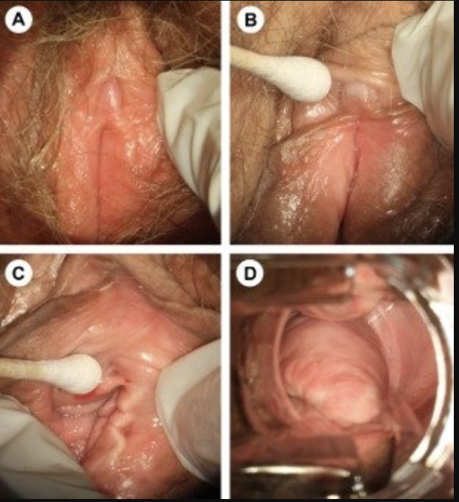
Evaluation
Pelvic examination
  Labia minora resorption or fusion
  Tissue fragility/fissures/petechiae
  Introital retraction
  Loss of hymenal remnants
  Prominence of urethral meatus
  Urethral eversion or prolapse
  Vulvovaginal pallor/erythem
  Loss of vaginal rugae
  Decreased vulvovaginal secretions/lubrication
  Decreased elasticity
  vaginal discharge that is thin, white, and nonodorous
Notes:
Atrophy of the vulva, clitoris, and vagina. (A) Vaginal atrophy is associated with pale, dry, shiny vulvar tissue and loss of adipose tissue in the labia majora and labia minora. (B) The prepuce and clitoris are often pale and reduced in size, while examination shows that (C) the introitus may be narrowed and friable. (D) In vaginal atrophy, the vaginal walls lack rugae and may be pale and/or erythematous

Slide 24
Evaluation
Laboratory evaluation
  laboratory tests are usually not necessary for the diagnosis
    other than for exclusion of other etiologies
    or to assess the efficacy of treatments in research studies
  Vaginal pH
    pH of an E2 vagina is acidic, typically in the range of 4 to 4.5
    reach levels of 5.5 to 6.8 or higher in postmenopausal patients
    pH of ≥5 in the absence of other causes can be an indicator of vaginal atrophy
  Maturation index
    is the proportion of parabasal, intermediate, and superficial cells
    in each 100 cells counted on a smear
Urogenital atrophy: prevention and treatment. Willhite LA, O'Connell MB Pharmacotherapy. 2001;21(4):464.
Notes:
and evaluation of GSM,

Slide 25
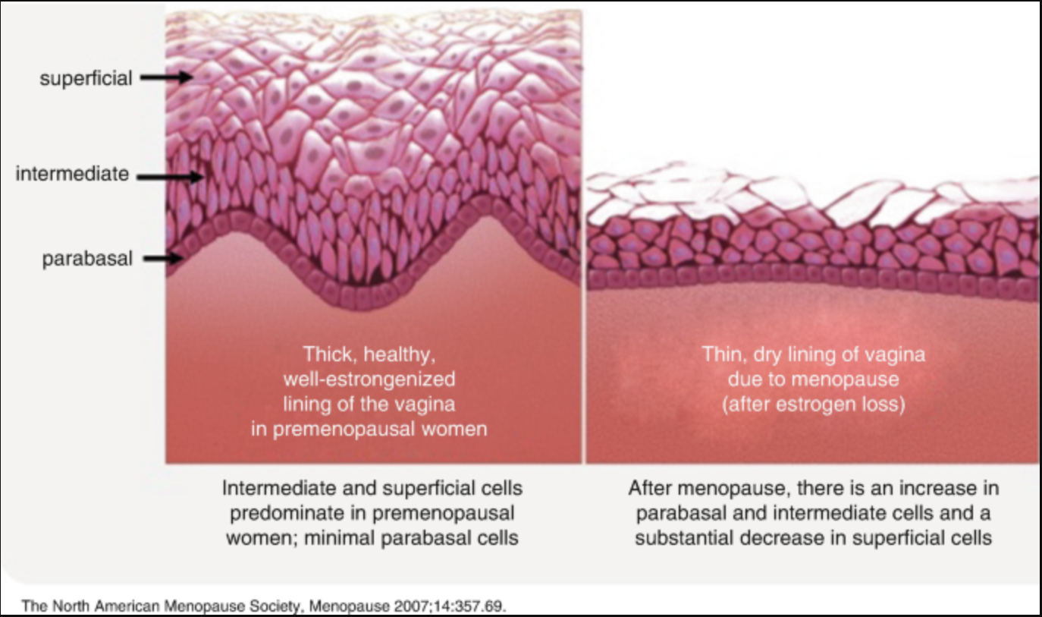

Slide 26
Evaluation
There are several patient-reported outcomes measures PROMs
  Vulvovaginal Atrophy Questionnaire
  Female Sexual Function Index (FSFI)
  Day-to-Day Impact of Vaginal Aging (DIVA)
  Menopause-Specific Quality of Life Questionnaire
Clinical score
  VHI
    vaginal secretions, pH, elasticity, hydration, and the epithelial mucous membrane condition
Notes:
available to measure only one component of GSM

Slide 27
Differential diagnosis
Vaginitis and vaginosis
  abnormal discharge, intense itching, culture +
Vulvar dermatitis in response to environmental agents
Vulvar lichen sclerosus
  white lesions, intense itching, postivie biopsy
Vulvovaginal lichen planus
Genital tract ulcers or fissures < to herpes lesions or systemic disease
Genital tract bleeding < to trauma, infection, or malignancy
Vulvodynia
Other etiologies of frequent urinary tract infection
Notes:
may be due

Slide 28
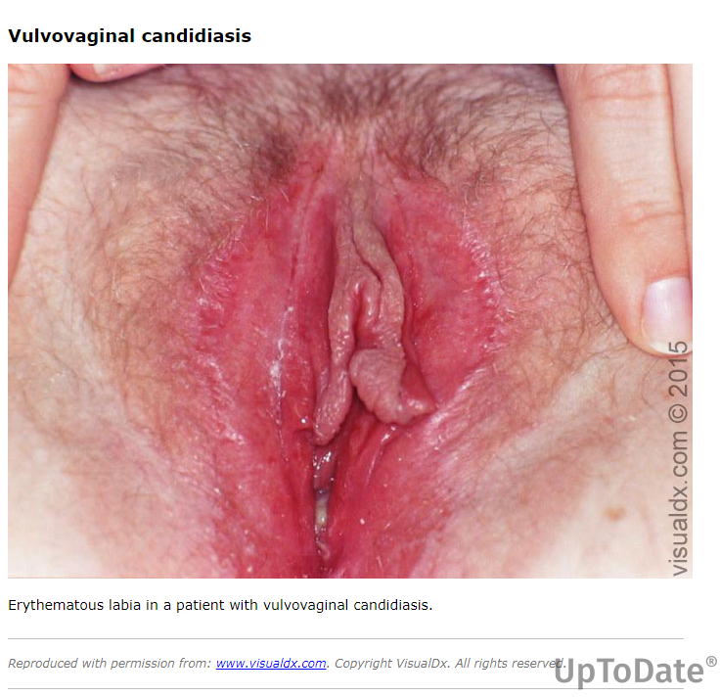

Slide 29
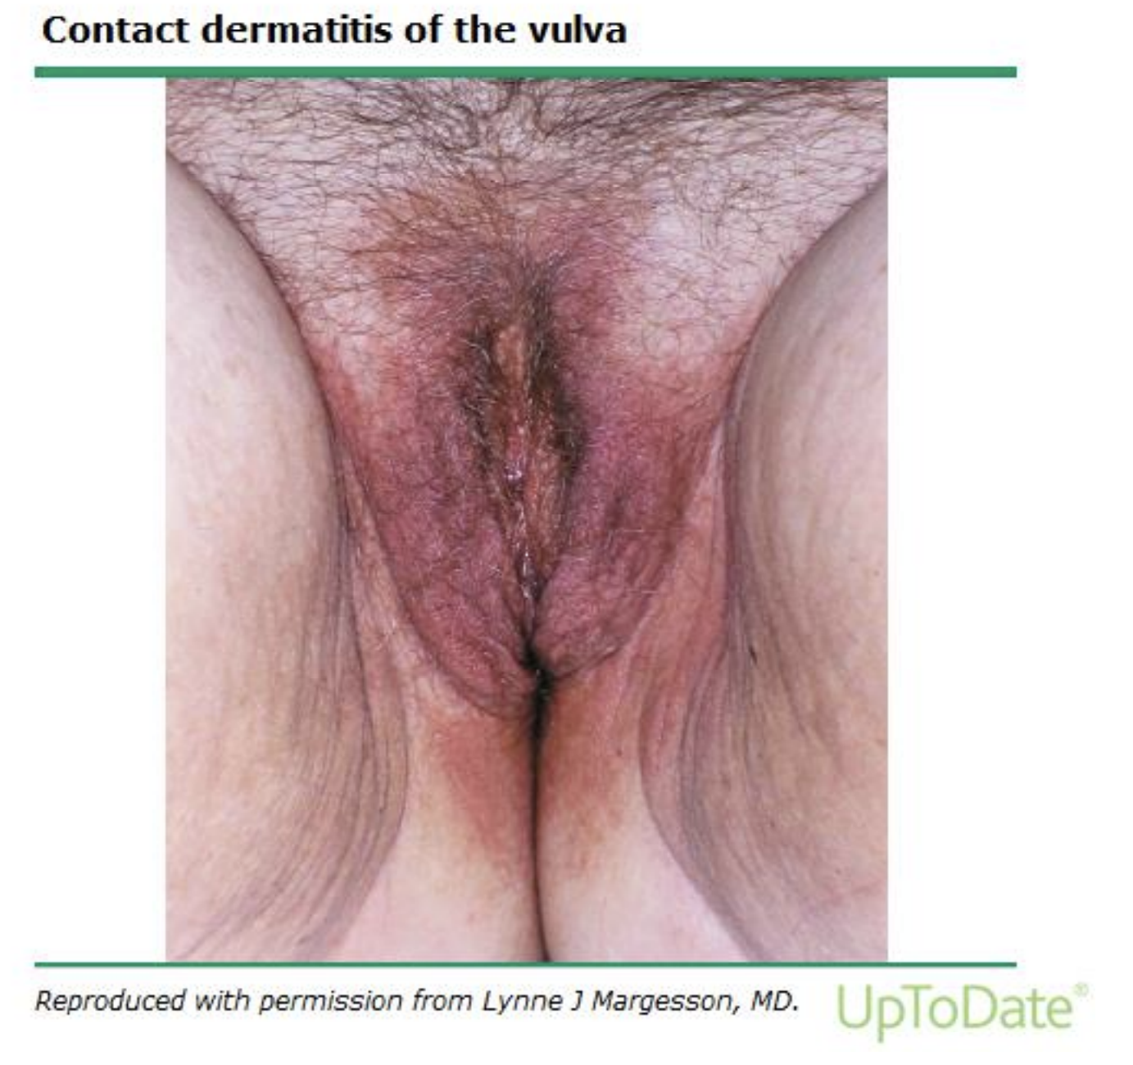

Slide 30
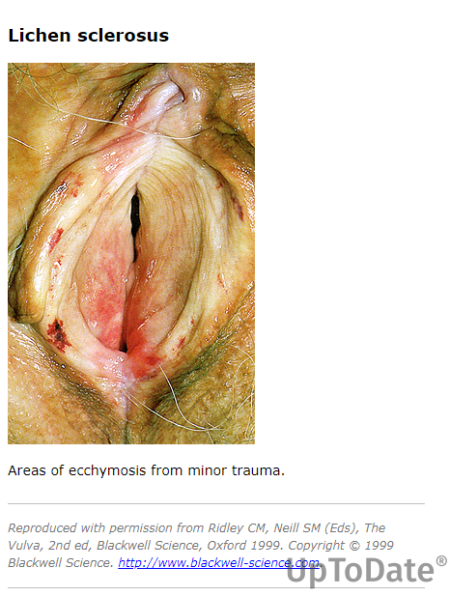

Slide 31
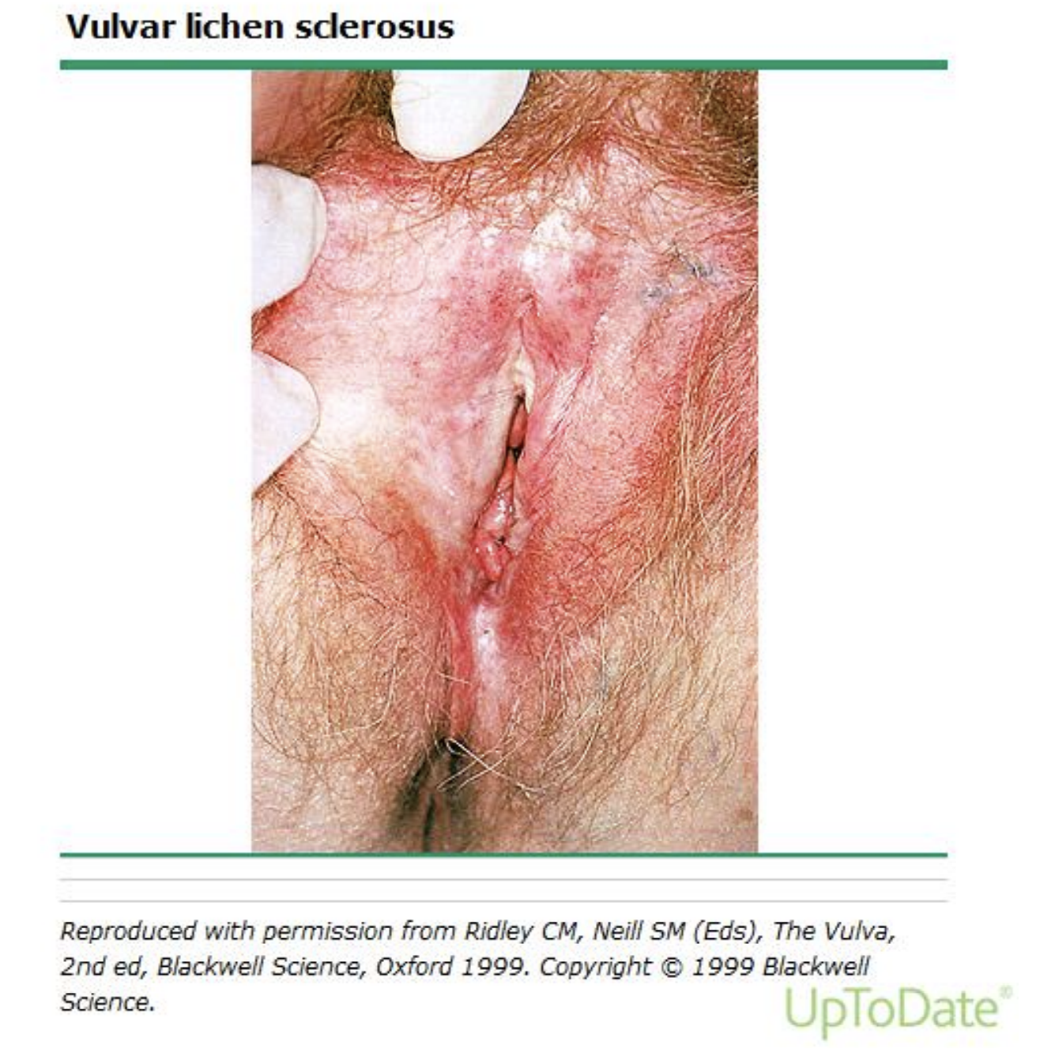

Slide 32
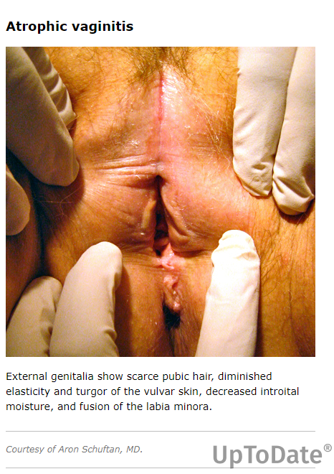

Slide 33
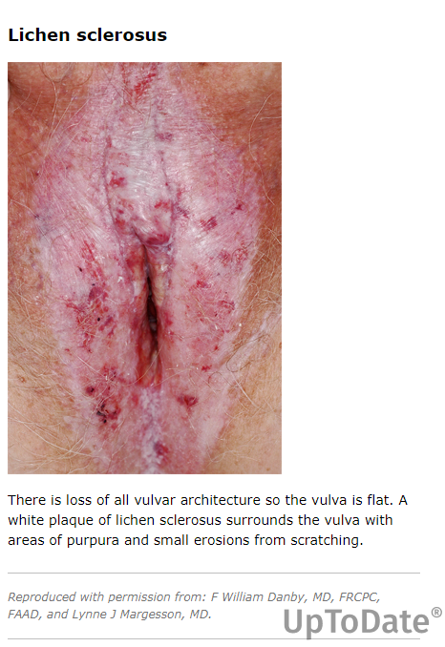

Slide 34
Take home message
GSM
  a frequent complication of hypoestrogenism
  characterized by various symptoms
    vaginal dryness, dyspareunia, and dysuria
  quality of life, sexual health and urinary function
  common but underdiagnosed and worsening over time
    It’s important to ask patients about it
  differentiating from other conditions is crucial to avoid misdiagnosis

