Slide 1



Revisiting Hormonal Treatments and Thrombosis Risks:
New Insights and Perspectives
Professeur Cedric HERMANS
MD, PhD, FRCP (Lon, Edin)
Brussels, BELGIUM
Version 21/03/2025 - FINALE

Slide 2
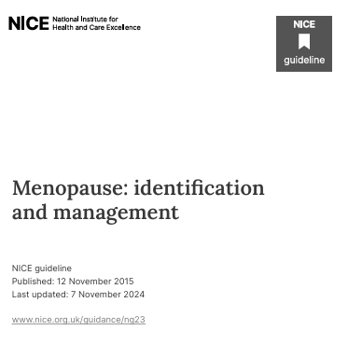
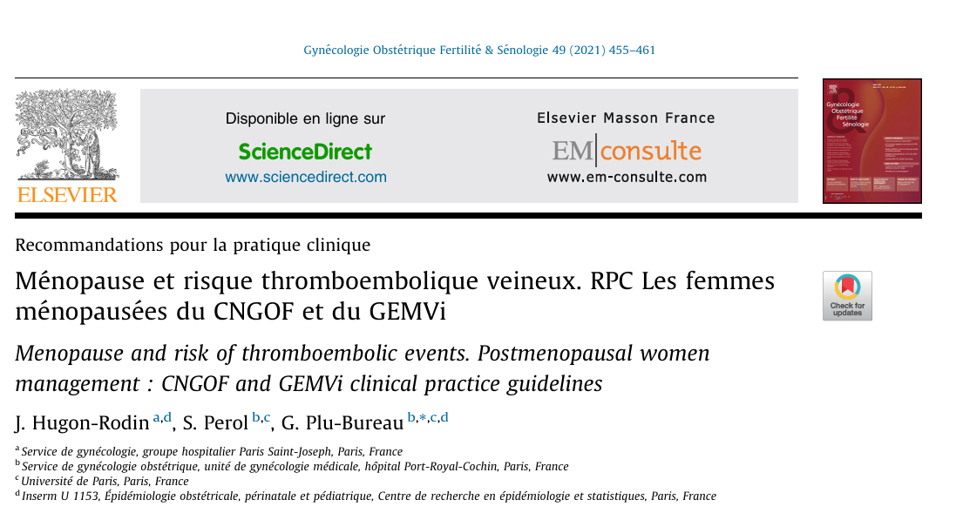
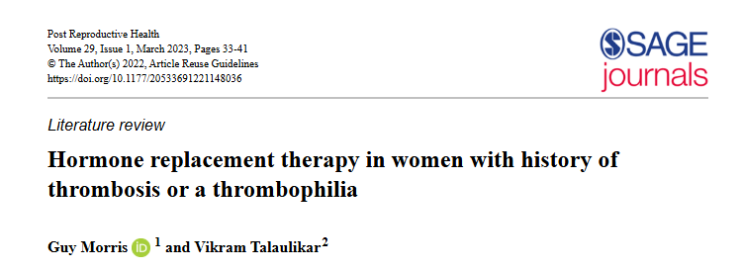

Slide 3
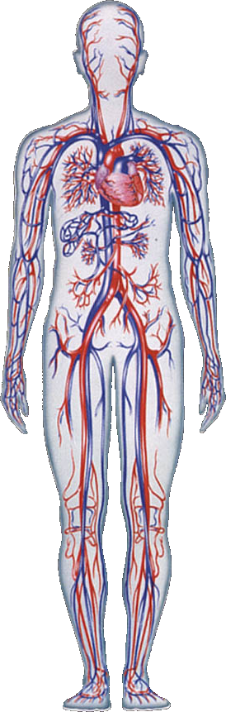
Arterial thrombosis
Stroke
Myocardial Infarction
Pulmonary Embolism
Venous thrombosis
Deep venous thrombosis
Cedric Hermans – UCL.
Abbreviation see last slide

Slide 4
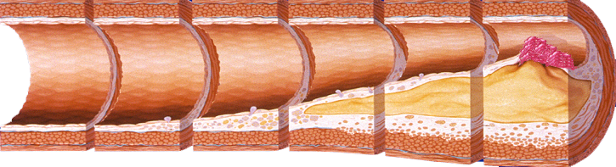
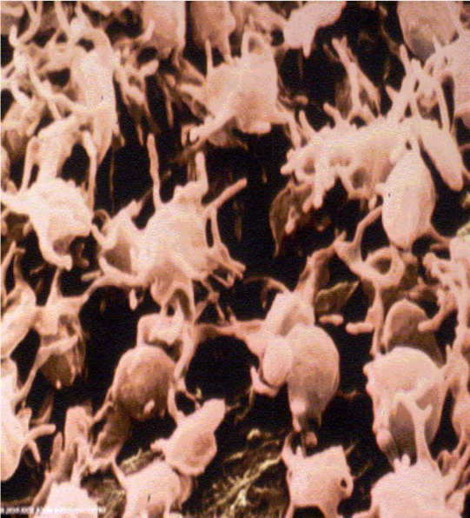
Arterial thrombosis
Unstable angina
Myocardial Infarction
Stroke - TIA
Acute ischaemia lower limbs
Cardio-Vascular Death
Atherosclerosis
Atherothrombosis
Cardiac ischaemia
Arterial insufficiency
Abbreviation see last slide
Adapted from Stary HC et al. Circulation. 1995; 92: 1355–74, and Fuster V et al. Vasc Med. 1998; 3: 231–9.
Notes:
Atherothrombosis is the common underlying disease process for MI, ischemic stroke, and vascular death.
Acute coronary syndrome (ACS) is a classic example of atherothrombosis (plaque rupture and thrombus formation).
ACS (in common with ischemic stroke and critical leg ischemia) is typically caused by rupture or erosion of an atherosclerotic plaque followed by formation of a platelet-rich thrombus.
Atherosclerosis is an ongoing process affecting mainly large and medium-sized arteries, which can begin in childhood and progress throughout a person’s lifetime.
Stable atherosclerotic plaques may encroach on the lumen of the artery and cause chronic ischemia, resulting in (stable) angina pectoris or intermittent claudication, depending on the vascular bed affected.
Unstable atherosclerotic plaques may rupture, leading to the formation of a platelet-rich thrombus that partially or completely occludes the artery and causes acute ischemic symptoms.
Reference:
1. Drouet L. Cerebrovasc Dis 2002; 13(suppl 1): 1–6.

Slide 5
Risk Factors for Atherothrombosis
Hypercoagulable states
Life-style
(e.g., smoking, diet,
lack of exercise)
Hyperlipidemia
Homocysteinemia
Hypertension
Diabetes
Infection ?
Obesity
Age
Atherosclerosis
Genetics
Gender
Atherothrombotic Manifestations
Cannabis
(MI, Ischemic Stroke, Vascular Death)
Abbreviation see last slide
Cedric Hermans – UCL.

Slide 6
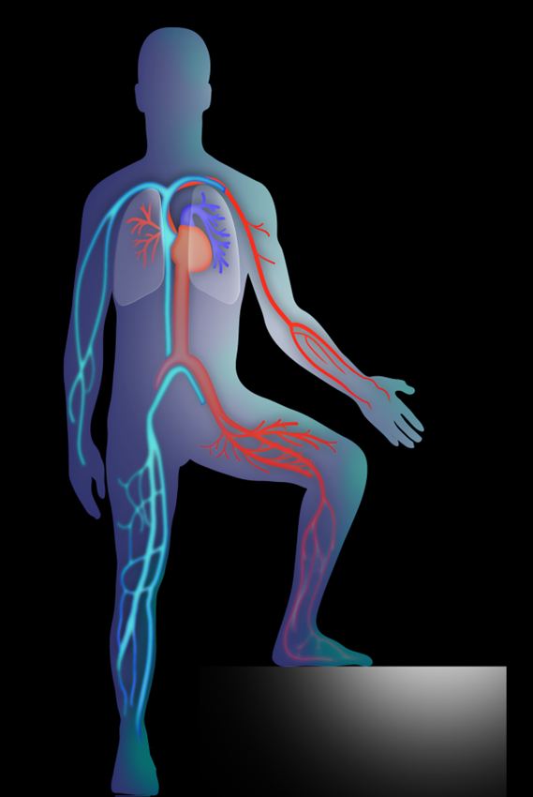
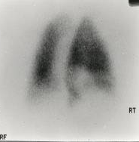
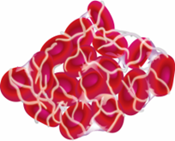

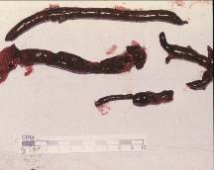

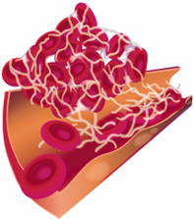
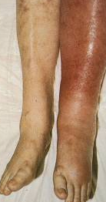
VTE: Deep Vein Thrombosis and
Pulmonary Embolism
Migration
PE
Embolus
Thrombus
DVT
Notes:
VTE: deep vein thrombosis and pulmonary embolism
There is a very strong association between PE and DVT.¹
90% of pulmonary emboli are the result of DVT^{2,3}
82% of patients with acute PE have detectable DVT at the time PE is diagnosed¹
Approximately 50% of patients with proven proximal DVT have an associated PE, which is asymptomatic in >50% of cases¹
[This slide contains animations]
References
1. Girard P et al. Chest 1999;116:903–908
2. Anderson FA, Jr, Audet A-M. Available at: http://www.outcomes- umassmed.org/dvt/best_practice/. Accessed August 2011
3. Hull D et al. Chest 1986;89;374S–383S

Slide 7


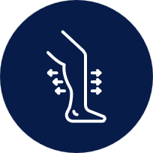

What are the characteristics of VTE?
Common symptoms of DVT in the leg, arm, or groin:¹
Common symptoms of PE:^{2,3}
Swollen veins that are hard or sore
Pale/blue toes,
ﬁngers, and lips
Low blood pressure
Red/darkening discoloration of skin
Light-headedness
Loss of consciousness
Sudden severe chest pain
Pleuritic chest pain
(when you take a breath)
Leg/arm swelling
Warm to touch
Increased heart rate
Cardiac arrhythmias
Pain, worsening when
bending the foot if DVT
is in leg
Cramps, especially at night
Sudden shortness of breath
Cough/wheezing
Rapid breathing

Slide 8
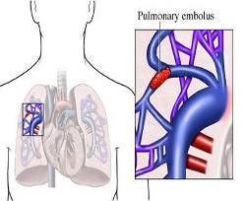
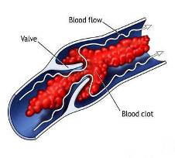
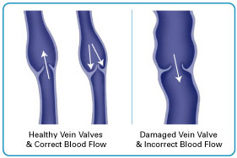
COMPLICATIONS OF DEEP VENOUS THROMBOSIS
DVT
Pulmonary
Embolism (PE)
Post-thrombotic
Syndrome
DVT recurrence

Slide 9
Women and venous thrombotic challenges
Risk factors for VTED
Age
Obesity
Past history of VTED (risk factors ? recurrence ? )
Family history of VTED (1st degree relative – before age of 50)
Thrombophilia (which ?)
Venous insufficiency
Lifestyle
…
Contraception
(Oestrogen)
Pregnancy
Menopause
HRT
Post-partum

Slide 10
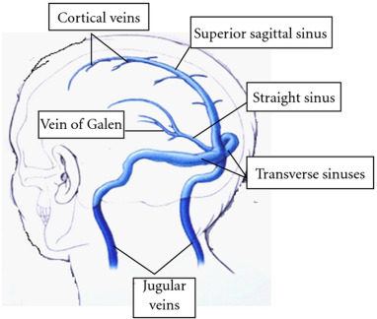
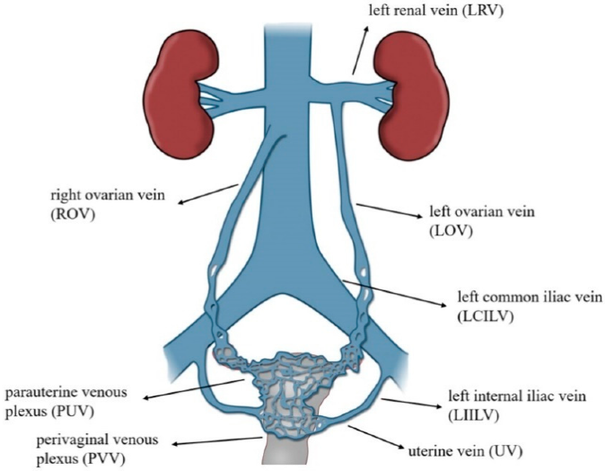
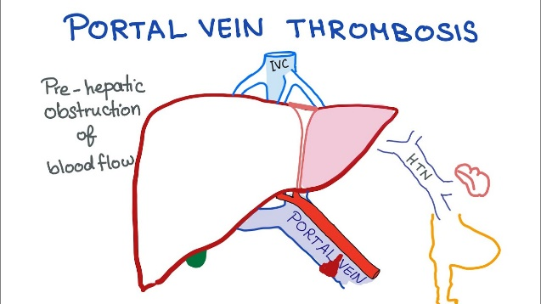
Venous thromboses in Women / Girls ?
DVT in lower limbs
Pulmonary embolism
Cerebral venous
thrombosis
Ocular venous thrombosis
CRVO
BRVO
Visceral venous thrombosis
Ovarian
Venous
thrombosis
Incidence : 5 / 10.000 Women year
DVT upper limb

Slide 11
Risk factors for thrombosis in women according to age
Contraception / OP pill
Pregnancy (Spontaneous – IVF)
Postpartum
HRT
Cancers and hormonal therapies

Slide 12
Risk factors for thrombosis
Risk Factors | Relative Risk
Past history of thrombosis | 16-35 x
Surgery | 6-22 x
Cancer | 6 x
Pregnancy and postpartum | 4-14 x
Immobilisation | 13 x
Thrombophilia | 2-50 x
OP pill | 3-4 x
HRT (oral) | 3-4 x
Obesity, long-haul flights, venous insufficiency | 2-4 x

Slide 13
Venous thrombo-embolic diseases:
Risk factors
Hormonal Treatments
Oral contraception
HRT
Androgens
Pregnancy
Post-Partum
Post-op
Post-trauma
Venous insufficiency
Cancer
Cancer treatments
Anatomical causes
Thoracic outlet syndrome/ Cockett Syndrome / Vascular malformation
Prolonged immobility /Travel
Dehydration/Hyperviscosity
Obesity/ Metabolic Syndrome
Heparin-Induced Thrombocytopenia
(HITT – PF4)
Chronic inflammatory diseases
(RA – Crohn – Behçet -…)
Nephrotic Syndrome
Hematological diseases
Myeloproliferative syndromes
PNH
Vaccinations
Thrombophilia
Hereditary and acquired
Klinefelter Syndrome
Viral infections
CMV – COVID-19
IDIOPATHIC,
Other …

Slide 14
Thrombophilia
Predisposition to venous trhombosis
Facteur V Leiden – 5 % of the population
FII (Prothrombin) G20210A mutation
1 % population
High FVIII
(? Implication)
Anti-phospholipid Antibodies (aquired)
Abs 5 % of population
Anti-PL syndrome : 5/100/000
AT, proteins C or S deficiency (rare)
Hyper-Homocysteinemia
(Limited relevance)

Slide 15
Thrombosis, Oral Contraception, and FV Leiden
Oral contraception | FV Leiden mutation | Risk of VTED / 10,000/year
No | No | 1
Yes | No | 2-3
No | Heterozygous | 5-7
Yes | Heterozygous | 30
No | Homozygous | 30
Yes | Homozygous | 100

Slide 16
Modeling the risk of venous thrombosis
Immobilization
Threshold for DVT/PE
Pregnancy
Factor V Leiden
Thrombotic Risk
Pill
Basal level
Age
Adapted from Rosendaal FR: Lancet 353: 1167, 1999.

Slide 17
VTED : epidemiology
Incidence :
  0.4-1.5 / 10.000 / year (25-29 years)
  0.6-3 / 10.000 / year (40-44 years)
  70.0000 deep venous thrombosis / year (France)
  20.000 deaths – PE / year (France)
PULMONARY EMBOLISM :
First cause of death in young women

Slide 18
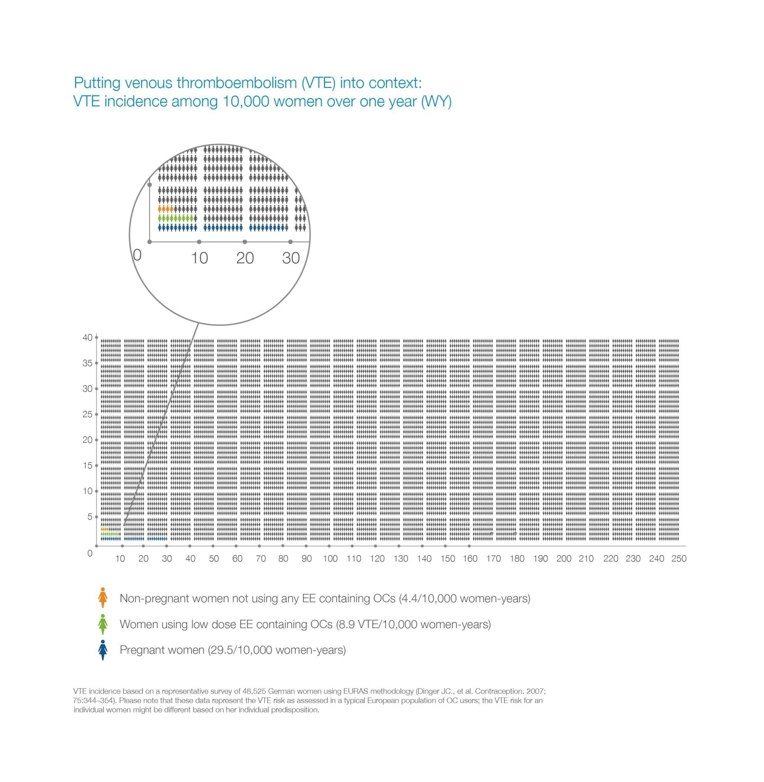
Risk of VTED among 10.000 women over 1 year
Non-pregnant women not using ethinylestradiol (EE)-containing COCs (4.4 events per 10,000 women-years)
Women using low-dose EE-containing COCs (8.9 events per 10,000 women-years)
Pregnant women (29.1 events per 10,000 women-years)
18
Dinger JC, Heinemann LA, Kühl-Habich D. The safety of a drospirenone-containing oral contraceptive: final results from the European Active Surveillance Study on Oral Contraceptives based on 142,475 women-years of observation. Contraception 2007; 75(5): 344–54.
Figure compiled using data from Dinger, et al. Contraception 2007;75:344–54
Notes:
18
18

Slide 19
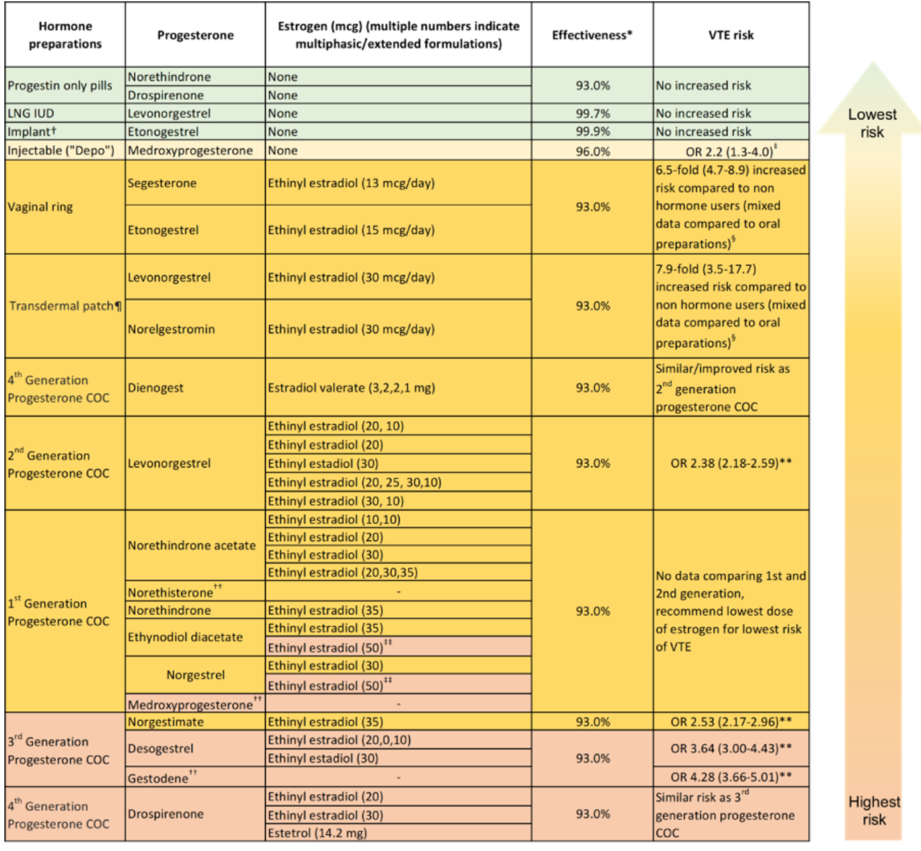

Slide 20
Hormone preparations | Progesterone | Estrogen (mcg) ( multiple numbers indicate multiphasic/extended formulations) | effectiveness | VTE risk
Progestin only pills | Norethindrone | None | 93.0 % | No increased risk
 | Drospirenone | None
LNG IUD | Levonorgestrel | None | 99.7 % | No increased risk
Implant | Etonogestrel | None | 99.9 % | No increased risk
Injectable (« Depo ») | Medroxyprogesterone | None | 96.0 % | OR 2.2 (1.3-4.0)
Vaginal ring | Segesterone | Ethinyl estradiol (13 mcg/day) | 93.0 % | 6.5-fold (4.7-8.9) increased risk compared to non hormone users (mixed data compared to oral preparations)
 | Etonogestrel | Ethinyl estradiol (15 mcg/day)
Transdermal patch | Levonorgestrel | Ethinyl estradiol (30 mcg/day) | 93.0 % | 7.9-fold (3.5-17.7) increased risk compared to non hormone users (mixed data compared to oral preparations)
 | Norelgestromin | Ethinyl estradiol (30 mcg/day)
4th Generation Progesterone COC | Dienogest | Estradiol valerate (3,2,2,1 mg) | 93.0 % | Similar/improved risk as 2nd generation progesterone COC
Lowest risk
Highest risk
Res Pract Thromb Haemost. 2022;6:e12763.

Slide 21
Hormone preparations | Progesterone | Estrogen (mcg) ( multiple numbers indicate multiphasic/extended formulations) | effectiveness | VTE risk
2nd Generation Progesterone COC | Levonorgestrel | Ethinyl estradiol | 93.0 % | OR 2.38 (2.18-2.59)
1st Generation Progesterone COC | Norethindrone acetate | Ethinyl estradiol | 93.0 % | No data comparing 1st and 2nd generation, recommend lowest dose of estrogen for lowest risk of VTE
 | Norethisterone⁺⁺
 | Norethindrone | Ethinyl estradiol
 | Ethynodiol diacetate | Ethinyl estradiol
 | Norgestrel | Ethinyl estradiol
 | Medroxyprogesterone
3rd Generation Progesterone COC | Norgestimate | Ethinyl estradiol | 93.0 % | OR 2.53 (2.17-2.96)
 | Desogestrel | Ethinyl estradiol | 93.0 % | OR 3.64 (3.00-4.43)
 | Gestodene |  | 93.0 % | OR 4.28 (3.66-5.01)
4th Generation Progesterone COC | Drospirenone | Ethinyl estradiol | 93.0 % | Similar risk as 3rd generation progesterone COC
 |  | Estetrol (14.2 mg)
Lowest risk
Highest risk
Res Pract Thromb Haemost. 2022;6:e12763.

Slide 22
Risk of thrombosis with HRT

Slide 23
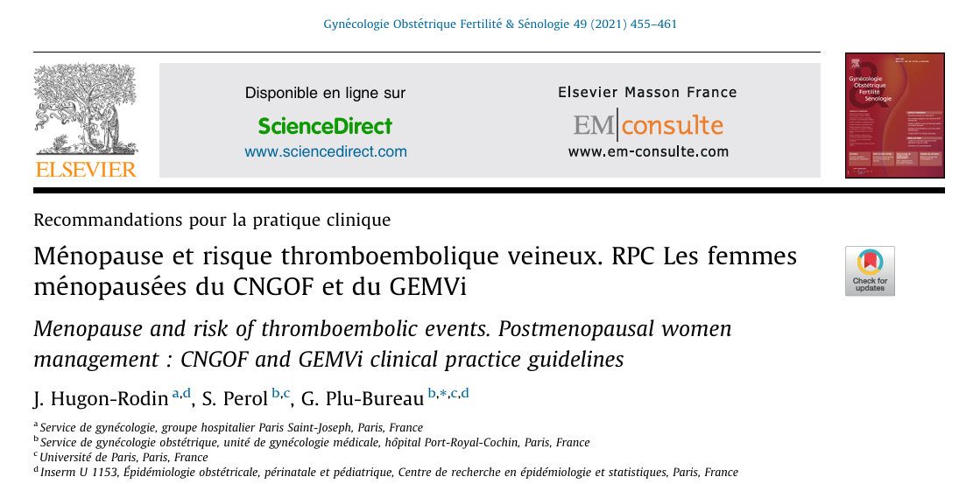

Slide 24
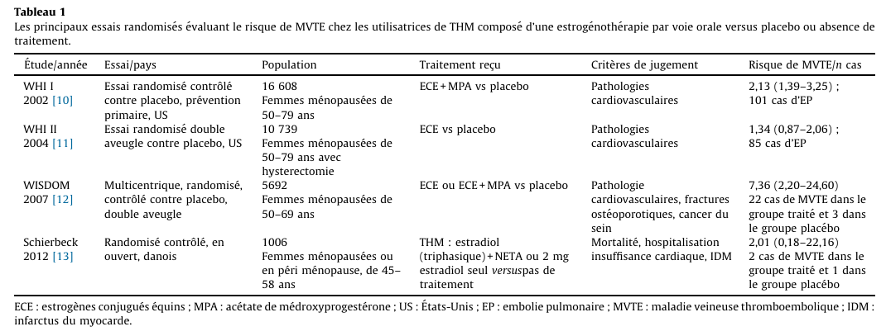
HRT and risk of venous thrombosis
Oral treatment

Slide 25
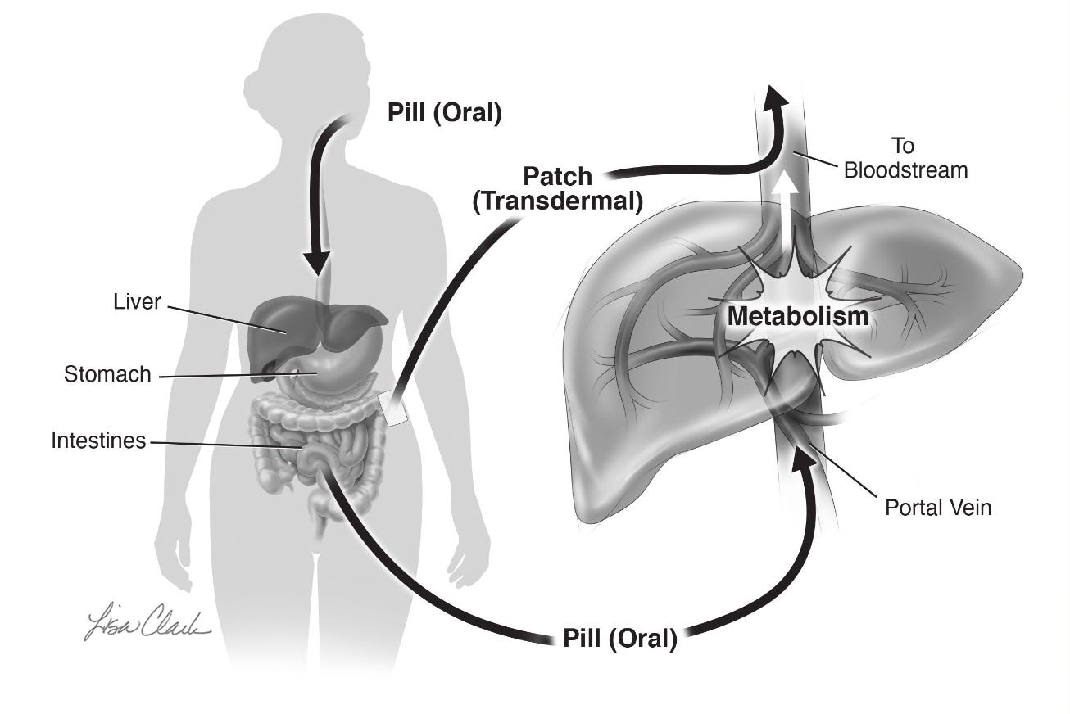
The reported link between HRT and risk of blood clot is based on a study conducted 20 years go where women were given older types of oestrogen (CEE), older synthetic progestagens and the oestrogen was taken in tablet form
High levels of oestrogen in the liver following oral intake lead to hypercoagulability

Slide 26
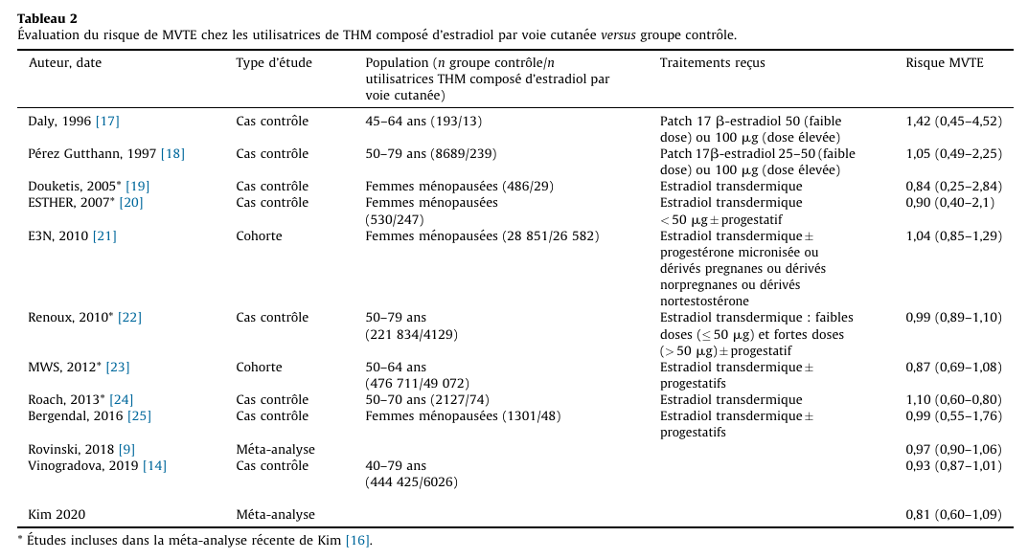
HRT and risks of venous thrombosis
Transdermal
treatment

Slide 27
HRT in the past
HRT today
Transdermal Oestrogens
Oestradiol
Oral oestrogens
CEE (Conjugated Equine Estrogens)
EE (Esterified Estrogens)
c
Oral progestagens
Medroxyprogesterone
Dihydrogesterone
Levonorgestrel
Drosperinone
Micronised progesterone

Slide 28
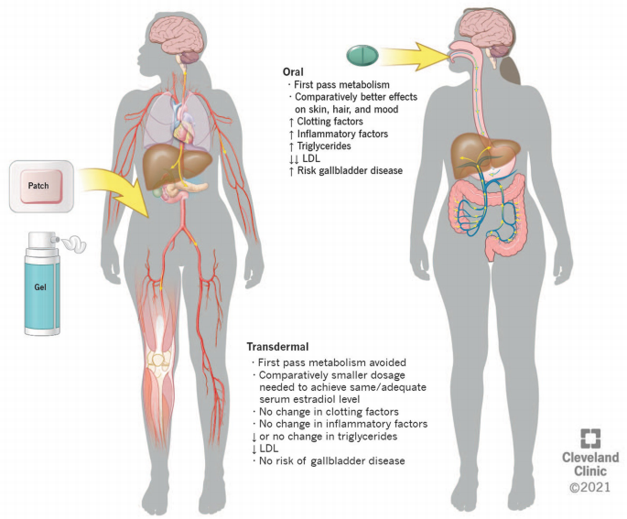
First-Pass Metabolism and Estrogens
When oral estrogens are taken, they pass through the liver before reaching systemic circulation.
This first-pass effect leads to increased hepatic protein synthesis, including clotting factors, inflammatory markers, and fibrinolysis inhibitors.
Transdermal routes bypass this hepatic first-pass metabolism, leading to lower systemic impact on coagulation.

Slide 29
Risk of thrombosis
Contraception
(OP)
oral
Vaginal
Transdermal
=
=
Hormonal Replacement therapy
Oral
Transdermal
>
Blood markers of hypercoagulability
No blood markers of hypercoagulability

Slide 30
Healthy woman 50 year of age
Risk of VTED : 6/10,000/year
With oral HRT : 12/10,000/year
With transdermal HRT : 6/10,000/year

Slide 31
HRT
If uterus present
Transdermal oestrogen ideally
Oral micronised progestative
Pregnane progestative
(no increased risk of thrombosis)
IUD
Levonorgestrel
It is important to note that data regarding use of levonorgestrel intrauterine system in women at risk of thrombosis are limited and larger studies are desirable.

Slide 32

Oestrogel (+ Utrogestan)

Slide 33
Starting hormonal therapy or hormone replacement therapy
No routine laboratory
screening for thrombophilia
recommended
Personal history of VTE
Family history of VTE
Active malignancy
BMI >30 kg/m2
Other risk factors
Start therapy
No
Emergence
of risk factors 
Yes
Hormonal contraceptive therapy
Hormonal replacement therapy
Consider methods without
increased VTE risk, i.e. :
Male partner methods if applicable
Progestin-only pills
LNG IUD
implant
If the former are of
inadequate effectiveness
or intolerable, recommend
COC with levonorgestrel or
dienogest with lowest dose
estrogen possible
If still desired after risk
benefit discussion,
recommend transdermal
estrogen at lowest
effective dose and/or
topical vaginal estrogen

Slide 34
HRT and Factor V Leiden
Factor V Leiden
Risk for VTED in the absence of hormonal treatment
3-4 X
Risk of VTE
FVL + oral contraception
25 X
Risk of VTE
FVL + HRT (transdermal)
3-4 X

Slide 35
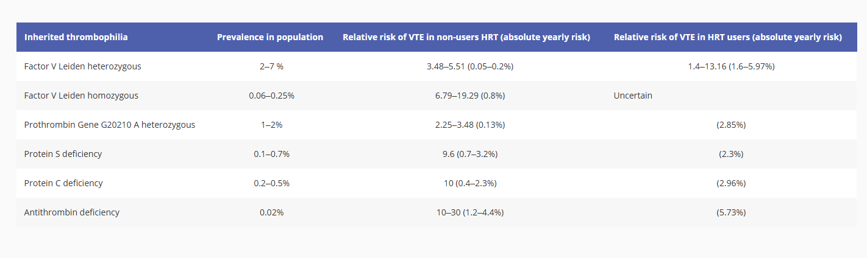
Relative risk of venous thromboembolism in users and non-users of hormone replacement therapy (oral) for the most common heritable thrombophilias
Although there is plenty of evidence that transdermal HRT does not increase VTE risk in healthy women with no background problems, data in women with history of thrombosis or thrombophilia are limited. Extrapolation of results from one group to another should be done with caution.

Slide 36
HRT and thrombophilia
No need for thrombophilia screening before starting HRT
If positive family history and known thrombophilia, screening should be considered
Limited evidence that Transdermal HRT is totally safe in patients with (severe) thrombophilia and past history of thrombosis
Caution in patients who had a hormonal-dependent thrombosis
(pill, pregnancy,…)

Slide 37
HRT in women with a personal history of venous thrombosis
Endocrine Clinical Practice Guideline
The British Menopause Society
A prior history of VTE confers the highest risk. If the patient has a known inherited coagulation defect, such as Factor V Leiden, oral HRT should be avoided because research has shown a high risk of VTE recurrence. A history of VTE due to pregnancy, oral contraceptives, unknown aetiology or blood clotting disorders poses a contraindication to any estrogen therapy, whereas VTE due to past immobility, surgery, or bone fracture would be a contraindication to oral but not necessarily transdermal MHT
In the presence of known risk factors for VTE, including personal history of VTE or family history of VTE, the combination of transdermal estrogen and micronised progesterone offers a safer option that is unlikely to significantly increase VTE risk above the individual’s intrinsic risk.

Slide 38
Any consideration about using HRT in women with previous DVT should be take into account
- the severity of menopausal symptoms,
- risk factors for VTE,
- circumstances at the time of past VTE,
- use of anticoagulants,
- medical comorbidities
Where necessary a decision about treatment should be reached in liaison with the haematology team.

Slide 39
HRT and Cancer
Cancer
Risk for VTED increased
Pancreas, colon, lung, stomach, ovary
Tamoxifen
Avoid HRT if oestrogen dependent cancer
Prefer transdermal oestrogen and micronised progesterone

Slide 40
HRT and Surgery
Surgery
Risk for VTED
increased ?
No need to stop transdermal oestrogen and micronised progesterone
Oral HRT should be interrupted

Slide 41

Coronary heart disease (Information in this table applies to people with no personal history of coronary heart disease) | Coronary heart disease risk does not increase with combined HRT Mortality from cardiovascular disease does not increase with combined HRT. [2024]
Stroke (Information in this table applies to people with no personal history of stroke) | Stroke risk is unlikely to increase with the use of combined HRT that includes transdermal oestrogen Stroke risk increases with combined HRT containing oral oestrogen and the increase rises with higher oestrogen dosage and longer duration of treatment, for example, if used for more than 5 years
Venous thromboembolism (VTE) | VTE risk is increased with oral HRT. VTE risk is greater with oral than transdermal HRT.

Slide 43
Weak risk
Moderate risk
High risk
Minor thrombophilia (heterozygous Factor V Leiden or heterozygous Prothrombin G20210A mutation)
Distal deep vein thrombosis (DVT) with a delay of more than 6 months, regardless of the triggering factor, with or without minor thrombophilia
Provoked proximal DVT or pulmonary embolism (PE) (excluding hormonal context) with a delay of more than 1 year
Family history of a single venous thromboembolism (VTE) event, with or without minor thrombophilia
Obesity without other vascular risk factors
Moderate thrombophilia (Protein C deficiency, Protein S deficiency, combined deficiency, Type HBS Antithrombin deficiency)
Unusual sites of venous thromboembolism (VTE) (e.g., cerebral venous thrombosis, portal vein thrombosis)
VTE in a hormonal or idiopathic context (excluding distal DVT) with a delay of more than 1 year
Recurrent distal VTE
History of VTE requiring long-term anticoagulation (excluding antiphospholipid syndrome - APS)
Multiple family history of VTE before age 50
Proximal DVT or PE associated with another risk factor (e.g., obesity, biological thrombophilia)
Multiple venous vascular risk factors
Distal deep vein thrombosis (DVT) < 6 months
Venous thromboembolism (VTE) (excluding distal DVT) < 1 year
Antiphospholipid syndrome (APS) (with or without anticoagulant or antiplatelet therapy)
Documented antithrombin deficiency, excluding Type HBS deficiency
Transdermal oestradiol + utrogestan
Case by case
Contra-indicated

Slide 44
Weak risk
Moderate risk
High risk
Minor thrombophilia (heterozygous Factor V Leiden or heterozygous Prothrombin G20210A mutation)
Distal deep vein thrombosis (DVT) with a delay of more than 6 months, regardless of the triggering factor, with or without minor thrombophilia
Provoked proximal DVT or pulmonary embolism (PE) (excluding hormonal context) with a delay of more than 1 year
Family history of a single venous thromboembolism (VTE) event, with or without minor thrombophilia
Obesity without other vascular risk factors
Moderate thrombophilia (Protein C deficiency, Protein S deficiency, combined deficiency, Type HBS Antithrombin deficiency)
Unusual sites of venous thromboembolism (VTE) (e.g., cerebral venous thrombosis, portal vein thrombosis)
VTE in a hormonal or idiopathic context (excluding distal DVT) with a delay of more than 1 year
Recurrent distal VTE
History of VTE requiring long-term anticoagulation (excluding antiphospholipid syndrome - APS)
Multiple family history of VTE before age 50
Proximal DVT or PE associated with another risk factor (e.g., obesity, biological thrombophilia)
Multiple venous vascular risk factors
Distal deep vein thrombosis (DVT) < 6 months
Venous thromboembolism (VTE) (excluding distal DVT) < 1 year
Antiphospholipid syndrome (APS) (with or without anticoagulant or antiplatelet therapy)
Documented antithrombin deficiency, excluding Type HBS deficiency
Hematologist should ideally be consulted
Transdermal oestradiol + utrogestan
Case by case
Contra-indicated

Slide 45
No risk of thrombosis with
topical vaginal oestrogen

Slide 46
Patients on COC/HRT who experience VTE
Start anticoagulation as able to
While on anticoagulation, can continue
COC/HRT, especially to prevent rebound
symptoms and menstrual bleeding
(which may be worse on anticoagulation)
No
After 3 months of anticoagulation
Stopping COC/HRT
Thereafter ?
Continue
anticoagulation
while on COC/HRT
Yes
No
Consider stopping anticoagulation if no ongoing provoking factors
such as active malignancy,
immobility after surgery
etc.
Can consider stopping anticoagulation if able to switch to formulation
without risk of VTE

Slide 47

HRT and
venous thrombosis
Oral HRT increases the risk of venous thrombosis by a factor of 2 to 4.
The estrogen doses used are lower than those in oral contraceptives.
The risk is highest during the first year of treatment.
Age is an additional risk factor.
No increased thrombotic risk has been observed with transdermal estrogen therapy (e.g., Oestrogel).
Cedric Hermans – UCL.

Slide 48
How to Reduce the Risk of Thrombosis in Patients Requiring Hormone Replacement Therapy (HRT)
Choose the Safest HRT Option
Prefer transdermal estrogen therapy (patch, gel, or spray) over oral estrogen, as it does not increase the risk of thrombosis.
Use the lowest effective dose for the shortest necessary duration.
For women with an intact uterus, combine estrogen with a progestogen, preferably micronized progesterone or dydrogesterone, which have lower VTE risk than synthetic progestins.
Consider non-hormonal alternatives (e.g., SSRIs, SNRIs, gabapentin) if HRT is not essential.

Slide 49
How to Reduce the Risk of Thrombosis in Patients Requiring Hormone Replacement Therapy (HRT)
2. Screen for Risk Factors Before Prescribing HRT
Personal or family history of VTE (deep vein thrombosis or pulmonary embolism).
Inherited thrombophilias (e.g., Factor V Leiden, prothrombin mutation) in carefully selected cases
Age and lifestyle factors (e.g., smoking, obesity, physical inactivity).
Cardiovascular risk factors (hypertension, diabetes, dyslipidemia).

Slide 50
How to Reduce the Risk of Thrombosis in Patients Requiring Hormone Replacement Therapy (HRT)
3. Encourage a Healthy Lifestyle
Promote regular physical activity to improve blood circulation.
Encourage weight management, especially for obese patients (BMI >30).
Advise against smoking and excessive alcohol consumption.
Ensure adequate hydration and movement during long-haul travel to reduce clot risk.

Slide 51
How to Reduce the Risk of Thrombosis in Patients Requiring Hormone Replacement Therapy (HRT)
4. Monitor Patients Closely
Reassess HRT indication and thrombosis risk regularly.
If HRT is necessary but risk factors exist, consider antithrombotic treatment or other preventive measures in consultation with a specialist.

Slide 52
Take-Away Messages
No systematic thrombophilia screening before starting OC or HRT
Detailed personal and family history is critical
Search for other risk factors ?
Careful selection of less thrombogenic treatment
Share-decision making

Slide 53
Thank you for your attention
hermans.cedric@gmail.com
cedric.hermans@uclouvain.be

