Slide 1
BMS - course
Definition – Reproductive stages – Related changes
Ameryckx Linda
Universitair ziekenhuis antwerpen

Slide 2




Definitions

Slide 3
Natural Menopause: 1year amenorhea due to spontaneous loss ovarian function – diagnosis in retrospect
Induced menopause: loss of ovarian function due to surgery , hormonal ‘castration’, chemo- radiotherapy
Mean age menopause ~ 51 year
Early menopause: menopause between age 40-45 year
Premature menopause or premature ovarian insufficiency (POI): loss ovarian function
  > age 40 (1%); age 30 (0,1%)
Notes:
We say a woman is in natural MP when she has’nt had a period for 1 year due to spontaneous cessation of ovarian function. So we make the diagnosis in retrospect.
MP can be induced after surgical removal of the ovaries, after hormonal castration or after destruction of ovarian tissue due to chemo/Radiorx
‘Natuurlijke menopauze’: het uitblijven van de menstruatie gedurende 12 opeenvolgende maanden a.g.v verlies van ovariële folliculaire activiteit zonder pathologische of fysiologische oorzaak. Menopauze heeft betrekking op de laatste menstruatie. De diagnose wordt aldus retrospectief gesteld, één jaar later. De gemiddelde leeftijd is 51 jaar.
‘Geïnduceerde menopauze’ : het uitblijven van de menstruatie t.g.v. heelkundige verwijdering van beide ovaria of een iatrogene destructie van ovariële activiteit (o.a. na chemotherapie of radiotherapie)
‘Premature menopauze’ en ‘vroege menopauze’: menopauze die veel vroeger intreedt dan de gemiddelde leeftijd van 51 jaar. Menopauze voor de leeftijd van 40 jaar is dus premature menopauze. POI of ‘premature ovariële ‘insufficiëntie’ is echter een betere term om het vroegtijdig ‘verlies’ van ovariële functie te beschrijven i.p.v. definitief ovarieel falen. Het komt voor bij +/- 1% vrouwen onder de leeftijd van 40 jaar en bij 0,1% onder de 30 jaar. Menopauze die intreedt tussen de leeftijd van 40 en 45 jaar is ‘vroege’ menopauze. Deze groep vrouwen verdient bijzondere aandacht gezien de hogere morbiditeit door vroegtijdig optreden van cardiovasculaire aandoeningen, osteoporose, cognitieve achteruitgang en seksuele dysfunctie. Er bestaat sterke consensus om, bij afwezigheid van contra-indicaties, hormonale substitutie te starten tot de gemiddelde leeftijd van de menopauze (51j).
‘Premenopauze’: de reproductieve periode vanaf de menarche tot de laatste menstruatie.
‘Postmenopauze’: de periode vanaf de laatste menstruatie of sinds het chirurgisch verwijderen van de eierstokken.
‘Perimenopauze’: de periode vanaf het optreden van de eerste klinische, biologische en endocrinologische veranderingen in een spontane cyclus tot een jaar na de laatste menstruatie. De periode kenmerkt zich door optreden van onregelmatige regels en het ontstaan van vasomotorische klachten. Ze wordt gevolgd door een spontane menopauze.
‘Menopauze transitie’: de periode voor de laatste menstruatie waarbij de menstruele cyclus steeds onregelmatiger wordt en climacterische klachten vaker optreden. Deze transitie periode wordt opgedeeld in een ‘vroege’ transitie waarbij de cyclus nog vrij regelmatig is maar korter of langer dan voorheen. In de ‘late’ transitieperiode zijn de cycli erg onregelmatig met vaak langere periodes van amenorroe vaak gevolgd door hevige of aanhoudende menstruatie. Deze worden afgewisseld met kort op elkaar volgende menstruaties. Het volume en patroon van de bloedingen varieert sterk tussen de cycli. (1)

Slide 4
Straw: stages of reproductive ageing
‘Gold standard’ Staging system
Criteria used to define the different stages
  Menstrual cycles
  Endocrinologic parameters: FSH, estradiol, AMH, inhibin-B
  Symptoms
  Fertility
  AFC (antral follicle Count)
Notes:
The STRAW staging system is considered the gold standard for characterizing reproductive aging through menopause

Slide 5
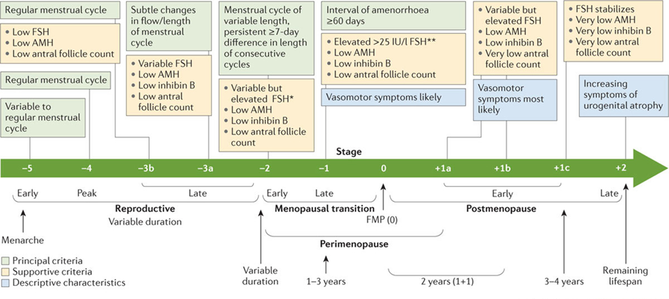
STRAW- staging system : adult female life divided into 3 phases
Notes:
STRAW divided the adult female life into three phases: reproductive, the menopausal transition, and postmenopause.
MP ussually doesn’t announce itself from one month to the other, except when awoman stops het COC. But ther is a transition period that takes many years. This period is divide in an early and a late TP

Slide 6
STRAW: 3 phases: subdivided in 7 stages centered around the FMP
Notes:
These three phases include a total of seven stages centered on the FMP (Stage 0)
The reproductive phase is divided into Stages –5, –4, and –3 corresponding to early, peak, and late, respectively.
The menopausal transition phase consists of Stage –2 (early) and Stage –1 (late), and
the postmenopause phase contains Stages +1 (early) and +2 (late). Stage +1 subdivided into 3

Slide 7
Late reproductive stage -3 : subdivided into 2 substages: -3b and -3a
Notes:
Late reproductive stage or Stage –3:
-characterized by regular menstrual cycles and increasing levels of FSH.
-marks the time when fecundability begins to decline and during which
- a woman may begin to notice subtle changes in her menstrual cycles.
- endocrine parameters begin to change before overt changes in menstrual cyclicity and that
- these endocrine changes are important to fertility assessments,
subdivided into two substages (-3b and -3a).
In Stage –3b, menstrual cycles remain regular without change in length or early follicular phase FSH levels; however, AMH and antral follicle counts are low. Most but not all studies suggest that inhibin-B is also low.
(inhibin-B: prod by granulosacells, ! Role in regulation of the cycle and hormonebalance: is a neg Feedback regulator on the hypfysis and inhibits FSH secretion. Is an indicator offollicle activity and short term ovarian function; fluctuates during ovarian cycle)
(AMH:prod by granulosacells; also a marker for ovarian reserve)
In Stage -3a,
-subtle changes in menstrual cycle characteristics, specifically shorter cycles begin.
-Early follicular phase (cycle days 2–5) FSH increases and becomes more variable,
-the other three markers of ovarian aging being low.
- Estradiol remains stable or can even increase because of increased FSH)
- de luteale phase can shorten and progesterone production decreases (more PMS, Painfull breasts because increasing E2 and moodswings, difficulties sleeping in or staying asleep)
The lack of standardized AMH assays prevented the development of quantitative recommendations for this biomarker.

Slide 8
Late reproductive stage -3
Regular menstrual cycles
Endocrine parameters change
Fecundability declines
  Stage -3b
    Cycles remain regular
    Early follicular phase FSH = low
    But AMH – AFC – inhibin-B = low
  Stage -3a
    Subtle changes in menstrual cycle: shorter
    Early pholicular phase FSH increases and becomes more variable
    Estradiol remains stable or can even increase
    Progesterone decreases (shorter luteal phase)
      More PMS symptoms
Notes:
Late reproductive stage or Stage –3:
-characterized by regular menstrual cycles and increasing levels of FSH.
-marks the time when fecundability begins to decline and during which
- a woman may begin to notice subtle changes in her menstrual cycles.
- endocrine parameters begin to change before overt changes in menstrual cyclicity and that
- these endocrine changes are important to fertility assessments,
subdivided into two substages (-3b and -3a).
In Stage –3b, menstrual cycles remain regular without change in length or early follicular phase FSH levels; however, AMH and antral follicle counts are low. Most but not all studies suggest that inhibin-B is also low.
(inhibin-B: prod by granulosacells, ! Role in regulation of the cycle and hormonebalance: is a neg Feedback regulator on the hypfysis and inhibits FSH secretion. Is an indicator offollicle activity and short term ovarian function; fluctuates during ovarian cycle)
(AMH:prod by granulosacells; also a marker for ovarian reserve)
In Stage -3a,
-subtle changes in menstrual cycle characteristics, specifically shorter cycles begin.
-Early follicular phase (cycle days 2–5) FSH increases and becomes more variable,
-the other three markers of ovarian aging being low.
- Estradiol remains stable or can even increase because of increased FSH)
- de luteale phase can shorten and progesterone production decreases (more PMS, Painfull breasts because increasing E2 and moodswings, difficulties sleeping in or staying asleep)
The lack of standardized AMH assays prevented the development of quantitative recommendations for this biomarker.

Slide 9
Menopausal transition : stage -2 (Early); stage -1 (Late)
Notes:
Stage –2 or early MP transition was characterized by increased variability in menstrual cycle length, defined as a persistent difference of 7 days or more in the length of consecutive cycles. Persistence is defined as recurrence within 10 cycles of the first variable length cycle. Cycles in the early menopausal transition are also characterized by elevated but variable early follicular phase FSH levels and low AMH levels and AFC
Stage –1 or late MP transition was characterized by onset of skipped cycles or amenorrhea of at least 60 days and continued elevation of FSH.
The late menopausal transition is marked by the occurrence of amenorrhea of 60 days or longer. Menstrual cycles in the late menopausal transition are characterized by increased variability in cycle length, extreme fluctuations in hormonal levels, and increased prevalence of anovulation. In this stage, FSH levels are sometimes elevated into the menopausal range and sometimes within the range characteristic of the earlier reproductive years, particularly in association with high estradiol levels. The development of international standards and the availability of substantive population-based data now permit the definition of quantitative FSH criteria, with levels greater than 25 IU/L in a random blood draw characteristic of being in late transition, based on current international pituitary standards that approximate more than 40 IU/L in the previously used urine-based gonadotropin standards . Empirical analyses should be undertaken to confirm this recommendation, and researchers and clinicians should carefully evaluate the appropriate FSH value, depending on the assay they use. Based on studies of menstrual calendars and on changes in FSH and estradiol, this stage is estimated to last, on average, 1 to 3 years. Symptoms, most notably vasomotor symptoms, are likely to occur during this stage.

Slide 10
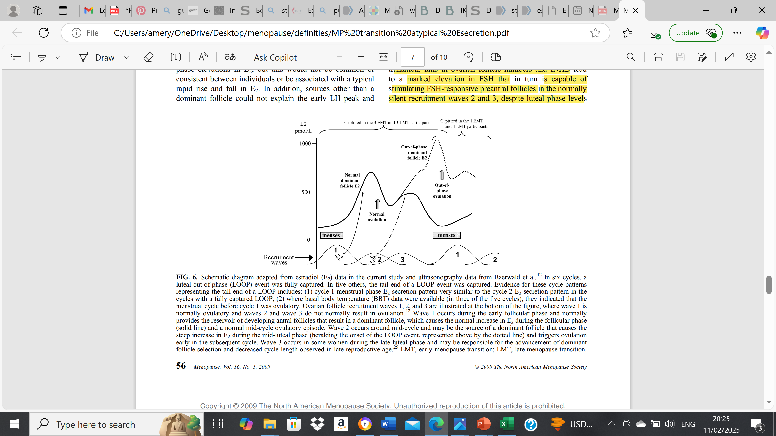
The LOOP cycle: Luteal out of phase cycle
LATE transition stage -1a
  Second ↑ in E2 during the mid and late luteal phase of an ovulatory cycle
  continues to peak during subsequent menstrual phase
  Often followed by a second ovulatory episode
  Typical higher early follicular phase FSH
  Typical lower luteal progesterone
Notes:
In late perimenopause (STRAW stage -1), is characterized by irregular menstrual cycles and unpredictable hormone levels, including dramatic swings in estradiol (E2). An increasing number of studies have found variable high E2 and low luteal phase progesterone occur with progression of Stages
the loop cycle refers to the irregular and unpredictable menstrual cycles caused by declining ovarian function. This phase is characterized by prolonged anovulatory cycles, significant hormonal fluctuations, and extended intervals between periods.
(37%) early and late menstrual transition ovulatory cycles exhibited a specific pattern of E2 secretion that was characterized by a second increase in E2 during the mid- and late luteal phases and that continued to a peak during the subsequent menstrual phase. This second rise and fall in E2 was typical in appearance of a normal follicular phase, except that it was superimposed on an existing ovulatory cycle (specifically during the luteal and menstrual phases). The pattern was therefore referred to as a luteal out-of-phase (LOOP) follicular event. In four of these LOOP cycles, a luteinizing hormone peak and ovulatory episode followed the second E2 peak early in the subsequent cycle. Compared with the typical ovulatory cycles, the cycles with LOOP events exhibited lower luteal phase progesterone, higher early cycle follicle-stimulating hormone, and lower early cycle inhibin B. They were also associated with abnormally short (G21 d) or long (940 d) cycle length.
Key Features of the Loop Cycle in Late Perimenopause
1. Long, irregular cycles (>60 days)
- Ovulation becomes increasingly rare.
- Some cycles may be very short, while others are very long or even absent.
- Periods may skip months before resuming.
2. Persistent High FSH and Fluctuating Estradiol
- FSH (Follicle-Stimulating Hormone) remains elevated as the body attempts to stimulate the ovaries.
- Estradiol (Eâ‚‚) fluctuates widelyâ€”sometimes high due to occasional follicular activity, sometimes very low.
-These fluctuations can cause intense symptoms, such as night sweats and mood swings.
3. Unopposed Estrogen Exposure
- Due to infrequent ovulation, progesterone production is reduced.
-This can lead to heavy, prolonged bleeding (if the endometrium builds up excessively before shedding).
4. Menstrual Patterns Vary
- Some women experience light, infrequent periods.
- Others have heavy, unpredictable bleeding due to endometrial instability.
- The cycle eventually leads to amenorrhea (no periods for 12 months), marking menopause.
Clinical Implications
- Increased risk of endometrial hyperplasia due to irregular shedding.
- Higher risk of symptoms like hot flashes, vaginal dryness, and sleep disturbances due to fluctuating estrogen.
- Hormone therapy (HT) may be considered for symptom relief and cycle regulation

Slide 11
LOOP cycle: luteal out of phase cycle
Late menopause transition : stage -1a
  Long - Irregular menses (> 60 days) – ovulation becomes increasingly rare
  High/ fluctuating FSH levels – fluctuating and unpredictable E2 – low luteal phase progesterone
  Often intense symptoms (nightsweats; moodswings)
  Often heavy prolonged bleeding
LOOP cycle:
  Second ↑ in E2 during the mid and late luteal phase of an ovulatory cycle
  continues to peak during subsequent menstrual phase
  Often followed by a second ovulatory episode
  Typical higher early follicular phase FSH
  Typical lower luteal progesterone
Notes:
In late perimenopause (STRAW stage -1), is characterized by irregular menstrual cycles and unpredictable hormone levels, including dramatic swings in estradiol (E2). An increasing number of studies have found variable high E2 and low luteal phase progesterone occur with progression of Stages
the loop cycle refers to the irregular and unpredictable menstrual cycles caused by declining ovarian function. This phase is characterized by prolonged anovulatory cycles, significant hormonal fluctuations, and extended intervals between periods.
(37%) early and late menstrual transition ovulatory cycles exhibited a specific pattern of E2 secretion that was characterized by a second increase in E2 during the mid- and late luteal phases and that continued to a peak during the subsequent menstrual phase. This second rise and fall in E2 was typical in appearance of a normal follicular phase, except that it was superimposed on an existing ovulatory cycle (specifically during the luteal and menstrual phases). The pattern was therefore referred to as a luteal out-of-phase (LOOP) follicular event. In four of these LOOP cycles, a luteinizing hormone peak and ovulatory episode followed the second E2 peak early in the subsequent cycle. Compared with the typical ovulatory cycles, the cycles with LOOP events exhibited lower luteal phase progesterone, higher early cycle follicle-stimulating hormone, and lower early cycle inhibin B. They were also associated with abnormally short (G21 d) or long (940 d) cycle length.
Key Features of the Loop Cycle in Late Perimenopause
1. Long, irregular cycles (>60 days)
- Ovulation becomes increasingly rare.
- Some cycles may be very short, while others are very long or even absent.
- Periods may skip months before resuming.
2. Persistent High FSH and Fluctuating Estradiol
- FSH (Follicle-Stimulating Hormone) remains elevated as the body attempts to stimulate the ovaries.
- Estradiol (Eâ‚‚) fluctuates widelyâ€”sometimes high due to occasional follicular activity, sometimes very low.
-These fluctuations can cause intense symptoms, such as night sweats and mood swings.
3. Unopposed Estrogen Exposure
- Due to infrequent ovulation, progesterone production is reduced.
-This can lead to heavy, prolonged bleeding (if the endometrium builds up excessively before shedding).
4. Menstrual Patterns Vary
- Some women experience light, infrequent periods.
- Others have heavy, unpredictable bleeding due to endometrial instability.
- The cycle eventually leads to amenorrhea (no periods for 12 months), marking menopause.
Clinical Implications
- Increased risk of endometrial hyperplasia due to irregular shedding.
- Higher risk of symptoms like hot flashes, vaginal dryness, and sleep disturbances due to fluctuating estrogen.
- Hormone therapy (HT) may be considered for symptom relief and cycle regulation

Slide 12
Menopausal transition - perimenopause
Notes:
. Perimenopause means the time around the menopause and includes:
• Early menopausal transition (Stage −2)
• Late menopausal transition (Stage −1)
• The first year after the FMP (early postmenopause Stage +1a)

Slide 13
Postmenopause
Notes:
Postmenopause:
FSH continues to increase and E2 continues to decline approximately till 2Y after the FMP. Afterwards levels stabilise
Therefore early PMP is divided in 3 stages
• Early postmenopause lasts approximately 5–8 years and includes the following stages:
Stage +1a lasts 1 year. It marks the end of the 12 month period of amenorrhea required to define that the FMP has occurred and corresponds to the end of the “perimenopause”. FSH increases fast and peaks – E2 is very low- VMS maximal – sleepproblems, changed mood, depressive,cognitive changes – peak bone mass loss
○ Stage +1b lasts 1 year. It includes the remainder of the period of rapid changes in mean FSH and estradiol levels – FSH high/variable
○ Stage +1c is estimated to last 3–4 years. It represents the period of stabilization of high FSH levels and low estradiol values – often decling symptoms
• Late postmenopause (Stage +2) includes the remaining lifespan. It represents the period in which further changes in the reproductive endocrine function are more limited and processes of somatic aging become of paramount concern.

Slide 14
Post menopause
EARLY post menopause +1
FSH continues to ↑ and E2 continues to ↓ till +/- 2 year after the FMP – then levels stabilise
the early PMP lasts +/- 5-8 y and is divided into 3 substages
  Stage +1a: 1year – marks the end of the 12 month amenorrhoe required to define
    = the end of peri-menopause
    FSH increases fast and peaks
    E2 = very low
    VMS are maximal – peak bone loss
  Stage +1b: 1 year – the remainder of the period of rapid FSH/estradiol changes
  Stage +1C: 3-4 years – stabilising high FSH /low E2 levels
    Often declining symptoms
LATE post menopause +2
The remaining lifespan
Somatic aging
Notes:
Postmenopause:
FSH continues to increase and E2 continues to decline approximately till 2Y after the FMP. Afterwards levels stabilise
Therefore early PMP is divided in 3 stages
• Early postmenopause lasts approximately 5–8 years and includes the following stages:
Stage +1a lasts 1 year. It marks the end of the 12 month period of amenorrhea required to define that the FMP has occurred and corresponds to the end of the “perimenopause”. FSH increases fast and peaks – E2 is very low- VMS maximal – sleepproblems, changed mood, depressive,cognitive changes – peak bone mass loss
○ Stage +1b lasts 1 year. It includes the remainder of the period of rapid changes in mean FSH and estradiol levels – FSH high/variable
○ Stage +1c is estimated to last 3–4 years. It represents the period of stabilization of high FSH levels and low estradiol values – often decling symptoms
• Late postmenopause (Stage +2) includes the remaining lifespan. It represents the period in which further changes in the reproductive endocrine function are more limited and processes of somatic aging become of paramount concern.

Slide 15
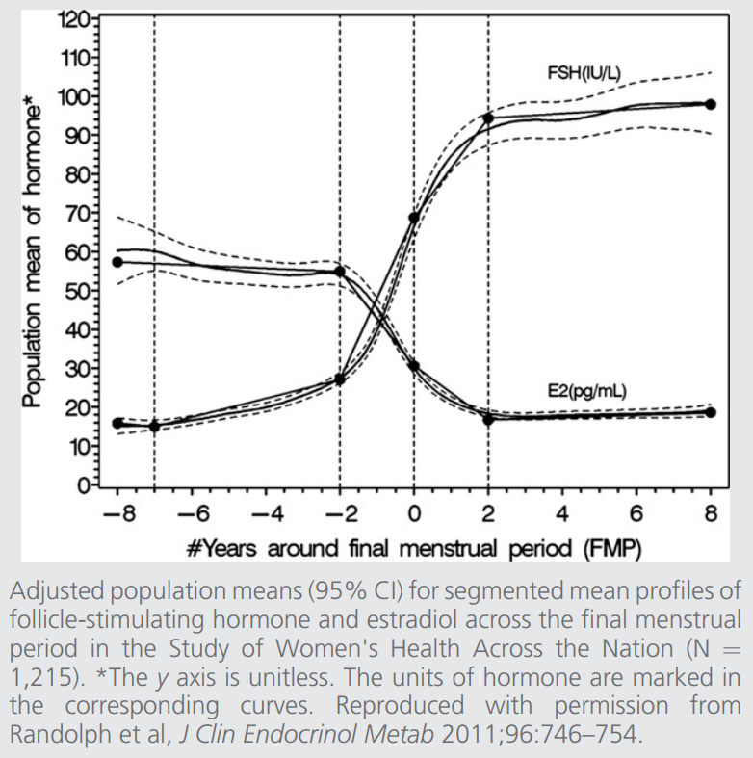

Slide 16
Straw criteria are not applicable in
PCOS
Hypothalamic amenorrhoe
POI (often resumption of follicular function)
After chemotherapy (often resumption of follicular function)
After hysterectomy; LNG-IUD; endometrial ablation
  Repeated measurement of FSH/E2
Use of some medications (ex tamoxifem)
Chronic illness

Slide 17
Diagnosis
Of menopause

Slide 18
Clinical diagnosis
Women > 45 year – not using contraception
  Difficult after hysterectomy or LNG-IUD
Notes:
Klinisch: in de eerste plaats wordt de diagnose klinisch gesteld bij een gezonde vrouw (die geen anticonceptie gebruikt) boven de leeftijd van 45 jaar met
ifv afwezige of irregular cycles +/- the presence of other climacteric symptoms
1 jaar amenorroe : ‘menopauze’
onregelmatige regels en eventuele vasomotorische klachten: ‘perimenopauze’.
na hysterectomie of met LNG-IUD met vasomotorische klachten : ‘perimenopauze of menopauze’.
Endocriene investigaties:
FSH en oestradiol: (Fig1)
FSH waarden stijgen en oestradiolwaarden dalen sterk en permanent in de ‘menopauze’.
In de ‘perimenopauze’ echter kunnen deze waarden sterk variëren van cyclus tot cyclus en zelfs binnen eenzelfde cyclus . FSH waarden stijgen gradueel en zijn een merker van follikel depletie. Echter kan FSH postmenopauzale waarden tonen in een toch nog ovulatoire cyclus (2). Oestradiol waarden schommelen tussen hypo- maar ook hyper- oestrogene waarden. Ze zijn daarom niet bruikbaar in diagnose stelling van de perimenopauze.
Het is dan ook niet aangewezen systematisch FSH en oestradiol te bepalen bij vrouwen > 45 jaar.
De test is eveneens zinloos bij vrouwen die de gecombineerde anti conceptiepil gebruiken, de minipil of een hoog gedoseerd progestageen preparaat.
Indicatie FSH en oestradiol investigatie:
Vrouwen < 45j met vasomotorische klachten en veranderingen in menstruele cyclus of LNG-IUD
Vrouwen < 40 jaar: minimaal 2x bepalen met interval v 4-6 weken
Schildkliertesten : TSH en T4 : schildklierdysfunctie kan symptomen van menopauze nabootsen alsook oorzaak zijn van onregelmatige menstruatie .
Indicatie TSH en T4 investigatie:
wanneer relevante symptomen aanwezig zijn
wanneer de klachten niet verbeteren bij behandeling met MHT.
Vrouwen < 45 jaar met vasomotorische klachten en/of veranderingen in menstruele cyclus.
Prolactine
Indicatie investigatie:
Relevante klachten: o.a. bilaterale melkafscheiding
Vrouwen < 45 jaar met veranderingen in de menstruele cyclus
Zwangerschapshormoon: HCG

Slide 19
Endocrine investigations: FSH - oestradiol
FSH ↑ gradually and are marker of follicle depletion
Menopause : FSH consistently > 40 IU/ml or higher // E2 < 25
Peri-menopause: FSH and E2 can vary greatly !
  FSH can be low in a woman with VMS
  FSH can be high in an ovulatory cycle
  E2 can vary between hypo- and hyper oestrogenic state
  Not informative in peri –menopause
Not systemically indicated in women > 45 years
Not indicated in women on COC / POP
Indication :
  women < 45 y with VMS and/or menstrual cycle changes
  Women < 40 years : multiple measurements 4-6 weeks apart
Notes:
Endocriene investigaties:
FSH en oestradiol: (Fig1)
FSH waarden stijgen en oestradiolwaarden dalen sterk en permanent in de ‘menopauze’.
In de ‘perimenopauze’ echter kunnen deze waarden sterk variëren van cyclus tot cyclus en zelfs binnen eenzelfde cyclus . FSH waarden stijgen gradueel en zijn een merker van follikel depletie. Echter kan FSH postmenopauzale waarden tonen in een toch nog ovulatoire cyclus (2). Oestradiol waarden schommelen tussen hypo- maar ook hyper- oestrogene waarden. Ze zijn daarom niet bruikbaar in diagnose stelling van de perimenopauze.
Het is dan ook niet aangewezen systematisch FSH en oestradiol te bepalen bij vrouwen > 45 jaar.
De test is eveneens zinloos bij vrouwen die de gecombineerde anti conceptiepil gebruiken, de minipil of een hoog gedoseerd progestageen preparaat.
Indicatie FSH en oestradiol investigatie:
Vrouwen < 45j met vasomotorische klachten en veranderingen in menstruele cyclus of LNG-IUD
Vrouwen < 40 jaar: minimaal 2x bepalen met interval v 4-6 weken
Schildkliertesten : TSH en T4 : schildklierdysfunctie kan symptomen van menopauze nabootsen alsook oorzaak zijn van onregelmatige menstruatie .
Indicatie TSH en T4 investigatie:
wanneer relevante symptomen aanwezig zijn
wanneer de klachten niet verbeteren bij behandeling met MHT.
Vrouwen < 45 jaar met vasomotorische klachten en/of veranderingen in menstruele cyclus.
Prolactine
Indicatie investigatie:
Relevante klachten: o.a. bilaterale melkafscheiding
Vrouwen < 45 jaar met veranderingen in de menstruele cyclus
Zwangerschapshormoon: HCG

Slide 20
Endocrine investigations
Thyroid function tests: TSH/ T4: when
  Relevant symptoms
  Symptoms don’t improve with MHT
  Women < 45 years with VMS and / or menstrual cycle changes
Prolactine
  Bilateral nipple secretion
  Women < 45 years with menstrual cycle changes
Human gonadotropine hormone: HCG
  To exclude pregnancy
Notes:
Schildkliertesten : TSH en T4 : schildklierdysfunctie kan symptomen van menopauze nabootsen alsook oorzaak zijn van onregelmatige menstruatie .
Indicatie TSH en T4 investigatie:
wanneer relevante symptomen aanwezig zijn
wanneer de klachten niet verbeteren bij behandeling met MHT.
Vrouwen < 45 jaar met vasomotorische klachten en/of veranderingen in menstruele cyclus.
Prolactine
Indicatie investigatie:
Relevante klachten: o.a. bilaterale melkafscheiding
Vrouwen < 45 jaar met veranderingen in de menstruele cyclus
Zwangerschapshormoon: HCG

Slide 21
Symptoms
Of menopause
Notes:
Klinische uitingen van de menopauze en epidemiologisch patroon: (fig.2)
Vasomotorische symptomen: vapeurs en nachtzweten (3)
Wat : plots gevoel van warmte meestal in bovenlichaam en gelaat. Vaak gaat dit gepaard met (intens) zweten, hartkloppingen en gevoel van angst. De warmteopwelling duurt meestal enkele minuten. Een vapeurs die ’s nachts optreedt gaat vaak gepaard met nachtzweten en/of ontwaken.
Frequentie : 60-80 % vrouwen in de (peri)menopauze ervaren vasomotorische klachten. Ongeveer 1/3 van deze groep ervaart ernstige klachten.
Risicofactoren: late perimenopauze en vroege postmenopauze, Afrikaanse etniciteit, roken, obesitas , depressieve gemoedstoestand (bi directioneel effect) .
Duur: starten vaak reeds tijdens de perimenopauze en persisteren gemiddeld 7.4 j, maar kunnen veel langer aanhouden bij ongeveer 20% van de vrouwen. De timing en frequentie van vasomotorische symptomen variëren gedurende de menopauze transitie, waarbij 4 patronen zijn geïdentificeerd (fig 3): (a) vroeg begin van vasomotorische symptomen 11 jaar voor laatste menstruatie met een afname snel nadien, (b) begin nabij de laatste menstruatie met een latere afname, (c) vroeg begin van frequente vasomotorische symptomen in de perimenopauze en aanhoudend tot laat in de postmenopauze en (d) aanhoudend lage frequentie van vasomotorische klachten. (3)
Effect: onderbroken nachtrust, vermoeidheid, concentratiestoornissen, depressieve gevoelens en angsten, verminderde levenskwaliteit. Ze gaan vaak gepaard hart palpitaties.
Link met gezondheid? Meer en meer studies ( WHI, HERS, SWAN) vinden een associatie tussen frequentie en persisterend karakter van hot flashes en aanwezigheid van onderliggende cardiovasculaire risicofactoren ( endotheel dysfunctie, aorta calcificaties, hogere intima media dikte, hypertensie). Hot flushes zijn mogelijk een uiting van onderliggende negatieve verandering van de bloedvaten. Daarnaast zien we een lagere botdensiteit en hogere botturnover bij vrouwen die vaker vasomotorische klachten hebben. (4)
Andere etiologie van hot flushes: schildklierdysfunctie (hypo- of hyperthyroïdie); hypo- of hyperglycemie; hypo- of hypertensie; kanker; mastocytose.

Slide 22
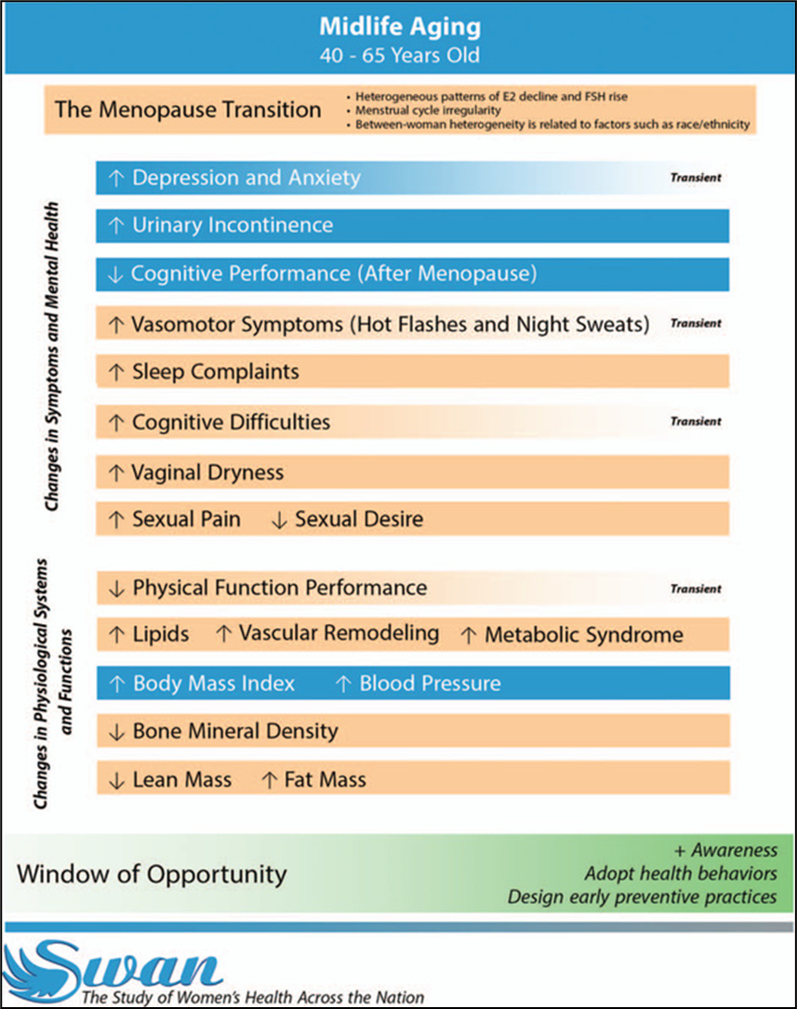
↓ Quality of life
Notes:
Climacteric symptoms
theSWAN study follow women from the age of 4à to 65 so through their transion period into MP
Moderate to severe symptoms disturb women’s health-related quality of life for variable (short to very long) durations.
Some symptoms are transient and especially prevalent in periMP en early MP (depressive mood, anxiety, VMS, cognitive diff) and will decline in post MP
Some symptoms /changes are permanent and progressive due to decline of E/P as well as aging .
MT causes significant alterations in cardiometabolic and vascular health parameters are strongly linked to higher CVD risk.
Some specific MP related symptoms seem also to contribute to future CV health or CVD risk

Slide 23
Vasomotor symptoms
Hot flushes and night sweats
Notes:
Klinische uitingen van de menopauze en epidemiologisch patroon: (fig.2)
Vasomotorische symptomen: vapeurs en nachtzweten (3)
Wat : plots gevoel van warmte meestal in bovenlichaam en gelaat. Vaak gaat dit gepaard met (intens) zweten, hartkloppingen en gevoel van angst. De warmteopwelling duurt meestal enkele minuten. Een vapeurs die ’s nachts optreedt gaat vaak gepaard met nachtzweten en/of ontwaken.
Frequentie : 60-80 % vrouwen in de (peri)menopauze ervaren vasomotorische klachten. Ongeveer 1/3 van deze groep ervaart ernstige klachten.
Risicofactoren: late perimenopauze en vroege postmenopauze, Afrikaanse etniciteit, roken, obesitas , depressieve gemoedstoestand (bi directioneel effect) .
Duur: starten vaak reeds tijdens de perimenopauze en persisteren gemiddeld 7.4 j, maar kunnen veel langer aanhouden bij ongeveer 20% van de vrouwen. De timing en frequentie van vasomotorische symptomen variëren gedurende de menopauze transitie, waarbij 4 patronen zijn geïdentificeerd (fig 3): (a) vroeg begin van vasomotorische symptomen 11 jaar voor laatste menstruatie met een afname snel nadien, (b) begin nabij de laatste menstruatie met een latere afname, (c) vroeg begin van frequente vasomotorische symptomen in de perimenopauze en aanhoudend tot laat in de postmenopauze en (d) aanhoudend lage frequentie van vasomotorische klachten. (3)
Effect: onderbroken nachtrust, vermoeidheid, concentratiestoornissen, depressieve gevoelens en angsten, verminderde levenskwaliteit. Ze gaan vaak gepaard hart palpitaties.
Link met gezondheid? Meer en meer studies ( WHI, HERS, SWAN) vinden een associatie tussen frequentie en persisterend karakter van hot flashes en aanwezigheid van onderliggende cardiovasculaire risicofactoren ( endotheel dysfunctie, aorta calcificaties, hogere intima media dikte, hypertensie). Hot flushes zijn mogelijk een uiting van onderliggende negatieve verandering van de bloedvaten. Daarnaast zien we een lagere botdensiteit en hogere botturnover bij vrouwen die vaker vasomotorische klachten hebben. (4)
Andere etiologie van hot flushes: schildklierdysfunctie (hypo- of hyperthyroïdie); hypo- of hyperglycemie; hypo- of hypertensie; kanker; mastocytose.

Slide 24
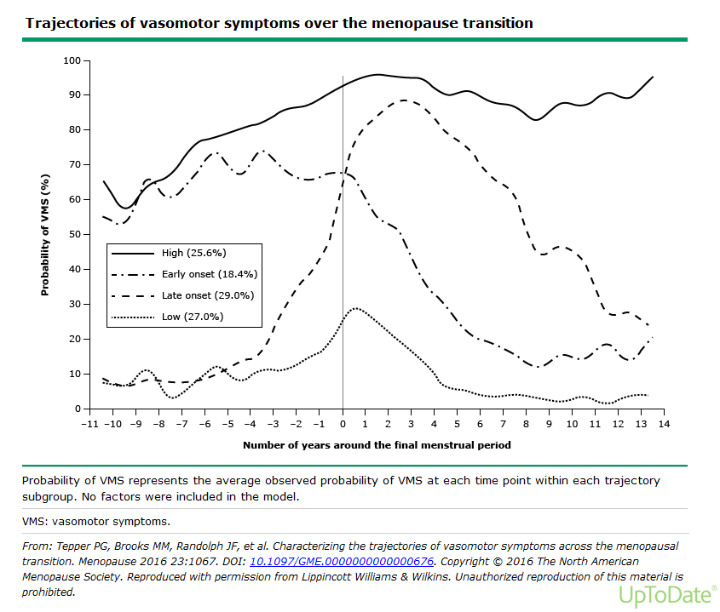
Duration ?
  Mean : 7 years
  4 patterns
Riskfactors ?
  Smoking
  Depressive mood
  obesity
Notes:
Longitudinals studies indicate that women follow distinct patterns of VMS
Both the SWAN study (US° and an Australian study ( Aus Longit Study of women’s health) found that VMS follow 4 trajectories in approx. equal proportions across 4 groups
4 types:
Mild : mild/ no HF
Late onset : start na laatste menstruatie → blijven tot late MP
Early onset : start reeds vroeg in de overgang maar↓ na laatste menses
Super flushers : start vroeg in de overgang → blijven tot late MP
RF voor HF vroege flushers
↑ BMI
Centrale obesitas
↓ slaapkwaliteit
↓ Quality of life
Risicofactoren: late perimenopauze en vroege postmenopauze, Afrikaanse etniciteit, roken, obesitas , depressieve gemoedstoestand (bi directioneel effect) .
Duur: starten vaak reeds tijdens de perimenopauze en persisteren gemiddeld 7.4 j, maar kunnen veel langer aanhouden bij ongeveer 20% van de vrouwen. De timing en frequentie van vasomotorische symptomen variëren gedurende de menopauze transitie, waarbij 4 patronen zijn geïdentificeerd (fig 3): (a) vroeg begin van vasomotorische symptomen 11 jaar voor laatste menstruatie met een afname snel nadien, (b) begin nabij de laatste menstruatie met een latere afname, (c) vroeg begin van frequente vasomotorische symptomen in de perimenopauze en aanhoudend tot laat in de postmenopauze en (d) aanhoudend lage frequentie van vasomotorische klachten. (3)
Effect: onderbroken nachtrust, vermoeidheid, concentratiestoornissen, depressieve gevoelens en angsten, verminderde levenskwaliteit. Ze gaan vaak gepaard hart palpitaties.
Link met gezondheid? Meer en meer studies ( WHI, HERS, SWAN) vinden een associatie tussen frequentie en persisterend karakter van hot flashes en aanwezigheid van onderliggende cardiovasculaire risicofactoren ( endotheel dysfunctie, aorta calcificaties, hogere intima media dikte, hypertensie). Hot flushes zijn mogelijk een uiting van onderliggende negatieve verandering van de bloedvaten. Daarnaast zien we een lagere botdensiteit en hogere botturnover bij vrouwen die vaker vasomotorische klachten hebben. (4)
Andere etiologie van hot flushes: schildklierdysfunctie (hypo- of hyperthyroïdie); hypo- of hyperglycemie; hypo- of hypertensie; kanker; mastocytose.

Slide 25
More migraine
More women suffering from migraine: 43% lifetime incidence (18% men)
Especially during reproductive years
  Sensitive to fluctuations of hormones: esp oestrogens
    puberty
    menses
    Perimenopause
    MP+ HRT
Migraines with/without aura
  Association between
    Oestrogen WITHDRAWL - migraine attacks WITHOUT aura
    HIGH oestrogenic state - migraine attacks WITH aura
Notes:
- sex differences are generally attributed to the differential effects of male and female sex hormones on migraine pathophysiology
- following puberty the prevalence increases more in women than in men reaching a three-fold difference in the prevalence ratio during the fourth decade.2
- Perimenopause marks a further increased risk
- menstruation is one of the most significant risk factors for migraine without aura. with the highest incidence of attacks, starting two days before menstruation and during the first three days of bleeding. Research suggests that one of the triggers of menstrual migraine is the natural fall or ‘withdrawal’ of estrogen in the late luteal phase of the menstrual cycle.17 Estrogen ‘withdrawal’ also accounts for the increased incidence of headache and migraine during the hormone free interval of combined hormonal contraception.
Migraine with aura has a different hormonal response, with high estrogen states such as pregnancy, combined hormonal contraception or hormone replacement therapy (HRT), associated with an increased incidence of migraine with aura.18–20
During the perimenopause attacks of migraine without aura often become more frequent and severe, part because menstrual periods are more frequent.21 Hyperestrogenism coupled with decreased luteal phase progesterone are likely causes
a stable hormonal milieu should be associated with fewer migraine attacks
Continuous OAC- POP
E2 supple before menses
Supress endogenous ov act
Following natural MP- M usually improves with time
MP and HRT: Few studies have assessed the effect of HRT on migraine and the results are inconsistent

Slide 26
Genito –urinary symptoms
Notes:
Genito-urinaire symptomen: het genito-urinair syndroom van de menopauze zijn symptomen geassocieerd aan de gevolgen van oestrogeen deficiëntie t.h.v. de labia, vagina, urethra, blaas, bekkenbodemspieren, ligamenten en fascia. (7)
Vulvovaginale atrofie is een chronische en progressieve aandoening dat ontstaat a.g.v. dalende oestrogenen. Dit resulteert in vermindering van bindweefsels collageen en elastine, dunner worden van het vaginaal epitheel, veranderingen in de gladde spiercellen en verminderen van de hoeveelheid bloedvaten. Deze veranderingen verminderen de elasticiteit van de vagina, verhogen de zuurtegraad en veranderen de flora. Vulvovaginale atrofie komt voor bij 50-65 % van alle postmenopauzale vrouwen. Symptomen zijn:
Vaginale droogte door verminderde lubricatie (~ 19% in vroege perimenopauze ~ 34 % tijdens de postmenopauze)
Vaginale branderigheid en irritatie
Oppervlakkige dyspareunie
Verminderd libido door bovenvermelde klachten alsook dalende testosteron waarden.(~ 64%)
Gevoeligheid voor vaginale infecties door verstoring van de vaginale PH en het vaginale microbioom.

Slide 27
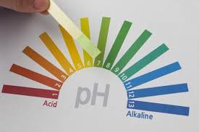
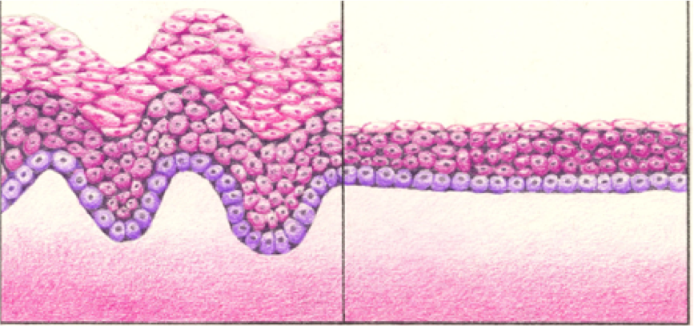
Change vaginal microbioma
Dryness
Pain
Dyspareunia
Burning
Itch
↑ Vaginal infections / inflammation
thinning vaginal epithelium
↓bloedvessels
↓secretions
↓collagen
↓elastine
↓ smooth muscle fibres
Notes:
Reduced blood flow and transudation→ dry + painfull: dyspareunia
Reduced glycogen:→ less lactic acid production:↑PH:↑bacterial vaginosis
Reduced collagen, elastin, smooth muscle → more prolaps
Genito-urinaire symptomen: het genito-urinair syndroom van de menopauze zijn symptomen geassocieerd aan de gevolgen van oestrogeen deficiëntie t.h.v. de labia, vagina, urethra, blaas, bekkenbodemspieren, ligamenten en fascia. (7)
Vulvovaginale atrofie is een chronische en progressieve aandoening dat ontstaat a.g.v. dalende oestrogenen. Dit resulteert in vermindering van bindweefsels collageen en elastine, dunner worden van het vaginaal epitheel, veranderingen in de gladde spiercellen en verminderen van de hoeveelheid bloedvaten. Deze veranderingen verminderen de elasticiteit van de vagina, verhogen de zuurtegraad en veranderen de flora. Vulvovaginale atrofie komt voor bij 50-65 % van alle postmenopauzale vrouwen. Symptomen zijn:
Vaginale droogte door verminderde lubricatie (~ 19% in vroege perimenopauze ~ 34 % tijdens de postmenopauze)
Vaginale branderigheid en irritatie
Oppervlakkige dyspareunie
Verminderd libido door bovenvermelde klachten alsook dalende testosteron waarden.(~ 64%)
Gevoeligheid voor vaginale infecties door verstoring van de vaginale PH en het vaginale microbioom.

Slide 28
Weight and fat distribution
Notes:
Gewichtstoename, vetverdeling
Gewichtstoename op middelbare leeftijd, die vaak gepaard gaat met een verminderd energieverbruik, kan grotendeels worden verklaard door veranderingen in de chronologische leeftijd en niet door reproductieve veroudering.
Lichaamssamenstelling: de transitieperiode is onafhankelijk geassocieerd met nadelige veranderingen in lichaamssamenstelling. Een versnelde toename van vetmassa, verlies van vetvrije massa en toename van visceraal vetweefsel.

Slide 29
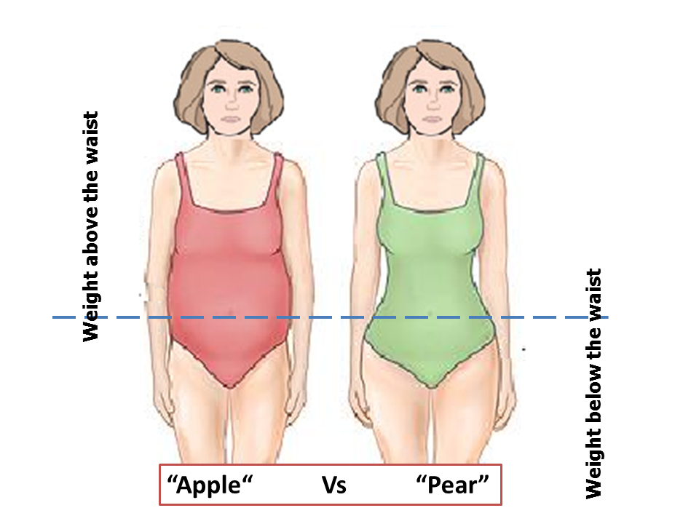
Transition to menopause
Body composition
↓oestradiol (E2): ↑ total fat mass
↓ gluteofemoral fat
↑ central (visceral) fat
↓ lean mass
↑ weight
- age related
-↓ energy consumption
- slight ↓ thyroid function
- ↓ metabolism
- ↓ sleep / ↓ E2:
- ↓ leptine: ↓ fatburning ↓ satiety
- ↑ ghereline: ↑ hunger, cravings
- ↑ cortisol (also stress): ↑ visceral fat
↑ craving
Waist-to-hip ratio !!
Mid-life weight gain is both pre- and post-menopausal, but pre-menopausal weight gain appears to be more pronounced
Notes:
Gewichtstoename, vetverdeling
Gewichtstoename op middelbare leeftijd, die vaak gepaard gaat met een verminderd energieverbruik, kan grotendeels worden verklaard door veranderingen in de chronologische leeftijd en niet door reproductieve veroudering.
Lichaamssamenstelling: de transitieperiode is onafhankelijk geassocieerd met nadelige veranderingen in lichaamssamenstelling. Een versnelde toename van vetmassa, verlies van vetvrije massa en toename van visceraal vetweefsel.
Decline in muscle mass from the age of 30_40; this results in a lower metabolism
Leptin: produced by fatcells; increase fatburning; makes you feel ‘full’
leptin resistance: less fatburning, lower metabolism; you feel hungry
Gherelin: produced by the stomach before a meal; sends asignal to the brain that you are hungry
increased gherelin due to lower progesterone: hungry++ cravings

Slide 30
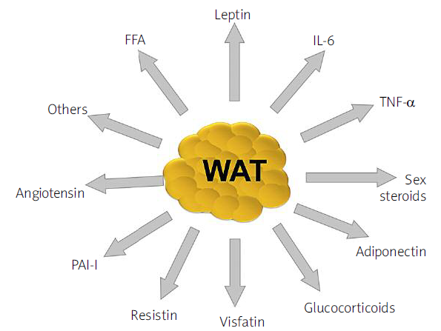
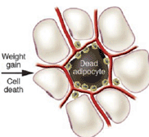
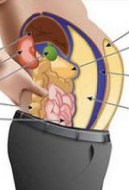
The ‘angry’ fat
Visceral fat = largest endocrine organ
‘geexplodeerde’vetcel
Source of adipokines =
- cytokines
- hormones
Obesity = systemic Chronic inflammation
macrofagen
Notes:
This visceral fat is of particular concern because it is a key player in in a variety of health problems
Besides the storage of excess energy , it also serves as an endocrine organ . adipocytes are complex cell types and synthesise a number of compounds ,like cytokines, hormones and growth factors that influence physiologic but also pathologic processes
there is evidence that low-grade inflammation within the adipose tissue results in the dysregulation of adipocytokine production, thereby contributing
to the pathophysiology of MetS.
In the obesestate, the adipose tissue is infiltrated by inflamed macrophages that release TNF-a and IL-6, thus linking obesity, inflammation and insulin resistance
Depending on the location in the body , they secrete different adipokines
Bij obesitas : De vetcellen zetten zo hard uit dat ze exploderen…genoemd de ‘angry’ fatcel
Macrofagen ruimen deze dode celle op
Maar ze regelen ook het gedrag vd vetcellen en zijn een bron v cytokines en hormonen: adipokines

Slide 31
Subclinical changes
Notes:
Genito-urinaire symptomen: het genito-urinair syndroom van de menopauze zijn symptomen geassocieerd aan de gevolgen van oestrogeen deficiëntie t.h.v. de labia, vagina, urethra, blaas, bekkenbodemspieren, ligamenten en fascia. (7)
Vulvovaginale atrofie is een chronische en progressieve aandoening dat ontstaat a.g.v. dalende oestrogenen. Dit resulteert in vermindering van bindweefsels collageen en elastine, dunner worden van het vaginaal epitheel, veranderingen in de gladde spiercellen en verminderen van de hoeveelheid bloedvaten. Deze veranderingen verminderen de elasticiteit van de vagina, verhogen de zuurtegraad en veranderen de flora. Vulvovaginale atrofie komt voor bij 50-65 % van alle postmenopauzale vrouwen. Symptomen zijn:
Vaginale droogte door verminderde lubricatie (~ 19% in vroege perimenopauze ~ 34 % tijdens de postmenopauze)
Vaginale branderigheid en irritatie
Oppervlakkige dyspareunie
Verminderd libido door bovenvermelde klachten alsook dalende testosteron waarden.(~ 64%)
Gevoeligheid voor vaginale infecties door verstoring van de vaginale PH en het vaginale microbioom.

Slide 32
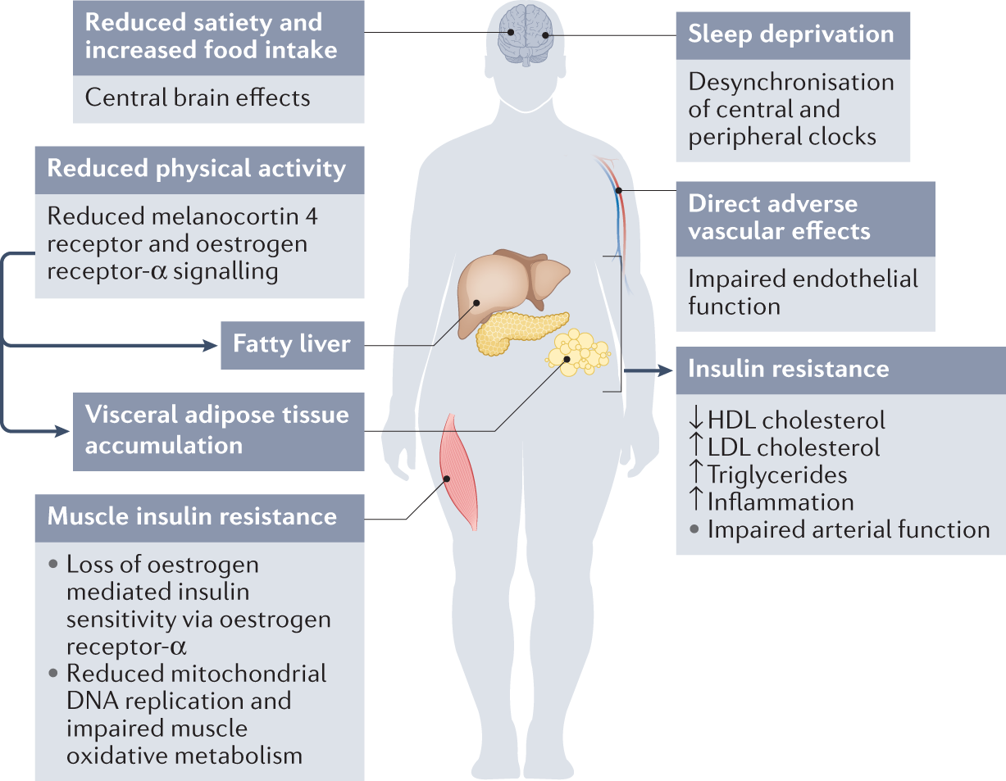
Davis & Baber, Nat Rev Endocrinol 2022; 18: 490-502
Notes:
Pronounced pre menopausal weight gain
Esp gain fat mass: central fat mass: visceral adiposity
Loss of lean muscle mass
Subklinische uitingen gelinkt aan de menopauze transitie (niet aan leeftijd): (4) (1)
verschillende lipidenparameters (totaal cholesterol, LDL-C en apolipoproteïne B-niveaus) stijgen dramatisch tijdens de late transitieperiode.
Toename incidentie metabool syndroom
Vasculaire gezondheid: meer arteriosclerose van de carotide arteries alsook toename van vasculaire stijfheid.
Het verlies van botmineraaldichtheid begint een paar jaar voor de laatste menstruatie, dus tijdens de overgang van de menopauze. Na de menopauze vertraagt het botverlies, doch het stopt niet.

Slide 33
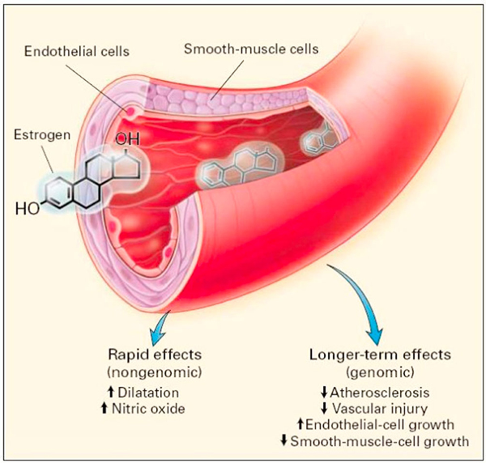
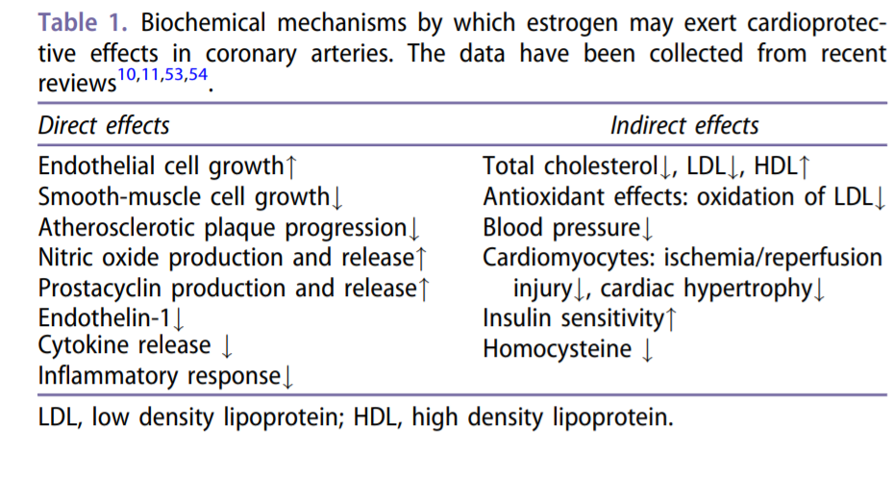
Oestrogens en coronary arteries :
Mikkola et al, Climacteric, 2017
Notes:
Effects of estrogen on coronary arteries has been extensively studied in vitro and in vivo
Direct effects:
Estrogen operates rapidly via E receptors alfa/beta in coronary arteries and the heart and causes dilatation and prevention of occlusive events within them
In addition, E mediates a number of Secundary changes in the vasculature that slow down the initiation and progression of atherosclerosis

Slide 34
Oestrogens en coronary arteries :
Mikkola et al, Climacteric, 2017
Notes:
Effects of estrogen on coronary arteries has been extensively studied in vitro and in vivo
Direct effects:
Estrogen operates rapidly via E receptors alfa/beta in coronary arteries and the heart and causes dilatation and prevention of occlusive events within them
In addition, E mediates a number of Secundary changes in the vasculature that slow down the initiation and progression of atherosclerosis

Slide 35
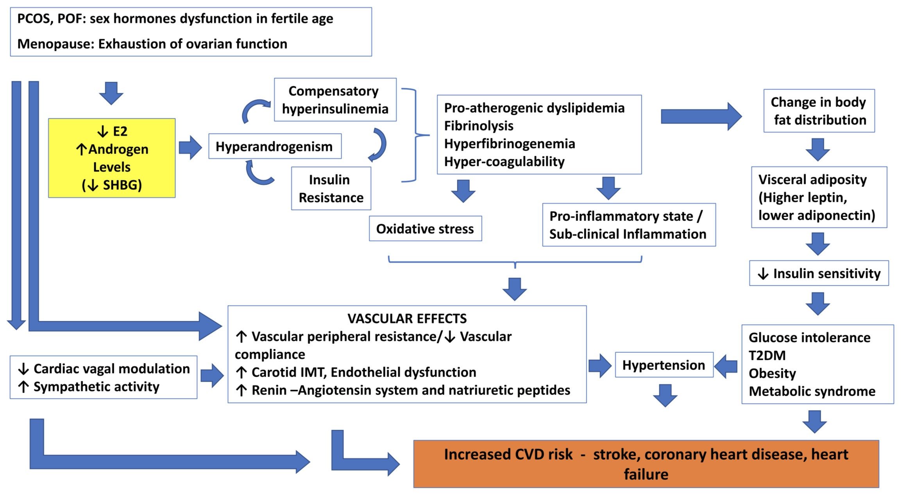
Verband tussen menopauze en cardiovasculaire aandoeningen
Physical inactivity
Mood instability
Sarcopenia
Obesity
Maffei S, Int J Cardiol 2019
Notes:
Maffei S Int J Cardiol 2019
Menopauze
Meer buikvet, hoge cholesterol, RAAS activatie → endotheeldysfunctie
Verouderen → endotheeldysfunctie
Direct effect op bloedvaten
Activatie renine-angiotensine systeem
Verhoogd angiotensine II
Verhoogd endotheline 1
Verminderde NO-synthese
Redenen om 7-10j later dan mannen CVD te ontwikkelen, beschermend effect van oestrogeen tijdens de reproductieve jaren:
Anti-oxidant
Meer bloedvatvorming en vasodilatatie
Minder fibroblast proliferatie
Anti-apoptose
Vrouw-specifieke risicofactoren om vroeger dan mannen CVD te ontwikkelen
Pre-eclampsie, zwangerschapsdiabetes, PCOS, vroege menopauze, vroege menstruatie, auto-immuunziekten

Slide 36
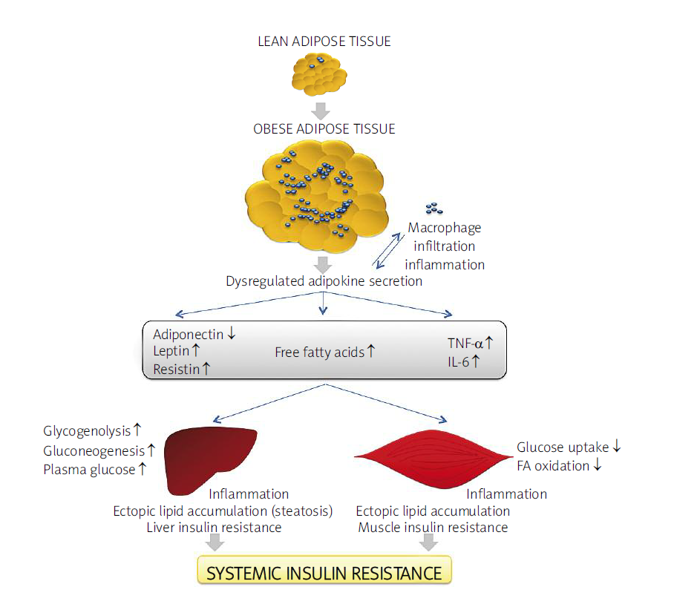
Notes:
PAI-1: plasminogen act inhibitor: a protein involved in fibrinolysis. In obesity, levels are raised . Raising a possible link between obesityand CVD. The protein protein can change the balance between fibrinolysis and fibrinogenesis, contributing to the AS process
Angiotensinogen: adipose T expresses all components of the RAAS . It may act on the BP

Slide 37
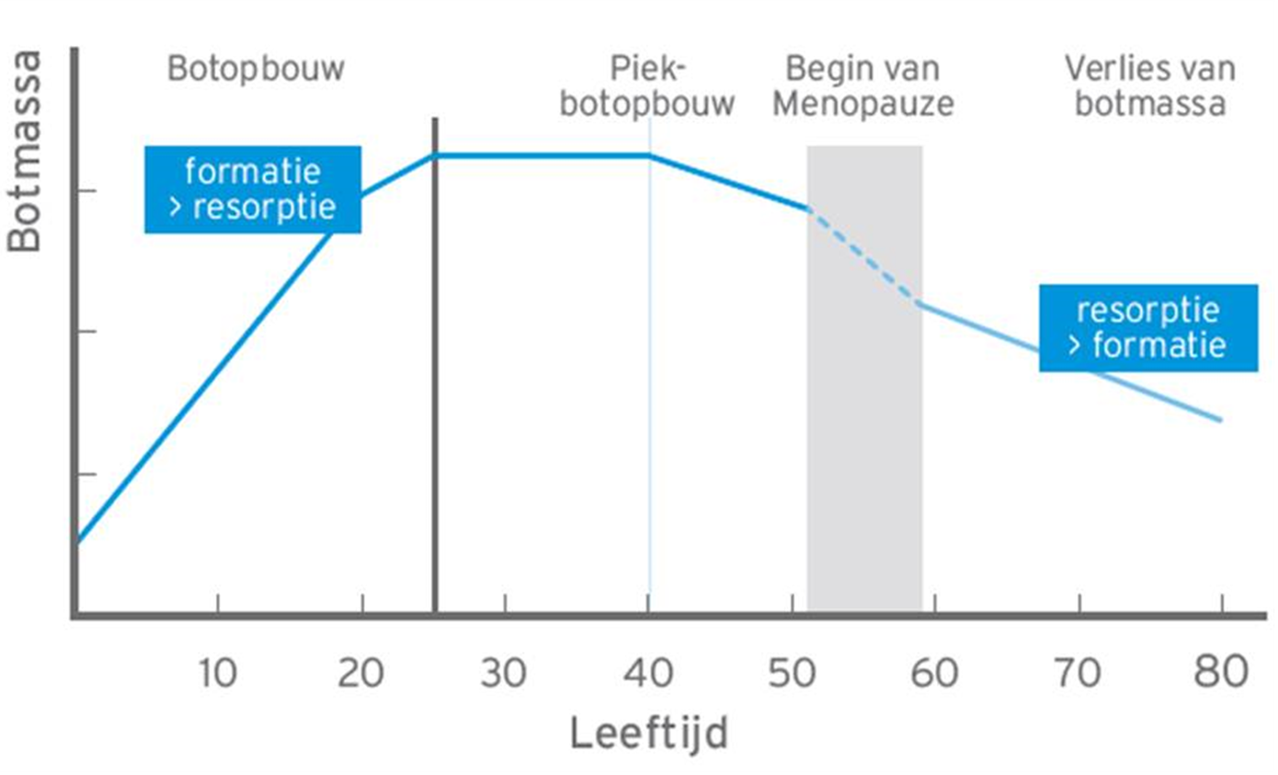
Notes:
MP is associated with increased bone resorption. This starts already in periM¨P , several years before the LMP
Rapid bone los esp cortical bone loss and micro architecture deterioration

Slide 38
Menopauze and MP symptoms
Do we need to make a difference?
Notes:
De menopauze is het ‘moment’ van de laatste menstruatie. Het betekent de definitieve stopzetting van de eierstokfunctie en de overgang van een reproductieve naar een niet-reproductieve levensfase. De voorraad eicellen is volledig uitgeput waardoor de hormonen oestrogeen en progesteron niet meer worden aangemaakt. Ook het testosteron gehalte daalt.
De menopauze en de perimenopauze markeert een kritieke fase die wordt gekenmerkt door opmerkelijke veranderingen in hormonale en menstruatiepatronen alsook fysiologische en psychosociale symptomen. Het is een belangrijke mijlpaal voor de gezondheidstoestand van de vrouw. De ‘klachten’ die hiermee gepaard gaan starten vaak reeds in de overgangsfase en kunnen bij sommige vrouwen blijven duren tot laat in de postmenopauze. Het vroeg en frequent optreden van vasomotorische klachten tijdens de transitieperiode alsook het persisteren ervan na de menopauze wordt geassocieerd met negatieve impact op de cardiovasculaire gezondheid. (4) De effecten op het lichaam door dit veranderende hormonale milieu, in combinatie met ouder worden, zijn vaak blijvend en cumulatief. De negatieve effecten op merkers van cardiovasculaire gezondheid ( lipiden, vasculaire remoddeling en lichaamsvet compositie), bot remoddeling en seksuele dysfunctie, zijn een direct gevolg van de transitie. Andere effecten zijn eerder tijdelijk en vooral prevalent tijdens de overgangsfase en de eerste fase van de postmenopauze, zoals de effecten op gemoed, slaap, cognitieve moeilijkheden en gewrichtspijnen. Deze levensfase is een opportuniteit om vrouwen te informeren van de impact op het lichaam en het belang een gezonde levensstijl te implementeren alsook preventieve strategieën.

Slide 39
Menopause = “moment” of final menstrual period
  depletion of oocytes; end of reproductive phase
  Depletion of estradiol and progesterone; lowering levels of testosterone
    Fysiological symptoms : some are transient; some are permanent
    Psychological symptoms : some are transient; some are permanent
    Metabolic changes
      Permanent fysical changes
      Increase risk chronic diseases
Notes:
De menopauze is het ‘moment’ van de laatste menstruatie. Het betekent de definitieve stopzetting van de eierstokfunctie en de overgang van een reproductieve naar een niet-reproductieve levensfase. De voorraad eicellen is volledig uitgeput waardoor de hormonen oestrogeen en progesteron niet meer worden aangemaakt. Ook het testosteron gehalte daalt.
De menopauze en de perimenopauze markeert een kritieke fase die wordt gekenmerkt door opmerkelijke veranderingen in hormonale en menstruatiepatronen alsook fysiologische en psychosociale symptomen. Het is een belangrijke mijlpaal voor de gezondheidstoestand van de vrouw. De ‘klachten’ die hiermee gepaard gaan starten vaak reeds in de overgangsfase en kunnen bij sommige vrouwen blijven duren tot laat in de postmenopauze. Het vroeg en frequent optreden van vasomotorische klachten tijdens de transitieperiode alsook het persisteren ervan na de menopauze wordt geassocieerd met negatieve impact op de cardiovasculaire gezondheid. (4) De effecten op het lichaam door dit veranderende hormonale milieu, in combinatie met ouder worden, zijn vaak blijvend en cumulatief. De negatieve effecten op merkers van cardiovasculaire gezondheid ( lipiden, vasculaire remoddeling en lichaamsvet compositie), bot remoddeling en seksuele dysfunctie, zijn een direct gevolg van de transitie. Andere effecten zijn eerder tijdelijk en vooral prevalent tijdens de overgangsfase en de eerste fase van de postmenopauze, zoals de effecten op gemoed, slaap, cognitieve moeilijkheden en gewrichtspijnen. Deze levensfase is een opportuniteit om vrouwen te informeren van de impact op het lichaam en het belang een gezonde levensstijl te implementeren alsook preventieve strategieën.

Slide 40
Counselling and prevention
Explain negative effect of MP on metabolism and impact chronic pathologies
  Lipids
  Glucose metabolism
  Cardio vascular diseases
  Bone metabolism
Notes:
MP is a milestone in a woman’s life and she needs to be aware of the changes in her body besides the fysical and psychological changes she notices.
It is an ideal moment to discuss prevention of future chronic diseases and the positive impact of life style needs to be addressed
De menopauze transitie en postmenopauze brengen veranderingen in het hormonale milieu, het fysisch en psychologisch welzijn alsook heel wat metabole veranderingen t.h.v. o.a. lipiden en suikermetabolisme, hart- en bloedvaten, het botmetabolisme. Deze negatieve veranderingen hebben een impact op ontstaan van chronische aandoening in het latere leven van de vrouw. Het is het ideale moment voor counseling rond preventie hiervan. (11)
Levensstijladvies : aanpak van levensstijlfactoren heeft een positief effect op menopauze symptomen en de algemene gezondheid. Het is een belangrijke hoeksteen van het menopauze beleid!
Nastreven van een gezond gewicht. Vermijden van abdominale obesitas. Viscerale adipositas is geassocieerd met een verhoogd risico op sterfte, zelfs bij mensen met een normale BMI.
Evenwichtig en gezond dieet: de energie inname moet in balans zijn met het energieverbruik.
Het traditionele mediterrane dieet wordt aanzien als evenwichtig en bevat veel groenten, fruit, volle granen, noten, zaden, gezonde onverzadigde vetten (olijfolie), matige inname van vis en gevogelte, lage inname van rood vlees, vleeswaren, zuivelproducten en snoep. (12) Lage consumptie van simpele koolhydraten, alcohol, verzadigde vetten en bewerkte voedingsproducten. implementeren van deze gezonde voedingswijze op ‘lange’ termijn kan
• het cardiovasculaire risico verminderen alsook de incidentie van cardiovasculaire gebeurtenissen en overlijden hierdoor
• leiden tot een gunstiger lichaamssamenstelling
• de botmineraaldichtheid handhaven of verbeteren bij vrouwen met osteoporose
• helpen cognitieve achteruitgang te voorkomen
• het risico op borstkanker te verminderen
• het risico op sterfte door alle oorzaken te verminderen
Op ‘korte’ termijn dat dit voedingspatroon:
• vasomotorische symptomen verbeteren
• Cardiovasculaire risicofactoren zoals bloeddruk, cholesterol en bloedglucosewaarden verbeteren
• de stemming verbeteren en symptomen van depressie
Adequate calcium inname: een totale calciuminname via de voeding van 1.200 mg/dag wordt aanbevolen; bij voorkeur uit voedingsmiddelen en zuivelproducten. Als deze dagelijkse inname niet bereikt wordt door voedselinname, moeten orale supplementen worden overwogen. Hogere calciumdoses kunnen nodig zijn na bariatrische chirurgie en bij patiënten
met achloorhydrie; calciumabsorptie kan worden verminderd door protonpompremmers, in dat geval verkies je calciumcitraat preparaten. (13)
Adequate vitamine D inname: 600-1000 IE vitamine D/d wordt aanbevolen, hetzij door blootstelling aan de zon, hetzij door middel van een dieet of suppletie. Vitamine D zorgt voor een adequate calciumopname uit de darm. Bij vrouwen met een laag fractuurrisico die geen farmacologische behandeling nodig hebben, is een minimaal niveau van 25OHD ≥20 ng/ml (≥50 nmol/l) na te streven, met een bovengrens van ≤50 ng/ml (≤125 nmol/l). (13)
Rookstop
Beperken alcoholconsumptie
Voldoende beweging
minstens 150–300 minuten matige intensiteit aërobe fysieke activiteit; of ten minste 75-150 minuten aërobe fysieke activiteit met hoge intensiteit/week ; of een gelijkwaardige combinatie van matige en krachtige intensiteit activiteit gedurende de week. (14)
Spierversterkende oefeningen bij matige of hogere intensiteit die betrekking heeft op alle belangrijke spiergroepen : 2 of meer dagen per week
Individuele en holistische aanpak: Opmaken van een individueel dossier m.b.t
Anamnese klachten patroon en leeftijd
risicofactoren voor cardiovasculaire aandoeningen, trombose, osteoporose, borstkanker alsook mogelijke contra-indicaties voor eventuele hormonale of niet hormonale therapie.
Fysiek onderzoek i.f.v klachten en in het kader van preventie. Noteren van bloeddruk, gewicht, lengte, BMI en abdominale omtrek.
Recente bloedafname beschikbaar? In kaart brengen van cardiovasculaire risico parameters: triglyceriden, cholesterol, glycemie, insuline resistentie.
Up to date mammografie en notitie type borstklierweefsel?
Botdensitometrie?
Standaard wordt een botmeting in België pas terugbetaald vanaf 65 jaar.
De Belgian Bone Club richtlijnen adviseren een vroegere screening vanaf 50 jaar (of vroeger bij vroegere menopauze) op basis van de aanwezigheid van een of meer van de volgende risicofactoren :
de leeftijd van de menopauze als deze eerder optreedt
leeftijd (≥65 jaar), lage body Mass index (<20 kg/m²), eerdere ‘fragiliteit’ fracturen, heupfractuurgeschiedenis bij een eerstegraads familielid, gemeten lengte verlies ≥4 cm, secundaire osteoporose, vroege niet-gesubstitueerde menopauze (<45), diabetes mellitus, glucocorticoïdtherapie, reumatische ontstekingsziekten en overmatig alcoholgebruik (≥3 eenheden alcohol/dag) en/of actueel tabaksgebruik. Frequente valpartijen (≥1/jaar) (13)
Individuele counseling rond mogelijkheden aanpak klachten van de perimenopauze en menopauze.
Bespreken van niet hormonale alternatieven en hormonale substitutie.

Slide 41
Individual and holistic approach
Age, symptoms, med history, risk factors CVD, VTE, Osteoporosis, Breastcancer other contra- indications
Gynaecological examination
Bloodpressure, weight, length, abdominal circumference
Recent bloodwork ?
Recent mammogram : type breasttissue?
DEXA?
Notes:
A MP consultation does involve more tha just a gynaecological ex and the prescription of hormones
We need a more holistic approach acc to the patients’ age, symptoms, med history and risk factors such as …
Check BP, BMI and abd cirumference
Check if there is a recent bloodsample availble, look for signs of metabolic syndrome and other RF’s for chronic disease development
Individuele en holistische aanpak: Opmaken van een individueel dossier m.b.t
Anamnese klachten patroon en leeftijd
risicofactoren voor cardiovasculaire aandoeningen, trombose, osteoporose, borstkanker alsook mogelijke contra-indicaties voor eventuele hormonale of niet hormonale therapie.
Fysiek onderzoek i.f.v klachten en in het kader van preventie. Noteren van bloeddruk, gewicht, lengte, BMI en abdominale omtrek.
Recente bloedafname beschikbaar? In kaart brengen van cardiovasculaire risico parameters: triglyceriden, cholesterol, glycemie, insuline resistentie.
Up to date mammografie en notitie type borstklierweefsel?
Botdensitometrie?
Standaard wordt een botmeting in België pas terugbetaald vanaf 65 jaar.
De Belgian Bone Club richtlijnen adviseren een vroegere screening vanaf 50 jaar (of vroeger bij vroegere menopauze) op basis van de aanwezigheid van een of meer van de volgende risicofactoren :
de leeftijd van de menopauze als deze eerder optreedt
leeftijd (≥65 jaar), lage body Mass index (<20 kg/m²), eerdere ‘fragiliteit’ fracturen, heupfractuurgeschiedenis bij een eerstegraads familielid, gemeten lengte verlies ≥4 cm, secundaire osteoporose, vroege niet-gesubstitueerde menopauze (<45), diabetes mellitus, glucocorticoïdtherapie, reumatische ontstekingsziekten en overmatig alcoholgebruik (≥3 eenheden alcohol/dag) en/of actueel tabaksgebruik. Frequente valpartijen (≥1/jaar) (13)
Individuele counseling rond mogelijkheden aanpak klachten van de perimenopauze en menopauze.
Bespreken van niet hormonale alternatieven en hormonale substitutie.
bespreken van de voor – en nadelen. Dit gebeurt best door ‘absolute’ risico’s te vermelden (vb. het extra risico is x/1000 vrouwen/5 jaar gebruik t.o.v. een placebogroep)
Opmaak van een individueel behandelplan, in samenspraak met de patiënte, rekening houdend met risico-baten balans.
Evaluatie van opgestarte therapie na 3 maanden. Eventueel aanpassen therapie. Regelmatige opvolging tot therapie tevredenheid.
Jaarlijkse opvolging nadien.
Aanpassen behandeling i.f.v leeftijd, duur therapie, indicatie opstarten therapie (vb. preventie osteoporose?), optreden nieuwe risicofactoren of beschikbaarheid nieuwe literatuur gegevens of nieuwe therapieën. Steeds in overleg en i.f.v de wens van de patiënte.
Opvolgen mammografie:
Via bevolkingsonderzoek , 2 jaarlijks
frequenter i.f.v individuele risicofactoren.
Over het algemeen wordt frequentere mammografie niet aanbevolen bij MHT-gebruiksters.
Opvolgen botdensitometrie:
Er is gebrek aan uniforme aanbevelingen over de periodiciteit van monitoring met DXA. De monitoring is afhankelijk van een eventuele behandeling, maar over het algemeen kan een tijdlijn van 2 tot 5 jaar worden overwogen. (13)
Multi disciplinaire samenwerking en verwijzing kan noodzakelijk zijn.

Slide 42
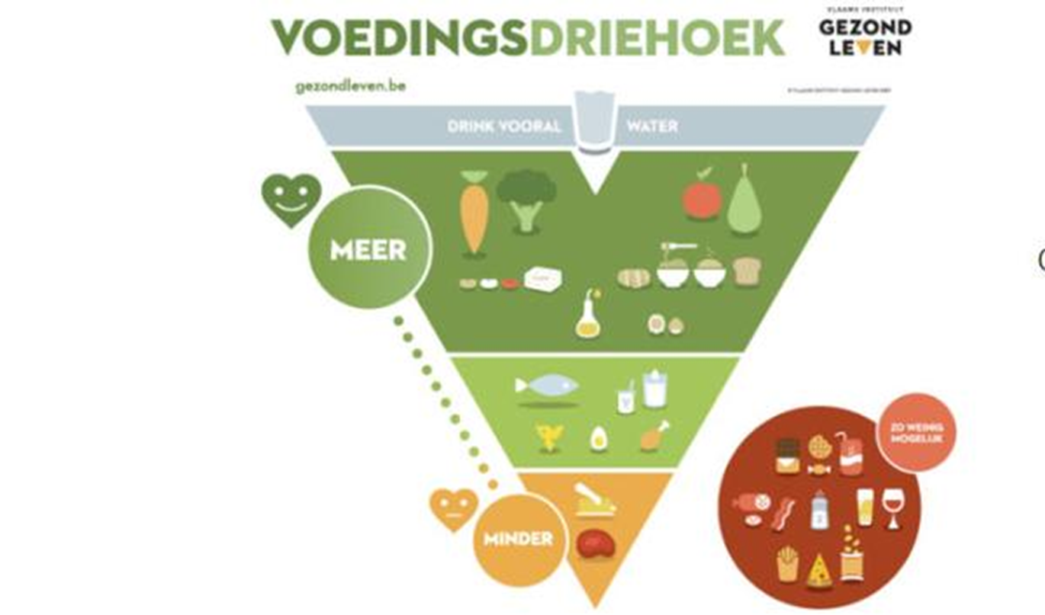


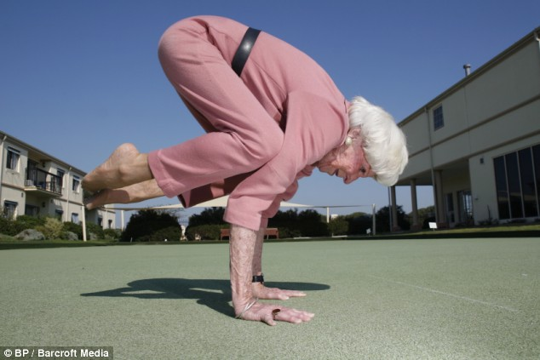



life style !!!!!!!!!!!!!!
Aerobic ex
30-90’/d
Volle granen
Lage glycemische index
spierversterking
Notes:
We need to stress the importance of a healthy life style with exercise such as regular aerobic ex but also muscle strenghtening ex to increase muscle mass a thus basic metabolic rate. Als a healthy diet with minimal alcohol use is most importnat
De menopauze transitie en postmenopauze brengen veranderingen in het hormonale milieu, het fysisch en psychologisch welzijn alsook heel wat metabole veranderingen t.h.v. o.a. lipiden en suikermetabolisme, hart- en bloedvaten, het botmetabolisme. Deze negatieve veranderingen hebben een impact op ontstaan van chronische aandoening in het latere leven van de vrouw. Het is het ideale moment voor counseling rond preventie hiervan. (11)
Levensstijladvies : aanpak van levensstijlfactoren heeft een positief effect op menopauze symptomen en de algemene gezondheid. Het is een belangrijke hoeksteen van het menopauze beleid!
Nastreven van een gezond gewicht. Vermijden van abdominale obesitas. Viscerale adipositas is geassocieerd met een verhoogd risico op sterfte, zelfs bij mensen met een normale BMI.
Evenwichtig en gezond dieet: de energie inname moet in balans zijn met het energieverbruik.
Het traditionele mediterrane dieet wordt aanzien als evenwichtig en bevat veel groenten, fruit, volle granen, noten, zaden, gezonde onverzadigde vetten (olijfolie), matige inname van vis en gevogelte, lage inname van rood vlees, vleeswaren, zuivelproducten en snoep. (12) Lage consumptie van simpele koolhydraten, alcohol, verzadigde vetten en bewerkte voedingsproducten. implementeren van deze gezonde voedingswijze op ‘lange’ termijn kan
• het cardiovasculaire risico verminderen alsook de incidentie van cardiovasculaire gebeurtenissen en overlijden hierdoor
• leiden tot een gunstiger lichaamssamenstelling
• de botmineraaldichtheid handhaven of verbeteren bij vrouwen met osteoporose
• helpen cognitieve achteruitgang te voorkomen
• het risico op borstkanker te verminderen
• het risico op sterfte door alle oorzaken te verminderen
Op ‘korte’ termijn dat dit voedingspatroon:
• vasomotorische symptomen verbeteren
• Cardiovasculaire risicofactoren zoals bloeddruk, cholesterol en bloedglucosewaarden verbeteren
• de stemming verbeteren en symptomen van depressie
Adequate calcium inname: een totale calciuminname via de voeding van 1.200 mg/dag wordt aanbevolen; bij voorkeur uit voedingsmiddelen en zuivelproducten. Als deze dagelijkse inname niet bereikt wordt door voedselinname, moeten orale supplementen worden overwogen. Hogere calciumdoses kunnen nodig zijn na bariatrische chirurgie en bij patiënten
met achloorhydrie; calciumabsorptie kan worden verminderd door protonpompremmers, in dat geval verkies je calciumcitraat preparaten. (13)
Adequate vitamine D inname: 600-1000 IE vitamine D/d wordt aanbevolen, hetzij door blootstelling aan de zon, hetzij door middel van een dieet of suppletie. Vitamine D zorgt voor een adequate calciumopname uit de darm. Bij vrouwen met een laag fractuurrisico die geen farmacologische behandeling nodig hebben, is een minimaal niveau van 25OHD ≥20 ng/ml (≥50 nmol/l) na te streven, met een bovengrens van ≤50 ng/ml (≤125 nmol/l). (13)
Rookstop
Beperken alcoholconsumptie
Voldoende beweging
minstens 150–300 minuten matige intensiteit aërobe fysieke activiteit; of ten minste 75-150 minuten aërobe fysieke activiteit met hoge intensiteit/week ; of een gelijkwaardige combinatie van matige en krachtige intensiteit activiteit gedurende de week. (14)
Spierversterkende oefeningen bij matige of hogere intensiteit die betrekking heeft op alle belangrijke spiergroepen : 2 of meer dagen per week
.

Slide 43
DEXA- bone densitometry
  Standard 65 y
  Belgian Bone Club : 50 y if presence of risk factors:
    Low BMI < 20 kg/m2
    Fragility fractures
    Hip fracture 1 degree relative
    Secondary Osteoporosis
    Diabetes, cortico therapy, rheumatic Disease
    Early Menopause without previous treatment
    Regular alcohol consumption , smoking
  Follow up
    No uniform guidelines: 2-5 years
Notes:
Opvolgen botdensitometrie:
Er is gebrek aan uniforme aanbevelingen over de periodiciteit van monitoring met DXA. De monitoring is afhankelijk van een eventuele behandeling, maar over het algemeen kan een tijdlijn van 2 tot 5 jaar worden overwogen. (13)

Slide 44
Thank you

