Slide 1

Natural vs Induced Menopause
(Surgical versus Chemotherapy related)
Daphné t’Kint de Roodenbeke MD
Medical Oncologist
Head of Oncogenetic Clinic
Institut Jules Bordet - Université Libre de Bruxelles
Brussels - Belgium
Workshop March 2025

Slide 2
No Disclosures

Slide 3
INTRODUCTION
What is Menopause:
Permanent cessation of menstruation (and loss of fertility) due to ovarian failure
Occurs naturally around age 50 or can be induced
Why is important
Impact on quality of life, bone health, cardiovascular risk and psychological well-being

Slide 4
NATURAL MENOPAUSE
Physiological process: gradual decline of ovarina function over the years
Symptoms: hot flashes, night sweats, mood changes, vaginal dryness
Hormonal changes: progressive decrease in oestrogen and progesterone

Slide 5
INDUCED MENOPAUSE
Surgical Menopause < bilateral Oopharectomy
Immediate symptoms due to sudden eostrogen loss
Increased risks → osteoporosis, cardiovascular disease, severe vasomotor symptoms
Chemotherapy-Induced Menopause
Temporary or permanent (depending type and dose of CT)
More unpredictable
! Fertility concern for young women
Notes:
Particularly concerning for young women who may wish preserve fertility

Slide 6
Association of Age at Onset of Menopause and Time Since Onset of Menopause With Cardiovascular Outcomes, Intermediate Vascular Traits, and All-Cause Mortality: A Systematic Review and Meta-analysis. Mielke et al. JAMA Oncology 2016
Association of Premenopausal Bilateral Oophorectomy With Cognitive Performance and Risk of Mild Cognitive Impairment. Mielke et al. JAMA Oncology 2021
Association of Premenopausal Bilateral Oophorectomy With Parkinsonism and Parkinson Disease. Mielke et al. JAMA Oncology 2022
…
→
« The abrupt discontinuation of ovarian function (by oophorectomy) in pre-menopausal women is associated with more severe consequences than natural menopause, such as increased overall mortality rate, and increased rates of coronary disease, stroke, cognitive impairment, Parkinson’s disease, psychiatric disorders, osteoporosis and sexual dysfunction »

Slide 7
NATURAL vs. INDUCED Menopause
Feature | Natural Menopause | Induced Menopause
Onset | Gradual | Sudden
Symptoms | Moderate | More severe
Hormonal decline | Progressive | Immediate
Long-term risks | Osteoporosis, cardiovascular disease | Increased risks due to abrupt estrogen loss
Psychological impact | Anticipated | Often distressing, especially in younger women

Slide 8
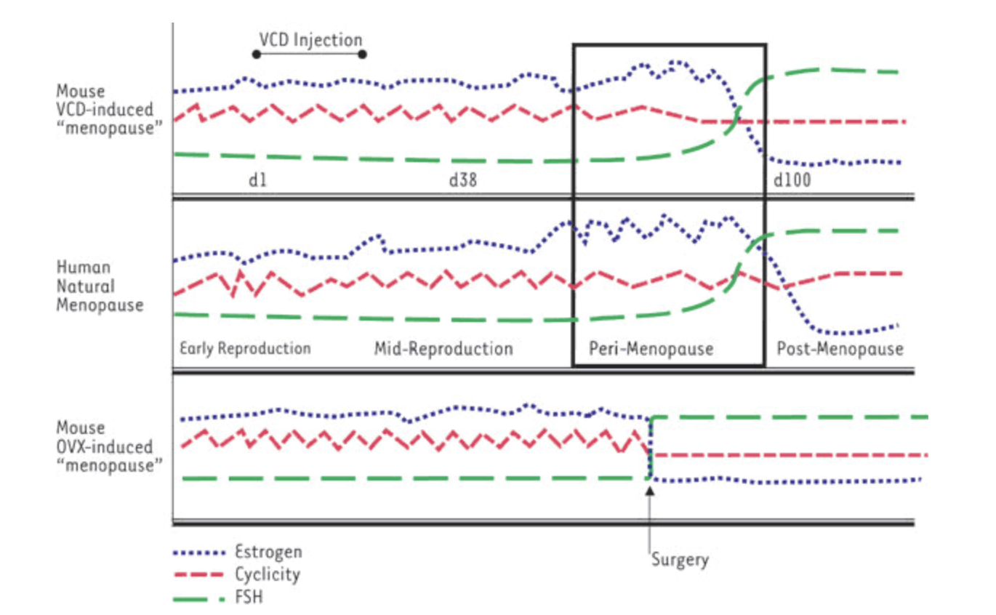
Chemical induced
Surgical oopharectomy
level
(of hormonal production)

Slide 9
SURGICAL CAUSES < Oncological Field
Gynecological Cancers
(Cervical, Endometrial, Ovarian)
Therapeutic reason < hormone-sensitive Breast Cancer
Genetic Risk Factors and Prophylactic approaches

Slide 10
SURGICAL CAUSES < others
Severe gynecological conditions: ovarian torsion, large cyst, severe endometriosis, etc…
Pelvis infections (PID, etc…)
Trauma or vascular compromise < ischemia

Slide 11
HOW TO MANAGE!
SURGERY approches
< by avoid or delay?
Chemothery-induced
< by protect ovaries

Slide 12
HOW TO MANAGE!
Gynecological cancers:
Discuss to avoid bilateral oopharectomy
low risk / low stage
in young patients (< 45y)
Therapeutic reasons < hormone-sensitive breast cancer
→ Balance between risk factors / duration of treatment / prevention / menopausal status / …
SAFETY CANCER FIRST!!!!

Slide 13
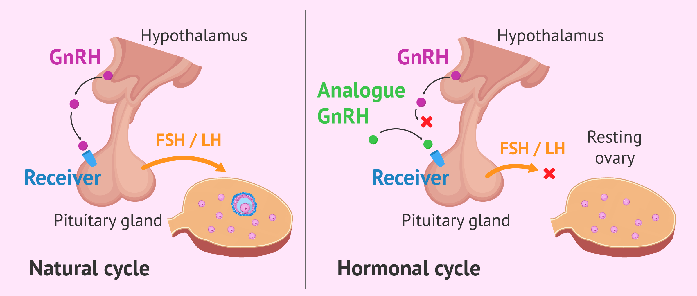
Using of GnRH Agonist - @Zoladex

Slide 14
GnRH Agonist
= Chemical induced REVERSIBLE menopause
→ SC, every 28days (or every 3months)
to preserve ovarian function (fertility concern vs early menopause)
As a complement for hormonal treatment (breast cancer)

Slide 15
CASE 1
47 years old women
Peri-menopause
Breast Cancer: lobular 38mm - Grade 1
Oestrogen and Progesterone Receptor (RO – RP): 100%
No axillary lymph node
No chemotherapy
Hormonotherapy by Aromatase Inhibiteur AND monthly GnRH Agonist
Discussion SURGICAL MENOPAUSE by bilateral annexectomy

Slide 16
CASE 2
36 years old women
Pre-menopause
Breast Cancer: NST 20mm - Grade 2
Oestrogen and Progesterone Receptor (RO – RP): 100%
No axillary lymph node
Chemotherapy (short scheddule - 4months)
Hormonotherapy by Aromatase Inhibiteur AND GnRH Agonist
@Zoladex START before CT
→ ovarian function preservation! AND treatment!

Slide 17
HOW TO MANAGE!
Gynecological cancers:
Preservation of ovarian function
→ early diagnostic (< 45y) AND low risk / low stage
Therapeutic reason < hormone-sensitive breast cancer
→ Balance between risk factors / duration of treatment / prevention / menopausal status / …
Genetic Risk Factors and Prophylactic approaches

Slide 18
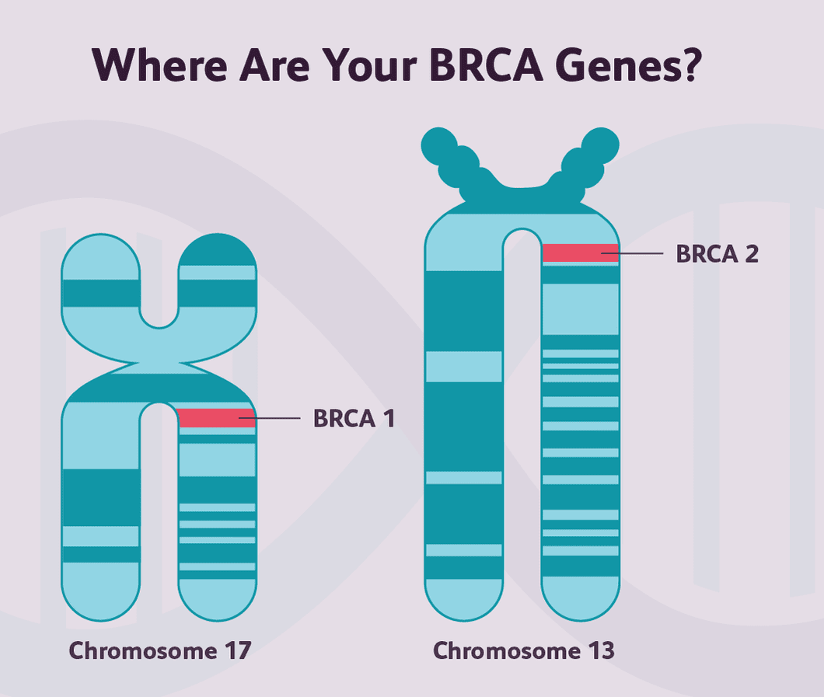
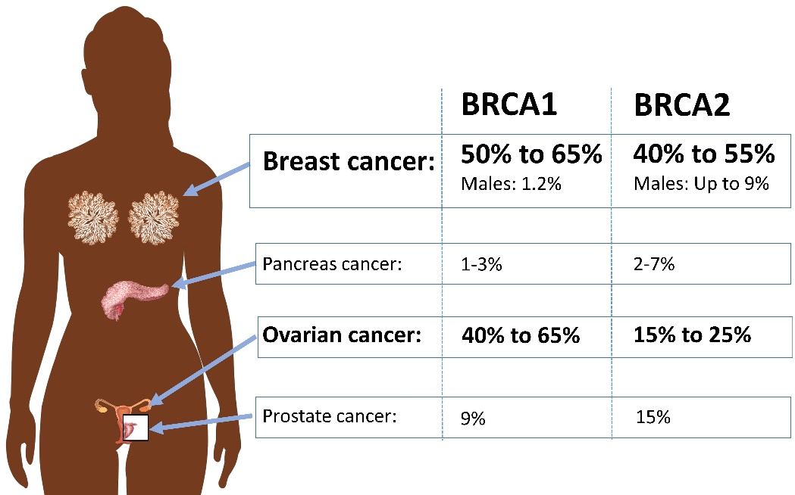
PROPHYLACTIC SURGERY for High Risk Hereditary Predisposition = Risk Reducing Salpingo-Oopharectomy (RRSO)

Slide 19
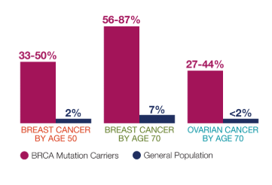
PROPHYLACTIC SURGERY for High Risk Hereditary Predisposition = Risk Reducing Salpingo-Oopharectomy (RRSO)
BRCA1: early risk OC
→ RRSO recommended < 40y
BRCA2: OC risk little bit later
→ RRSO recommended < 45y

Slide 20
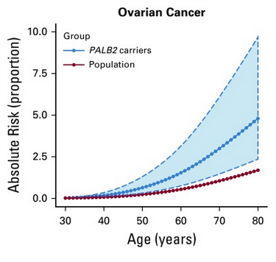
PROPHYLACTIC SURGERY for High Risk Hereditary Predisposition = Risk Reducing Salpingo-Oopharectomy (RRSO)
Moderate risk genes
(PALB2, RAD51C/D, BRIP1):
→ RRSO < 50y

Slide 21

RRSO – inconvenients!!!!
! Early menopause
! STOP fertility
! Hormonal Therapy of substitution admitted only if no breast cancer personnal history but less comfortable!

Slide 23
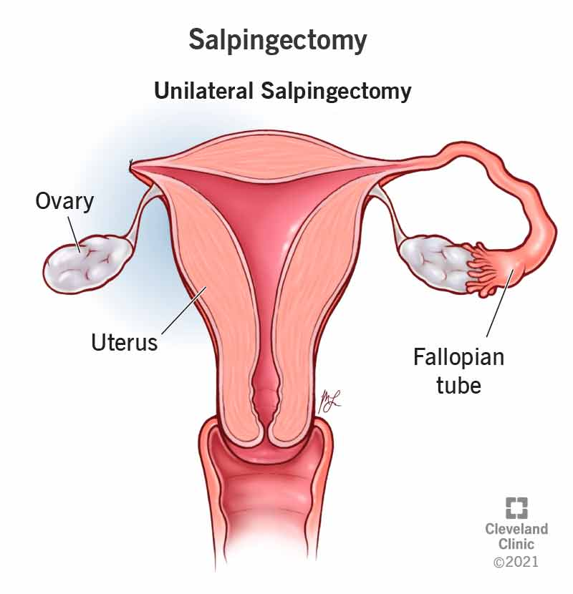
Actual and promising question:
Can we use a « 2 surgical times strategy » in high risk patients?
(Early Salpingectomy + Delayed Oophorectomy)?
  Target = 80 - 90% risk reduction
  (idem post RRSO)
  Endpoint 2aires
    QoL
    BC risk?

Slide 24
Changing of strategy
→ Bilateral Salpingectomy < When patient wishes!
(even without child because PMA frequent)
AVOID EARLY MENOPAUSE
→ delayed Oopharectomy
  When?

Slide 25


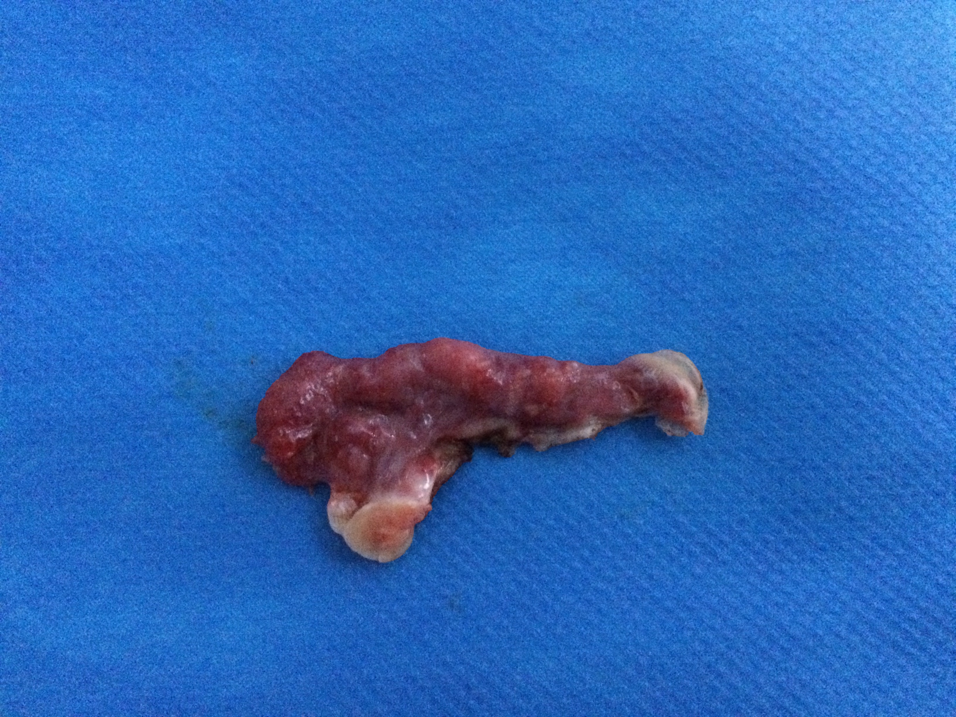
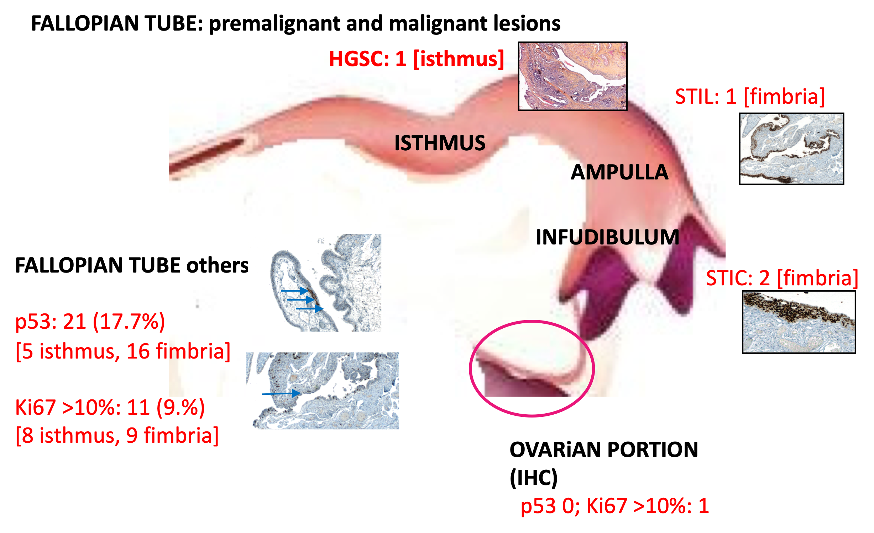
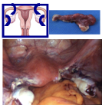
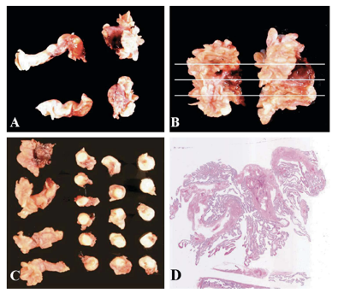
#1594
Prophylactic radical fimbriectomy in women with a documented high risk of breast/ovarian cancer. Final pathological results and outcomes of a prospective phase II national study (NTC : 1608074)
Authors:
Leblanc E1, Narducci F 1, Hudry D1, Bresson L1, Charvolin JY2, Ferron G3, Guyon F 4, Fourchotte V 5, Lambaudie E6, Baron M7, Fouche Y8, Gouy S9, Collinet P10, Caquant F 11, Pomel C 12, Golfier F13, Vaini-Cowen V14, Lemaire AS 1, Vuagnat P 1, Salzet M 15
1. Centre Oscar Lambret Lille France; 2. Clinique Du Bois Lille France, 3. Institut Claudius Regaud Toulouse France, 4. Institut Bergonié Bordeaux France, 5. Institut Curie Paris France, 6. Institut Paoli Calmettes Marseille France, 7. Centre Becquerel Rouen France, 8. Centre A Lacassagne Nice France, 9. Institut G Roussy Vilejuif France, 10. CHRU Lille France, 11. Clinique du Parc Croix France, 12. Centre J Perrin Clermont Ferrand France, 13. Hospices civils Lyon France, 14. Polyclinique Parc Rambot Aix en Provence, France, 15. INSERM U1192, Université Lille France
Background:
Risk-reducing salpingo-oophorectomy (RRSO) is the gold standard to prevent the development of a pelvic high-grade serous carcinoma (HGSC) in women carrying a high risk of breast/ovarian cancer (NCCN Guidelines ovarian cancer v 2019).
Due to adverse effects, a significant number are reluctant to perform this procedure (Meserve et al 2019).
Given the information that most of HGSC arise from the fimbrial end of fallopian tubes (Kurman et al 2010), precisely at mesothelo mullerian junctions (Seidman 2011) , we suggest a new 2-step prophylactic procedure called radical fimbriectomy with delayed oophorectomy (RF/DO) (Leblanc et al 2011)
We present the final results of a national phase 2 study (NCT 1608074), testing this procedure offered to women, more 35 years old with completed pregnancy project, carrying a hereditary (BRCA1/2 mutation) or a documented familial risk of developing a pelvic HGSC, who refused the standard RRSO.
Conclusions
Risk-reducing radical fimbriectomy with delayed oophorectomy is a safe and efficient alternative to RRSO for the detection of adnexal occult neoplasia
2. It preserves both femininity and possibly fertility
3. Although promising, a bigger cohort with longer follow-up is necessary to confirm its efficacy in terms of ovarian cancer prophylaxis.
4. Surveillance of breast is to be maintained
Acknowledgements to all French onco-geneticians and pathologists involved in this study
Statisticians : MC Le Deley and E Tresh dept of Biostatistics Centre O Lambret Lille France
and Philippe Vennin MD ☨: oncogenetician at the origin of the discussion.
Contact: Leblanc Eric, MD: e-leblanc@o-lambret.fr
Results: from 2012-2014: 121 women from 11 French institutions underwent RF/DO
1. Population characteristics
Age: 39.2 years old (28-48) BMI 22.7 kg/m2 (17.6-38.6)
77 BRCA1m/ 31 BRCA2m // 9 negative // 5 unknown
History of breast cancer : 69
Previous prophylactic bilateral mastectomy 30
2. Primary objective
After 63 months median follow-up (3-86): 0 pelvic HGSC was observed
The only pelvic ”malignancy” was 1 CIN3 managed by total hysterectomy
3. Secondary objectives
a) Morbidity
intraoperative (laparoscopy 120, laparotomy 1): 121 FR: 0 / 29 DO: 0
post operative:
FR: 36 Clavien grade 1 (post-operative pain) and 2 grade 2 (dysmenorrhéas)
DO: 1 Clavien 3b (at J0: hemoperitoneum)
distant (> 30 days): 0
b) Pathological results (SEE FIM)
a) Fimbriectomies:
1 HGSC + controlat STIC
reop (THBO peritoneal and retroperitoneal staging )
-> St IIIA – chemo: alive NED at 64 M
1 STIC (serous tubal intraepithelial carcinoma)
reop: bilat oophorectomy+ peritoneal staging: no lesion
1 STIL (serous tubal intraepithelial lesion): surveilled
tubo-ovarian or peritoneal junctions: no disease
b) Delayed (median 3.9 years) oophorectomy: n= 29 (21%) (17 menopause, 12 personal choice): No malignant lesion
c) Secondary breast cancers:
21 (17%) (3 de novo/18 recurrences); delay from FR : 3.2 years (0.7-7.3)
16/77 BRCA1 and 5/31 BRCA2 (p=0.8)
d) Other: 1 post-RF twin uneventful pregnancy thanks to ART
Methods:
This study was approved by our national scientific committee and by our local ethic committee. All surgeons and pathologists were aware of the surgical technique (video) and pathological requirements.
Technically RF/DO consists of the resection (ideally by laparoscopy) of both tubes along with the fimbrio-ovarian junction (tethered ovarian fragment), completed at 50 years-old or at menopause, by a delayed oophorectomy (RF/DO). All specimens are analyzed using the Serial Extended Examination of FIMbria (SEE-FIM) protocol (Medeiros 2006).
Regular follow-up of patients consisted in an annual clinical examination, along with the assessment of tumor markers, hormone levels and ovarian reserve. If complaint or blood test abnormality further explorations were defined
All data were reported on CRFs and stored in a unique place before processing by statisticians
Primary study objective : rate of pelvic HGSC which should be less than 10% until 50 years old or less than 3% each 3 years, to declare the method effective. Strict stopping rules had been predefined.
Secondary study objectives : morbidity of the procedures (RF and DO), rate and pathology of DO and breast cancers (de novo or recurrent)
A population of 120 women with a follow up of at least 5 years was expected
Intraoperative aspect of radical fimbriectomies and process of SEEFIM examination
Fallopian tube: invasive and preinvasive lesions
ISTHMUS
AMPULLA
1 invasive HGSC
1 STIL
FIMBRIA
2 STIC
OVARIAN
FRAGMENT
Fallopian tube: others
P53 signature: 21 (17.4%)
{loc: isthmus ; fimbria: }
Ki67 > 10%: 10 (8,3%) (inflammation)
{loc: isthmus : fimbria: }
Ovarian fragment
P53 signature : 0
Ki67> 10%: 1 (inflammation)
Fallopian tube
Fimbria
RF specimen
Ovarian fragment
Laparoscopic final aspect after RF
A future direction could be to promote a large international prospective study giving the choice to women between RRSO or RRS/RRFR/DO and follow them for ≥10 years to validate or not a 2-step alternative
Uterus
Ovary
Ovary
Notes:
Poster Template using Individual Text Boxes

Slide 26
Early salpingectomy (TUbectomy) with delayed oophorectomy as alternative for BSO to improve menopause-related QoL in women with a BRCA1/2 pathogenic variant
→ 577 patients
164 BSO 35-40 BRCA1/40-45 BRCA2
413 (72%) salpingectomy + oopharectomy (maximum 5y more than the recommended age (45y for BRCA1 / 50y for BRCA2)
→ beter QoL and beter sexual function in the second arm…even compared with the women who take THS (2/3) in the BSO arm
Steenbeek, Harmsen et al. JAMA Oncology 2021

Slide 27



Slide 28

Essai en cours: TUBectomy with delayed oophorectomy as Alternative for RRSO in high-risk Women to assess the Safety of Prevention
TUBA-WISP II
RAD51C, RAD51D, BRIP1, PALB2
BRCA1, BRCA2, BRIP1, RAD51C, RAD51D
25-40 (BRCA1) or 45 (BRCA2) or 50 (BRIP1, RAD51C/D)
RRS versus RRS with DO
End point: incidence of tubal/ovarian cancer (non inferiority trial)
3000 patients
BRCA1
BRCA2

Slide 29















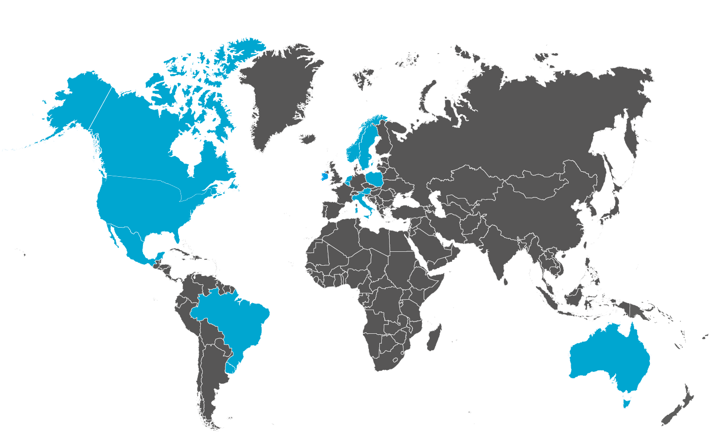



































54 participating centers in 14 countries
The Netherlands
Norway
Ireland
Canada
Sweden
USA
Poland
Belgium
Australia
Mexico
Italy
Brazil
Austria
Uruguay

Slide 30
CASE 3
30 years old women
Pre-menopausis
Breast Cancer: triple negatif 18mm - Grade 3
Oestrogen and Progesterone Receptor (RO – RP): 0%
No axillary lymph node
BRCA1
Chemotherapy (long scheddules – 6months) + Immunotherapy
GnRH Agonist → ovarian function preservation!

Slide 31
Some paradigms of evolution
In high risk hereditary predisposition → delay safety the Oopharectomy and the menopause
Early oopharectomy → NO incidence on breast cancer risk
Discuss THS cautiously even in POST-BC patient

Slide 32
Summary and Perspectives
Early induced menopause is a real concern
For oncologic decisions: importance to balance medical risk, psychological aspect of aging, reproductive health and quality of life
Evolution of prophylactic approaches in High Risk Ovarian Cancer population

Slide 33
THANK YOU

Slide 34
5 étapes de l’annexectomie prophylactique
Inspection de la cavité abdominale
Rinçage péritonéal → cytologie
Dissection rétropéritonéale du pédicule lombo-ovarien sectionné à 2 cm de l’ovaire
Section de la trompe et du ligament utéro-ovarien à ras de l’utérus
Extraction des pièces dans un sac
Examen anatomopathologique des specimens selon protocole SEE FIM (coupes longitudinales de la fimbria + coupes de la section du reste de la trompe/2mm)

Slide 35
Conclusions
- Chirurgie de réduction du risque de cancer ovarien: annexectomie bilatérale prophylactique (Risk Reduction Salpingo Oophorectomy) chez les patientes sans souhait de conception ultérieur
  À l’âge de 40 ans (BRCA1)
  À l’âge de 45 ans (BRCA2)
  5 ans avant l’âge du diagnostic de cancer ovarien familial le plus précoce
- Cette chirurgie a un impact négatif sur la qualité de vie des patientes
- Une approche en 2 temps (salpingectomie de RR et ovariectomie reportée) est en cours d’évaluation au sein de l’essai TUBA WISP II
- Attention à la qualité de cette chirurgie et à la recherche systématique des STIC

