Slide 1
Menopause Care
Indications
Benefits
Complications
Side effects
Dr.Eveline Markowicz Menopause Care, Brussels, March 21 & 22 March

Slide 2
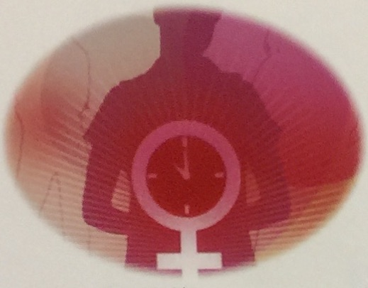
Symptoms of the perimenopause and the menopause
Change in menstrual patterns
Shorter cycles are typical
Irregular bleeding (heavier, lighter with spotting)
General Appearance
Dry, itchy skin
Weigth gain
Thinning of hair
Breast drop, flatten
Teeth loose, gums recede
Vasomotor symptoms
Hot flushes
Night sweats
Sleep disturbances, frequent awakenings
Somatic Symptoms
Headache
Dizziness
Palpitations
Breastpain and enlargment
Joint aches and backpain
Psychological and Mental
disturbances
Worsening of PMS
Low mood not clinical depression
Irritability, anxiety
Mood swings
Loss of concentration, Brain fog
Fatigue
Urogenital Problems
Stress and mixed incontinence
Urinary tract infection
Sexual dysfonction
Decreased libido
Painful intercourse
Vaginal dryness, VVA
Increasing risks
Cancer
Osteoporosis
Cardiovascular dideases
Dementia,Cognitive decline,Depression
Obesity, Diabetis
Prof. Johannes Bitzer, Universitätsspital Basel
Notes:
Exclude other causes of the symptoms : thyroid function, iron deficiency, diabetis, etc
However, in many countries menopause-associated musculoskeletal pain is more problematic than VMS

Slide 3
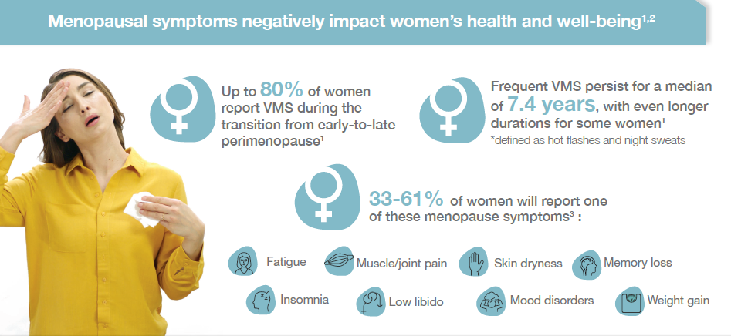
Menopausal symptoms negatively impact women’s health and well-being
El Khoudarry SR, et al. Menopause: The Journal of The North American Menopause Society 2019; 26(10): 1213–1227.
Makara-Studzińśka MT, et al. Prz Menopauzalny 2014; 13(3): 203–211.
Tremollieres FA, et al. Maturitas 2022; 166: 58–64.

Slide 4
Menopausal symptoms negatively impact women’s health and well-being
El Khoudarry SR, et al. Menopause: The Journal of The North American Menopause Society 2019; 26(10): 1213–1227.
Makara-Studzińśka MT, et al. Prz Menopauzalny 2014; 13(3): 203–211.
Tremollieres FA, et al. Maturitas 2022; 166: 58–64.

Slide 5
Menopausal symptoms negatively impact women’s health and well-being
El Khoudarry SR, et al. Menopause: The Journal of The North American Menopause Society 2019; 26(10): 1213–1227.
Makara-Studzińśka MT, et al. Prz Menopauzalny 2014; 13(3): 203–211.
Tremollieres FA, et al. Maturitas 2022; 166: 58–64.

Slide 6
Menopausal symptoms negatively impact women’s health and well-being
El Khoudarry SR, et al. Menopause: The Journal of The North American Menopause Society 2019; 26(10): 1213–1227.
Makara-Studzińśka MT, et al. Prz Menopauzalny 2014; 13(3): 203–211.
Tremollieres FA, et al. Maturitas 2022; 166: 58–64.

Slide 7
Menopause is inevitable, suffering is not
A postmenopausal woman is more likely to be prescribed an antidepressant than hormone therapy
Dr. Mary Claire Haver – Podcast/Youtube

Slide 8
Why prescribe HRT
The cardinal symptoms are recognized as occurring as a result of systemic estrogen insufficiency.
The most robust menopause Clinical Practice Guidelines (CPGs) support HRT as the most effective treatment to alleviate most of the symptoms .
Despite HRT has been shown to remain the most effective treatment for vasomotor symptoms (VMS), the genitourinary syndrome of menopause and to prevent bone loss and fracture, by the end of 2010, the HRT uptake was lower than 10% .
HRT use also declined overall among women who were within 10 years of the mean age of menopause.
The greatest decline in HRT use was among women aged 50 to 59 years, falling from 7.3% in 2007 to 3.8% in 2023.
mean age of menopause.
The 2023 Practitioner’s Toolkit for Managing Menopause; S. R. Davis , S. Taylor,C. Hemachandra,K. Magraith,P. R. Ebeling,F. Jane &R. M. Islam

Slide 9
Benefits of hormone HRT
Vasomotor symptoms
Urogenital symptoms
Female sexual function
Mood and depression
Osteoporosis and fracture
Degenerative arthritis
Skin
Cognition
Cardiovascular disease
Type 2 diabetes
Colorectal cancer

Slide 10
Vasomotor symptoms (hot flashes and sweats)
Affect 60 to 80 %of menopausal women
A Cochrane review reported
75 % reduction in the frequency
85% reduction in severity of hot flashes in HRT users
As these symptoms can be debilitating in a significant proportion of women ,managing them effectively should have an important positive impact on their quality of life
The addition of a progestegen to estrogen as part of HRT did not show any change in results
The lowest effective estrogen dose should be used, and increasingly lower and lower doses have been proven to be effective

Slide 11
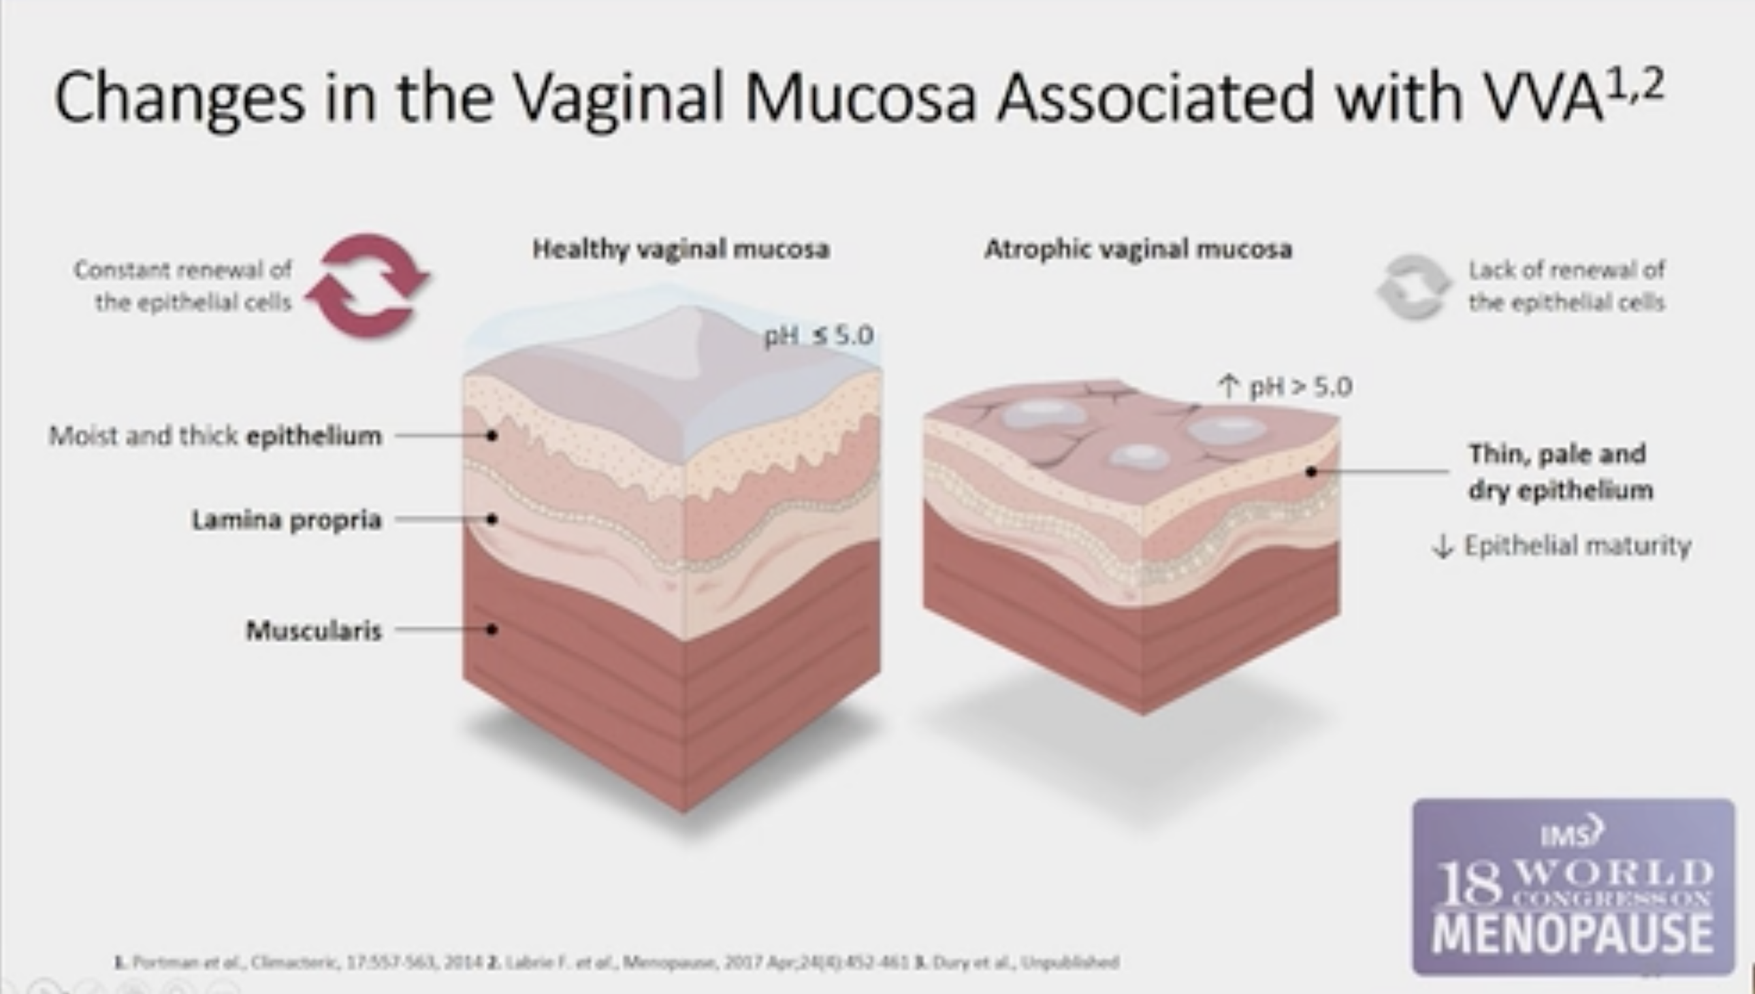
Urogenital symptoms
Prevalence of VVA is around 27%
Topical vaginal estrogen therapy provides effective symptoms relief
They are also effective in reducing the number of episodes of recurrent urinary tract infections
Topical vaginal estrogen have minimal systemic absorption, and they are considered safe they are not associated with the risk associated with HRT discuss later
Systemic HRT preparation offer no therapeutic advantage over low dose local estrogen in the management of atrophic vaginitis in the menopause

Slide 12
Female sexual function
Sexual dysfunction is common among postmenopausal women and its correction can lead to improved quality of life for women and their partners
Systemic and topical HRT improve the superficial and sometimes deep dyspareunia associated with vulvovaginal atrophy in postmenopausal women
Restoring libido is altogether a more complex challenge
For some women correction of underlying menopause symptoms and improvement in sleep and mood can all have a positive impact
The addition of testosterone therapy has been shown to improve sexual desire and satisfaction

Slide 13
Mood and depression
Peri and postmenopausal are associated with an increase in mood and depressive disorders
Estrogen interacts with mood -regulating brain mechanisms through a number of neurotransmitters and serotonin system
60 to 80% of women using estrogen only HRT reported decreased mood symptoms compared with only 20 to 22% of women using placebo
Both estrogen only and combined preparation improved depressive symptoms in menopause when compared with placebo
Use of HRT has also been associated with a significant improvement in sleep quality
For some women the additional progestogen can have a negative impact on this symptom
This may vary with the type dose and the route of progestogen so carefully selection of combination therapy is required

Slide 14
Osteoporosis and fractures
Declining estrogen levels in the menopause are strongly associated with bone density loss and osteoporotic fractures
There is a 30% reduction in osteoporotic fracture (hip ,vertebrae and overall )among women taking estrogen-only or combined HRT compared with placebo
HRT should be considered one of the first line choices of therapy in postmenopausal women below the age of 60 with a significant fracture risk and for those women with POI
These particular groups of women are also the most likely to suffer from menopausal symptoms
Initiating HRT after the age of 60 for the sole purpose of osteoporosis prevention is not recommended as a first line therapy although it may still be effective
The protective effect of HRT on bone mineral density may remain for a variable length of time after cessation of therapy before an inevitable gradual decline in bone density occurs emphasizing the importance of ongoing bone conservation strategy

Slide 15
Transdermal estradiol gel improves BMD vs baseline
Study design: Randomized trial comparing transdermal OESTROGEL® 1.5 mg/day (n=20), Oral CEE 0.625 mg/day (n=17), and no treatment (n=24) on BMD in 65 hysterectomized women (15 dropped out). BMD was measured by dual gammagraphic densitometry in the lumbar spine (L2– L4). Primary endpoint: Differences in BMD at 12, 24, and 36 months, with BMD expressed in grams of hydroxyapatite/cm2 as a parameter (coefficient of variance 2.3%)
Adapted from Palacios S, et al. Maturitas 1995; 20(2-3): 209–213.

Slide 16
Degenerative arthritis
Estrogen has a regulatory role in the metabolism of cartilage in menopause
The decrease of estrogen levels is associated with
  thinning of intervertebral discs
  osteoarthritic joint changes
Most of these changes occur in the first five years after the menopause
HRT can have a protective effect on intervertebral discs and articulate joint cartilage

Slide 17
Skin
The hypoestrogenic state of the menopause accelerates age-related skin changes
  thinning and dryness of the skin
  increasing the number and depth of wrinkles
  decrease in skin elasticity
Several randomized double-blind placebo-controlled trials have shown a 30 % increase in dermal thickness in postmenopausal women after 12 months of estrogen therapy as well as an overall increase in collagen content and decrease in facial wrinkling

Slide 18
Cognition
The impact HRT on cognitive function depends on the woman's age and timing of HRT initiation
Several studies have revealed cognitive benefits of HRT if commenced around the time of menopause
It improves memory ,stronger global cognition and executive function
Recent observational study has shown a 30% reduction of Alzheimer disease risk in women who initiate HRT within five years of menopause and use it for more than 10 years

Slide 19
Cardiovascular disease (I)
Leading cause of death in women over 50 years of age worldwide
Considerable evidence suggests that atherosclerotic changes are delayed by estrogen whether endogenous in the pre menopause or exogenous in the form of HRT after the onset of menopause
Estrogen are associated with
  reduction in endothelial injury as well as
  plaque formation
  through lowering total and LDL cholesterol and raising HDL cholesterol levels
Observational studies have shown a 40% decrease in cardiovascular disease rates as well as cardiovascular disease related and all cause mortality rates in women who commeced HRT in early menopause vs. nonusers
Critical therapeutic window theory can be applied here as the cardioprotective effect was not observed in women starting HRT after the age of 60 ( WHI)

Slide 20
Cardiovascular disease (II)
A more recent 10- year randomized trial of women receiving HRT started early after menopause showed that the HRT group had a significantly reduced risk of mortality ,heart failure and stroke compared with the untreated group
Current evidence suggests that
  estrogen only regimens may offer greater cardio protection than combined regimen
  a transdermal route of administration may provide further additional benefit of lowering the blood pressure and preventing atherosclerotic plaque rupture and thrombosis as compared with oral estrogen preparation
  treatment seems to be duration dependent and becomes effective after at least 6 years of use
More research is needed on the role of cardiovascular effect of progesterone in combined HRT

Slide 21
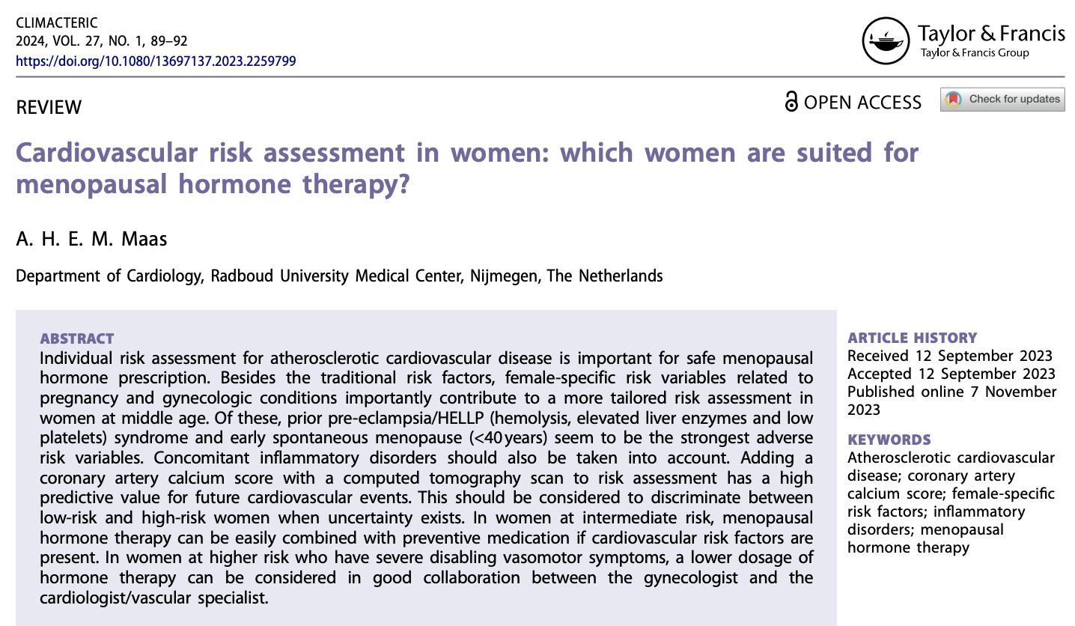
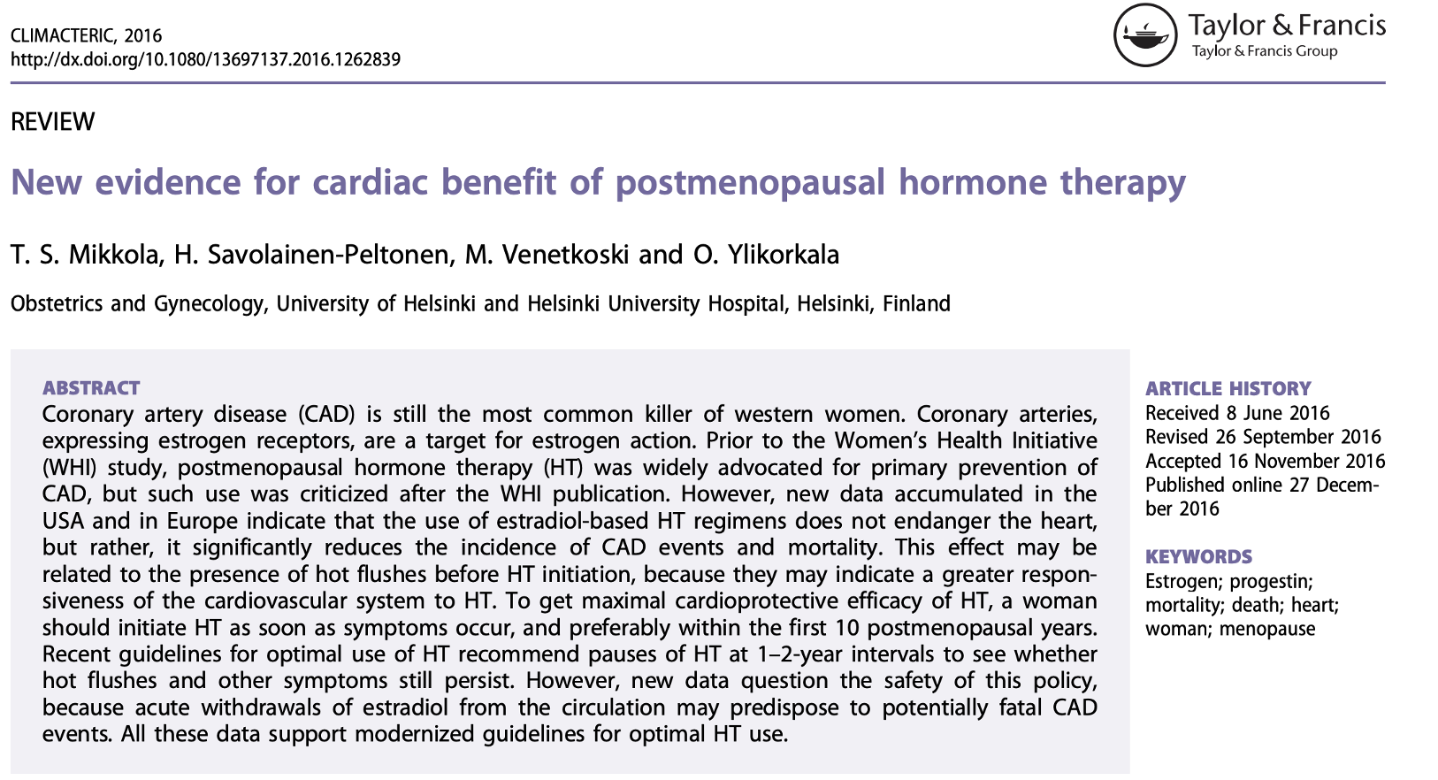
Cardiovascular disease (III)

Slide 22
Type II diabetes
Multifactorial condition with increasing incidence in the midlife
Decline in estrogen levels may play a role in insulin sensitivity
A large RCT indicate a lower incidence of type 2 diabetes among women using combined HRT in comparison with the placebo group ( by 7.5 cas per 1000 women per 5 years of use )

Slide 23
Colorectal cancer
Epidemiologic studies have shown up to a 20% reduction in colon cancer incidents in ever-users of HRT compared with never-users

Slide 24
Risks of HRT
    Breast cancer
    Cardiovascular disease
    Stroke
    Venous thromboembolism
    Ovarian cancer
    Endometrial cancer
    Gallbladder disease

Slide 25
Breast cancer
The potential risk of breast cancer associated with HRT remains one of the principal reason for anxiety among patients and healthcare professional about prescribing HRT
Woman should be reassured that the absolute increase in breast cancer risk associated with HRT use is small and is overall less than the increase in risk associated with obesity, nulliparity or consumption of three alcohol drinks per day
Whether breast cancer risk differs between oral and non oral HRT has not been established in randomized clinical trial
Observational studies implicate progesterone as safer than synthetic progestogens ( progestins) with regards to breast cancer risk
There are few long term observational data ( > 5 years) and no evidence from randomized controlled trials to inform whether progesterone is safer than progestins
However expert opinion is that progesterone may confirm less breast cancer risk

Slide 26
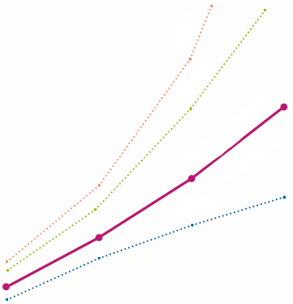
Breast Cancer
Breast cancer risk factors
Cumulative risk of breast cancer by age in function of several factors
< 1: Decreased risk
> 1 : Increased risk
[5 years MHT with Estradiol (E2) ± Micronised progesterone (P4) versus exercise, obesity or alcohol]
Regular physical exercise³ (min. 4 H/week)
No MHT
MHT with E2 ±P4 ²
Obesity⁴
Alcohol⁵ (2 units per day)
Tabacco⁶
Nulliparity or 1st baby born late⁷
Family history (first degree) of breast cancer after the age of 50⁷
BRCA1 gene mutation and postmenopause⁸
Cumulative risk of breast cancer per 1000 women
No Hormone Replacement or MHT with E2 ± P4²
Alcohol⁹
Obesity¹⁰
Exercise³
Relative Risk
Age
2. Yang, et al. Gynecol Endocrinol 2017; 33(2): 87–92; 3. Thune, et al. N Engl J Med 1997; 336(18): 1269-75; 4. van den Brandt, et al. Am J Epidemiol 2000; 152(6): 514-27. 5. Collaborative Group on Hormonal Factors in Breast Cancer. Br J Cancer 2002; 87: 1234–1245. 6. Reynolds, et al. J Nat C Inst 2004; 96(1): 29–37. 7. Singletary S. Ann Surg 2003; 237(4): 474–482. 8. Easton, et al. Am. J. Hum Genet 1995; 56: 265-271. 9. Smith-Warner et al. JAMA 1998; 279(7):535-40; 10. Kelsey, et al. JAMA 1997; 278(17):1448-1449

Slide 27
Cardiovascular disease
The beneficial cardioprotective effect of HRT in women under the age of 60 are discussed above
For women starting HRT after the age of 60 there appears to be an increased risk of cardiac events during the first five years of use however other data suggests that cardiac morbidity declines in a population of older healthy women after taking HRT for two years
estrogen is a potent vasodilator, and it's hypothesized that when HRT is initiating women with established coronary disease estrogen may promote atherosclerotic plaque rupture and thrombosis
this effect seems to to be dose dependent they may not be seen with lower dose

Slide 28
Stroke
Second leading cause of mortality among female associated with hypertension obesity and other factors
Stroke incidence increase with age but remains constant
the absolute risk also appears to increase with age
among women < 60 years of age the excess risk relate to HRT use approximates 1 case per 1000 women per 5 years of use
whereas
in women 60 >years of age the risk is 4.5 cases per 1000 women per 5 years of use
This small increase in risk may be route dependent possibly mediated by an increased thrombotic tendency as observational studies suggest no increase in stroke risk with low dose transdermal preparation

Slide 29
Venous thromboembolism
Because of its background prevalence and potentially serious consequence the risk of VTE is one of the most important factors in the risk to benefit equation of HRT
Absolute risk depends on coexistent risk factors such as age obesity immobility and presence of thrombophilia
The estimate HRT- related thromboembolic events in women aged 50 to 59 years approximate to
  2 per 1000 per 5 years of use of unopposed estrogen or
  5 per 1000 per 5 years of use of combined HRT
Oral estrogens increase the risk of VTE but there is a general agreement that non-oral estrogen is associated with little/no increase in VTE risk
However, as the absolute risk of is low in healthy women at the average age of menopause the route of administration is best determined by the patient's preference
For those with a very high-risk factor V Leiden even transdermal estrogen are associated with a significantly increased risk
in such women with very severe symptoms HRT may be prescribed in conjunction with thromboprophylaxis

Slide 30
Ovarian cancer
Observational studies report a RR of 1.6 with estrogen only HRT with a 7% increase in risk per year of use
Risk declining to average population risk 2-4 years after cessation of therapy
However, these results have not been consistently reproduced and the WHI trial observe a nonsignificant RR of 1.5 for continuous combined HRT versus placebo
In women with epithelial ovarian cancer studies have either shown no difference or an improvement in survival rate with the use of HRT

Slide 31
Endometrial cancer
90% develop after the age of 50
Estrogen only HRT used for 10 years increased risk of endometrial cancer by 9.5 times
The risk tends to persist for many years after cessation of therapy (RR of 1.9 12 years after stopping estrogen)
The addition of cyclical or continuous progestogen eliminates the increased risk
Continuous progestogen regimens are associated with lower risk than sequential ones

Slide 32
Gallbladder disease
Both estrogen only and combined HRT increased risk of gallbladder disease (Cholecystitis and cholelithiasis )and cholecystectomy
The risk tends to persist for many years after HRT cessation and depends on the type and dose of estrogen as well as the route of administration
Transdermal estrogen preparation are associated with a significantly lower gallbladder disease risk
Shorter duration of HRT also minimize this risk

Slide 33
Side effects of HRT
Initiating treatment with low-dose MHT will minimize the likelihood of adverse effects.
Common adverse effects of estrogen include:
    Nausea (mostly limited to oral therapy)
    Breast tenderness
    Bloating
    Headaches
    Mood changes (irritability, anxiety)
    Weight gain or fluid retention
    Breakthrough bleeding
    Somnolence
    Change in cholesterol level
    Increased insulin resistance
Notes:
Breakthrough bleeding is not unexpected in the first 3 months of continuous-combined estrogen–progestogen therapy, and occasionally heavy bleeding can occur. Progestogen therapy may cause low mood or irritability. When this occurs either the dose needs to be reduced or another progestogen tried. Micronized progesterone may improve sleep and sometimes causes somnolence, and so should be taken at bedtime [Citation66]. Changing from one regimen to another in many cases will alleviate adverse effects.
Potential adverse effects of tibolone include fluid retention, mild weight gain and initial vaginal bleeding or spotting.

