Slide 1
Menopause Care : A Comprehensive 2-Day Workshop
March 21/22 2025
Forum CHU St Pierre Bruxelles

Slide 2

Evaluation, Prevention and Treatment of Neurocognitive Disorders
Joachim Schulz MD PhD
Service de Neurologie CHU Saint Pierre
ULB

Slide 3
Evaluation of Neurocognitive Disorders

Slide 4
What is not a Neurocognitive Disorder
Forget the PIN code once
Unable to read or write
Being depressed
Low IQ
Old age

Slide 5
Neurocognitive Disorders (NCD)
(Diagnostic and Statistical Manual of Mental Disorders IV, ICD11)
-Significant impairment of cognition in at least one cognitive domain
Deterioration from a previous level of function (acquired as opposed to developmental)
Cave: premorbid level, age, cultural and linguistic factors
-Mental health disorders that primarily affect cognitive abilities:
Not a mood or other psychiatric condition such as Attention Deficit Hyperactivity Disorder,
schizophrenia or other primary psychotic disorders, Mood disorders, anxiety,
post-traumatic stress disorder, dissociative disorders
-Neurobehavioral changes may be present and in some forms the presenting symptom
-May have different etiologies
-May be static, progressive, or may improve depending on underlying cause or treatment

Slide 6
Forms of Neurocognitive Disorders (NCD)
1. Delirium
2. Minor NCD
3. Major NCD

Slide 7
Delirium
- Characterized by fluctuating changes in global cognition, attention and level of consciousness
- Accompanied by mood swings, violent or unordinary behaviors, and hallucinations
- Develops within a short period of time from minutes to hours and sometimes days and
lasts from a few hours to weeks (reversible)
- Includes effects of substance abuse or medication

Slide 8
Mild Neurocognitive Disorder (Mild cognitive impairment)
- Modest and documented cognitive impairment in at least one domain (not necessarily memory)
- Based on concern by the individual, informant or clinician
- Does not interfere with independence in daily activities (greater effort, compensatory
strategies or accommodation may be required)
- Higher rate of progression to major neurocognitive disorder than age-matched controls
Major Neurocognitive Disorder (Dementia)
- Significant cognitive decline in at least one domain (not necessarily memory)
- Interfering with independence in daily activities

Slide 9
Initial Evaluation of Neurocognitive disorders:
Cognitive Screening
- Mini Mental State Examination (Folstein et al. 1975)
- Montreal Cognitive Assessment (Nasreddine et al. 1996)

Slide 10
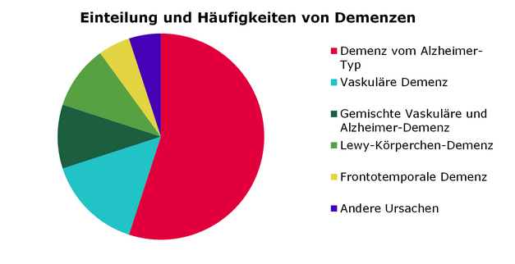
Which are the most frequent causes of Dementia?
Alzheimer
Vascular
Alzheimer/vascular
Lewy Body
Frontotemporal
Other

Slide 11
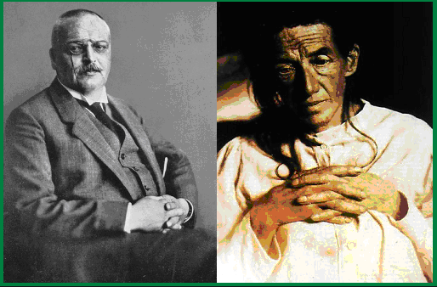
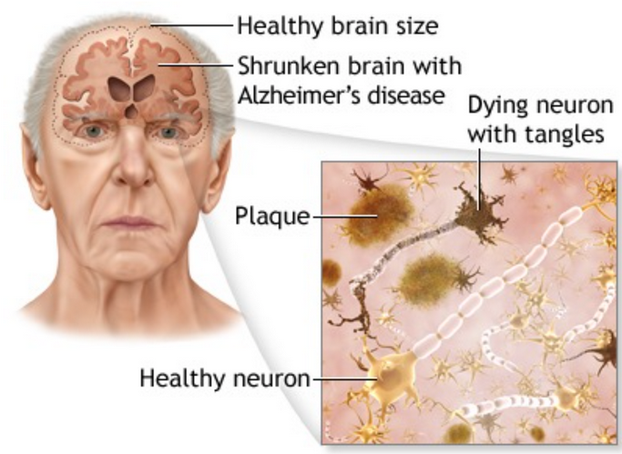
Alzheimer Neuropathology
Alzheimer 1905

Slide 12
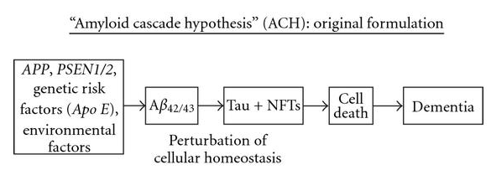
Alzheimer‘s Disease Pathogenesis
Hardy and Selkoe 2016

Slide 13
Alzheimer’s Dementia diagnosis
- A possible or probable clinical diagnosis
- Dementia with gradual onset and slow progression, usually beginning with memory problems
- Requires exclusion of other dementia etiologies by medical history, clinical assessment, cognitive testing, neuroimaging and lab tests

Slide 14
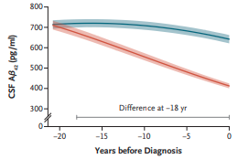
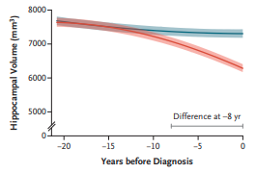
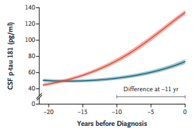
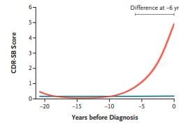
Alzheimer’s disease begins years before first clinical symptoms
Jia et al. 2024

Slide 15
Alzheimer’s disease
-Biological process that begins with the appearance of AD neuropathological change
while people are asymptomatic
-Progression of the neuropathological burden (beta-amyoid plaques and tangles)
leads to the later appearance and progression of clinical symptoms
-Abnormal biomarkers are sufficient to establish a diagnosis of AD:
Amyloid PET
Cerebrospinal fluid biomarkers
Plasma biomarkers
Jack et al. 2024

Slide 16
Prevention
of Neurocognitive disorders

Slide 17
Dementia prevention, intervention, and care:
2024 report of the Lancet standing Commission
-Interdisciplinary, international, multicultural group of experts
-Framework prioritizing systematic reviews and meta-analyses
-Each commissioner chosen from a wide geographical and cultural range
-Unanimously agreement on the best available evidence and its consistency
Livingston et al. 2024

Slide 18
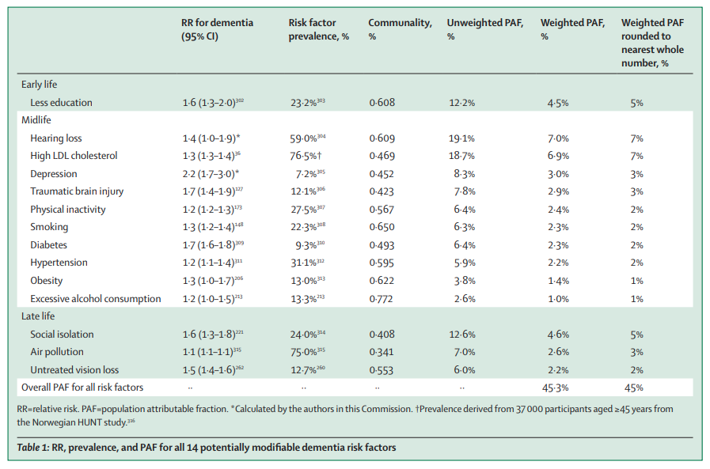
Livingston et al. 2024

Slide 19
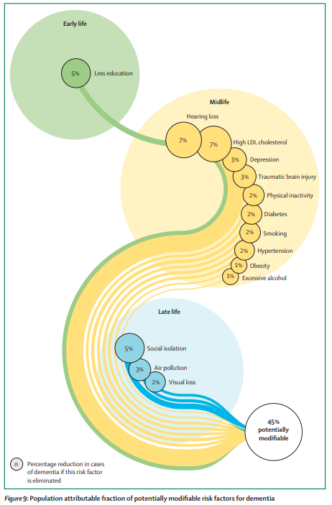
Livingston et al. 2024

Slide 20
Menopause, Hormone replacement and dementia risk
RR 0.87 for AD when menopause occurs after age 44 (case-control, >80.000)
RR 1.24 for dementia and Alzheimer’s with oestrogen–progestogen at age 50–60
RR 1.11 for AD with oestrogen– progestogen therapy for 5–9 years
RR 1.19 for AD with oestrogen– progestogen therapy for >10 years
RR 0.85 for dementia with oestrogen-only at age <80 years for >9 years
Conclusion:
It is unclear whether menopause and HRT are causally related to dementia risk
Adapted from Livingston et al. 2024

Slide 21
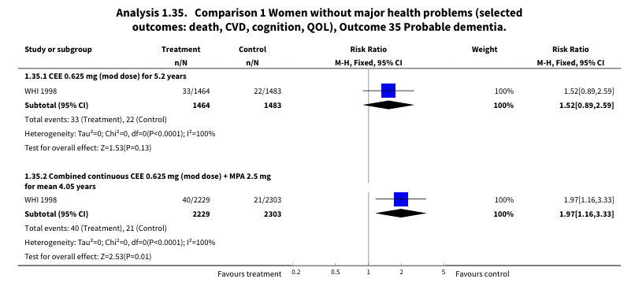
COCHRANE 2017 (22 studies involving 43,637 women)
Long-term hormone therapy for perimenopausal and postmenopausal women
Marjoribanks J, Farquhar C, Roberts H, Lethaby A, Lee J
Oestrogen-only: no statistically significant difference
Combined HT: incidence of probable dementia was significantly higher in the group taking combined continuous HT than in the placebo group (RR 1.97)

Slide 22
Treatment
of Neurocognitive disorder

Slide 23
Treatable Neurocognitive disorders
Metabolic Vitamin deficiency (B1, B3, B6, B9, B12)
Electrolytes (Na, K, Ca, Mg), osmolality
Kidney/liver insufficiency Hyper-/hypoglycemia, hyper-/hypothyroidism, hypopituitarism
Anemia, polycythemia
Sleep apnea, chronic hypoxia
Genetic Disorders of carbohydrate, lipid or metal metabolism
(Wilson, Fabry, leucodystrophies, porphyria, …)
Toxic Heavy metals (Hg, Pb), CO, alcohol, drugs
Vascular Stroke, vasculitis, hypotension, hypoxic
Cerebral mass Hydrocephalus, neoplasm, hemorrhage, abscess,
Traumatic TBI
Infectious Viral (HIV), bacterial (syphilis, Whipple), parasites, fungi
Auto-immune Paraneoplasia, vasculitis, sarcoidosis, MS, Hashimoto
Iatrogenic Psychoactive, anticholinergic medication
Epileptic Non convulsive status epilepticus
Psychiatric Depression, schizophrenia

Slide 24
Treatment of Alzheimer’s Disease
Symptomatic treatment
-Multicomponent coping interventions for family carers
-Treatment of neuropsychiatric symptoms
-Cholinesterase inhibitors and Memantine:
Relatively few side-effects
Attenuate cognitive deterioration to a modest extent
Good evidence of a long-term effect
Disease-modifying treatment
-Amyloid-β-targeting antibodies:
ARIA side effects
Reduced cognitive deterioration after 18 months of treatment
Few data about long-term effects

Slide 25
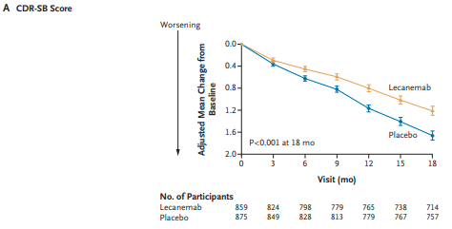
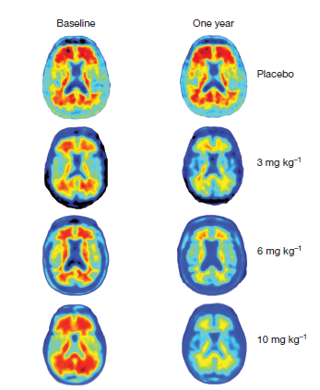
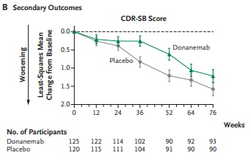
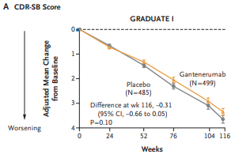
Amyloid-PET
Clinical Score
Van Dyck et al. 2023
Mintun et al. 2021
Bateman et al. 2023

Slide 26
Lecanemab
- MMSE >21/30
- I.v. every 2 weeks
- 27% reduction of cognitive degradation in 18 months
- 3.5% symptomatic ARIA side-effects particularly for APOE ε4 genotype carriers
- EMA has recommended approving the marketing authorization
- EC which in the decision-making process
Van Dyck et al. 2023

Slide 27
Specific actions to reduce dementia risk across the life course
• Have good quality education and cognitively stimulating activities
• Reduce social isolation, hearing loss and vision loss
• Treat depression effectively
• Avoid brain trauma
• Be physically active
• Reduce cigarette and alcohol consumption
• Maintain systolic blood pressure of 130 mm Hg or less
• Detect and treat high LDL cholesterol from midlife
• Maintain a healthy weight and treat obesity
• Reduce exposure to air pollution
Not enough consistent evidence for
Sleep, diet, infections, mental health conditions, menopausal hormone replacement therapy
Adapted from Livingston et al. 2024

Slide 28

Clinique de la mémoire CHU Saint Pierre
Tel. 02-535-3774

