Slide 1



Osteoporosis risk
Olivier Bruyère
University of Liège

Slide 2
Competing interests
Not for the present talk
General competing interests
Grant research (in the last 5 years): Biophytis, IBSA, Mylan.
Consulting or lecture fees (in the last 5 years): Amgen, Aptissen, Biophytis, IBSA, Mylan, Novartis, Sanofi, UCB and Viatris.
Board member of the BBC and the ESCEO

Slide 3
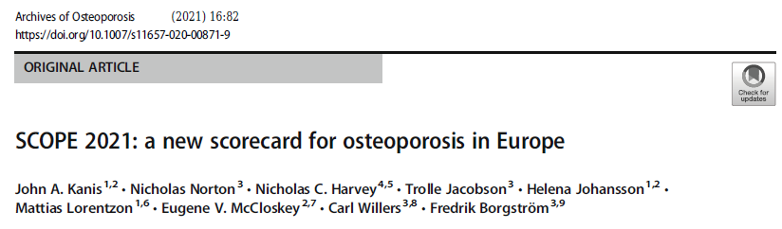
Kanis et al. Archives of Osteoporosis 2021

Slide 4
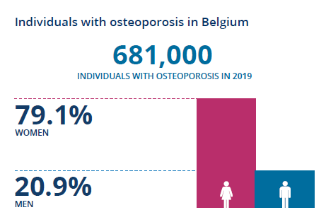
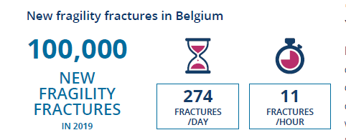
Kanis et al. Archives of Osteoporosis 2021

Slide 5
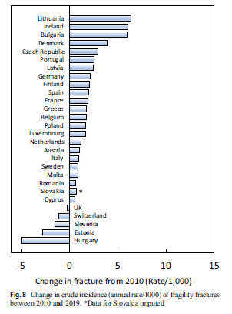
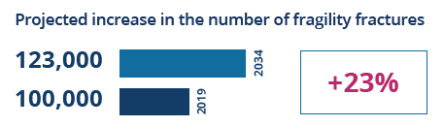
Kanis et al. Archives of Osteoporosis 2021

Slide 6
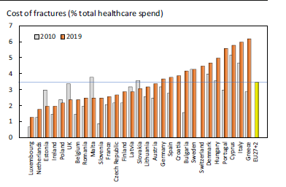
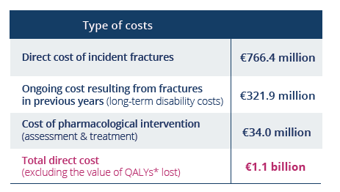

Kanis et al. Archives of Osteoporosis 2021

Slide 7
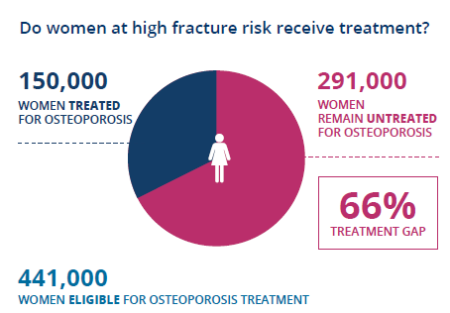
Kanis et al. Archives of Osteoporosis 2021

Slide 8
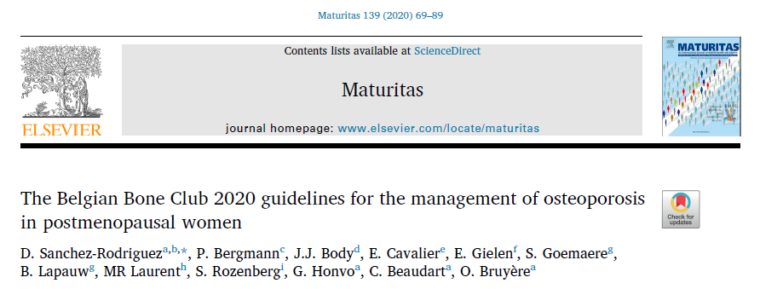
Sanchez-Rodriguez et al. Maturitas 2020

Slide 9
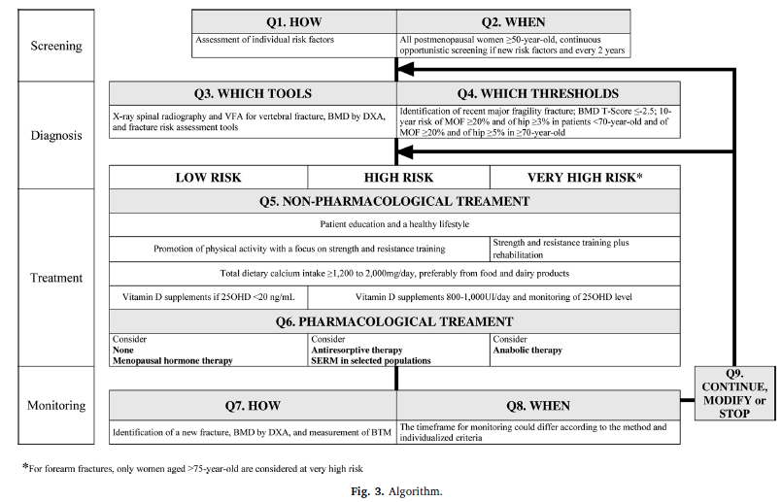
Sanchez-Rodriguez et al. Maturitas 2020

Slide 10
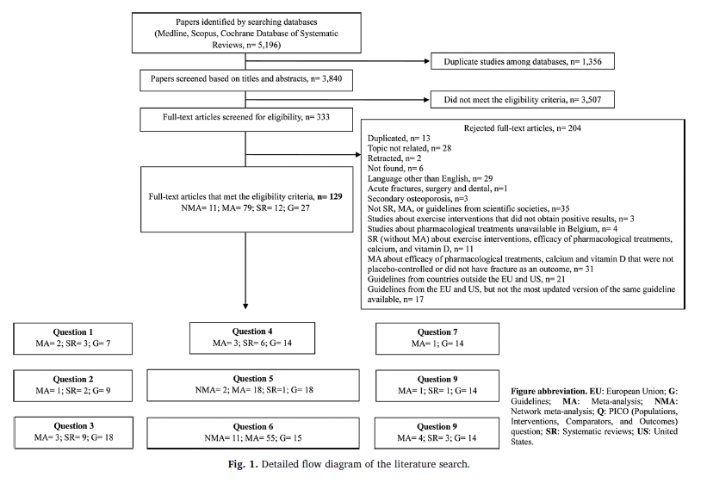
Sanchez-Rodriguez et al. Maturitas 2020

Slide 11
Questions
Q1. HOW should osteoporosis be screened in postmenopausal women?
Q2. WHEN and HOW OFTEN should postmenopausal women be screened for osteoporosis?
Q3: WHICH TOOLS should be used to diagnose osteoporosis and assess fracture risk in postmenopausal women?
Q4. WHICH THRESHOLDS should be used to diagnose and assess the severity of osteoporosis in postmenopausal women?

Slide 12
Q1. HOW should osteoporosis be screened in postmenopausal women?
15 screening questionnaires composed of a varying number of clinical risk factors have been published.
The diagnostic accuracy (i.e., sensitivity and specificity) of the screening tools for osteoporosis varied depending on the target populations assessed.
However, none of the tools performed consistently better than the other

Slide 13
Postmenopausal women with ≥1 major risk factor or ≥2 additional risk factors should receive a formal fracture risk evaluation (Q3-Q4).
Major risk factors
Age (≥65 years)
Low body mass index (<20 kg/m²)
Prior fragility fractures
Hip fracture history in a first-degree relative
Frequent falls (≥1/year)
Measured height loss ≥4 cm
Secondary osteoporosis
Early menopause (<45 years)
Diabetes mellitus
Glucocorticoid therapy
Rheumatic inflammatory diseases
Excessive alcohol (≥3 units of alcohol/day)
Current tobacco use
Additional risk factors
Family history of osteoporosis
Absence of a healthy balanced diet
Diseases involving clinical nutrition and metabolism
Thyroid and parathyroid diseases
Psychiatric, mental, and eating disorders
Drugs: Antidepressants, antiepileptic drugs, benzodiazepines, loop diuretics, opioids, proton-pump inhibitors, zolpidem, etc.

Slide 14
Q1. HOW should osteoporosis be screened in postmenopausal women?
Q2. WHEN and HOW OFTEN should postmenopausal women be screened for osteoporosis?
Q3: WHICH TOOLS should be used to diagnose osteoporosis and assess fracture risk in postmenopausal women?
Q4. WHICH THRESHOLDS should be used to diagnose and assess the severity of osteoporosis in postmenopausal women?

Slide 15
When
Most of the studies included in two SR that assessed the performance of risk assessment instruments to predict fracture risk included participants ≥50 years
Individual studies have suggested that screening at an age of 65 or over could be more relevant
Screening at the age of 50 years, or at the age of menopause if it occurs earlier, should be considered.

Slide 16
How often
Screening policy is an unmet need. But:
  Two years is generally taken as the timeframe to consider a fracture as recent.
  It leads to the emerging concept of “imminent fracture risk”.
    During this 2-year period of time following a fracture, individuals have the highest risk for a new fracture
    Detection and early treatment might involve the highest benefits.

Slide 17
Q1. HOW should osteoporosis be screened in postmenopausal women?
Q2. WHEN and HOW OFTEN should postmenopausal women be screened for osteoporosis?
Q3: WHICH TOOLS should be used to diagnose osteoporosis and assess fracture risk in postmenopausal women?
Q4. WHICH THRESHOLDS should be used to diagnose and assess the severity of osteoporosis in postmenopausal women?

Slide 18
WHICH TOOLS
Existing tools for the identification of previous fragility fractures
Existing tools for BMD assessment
Existing fracture risk assessment tools

Slide 19
X-ray radiography is the recommended imaging technique to confirm a fracture.
Vertebral, pelvis, hip, femur, humerus, and forearm are considered major osteoporotic fractures (MOFs).

Slide 20
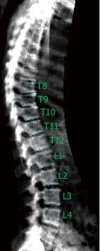
The use of VFA in patients with low clinical suspicion of vertebral fractures could be considered.

Slide 21
WHICH TOOLS
Existing tools for the identification of previous fragility fractures
Existing tools for BMD assessment
Existing fracture risk assessment tools

Slide 22
BMD measured by DXA has been the international gold standard to diagnose osteoporosis since 1994.
Other techniques not recommended
Ultrasound
Computed tomography (CT) imaging
Trabecular bone score
Emerging tools
Central and peripheral (high-resolution) quantitative CT
Radiofrequency echographic multi spectrometry (REMS)

Slide 23
BMD Predicts Hip Fracture as Well as
BP Predicts Stroke
Notes:
The standardized risk ratio is a relative risk. I.e. the risk of one group compared to another. It is commonly used in medicine and BMD compares well in its ability to predict the relative risk of fracture compared to other common test in predicting the relative risks of other diseases.

Slide 24
Fractures Occur in Patients Without Densitometric Osteoporosis (OFELY Study)
BMD | Total | 10 yr Fracture Incidence | N with Fx (%)
All | 668 | 20% | 134 (100)
Osteoporosis | 142 | 37% | 52 (39)
Osteopenia | 322 | 21% | 67 (50)
Normal BMD | 204 | 7% | 15 (11)
Notes:
The other thing to remember is that most people who fracture don’t have osteoporosis. This is because the absolute no’s with OP are low are even though their risk is high, the greater no’s in the osteopenic range result in a greater no of fractures in that group.See also next slide

Slide 25
BMD Overlaps in Women With and Without Fracture
EPISEM study; 6862 postmenopausal white women ≥70 years, randomly selected from population based listing
Mean f/u of 3.2 yrs. 678 OP fractures (hip, distal forearm, proximal humerus)
Fracture rate
No of women with fractures
BMD distribution
Fracture rate per 1000 Person-years
No of women with fractures
Courtesy of D Hans & MA Krieg – Adapted from the EPISEM Study
Presented at the SSR, Lausanne, CH, September, 2009 and ASBMR, Philadelphia 2006
Notes:
These are unpublished data from Switzerland and France (EPIDEM Study, only women) . Note that fracture rate goes up exponentially as BMD decline. Importantly, many fractures occur in women who do not have osteoporosis by T-score; in this cohort, roughly one third of fractures occurred in those with a T-score of better than -2.5.

Slide 26
WHICH TOOLS
Existing tools for the identification of previous fragility fractures
Existing tools for BMD assessment
Existing fracture risk assessment tools

Slide 27
Multiple Fracture Risk Factors Exist
Which Ones to Use?
Age
Prior fracture
Low body weight
Weight loss
Inactivity
Glucocorticoids
Hyperparathyroidism
Diabetes type 1
Anorexia
Gastrectomy
Gender (female)
Current smoking
Low sunlight exposure
Family Hx of fracture
Surgical menopause
Low calcium intake
Hyperthyroidism
Diabetes type 2
Rheumatoid arthritis
Notes:
There are many factors identified as being associated with increased risk of fracturing. Some are better quantified than others and some are more difficult to assess. The larger epidemiologic studies have included different risk factors when listing fracture risks.

Slide 28
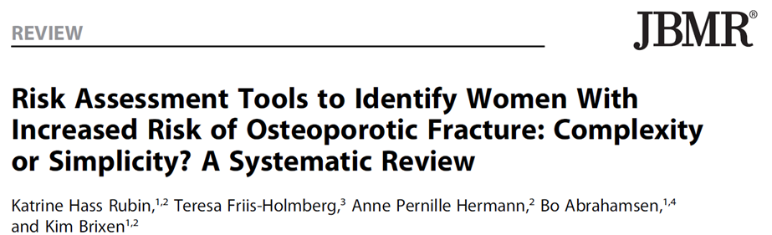
A total of 48 tools were identified
  20 had been externally validated,
  6 had been tested more than once in a population‐based setting with acceptable methodological quality.
    3 for BMD
    3 for fracture

Slide 29
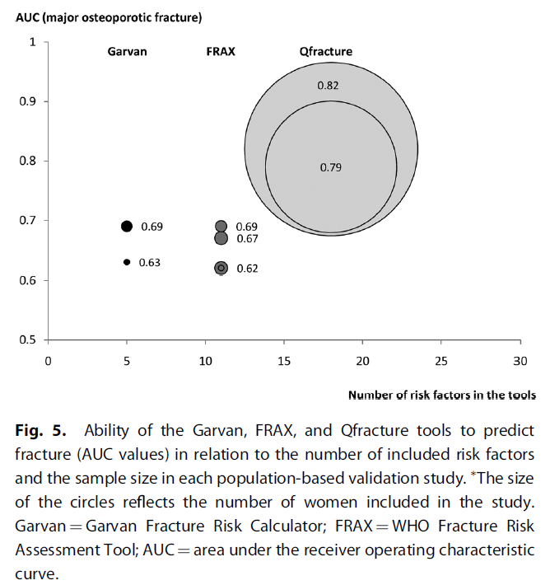

Slide 30
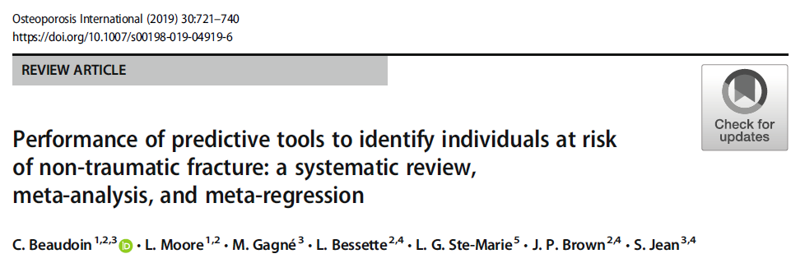
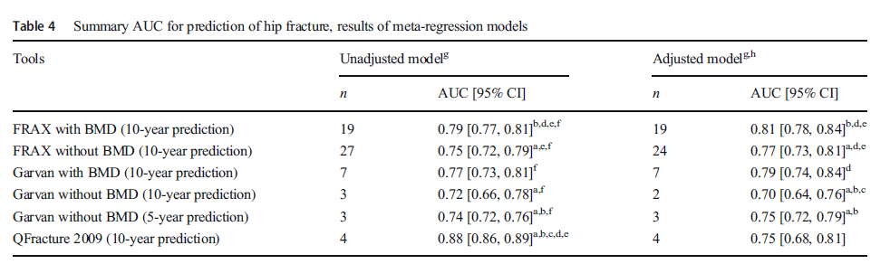

Slide 31
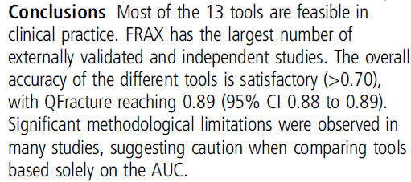
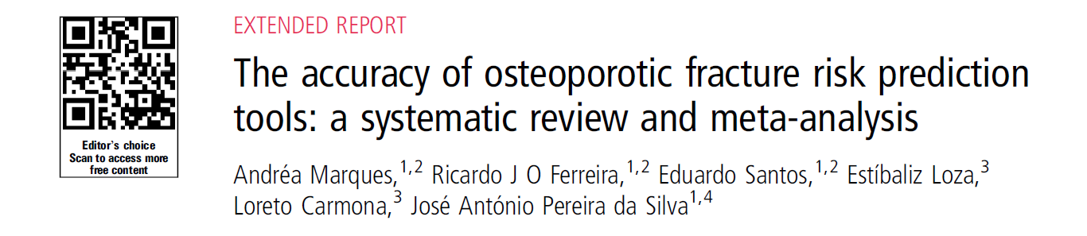

Slide 32
10-year fracture risk
Q-fracture is validated only in the UK and recommended only in the UK and Scottish guidelines
FRAX® and Garvan could be considered in Belgium.

Slide 33
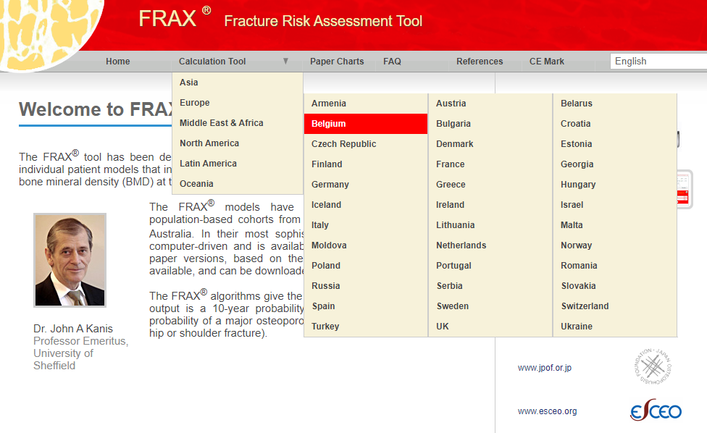

Slide 34
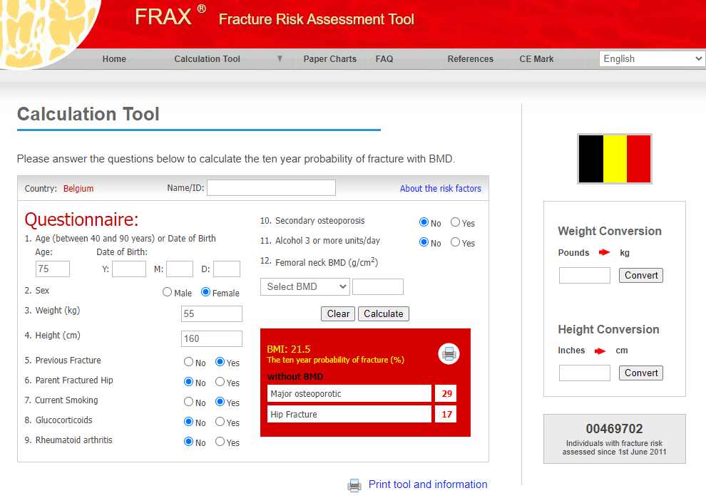

Slide 35
Q1. HOW should osteoporosis be screened in postmenopausal women?
Q2. WHEN and HOW OFTEN should postmenopausal women be screened for osteoporosis?
Q3: WHICH TOOLS should be used to diagnose osteoporosis and assess fracture risk in postmenopausal women?
Q4. WHICH THRESHOLDS should be used to diagnose and assess the severity of osteoporosis in postmenopausal women?

Slide 36
WHICH THRESHOLDS
Identification of fragility fracture
BMD
Fracture risk assessment tools

Slide 37
Vertebral fracture is defined as at least a 20 % reduction in vertebral height on X-ray spinal radiography using the Genant semi-quantitative method
It confers a 2.5-fold greater risk of subsequent vertebral fractures

Slide 38
WHICH THRESHOLDS
Identification of fragility fracture
BMD
Fracture risk assessment tools

Slide 39
The threshold considered in the majority of references is a BMD (assessed by DXA) of at least 2.5 SDs (i.e., T score ≤−2.5) below the reference population
Patients with a T-score ≤-3.5 should be considered at “very high risk”.

Slide 40
WHICH THRESHOLDS
Identification of fragility fracture
BMD
Fracture risk assessment tools

Slide 41
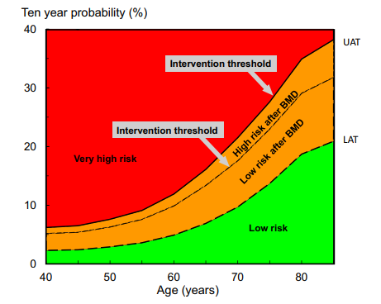
Kanis et al. OI 2020

Slide 42
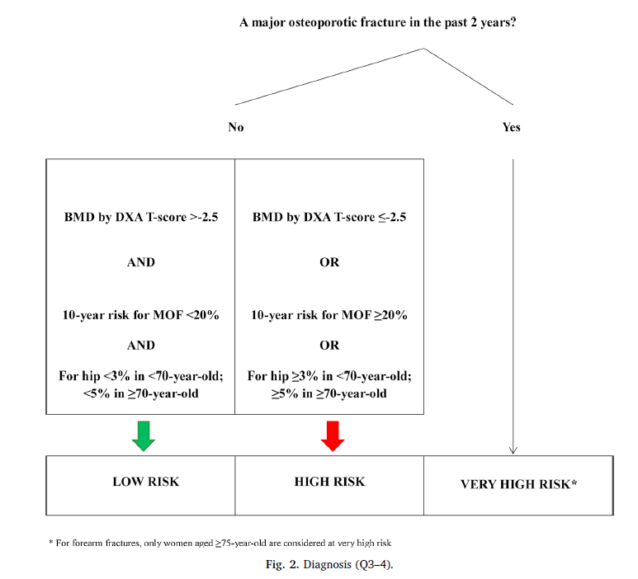

Slide 43
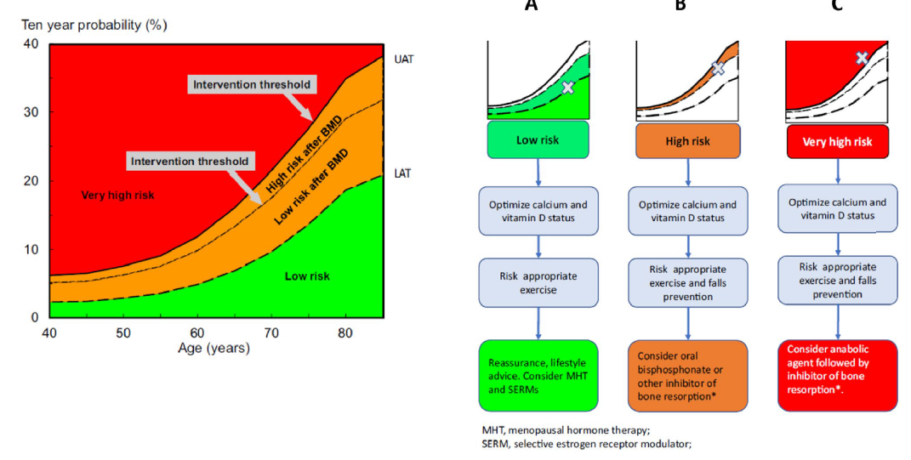
Curtis et al. ACER 2022

Slide 44
Sanchez-Rodriguez et al. Maturitas 2020

