Slide 1



Urinary incontinence and pelvic floor health
Silke Vasseur, Gynaecologist
Perineology Clinic

Slide 2
Content
Pelvic floor health
Urinary incontinence
Pelvic organ prolapse
Clinical case

Slide 3
Content
Pelvic floor health
Urinary incontinence
Pelvic organ prolapse
Clinical case

Slide 4
Clinical case
Ms X, 57 years old
  G5P5 (5 vaginal births, 2x forceps, “big babies”)
  Complaints:
    Hot flashes
    Vaginal dryness causing dyspareunia and decreased libido
    Lump in the vagina + sensation of heaviness at the end of the day
    Recently she wets herself during jogging and jumping and during sexual intercourse
    Very annoying, she is very distressed

Slide 5
Clinical case
Thorough questioning:
  Constipation “all her life”, she doesn’t take time to drink enough or to stay on the toilet for long. Precautionary mictions. She smokes
Clinical examination:
  Vulvovaginal atrophy
  Cystocele stage 2
  Stress urinary incontinence with coughing, stopped by Ulmsten manoeuvre

Slide 6
Content
Pelvic floor health
Urinary incontinence
Pelvic organ prolapse
Clinical case

Slide 7
Pelvic floor health
Normal urinary function:
  Micturition: 4-8x/day, max 1x/night
  SIT DOWN TO PEE
  Relax to pee, 1 continuous stream, without pushing – no “pipi-stop”
  250-500 mL per micturition (1-2 glasses !)
  Pelvic floor muscles contract in reflex to pressure (coughing, sports, physical effort)
  Incontinence is never normal !

Slide 8
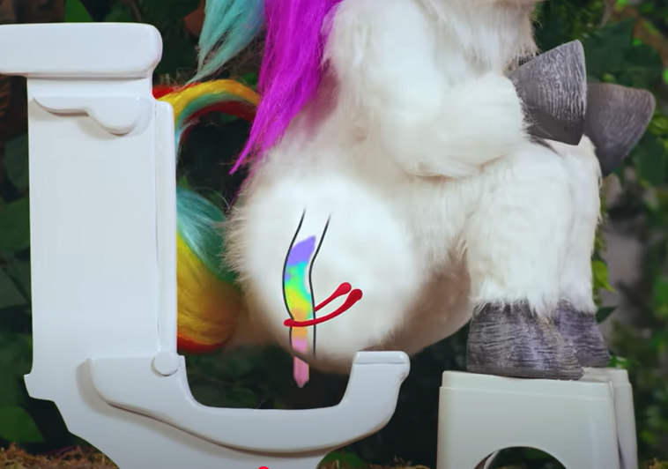
Pelvic floor health
Normal defecation function:
  Defecation: between 2x/day and 2x/week
  Relax to defecate, without pushing
  Use a stool (Squatty Potty)

Slide 9
Pelvic floor health
Overall recommendations:
  Drink 1,5-2L/day, in 4-8 sips per hour !
  Eat enough fibers, fruits, vegetables
  Squeeze your pelvic floor muscles when you cough, lift a weight
  Relax your pelvic floor muscles when you don’t need them

Slide 10
Pelvic floor disorders
Urinary incontinence
Prolapse
Constipation
Painful intercourse
Chronic pelvic pain
Anal incontinence
=> 1 out of 3 women, and 1 out of 2 from menopause

Slide 11
Impact of pelvic floor disorders
Reduced quality of life
Increased morbidity
“It doesn’t kill you, it just steals your life”
Notes:
Not cancer – but very harmful

Slide 12
Content
Pelvic floor health
Urinary incontinence
Pelvic organ prolapse
Clinical case

Slide 13
Urinary incontinence
Types of urinary incontinence
  Stress urinary incontinence
  Urge urinary incontinence
  Mixed urinary incontinence

Slide 14
Urinary incontinence
Types of urinary incontinence
  Stress urinary incontinence
  Urge urinary incontinence
  Mixed urinary incontinence

Slide 15
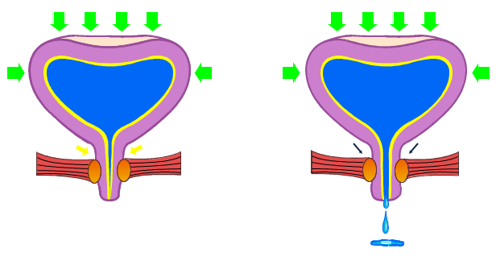
Urinary incontinence
Stress urinary incontinence:
  sudden, involuntary loss of urine
  with physical effort (coughing, lifting weights, laughing…)
  without urgency
  often in standing position
  ➔ loss of support

Slide 16
Stress urinary incontinence
45
Risk factors:
  Age
  Pregnancy and delivery
  Smoking
  Diabetes
40
UK
Spain
Sweden
Europe
35
30
25
Mean prevalence (%)
20
15
10
5
0
40–44
45–49
50–54
55–59
60–64
65–69
70–74
75+
*survey conducted by the Gallup Group

Slide 17
Stress urinary incontinence
Influence of menopause on urinary incontinence ?
Estrogen:
  Structural integrity of urogenital tissues (bladder, urethra, pelvic floor musculature)
  Neuromodulatory action of estrogen on the bladder
  Elasticity of tissues

Slide 18
Stress urinary incontinence
Slight worsening of incontinence in early and late perimenopause
Association of urinary incontinence with
  BMI
  Diabetes
  Weight gain
    Higher intra-abdominal pressure
    Change in activities, diet habits => increase in UI ?
Waetjen (Obstet Gynecol. 2011)
HRT for urinary incontinence?
  Increased risk of incontinence with use (RR 1,6)
  Decrease after stopping HRT
  Role of progestins? Quinn (Climacteric, 2009)

Slide 19
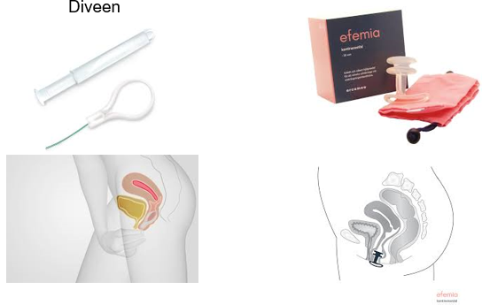
Stress urinary incontinence
Treatments
  Physiotherapy (pelvic floor muscle training)
  Pessaries (support of urethra)

Slide 20
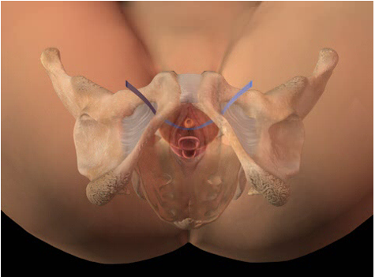
Stress urinary incontinence
Surgery
  TVT / TVT-O
  Bulking agents
  Burch colposuspension

Slide 21
Urinary incontinence
Types of urinary incontinence
  Stress urinary incontinence
  Urge urinary incontinence
  Mixed urinary incontinence

Slide 22
Urge urinary incontinence
Urge urinary incontinence: symptoms
  Urgent need to pee, sometimes with loss of urine
  “key on the door” syndrome
  Functional problem: detrusor muscle hyperactive or hypersensible bladder
  Bad habits, precautionary mictions, “going to the toilet before you leave the house”

Slide 23

Urge urinary incontinence
Risk factors:
  Age
  Pregnancy and delivery
  BMI
  Diabetes

Slide 24
Urge urinary incontinence
Influence of menopause on urge incontinence:
  Decrease in estrogen: urethral atrophy
  Weight gain
  Anxiety
    Increase in reporting because of anxiety ?
    Physiological relationship (increased sensitivity of LUT) ?

Slide 25
Urge urinary incontinence
Treatments
  Topical estrogens: decrease in urinary tract infections, urinary frequency and nycturia (Quinn (Climacteric, 2009)
  Bladder training (postponing the miction)
  Changing habits +++ (no precautionary mictions, drinking more…)
  Pelvic floor muscle training – mahoney reflex
  PTNS
  Medication: anticholinergics, B3 agonists
  Injections of Botox
  Sacral neuromodulation

Slide 26
Content
Pelvic floor health
Urinary incontinence
Pelvic organ prolapse
Clinical case

Slide 27
Pelvic organ prolapse
Descent of bladder, uterus, rectum or intestines into the vagina and beyond because of lack of support (ligaments, muscles)
Sensation of bulging, mass, but also urinary, defecatory, sexual dysfunctions
Prevalence: up to 50% in parous women (not all symptomatic)

Slide 28
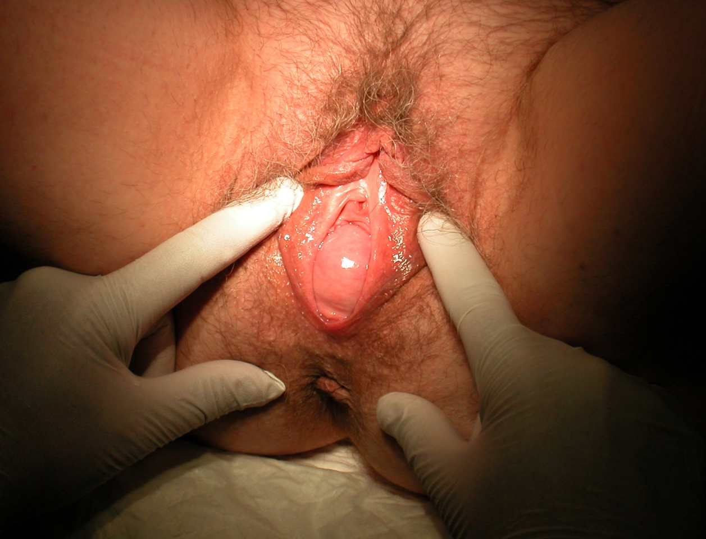
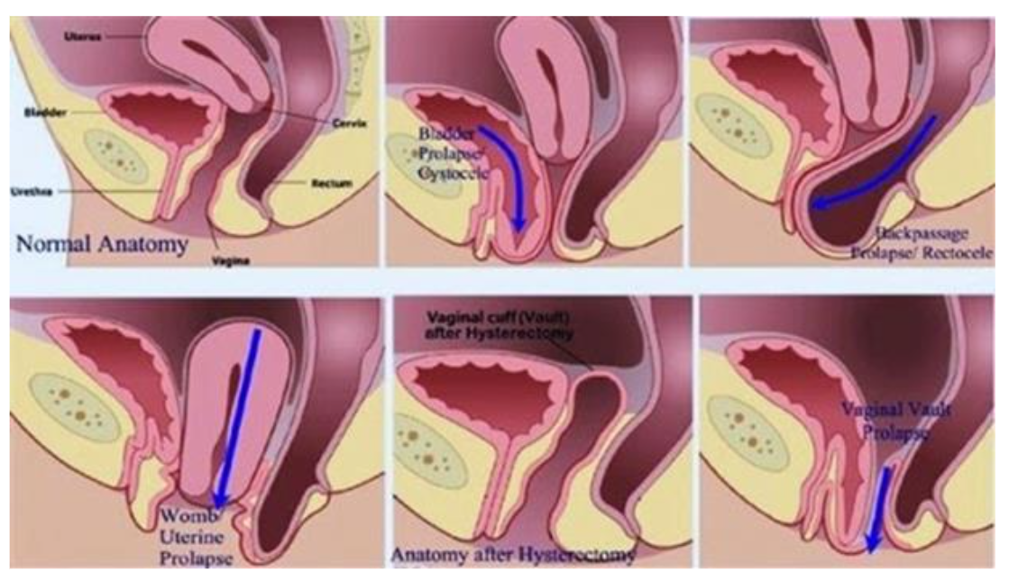
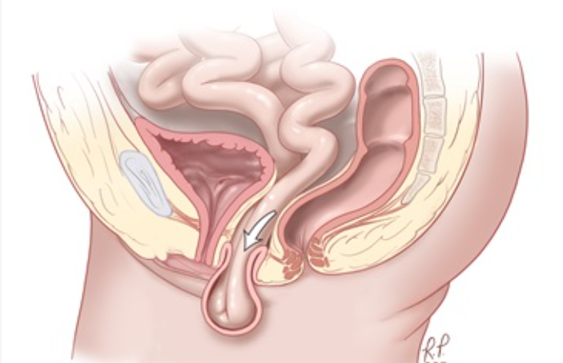
Pelvic organ prolapse

Slide 29
Pelvic organ prolapse
Risk factors
  Age
  Pregnancy and delivery
  Chronic constipation
  Hysterectomy

Slide 30
Pelvic organ prolapse
  Oxford Family Planning Study: 17000 women (17 y FU)
    P1: 4x higher risk to have surgery for POP
    P2: 8x higher risk
    P3: 9x higher risk
    P4: 10x higher risk
  Lifetime prevalence of surgery for POP is 11%
Mant, 1997

Slide 31
Pelvic organ prolapse
Influence of menopause on pelvic organ prolapse:
  Decrease in systemic estrogen and in estrogen receptors
    Change in concentration and quality of collagen
    Decrease of muscle mass
    Weintraub (IBJU,2020)

Slide 32
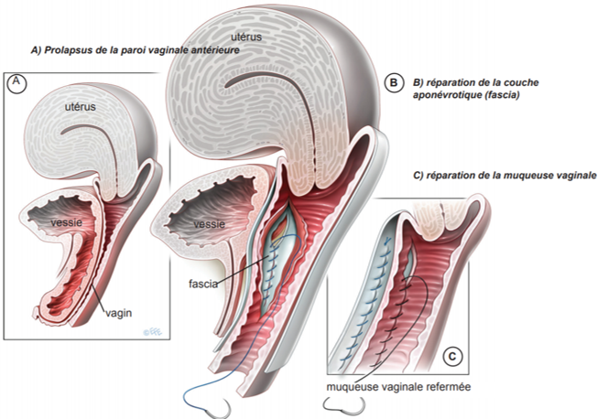
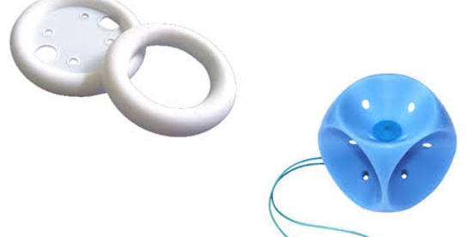
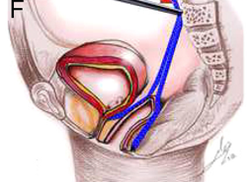
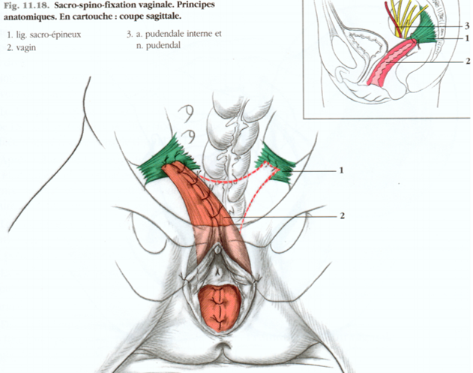
Pelvic organ prolapse
Treatments :
  Physiotherapy
  Pessaries
  Surgery

Slide 33
Clinical case
Ms X, 57 years old
  Vulvovaginal atrophy causing dyspareunia and decreased libido
  Cystocele causing a lump in the vagina + sensation of heaviness at the end of the day
  Stress urinary incontinence during sports and during sexual intercourse
  Chronic constipation
  Bad drinking habits

Slide 34
Clinical case, Ms X
Treatments:
  Hygienic and dietary measures : drinking more, no precautionary mictions
  Vaginal estrogen
  Treatment of constipation !! Less pressure on the perineum
  Pelvic reeducation with a specialised physiotherapist
    Training of muscles, and of reflex with pressure
>50% of patients only need the above treatments to have resolution of symptoms
  Pessary for incontinence and prolapse
  Surgery if remaining complaints

Slide 35

Take home messages
Menopause has a (small) influence on pelviperineal pathologies
Vaginal estrogen can be useful for urinary complaints
Pelviperineal pathologies can be prevented and treated !

Slide 36
Squatty potty unicorn video
https://www.youtube.com/watch?v=YbYWhdLO43Q

Slide 37
Quinn SD, Domoney C. The effects of hormones on urinary incontinence in postmenopausal women. Climacteric. 2009 Apr;12(2):106-13. doi: 10.1080/13697130802630083. PMID: 19259853.
Allafi AH, Al-Johani AS, Babukur RM, Fikri J, Alanazi RR, Ali SDMH, Alkathiry A, Alfozan AM, Mayoof KIAAH, Abualhamael MA. The Link Between Menopause and Urinary Incontinence: A Systematic Review. Cureus. 2024 Oct 11;16(10):e71260. doi: 10.7759/cureus.71260. PMID: 39525118; PMCID: PMC11550778.
Weintraub AY, Glinter H, Marcus-Braun N. Narrative review of the epidemiology, diagnosis and pathophysiology of pelvic organ prolapse. Int Braz J Urol. 2020 Jan-Feb;46(1):5-14. doi: 10.1590/S1677-5538.IBJU.2018.0581. PMID: 31851453; PMCID: PMC6968909.

