Slide 1
Monitoring HT potential risks; contra-indications
Ameryckx Linda
UZA

Slide 2
Follow up 3 months after prescribing HT
  Check symptoms – side effects – risk factors
  dose of Estradiol?
    Dose too low?
      Usually start with the lowest dose (depending on age)
      Lower doses are often insufficient to treat symptoms of VVA/GUS
    Dose too high?
      Painfull breasts
      Fluid retention / weight gain
      Headache or migraine
      Effect on sleep ?
Notes:
E2 generally has sleep promoting effects, excessive levels can leed to disruptions
More frequent awakenings
May elevate cortisol, making it harder to fall/stay asleep
Imbalance to progesteronecan contribute to insomnia
May supress melatonin
Natural progesterone:
more selective binding on progesterone receptor – less interaction with androgenic or mineralocorticoid receptors
Side effect: PMS like symptoms, sleepiness or drowsyness
oral: reduce the dose: 12d/month or min 7 days/month
vaginally
Dydrogesterone :
Syntetic progestin but Neutral metabolic profile
oral 14 days/month
LNG-IUD ( 5y)
Tibolone: is metabolised in 3 metabolites binding on ER/ PR/ AR- weak effects
Bazedoxifene / Equine estrogens
drosperinone

Slide 3
  P- related side effects
  irritability, anxiety, aggression, depressed mood,
  breast tenderness, bloating, constipation acne, greasy hair/skin, fluid retention)
    Progesterone: PMS like symptoms, drowsiness
    reduce dose 12d/month
    vaginally 200 mg/d – 12 d/month minimal ! (less break down products)
    Dydrogesterone: 0,5 co - 12d:month
    LNG-IUD (5y)
    Tibolone : weak androgenic effects – less prog side effects
    Bazedoxifene + equine estrogens (progesterone intolerance / high breast density)
    Drosperinone (PMS symptoms, mild AHT, fluid retention)

Slide 4
Case : Louisa
36 years
POF – unilat ovarectomy (large cyst) + cystectomy other ovary
Irregular cycles 2 years - oligomenorrhoa 1 year – amenorrhea 1 year
  few symptoms – awakenings – tired - low libido – dyspareunia
  Menopausal gonadotrofines FSH 85 E2<25
  Rx oestrogel 1-2 pumps /micronized progesterone 100
Follow up 3 months MP clinic:
  Sleep is good, still low energy , very low libido
  DEXA: ! Osteopenia
  Blood : E2: 42 testosterone: very low
  Rx oestrogel 3-4 pumps / micronized prog 200 / androgel 3x/w ‘pea size’ or 1 pump/week
Follow up 3 months MP clinic:
  Good!
  E2: 150 ;
  testosterone within fysiologic range

Slide 5
POF/ premature menopause (< age 40)
Early hypogonadism:
  HT minimal till age of natural Menopause ~ 51 y
  longer if need for further OP prevention – symptoms
in POI (< 40 j) and early MP(< 45 jaar)
  Dosage should be adapted according to symptomatology (Level 3),
  aim for physiologic levels
  Higher dose E2 might be necessary for adequate osteoporosis treatment (Level 3)
  50 -100 ùg E2 -patch
  3-4 pumps oestrogel
  2 mg HRT
  COC with EE
  COC with E2 or estradiolvalerate = preffered
  TD testosterone gel may be required :
Notes:
HRT may be more beneficial in improving bone health compared to the COC according to data of 2 RCT
in improvind CVD risk ( sign lower mean Pd and Ps

Slide 6
Testosterone
  Indication:
    After BSO
    HSDD: hypo active sexual dysphoric disorder
      When Estrogen/prog HT is not enough
      When on oral E2: change to transdermal (effect on SHBG)
      When other causes are excluded (relation, atrophy, infection, depression, medication,..)
    RCT’s have not shown beneficial effects on
      Cognition: some RCT’s show mild improvement on short memory when used short term – no long term protection
      musculoskeletal health: T can have positive but minimal effect on muscle mass/strength when low baseline
  Dose: androgel 2,5 - 5 mg/d ( 1 pump 2% androgel = 20 mg): pea size 3X/w
  Monitoring!
    Before start: measure SHBG + free testosterone
    After 6-8 weeks: check testosterone levels (within fysiologic limits);
    check effect on symptoms; if no effect after 6 months: STOP
    check side effects : acne, greasy skin, hirsutism/hairloss; voice deepening
    Check after 6 months / 1 year ; check RBC; Ht; cholesterol

Slide 7
Case Charlotte
49 years
Changed cycle for 1 y: 24 - 40 days; mild to very heavy periods
Lab 6/2024 FSH 4.3 IU/L E2: 40 pg/ml
Consultation 10/2024:
  Changed cycle – skip cycles - Episodes VMS – moodswings – night time awakenings
  LMP: 3 months: 8/2024
  Lab: FSH: 80 IU/L and E2 < 25 pg/ml
  US: normal – endometrial lining 2 mm
  Rx/ bijuva
Follow up MP clinic 2/2025:
  Painfull breasts – bloated - headache ++ - had period 2 x unexpected and heavy
  US: cyst left ovary 4X4 cm and 3x3,5 cm
  Lab: E2: 1800 pg/ml

Slide 8
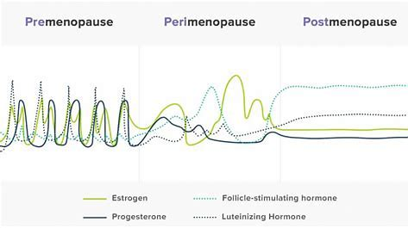
Transition phase – need for contraception?
little research ! Stabilize hormonal fluctuations
Block gonadotropic axis
EARLY perimenopause
  ONLY complaints of irregular / changed bleeding:
    LNG IUD
    POP
    Cyclic progesterone
    COC
LATE perimenopause (oligo) if ALSO (episodic) complaints of E2-deficienty/ no E2 dominance:
    Same +/- TD estradiol
    POP: not licened for use as part of HT / some studies : as effective as 150 µg:off license 150 µg can be used –
    Prefer lutenyl
    COC (with E2/ E- valerate / E4)
    Sequential MHT
Cave symptoms of estrogen overload
Notes:
r In de vroege perimenopause is de cyclus nog aanwezig die onregelmatig of regelmatig kan zijn maar korter of langer dan voorheen. De menstruatie is vaak lichter of net heviger dan voorheen. Skipcycles kunnen voorkomen. Er zijn vaak erge hormonale schommelingen met klachten van oestrogeen tekorten maar ook van oestrogeen overload zoals pijnlijke borsten, meer hoofdpijn en PMS klachten
LATE periMP
Langere periodes v amenorrhoe- vaker VMS

Slide 9
  Charlotte is in late peri-menopause
  Change to :
    cyclic HT : but high fluctuations - ! Side effects of estrogen dominance
    COC with E2/E4 or E-val: no fluctuations- rx cysts (preferred)

Slide 10
Case Sophie
52 years
Menopause + VMS + joint pain + other symptoms
Used several HT: not well tolerated
MP clinic
  History severe PMS / PMDD – PP depression - never tolerated COC/POP/mirena
  Tried vaginal progesterone – better tolerance but still PMS symptoms while taking
  ? Progesterone/progestin intolerant
  DEXA: osteopenia
  Other ex / history : NP
  Rx/ Duavive (equine estrogens + bazedoxifene )
MP clinic follow up 3 months
  Well tolerated
  continue

Slide 11
Duavive : bazedoxifene + conjugated estrogens
Duavive = TSEC ( Tissue selective Estrogen complex)
  Bazedoxifene = SERM selective estrogen receptor modulator
  = chemical compound that interacts with the ER as an agonist or antagonist
  depending on the target tissue
    3 RD generation SERM : agonist on the bone : ↓ risk vertebral/non-vertebral fractures
    antagonist on endometrium and breast
    tamoxifen / raloxifene : ↓ breastcancer
    bazedoxifene : ↓ proliferation ER+ BC cells in vitro / ↓ BC biomarkers /↓ B density
    -┤ IL-6/GP130 pathway
    side effect: VMS ++
  Conjugated estrogens: treat VMS
Contains no progestogens :
  In case of P – intolerance (Mood, weight, fluidretention,..)
  P component (MPA) in HT increased risk for breastcancer
Alternative for prog intolerance: tibolone
Notes:
BZE is being examinened as a potential cancertherapy agent by blocking the IL-6/glycoprot 130 pathway
This is relevant as over activity of the pathway (involved in celsurvival and proliferation) is involved in progression of different cancer types
So far howeven only pre clinical studies especially in ER+ BC have been done

Slide 12
Case Hilda
65 Years
MP age 50 – start oral HT at age 52 : kliogest (2 mg E2+ norethisterone acetate 1 mg)
GP advised to stop: ↑↑ VMS - > 6 months : ! Effect on Quality of life
MP clinic
  Mammogram recent: NL Type A breasttissue
  Healthy – no medication – NL BP – healthy lifestyle
  Blood: NL
  Options:
    Conservative – supplements
    SSRI
    VEOZA: NK3 rec antagonist
    Re – start HT

Slide 13
Extended use after age 65
  In healthy women at low risk of CHD and breast cancer with VMS or increased fracture risk
  Use lowest effective dose – prefer transdermal route – neutral progestogen/progesterone
  Restarted on TD E2 – 25 µg patch + micronized progesterone

Slide 14
Case Marie Claire
70 years
MP since age 50 – never HT – because few symptoms
VMS ++ since 1 year
History: hypercholesterolemia (statin)- G2P2 ( PET)
Rx femoston 1/10
MP clinic :
  Heavy bleed
  Abdominal obesity Abd circum 105 cm – BMI 31 – BP: 162/100 – hyperinsulinism
  STOP HT !
  Sent to womens Heart clinic

Slide 15
New onset VMS many years after start Menopause may be related to underlying medical causes:
  OSAS, AHT, hypo / hyperglycemia, hyperthyroidism, carcinoid, lymphoma, TBC, HIV, medication, alcohol,…)
START HST WITHIN 10 y after initiation of MP and < 60 years
= window period : maximal benefits – minimal risks
Initiation after age 60 or > 10 years from MP
  Re initiation of MHT
  Initiation not advised, if so counsel of higher Absolute risk of CHD, VTE, stroke

Slide 16
Oral HT :
  Increased risk of VTE, especially when presence of risk factors
  When risk factors : prefer transdermal estradiol
In post menopause : prefer
  Lowest dose
  Continuous HT to avoid bleeding

Slide 17
Case Tina
53 years
Healthy - G2P2
Age 48 : hysterectomy (menorrhagia non responsive to Rx - adenomyosis
cystectomy (endometrioma) – some endometriosis spots on bladder peritoneum
Age 51 y : mild VMS – sleeplessness – tired – moodswings
RX / oestrogel 2 pumps/d
Follow up MP clinic after 2 years
  Feeling better
  TVU: New endometrioma - pain
  Decided for Bilateral ovariectomy
  RX/ oestrogel + progesterone or progestin

Slide 18
Hysterectomy:
  E - alone
  except:
    History of severe endometriosis
      E+P
      Tibolone
    Sleep problems
Without //progestin/progesterone
possibility of endometriosis recurrence
Risk of malignant transformation
  AR is unclear – likely to be very low – no robust data
  Regular F-up - Seek medical advice if symptomatic – US! – histology if suspicious

Slide 19
Case : Sandrine
55 years
LMP > 1 year: menopause – heathy - dens breast tissue on mammogram
VMS and other MP related symptoms
Rx/ transdermal estradiol 1- 2 pumps + micronized progesterone 100 PO
Follow up 3 months MP clinic:
  1 pump gel : okay; but still vaginal dryness and dyspareunia; burning
  2 pumps gel : still dyspareunia; burning – breast sensitivity
  3 pumps gel : still dyspareunia; burning – breast pain
  Gyn ex : vaginal inflammation and yellow discharge; microscopy / culture: aerobic vaginitis
  Rx of Aerobic vaginitis and gel reduced to 1 pump
    3 months follow up: okay – still vaginal dryness – no more dyspareunia – no more infection but mild atrophy
    1 pump gel + vaginal E2
    Okay
    Alternatives: tiboline; bazedoxifene+equine Estrogens; NK3rec antagonist

Slide 20
Case Sara
Age 54
Menopause 2 y – VMS
BMI 29 – abdominal obesity – AHT on Rx – insulin resistance – hyperchol (statins) :
  metabolic syndrome
Smoker
Father : 2 bypasses – DM type 2 - mother: obesity – smoker - CVA
G2P2 – 2x IOL hypertension / PET / SGA
Started on angeliq ( oral 1 mg estradiol + drosperinone)
MP clinic 3 months follow up: symptoms better
  increased risk of VTE
  CVD risk factors: personal + familial + pregnancy RF’s
  Women’s Heart clinic
  Lifestyle advice
    Transdermal estradiol + progesterone
    NK3 rec antagonist

Slide 21
Women at risk of VTE
Incidence: 1/1000 women- years ~ 50 y
Risk factors VTE:
  Age
  Personal /family history VTE
  Inherited thrombophilia
  Obesity
  Smoking, AHT, Diabetes
  Migraine with aura
  MHT (2-3 x higher risk with oral )
  COC (7.5 x higher risk DVT; 5.3 x higher risk PE with EE)
Notes:
Incidence of VTE increases with age, reaching close to 1/1000 women years around 50 y

Slide 22
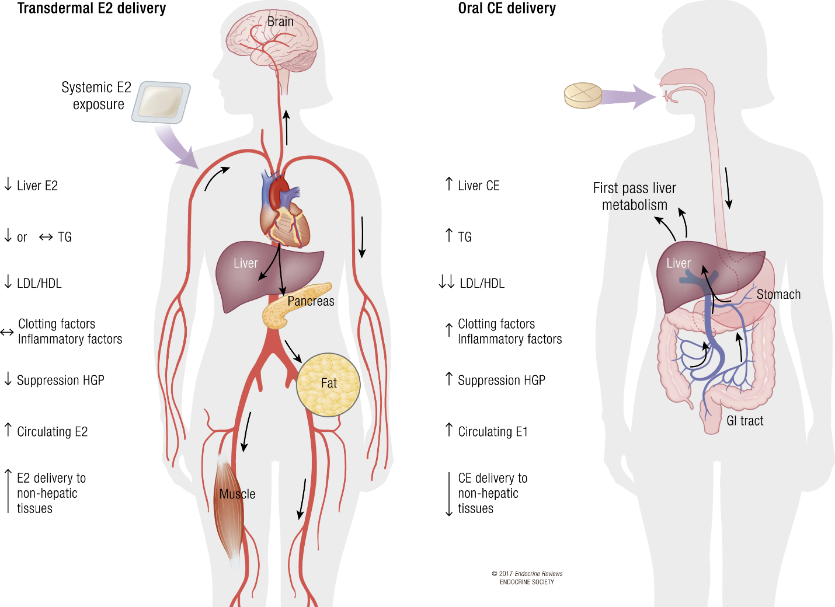
Transdermal estradiol appears to have a neutral effect on lipoproteins, clotting factors and inflammatory factors
Only observational data available,
no ↑ risk of VTE- PE – stroke
for mild and moderate doses (transdermal estradiol ≤50 µg/d)
in a HEALTHY population
BMJ 2010; 340: c2519; Curr Opin Hematol 2010; 17: 457-63; J Thromb Haemost 2012; 10: 2277-86; Menopause 2016; 23: 600-10; Menopause 2018; 25: 1297-1305
Notes:
There is compelling evidence from large observational studies and meta analyses as well as laboratory studies that TD MHT does not increase the risk of VTE above that of non users. However no RCT’s are available
TD admin avoids the first pass effect through the liver and does not alter the coagulation cascade the same way as oral E do.
Lab data show neutral effect on thrombin generation and pro inflamm markers
One possible mechanism for the increased VTE risk is an increase in activated protein C resistance that has been reported with both unopposed estradiol and combined estradiol-progestin therapy

Slide 23
women at moderate risk of VTE
  TD oestradiol + progesterone/ dydrogesterone / LNG IUD
In women who have a past history of VTE > 1 year ago ~ triggering factor
    exclude thrombophylia
    check whether the risk is still present.
    If not, MHT may be used (rather transdermal, low dose). (BMS guideline)
women at high risk of VTE / CHD / stroke should not take MHT - however
  ESTHER (multi centre Case control): FVL or prothrombin mut + oral E2: : ↑ risk VTE x 25
  + TD E2 : NO ↑ risk VTE
Circulation. 2007;115:840-845.
Notes:
MHT should not be prescribed to women at high CHD –stroke of DVT risk (1A-1B).
The stroke and DVT risks may be lower using transdermal estrogens than oral estrogens and using low dose estrogens rather than high dose estrogens and using progesterone or dihydrogesterone rather than androgenic progestins ( 2C)
Migraine without aura
Continuous OAC ( supress endogenous E – production)( prefer natural E2/ E-Val)
POP +/- oestradiol ( TD – lowest effective dose for VMS)
Mirena + oestradiol ( TD – lowest effective dose for VMS)
HRT : continious E2 (TD) + cyclical natural progesterone
E-only (after hysterectomy)
Migraine with aura
POP + TD E2
? Continuous OAC with natural E2 / E-Val (no studies – less impact on VTE – no fluctuations)
SSRI (ecitalopram) – SNRI (venlafaxine) (for migraine and VMS)
Randomized and observational studies reported that MHT increases the risk of VTE (2 to 3 fold) (level 1b evidence). This means that in a cohort of 1000 women using MHT, an additional 2 cases occur per year of use on a typical baseline risk of 1 per 1000 woman-years.
Standard ET doses were associated with a rare, but significant increase in VTE (WHI) (0.8 excess/ 1000 women-year). Major identified risk factors are age, overweight, sedentarity and thrombophilia. The risk is highest during the first year of use.

Slide 24
Case Sophia
Age 50
Stop lutenyl
Peri – menopause – more headaches – moodswings – irregular bleeding
Rx/ femoston 2/10
MP clinic 3 months follow up
  Even more headaches
  History migraine – sometimes aura when younger

Slide 25
Migraine
Migraine without aura
  Stabilize estrogenic fluctuations - Avoid estrogen withdrawl
Migraine with aura
Avoid high estrogen levels
  perimenopause
    POP (off label 150 µg) + TD E2 (lowest effective dose)
    ? Continuous OAC with natural E2 / E-Val (no studies – less impact on VTE – no fluctuations- but oral EE oe E2 = CI)
    SSRI (ecitalopram) – SNRI (venlafaxine) (for migraine and VMS)
  Postmenopause
    continuous combined TD Estradiol – low dose + neutral prog or LNG IUD
    NK3 rec antagonist
Notes:
periMP is period with Peak migraine incidence
Women seem to be Sensitive to fluctuations of hormones: esp oestrogens
Migraines with/without aura
Association between
Oestrogen WITHDRAWL - migraine attacks WITHOUT aura
HIGH oestrogenic state - migraine attacks WITH aura
During the perimenopause attacks of migraine without aura often become more frequent and severe, part because menstrual periods are more frequent.21 Hyperestrogenism coupled with decreased luteal phase progesterone are likely causes
a stable hormonal milieu should be associated with fewer migraine attacks
Continuous OAC- POP
E2 supple before menses
Supress endogenous ov act
TD via gel/ spray/patches: more stable and fysiologic levels
avoid 1st pass effect off the liver: less effect on clotting – seen the higher CV and cerebrovascular risk of PM women with migrain

Slide 26
Overall:
Oestradiol:
  Prefer transdermal oestradiol
    More stable and physiologic levels
    No 1st pass effect on liver and no/less effect on metabolic / clotting factors
      Women with migraine have higher CV- and cerebrovascular risk factors
  Lowest effective dose for VMS
Progesterone
  No data on types / dose / route of P and effect on migraine
  Prefer progestin with little metabolic impact or natural progesterone (?)
  IUD-LNG
Stop HRT if aura worsens
If aura starts / re occurs after start HRT- refer to neurologist – re-assess cardiometabolic RF’s
New onset headaches in women > 50 should be carefully evaluated CAVE TIA’s

Slide 27
E/P sensitive malignancies
Breastcancer
  CI for systemic MHT
  Local estriol may be used with VVA if non hormonal products failed
Endometrial cancer:
  Endometrial stromal sarcomas or leiomyosarcomas ( E- sensitive)
  High grade advanced stage endometrial cancers (insufficient data)
Ovarian cancer:
  Significant improved overall survival and progression free survival with MHT (meta-analyse)
  little data for serous borderline tumours, low grade serous tumours
  Ovarian germ cell and granulosa cell tumours (no data – theoretical grounds)
  BRCA1/ BRCA2 + and risk-reducing BSO: MHT appears safe
NAMS- guidelines 2022; NICE guidelines 2020
Notes:
Breastcancer:
Risk of recurrence of BC with MHT use is inconclusive as number of BC events in studies is too small for definitive conclusions. Two RCTs reported conflicting outcomes of breast cancer recurrence with hormone therapy. One showed an increased RR, the other one didn’t
Meta analysis 2022 showed sign increase in the risk of BC recurrence with the use of HRT was significantly increased in patients with hormone receptor-positive disease
but not in those with hormone receptor-negative tumors
Treatment for gyn malignancies often requires oophorectomy of loss of ovarian function from adjuvant treatment causing sudden premature/early MP wich may require MHT to rx symptoms and to prevent early morbidity/mortality due to early MP
Een meta analyse toonde dat pt behandeld met MHT een sign verbetering hadden v progression free en overall survival
There are theoretical concerns of recurrence risk due to stimulation of Hormone sensitive tumours
There is limited available evidence regarding the use of MHT after gynaecological cancer treatment.
Recommendations are based on old and largely retrospective information and scarce RCTs that are generally underpowered
Endometrial cancer
in women with low-grade, Stage I endometrial cancer after hysterectomy.
Meta-analyses of retrospective studies, with one RCT, do not identify an AE on the risk of recurrence or survival in these cases. A woman’s oncologist should be included in shared decision-making. Systemic hormone therapy is not advised with high-grade, advanced-stage endometrial cancers or with endometrial stromal sarcomas or leiomyosarcomas, because there are insufficient studies assessing safety
Ovarian cancer
Current and recent use of hormone therapy is associated with a small but statistically significant risk of ovarian cancer in observational studies, principally for serous type, although there was no increase in ovarian cancer risk in women randomized to EPT in the WHI.
In women with a history of ovarian cancer, benefits of hormone therapy use generally outweighs risks, especially with bothersome VMS or early menopause;
No evidence that MHT will adversely affect prognosis
Epithelial ovarian cancer: MHT may slightly improve survival (Cochrane RV- 3 RCT’s – 350 women)
use of hormone therapy is not advised in women with hormone-dependent ovarian cancers, including granulosa-cell tumors
low-grade serous carcinoma. Conflicting: 1 case control showed improved progression free interval with anti estrogen therapy (nolvadew/letrozole)(Level II) •
Germ cell tumours: small subset may be hormone sensitive: avoid MHT
Granulosa cell tumours: no data : avoid MHT
Short-term hormone therapy use appears safe in women with BRCA1 and BRCA2 gene mutations who risk-reducing BSO before the average age of menopause. (Level II)- meta analysis
Cervical cancer: evidence suggests no ecc risks with MHT with squamous or adenoca
Vulval/vaginal cancer: no evidence of increased recc risk. Syst and topical can be used

Slide 28
Contra-indications of HT
Undiagnosed vaginal bleeding
untreated endometrium hyperplasia
History of / at high risk for VTE / PE /CHD / AMI / stroke
Untreated AHT or atrial fibrillation
liverdisease
Meningioma : avoid progestins
alzheimer
Porphyria cutanea tarda
Secundary prevention CVD (HERS trial)
Primary prevention CVD ?
Notes:
HERS sec prevention trial:Oral HRT transiently increases coronary heart disease in women with established CHD:
High-quality trial: 1380 women on oral CEE+MPA and 1383 on placebo
Age at baseline: mean 66.7 +/- SD 6.7 y, follow-up mean 4.1 y
No significant changes overall, but a transient increase in CHD events in year 1 (1.52, 95%CI 1.01–2.29)
If there are atherosclerosis plaques: MHT can stimulate MMP9 proteasis and make the plaques instable and increase thrombosis risk
matrix metalloproteinase 9 (MMP9) genes expression levels were significantly increased in atherosclerosis coronary artery tissue

Slide 29
Hormone replacement therapy and cardiometabolic mechanisms / clinical endpoints: data from (older) high-quality US-based placebo-controlled randomized controlled trials (RCTs)
Weight gain robust evidence PEPI and WHI trials
Diabetes robust evidence HERS and WHI trials
Blood pressure growing evidence PEPI, EPAT, WHI, etc. trials
Atherosclerosis progression growing evidence EPAT, ELITE, KRONOS and WHI trial
Heart failure robust evidence HERS and WHI trials
Coronary heart disease (CHD) incidence robust evidence HERS and WHI trials
Stroke incidence robust evidence HERS and WHI trials
Long-term CHD and stroke mortality robust evidence WHI trials

Slide 30
MHT is not (yet) recommended for primary prevention
The cardiometabolic benefits / risks of MHT depend on:
  mode of administration
    Oral MHT: ↑ thrombosis risk VTE: all ages
    ↑ stroke: from age 60 y
    ↑ CHD from age 70 y ↔ TD
    Oral MHT has proven cardiometabolic benefits:
      Slightly lower weight gain
      reduced insuline resistance and diabetes incidence (20%)
      Anti- atherosclerotic effect in early Menopause
    These have yet to be proven for TD MHT !!
  Type of pharmacological composition
    May studies have been done with oral Equine estrogens / Medroxyprogesterone acetate
  Dosage of MHT: ? Difference with lower doses?
Notes:
Effect op BP
In the PEPI and WHI trials (oral CEE +/- MPA), there was a small increase in systolic BP (+0.9-1.8 mm Hg, E+P > E alone) but not diastolic BP
Transdermal HRT with estradiol and oral HRT combinations containing oral estradiol + drosperinone (DRSP) tend to reduce blood pressure, especially in women with mild-to-moderate hypertension

Slide 31


