Slide 1



Hands-on practice of pelvic floor exercises and demonstration of treatment options (vaginal creams, pessaries)
Menopause care: a 2-day comprehensive workshop
Elise Maes
Gynaecologist

Slide 2
The Pelvic Floor and Menopause
Sex hormone deprivation and aging lead to a progressive decrease in collagen, skeletal muscle mass and strength, affecting the pelvic floor muscles
This can lead to symptoms such as incontinence, prolapse, constipation and painful intercourse
Importance of strengthening these muscles
  Use it or lose it!
Notes:
The pelvic floor can be weakened by childbirth, prolonged straining to empty your bowels, lack of exercise and the menopause. It may also simply become weak as a result of ageing. A weak pelvic floor gives you less control so that you may leak when you exercise, lift, cough or sneeze.

Slide 3
Benefits of Pelvic Floor Exercises
Improved bladder and bowel control
Reduced risk of pelvic organ prolapse
Reduced signs and symptoms of GSM (< improvement of vulvovaginal vascularization, normalization of PFM tone ( ) and improvement of tissue elasticity)
Enhanced sexual function
Increased confidence and active lifestyle
Notes:
improvement of vulvovaginal vascularization, normalization of PFM tone and improvement of tissue elasticity play a significant role.
Mercier et al (2019): The positive effect was related to vulvo-vaginal blood flow improvement and increase in PFM coordination and normalization of PFM tone.

Slide 4
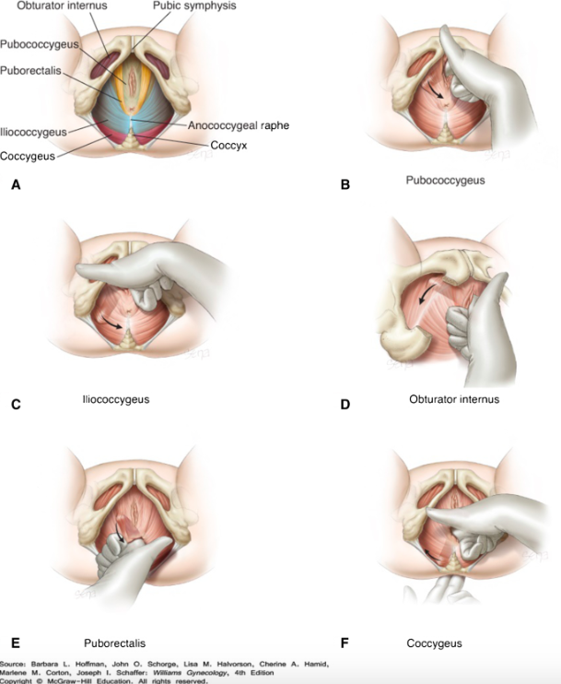
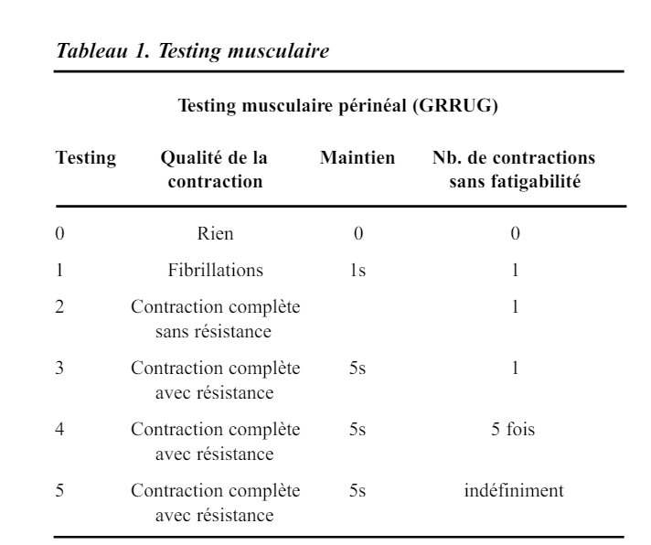

Slide 5
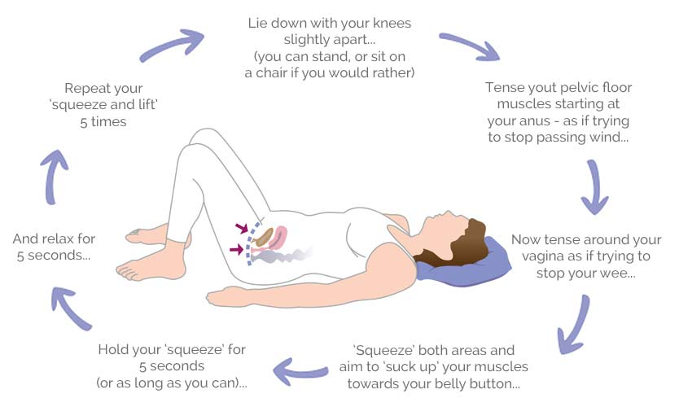
Pelvic Floor Exercises
Locate pelvic floor muscles
Slow Kegel Exercises
  Contract PF muscles for 5-10 seconds
  Relax for 5-1O seconds
  Repeat 10 times, 3 times a day
Quick Kegel Exercises
  Contract PF for 1 sec, repeat 10x
Lock your pelvic floor when you contract your abdominal muscles to cough, laugh, sneeze or lift weights.
Notes:
If you can stop your urination flow mid-stream, you have identified your pelvic floor muscles. That’s the most difficult part of the exercise. (If you’re having problems identifying the correct muscles, stop and make an appointment with a pelvic floor PT.)
It's important to do pelvic floor exercises every day (Kegel exercises or other exercises). While this may seem tedious at first, it will quickly become a habit, even a reflex.
Indeed, when you contract your abdominal muscles, you exert pressure from the top down. Therefore, it's essential to have a "solid base," that is, a strong pelvic floor, to avoid minor inconveniences like urinary leaks, vaginal farts, or pelvic heaviness.
Be careful not to flex the muscles in your abdomen, thighs, or buttocks. Also, avoid holding your breath. Breathe freely during the exercises to keep from stressing the rest of your body. It might be helpful to count the seconds of your hold out loud in order to maintain normal breathing.
Quick or Short Muscle Contractions (Fast Twitch Muscle Exercise) – The first exercise is called a quick or short contraction. It works the fast-twitch muscle fibers that respond quickly to compress the urethra and shut off the flow of urine to prevent leakage.
To perform these contractions, the muscles are quickly tightened, lifted up, held for 1-2 seconds, and then released back down. You should continue to breathe normally as you do these exercises.
Long Hold Muscle Contractions- This exercise works on the supportive strength and endurance of the slow-twitch muscle fibers and is referred to as a long hold contraction.
A solid Kegel workout plan would be to perform 1 set of 10 short contractions and 1 set of 10 long contractions 2 or 3 times per day. Remember: Quality is more important than quantity. You should see improvements in as little as 4 weeks or longer depending on the severity of your problem.

Slide 6
Pelvic Floor Physiotherapy
When patient is unable to identify her pelvic floor
When established pelvic floor disorder
When pelvic floor is too active/tense (hypertonic pelvic floor)

Slide 7
Pelvic Floor Physiotherapy
Therapeutic Education/Healthy Lifestyle
Diaphragm relaxation
Manual Pelvic Floor Exercises - Relaxation
Pelvic Floor Strengthening Exercises
Perineo-detrusor inhibitory reflex
Biofeedback, electrical stimulation
Pelvic Floor Activation and Proprioception
Non-Pressure Abdominal Exercises
Lumbopelvic Stability
Strengthening the Abdominal and Pelvic Muscles

Slide 8
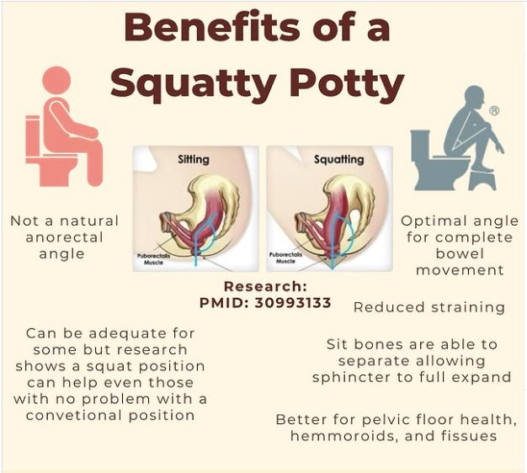
Pelvic Floor Physiotherapy
Therapeutic Education/Healthy Lifestyle
Diaphragm relaxation
Manual Pelvic Floor Exercises - Relaxation
Pelvic Floor Strengthening Exercises
Perineo-detrusor inhibitory reflex
Biofeedback, electrical stimulation
Pelvic Floor Activation and Proprioception
Non-Pressure Abdominal Exercises
Lumbopelvic Stability
Strengthening the Abdominal and Pelvic Muscles

Slide 9
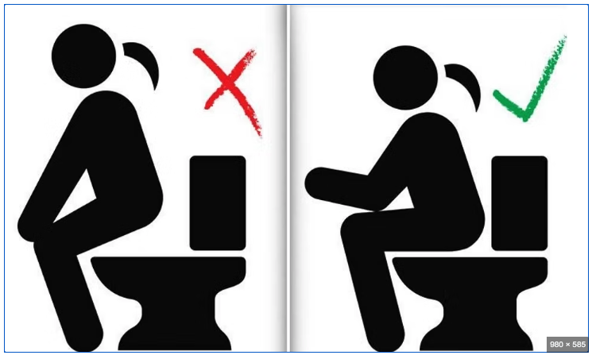
Pelvic Floor Physiotherapy
Therapeutic Education/Healthy Lifestyle
Diaphragm relaxation
Manual Pelvic Floor Exercises - Relaxation
Pelvic Floor Strengthening Exercises
Perineo-detrusor inhibitory reflex
Biofeedback, electrical stimulation
Pelvic Floor Activation and Proprioception
Non-Pressure Abdominal Exercises
Lumbopelvic Stability
Strengthening the Abdominal and Pelvic Muscles

Slide 10

Pelvic Floor Physiotherapy
Therapeutic Education/Healthy Lifestyle
Diaphragm relaxation
Manual Pelvic Floor Exercises - Relaxation
Pelvic Floor Strengthening Exercises
Perineo-detrusor inhibitory reflex
Biofeedback, electrical stimulation
Pelvic Floor Activation and Proprioception
Non-Pressure Abdominal Exercises
Lumbopelvic Stability
Strengthening the Abdominal and Pelvic Muscles

Slide 11
Pelvic Floor Physiotherapy
Therapeutic Education/Healthy Lifestyle
Diaphragm relaxation
Manual Pelvic Floor Exercises - Relaxation
Pelvic Floor Strengthening Exercises
Perineo-detrusor inhibitory reflex
Biofeedback, electrical stimulation
Pelvic Floor Activation and Proprioception
Non-Pressure Abdominal Exercises
Lumbopelvic Stability
Strengthening the Abdominal and Pelvic Muscles

Slide 12

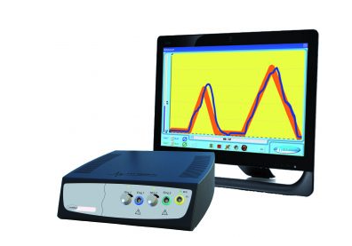
Pelvic Floor Physiotherapy
Therapeutic Education/Healthy Lifestyle
Diaphragm relaxation
Manual Pelvic Floor Exercises - Relaxation
Pelvic Floor Strengthening Exercises
Perineo-detrusor inhibitory reflex
Biofeedback, electrical stimulation
Pelvic Floor Activation and Proprioception
Non-Pressure Abdominal Exercises
Lumbopelvic Stability
Strengthening the Abdominal and Pelvic Muscles

Slide 13
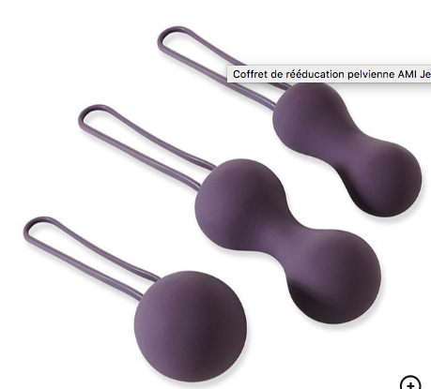
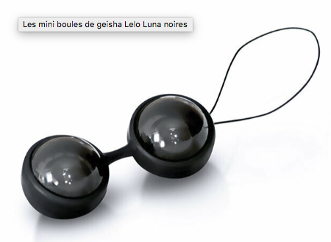
Other ways to strengthen the pelvic floor:
Weighted vaginal cones (Geisha balls)
Sport: Yoga, Pilates
Pelvic Floor Trainers (Perifit, Elvie, kGoal)

Slide 14
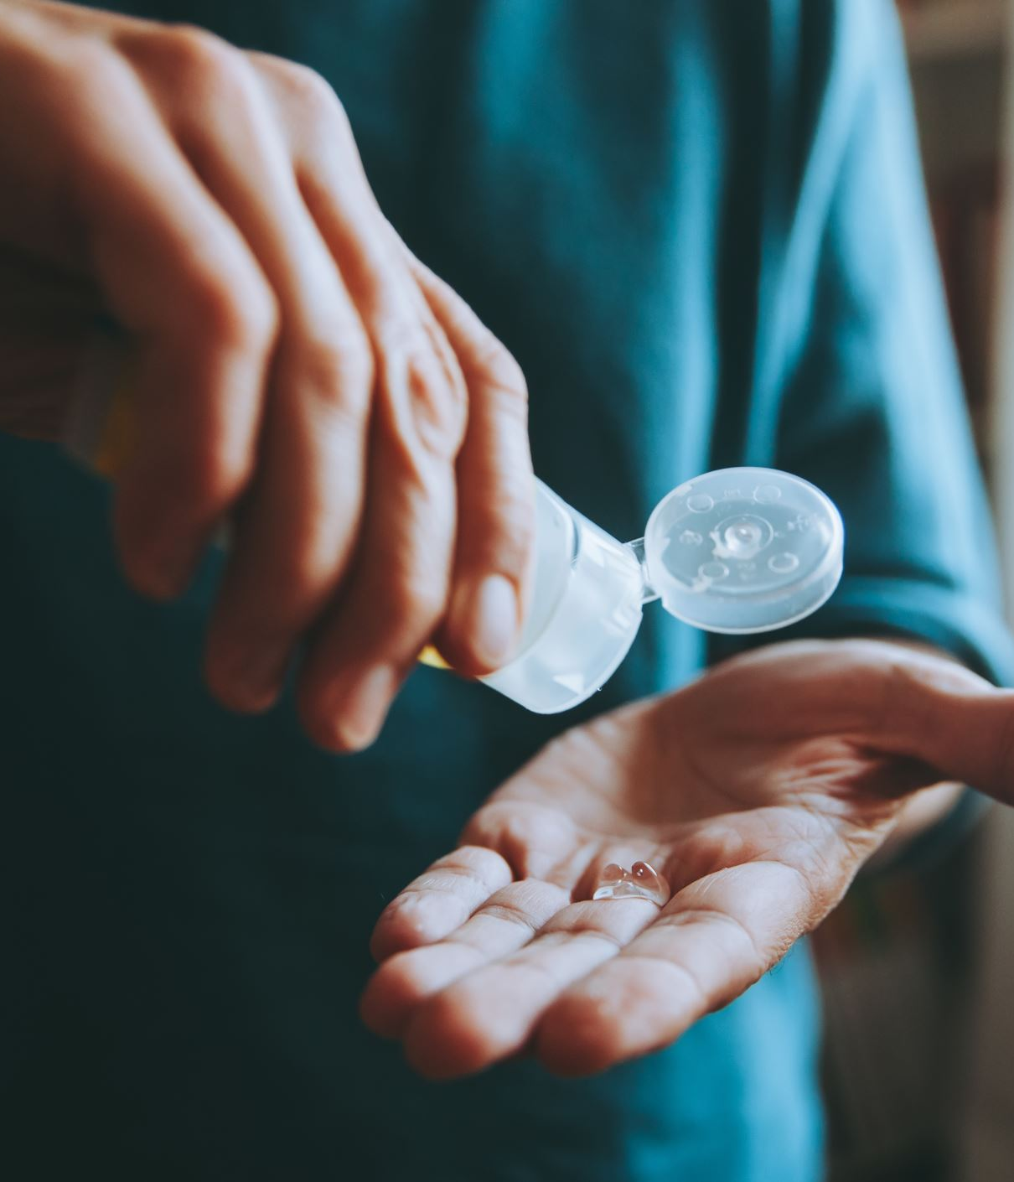
Vaginal creams:
Lubricants
Vaginal moisturizers
Vaginal estrogen

Slide 15
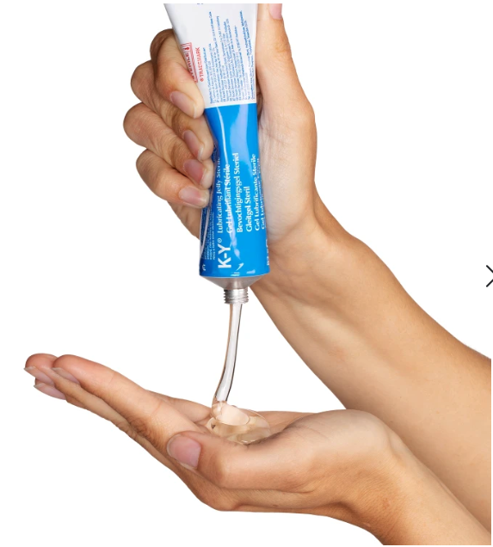
Vaginal creams:
Lubricants
  Short term relief of vaginal dryness
  Reduce discomfort during intercourse
  Water, oil or silicone based

Slide 16

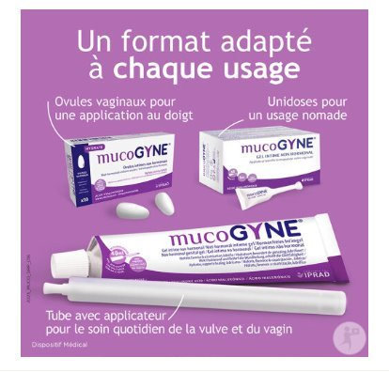

Vaginal creams:
Moisturizers
  Bioadhesives – Hyaluronic acid
  Routine use: 2-3 times / week
  Replace normal vaginal secretions --> relief symptoms of GSM and discomfort during intercourse
  No objective improvement of vaginal atrophy

Slide 17


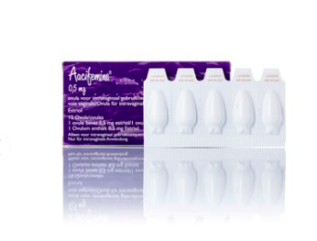
Vaginal creams:
Vaginal estrogen
  Improve vaginal tissue health and elasticity
  Restore natural pH balance
  Relieve symptoms of GSM (including LUTS)
  Estradiol (Vagifem, Rewellfem - tablets) or estriol (Aacifemine, Oekolp, Blissel – cream or ovules)
  Daily for 2 weeks, then twice weekly
  Alternative: DHEA (Intrarosa) 1 daily

Slide 18
Vaginal creams:
Lubricants
Vaginal moisturizers
Vaginal estrogen
Vulvar?
  Avoid soap
  Consider hydrating skin care
  PFE

Slide 19
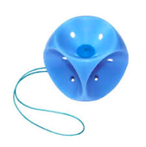
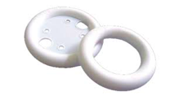
Pessaries
Inserted into the vagina to support prolapsed organs
Reduces discomfort and urinary leakage
Notes:
Medical-grade silicone
Soft
Inert, can be used for years
Sterilizable
PVC
Less used because it's more rigid
Must be changed every 6-12 months
Sterilizable
Latex
Very soft
Allergenic, porous, remove after 12 hours
Not sterilizable

Slide 20
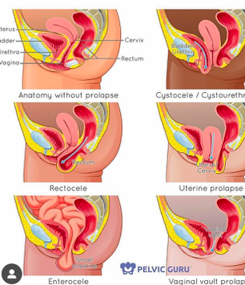
Pessaries
INDICATIONS:
Symptomatic pelvic organ prolaps
  Short or long-term
  Alternative / CI surgery
  Postpone surgery
Prevent prolapse aggravation
Asses the effect of reducing a prolapse on bladder and bowel function prior to considering surgical management.
CONTRA-INDICATIONS:
Non compliant patient or patient unable to come to consultation for regular follow-up (dementia)
Vaginal Mesh erosion
Previous radiotherapy
Notes:
The woman is neither able to comply with regular follow-up, nor self-manage the pessary. • There is active vaginal or pelvic infection, inflammation, unexplained bleeding, or ongoing vaginal or cervical cancer. • The woman has had previous radiotherapy affecting the vaginal tissues. • The vaginal tissue is severely atrophic and has not responded to pre-pessary oestrogen treatment. • The vaginal space is too narrow or too short to fit a pessary. • There is identifiable synthetic vaginal mesh erosion.

Slide 21
Pessaries:
Predictors of failure:
Advanced prolaps
Enlarged genital hiatus
Short vagina (previous POP surgery)
Rectocele?
Predictors of stopping use of pessary:
Rectocele
Young patients
Urinary incontinence
Discomfort
Notes:
Prescribe the pessary model best suited to the patient's needs (pathology, but also sexual activity and independence in pessary management).
Prescribe the smallest possible pessary.
Insist on explaining their use and have the patient practice.
Insist on follow-up.
Prescribe local hormone therapy, or at least a moisturizing vaginal gel, particularly for postmenopausal women.
Treat any constipation.
Adapt the type of pessary during treatment if necessary.

Slide 22
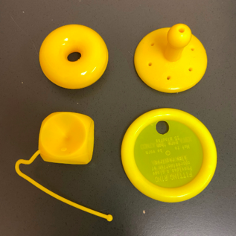
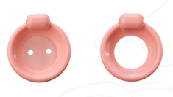
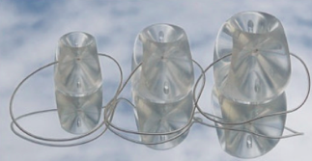
Pessaries:
Different types
Support pessaries (ring, ring with support, ring with knob)
Space filling pessaries (donut, gellhorn, cube)
Pessaries for urinary incontinence

Slide 23
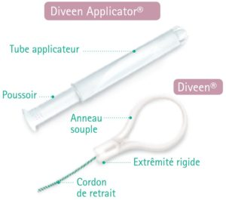
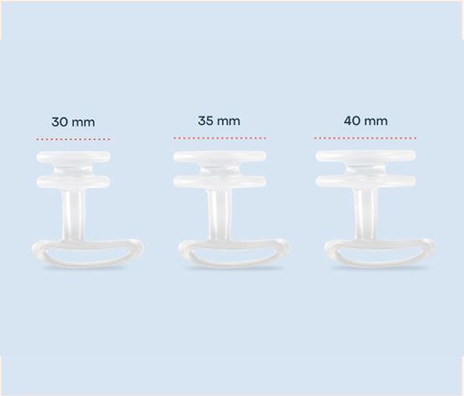
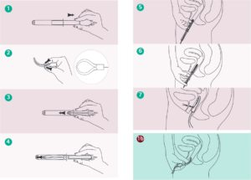
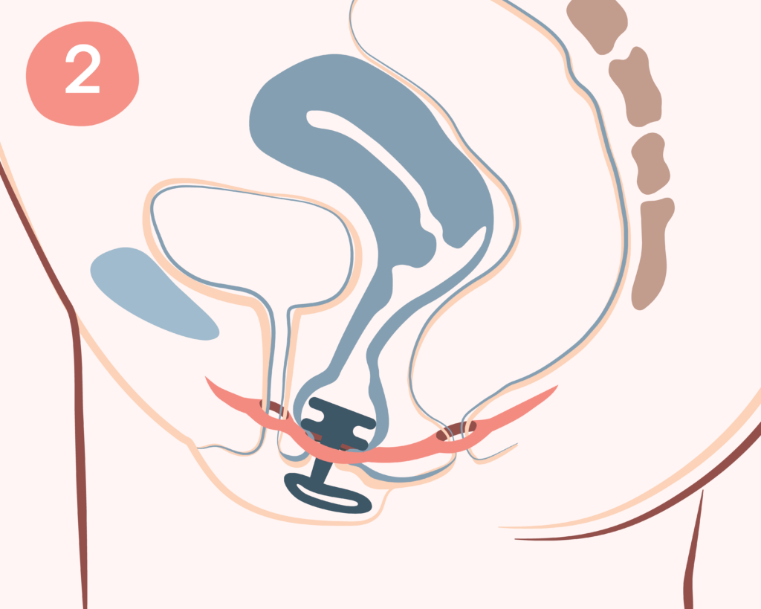
Pessaries for stress urinary incontinence

Slide 24
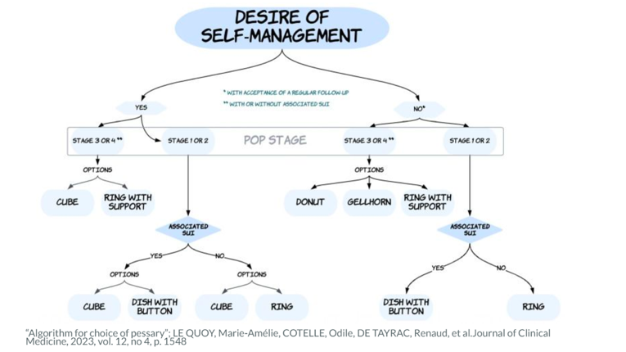
How to choose the type of pessary:

Slide 25
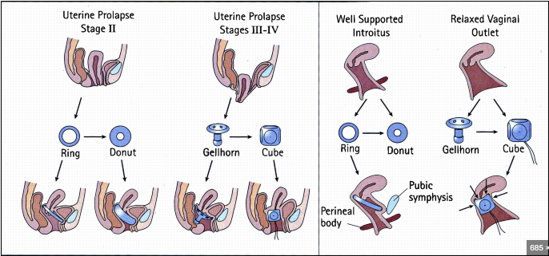
How to choose the type of pessary:

Slide 26
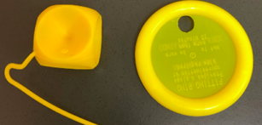
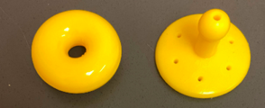

How to choose the type of pessary:
Ring or cube pessary often in a first place
When vagina/genital hiatus too large: donut, gellhorn or cube
If stress urinary incontinence when pessary in place: ring with knob
Notes:
The healthcare professional will first check for a cervix, which allows the use of a support pessary (ring type). If there is no longer a cervix, only a filler pessary (Cube or Gellhorn type) can be inserted. The same applies if your pelvic floor is too weak to maintain a support pessary.
He/she will also ensure your willingness and ability to manage your pessary yourself on a daily basis. A Cube pessary will only be prescribed under this condition. A woman who does not wish to remove and replace her pessary herself, or who wishes to do so on a non-daily basis, should be prescribed a Ring, Donut, Dish, or Gellhorn type pessary, which can remain in place in the vagina for up to 3 months continuously.
Finally, you and your healthcare professional will discuss your needs and habits: whether you have or wish to have an active sex life, for example, will strongly influence the choice of pessary. The goal is to meet your expectations and give you more freedom to do what you enjoy.

Slide 27
How to choose the size?
Pessary size is estimated using a vaginal examination:
  Measure width at the vaginal top (# cm between fingers) ≈ width of the pessary.
  Measure distance between posterior cul-de-sac and behind the pubic bone
When pessary in place, you must be able to pass a fingertip between the outer edge of the pessary and the wall of the vagina
A good pessary is not felt by the patient and does not fall out during exertion (Valsalva, defecation): test for 30 min - 1h
Sometimes several pessaries are tested before finding the right one.
Notes:
Pessary size is estimated using a vaginal examination. The healthcare professional will place the tip of their right index finger in the posterior cul-de-sac of your vagina and the tip of their middle finger just behind the pubic bone. They will then estimate the distance in millimeters between these two points. This value will give the size of the pessary to try (i.e. its outer diameter). The most commonly prescribed sizes are between 60 and 70 mm in diameter.
Once these steps are completed, the healthcare professional will have you try on the pessary to ensure the chosen model and size are appropriate. To do this, they usually have a set of test pessaries available in their office.
Once the pessary is in place, the healthcare professional will check whether they can pass their fingertip between the outer edge of the pessary and the wall of your vagina. If they cannot, they should try the next smaller size. If, on the other hand, their finger fits too easily, they should try the next larger size. The healthcare professional should feel some flexibility between the pessary and the vaginal wall.
Once this step is complete, if the size seems appropriate, the healthcare professional will ask you to stand, walk, tap your feet on the floor, bend forward, squat, cough, etc. If the pessary remains in place after a few minutes of these "exercises" and you feel no discomfort, then the pessary being tried is probably the right one. The healthcare professional may complete the check by asking you to urinate. If you can do so without discomfort and without the pessary falling out, the trial is over, and the healthcare professional will be able to prescribe that model.
If, however, the pessary falls down or falls out, it will be advisable to try another one. Be careful, a pessary can fall out because it is too small, but also because it is too large and ends up in a longitudinal position. A pessary can also fall out if the model is not suitable: weak pelvic muscles may not be able to hold a so-called support pessary in place, requiring the use of a filler pessary, particularly a cube pessary, which will hold better thanks to the suction effect exerted on the vaginal wall.
It is not uncommon for it to be necessary after a few months or years to change the size or model of pessary, depending on the evolution of your pathology and the tone of your pelvic floor muscles. It is important to adapt the pessary to ensure its effectiveness while ensuring your daily comfort.
The fitting process is sometimes very quick, and the first pessary tried is suitable. Other times, several models must be tried, and the consultation can last up to half an hour. Experience shows that, on average, three or four models must be tried to find the right one (usually the most frequently prescribed sizes).

Slide 28
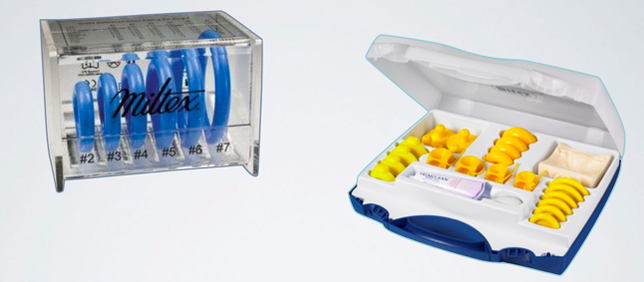
How to choose the size?
www.pessary-shop.be
www.gyneas.com
www.benetec.com
Testing kits:
Milex
Gyneas

Slide 29
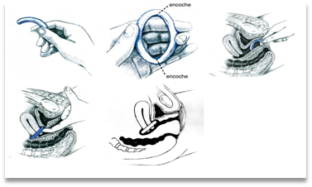
How to place?
Apply gel to the ring
Fold the ring, arch downward
Spread the labia minora (!)
Insert the pessary, slide it down to the vaginal floor
Release the pessary, it will lie horizontally
Deep: behind the cervix
Superficial: 'wedged' behind the pubis
1 finger between the pessary and the vaginal wall
No expulsion with Valsalva, lying or standing

Slide 30
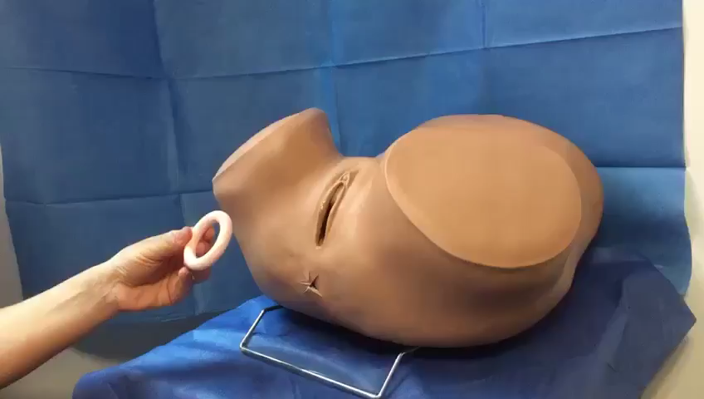

Slide 31
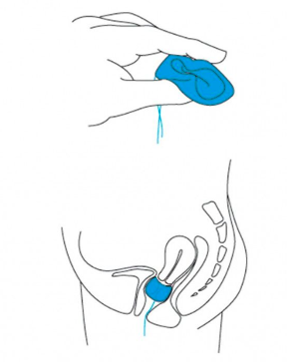
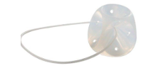
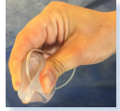
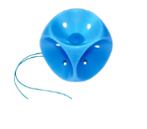
Cube pessary
Compress before inserting inside the vagina
Removing: locate the pessary using the silicone string. Do not pull on the string. Sweep a finger around the pessary to break the suction.
Self-management: must be removed daily

Slide 32
Pessaries: Care and follow-up
Vaginal estrogen (2x/week) suggested by experts
Review appointment 4–6 weeks after the initial pessary fitting
Cube (self-management): removal 1x/day – rinse with water + neutral soap – leave to dry
Other pessaries: follow-up every 3-6 months
  Removal using lubricant
  Rinse with soap and water
  Vaginal inspection with a speculum for erosions and infections before replacing the pessary
A new pessary is required when the pessary is showing signs of wear, such as cracks or splits (often after 2 years)

Slide 33
Pessaries: possible complications
Mild vaginal discharge
  Reassurance if not bothersome
Malodourous or heavy vaginal discharge
  Consider treatment to maintain normal acid pH (vaginal estrogen/ moisturizer/ probiotics?)
  Treat bacterial vaginosis if necessary
Vaginal bleeding due to abrasion/erosion/ulceration
  Remove pessary until vagina heals (2 weeks)
  Offer vaginal estrogens to aid vaginal tissue healing
  If the underlying cause is a tight pessary replace with smaller pessary
  Vaginal biopsy should be considered when ulcerations do not heal

Slide 34
Pessaries: possible complications
Pain or discomfort
  Remove pessary − Re-size pessary/consider different type
De novo urinary incontinence with pessary (occult incontinence)
  Change for pessary with knob
Pessary falls out
  In which conditions? Straining? Treat constipation!
  Re-size pessary
Rare complications < neglected pessary
  Difficult removal due to granulation of neglected pessary
  Impacted/embedded pessary +/- fistulae
  Sometimes surgical removement

Slide 35
Take Home Messages
Encourage your patients to do pelvic floor exercises (strength training for muscle maintenance)
Prescribe pelvic floor physiotherapy when necessary (unable to locate pelvic floor, pelvic floor too tense, established pelvic floor disorder)
Lifestyle – avoid constipation
Encourage the use of vaginal lubricants and/or moisturizers. Prescribe vaginal estrogen when indicated.
Pessaries are a valuable treatment option for pelvic organ prolapse

Slide 36
Thank you

Slide 37
References
Dumoulin C, Pazzoto Cacciari L, Mercier J. Keeping the pelvic floor healthy. Climacteric. 2019;22(3):257-262.
Mercier J, Morin M, Zaki D, Reichetzer B, Lemieux MC, Khalifé S, Dumoulin C. Pelvic floor muscle training as a treatment for genitourinary syndrome of menopause: A single-arm feasibility study. Maturitas. 2019;125:57-62.
Vaginal Pessary Use and Management for Pelvic Organ Prolapse: Developed by the joint writing group of the American Urogynecologic Society and the Society of Urologic Nurses and Associates. Individual writing group members are noted in the Acknowledgments section. Urogynecology (Phila). 2023 Jan 1;29(1):5-20. doi: 10.1097/SPV.0000000000001293. PMID: 36548101.
UK Clinical Guideline for best practice in the use of vaginal pessaries for pelvic organ prolapse

Slide 38
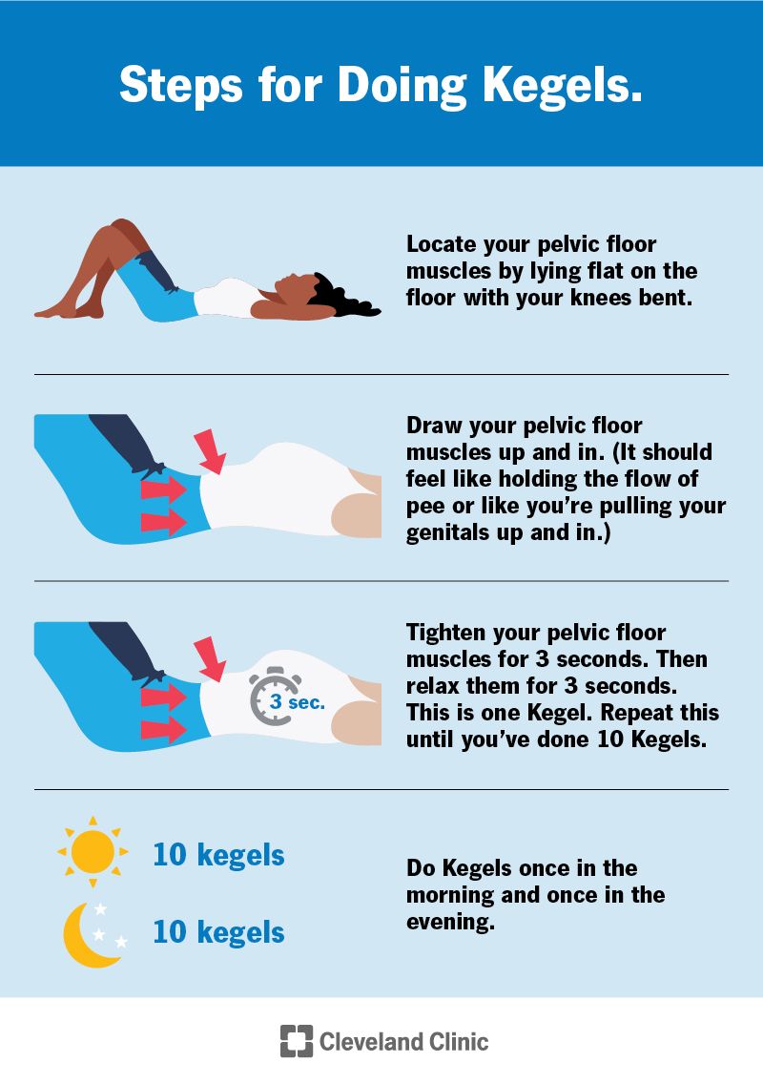
Pelvic Floor exercices
Kegel Exercices
  Contract PF muscles for 5 seconds
  Relax for 5 seconds
  Repeat 10 times, 3 times a day
Breathing and relaxation techniques

Slide 39
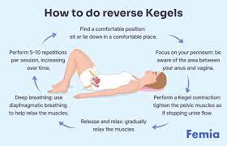
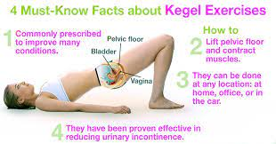
Pelvic Floor exercices

Slide 40
WORK BOTH YOUR FAST-TWITCH AND SLOW-TWITCH MUSCLE FIBERS
To give your pelvic floor a full workout, there are two types of focused Kegel exercises you could perform.
Quick or Short Muscle Contractions (Fast Twitch Muscle Exercise) – The first exercise is called a quick or short contraction. It works the fast-twitch muscle fibers that respond quickly to compress the urethra and shut off the flow of urine to prevent leakage.
To perform these contractions, the muscles are quickly tightened, lifted up, held for 1-2 seconds, and then released back down. You should continue to breathe normally as you do these exercises.
Long Hold Muscle Contractions- This exercise works on the supportive strength and endurance of the slow-twitch muscle fibers and is referred to as a long hold contraction.
To perform these contractions, the same muscles you used with the quick contractions are now going to be gradually tightened, lifted up, and held over several seconds.
At first, it may be difficult to hold the contraction for more than 1 or 2 seconds. Ultimately, the goal is to hold the contraction for 10 seconds then rest for 10 seconds between each long contraction to avoid taxing the muscles.

