Slide 1

Menopause care:
A comprehensive 2 days workshop
Session 2
Common Symptoms and consequences of Menopause and how to measure them
Hot flashes, night sweats, and sleep disturbances: differential diagnosis and measurements
Dr Anne Firquet Ulg ( CHU Liège – Citadelle liège)

Slide 2
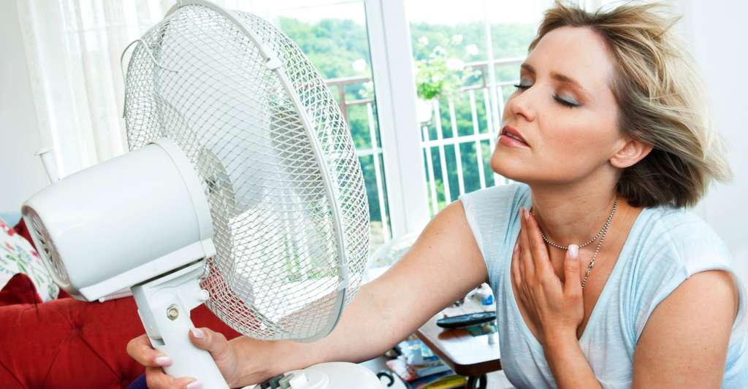
Hot Flushes
Hot flashes are reported by up to 85% of menopausal women
Hot flashes are present in as many as 55% of women even before the onset of the menstrual irregularity that defines entry into the menopausal transition and their incidence and severity increases as women traverse the menopause, peaking in the late transition and tapering off within the next several years
Approximately 25% of women continue to have hot flashes up to 5 or more years after menopause.
Nanette Santoro Endocrinol Metab Clin North Am. 2015 September ; 44(3): 497–515. doi:10.1016/j.ecl.2015.05.001

Slide 3
Bouffées de chaleur
D e 60 % a 80 % des femmes entrant en ménopause présentent des symptômes vasomoteurs
Les bouffées de chaleur sont courantes au cours de la transition perimenopausique, période pendant laquelle l’activite ovarienne peut s’avérer intermittente; elles ont de plus été documentées au cours des phases lutéale et menstruelle du cycle chez les femmes qui présentent un trouble dysphorique premenstruel.

Slide 4

This study, which has been examining women’s health during midlife since the late 1990s, has been collecting data on more than 3,000 multiethnic women at seven centers across the United States.
The study focuses on the physical, biological, psychological, and social changes that occur before, during, and after menopause.
Samar R. El Khoudary, Menopause: The Journal of The North American Menopause Society. 2019-Vol. 26, No. 10, pp. 1213-1227

Slide 5

Over the past 23 years, SWAN has advanced our understanding of the impact of the MT and midlife aging on health and well-being in women.
SWAN will be instrumental to determine whether MT-related changes during midlife are related to unfavorable health and well-being in early old age.

Slide 6
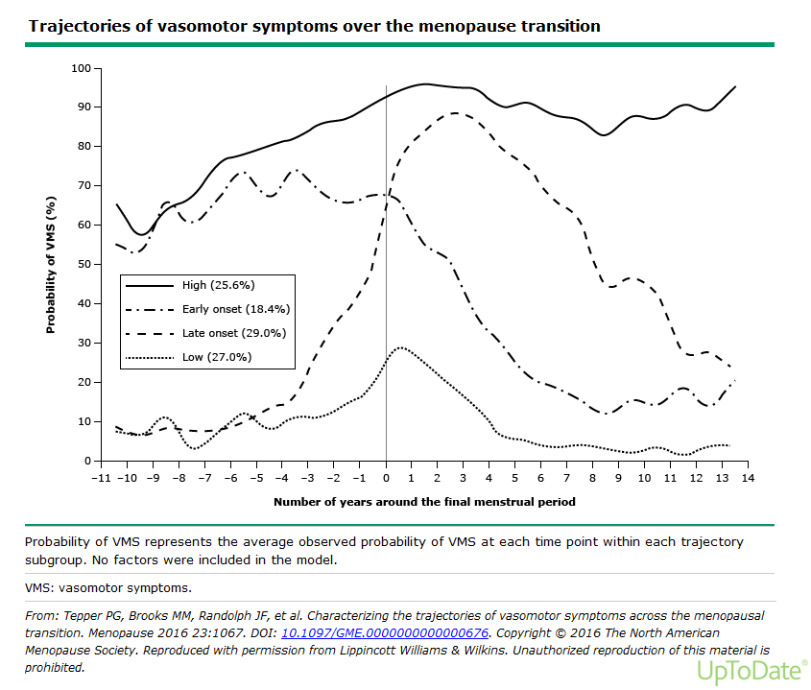
Notes:
Longitudinals studies indicate that women follow distinct patterns of VMS
Both the SWAN study (US° and an Australian study ( Aus Longit Study of women’s health) found that VMS follow 4 trajectories in approx. equal proportions across 4 groups
4 types:
Mild : mild/ no HF
Late onset : start na laatste menstruatie → blijven tot late MP
Early onset : start reeds vroeg in de overgang maar↓ na laatste menses
Super flushers : start vroeg in de overgang → blijven tot late MP
RF voor HF vroege flushers
↑ BMI
Centrale obesitas
↓ slaapkwaliteit
↓ Quality of life

Slide 7
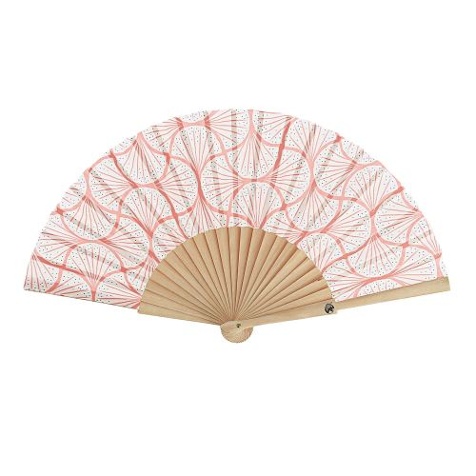
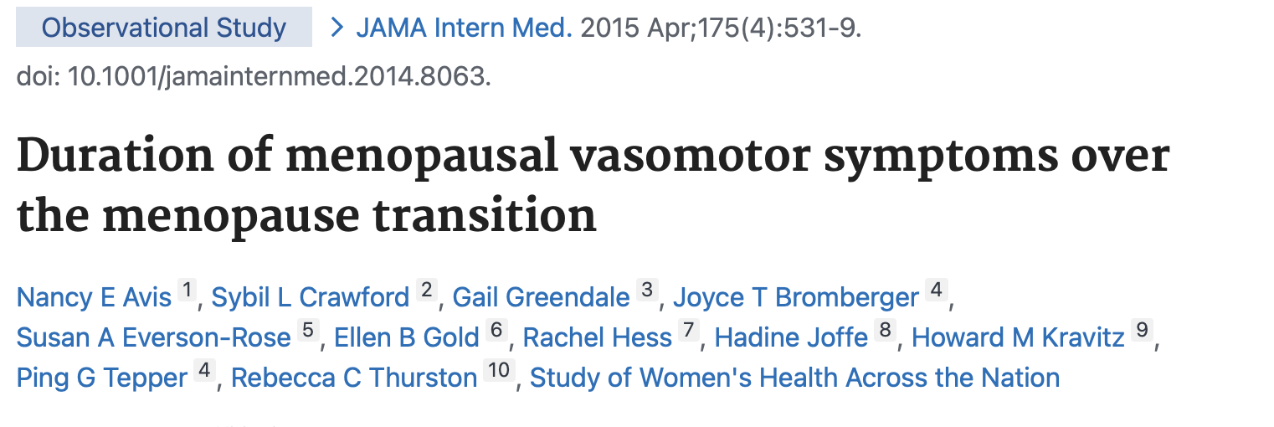
Persistance des BDC ?

Slide 8
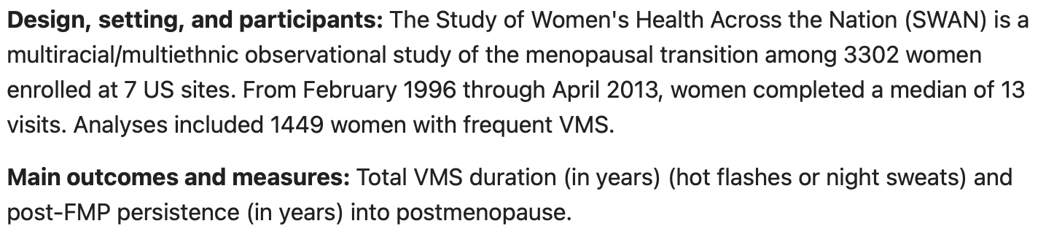



Persistance des BDC ?
Notes:
This multiracial observational sudy included more than 1000 women with fresuent VMS
The total VMS duration « in years » was measured in post menopause

Slide 9
Persistance des BDC ?
BDC fréquentes durent plus de 7 ans après la « transition » de la ménopause pour plus de la moitié des femmes et persistent pendant 4 ½ ans après pour les autres.
Caractéristiques individuelles ( longue période de pré/périménopause, et facteurs « négatifs » affectifs pdt cette période lors des premières BDC)ont été associés à de plus longues périodes de BDC.
Professionnels de santé devraient conseiller / informer les femmes BDC peuvent durer plus de 7 ans et encore plus chez les patientes afro américaines
Notes:
And the conclusions showed it was still very long!

Slide 10
Diagnostic différentiel
l’hyperthyroidie
l’anxiete, les attaques de panique, stress
l’hypertension
bouffees vasomotrices affectives ou neurologiques
variation de la glycémie
syndrome carcinoïde
Effets secondaires médicamenteux
reactions aux aliments, aux medicaments et a l’alcool

Slide 11
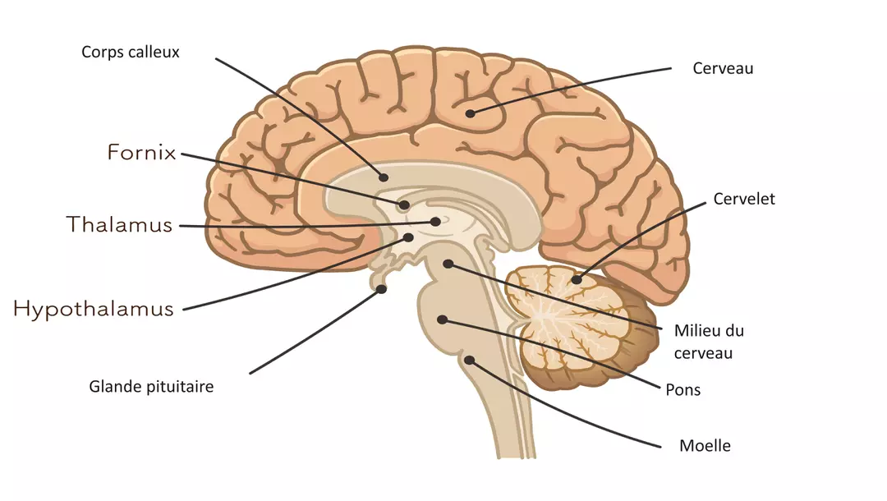
Régulation température corporelle
L'hypothalamus, qui contient le centre thermorégulateur, reçoit des informations de tous les récepteurs (cutanés et centraux), analyse la température en permanence, et la compare à une valeur de consigne (environ 37 °C). En plus, d'une régulation nerveuse il y a aussi une régulation hormonale⁵.

Slide 12
thermogenèse
La thermogenèse est la production de chaleur de l’organisme chez les animaux et certaines plantes par augmentation du métabolisme cellulaire. Elle s'oppose à la thermolyse, qui correspond aux mécanismes d’exportation de la chaleur produite en excès par l’organisme. Elle intervient quand la température du corps est inférieure au point de consigne (température d'environ 37 °C). Cela entraîne alors la libération dans le sang de catécholamines(adrénaline), qui entraînent une vasoconstriction au niveau de la peau. Le corps produit alors de la chaleur par :
activité musculaire : volontaire ou frissons thermiques ;
métabolisme : catécholamines, hormones thyroïdiennes ;
lipolyse du tissu adipeux brun (la graisse brune n'est présente que chez les nourrissons et diminue progressivement avec l'âge sans disparaître, sauf chez les animaux qui hibernent).

Slide 13
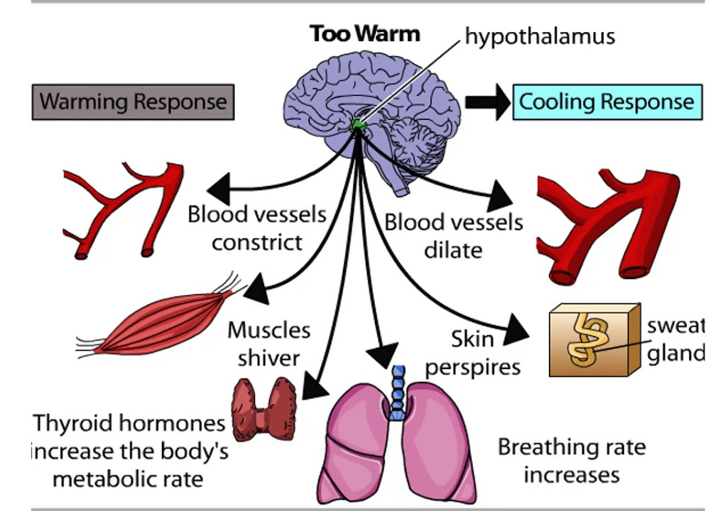
Physiopathologie
Perturbation du mécanisme thermorégulateur au sein de l’hypothalamus qui serait attribuable a la présence de faibles taux d’œstrogenes, après un amorçage préalable par les œstrogenes.

Slide 14
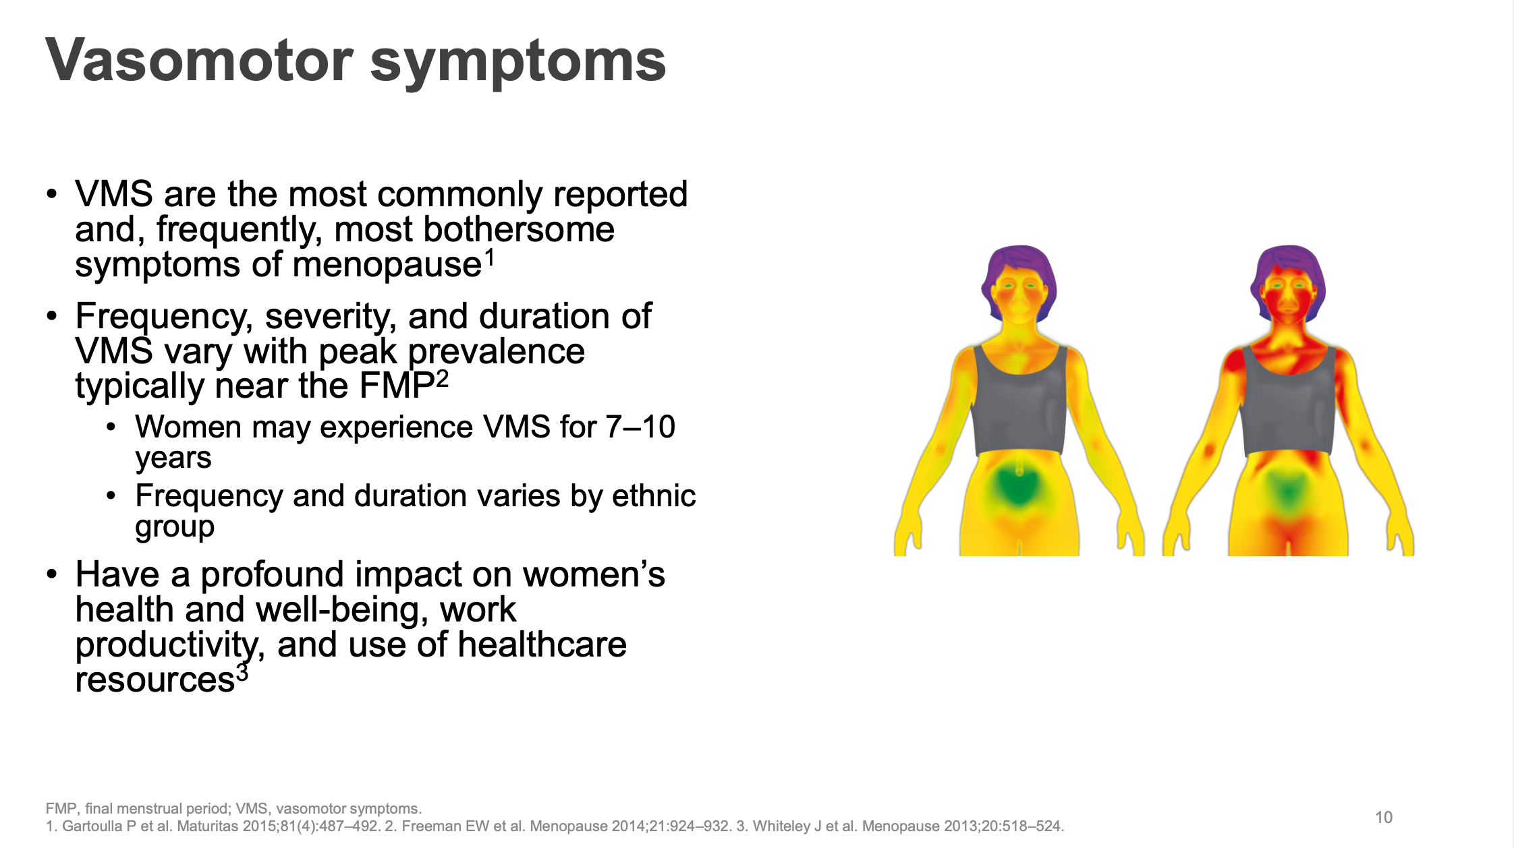

Slide 15
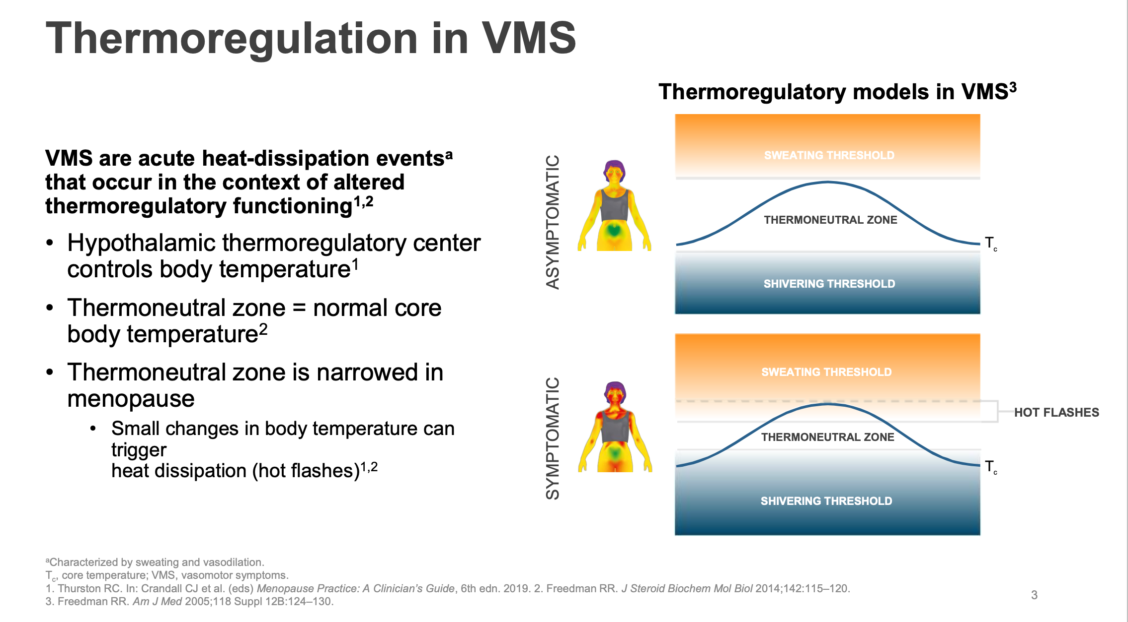

Slide 16
Night sweats
Les sueurs nocturnes représentent une transpiration soudaine et excessive durant le sommeil. Cette transpiration peut apparaître de manière ponctuelle ou se répéter plusieurs nuits d’affilée. La production excessive de sueurs est appelée "hyperhidrose".
Les sueurs nocturnes sont souvent associées à des troubles du sommeil.
Globalement, les sueurs nocturnes sont la conséquence d’une stimulation du système nerveux sympathique qui est l’un des systèmes nerveux autonomes de l’organisme. L’origine de cette sudation est l’excitation de ce système nerveux.
Néanmoins, les causes sont diverses. Il convient alors d’en identifier l’origine précise pour éviter toute complication.

Slide 17
Night sweats
Other etiologies
Sleep apnea
Restless legs syndrome
Gastroesophageal reflux
Acute infections VIH, l’hépatite C, une endocarditis,
hyperthyroidism
Hodgkin lymphoma, myeloma
Adrenal pathology

Slide 18
Conséquences sleep disturbances
Attention and concentration deficency,
Memory loss
chronic fatigue and discouragement
mood disorders (irritability, sadness)
increased sensitivity to pain
overweight and obesity
Depression
reduction of immune defenses
Increased risk of cardiovascular disease
Increase in the occurrence of diabetes
Premature aging of the skin

Slide 19
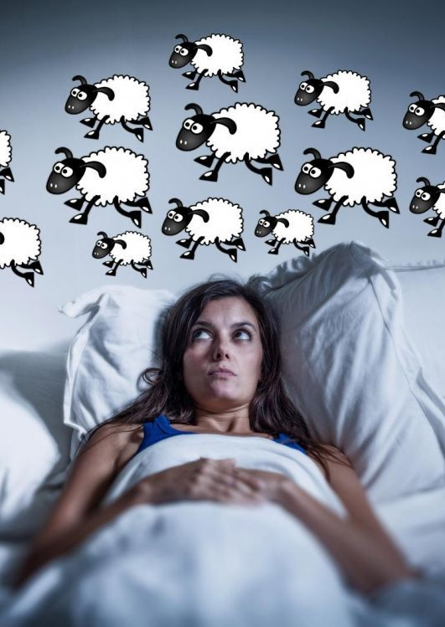
Frequency and severity of hot flushes had an approximately linear relationship with sleep parameters and menopause-specific quality of life (MSQoL),and that improvements in hot flushes are associated with improvements in sleep and in MSQoL

Slide 20
Age-adjusted odds ratios for self-reported sleep difficulties in women participating in the SWAN prospectively tracked across the natural menopausal transition relative to premenopausal baseline and in women who transitioned to surgical menopause.

Slide 21
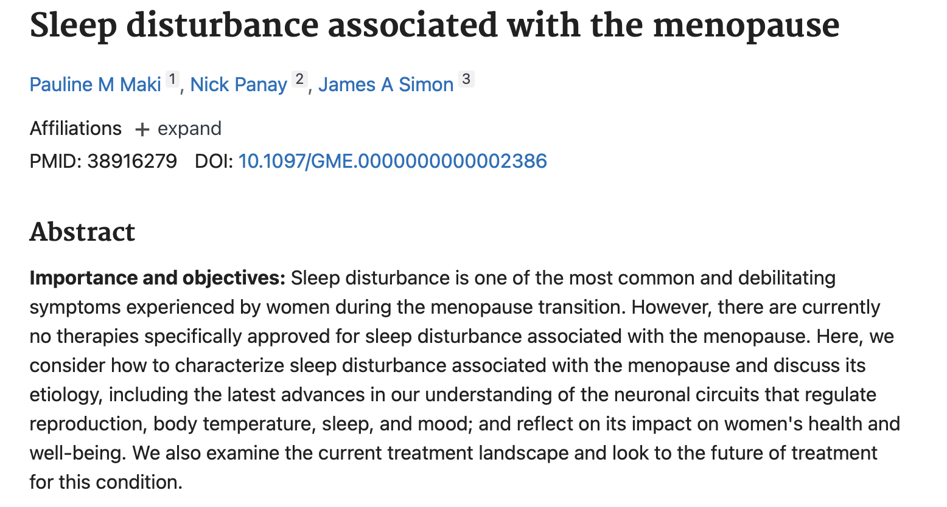
Sleep disturbance

Slide 22
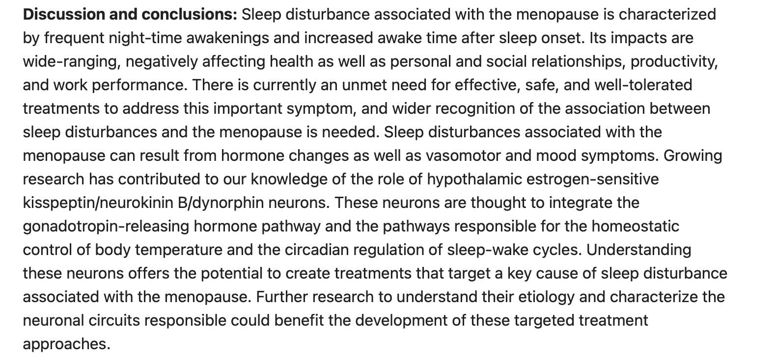
Sleep disturbance

Slide 23
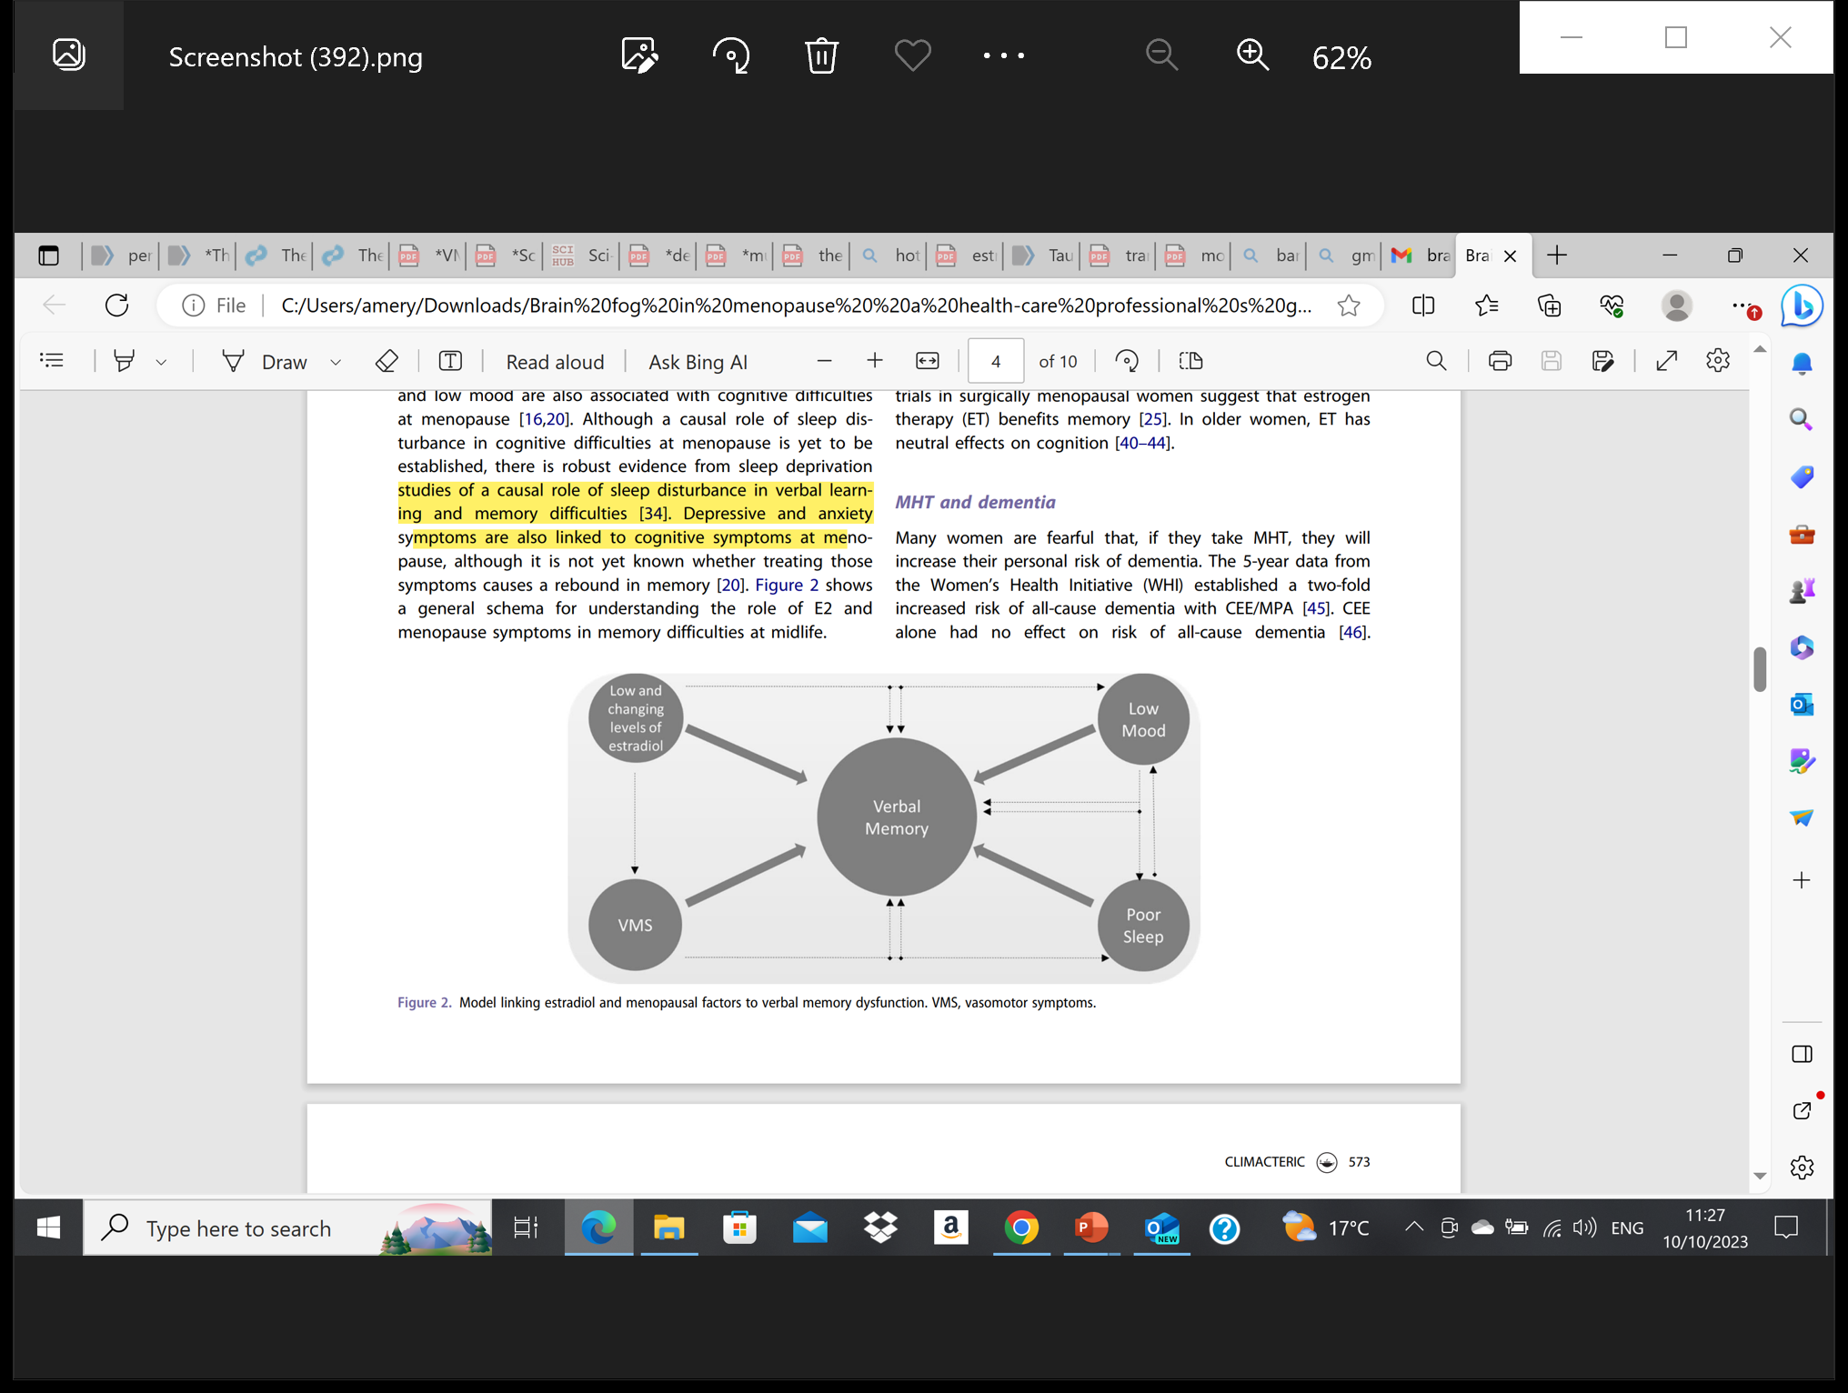
Cognitive complaints
Frequent in midlife women and across MP transition
Role of E2
Role of VMS, sleep disturbances and mood changes
Notes:
- studies show a role for E2 in mediating MP related changes in cognition
removal of ovaries or suppression of E2 leads to declines in verbal learning which is reversed by E treatment
E receptors are replete in brain areas subserving memory and other cognitive functions (hippocampus and prefrontal cortex)
In addition: MP related sympt : VMS, sleep disturbances and mood changes contribute to cognitive difficulties
Mp sympt also appear to contribute tot memory difficulties
Brain imaging studies link VMS to adverse changes in brain structure and function
A study done by Rebecca thurstona and Pauline Maki showed
That more frequent physiologically detected VMS were associated with greater white matter hyperintensities, a measure of small vessel disease in the brain. They also found greater default network connectivity with more frequent VMS

Slide 24
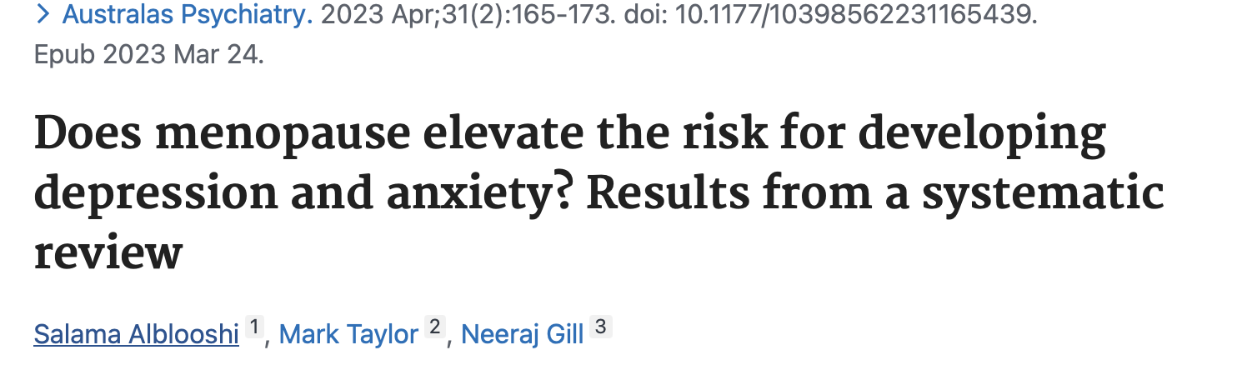
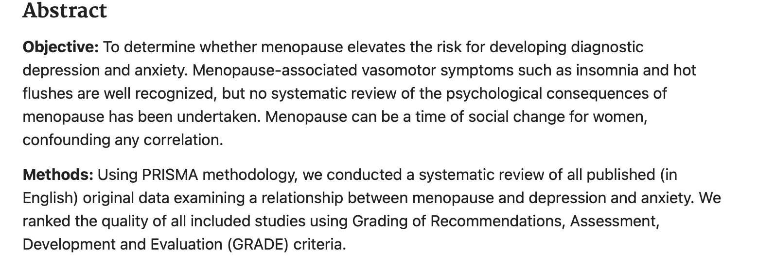
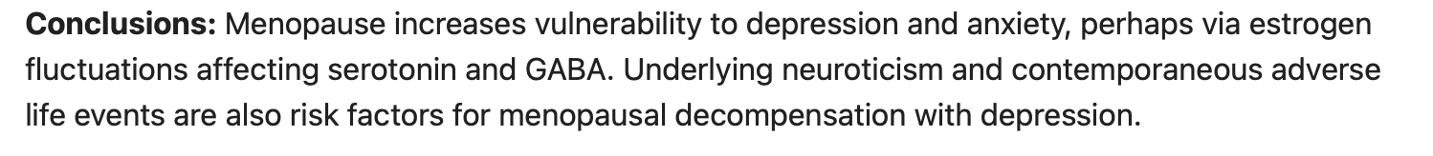

Slide 25

Mood disturbances
Menopause transition as well as early menopause may increase vulnerability for some women.
Women who have experienced previous periods of depression associated with PMS or postpartum, are more susceptible to depression at the menopause. These women should probably be treated with MHT first before using anti-depressant drugs (grade IIC)
Mood disturbances and depression as such are not an indication of MHT. However, it may help women who have mood disturbances associated with climacteric symptoms.
Notes:
Estrogen lowers serotonine and endorphines

Slide 26
Mood disturbances
Menopause transition as well as early menopause may increase vulnerability for some women.
Women who have experienced previous periods of depression associated with PMS or postpartum, are more susceptible to depression at the menopause. These women should probably be treated with MHT first before using anti-depressant drugs (grade IIC)
Mood disturbances and depression as such are not an indication of MHT. However, it may help women who have mood disturbances associated with climacteric symptoms.
Notes:
Estrogen lowers serotonine and endorphines

Slide 27
MHT and perimenopause : Mood and depressive symptoms
Some data support a potential beneficial effect of MHT on mood
MHT should not be proposed to non-depressed, asymptomatic peri-menopausal women to prevent or alleviate mood symptoms.
Estrogen seems to have a potential role among specific sub-populations at risk of depressive symptoms during menopausal transition.
Estrogens can be considered in menopausal women with other concurrent conditions such as vasomotor symptoms as they may increase the response to anti-depressants.
Only a small proportion of women experience depressed mood in relation to menopause, it is mandatory to accurately investigate the origin of depressive symptoms in order to detect those women who had history of depression before the menopause transition and those who had the onset during the menopausal transition.
Antidepressants remain the first-line treatment of depression for patients with previous history of depression
Giulia Gava, Medicina 2019, 55, 668, Maki, P.M.; Kornstein, S.G.; Joe, H.; Bromberger, J.T.; Freeman, E.W.; Athappilly, G.; Bobo,W.V.; Rubin, L.H.;Koleva, H.K.; Cohen, L.S.; et al. Guidelines for the evaluation and treatment of perimenopausal depression:Summary and recommendations. Menopause 2018, 25, 1069–1085

Slide 28
Intricated conditions : HRQoL and sedentary life style
Women who had gained weight during the MT reported more vasomotor symptoms (hot flushes) than women whose weight remained stable. Women suffering from more hot flushes experience a poorer HRQoL.
A Finnish study concluded that change in global quality of life is more associated with change in physical activity than change in menopausal status. Women who decreased their physical activity had deterioration in HRQoL compared to women whose physical activity remained stable.
Moilanen JM, Aalto AM, Raitanen J, et al. Physical activity and
change in quality of life during menopause – an 8-year follow-up
study. Health Qual Life Outcomes 2012;10:8

Slide 29
Hot flushes impact the daily activities of most postmenopausal women, especially those with more frequent/severe symptoms.
affected work (46.0%)
social activities (44.4%)
leisure activities (47.6%)
sleep (82.0%)
mood (68.6%)
concentration(69.0%),
sexual activity (40.9%)
total energy level (63.3)
overall quality of life (69.3%)
Williams RE, Levine KB, Kalilani L, et al. Menopause-specific questionnaire assessment in US population-based study shows negative impact on health-related quality of life. Maturitas 2009;62:153–9

Slide 30
Menopause transition and symptomatic women
Looking specifically at symptomatic women revealed that hot flushes are significantly associated with psychological symptoms of anxiety and depression in peri and early postmenopause, but not in late postmenopause.
As in other female-specific reproductive periods, such as perimenstrual changes, pregnancy and the postpartum, the menopausal transition represents a window of vulnerability for depression and anxiety.
Juang KD, Wang SJ, Lu SR, Lee S-J, Fuh J-L. Hot flashes are associated with psychological symptoms of anxiety and depression in peri- and post- but not premenopausal women. Maturitas
2005;52:119–26 ; Clayton AH, Ninan PT. Depression or menopause? Presentation and management of major depressive disorder in perimenopausal and postmenopausal women. Prim Care Companion J Clin
Psychiatry 2010;12:PCC.08r00747 ; Ayers B, Hunter MS. Health-related quality of life of women with
menopausal hot flushes and night sweats. Climacteric 2013;16:235–9

Slide 34
Fiona C Baker, Nature and Science of Sleep 2018:10 73–95

Slide 35
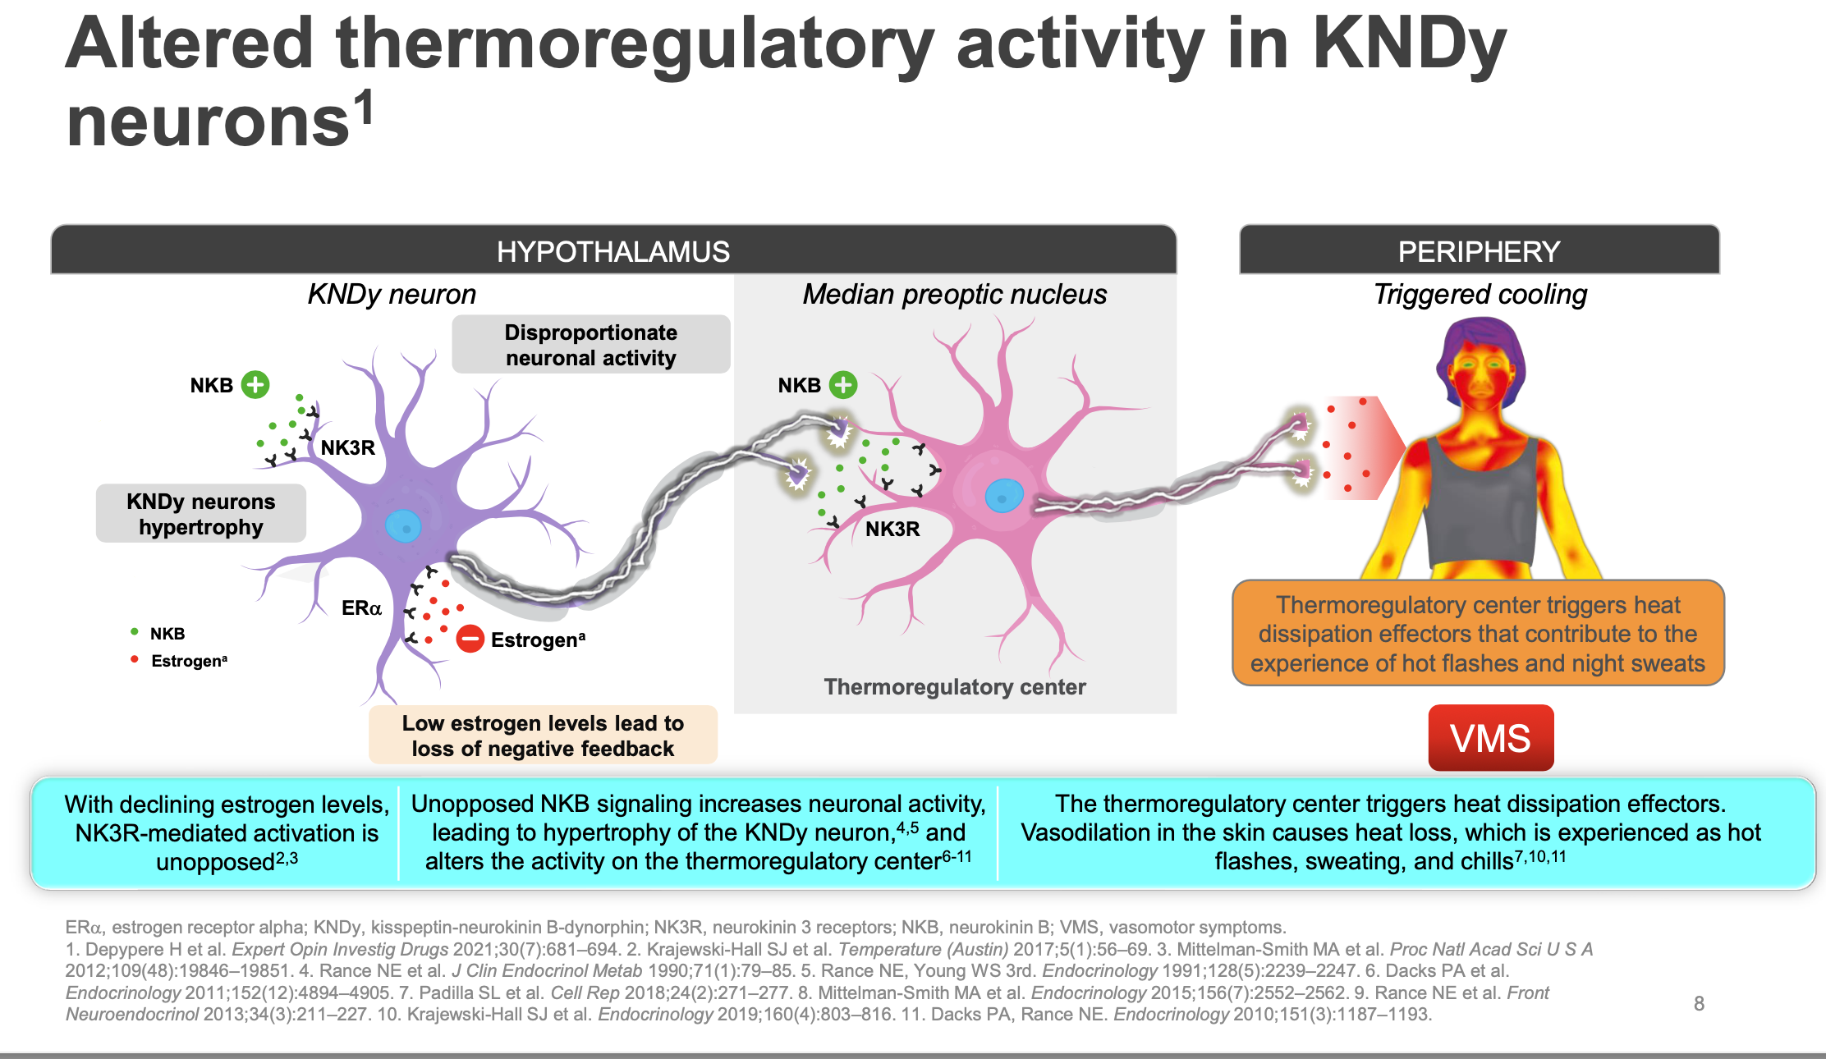

Slide 36
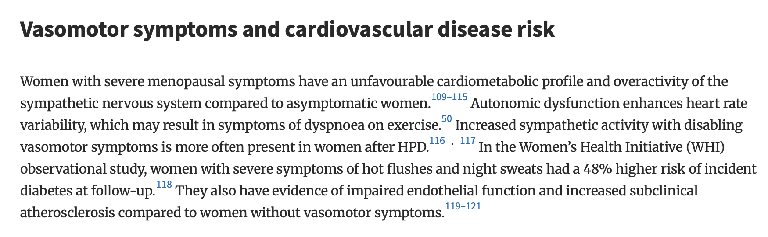
Conséquences cardiovasculaires des BDC

Slide 37

Is a hot flush trivial ??
Increasing amount of studies show that ↑ HF //
  ↑ Cardio vascular disease (CVD)
  The strongest predictor of underlying CVD are early flushers/ superflushers
  ↑ other precursors v CVD
    Abnormal endothelial function
    ↑ coronary / Aorta calcification = arteriosclerosis
    ↑ carotid intima media thickness
    ↑ central obesity – high BMI
    ↑ hypertension
    ↑LDL cholesterol - Triglycerides
    ↑ insulin resistance - (pre)diabetes
    ↑orthosympatic activity
    ↑ hypothalamic – hypophyse- adrenal axis : ↑cortisol
    ↑inflammation - cytokines
Notes:
VMS are among the strongest predictors of subclinical CVD
VMS are associated with a more adverse CVD risk profile
Endotheeldysfunctie: endotheel: 3 lagen: buitenste BW/middenste gl spierweefsel/ binnenste 1 laag endotheel
Endotheel : behoud lage vasc tonus
bron v NO (!! VD, verminderd OX stress, inflamm, WBC adhesive, Plaatjes aggregatie en gl spiercelprolif
endotheline, prostacycline (ox stress mediatoren)
Endotheeldysfunctie agv: verminderde NO(!!), meer ox stress, AHT, inflamm, obesitas, tabak
gevolg: dalen flow mediated dilatation: behouden v flow dmv VD/VC
is belangrijke voorloper v arteriosclerose ontwikkeling: onder beschadigd endotheel nestelen zich LDL+ WBC→ ox/inflamm → plaque
IMT (intima media thickness): meting v binnenste/middenste lag carotis: ! Marker voor cor plaque en CVD !!

Slide 38

Conclusion
Please let’s not trivialize hot flushes !!.....
It’s not ”nothing”!!.

Slide 39
