Slide 1
BMS Course
21-22/03/25
Epidemiology of Menopause and menopause related complications
Serge Rozenberg,
CHU St Pierre Université libre de Bruxelles
Vrije Universiteit Brussel
Belgium
serge_rozenberg@stpierre-bru.be
serge.rozenberg@skynet.be

Slide 2
Conflict of interest & Disclosure
Conflicts of interest: nil
Disclosure SR
Research funding IRIS- King Baudouin Fondation, Vesale research Foundation, Amgen, MSD
Speakers bureau &/or Advisory Boards
Abbot, Pfizer, Will, Gedeon Richter, MSD, Amgen, UCB, Astellas

Slide 3
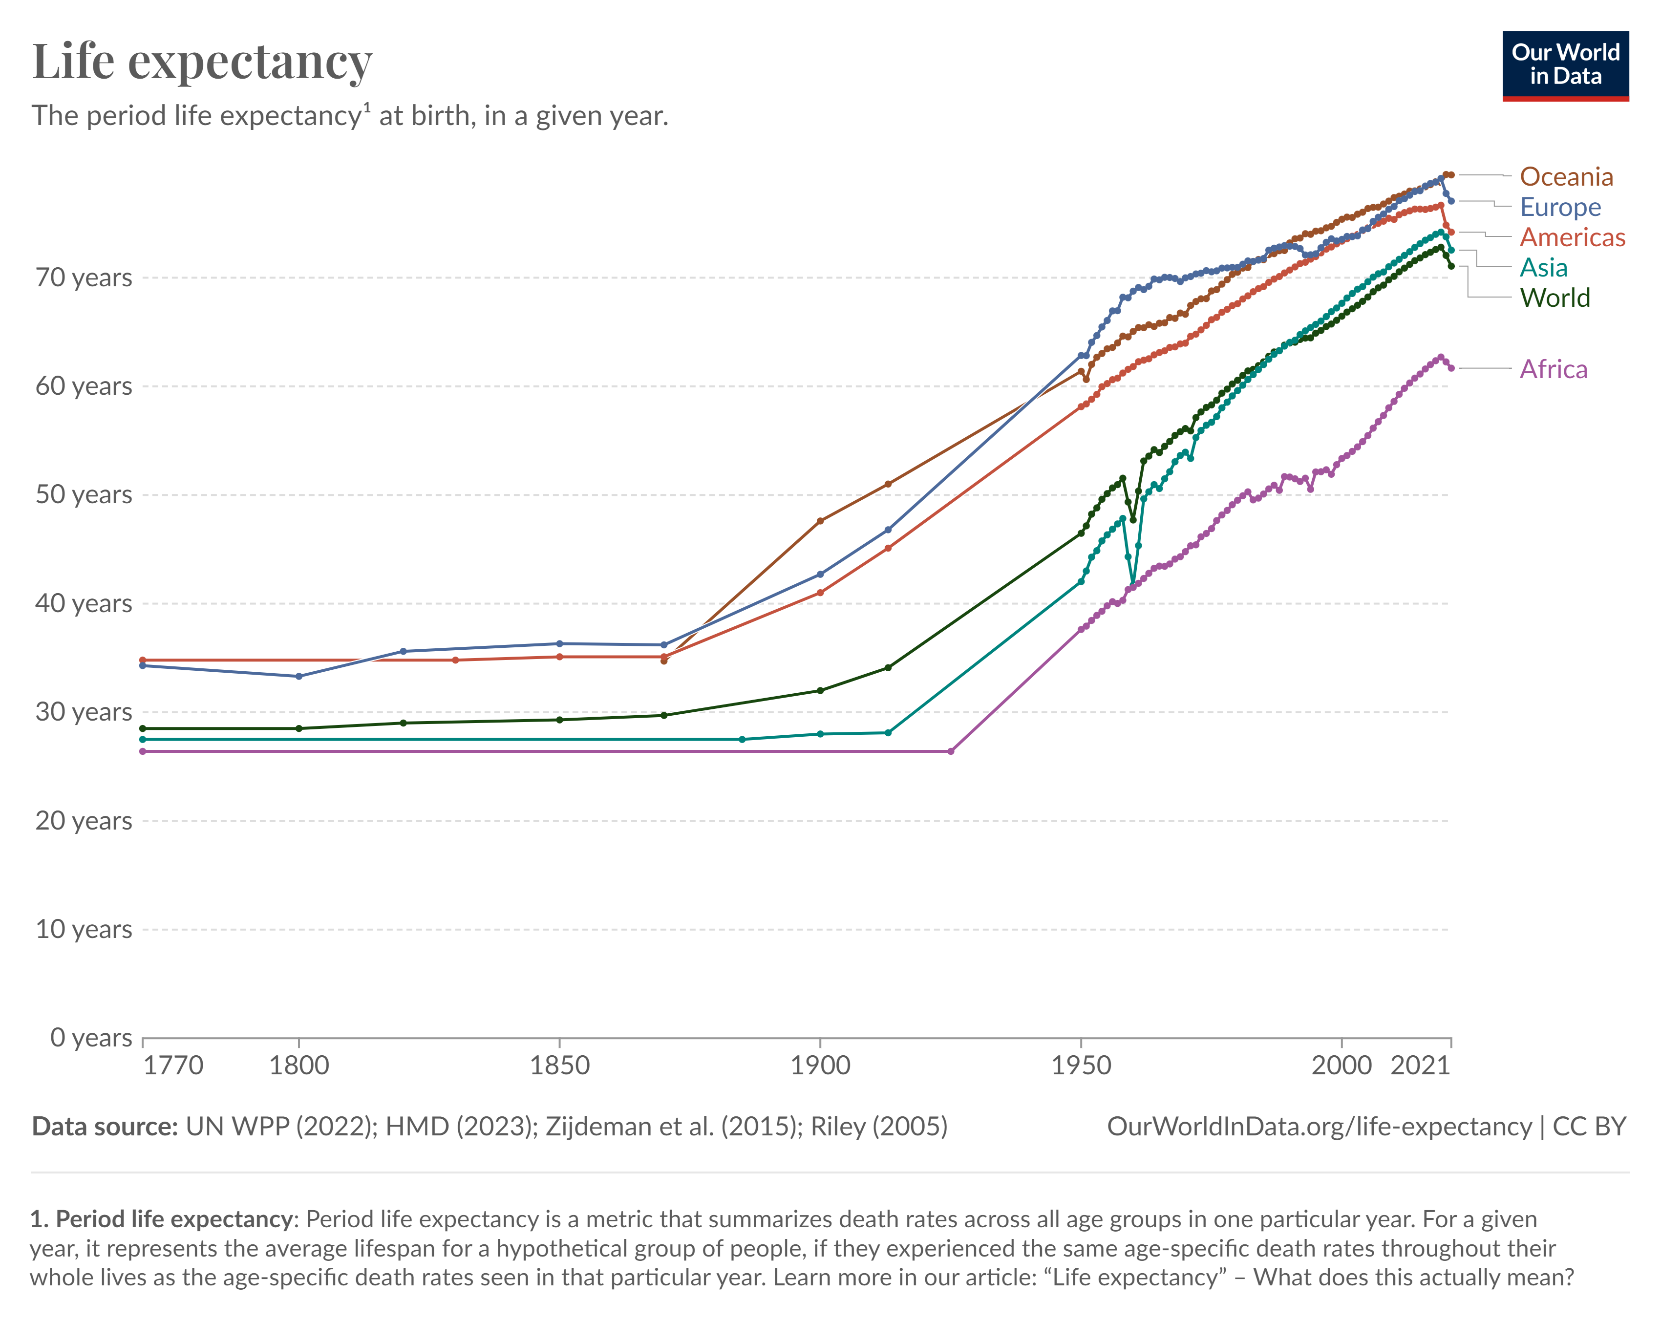
Average age = 51 Years

Slide 4
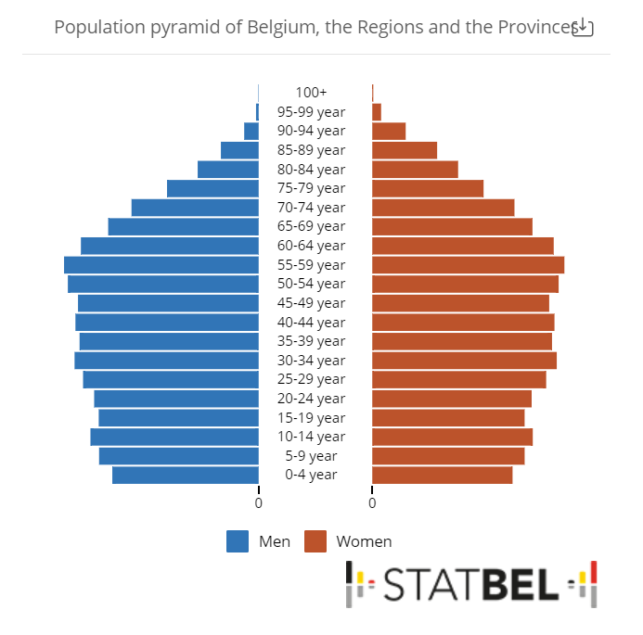
1.5 Million women aged 45-60 yrs

Slide 5

Definition and stages (Straw, reproduction, late reproduction, Perimenopause, Menopause, Postmenopause), related changes (Linda Ameryckx UZA
Physiology: Hormonal changes during menopause, the importance of KNDy, NKB signaling, Neurokinin and antagonists) (Axelle Pintiaux ULiège)

Slide 6
Menopause in the workplace: Challenges, impact, and next steps
Women experiencing severe menopause symptoms report more often adverse work outcomes, absenteeism, quitting, retiring early, or declining promotions than women experiencing few symptoms.
Lack of awareness about menopause, inflexible work conditions, and high-stress jobs can exacerbate the severity of these symptoms.
Unaddressed menopause symptoms contribute to economic costs, lost work productivity, resulting in a substantial economic burden.
Safwan et al. Maturitas. 2024

Slide 7
Global cross-sectional survey of women with vasomotor symptoms associated with menopause: prevalence and quality of life burden.
Prevalence of moderate-to-severe VMS
  Europe : 40%
  US 34%,
  Japan 16%
Which symptoms
  Tired or worn out (75%)
  Aching muscles & joints (60-70%)
  Sleeping difficulty (60%-70%)
  Hot flashes (60Europe 67%, US 68%, Japan 62%).
  Weight gain.
  Impact on daily & working activities
Nappi, et al Menopause. 2021;28(8):875. Epub 2021 May 24.

Slide 8
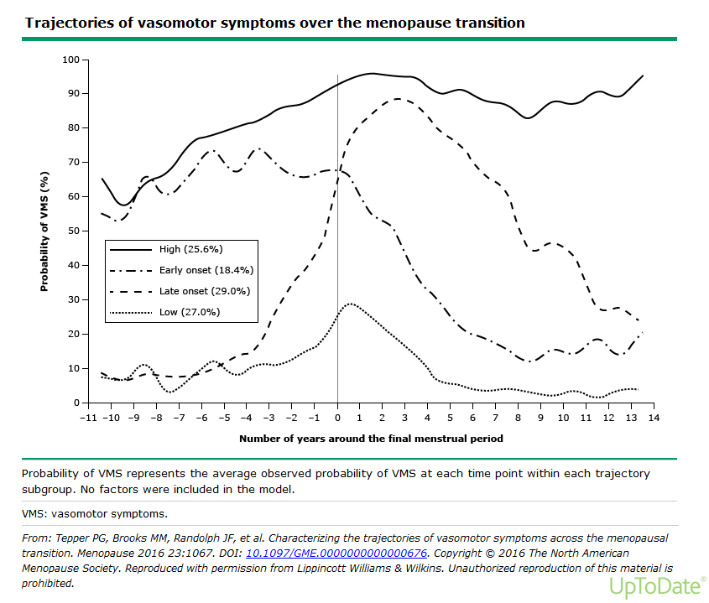

Slide 9
Hot flashes, night sweats, and sleep disturbances: differential diagnosis and measurements (Anne Firquet ULiège)

Slide 10
MHT
Pharmacology and Regimens (Anne Firquet ULiège)

Slide 11
VERTEBRAL FRACTURES
Most common osteoporotic fractures.
8-fold increase in age-adjusted mortality.
A 50-year-old white woman: 16-25% lifetime risk of experiencing a vertebral fracture
Under-diagnosed in 30-45%
https://www.osteoporosis.foundation/facts-statistics/epidemiology-of-osteoporosis-and-fragility-fractures

Slide 12
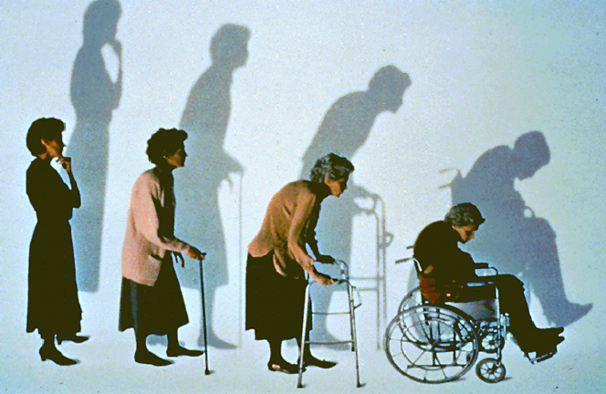
Kyphosis
Loss of height
Bulging abdomen
Acute and chronic pain
Breathing difficulties, reflux and other GI symptoms

Slide 13
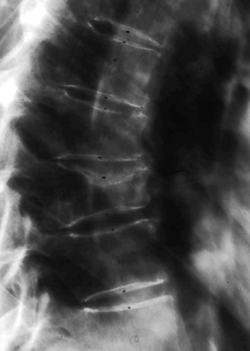
Vertebral Fractures Substantially Increase the Risk of New Fragility Fractures
Women with vertebral fractures have a 5-fold increased risk of a new vertebral fracture and a 2-fold increased risk of hip fracture
Black et al., J Bone Miner Res 1999
Melton et al, Osteoporos Int 1999
One woman in five will suffer from another vertebral fracture within a year
Lindsay et al., JAMA, 2001

Slide 14
Hip fracture
Lifetime probability of women at the age of 50 years is 15.0% (varies by country: 7.0 - 25.1%)
Nearly 75% occur in women.
Reported mortality rates up to 20-24% in the first year after a hip fracture.
40% unable to walk independently, 60% requiring assistance a year later.
https://www.osteoporosis.foundation/facts-statistics/epidemiology-of-osteoporosis-and-fragility-fractures

Slide 15
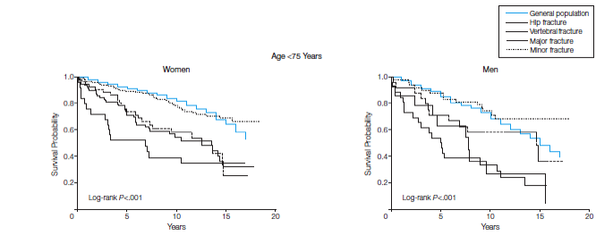
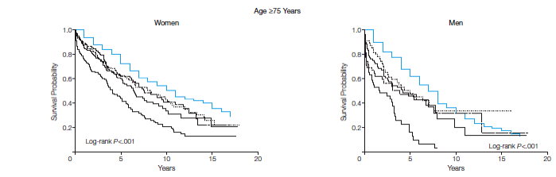
Survival curves according to type of fracture
From Bliuc D et al, JAMA 2009
Notes:
There is also an increased mortality that is due to vertebral fractures as is illustrated on these Kaplan Meyer survival curves. Although hip fracture patients have the lowest survival, patients suffering from other major osteoporotic factures and from vertebral fractures have also a reduced survival in both women and men independently of their age.

Slide 16
Survival probability decreases with the presence, number and severity of vertebral fractures
The mortality rate 1-year post-fracture is ~18% for patients with a VFx¹
VFx status²
Number of prevalent VFxs²
Severity of prevalent VFxs²
1.00
1.00
1.00
0.75
0.75
0.75
0.50
0.50
0.50
Survival probability
Survival probability
Survival probability
0.25
Fracture status
No fracture
Has fracture
0.25
No. of fractures
No fracture
1
2
≥3
0.25
Fracture severity
No fracture
Moderate
Severe
0.00
0
5
10
15
0.00
0
5
10
15
0.00
0
5
10
15
Years of follow-up
Years of follow-up
Years of follow-up
Figures adapted from Johansson J, et al. 2023.
Notes:
Objective: To visualise how a VFx influences mortality risk over time
Communication points (plus additional points):
VFx is associated with a greater all-time mortality risk
Prevention of subsequent fracture may improve the prognosis of patients with an osteoporotic VFx
VFx, vertebral fracture.
Reference:
Ikeda Y, et al. J Orthop Surg (Hong Kong). 2010;18(2):148–152.

Slide 17
Extended-interval dosing for zoledronic acid in postmenopausal women with low bone mass (February 2025)
In postmenopausal women with low bone mass, zoledronic acid administered every one to two years increases bone mineral density. The clinical efficacy of a longer dosing interval was evaluated in a 10-year trial of zoledronic acid (5 mg IV once at baseline only or once at baseline and again at five years) versus placebo in 1054 early postmenopausal women (mean age 56 years) with T-scores >-2.5 and <0.0 [1]. Participants who received one or two doses of zoledronic acid had a lower incidence of morphometric vertebral fracture compared with those who received placebo. Both zoledronic acid regimens also reduced risk of major osteoporotic fracture. Extended dosing intervals for zoledronic acid may help reduce treatment burden for postmenopausal women who opt for pharmacotherapy to prevent osteoporosis

Slide 18
Osteoporosis risk (Olivier Bruyère ULG)
Osteoporosis treatment (Charlotte Verroken UGent)

Slide 19
Age of menopause
5% < 45 (early)
< 40 = Ovarian Insufficiency

Slide 20
Risk factors for POI and early menopause
Genetics : family history of early mеոοpаսѕe
The fragile X messenger ribonucleoprotein 1 (FMR1) premutation up to 7 years.
Ethnicity (earlier among Hispanic ԝomen)
Night shift work
Smoking one to two years earlier than average.
Hysterectomy with ovarian conservation
Uptodate

Slide 21
9-9:30 Fertility issues in Premature Ovarian Insufficiency Asma Sassi

Slide 22
Increased Morbi-mortality of early menopause

Slide 23
Early menopause & CVD meta-analysis
Menopause before age 45 have a 50% higher risk of coronary heart disease, cardiovascular mortality, and overall mortality compared with women who experienced menopause after age 50
T. Muka, et al.Association of age at onset of menopause and time since onset of menopause with cardiovascular outcomes, intermediate vascular traits, and all-cause mortality: a systematic review and meta-analysis JAMA Cardiol (2016)

Slide 24
Premature Ovarian Insufficiency (< 40 years),
“Untreated POI is associated with reduced life expectancy, largely due to cardiovascular disease
“Despite lack of longitudinal outcome data, hormone replacement therapy (HRT) with early initiation is strongly recommended in women with POI to control future risk of cardiovascular disease; it should be continued at least until the average age of natural menopause”.
(Grade C recommendation of ESHRE).

Slide 25
Osteoporosis
Evaluate risk factors
Measure BMD (use Z-score)
Frax is not validated in POI

Slide 26
POI & osteoporosis prevention
Physiologic HRT was superior to OCPs in protecting and improving BMD
HRT (100–150 μg/d transdermal E₂ plus cyclic progestin)
Paucity of data on fractures in POI
B. Cartwright et al J Clin Endocrinol Metab, 101 (2016), pp. 3497–3505

Slide 27
Early or premature menopause: Causes and management (Axelle Pintaiux ULG)
Natural vs. Induced Menopause (Surgical or Chemotherapy-related) Daphné ‘T Kint de Roodenbeeke (ULB)

Slide 28
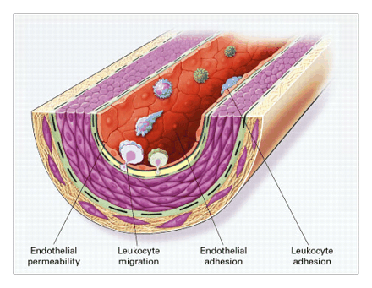
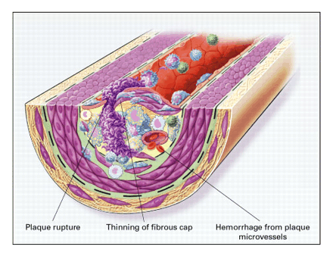
Atherosclerosis¹
Cardiovascular risk, menopause and MHT Shivalkar Bharati
Ross. N Engl J Med 1999; 340:115-126
Notes:
28

Slide 29
Increased risk of cognitive impairment or dementia in women who underwent oophorectomy before menopause
Women with uni- (n=813) or bilateral (n=676) oophorectomy before the onset of menopause for a non-cancer, matched by age not undergone oophorectomy (n=1,472).
Unilateral or bilateral oophorectomy increased risk of cognitive impairment or dementia compared to referent women HR = 1.46; 95% CI 1.13- 1.90; adjusted for education, type of interview, and history of depression).
The risk increased with younger age at oophorectomy (p < 0.0001).
Rocca et al Neurology 2007

Slide 30
Increased risk of parkinsonism in women who underwent oophorectomy before menopause
1,252 women with unilateral oophorectomy,
1,075 women with bilateral oophorectomy, and 2,368 referent women.
Unilateral or bilateral oophorectomy before the onset of menopause had an increased risk of parkinsonism compared with referent women (HR 1.68; 95% CI 1.06 to 2.67; p = 0.03), and the risk increased with younger age at oophorectomy (test for linear trend; p = 0.01).
Rocca et al Neurology 2008

Slide 31
Mood changes, depression and memory concerns (Herman Depypere (UGent)
 | Evaluation and Prevention and treatment of Neurocognitive disorders Joachim Schulz (ULB)

Slide 32
Age of menopause
5% > after 55 Years (late)
  Risk factor for Endometrial & breast cancer

Slide 33
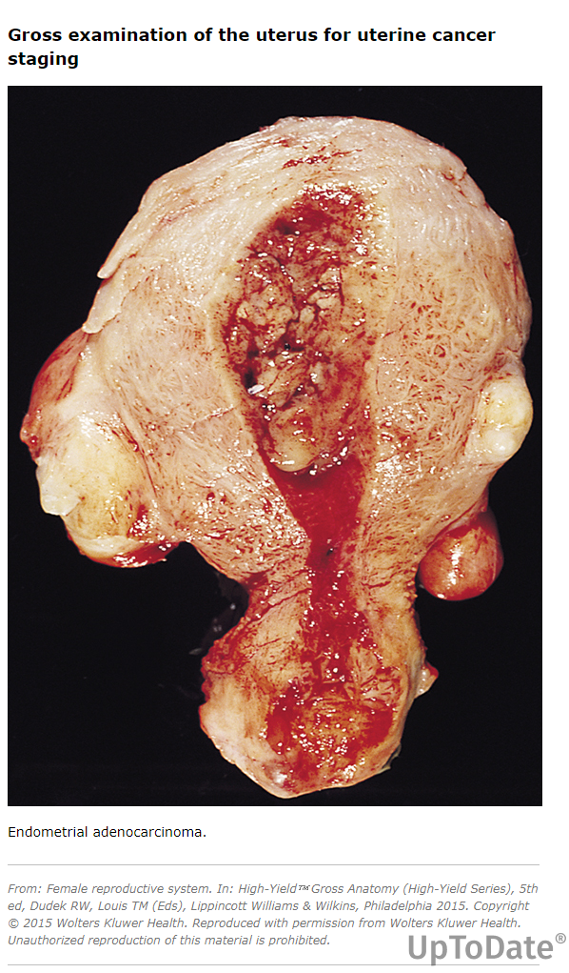

Slide 34
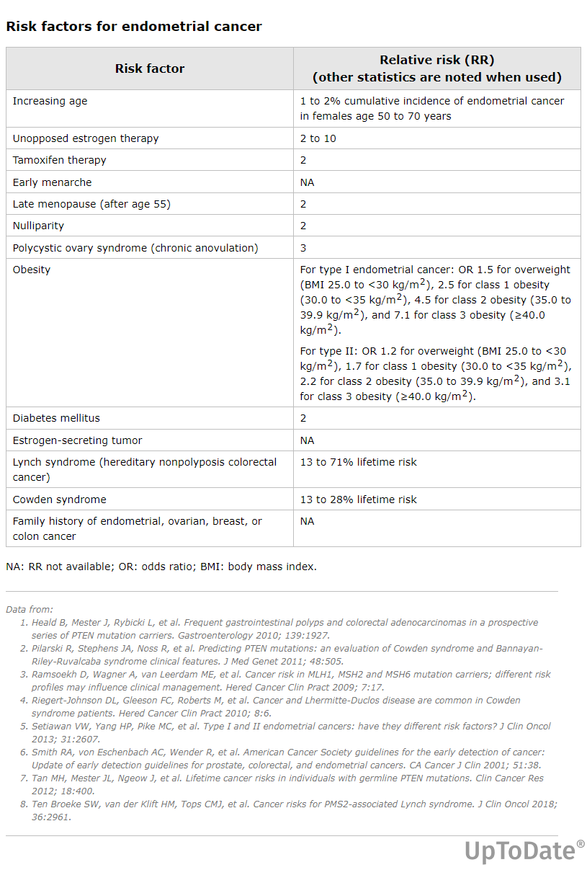
Menopause > 55
RR = 2

Slide 35
MHT related complications
Indications of MHT, benefits & Managing Complications /Side Effects (Eveline Markowicz Brussels)
Potential risks, Contra-indications & Monitoring and Assessment of MHT Efficacy and Safety (Linda Ameryckx UZA)

Slide 36
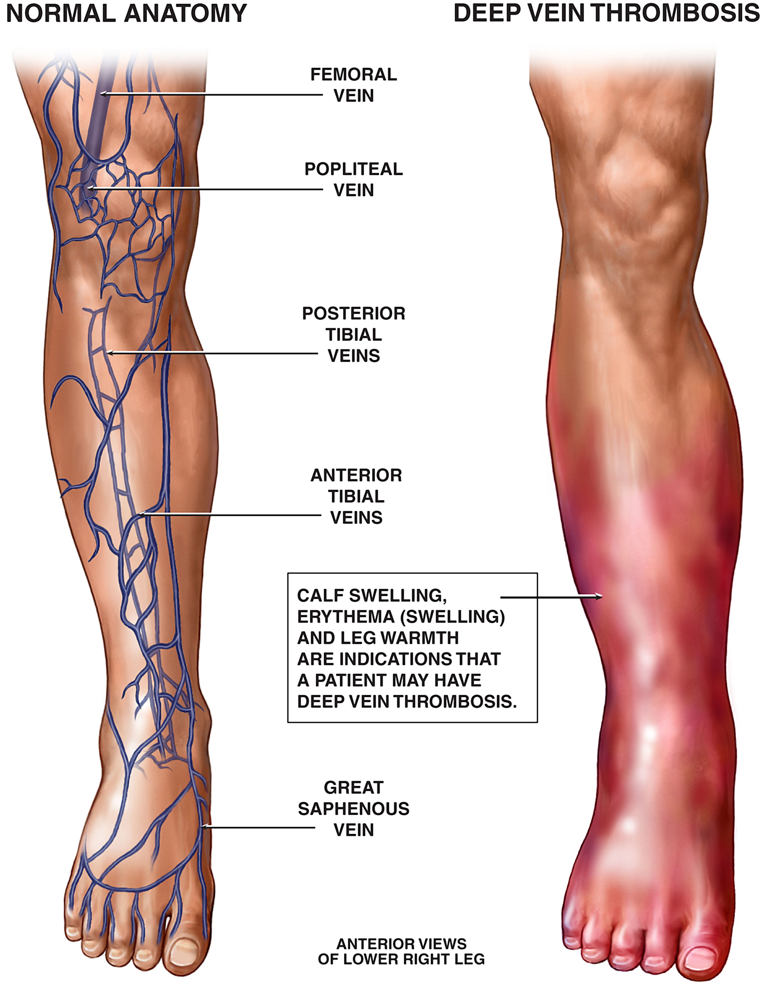
MHT related complications
Revisiting Hormonal Treatments and Thrombosis Risks: New Insights and Perspectives (Cidric Hermans UCL)

Slide 37
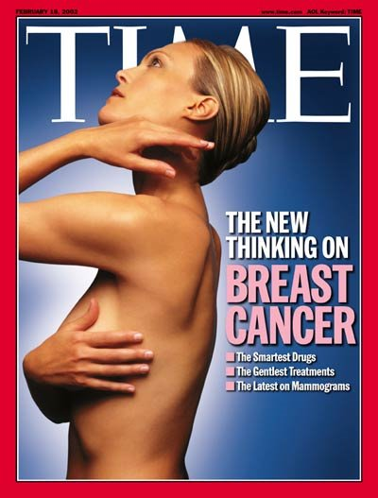

Slide 38
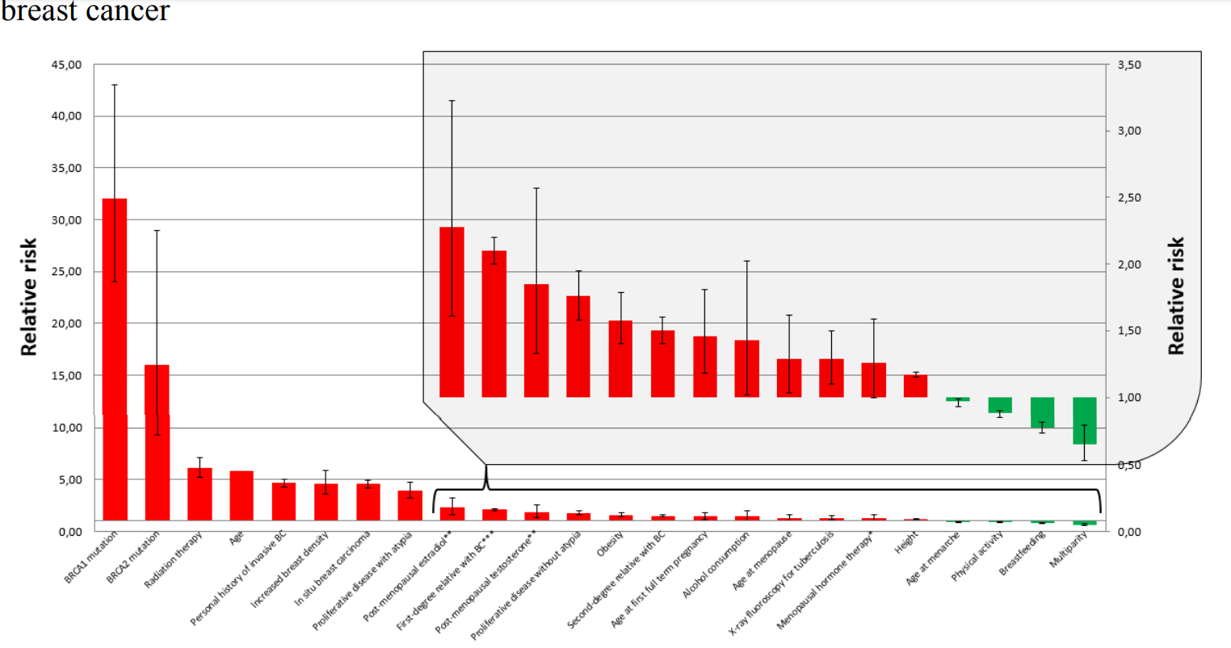
Thesis C Antoine
2018

Slide 39
Perspective Menopause Management —
Getting Clinical Care Back on Track
JE Manson, AM Kaunitz N Engl J Med March 3, 2016

Slide 40
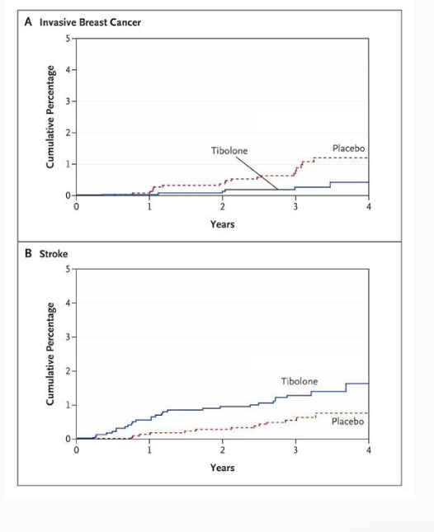
The Effects of Tibolone in Older Postmenopausal Women
Cumulative Percentages of Patients with Breast Cancer and Stroke.
At 4 years, therapy with tibolone was associated with a decrease in the risk of invasive breast cancer (relative hazard, 0.32; 95% CI, 0.13 to 0.80; P=0.02) (Panel A) but with an increase in the risk of stroke (relative hazard, 2.19; 95% CI, 1.14 to 4.23; P=0.02) (Panel B).
Cummings et al NEJM 2008

Slide 41
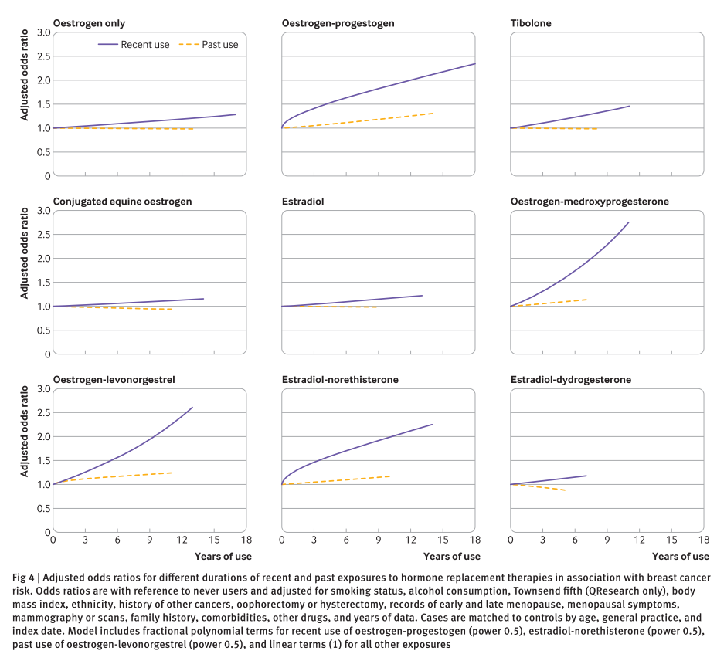
Vinogradova et al BMJ 2020;371:m3873

Slide 42
Breast health during menopause Patrick Neven (KUL)
Breast cancer risk assessment (Herman Depypere Ugent)

Slide 43
Lifestyle changes, herbal remedies and Non-Hormonal treatments: SSRIs, GABA, …
Axelle Pintiaux (ULiège)
A New paradigm: NK3 and NK1,3 antagonists Serge Rozenberg (ULB)

Slide 44

GSM
VVA affects up to 70% of women after the menopause

Slide 45
GSM
Vaginal dryness and urinary symptoms (Genitourinary syndrome) : differential diagnosis and measurements (Aurélie Joris ULB
Urinary incontinence and pelvic floor health (Silke Vasseur VUB)
Hands-on practice of pelvic floor exercises and demonstration of treatment options (vaginal creams, pessaries). Elise MAes (VUB)
Vulvovaginal atrophy & Genito Urinary Syndrome: Treatments Serge Rozenberg (ULB)

Slide 46
Ready for a menopause consultation ?
How to manage a menopause consultation : (Eveline Markowicz, Delta Brussels)

Slide 47
Take home messages
Most women are likely to spend 1/3 of their life after menopause
Up to 40% of them will suffer moderate –severe VMS
Many can be helped using MHT
Others using other therapies, such as NK3 antagonists
25% will suffer from osteoporosis
MHT decreases bone loss, but other osteoporosis therapy should be used later
Our goal is to help all our patients !

Slide 48
Notes:
48

