Slide 1
BMS Course
21-22/03/25
VVA treatment
Serge Rozenberg,
CHU St Pierre Université libre de Bruxelles
Vrije Universiteit Brussel
Belgium
serge_rozenberg@stpierre-bru.be
serge.rozenberg@skynet.be

Slide 2
Conflict of interest & Disclosure
Conflicts of interest: nil
Disclosure SR
Research funding IRIS- King Baudouin Fondation, Vesale research Foundation, Amgen, MSD
Speakers bureau &/or Advisory Boards
Abbot, Pfizer, Will, Gedeon Richter, MSD, Amgen, UCB, Astellas

Slide 3
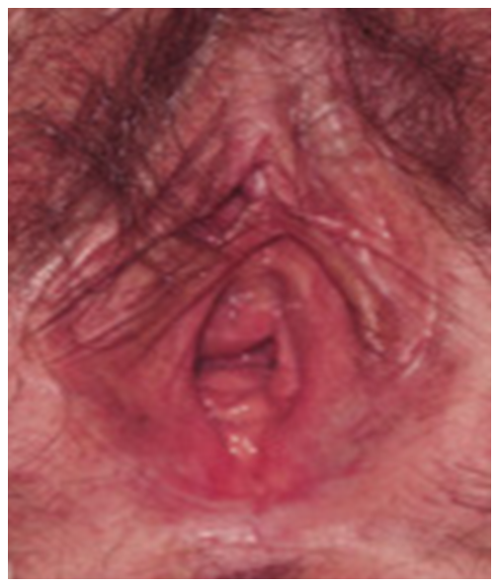

Slide 4
Agenda
Avoid risk factors
Correct etiological factor
Vaginal estrogen therapy
Dehydroepiandrosterone (prasterone)
Ospemifene
Testosterone
Therapies needing further evaluation
Breast cancer survivors ?

Slide 5
Risk factors
Vaginal nulliparity
Vaginal surgery
Abstinence from sexual activity
Cigarette smoking
Patients with depression
Urinary incontinence
Castelo-Branco C, Maturitas. 2005

Slide 6
INITIAL THERAPY WITH MOISTURIZERS AND LUBRICANTS
1st line : vaginal moisturizers and lubricants.
These agents may improve coital comfort and increase vaginal moisture, but they do not reverse most atrophic vaginal changes.
Thus, many patients will require hormonal medications
Edwards D, et al Climacteric. 2016

Slide 7
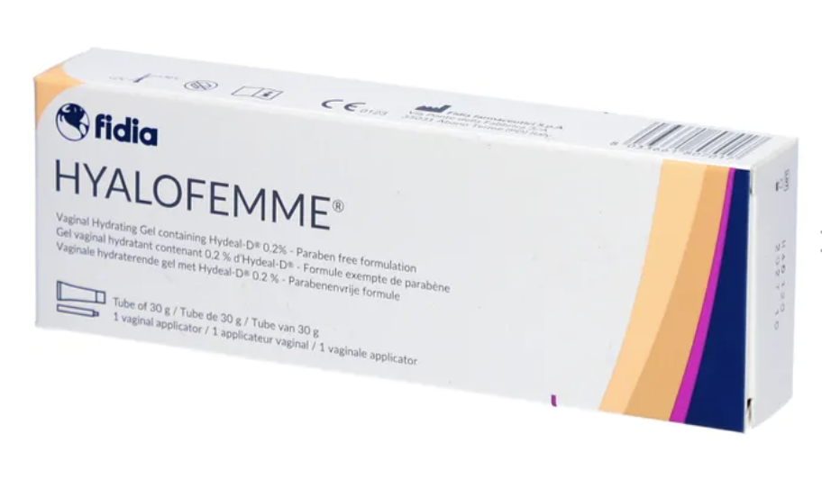

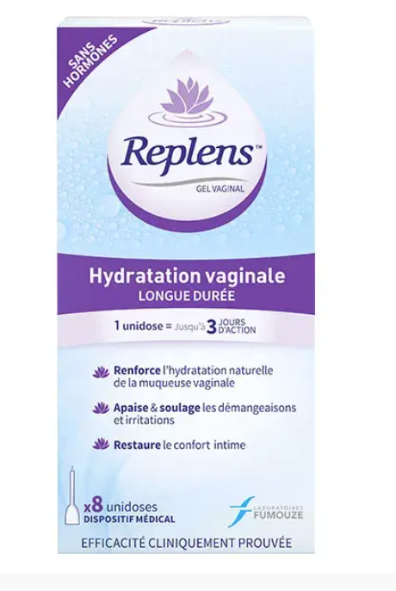

Vaginal moisturizers
Intended for use routinely (2-3/w) not just during sexual activity.

Slide 8
Role of pelvic floor muscle exercises
1st-line therapy may also include pelvic floor muscle (Kegel) exercises.
These can be taught to the patient during the clinic visit and are discussed in detail separately.

Slide 9
CLINICAL APPROACH
  Prior to initiating treatment for vaginal atrophy, other conditions should be excluded, in particular:
  Patients with postmenopausal bleeding should be evaluated for endometrial hyperplasia or cancer.
  Patients with urinary tract symptoms should be evaluated for urinary tract infection or other conditions (interstitial cystitis, urinary tract malignancy), as appropriate.
  Bachmann et al Uptodate 2024 ,

Slide 10
Vaginal estrogen therapy
Most effective treatment for moderate to severe symptoms of vaginal atrophy not responsive to nonhormonal intervention.
Appropriate for patients with symptoms of vaginal atrophy in the setting of low estrogen levels, provided that there are no contraindications to this therapy (eg, some patients with estrogen-dependent tumors, particularly those on antiestrogen therapy).
Restores normal vaginal acidic pH and microflora, thickens epithelium, increases vaginal secretions, and decreases vaginal dryness and dyspareunia.
Associated with urinary tract benefits (reduction of urinary tract infections and urgency).
Adverse effects : uncommon
Suckling J, et al . Local oestrogen for vaginal atrophy in postmenopausal women. Cochrane Database Rev. 2016 Aug 31;(8):CD001500. doi: 10.1002/14651858.CD001500.pub3. PMID: 17054136.

Slide 11
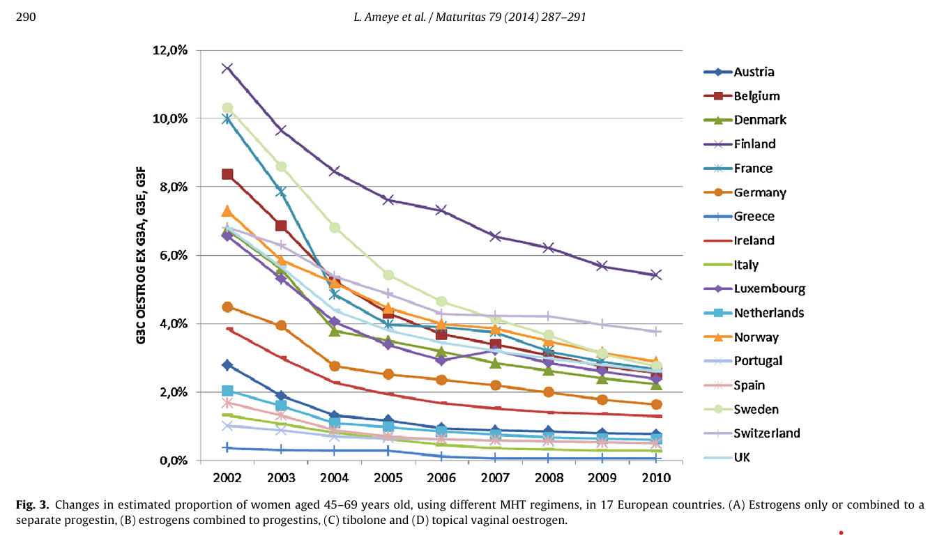

Slide 12
CLINICAL PRESENTATION
By definition, GSM are symptomatic, but not all patients with atrophic changes are symptomatic.
Up to 70% with symptoms do not discuss their condition
  Aging, cultural, religious, societal beliefs, embarrassment, not aware of treatment options
  stop sexual activity

Slide 13
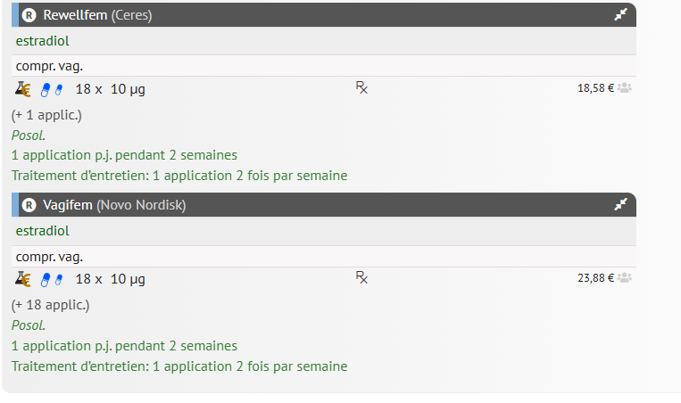

Slide 14
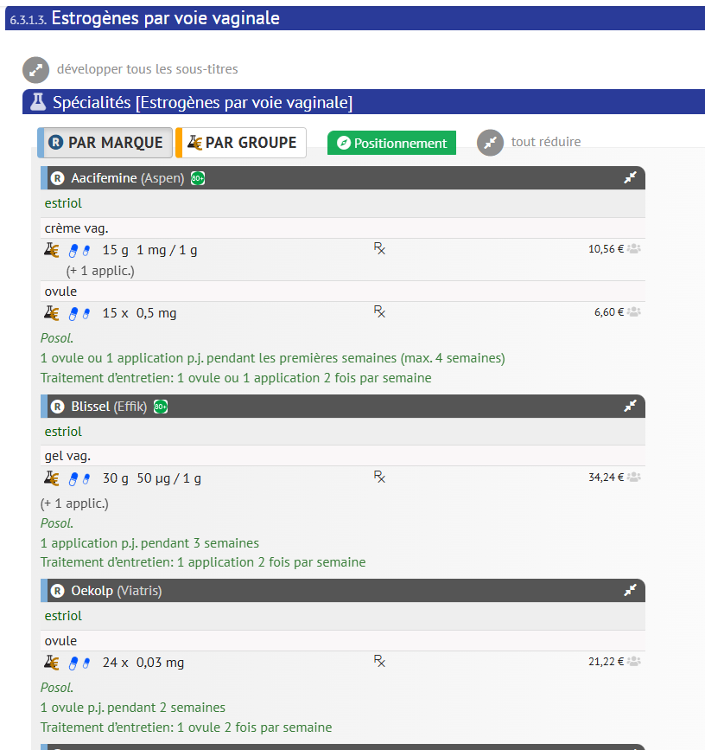

Slide 15


Slide 16


Slide 17
Estriol vaginal cream and suppositories
Estriol is the 16-hydroxylated metabolite of estradiol.
In vulvar and vaginal tissues, estriol is a weak estrogen agonist.

Slide 18
Impact of vaginal estriol on serum hormone levels: a systematic review.
No alterations in serum E1, E2, testosterone, progesterone, SHBG levels after vaginal E3 application.
The lack of clinically relevant long-term changes in serum sex hormone levels supports the current literature providing evidence about the safety of vaginal E3 products.
Kolokythas A, et al Climacteric. 2024 Apr;27(2):137-153.

Slide 19
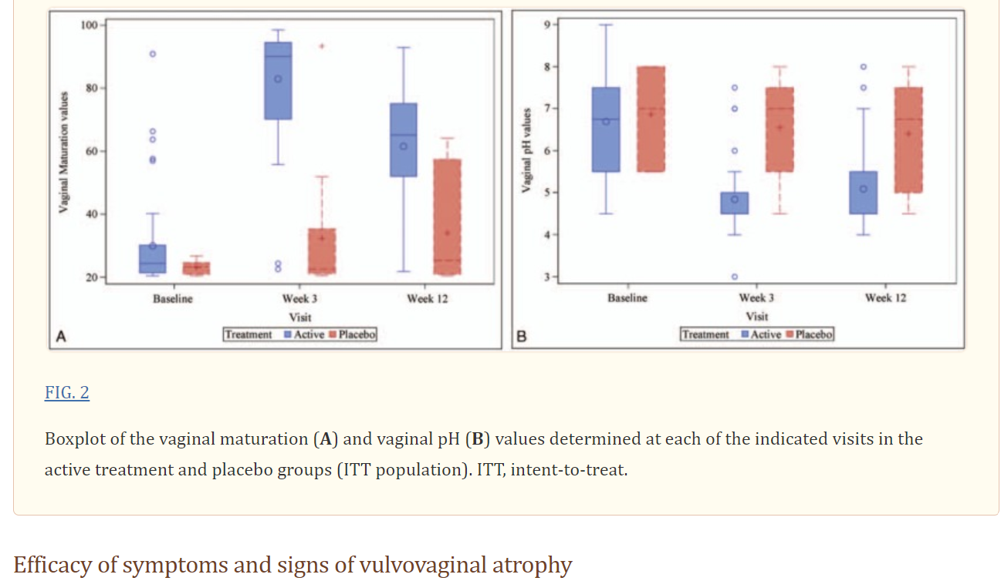
Efficacy and safety of ultra-low dose 0.005% estriol vaginal gel for the treatment of VVA in
postmenopausal women with early breast cancer with AI : a phase II RCT.
Hirschberg et al Menopause. 2020 May;27(5):526-534.

Slide 20
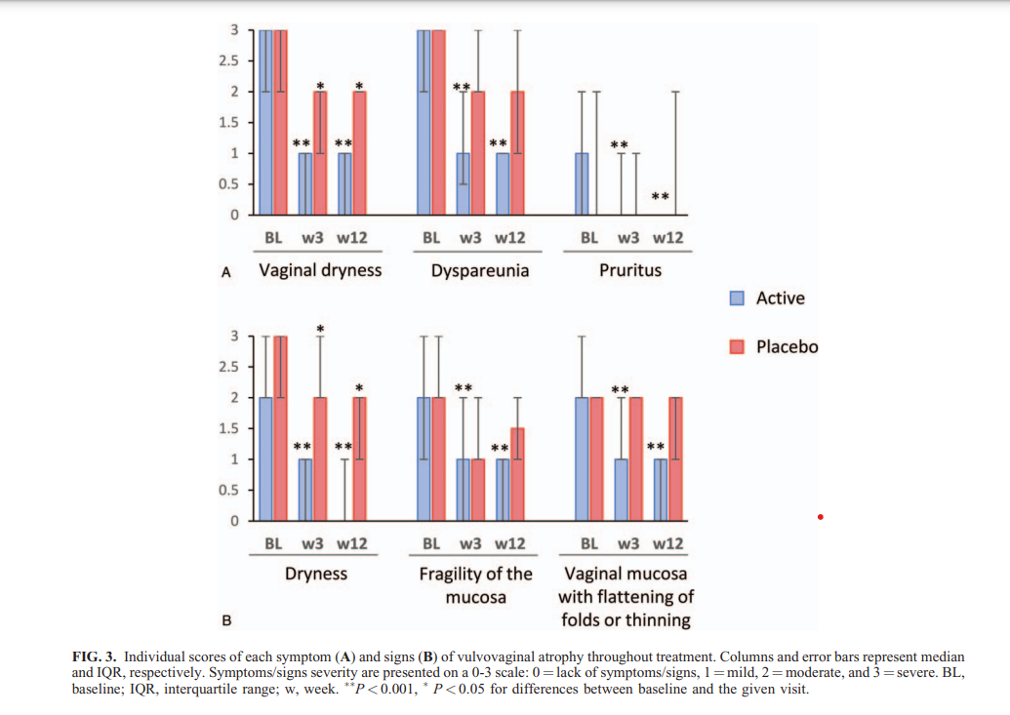
Hirschberg et al Menopause. 2020 May;27(5):526-534

Slide 21
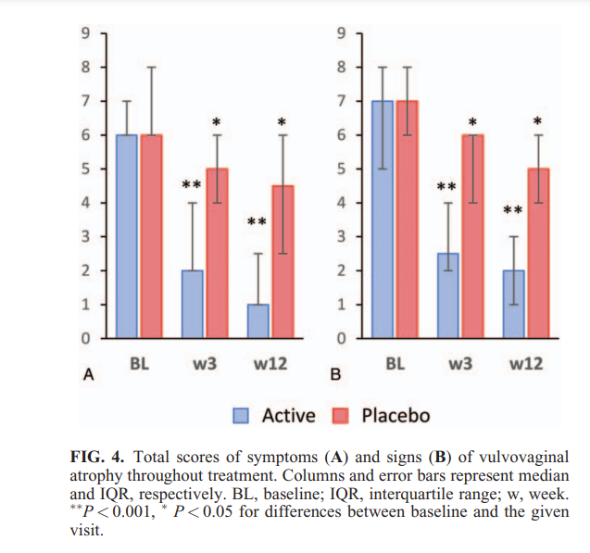
Hirschberg et al Menopause. 2020 May;27(5):526-534

Slide 22
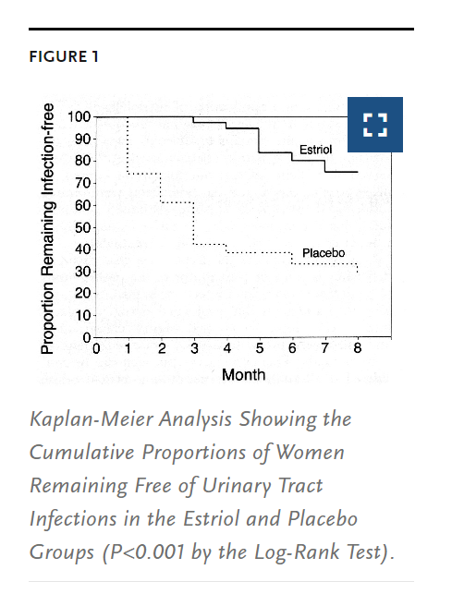
Raz R, Stamm WE.
A controlled trial of intravaginal estriol
in postmenopausal women with
recurrent urinary tract infections.
N Engl J Med. 1993 Sep 9;329(11):753-6

Slide 23
The efficacy and safety of estriol to treat vulvovaginal atrophy in postmenopausal women: a systematic literature review
188 studies, 22 of which met the inclusion criteria;
13 were controlled clinical trials and nine were quasi-experimental, and 1217 women were included.
These studies confirmed the efficacy of local estrogens to treat symptoms of vulvovaginal atrophy with few adverse effects reported.
Following treatment, serum estriol levels rose, peaking at 1 h. At the 6-month follow-up, there was no increase in serum estriol in treated women.
Conclusions: The available evidence (of low and moderate quality) shows that, when administered vaginally, estriol preparations appear to be safe for women who have risk factors related to systemic estrogen therapy.
Rueda C, et al Climacteric. 2017 Aug;20(4):321-330.

Slide 24
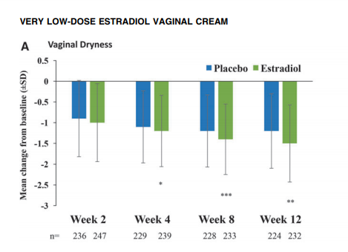
A Randomized, Multicenter, Double-Blind, Study to Evaluate the Safety and Efficacy of Estradiol Vaginal Cream 0.003% in Postmenopausal Women with Vaginal Dryness as the Most Bothersome Symptom
Archer et al JOURNAL OF WOMEN’S HEALTH Volume 27, Number 3, 2018

Slide 25
Use of an opposing progestogen ?
Not indicated
Previously estradiol 25 mcg (Vagifem) -> 10 mcg
Estradiol insert (Vagifem), a prospective study evaluated daily use for two weeks then twice weekly for 52 weeks
386 patients biopsy after 52 weeks therapy:
1 complex hyperplasia without atypia (exposed to the drug for only nine days, suggesting a preexisting abnormality)
1 endometrioid adenocarcinoma (preexisting disease could not be excluded because the pretreatment biopsy sample was inadequate for analysis).
Previous study supported the endometrial safety of the 25 mcg estradiol vaginal insert, which has been discontinued.
Simon J, et al Obstet Gynecol. 2010 Oct;116(4):876-883. ; Weisberg E, et al Climacteric. 2005 Mar;8(1):83-92.

Slide 26
Response and duration of therapy
Improvement in symptoms after 2-4 weeks.
May be used indefinitely, based upon the low risk of adverse effects, but few data)
  No increased breast cancer and thrombosis risk
low-dose vaginal therapy may be added to systemic MHT in order to keep a low dose MHT.
Low-dose vaginal estrogen probably ineffective for osteoporosis.
Low compliance

Slide 27
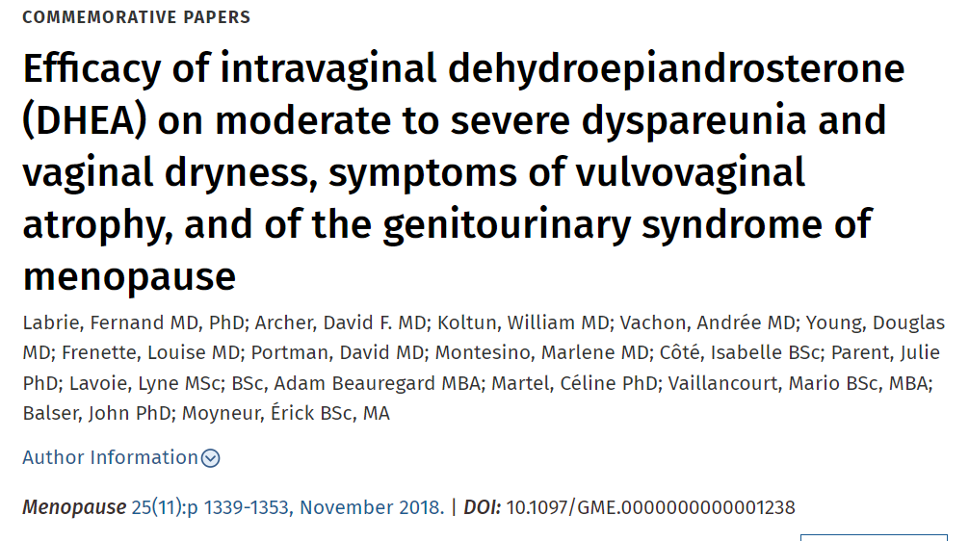

Slide 28
Effects of ospemifene on the female reproductive and urinary tracts: translation from preclinical models into clinical evidence.
…..ospemifene has ….favorable long-term profile for the relief of vulvar and vaginal atrophy compared with other estrogen receptor agonists/antagonists with no short-term concerns about endometrial safety…..
Archer et al Menopause. 2015 Jul;22(7):786-96.

Slide 29
Hormonal Treatments and Vaginal Moisturizers for Genitourinary Syndrome of Menopause : A Systematic Review
Variation in populations, interventions, comparators, and outcomes precluded meta-analysis.
Compared with placebo or no treatment, vaginal estrogen may improve vulvovaginal dryness, dyspareunia, most bothersome symptom, and treatment satisfaction.
Compared with placebo, vaginal dehydroepiandrosterone (DHEA) may improve dryness, dyspareunia, and distress, bother, or interference from genitourinary symptoms;
oral ospemifene may improve dryness, dyspareunia, and treatment satisfaction; and vaginal moisturizers may improve dryness (all low COE).
Vaginal testosterone, systemic DHEA, vaginal oxytocin, and oral raloxifene or bazedoxifene may provide no benefit (low COE) or had uncertain effects (very low COE).
Danan ER, et al Ann Intern Med. 2024 Oct;177(10):1400-1414. doi: 10.7326/ANNALS-24-00610. Epub 2024 Sep 10. PMID: 39250810.

Slide 30
Testosterone
Androgen receptors in vaginal tissueMay stimulate vaginal mucosa and improve symptoms of vaginal atrophy .
Not approved for use in females.
Indication Low libido?
GSM in patients on AI therapy, but the safety is uncertain. and an inverse correlation with age.
Small series
Gloria Bachmann, MD, MMS
JoAnn V Pinkerton, MD, FACOG, MSCP
Uptodate 2025

Slide 31
Therapies needing further evaluation
Laser or radiofrequency devices — Laser and other energy-based devices (eg, fractional microablative CO₂ laser, erbium:YAG [Er:YAG] laser, temperature-controlled radiofrequency [RF] laser) have been marketed for treatment of VVA, but there are limited data regarding the safety and efficacy of these devices.
FDA issued a safety communication warning !
Gloria Bachmann, MD, MMS
JoAnn V Pinkerton, MD, FACOG, MSCP
Uptodate 2025

Slide 32
RCT with negative results
Li FG, et al Vaginal epithelial histology before and after fractional CO₂ laser in postmenopausal women: a double-blind, sham-controlled randomized trial. Am J Obstet Gynecol. 2023 Sep;229(3):278.e1-278.e9.
Li FG, et al Effect of Fractional Carbon Dioxide Laser vs Sham Treatment on Symptom Severity in Women With Postmenopausal Vaginal Symptoms: A Randomized Clinical Trial. JAMA. 2021 Oct 12;326(14):1381-1389.
Mension E, et al Effect of Fractional Carbon Dioxide vs Sham Laser on Sexual Function in Survivors of Breast Cancer Receiving Aromatase Inhibitors for Genitourinary Syndrome of Menopause: The LIGHT Randomized Clinical Trial. JAMA Netw Open. 2023 Feb 1;6(2):e2255697.
Joris A, et al Randomized trial: treatment of genitourinary syndrome of menopause using radiofrequency. Climacteric. 2024 Apr;27(2):210-214.

Slide 33

Through the eyes of an amazone
Thursday 30 September – 10:00 to 14:00
Marie Mandy

Slide 34
Increased menopausal (sexual) symptoms in BR CA survivors
Disease
estrogen
deprivation
Stress due
to diagnosis
Interaction couple
Depression
Feminity image

Slide 35
Survey among breast cancer survivors
Current users of aromatase inhibitors
  significant increases ( + X 2)
  - sexual disorders (65%)
  - unsatisfactory sexual life (55%)
  - vaginal dryness (88%)
  - decreased libido (84 %)
Antoine et al Climacteric 2008
Notes:
48

Slide 36
Vaginal estrogen use in breast cancer survivors: a systematic review and meta-analysis of recurrence and mortality risks
5522 articles -> 8 observational studies
No increased risk of breast cancer recurrence (6 articles, 24,060 patients, OR, 0.48; 95%CI : 0.23-0.98).
No increase in BRCA mortality (4 articles, 61,695 patients, OR: 0.60; 95%CI 0.18-1.95).
No increase overall mortality (5 articles 59,724, OR: 0.46; 95%CI 0.42-0.49).
Beste ME, et al Am J Obstet Gynecol. 2025 Mar;232(3):262-270.e1. doi: 10.1016/j.ajog.2024.10.054. Epub 2024 Nov 7. PMID: 39521301.

Slide 37
Effects of vaginal estrogen on serum estradiol during aromatase inhibitor therapy in breast cancer patients with vulvovaginal atrophy: a prospective trial
20 postmenopausal patients undergoing adjuvant letrozole therapy and experiencing VVA symptoms were treated with vaginal estradiol for 12 weeks.
Gynecologic examination and symptom screening were conducted at baseline and after 12 weeks.
Serum E2 levels were analyzed at baseline, and at two, four, eight, and 12 weeks.
E2 levels were measured using both a routine liquid chromatography-tandem mass spectrometry (LC–MS/MS) method and a highly sensitive (hsE2-MS) LC–MS/MS method.
Faltinová M, Breast Cancer Res Treat. 2024 Dec 27.

Slide 38
Safety of Vaginal Estrogen Therapy for Genitourinary Syndrome of Menopause in Women With a History of Breast Cancer
Cohort : U.S. health research network 2009 –2022 :
Women with breast cancer within 5 years before the initial genitourinary syndrome of menopause diagnosis.
Exclusion : active disease
Outcome : Recurrence within 3 months to 5 years after the initiation of vaginal estrogen therapy for GSM
Cases > vaginal estrogen prescriptions; Control cohort: women with breast cancer without any vaginal estrogen prescriptions after GSM.
Propensity matching was performed.
A subanalysis by positive estrogen receptor status, when available, was performed.
Agrawal et al Safety of Vaginal Estrogen Therapy for Genitourinary Syndrome of Menopause in Women With a History of Breast Cancer. Obstet Gynecol. 2023 Sep

Slide 39
Safety of Vaginal Estrogen Therapy for Genitourinary Syndrome of Menopause in Women With a History of Breast Cancer
42,113 women with a diagnosis of genitourinary syndrome of menopause after breast cancer diagnosis with any estrogen receptor status,
5.0% received vaginal estrogen.
Of the initial cohort, 10,584 patients had a history of positive estrogen receptor breast cancer, and 3.9% of this group received vaginal estrogen.
Risk of breast cancer recurrence using vaginal estrogen :(RRatio 1.03, 95% CI 0.91-1.18)
Positive estrogen receptor (RRatio 0.94, 95% CI 0.77-1.15)
CCL : No increased risk of breast cancer recurrence within 5 years in women with a personal history of breast cancer who were using vaginal estrogen for genitourinary syndrome of menopause.
Agrawal et al Safety of Vaginal Estrogen Therapy for Genitourinary Syndrome of Menopause in Women With a History of Breast Cancer. Obstet Gynecol. 2023 Sep

Slide 40
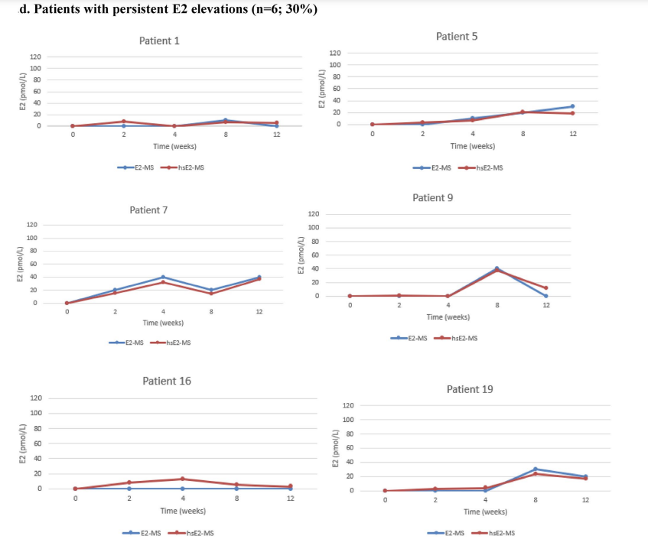
Effects of vaginal estrogen on serum estradiol during aromatase inhibitor therapy in breast cancer patients with vulvovaginal atrophy: a prospective trial
Faltinová M, Breast Cancer Res Treat. 2024 Dec 27.

Slide 41
Committee Opinion No. 659: The Use of Vaginal Estrogen in Women With a History of Estrogen-Dependent Breast Cancer.
….Nonhormonal approaches are the first-line choices for managing urogenital symptoms or atrophy-related urinary symptoms experienced by women during or after treatment for breast cancer.
….vaginal estrogen should be reserved for those patients who are unresponsive to nonhormonal remedies.
The decision ….may be made in coordination with a woman's oncologist. …..Data do not show an increased risk of cancer recurrence among women currently undergoing treatment for breast cancer or those with a personal history of breast cancer who use vaginal estrogen to relieve urogenital symptoms.
Obstet Gynecol. 2016 Mar;127(3):e93-6. doi: 10.1097/AOG.0000000000001351.

Slide 42
Take home messages
GSM / VVA is a frequent complication of hypoestrogenism
Often unreported
Important to question patients about it
Decreased QOL
Favour lubricants
Generally simple to treat using weak/ low dose topical estrogens (estriol, estradiol)
Well tolerated / no risk
Long term compliance is an issue

Slide 43
Notes:
73

