Slide 1
What is normal and abnormal sleep
Prof J. Verbraecken
Dept Pulmonary Medicine and Multidisciplinary Sleep Disorders Centre
UZA/UA, Belgium

Slide 2
Disclosure of speaker’s interests
Potentially relevant company relationships in connection with event | Company names
Sponsorship or research funding Fee or other (financial) payment | • AirLiquide, Bioprojet, Ectosense, Epilog, Inspire, Löwenstein Medical, Mediq Tefa, Micromed, Nyxoah, Philips, ProSomnus, ResMed, SomnoMed, SOS Oxygene, Sefam, Tilman, Total Care, Vivisol, Westfalen Medical, ZOLL Itamar, VLAIO, Vlaamse Gemeenschap. • AstraZen, Atos Medical, Aurobindo, Azelis, Bioprojet, DEME, Desitin, Total Care, SDWorx.
Courtesy to M Klaaver and R Rijsman

Slide 3
EEG States of Being
Stage 1
Light sleep
Deep sleep
Non
Rapid
Eye
Mov
Stage 2
Stage 3
REM

Slide 4
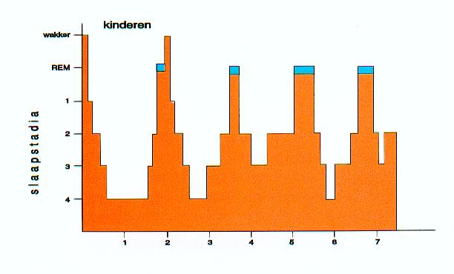
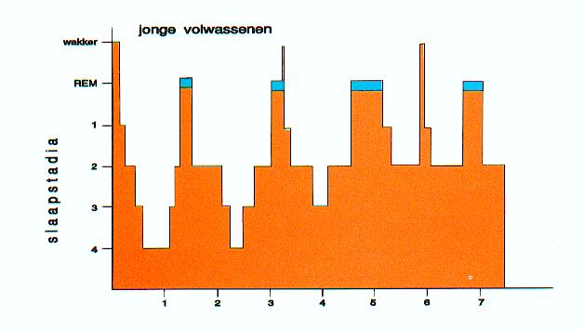
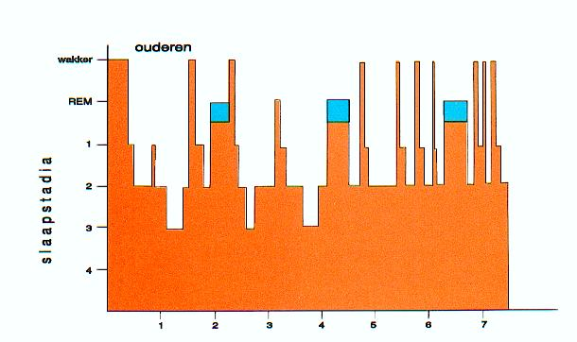
Sleep pattern according to age

Slide 5
Normal Sleep Need
Fatigue: do you sleep enough ?

Slide 6
Distribution Sleep stages Children/young adults
 | NonREM (75% TST) | REM (25% TST)
Stage N1 | 5%
Stage N2 | 45%
Stage N3 | 25%
Wake < 5% of the night

Slide 7
TIB= time in bed (total time recorded)
TIB

Slide 8
TST=Total Sleep Time
TST=SPT-WASO***
*
*
*
*
*
*
*
*
*
*
*
*********
WASO (all periods with *)
( “wake after sleep onset” or intermittent wake)

Slide 9
Sleep latency (SL)
SL
How long is a normal SL ?

Slide 10
REM sleep latency
REM latency
How long is a normal REM sleep latency time ?

Slide 11
SEI=Sleep Efficiency Index
SEI=TST/TIB

Slide 12
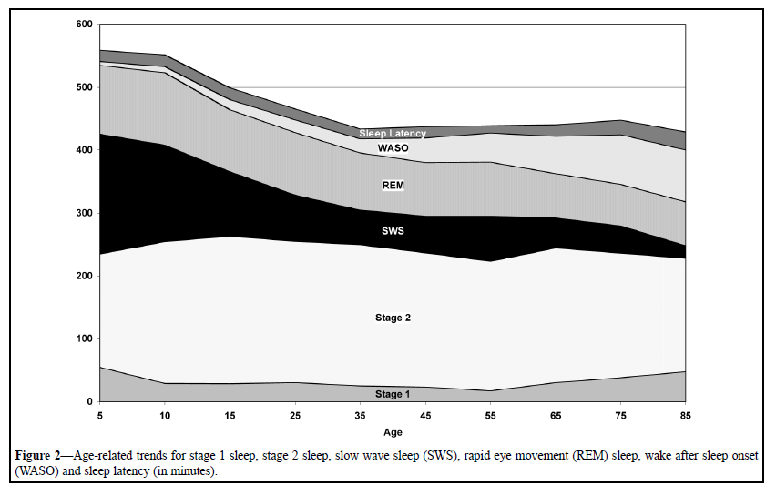
Sleep during life span
Ohayon MM et al Sleep 2004;27(7):1255-73

Slide 13
Sleep patterns: sex differences
Sleep patterns
Sleep duration: Girls sleep consistently 5-10 minutes longer than boys (6 mnd-11 yrs)
Sleep quality: Girls have less fragmented sleep and better sleep efficiency
Brain maturation: Girls demonstrate an earlier decrease of delta-waves (~1,2 years earlier)
Sex-specific hormones
Oestradiol influences sleep-wake activity
Ventro-lateral preoptic nucleus, which stimulates sleep, is influenced by oestradiol
Women have a shorter circadian period than men
Sex differences in the brain develop already during the fetal phase
Franco P et al Sleep Med Rev 2020; 51:101276

Slide 15
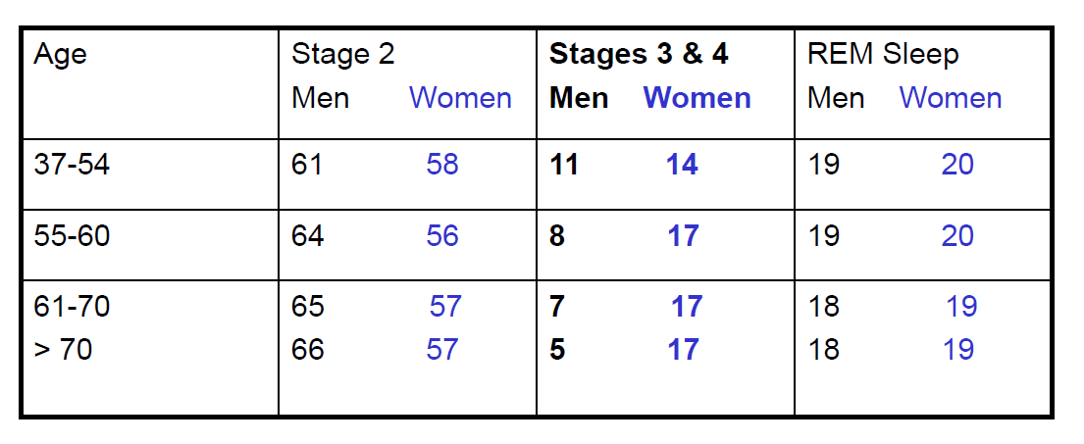
Gender and sleep stages
Redline S et al Arch Intern Med 2004;164:406-18

Slide 16
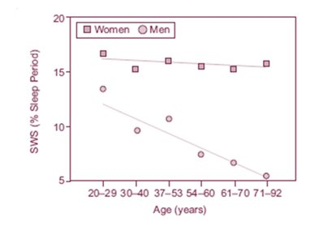
Elderly: sleep EEG
N3 Slow wave sleep
Reduction 75%–80% relative to young adults
Prefrontal cortex
1st and 2nd NREM sleep cycle
SWS wave frequency slows on average with 0.1 Hz in adults related to cortical β-amyloid deposition and poor memory marker
Male –female difference
Men > 70 yrs 50% decrease in N3 and increase in N1&N2, not in women
Men > 70 yrs > 3x less N3 compared to age matched women

Slide 17
Sleep in women: diagnostics
Polysomnography
Longer sleep latency
Shorter TST
More SWS
Older women sleep longer with less sleep fragmentation
Ulander M et al Sleep Med Clin 2021;16(4):635-48

Slide 18
Sleep in childhood - adolescence
Development of differences in sleep
Childhood:
In newborn sleep patterns are not organised
Subtile differences between boys and girls can be detected
Boys demonstrate more restless sleep, girls have longer periods of quiet sleep
Adolescence:
During the first menstruation significant differences in sleep occur
Sex hormones (oestrogen/progesteron) influence the sleep-wake cycle
Progesteron improves sleep duration and quality
Oestrogen protects probably against sleep apnea
Pengo M et al Chest 2018;154(1):196-206

Slide 19
Sleep in childhood – adolescence: Clinical consequences
Age 4-8 yrs:
Boys have 2,5x more risk for sleep disturbances (27,8% vs 10,9%)
Age 12-16 yrs:
Girls have 2,5x higher risk for sleep disturbances (24,7% vs 10%)
Girls: more insomnia during adolescence
Boys: more parasomnia's in young years
Explanations for insomnia in adolescent girls
Gender differences in exposure to stress
Differences in stress reactions
Adolescence related changes in stress hormones
Variations in ovarial hormones
Franco P et al Sleep Med Rev 2020; 51:101276

Slide 20
Sleep in the menstrual cycle
spindles

Slide 22
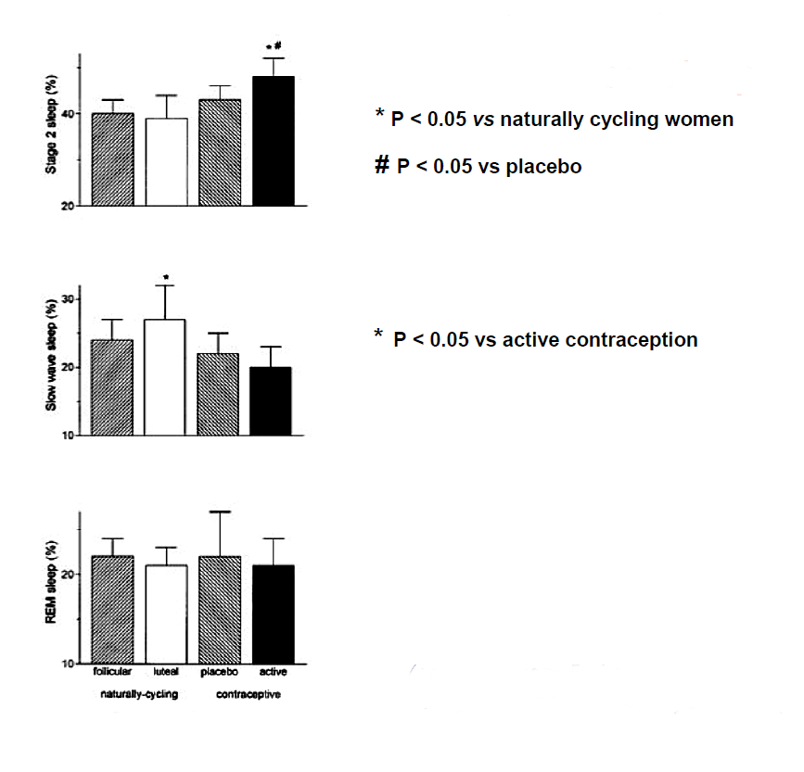
Oral contraconceptives and sleep
N2
N3
REM
Baker FC et al Pflugers Arch 2001;442(5):729-37

Slide 23
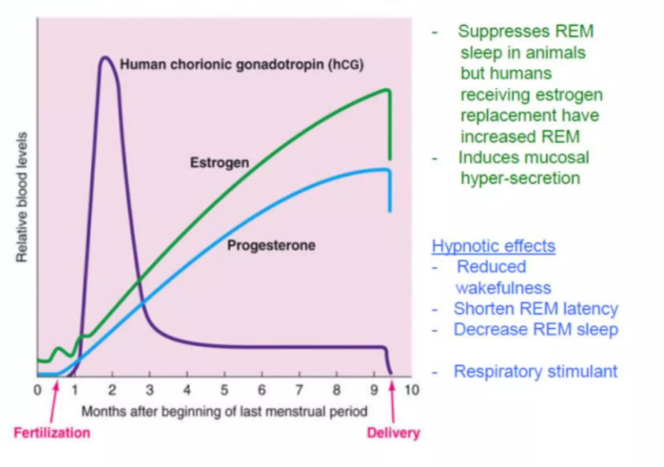
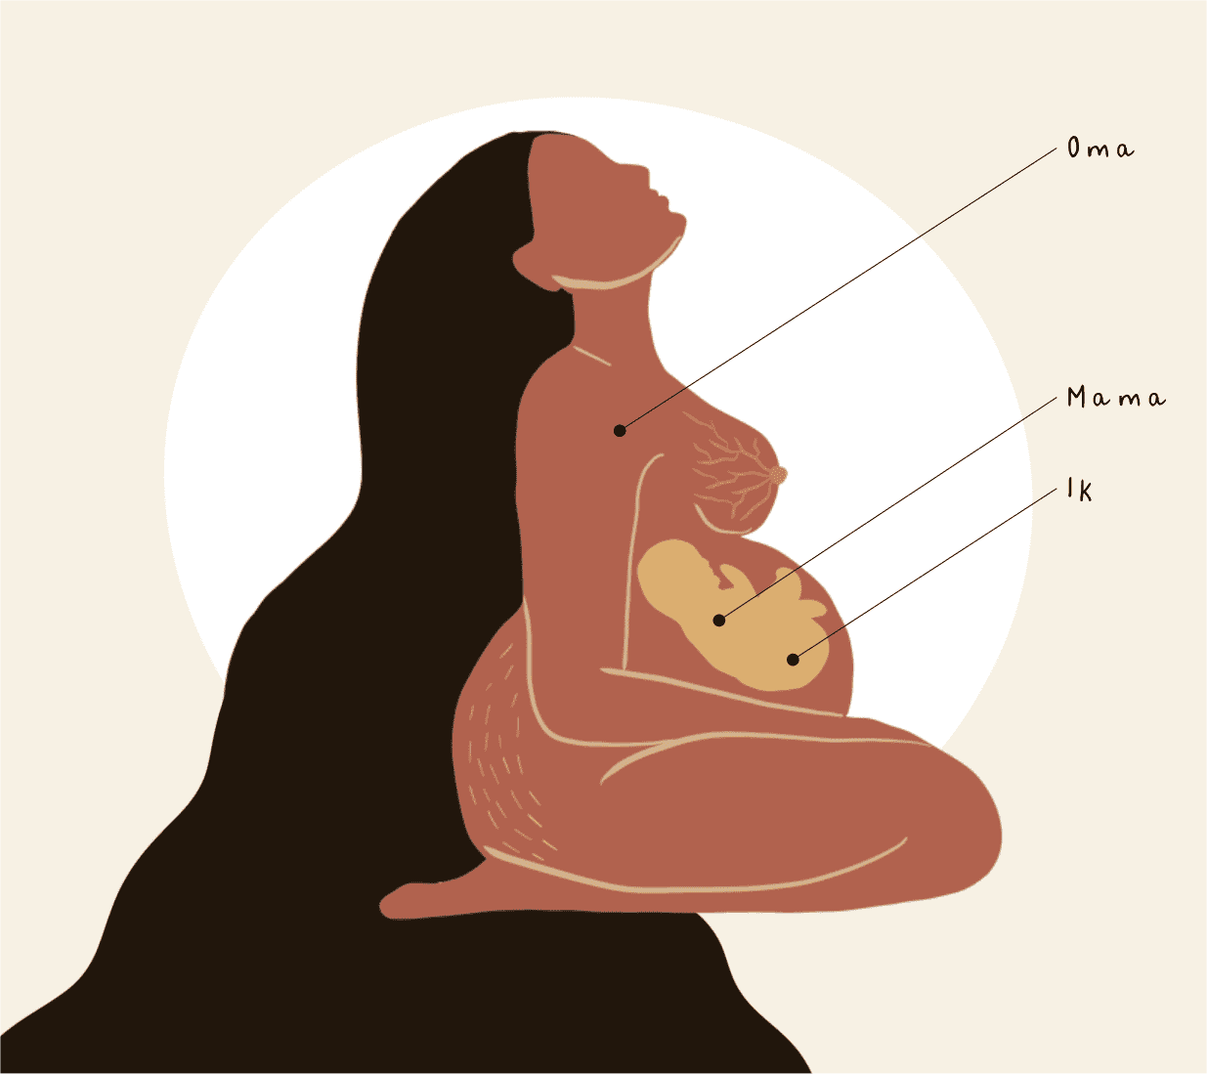
Sleep during pregnancy

Slide 24
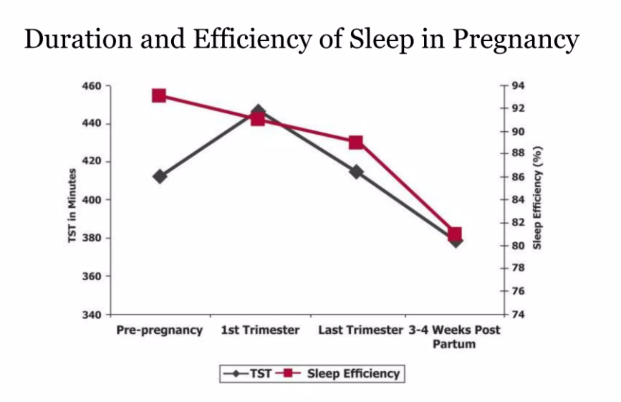
Lee KA T et al Obstet Gynecol 2000;95(1):14-8

Slide 25
Hormonal life phases
Pregnancy:
Sleep quality decreased with advanced pregnancy (30 min less in 3rd trimester)
Physiological changes disturb sleep (reflux, nocturia)
46% of pregnant women report poor sleep
Sleep disturbance correlates with pregnancy complications (diabetes, hypertension)
Postpartum sleep
Considerable sleep disruption
Decrease in sleep efficiency
Sleep deprivation & impact on mood
Irregular sleep schedules, napping
Impact of several factors:
Infant’s sleep and feeding
Emotional and physical health of mother
Parity
Method of birth and feeding
Pengo M et al Chest 2018;154(1):196-206

Slide 26
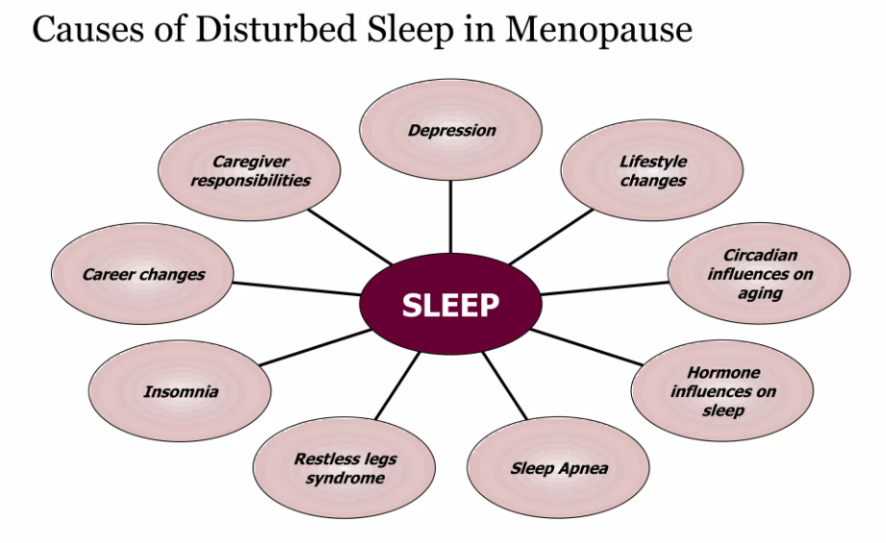
Hormonal life phases
Menopause:
40-60% of women in this phase perceive sleep problems
Hot flashes and nocturnal sweating cause sleep fragmentation
Hormonal changes disturb sleep regulation
Sleep problems are amplified by age related changes and mood disturbance
Differences in sleep between men and women are most clear after adolescence and are directly related to hormonal changes during the female life span, with important implications for health and well-being

Slide 27
Sleep in women across life span
Pengo M et al Chest 2018;154(1):196-206

Slide 28
Disturbed sleep
Problem to initiate sleep
Problem to maintain sleep
Early awakening
“Insomnia”
Hypersomnia
Parasomnia
+
At least 1 of the following characteristics of disturbance during the daytime related to nocturnal problems:
A Fatigue or malaise;
B Disturbed attention, concentration, memory; social; professional or poor performance at school; mood disturbances; daytime sleepiness;
less energy and motivation.

Slide 29
Disturbed sleep (insomnia)
At least 3 poor nights per week
Present during at least 3 months

Slide 30
Prevalence of insomnia with ageing
About 50% of elderly people report insomnia and global dissatisfaction about their sleep quality

Slide 32
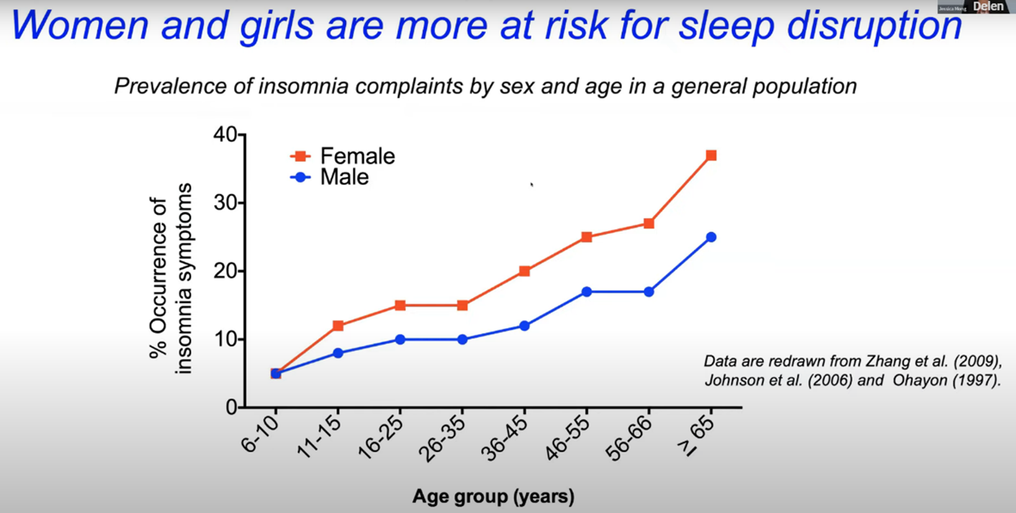
Disturbed sleep (insomnia)
Prevalence higher in ♀
♂ after stroke have more often insomnia
Insomnia often procedes cardiac events in ♀ 48%
♂ with insomnia lose 3,84 yrs CVD free survival compared to 1,43 yrs in ♀
After COVID infection ♀ demonstrate more insomnia complaints
Sex Differences in Insomnia and circadian Rhythm Disorders: A systematic review. Pajediene E et al, Medicina 2024; 60(3):474

Slide 33
Disturbed sleep: women and circadian rythms
Normal average cycle length of circa 24h, but shorter in women
Melatonin rythm and body temperature different compared to ♂
Women have more cognitive impairment if disturbance of the circadian rythm
Women have more often complaints if shift work or jetlag
Santhi N et al Proc Natl Acad Sci USA 2016;113(19):E2730-9 Spitschan M et al Elife 2022;11:e65419

Slide 34
Conclusions
Sleep quality changes during life span
Differences between men and women already present in early years
Sleep in women is like women: very complex

Slide 35
www.acco.be/sleep

Slide 37
