Slide 1
Luts Journey through the Ages - From Pediatric to Geriatric Care
Focus on women and menopause
Karel Everaert, François Hervé, George Bou Kheir
NOPIA research Group
Department of Urology
Ghent, Belgium

Slide 2
Introduction, the concept of lifelong LUTS
Disclosures: Grants, honoraria to institution from Ferring, Medtronic, Astellas, Synapstim
SPECIAL SECTION: LIFELONG LUTS, A MATTER OF TRANSITION? Neurourology and Urodynamics: 2024. Volume 43, Issue 5, 1029-1156.

Slide 3
Introduction: lifelong LUTS
The Big Bang, the rotation of celestial bodies around their axes and around each other.
The foundation of how chaos became order and how the concept of time takes shape in the form of day and night.
Life is a temporary form of order in which numerous processes take place in our bodies, governed by day/night rhythms.
These processes, organs, and cells communicate through the brain, nerves, and neurotransmitters and hormones and receptors.
All of these are under the control of clock genes.
During our lives, we upgrade order, but after reaching adulthood, a downgrade towards chaos occurs.
The bladder is an involuntary, reflexively contracting organ that, after birth, comes under cerebral control (maturing nervous system):
Reflex activity is suppressed, and bladder sphincter control is established, allowing us to optimally fulfill our roles in society and reproduce.
Later in life, an increase in chaos occurs, where we may lose some control and circadian rhythms and loose ability suppressing overactivity of the bladder muscle and sphincter control.
Disease, defects and malfunction adds-on, our sensory system fails, neurotransmitters and hormones decrease,…
Until we die…
SPECIAL SECTION: LIFELONG LUTS, A MATTER OF TRANSITION? Neurourology and Urodynamics: 2024. Volume 43, Issue 5, 1029-1156.

Slide 4
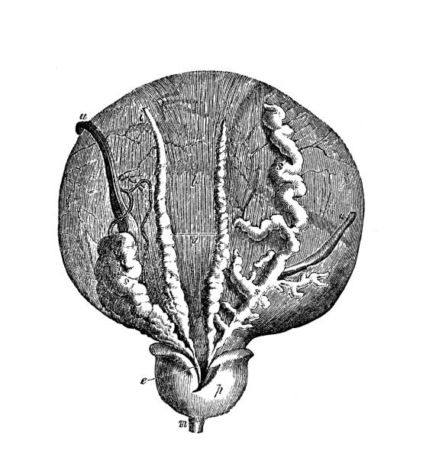
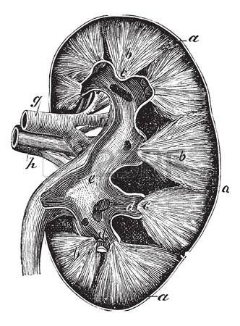
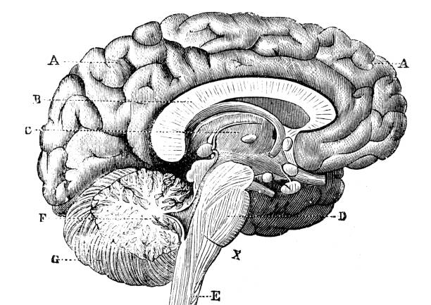
Lifelong LUTS

Slide 6
BLAAS / LUT functie
Toilet training
Pelvic cross-talk
Aging bladder
Hormonal influence
Genetics
BPH
Age
Age
Toddler to Child
Puberty
Adult to elderly
Elderly to frail
No unicist pathophysiology
All hypothesis applicable to all age groups
Notes:
the lower urinary tract undergoes structural and functional changes throughout life, from toilet training for toddlers to urothelial aging by the elderly, and these changes play a role in the clinical perception of LUTS. what is genetically determined will define a baseline state of the bladder, then transitions are added: hormones play a role during puberty but also during menopause, BPH is an important factor to be considered by the aging man as well as pelvic cross-talk for the 2 sexes.

Slide 7
HERSENEN / SLAAP FUNCTIE
Insomnia
Hormonal changes
Neurological damage
Circadian rhythm
OSAS
Nocturnal enuresis
Hours of sleep
Cognitive patterns
Age
Sleep stages
Age
Toddler to Child
Puberty
Adult to elderly
Elderly to frail
No unicist pathophysiology
All hypothesis applicable to all age groups
Notes:
We know that sleep is also subjected to transition throughout the course of life and this timeline represents only a fraction of topics related to that. The amount of sleep, for example, drastically changes from childhood to elderly, but also circadian rhythm, sleep stages, sleep apnea and many other sleep related factors transition over time.

Slide 8
NIER FUNCTIE EN DIURESE
Kidney function
Blood pressure
Fluid intake
Metabolic syndrom
Circadian rhythms
Age
Hormonal changes
Age
Toddler to Child
Puberty
Adult to elderly
Elderly to frail
No unicist pathophysiology
All hypothesis applicable to all age groups

Slide 9
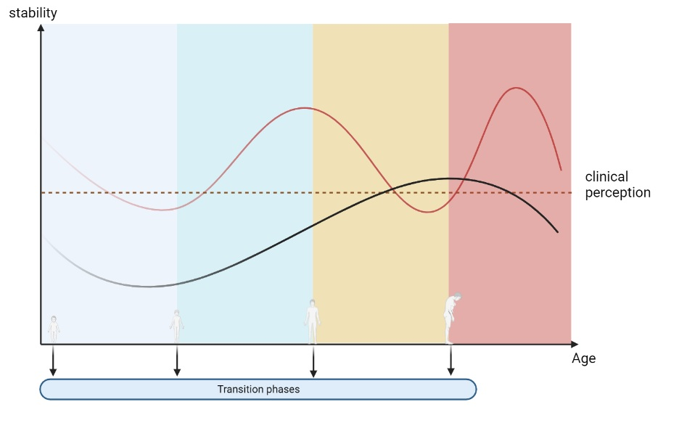
TRANSITIE FAZEN TIJDENS HET LEVEN
Toddler to child
Puberty
Adult to elderly
Elderly to frail

Slide 10
Ageing, diseases/defects and nocturia and LUTS
The human body experiences three major aging shifts around ages 34, 60, and 78. These shifts are characterized by changes in the levels of blood proteins, which are linked to metabolism, immunity, and organ function (Nature Medicine 2019, study on > 4000 peoples).
Shifts, not gradual aging:
The research indicates that aging is not a smooth, continuous process but rather occurs in distinct phases with rapid changes at specific ages.
Age 34:
At this age, the study found a downregulation of proteins involved in structural pathways like the extracellular matrix (ECM).
Age 60: circadian rhythms flatten of inverse
This shift is marked by a prominent role of hormonal activity, binding functions, and blood pathways.
Age 78: merging from older to frail
Key processes include blood pathways, but also bone morphogenetic protein signaling, which is involved in numerous cellular functions.

Slide 11
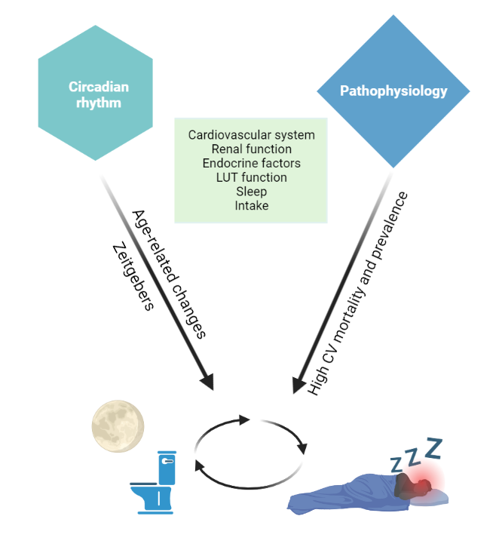
Ageing, circadian rhythms, zeitgebers + diseases/defects and nocturia and LUTS
LUTS is resultant of dysfunction in:
Brain (awareness, sleep)
LUT (functional capacity)
Kidney (diuresis)
Verbakel I et al. How should we assess the cardiovascular system in patients presenting with bothersome nocturia? ICI-RS 2023. Neurourol Urodyn. 2024 Aug;43(6):1391-1399.

Slide 12
RESIDU!!!!

Slide 15
Review on how LUTS are related to the menopause
The relative deficiency in endogenous estrogen production after the menopause is thought to exacerbate all major pathophysiological mechanisms that may underlie nocturia, including reduced bladder capacity, nocturnal polyuria, global polyuria, and sleep disorders.
Diminished estrogen may induce anatomical and physiological bladder changes, contributing to a reduction in functional bladder capacity.
Excess nocturnal urine production can also be provoked by estrogen depletion, either via free water-predominant diuresis by an impaired secretion of antidiuretic hormone, or a salt-predominant diuresis owing to diminished activation of the renin-angiotensin-aldosterone axis.
Additionally, a relationship between the transition to menopause and impaired sleep has been described, mediated by increased incidence in vasomotor symptoms and obstructive sleep apnea signs during the menopause.

Slide 16
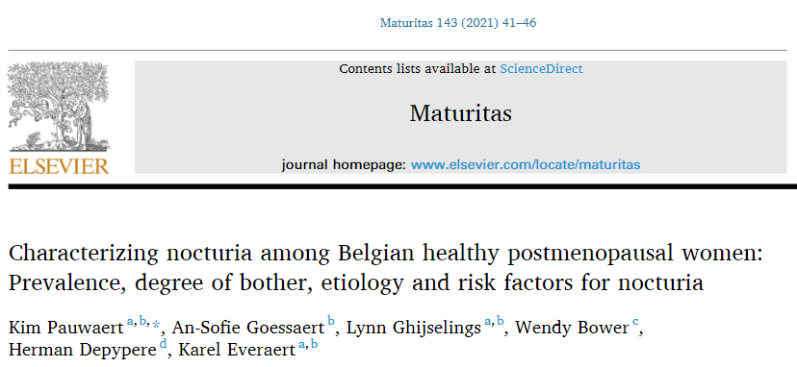
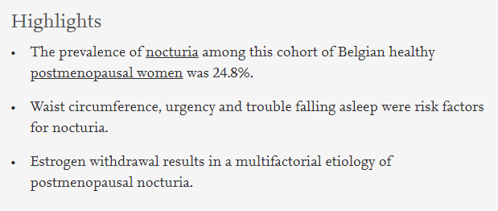
Nocturia and menopause in Belgium

Slide 17
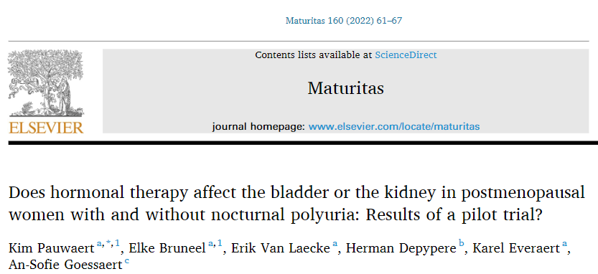
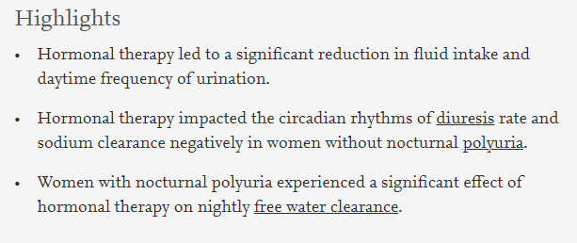
Pilot trial: bladder or kidney?

Slide 18
Ageing, Cardiovascular Disease and Diabetes
. 2025 Jul:198:108595.
Cross-sectional study involving 3918 women aged 40-55 years.
Menopause represents an independent risk factor for GFR decline, beyond the effects related to body composition and metabolic risk factors.
Maturitas 2025 Jul: 198:108595

Slide 19
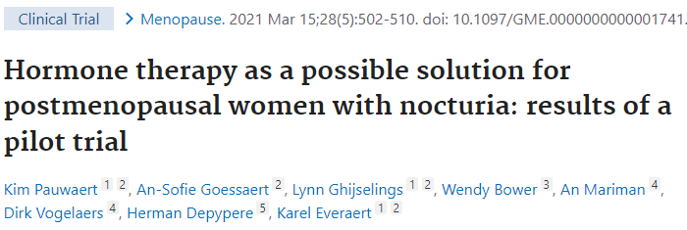
Or is it sleep???
E+P and TSEC treatment led to a significant reduction in nocturia prevalence and bother in women with ≥ 2 nocturnal voids. This effect is mainly the result of improvement in sleep disorders, however an improvement in bladder disorders can be suggested as well. More research is necessary to confirm these findings.

Slide 20
RESIDU!!!!

Slide 21
RESIDU!!!!
The low dopamine hypothesis: A plausible mechanism underpinning residual urine, overactive bladder and nocturia (RON) syndrome in older patients. Haddad R, Panicker JN, Verbakel I, Dhondt K, Ghijselings L, Hervé F, Petrovic M, Whishaw M, Bliwise DL, Everaert K. Prog Urol. 2023 Mar;33(4):155-171

Slide 22
Ageing: brain, nerves, neurotransmitters and hormones
1) Maturation nervous system, clock genes, genetics, epigenetics have effect on brain/kidney/LUT.
2) Impact of sex hormones in puberty, menopause and andropause (prostate enlargement) on brain/kidney/LUT.
3) At older age there is impact of declining neurotransmission and hormones on brain/kidney/LUT:
Ageing is quite endocrine and neurogenic isn’t it?
SPECIAL SECTION: LIFELONG LUTS, A MATTER OF TRANSITION? Neurourology and Urodynamics: 2024. Volume 43, Issue 5, 1029-1156.

Slide 23
Ageing: brain, nerves, neurotransmitters and hormones
- decline in parasympathetic (PS) activity:
Less cognition, reduced "rest and digest," decreased voluntary detrusor contraction, reduced erection.
- decline in sympathetic (OS) activity:
Reduced "fight or flight" response, increased urgency.
- decline in dopamine:
Associated with restless legs, sexual dysfunction, sphincter dysfunction, urgency, etc... (Parkinson's disease-like symptoms)
- decline in vasopressin:
Results in reduced "fight or flight" response, diminished day/night rhythm, less sleep, increased diuresis, higher
bladder tone, etc…
Ageing is quite cardiovascular, endocrine and neurogenic isn’t it?
SPECIAL SECTION: LIFELONG LUTS, A MATTER OF TRANSITION? Neurourology and Urodynamics: 2024. Volume 43, Issue 5, 1029-1156.

Slide 24
Ageing, Cardiovascular Disease and Diabetes
National Health and Nutrition Examination Survey (NHANES) data were extracted (2011–2020). LE8 comprised eight health behaviours and factors (score of 0–100) classified into low (0–49), moderate (50–79), and high (80–100) cardiovascular health status.
N= 4502 postmenopauzale vrouwen, 2011-2020.
The inverse relationship between LE8 scores and MetS suggests that integrating LE8 components into management strategies may help prevent CVD in postmenopausal women. The most critical impact was sigarette smoking.
Nutrients 2025 May: 20;25(1):399

Slide 25
Ageing, circadian rhythms, zeitgebers + diseases/defects and nocturia and LUTS
LUTS is resultant of dysfunction in:
Brain (awareness, sleep)
LUT (functional capacity)
Kidney (diuresis)
LUTS increase during menopause due to:
Brain (awareness, sleep)
LUT (functional capacity)
Kidney (diuresis)
LUTS are strongly related with the metabolic syndrome on:
Brain (awareness, sleep)
LUT (functional capacity)
Kidney (diuresis)
Lifestyle interventions, exercise!!!
Verbakel I et al. How should we assess the cardiovascular system in patients presenting with bothersome nocturia? ICI-RS 2023. Neurourol Urodyn. 2024 Aug;43(6):1391-1399.

Slide 26
Impact op therapie van de LUTS
Intensiteit en fenotype van LUTS veranderen met de leeftijd.
Dit betekent nood aan titreren van therapie hetzij combineren van therapie.
Levenstijl interventies en bewegen!

Slide 28
Minder residu?
Personalized medicine, andere patiënten?

Slide 30
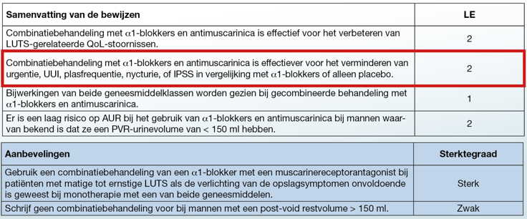

Slide 31
CONCLUSIE Life-Long LUTS
Transitie fazen van het leven hebben impact op:
de overactieve blaas en ledigingsfaze stoornissen
de klinische perceptie ervan (andere fenotypes)
de diagnose en de therapie ervan
LUTS zijn de resultante van een verstoorde LUT, nier en slaap functie
Er is nood aan personalized medicine in de therapie van de OAB, lees combineren en optitreren!
LUTS zijn alarmbellen voor systemische (CV, nier, endocrien,…) pathologie tijdens menopauze en later! Aanpassen levensstijl, meer bewegen,…

