Slide 1
Menopause Treatment Tool MTT
EMAS 2025
Dr. Eveline Markowicz BMS 21/06/2025

Slide 2
MTT
The goal of our meetings is to improve our knowledge of menopause in order to provide patients with the best possible care.
Despite this, the use of hormone replacement therapy is declining in Europe and the USA.
Access to menopause consultations is limited by the number of practitioners who feel trained in this treatment.

Slide 3
MTT
Furthermore, an initial menopause consultation is extremely time-consuming, as we must take a medical history, as we would for any other medical condition.
Family and personal history (medical, surgical, and obstetric)
To limit INAMI expenses, we must include:
the last blood test
the last smear test
any specialist consultations (colonoscopy, cardiology exam, rheumatology, smear test, bone density screening, mammography).

Slide 4
MTT
I was very interested by a presentation of Petra Stute (current president of EMAS) entitled
“Development of a Menopausal Treatment Tool to help clinicians evaluate the benefit/risk of Menopause Hormonal Therapy in symptomatic menopausal women: Results from an international study.”

Slide 5
MTT
Study Objective(s):
To develop and test the practicality and usefulness of the Menopause Treatment Tool in real-world clinical settings across Europe (United Kingdom, Germany, Italy, Poland, Spain, Switzerland and U.S.
Study Design:
Study type: Non-interventional mixed method research collected the feedback through:
a) questionnaires and interviews with Health Care Professionals (MTT-HCPs)
b) questionnaires with menopausal women (MTT-MW)
•Methods for the study included literature review, qualitative research, and expert committee involvement throughout by testing 2 types of questionnaires
Study Population:
• 41 gynecologists
• 8 primary care physicians
used MTT-HCP or MTT-W questionnaires with:
172 suspected menopause women (age range: 45-60).
Total: 227 participants

Slide 6
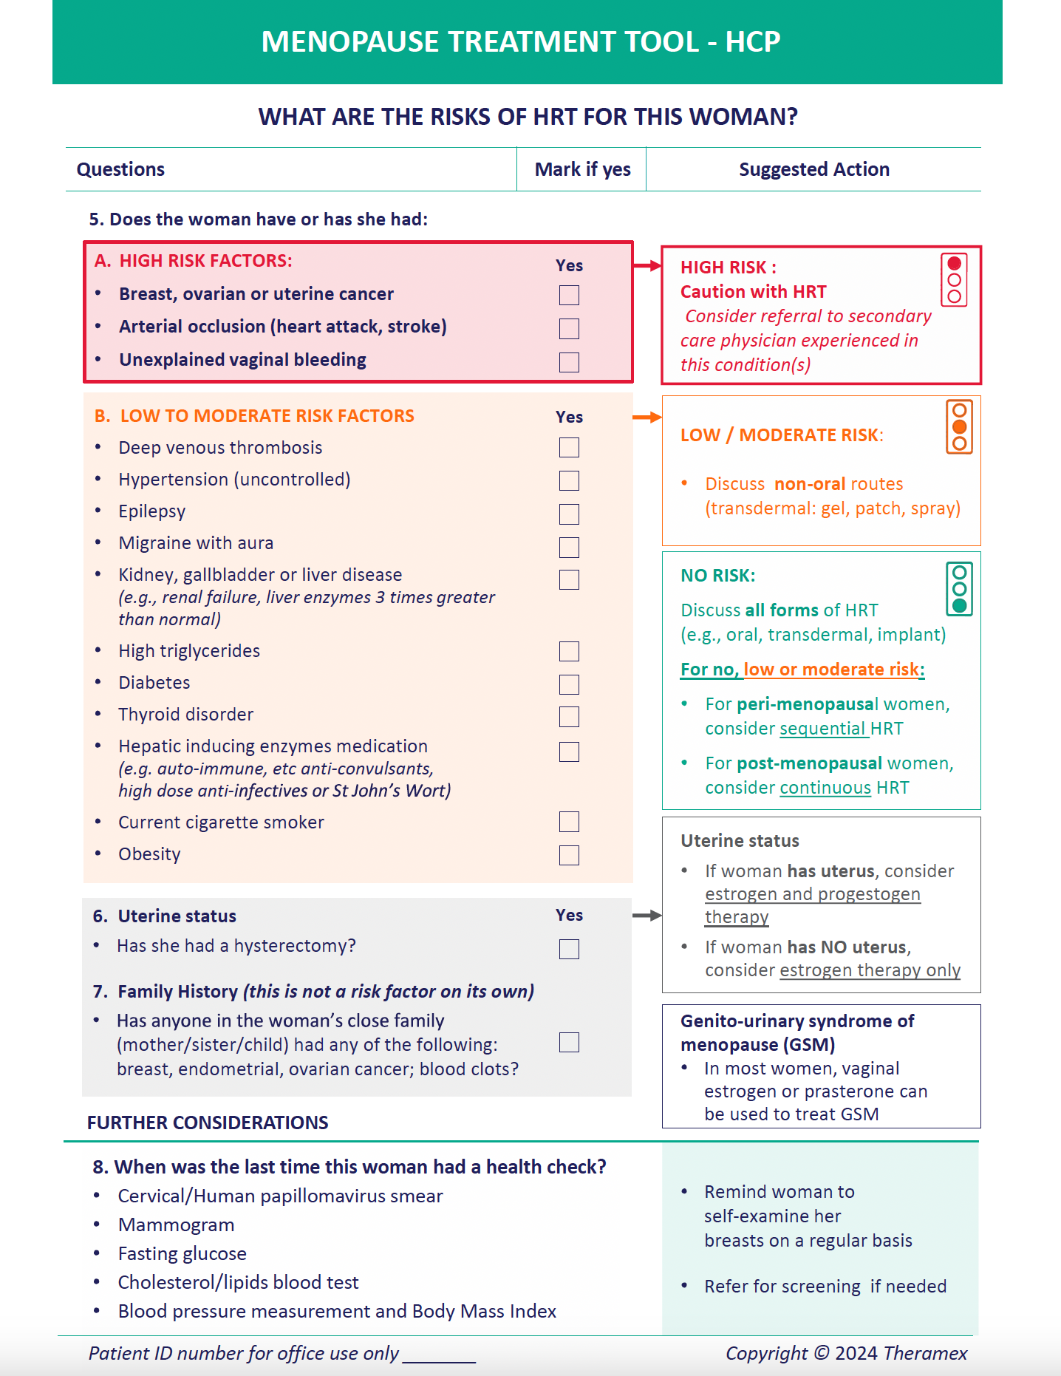
MTT

Slide 7
MTT
Results Summary:
Based on feedback questionnaires (160 clinician’s and 156 menopausal women’s)
a. Most (>85%) clinicians and women reported both tools to be convenient and valuable for discussing symptoms and treatment options.
b. Most clinicians (>55%) and women (>70%) reported improved interactions and confidence in treatment decisions.
Menopausal women were positive about MTT-HCP use in their consultation. They reported the MTT-HCP was:
a. easily understood (93%)
b. asked about relevant symptoms (96%)
c. provided clear and structured conversations with their HCPs (93%)
d. reassured (89%) and increased confidence (82%) in their treatment options
• Clinicians acknowledged the shift towards electronic tools in implementation phase, considered diverse formats
(paper,app, tablet) and linkage to medical records.

Slide 8
MTT
Ideally, the complaint questionnaire should be sent to the patient before her first consultation
so that she can correctly identify the relationship between these possible symptoms and menopause.
One might wonder whether it would be better to provide either an information brochure about menopause or a reference to a podcast she should consult or listen to in order to optimize the questions asked during the consultation.

