Slide 1
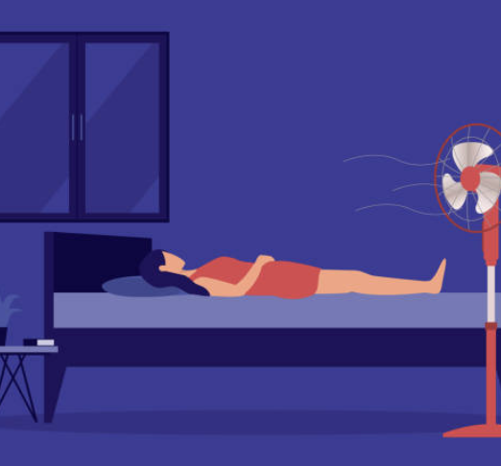

Sleep disorders in the menopausal transition and thereafter
M. BRUYNEEL
Pneumologist, Somnologist

Slide 2
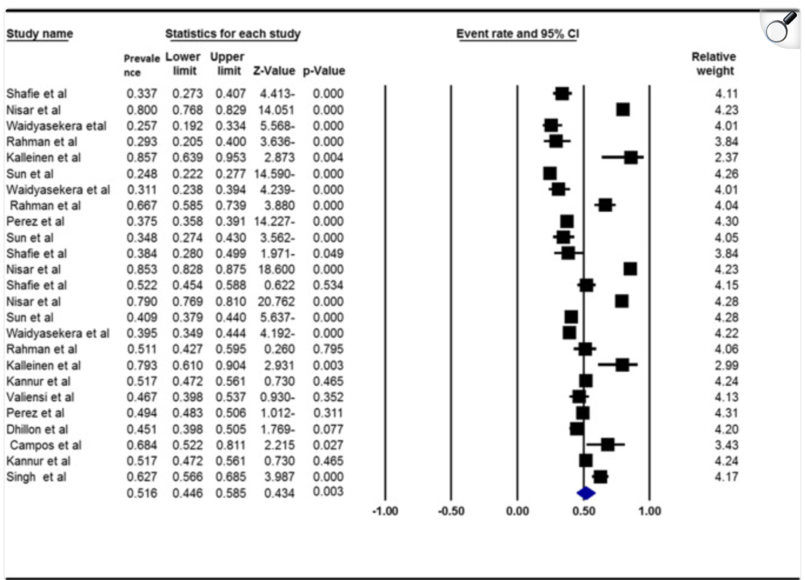
Sleep complaints
Sleep disturbance and fatigue
  From 12 (30y) to 40% during 5th decade
SWAN Study (12,603 multi-cultural women 40-55) 38% reported sleep difficulty ; higher in the menopause group 46-48%
Gold EB Am J Epidemiol 2000
Changes in sleep quality on PSG are pre-existant to menopause and age-related
Lampio et al 2017
Insomnia:
Difficulty to initiate, maintain sleep/non-restorative sleep
Meta analysis – Salari N Sleep Breath 2023

Slide 3
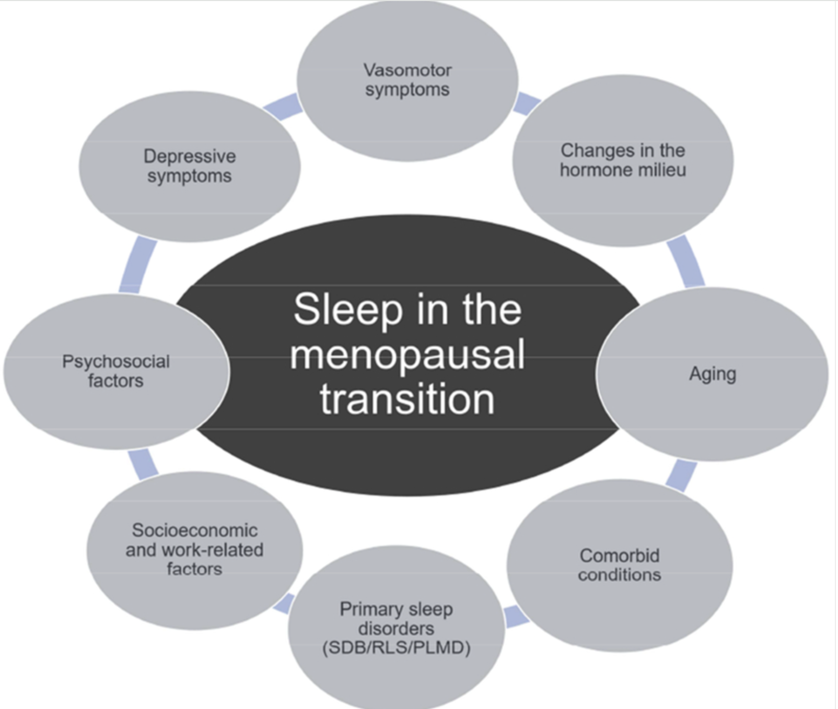

Slide 4
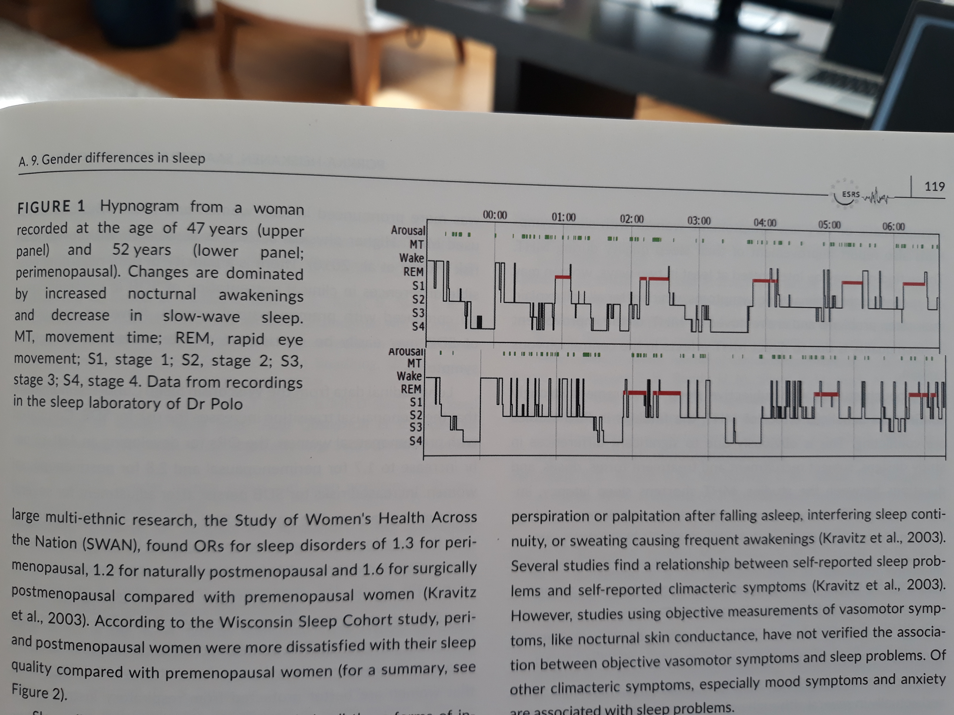
Hypnogram from a woman at 47 and 52 years

Slide 5
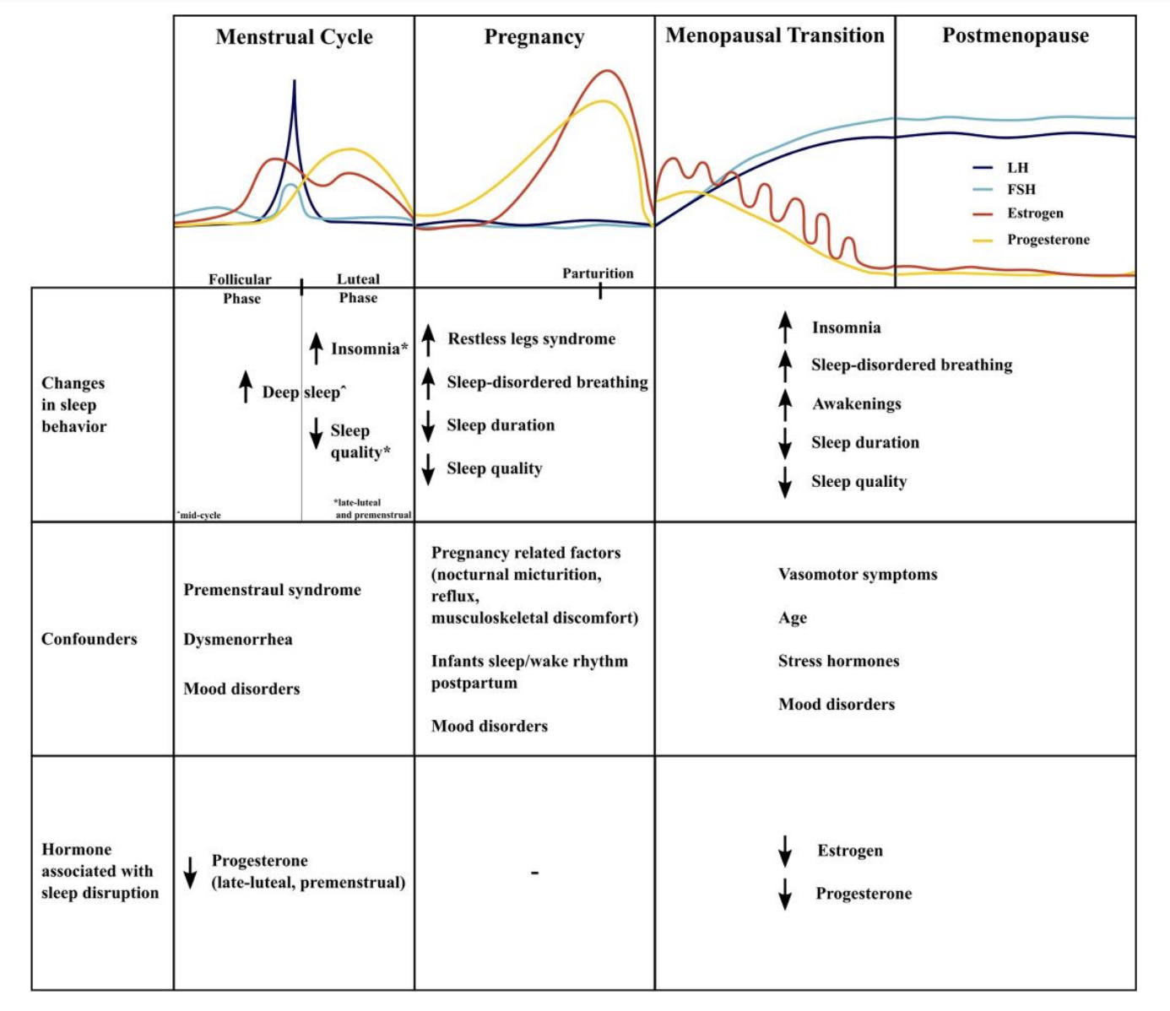
Hormonal influence on sleep
Haufe A J Endocr Soc 2023

Slide 6
Sleep disorders related to hot flashes
Vasomotor symptoms : 36-87% women
Night sweats +/- increase in body t°
Less hot flashes last 1/3 of night (REM, no thermoregulation)
Worse sleep in women with high body t°
EEG arousals prior to hot flashes explain poor sleep
Associated with insomnia: 29% vs 11 % in woman without VMS
Murphy PJ Sleep 2007 Joffe H Semin Reprod Med 2010

Slide 7
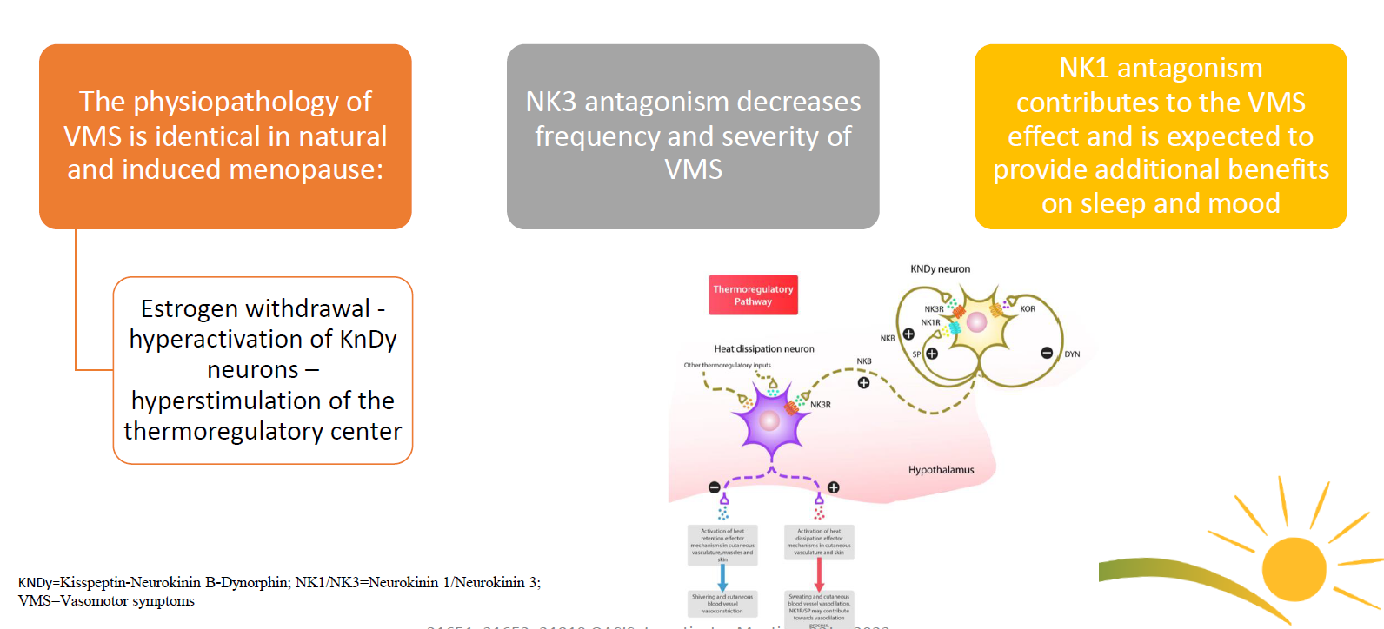
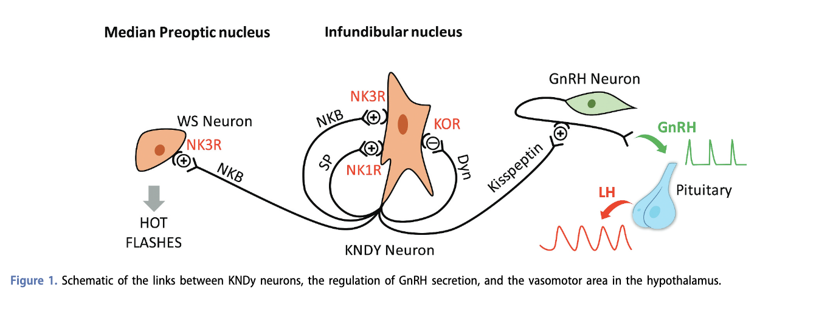
Non hormonal treatments
Elinzanetant (anti NK1 and 3) and Fezolinetant (anti NK3)

Slide 8
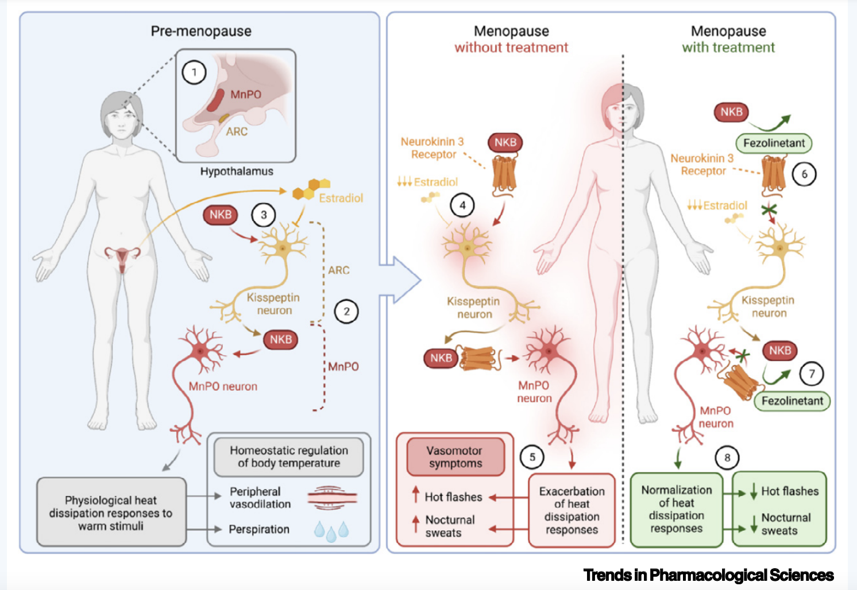

Slide 9
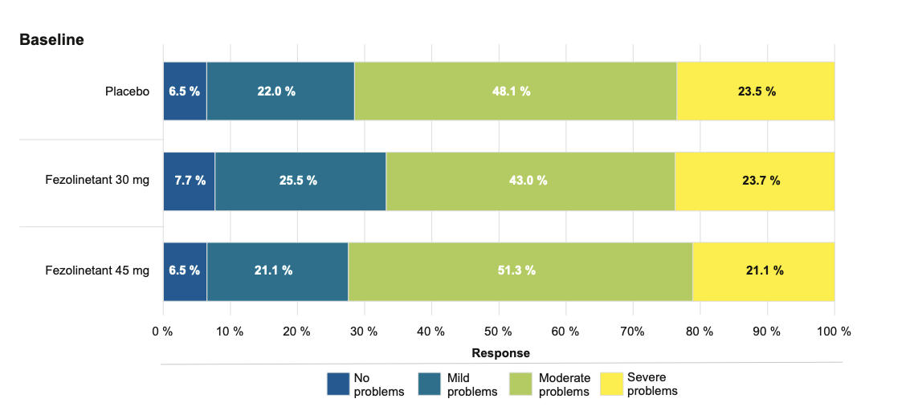
Fezolinetant
Skylight 1 and 2 studies
Phase-3, double-blind investigations.
Individuals (≥40–≤65 years) suffering from moderate-to-severe VMS were enrolled.
Arms: placebo, fezolinetant 30 mg, or fezolinetant 45 mg during a 12-weeks
N= 1022
Reduction of VMS: 51%
Side effects: headaches, liver disorders
Shapiro M, Maturitas 2024

Slide 10
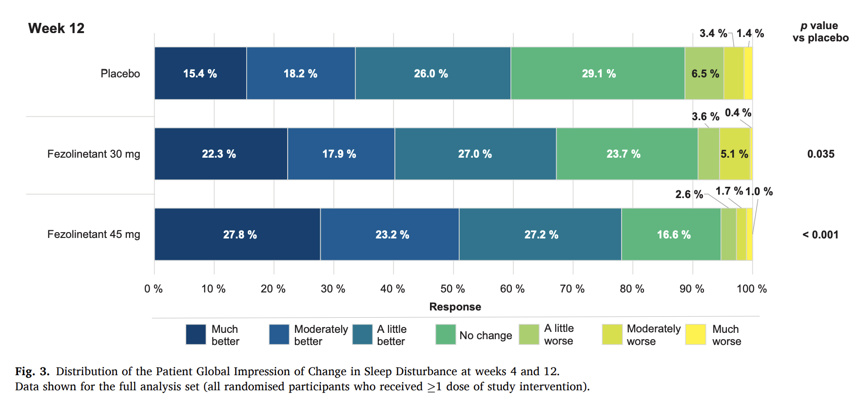
FDA/EMA approved
Shapiro M, Maturitas 2024

Slide 11
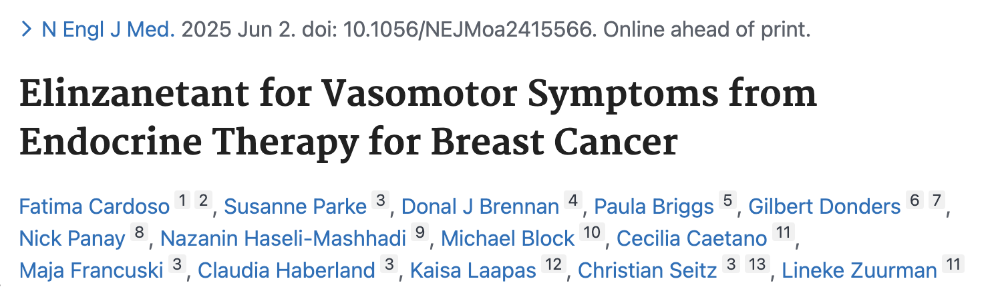
ELINZANETANT
Elinzanetant is the first dual NK-1 and NK-3 receptor antagonist to receive FDA approval.
positive results from the OASIS-1, OASIS-2, and OASIS-3 Phase III clinical studies
The studies enrolled 396 and 400 postmenopausal women, respectively, aged 40–65 years, across 184 sites in 15 countries.
120 mg of elinzanetant or placebo, 26 weeks,
At week 12, VMS frequency decreased further, to 65.2% and 67.0%, compared to placebo reductions of 42.2% and 45.9%
Ongoing studies in Europe (Nirvana, focused on sleep disorders)
Sassarini J Exp Opini Invest Drugs 2024

Slide 12
Gabapentin
Effective treatment for hot flashes
Pinkerton JV Menopause 2013
Improves sleep quality across several clinical conditions
-Increases slow-wave sleep /less time in stage 1 sleep
-Direct effect on sleep
Reduces release of certain excitatory neurotransmitters (GLUT, NORADR, Substance P)
Major effects:
1. anti-epileptic
2. analgesic
3. anxiolytic

Slide 13
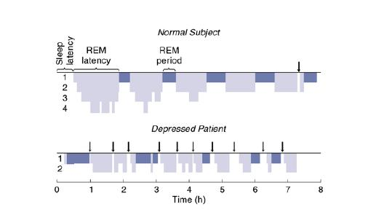
Sleep disorders related to depression
50-78% of menopausal women complain from mood disorder
20% hypersomnia (subjective)
80% insomnia
Among insoniacs: 35% are suffering from depression
PSG:
  Early awakenings/inability to reinitiate sleep
  Frequent WASO
  Short REM latency
  Short sleep:5-6h
  Rush AJ ARch Gen Psychiatry 1986

Slide 14
Treatments: Zuranolone
Indication: anxiodepression and sleep disorder in the peri-menopausal period, rapidly active
Also used in post partum depression (FDA +)
Neuroactive steroids are natural derivatives of progesterone (Allopregnanolone agonists)
GABA-A receptor agonists: sedative and anxiolytic effects
Single 14-days course, bridging to SSRI –persisting effects a 45 days
2 phase III trials of zuranolone for PPD -efficacy from D3 of treatment. dosage of 30 mg/day in the first phase III PPD study (Deligiannidis et al., 2021) and 50 mg/day in the second phase III PPD study (Deligiannidis et al., 2023). Reductions in depressive symptoms were observed by day 3 and sustained at day 45. Limited evidence in menopause.
FDA approved
EMA pending

Slide 15
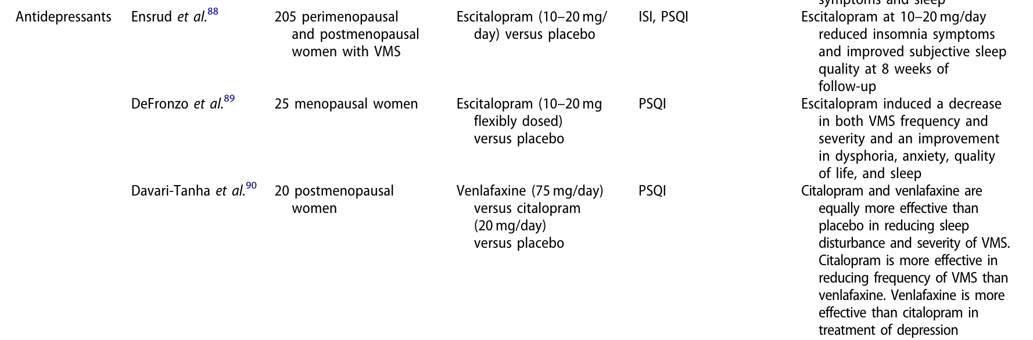
Treatments: anti depressants
Proserpio P Climateric 2020

Slide 16
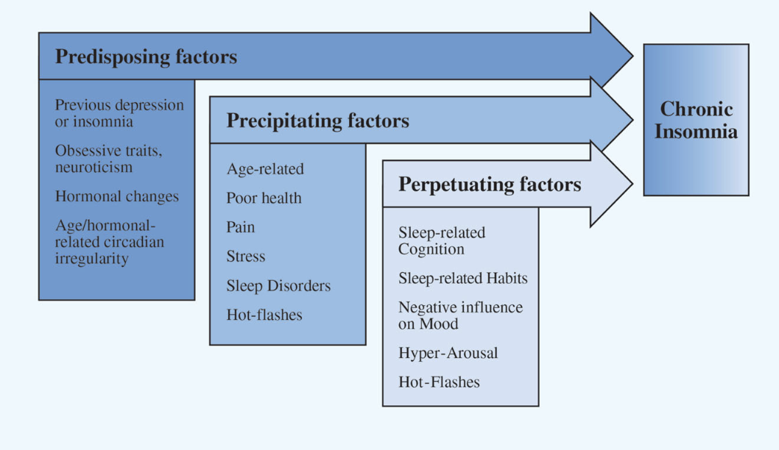
Chronic insomnia 40-60%

Slide 17
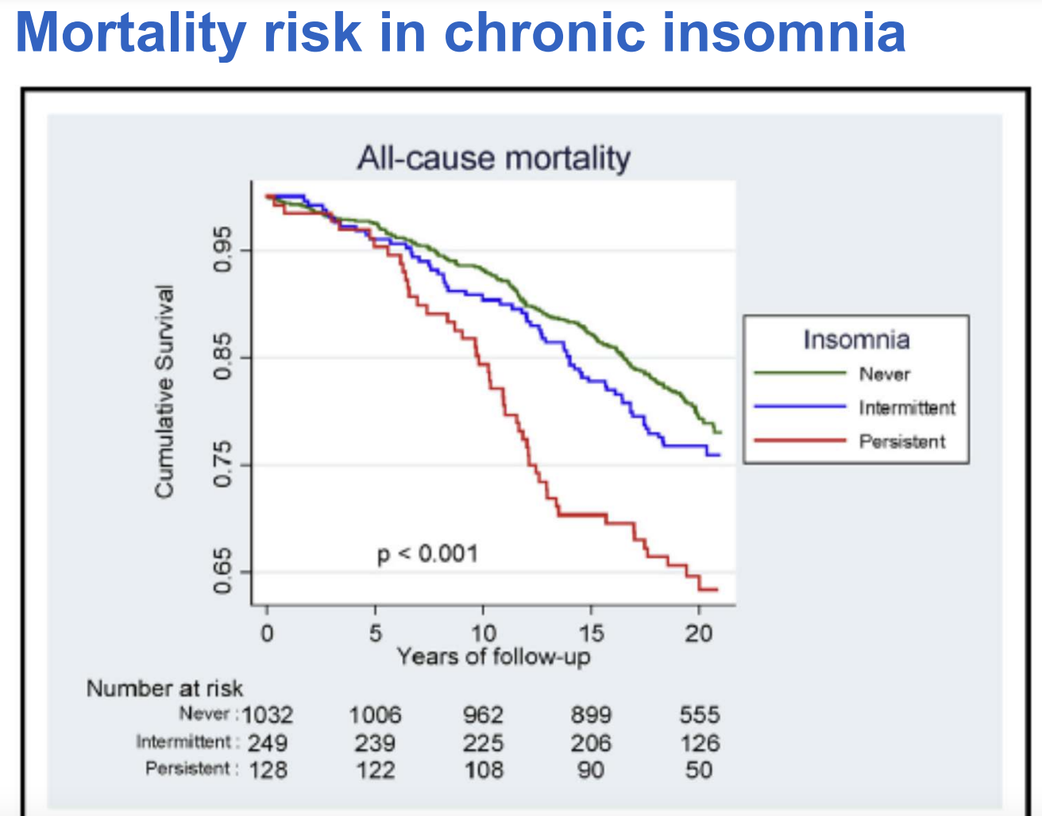
Definition
Difficulty initiating sleep
Difficulty maintaining sleep
Waking up earlier than desired
Several times/week
> 3 months
Parthasarthy et al. Am J Med 2015

Slide 18
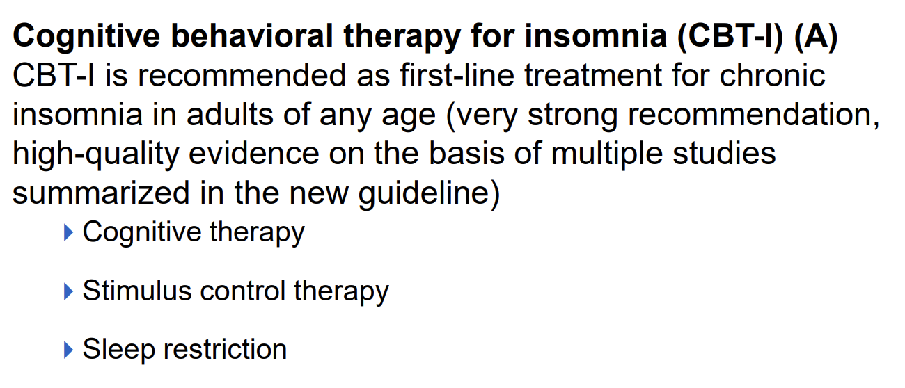
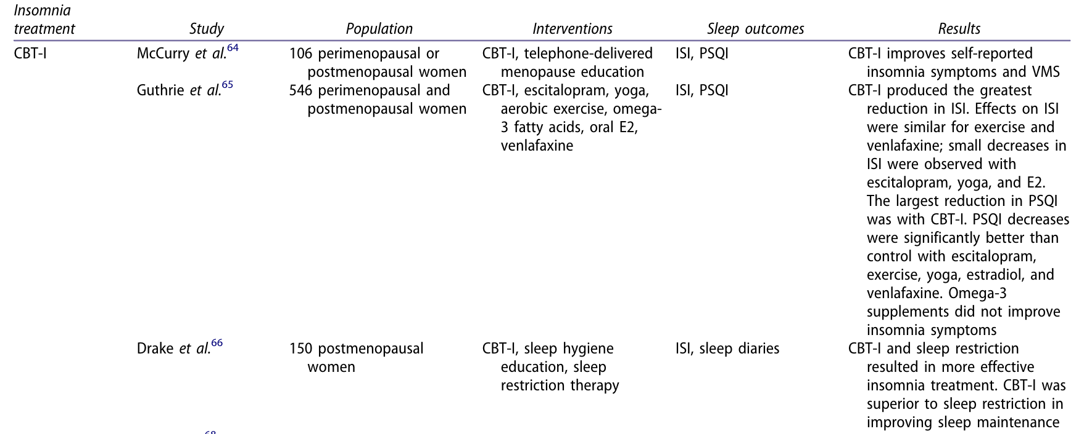
Treatment: cognitive behavioral therapy
Very efficient short-term psychotherapy for primary insomnia –benefit in 70-80%
Morin CM JAMA 2009
Proserpio P Climateric 2020

Slide 19
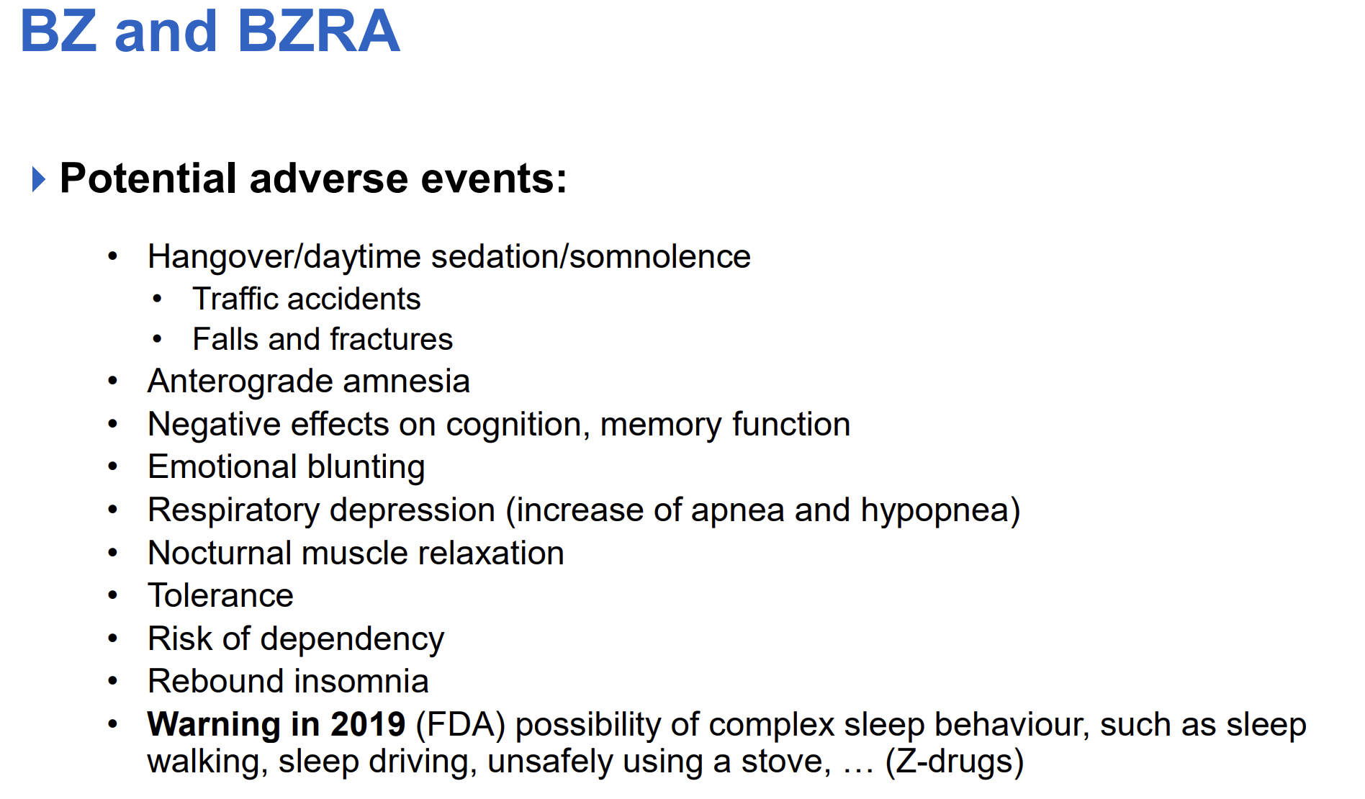
Hypnotics
Zolpidem and eszopiclone effective in menopause
Improve sleep induction and maintenance, even in women with VMS
  No effect on diurnal VMS
  Women sleep « through » their hot flashes
  Joffe H Am J Obstet Gynecol 2010 - Dorsey CM Clin Ther 2004

Slide 20
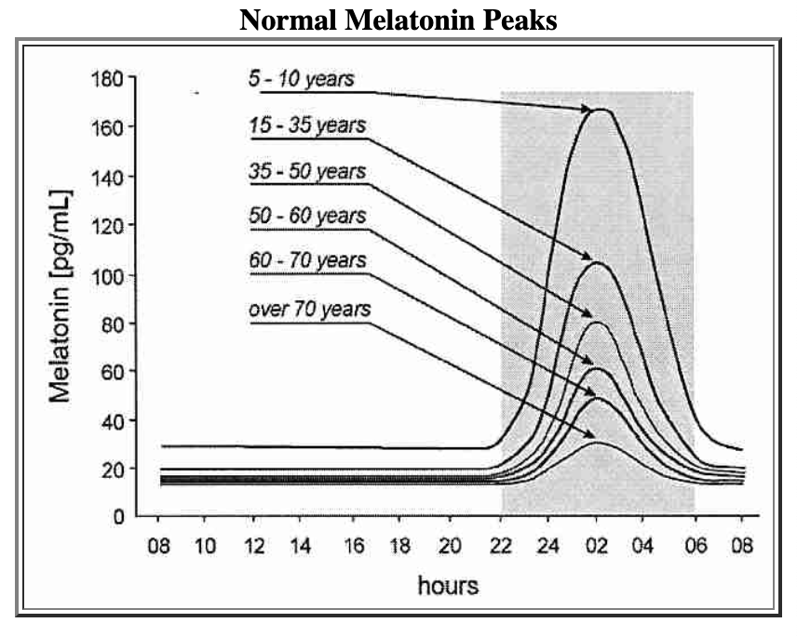
Hypnotics
Melatonin
Transient perimenopausal increase < low oetrogen levels

Slide 21
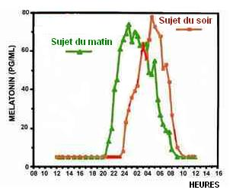
Hypnotics
Post menopause:
lower concentrations and shorter secretion
Altered secretion profile
« Advance phase syndrome »
Effective to improve sleep in In primary insomnia >55y
Circadin®
      Lemoine P et al. J Sleep Res 2007 RCT 170 patients
      Wade AG et al. Curr Med Res Opin 2007 RCT 354 patients

Slide 22
Dual Orexin receptor antagonists (DORA)
Suvorexant, lemborexant, daridorexant
Mechanism of action : inhibition of orexin R
Very efficient in menopausal women with VMS (RCT with suvorexant, n=56) or without VMS (RCT with lemborexant, n= 280) –persisting effects at 12 months
Few side effects (somnolence)
FDA/EMA approved
Rahman, S. A. Sleep 2022, Terauchi, M. Menopause 2023

Slide 23
Hormonal replacement therapy
  Widely studied
  Improve subjective sleep quality
  PSG: not found in all studies but in majority:
    Less sleep fragmentation, ⇓ SL, ⇑SWS
    More effective in patients with VMS
    Schurmann R Climacteric 2004 - Hays J N Engl J Med 2003- Bixler EO J Clin Sleep Med 2009
  Positive effect found also with estrogen alone or progestin alone
    Natural progesterone more efficient
    Montplaisir J Menopause 2001 - Gambacciani M Maturitas 2005

Slide 24
Primary Sleep disorders
Obstructive sleep apneas (OSA)
OSA prevalence 0.6% preM -1.9% at 50y
OR 2.6 to 3.5 // pre-menopause
Increase with age, BMI but also with change in hormone status: reduction in progesterone
Symptoms: EDS, fatigue, insomnia, depression, nocturia, loud snoring, headache, choking,….
Young T Am J Respir Crit Care Med 2003

Slide 25
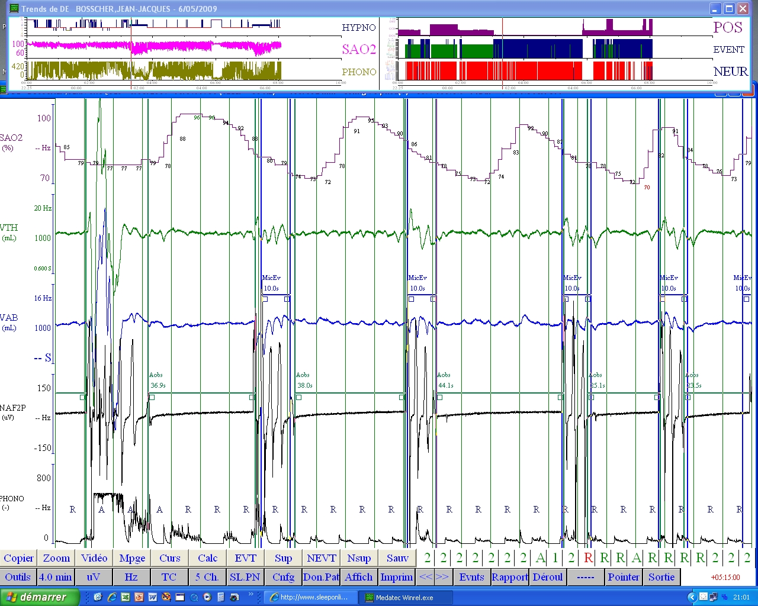

Slide 26
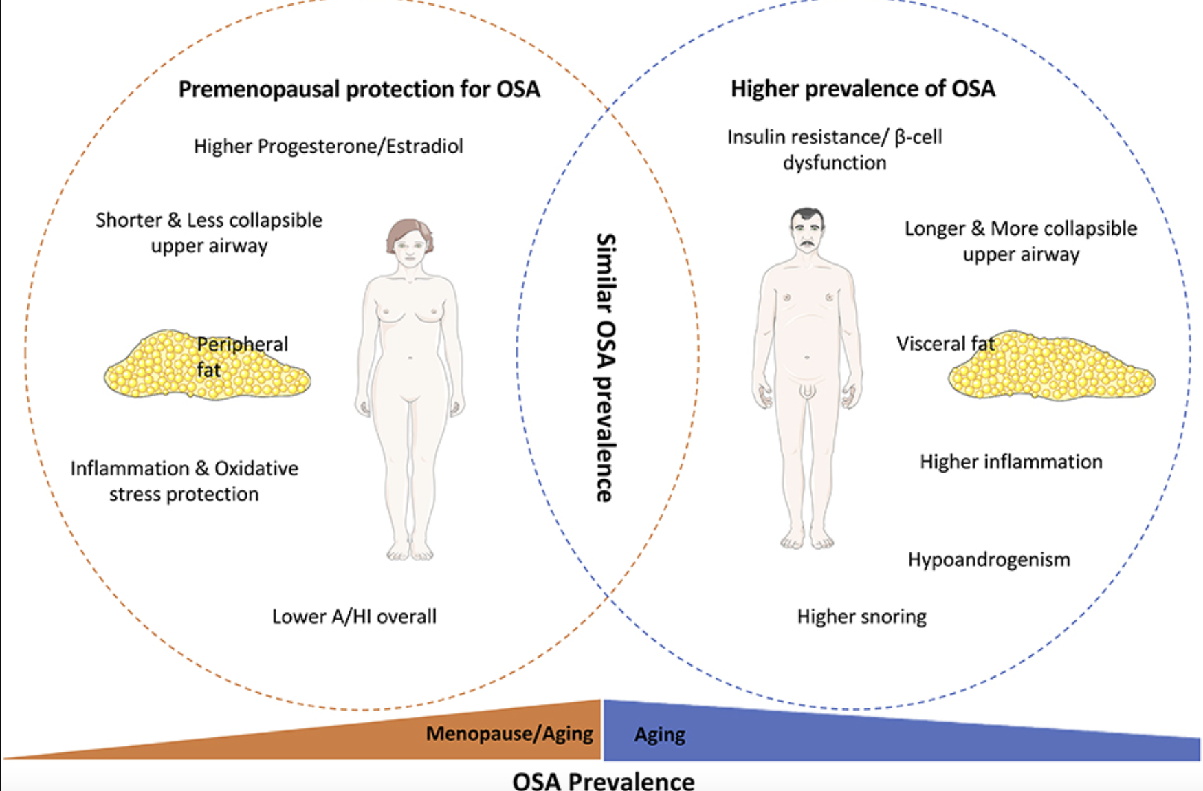

Slide 27
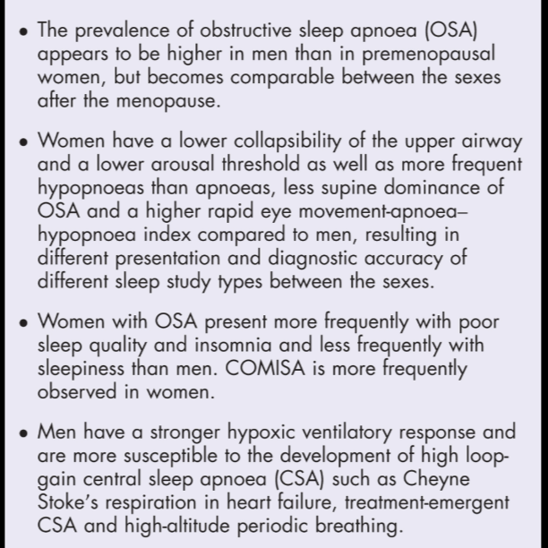
Specificities of OSA in woman
Complaints: fatigue-depression, less EDS, insomnia, RLS, palpitations
Valipour A Sleep 2007
Milder OSA, REM centered
At similar OSA severity, Women are more obese
Jordan AS J Appl Physiol 2005
Hormonal changes: higher OSA prevalence after menopause
Lin CM Sleep Med Rev 2008
Schwarz EI Curr Opin Pulm Med 2024

Slide 28
Causes of increased OSA in post-menopausal women
Weight gain
Fat distribution
Hormonal changes
  Testosterone
  Gonadal feminine hormone
At similar weight, prevalence of OSA in postM woman on HRT is similar to preM
Bixler EO. Am J Crit Care Med 2001

Slide 29
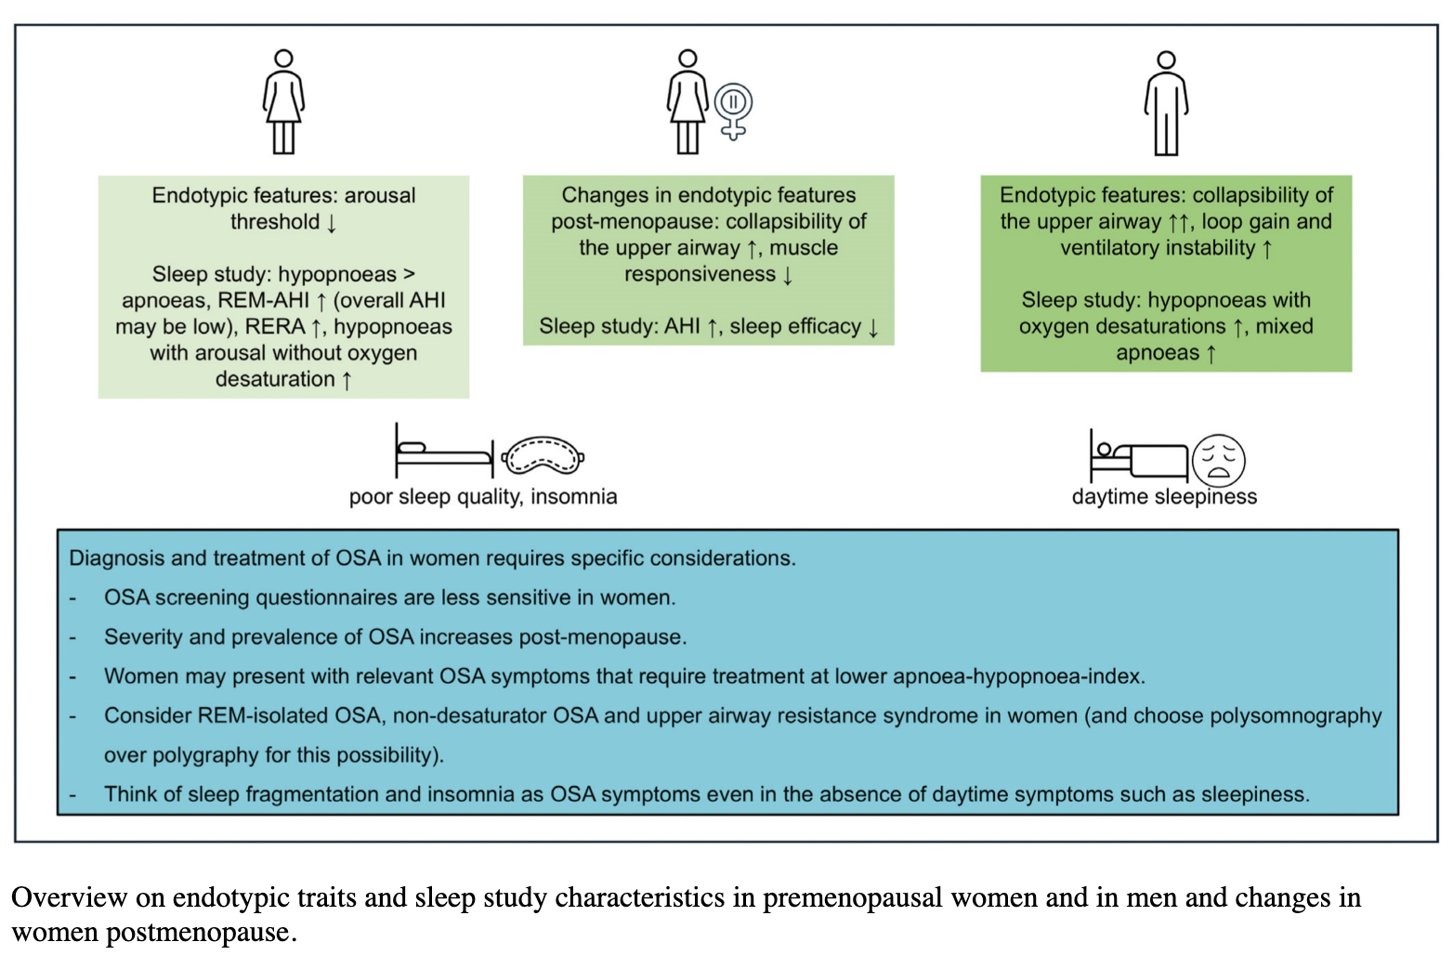
Schwarz EI Curr Opin Pulm Med 2024

Slide 30
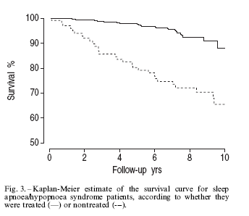
Medical risks associated with OSA
Stroke
AMI
HTA
Metabolic syndrome
Depression
…death Marty ERJ 2002
Moreover, higher testosterone level in postmenopausal woman contributes to increase CV risk
Lavie P et al. Eur Respir J 2005 - Shahar E et al. Am J Respir Crit Care Med 2001

Slide 31
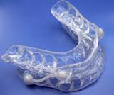
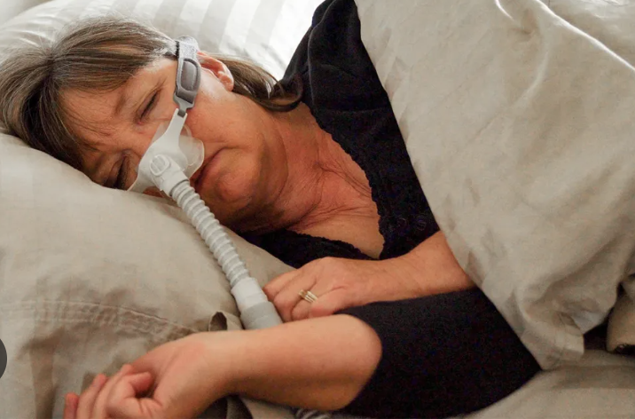
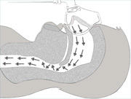
Treatment of OSA in menopausal women
According to the severity of the disorder
  Mild, moderate, severe
  Weight loss
  Mandibular advancement device
  CPAP
  ENT Surgery

Slide 32
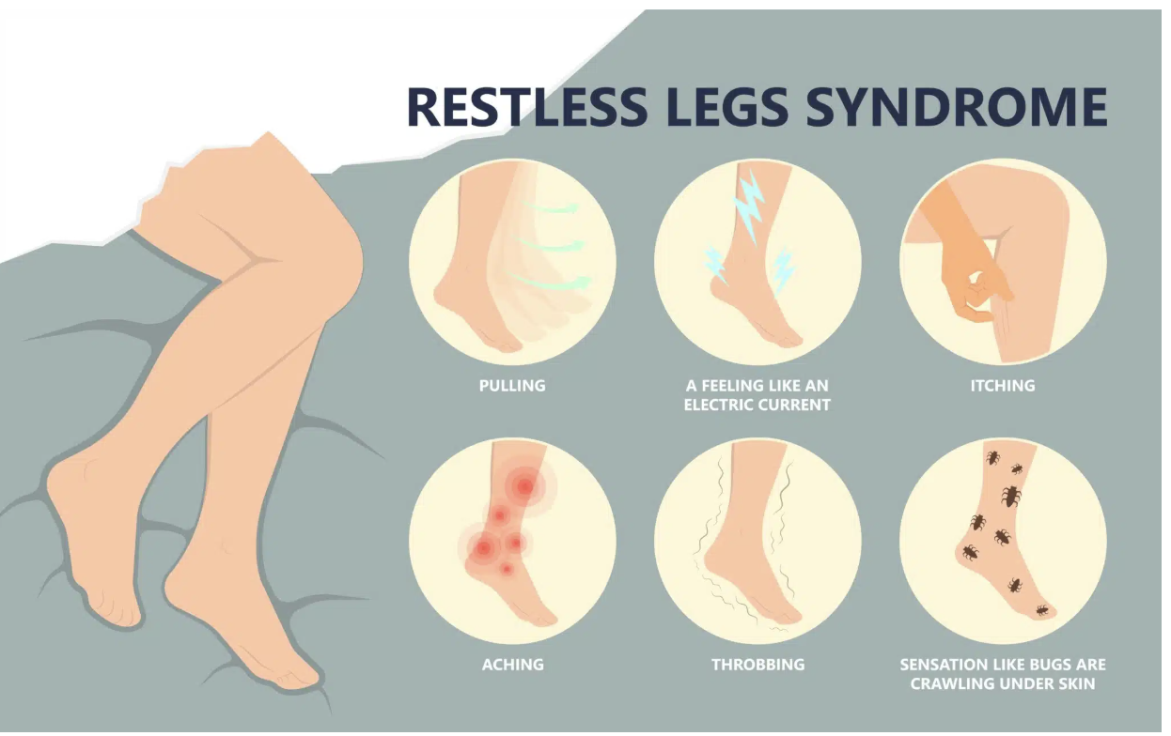
Primary Sleep disorders
Restless legs syndrome (RLS)
Prevalence: 10% general population, > 15% in menopausal women
2 times more frequent in woman
Genetic or secondary to iron deficit, renal insufficiency, hypothyroidy, medications,..
More frequent in VMS
Associated with hypertension
Shen Y Neurol Sci. 2018

Slide 33
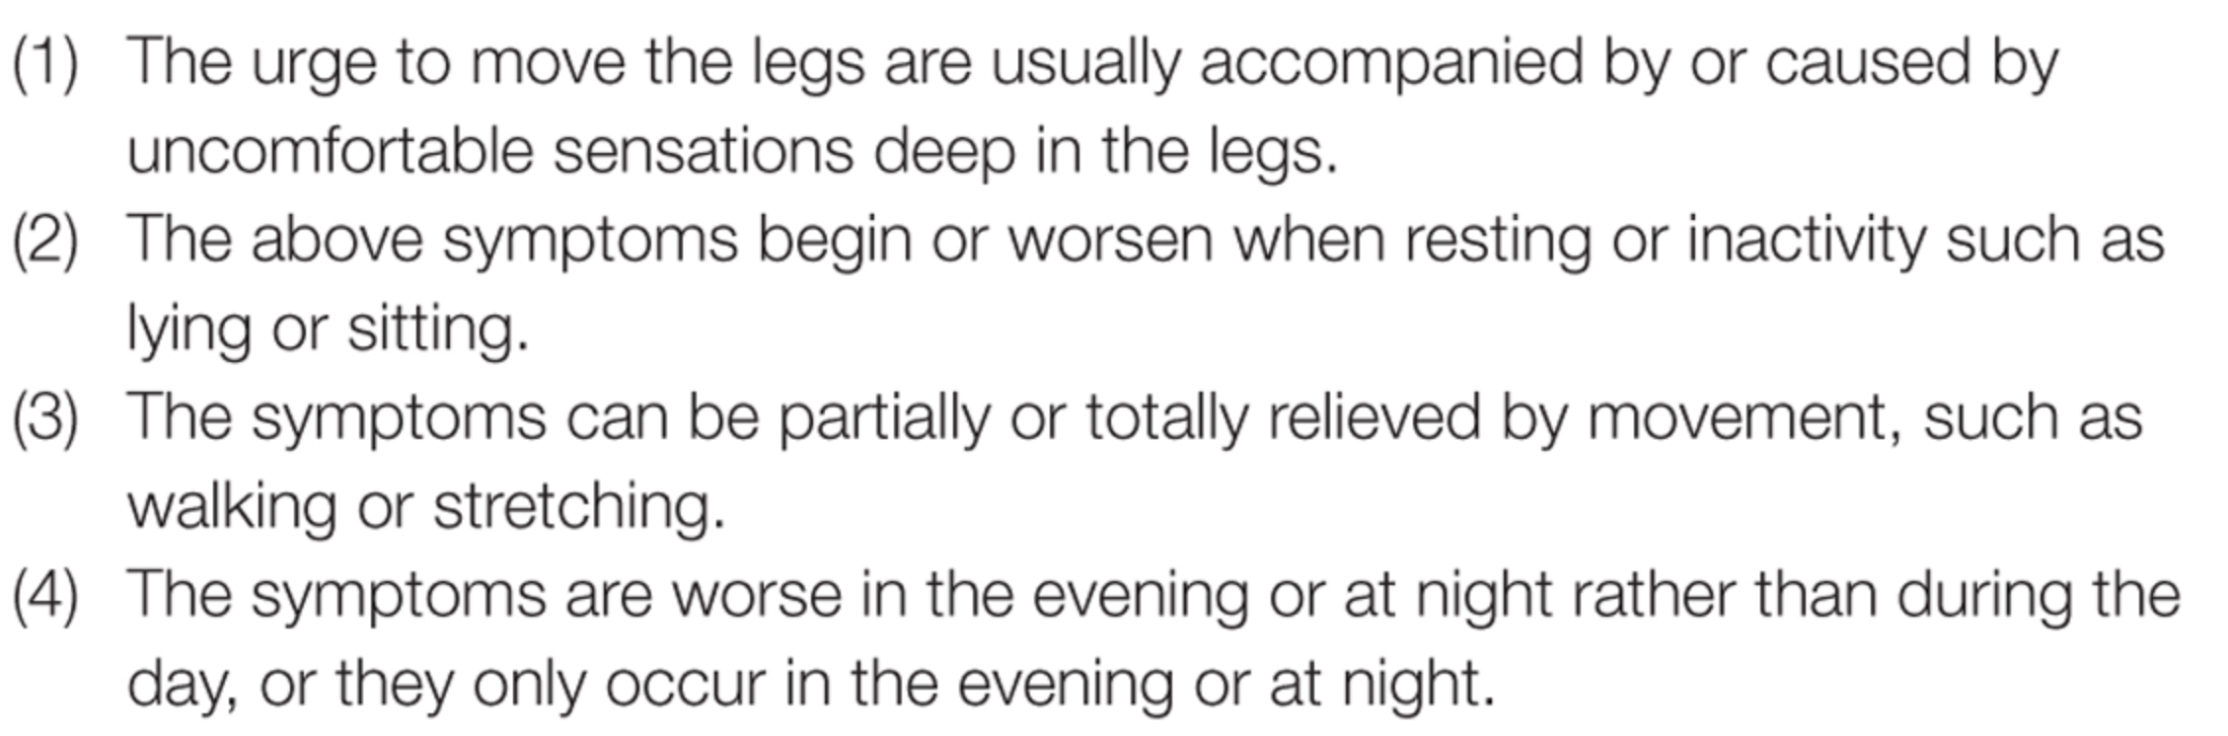
Definitions: RLS
Clinical diagnosis
IRLSSG criteria
Allen, Sleep Med 2004
Notes:
33

Slide 34
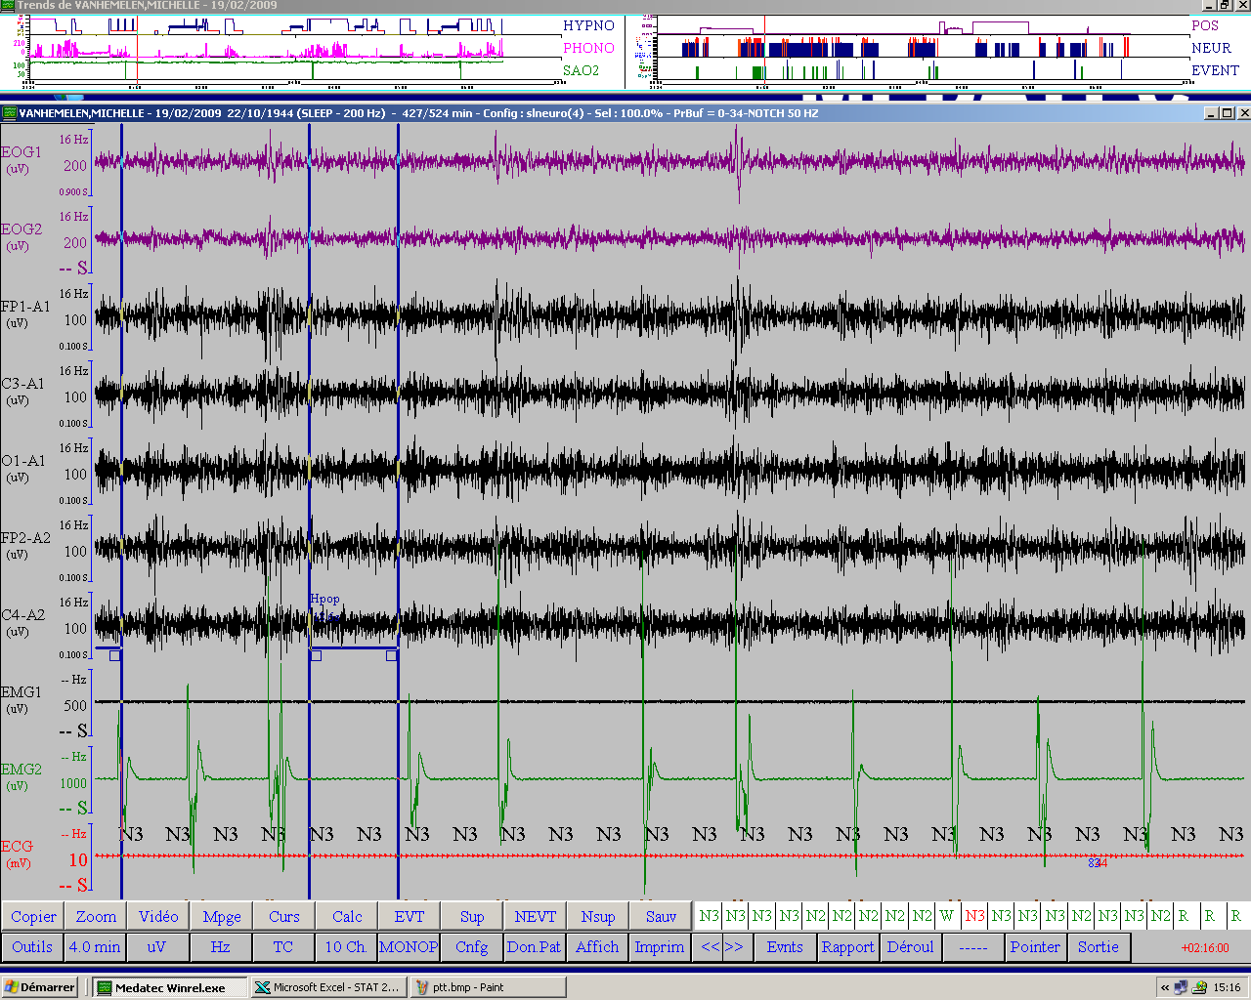

Slide 35
Treatment
Avoid precipiting factors (cafeine, alcohol, SSRI, antidopaminergic, OSA)
Iron supplementation if serum ferritin ≤ 75 ng/mL or transferrin saturation < 20%
Gabapentin
  Vs PLB: Effective in RLS, decrease symptoms and increase sleep quality on PSG Garcia-Borreguero D Neurology 2001
Pregabalin
Dypiridamole
oxycodone
And forget……Dopaminergic agonists, Benzodiazepines,…
Winckelman W J Clin Sleep Med 2025

Slide 36
Isoflavones
One study showing Similar to HRT for fracture prevention Bolanos R Menopause 2010
For sleep problems: Hachul H Menopause 2011
  38 W; 80mg isoF vs PLB, 4 months
  PSG: ⇑ SE
  Subjective sleep quality improvement
  TOFU 100g= 30 mg isoF
  SOJA drinks 250 mL = 20 mg isoF
« Phytoestrogens may provide a safe and partially effective alternative to HT » Bedell S J Steroid biochem Mol Biol 2014
No effect on VMS Cochrane Database Syst Rev 2013

Slide 37

Conclusion
Menopause = period of worsening of sleep quality
  < normal aging
  < hormonal changes (VMS, mood disturbances)
  Occurrence/worsening of obstructive sleep apnea , restless legs syndrome
Do not minimize sleep complaints!
  Send the patient to the sleep specialist
  PSG will be often required to exlude OSA/RLS
  Specific and efficient treatments for different disorders (primary sleep disorders or comorbid sleep disorders) can be offered
  Several drugs in development/FDA approved/coming soon…
    Elinzanetant, zuranolone, Lamborexant

