Slide 1
“BMS Review November 22, 2025"
Serge Rozenberg, CHU St Pierre Université libre de Bruxelles
Vrije Universiteit Brussel
Belgium serge_rozenberg@stpierre-bru.be serge.rozenberg@skynet.be

Slide 2
Conflict of interest & Disclosure
Disclaimer: no conflict of interest
Disclosures SR
Research funding IRIS- King Baudouin Fondation, Vesale research Foundation, Speakers bureau &/or Advisory Boards
Theramex, Abbot, Gedeon Richter, MSD, Amgen, Serylis Pharma, Besins, UCB, Orifarm, Astellas, Bayer, Aspen

Slide 3
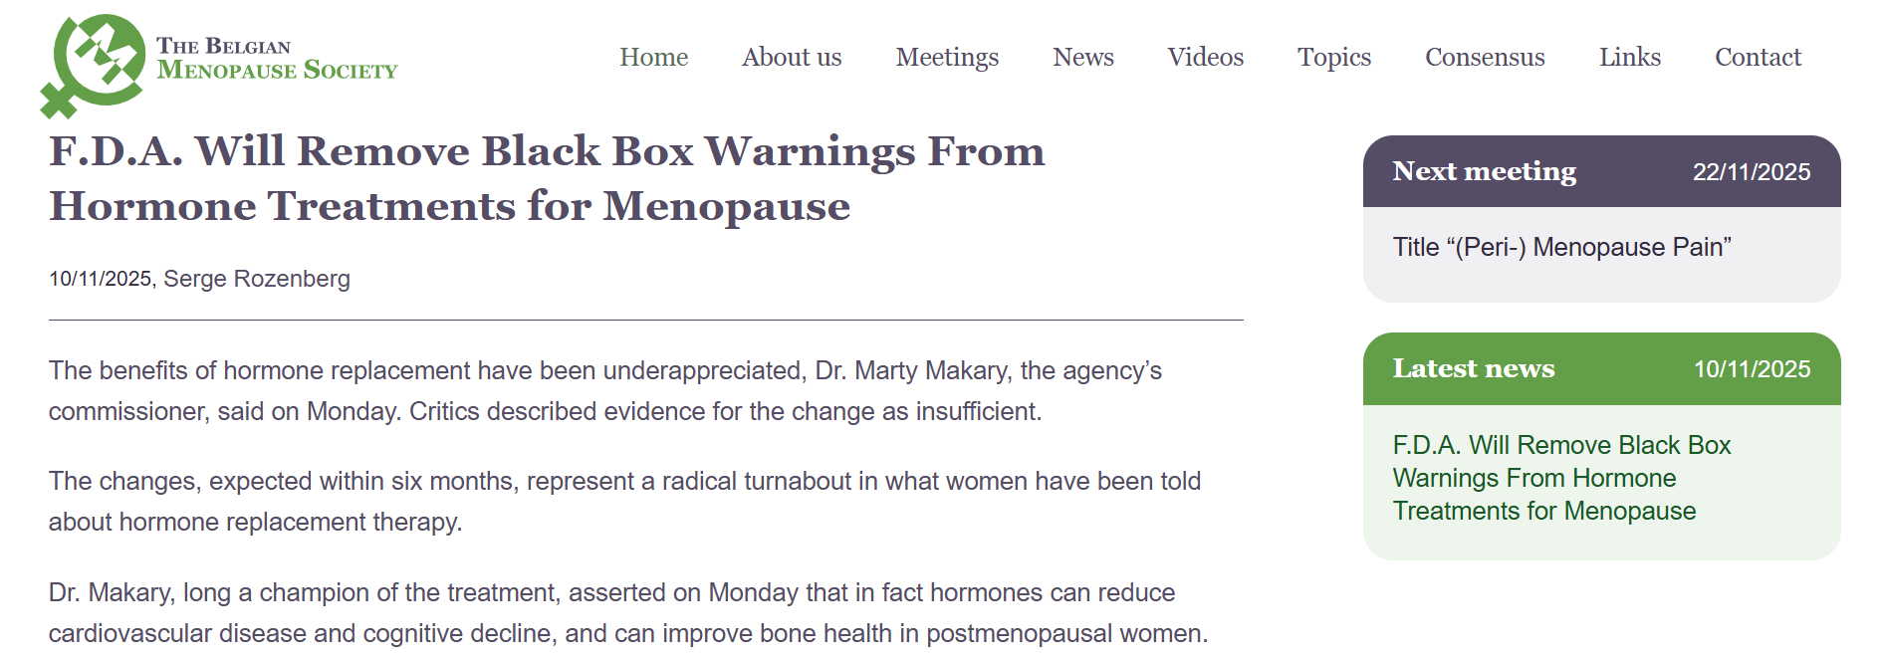

Slide 4
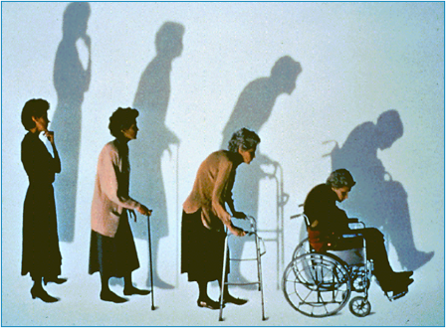
Osteoporosis
What happens after discontinutaion of MHT ? Do you lose bone rapidly or do you keep some of the bone sparing benefit of MHT ?

Slide 5
Discontinuation of menopausal hormone therapy and risk of fracture: nested case-control studies using routinely collected primary care data
Nested case-control study using UK
Women > 40 years (199-2023) (n=648 747 ), and with a first record for any fracture, matched at the fracture index date with up to 5 controls (n=2 357 125) with no fracture history,
Vinogradova Y,et al Lancet Healthy Longev. 2025 Jul;6(7):100729. doi: 10.1016/j.lanhl.2025.100729. Epub 2025 Jul 23. PMID: 40713950; PMCID: PMC12316639.

Slide 6
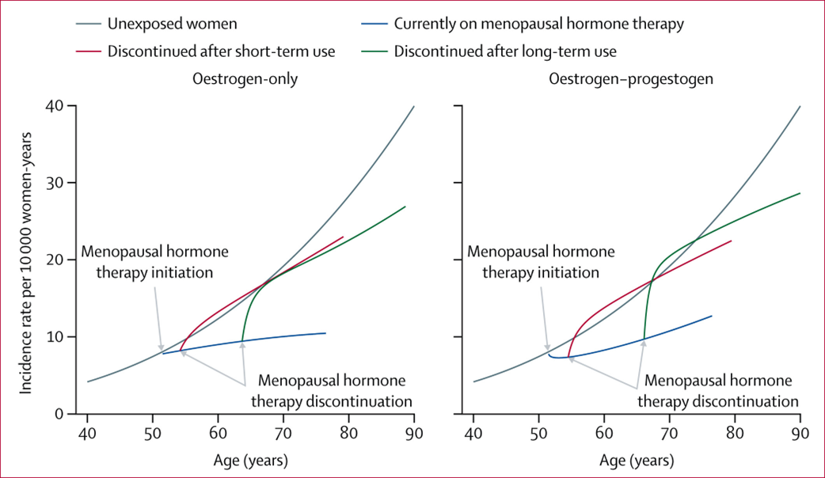
Discontinuation of menopausal hormone therapy and risk of fracture: nested case-control studies using routinely collected primary care data
Vinogradova Y,et al Lancet Healthy Longev. 2025

Slide 7
Osteoporosis
Can Frax be improved ?

Slide 8
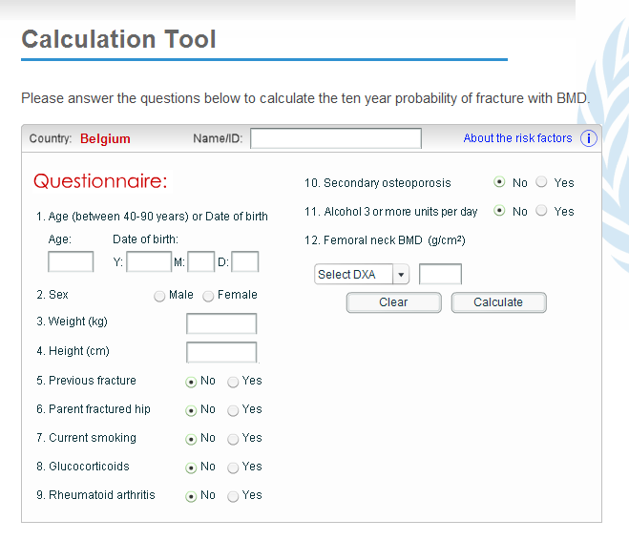
WHO Fracture Risk Assessment Tool¹
http://www.shef.ac.uk/FRAX
1. WHO FRAX tool. Available from http://www.shef.ac.uk/FRAX/tool.jsp

Slide 9
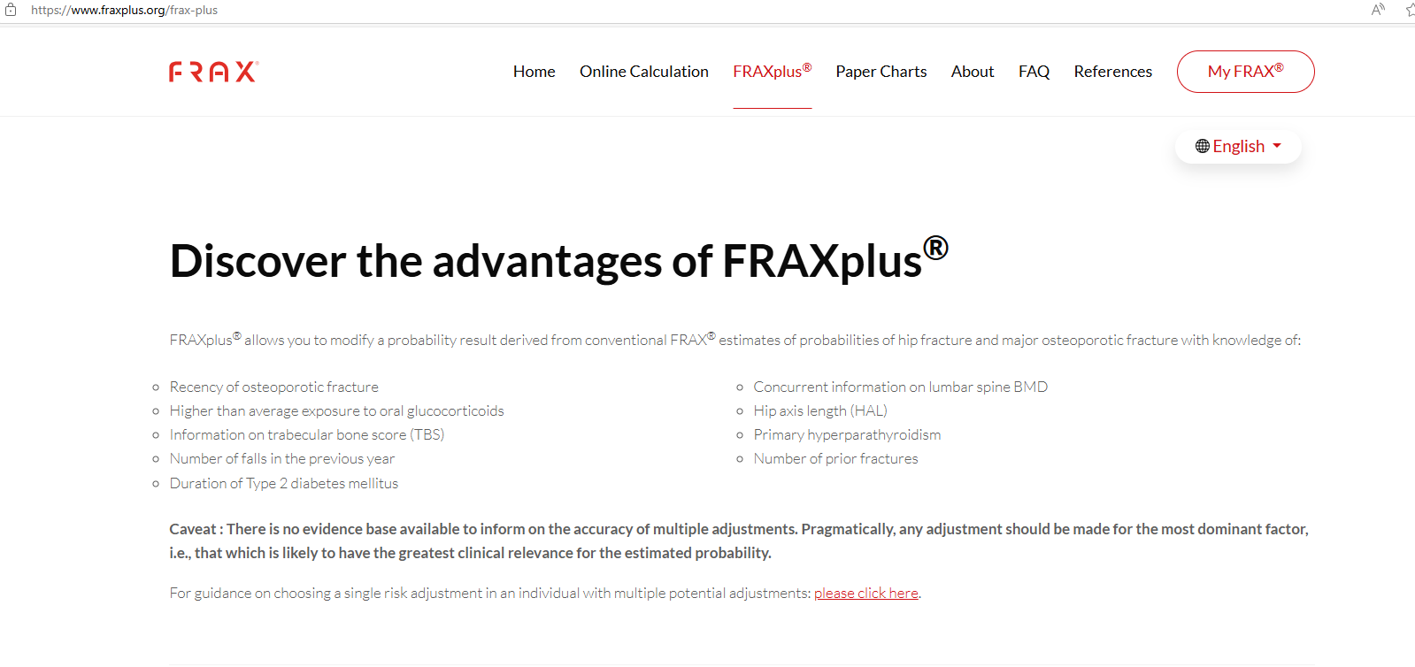
WHO Fracture Risk Assessment Tool

Slide 10
FRAX
Treatment should be considered when there is a 10 year hip fracture risk of at least 3% (and less than 70 years) or 5% (and ≥70 years)
or a 20% risk (all ages) of a major osteoporotic fracture (MOF)
Sanchez-Rodriguez D, Bergmann P, Body JJ, Cavalier E, Gielen E, Goemaere S, Lapauw B, Laurent MR, Rozenberg S, Honvo G, Beaudart C, Bruyère O. The Belgian Bone Club 2020 guidelines for the management of osteoporosis in postmenopausal women. Maturitas. 2020

Slide 11
Osteoporosis
Prevention of bone loss and fractures with a single Zoledronic acid perfusion ?

Slide 12
Fracture Prevention with Infrequent Zoledronate in Women 50 to 60 Years of Age
10-year, prospective, RCT early postmenopausal women (50 to 60 years of age) with bone mineral density T scores lower than 0 and higher than -2.5 (scores of -1 or higher typically indicate normal bone mineral density) at the lumbar spine, femoral neck, or hip.
zoledronate 5 mg at baseline and at 5 years (zoledronate-zoledronate group), zoledronate 5 mg at baseline and placebo at 5 years (zoledronate-placebo group), or (placebo-placebo group).
Spinal radiographs were obtained at baseline, 5 years, and 10 years.
1054 women with a mean age of 56.0 years at baseline, 1003 (95.2%) completed 10 years of follow-up.
A new morphometric fracture occurred in 22 women (6.3%) in the zoledronate-zoledronate group, in 23 women (6.6%) in the zoledronate-placebo group, and in 39 women (11.1%) in the placebo-placebo group (RR, zoledronate-zoledronate vs. placebo-placebo, 0.56 [95%{CI}, 0.34-0.92; P = 0.04]; and zoledronate-placebo vs. placebo-placebo, 0.59 [95% CI, 0.36 to 0.97; P = 0.08]).
RR of fragility fracture, any fracture, and major osteoporotic fracture was 0.72 (95% CI, 0.55 - 0.93), 0.70 (95% CI, 0.56 - 0.88), and 0.60 (95% CI, 0.42- 0.86), respectively, when zoledronate-zoledronate was compared with placebo-placebo and 0.79 (95% CI, 0.61 - 1.02), 0.77 (95% CI, 0.62 - 0.97), and 0.71 (95% CI, 0.51 - 0.99), respectively, when zoledronate-placebo was compared with placebo-placebo.
Conclusions: Ten years after trial initiation, zoledronate administered at baseline and 5 years was effective in preventing morphometric vertebral fracture in early postmenopausal women.
Bolland MJ, et al . N Engl J Med. 2025 Jan 16;392(3):239-248. doi: 10.1056/NEJMoa2407031. PMID: 39813642.

Slide 13
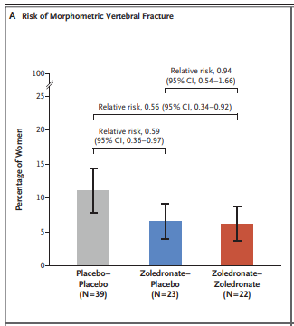
Fracture Prevention with Infrequent Zoledronate in Women 50 to 60 Years of Age
Bolland MJ, et al . N Engl J Med. 2025 Jan 16;392(3):239-248. doi: 10.1056/NEJMoa2407031. PMID: 39813642.

Slide 14

Cardiovascular

Slide 15
Cardiovascular
WHI data first global results : No Benefit of MHT …
But....
Actually, benefit of E-therapy before < 60 yrs , not so of E-P (but MPA!)
Women with VMS may have increased CVD risk …
So What about these women?

Slide 16
MHT and CVD in Women With Vasomotor Symptoms: A Secondary Analysis of the WHI RCT
CEE alone and CEE + MPA neutral effects on ASCVD in women with VMS aged 50-59 years (CEE alone: HR, 0.85; 95% CI, 0.53-1.35; CEE + MPA: HR, 0.84; 95% CI, 0.44-1.57).
No harm in women with VMS aged 60-69 years, (CEE alone: HR, 1.31; 95% CI, 0.90-1.90; CEE + MPA: HR, 0.84; 95% CI, 0.51-1.39).
Women with VMS > 70 years had increased risks of ASCVD (CEE alone: HR, 1.95; 95% CI, 1.06-3.59; 217 excess events per 10 000 person-years; CEE + MPA: HR, 3.22; 95% CI, 1.36-7.63; 382 excess events per 10 000 person-years).
Rossouw JE,et al JAMA Intern Med. 2025 Nov 1;185(11):1330-1339.

Slide 17
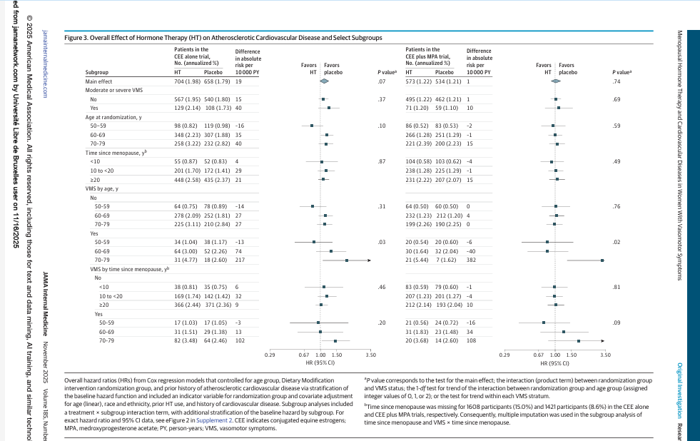

Slide 18
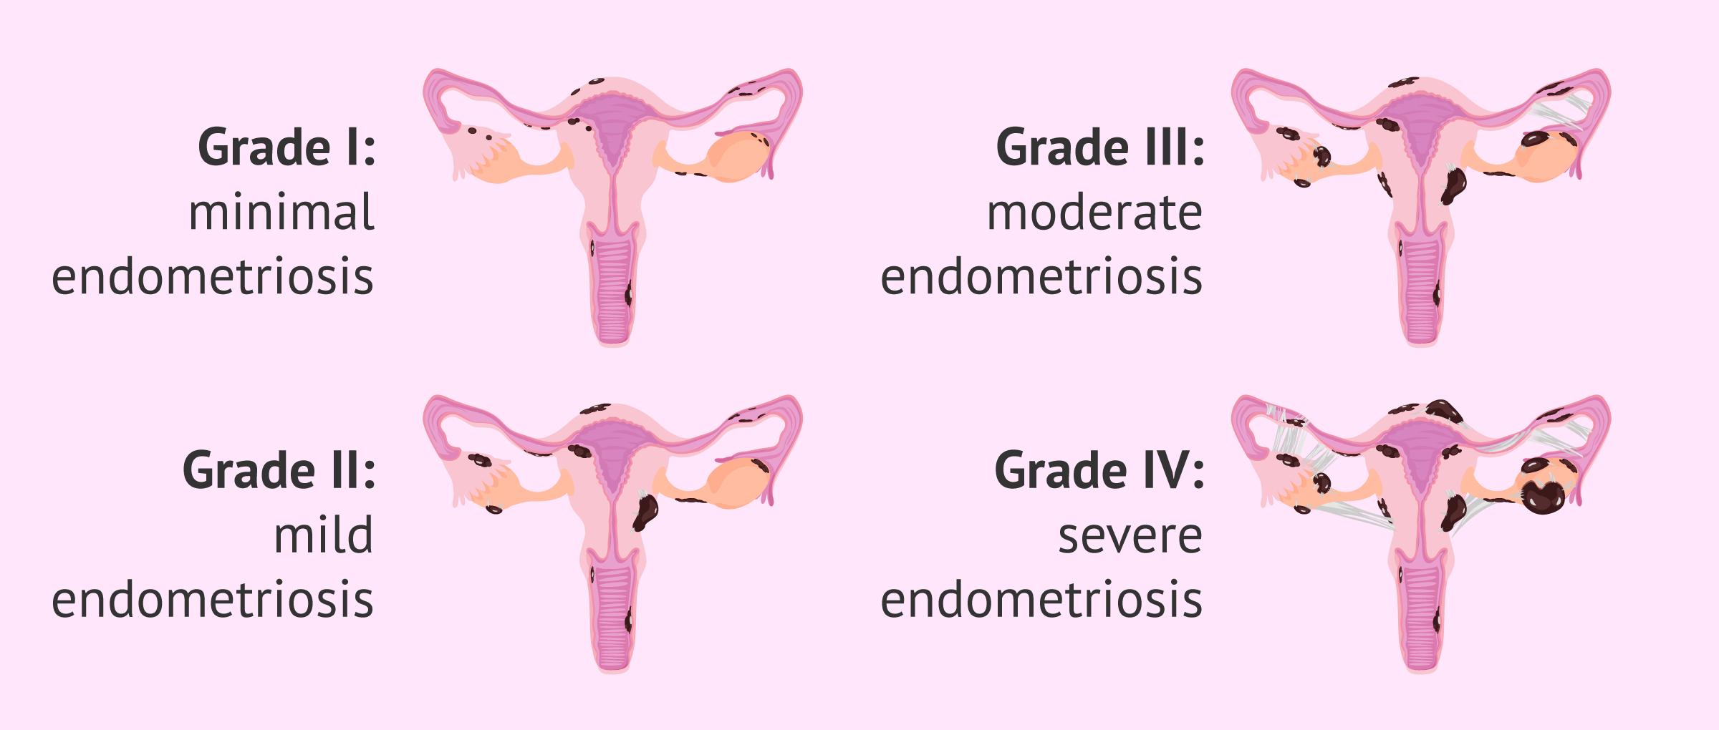
Endometriosis & menopause
Inflammatory disease and diminished ovarian reserve
Earlier menopause due to surgery and/or to endometriosis

Slide 19
Association between endometriosis and type and age of menopause: a pooled analysis of 279 948 women from five cohort studies
The study analysed individual-level data from 279 948 women in five cohort studies conducted in the UK, Australia, Sweden, and Japan between 1996 and 2022.
Women with endometriosis had a 7-fold increased risk of undergoing surgical menopause rather than natural menopause
and were more likely to experience premature or early menopause, both surgically and naturally.
Hsin-Fang Chung, et al Human Reproduction, June 2025,

Slide 20
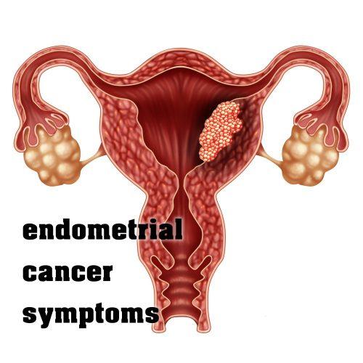
ART & Endometrial Cancer
Increased risk ?

Slide 21
Long-term risk of endometrial cancer after assisted reproductive technology
The OMEGA-cohort (n= 30 625 women who received ovarian stimulation for ART (ART group) in 1983–2000 and 9988 subfertile women not treated with ART (non-ART group). After a median follow-up of 24 years,
The risk of endometrial cancer is not increased in women who underwent ART in the Netherlands between 1983 and 2001, neither compared with women from the general population nor compared with subfertile women not treated with ART.
Mandy Spaan, et al Human Reproduction, , April 2025,

Slide 22
Risk of endometrial cancer after insufficient endometrial biopsy: a retrospective cohort study
Retrospective cohort study, Danish Pathology Register endometrial biopsies between 2013 and 2017.
Initial and follow-up samples as normal, insufficient, hyperplastic,
4 years of follow-up until December 31, 2021, a
Kaplan-Meier analysis, a log-rank test, and Cox regression.
Vang, Chanella et al. American Journal of Obstetrics & Gynecology, Volume 233, Issue 5, 457.e1 - 457.e10

Slide 23
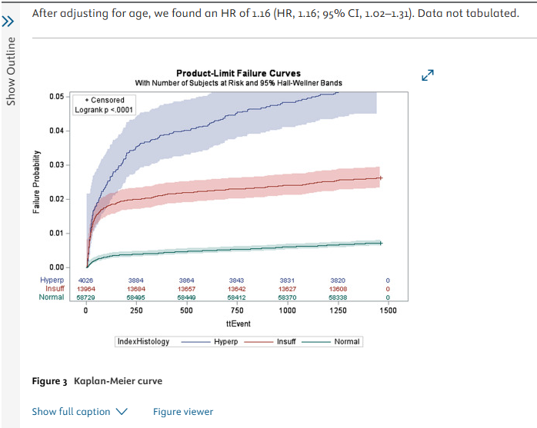
Risk of endometrial cancer after insufficient endometrial biopsy: a retrospective cohort study
Vang, Chanella et al. American Journal of Obstetrics & Gynecology, Volume 233, Issue 5, 457.e1 - 457.e10

Slide 24
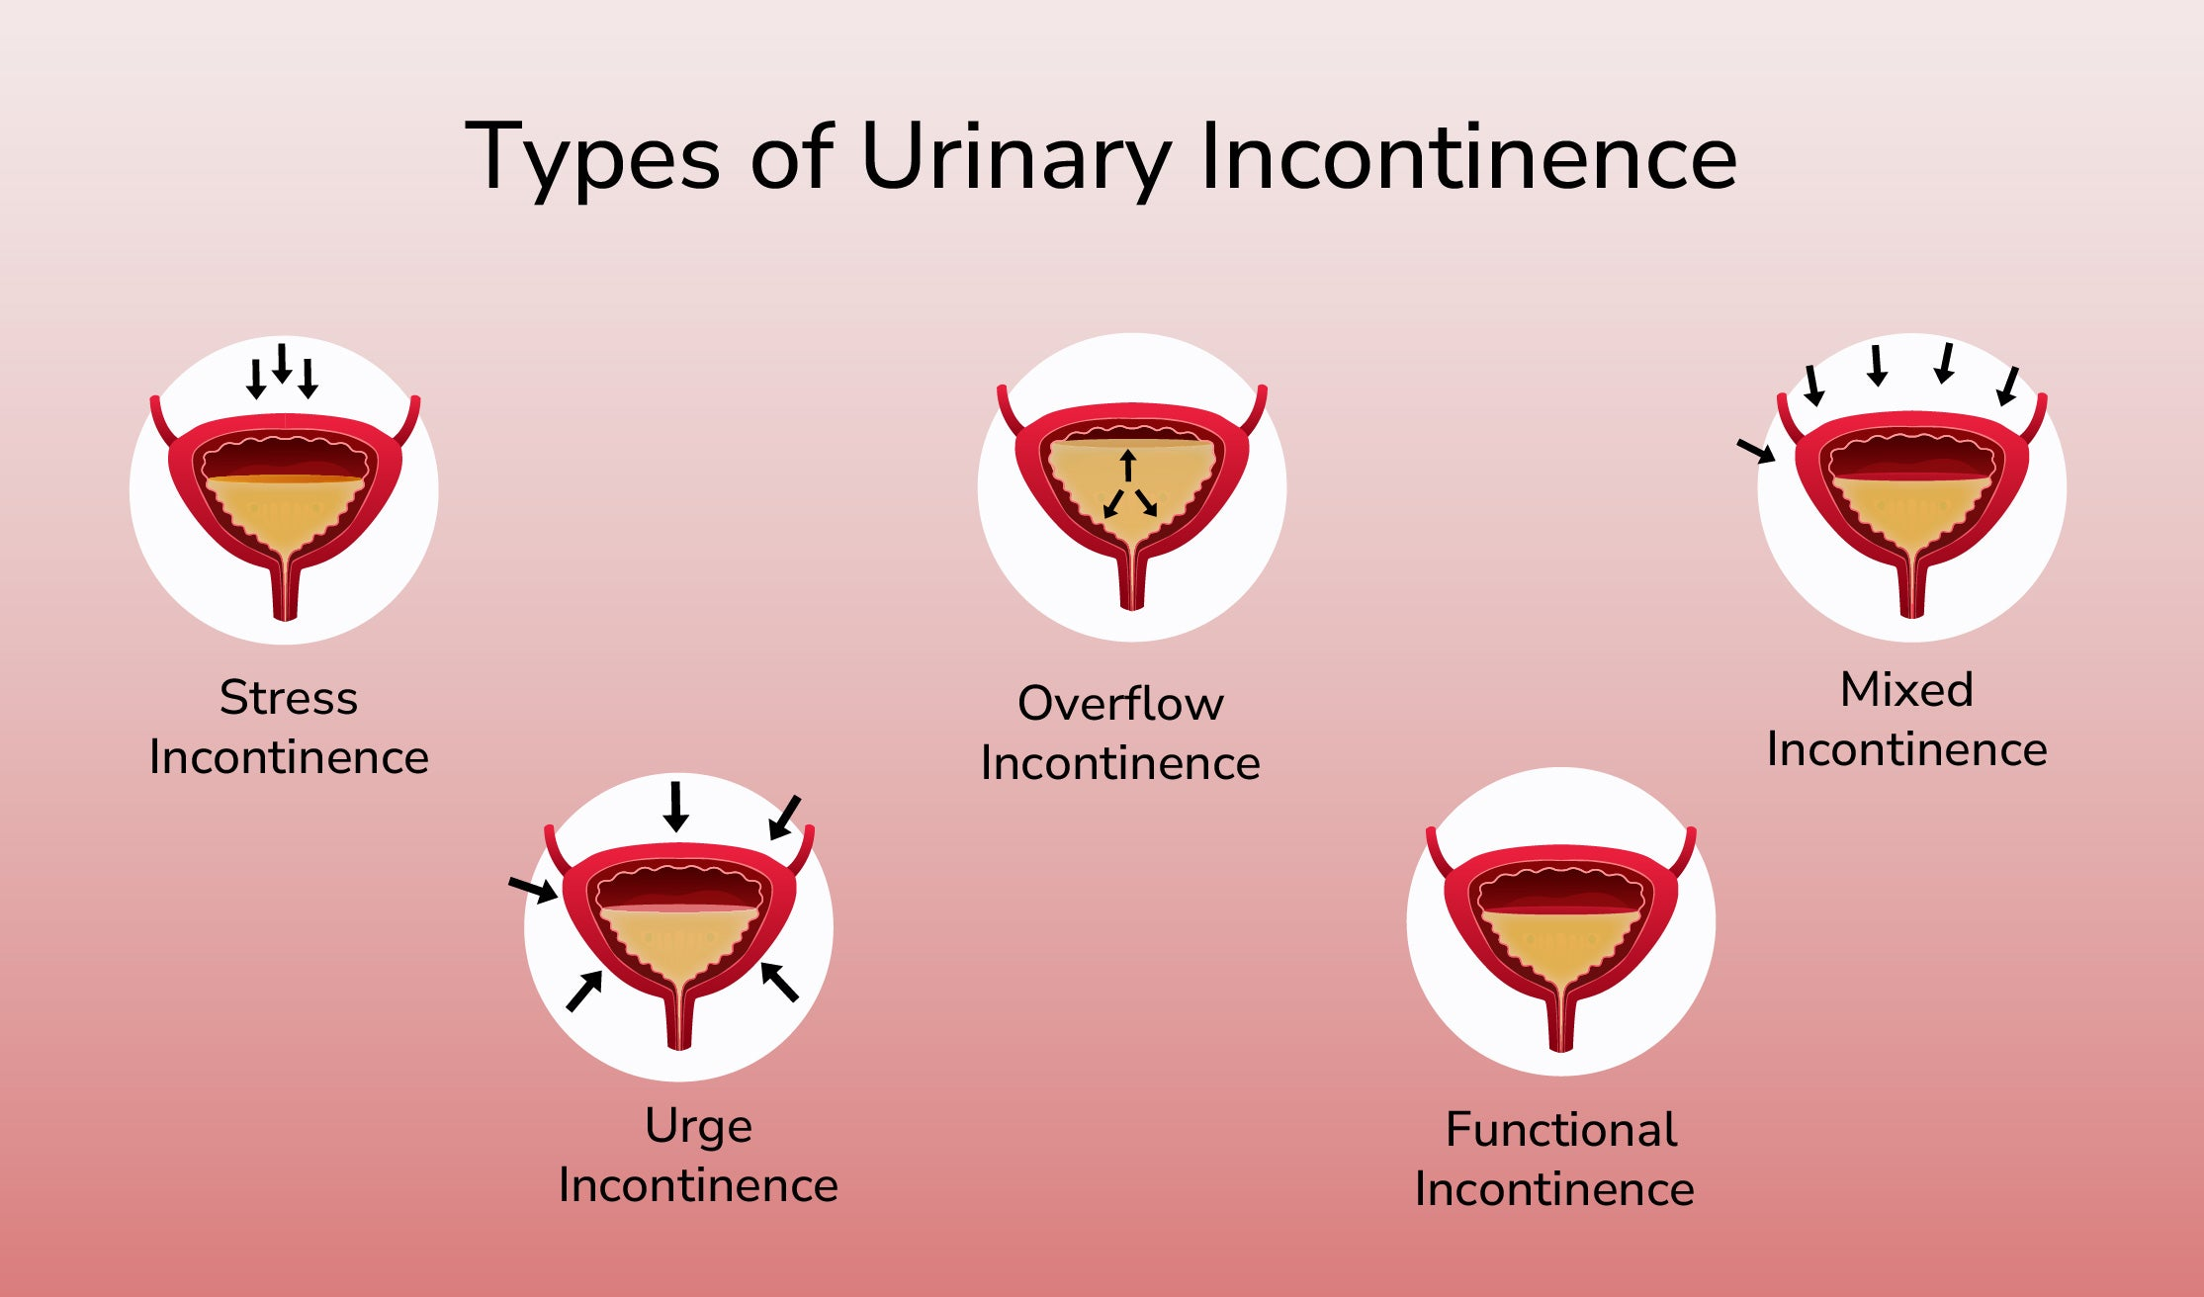

Slide 25
Double-blind randomized controlled trial of Er: YAG vaginal laser to treat female stress urinary incontinence
6-week and 6-month follow-ups
144 adult female patients with symptomatic stress urinary incontinence.
2 vaginal laser therapies 6 weeks apart, with patients randomized to either laser or sham.
YAG laser was no more effective than sham for curing or improving female stress urinary incontinence at 6 months.
Lee, Patricia et al. American Journal of Obstetrics & Gynecology, Volume 232, Issue 6, 541.e1 - 541.e12

Slide 26
VVA

Slide 27
Platelet-Rich Plasma for Genitourinary Syndrome of Menopause in Breast Cancer Survivors
prospective, single-arm pilot study of breast cancer survivors (stage 0–III) who reported vaginal dryness with or without dyspareunia. Participants underwent a one-time treatment with 7 mL autologous PRP injected throughout the vaginal canal and posterior fourchette into 35 sites. The primary outcome was to assess safety and feasibility. Secondary outcomes included VMI (Vaginal Maturation Index), VHI (Vaginal Health Index), VAS/VuAS (Vaginal and Vulvar Assessment Scales), DIVA (Day-to-Day Impact of Vaginal Aging questionnaire), FSFI (Female Sexual Function Index), and UDI-6 (Urogenital Distress Inventory–Short Form) scores. Vaginal caliber was measured with silicone dilators. Patient Global Impression of Improvement (PGI-I) was assessed with a 7-point Likert scale.
Chen, A. ,et al (2025). Platelet-Rich Plasma for Genitourinary Syndrome of Menopause in Breast Cancer Survivors. Obstetrics & Gynecology, 146 (5), 728-736. doi: 10.1097/AOG.0000000000006081.

Slide 28
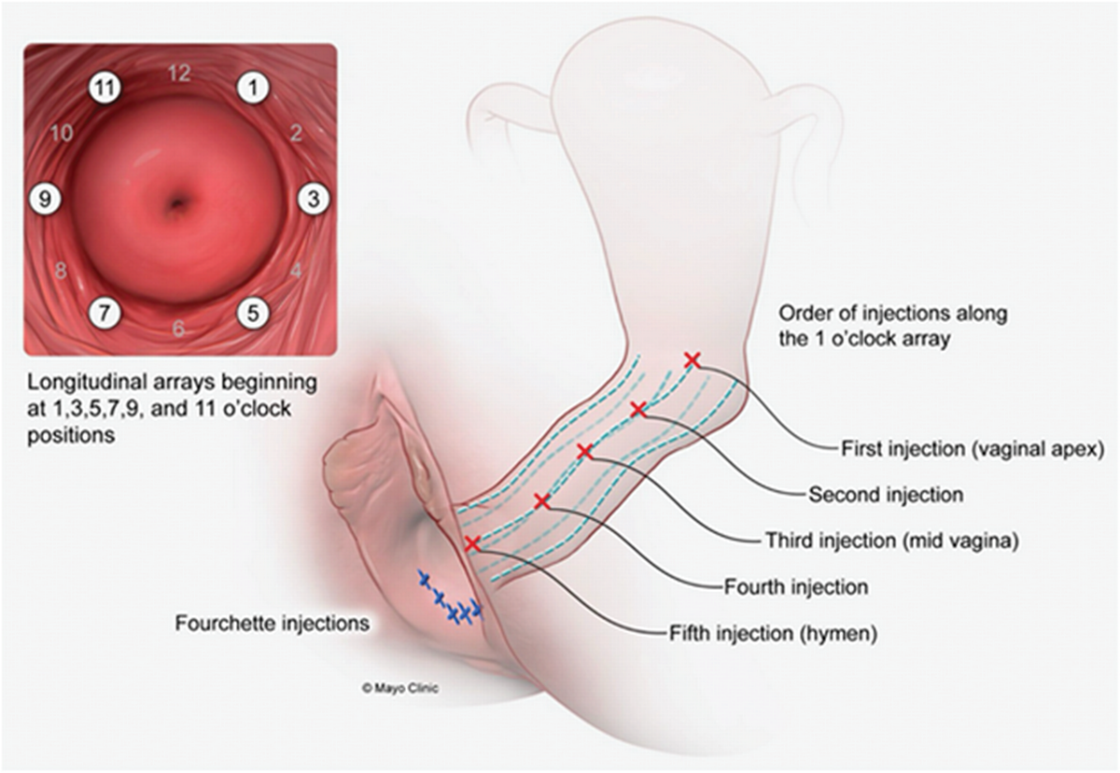
Chen, A. ,et al (2025). Platelet-Rich Plasma for Genitourinary Syndrome of Menopause in Breast Cancer Survivors. Obstetrics & Gynecology, 146 (5), 728-736. doi: 10.1097/AOG.0000000000006081.

Slide 29
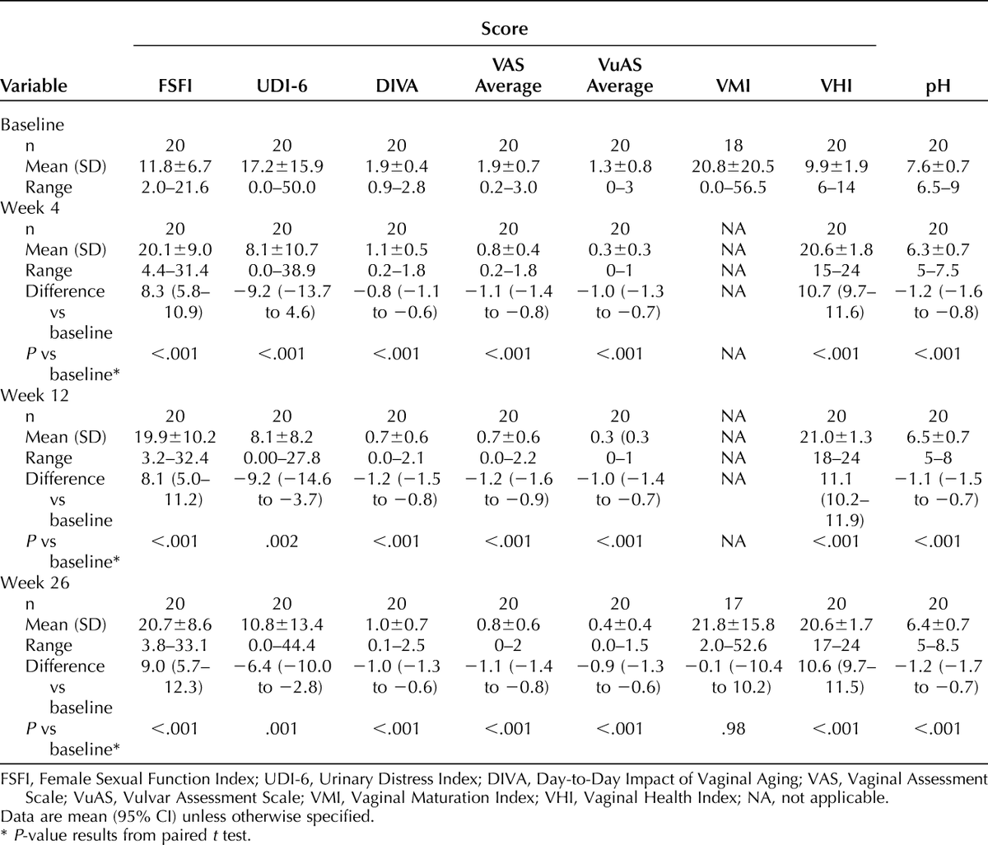
Chen, A. ,et al (2025). Platelet-Rich Plasma for Genitourinary Syndrome of Menopause in Breast Cancer Survivors. Obstetrics & Gynecology, 146 (5), 728-736. doi: 10.1097/AOG.0000000000006081.

Slide 30
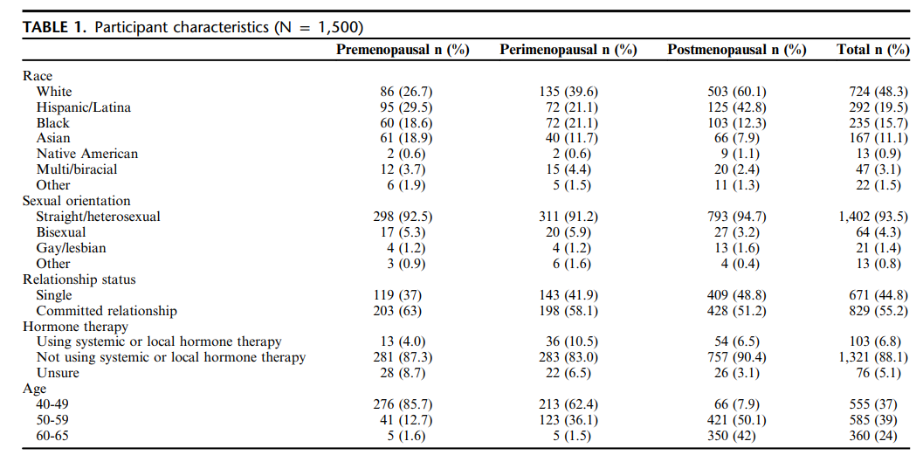
Masturbation frequency and experiences among US women aged 40-65 years: comparisons across different stages of the menopause transition
A nationally representative US sample of 1,500 women aged 40-65 (M age: 52.5 y) completed an online survey asking about their experiences during masturbation.
Graham, Cynthia A. et al Menoapuse 2025

Slide 31
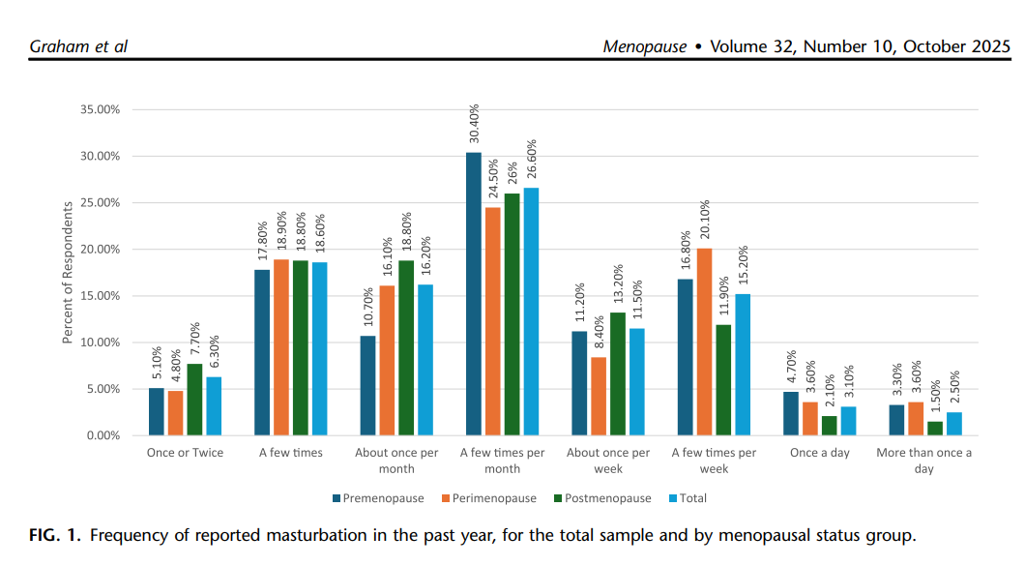
Masturbation frequency and experiences among US women aged 40-65 years: comparisons across different stages of the menopause transition
A nationally representative US sample of 1,500 women aged 40-65 (M age: 52.5 y) completed an online survey asking about their experiences during masturbation.
Graham, Cynthia A. et al Menoapuse 2025

Slide 32
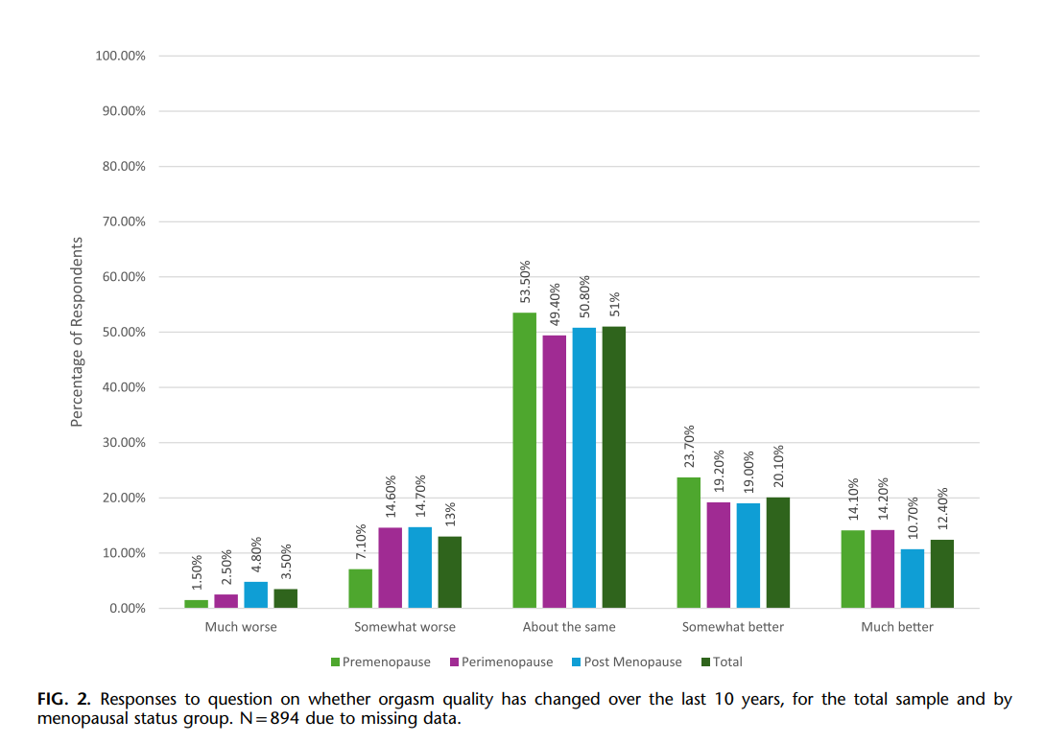
Masturbation frequency and experiences among US women aged 40-65 years: comparisons across different stages of the menopause transition
A nationally representative US sample of 1,500 women aged 40-65 (M age: 52.5 y) completed an online survey asking about their experiences during masturbation.
Graham, Cynthia A. et al Menoapuse 2025

Slide 33
Notes:
43

