Slide 1




Cardiovascular Health in Menopause:
Early Detection & Integrated Care
Belgian Menopause Society
17.01.2026
Bharati Shivalkar MD, PhD, FESC, Clin. Pharm/Pharm. Med

Slide 2
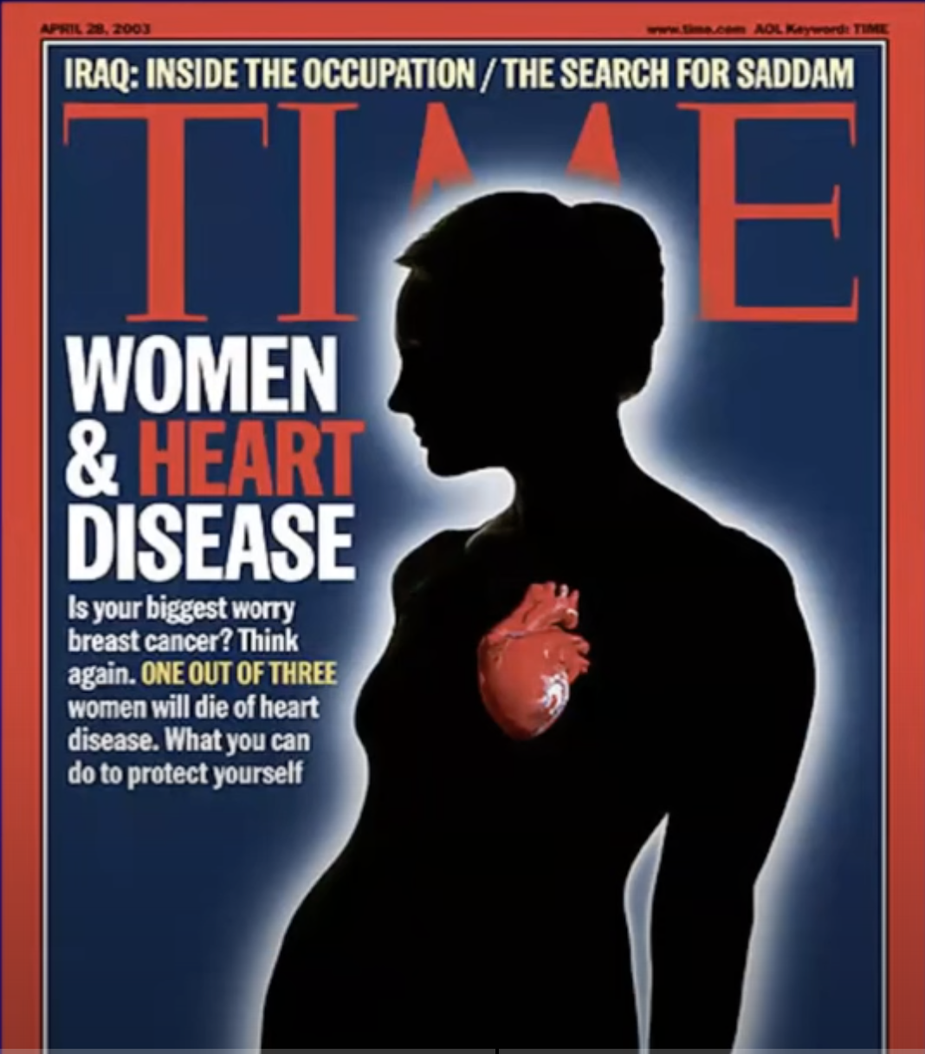
I. Epidemiology: CVD in Women
* Timelag of 10 yr between men & women for CAD development
* Before age 50 y, 2 x more AMI in men vs women
* Menopause = Inflection point, CVD risk accelerates
* Premature MN further amplifies risk of CVD
* CVD risk assessment underestimated in women
AHA Scientific Statement 2022. ESC Consensus Document 2024

Slide 3
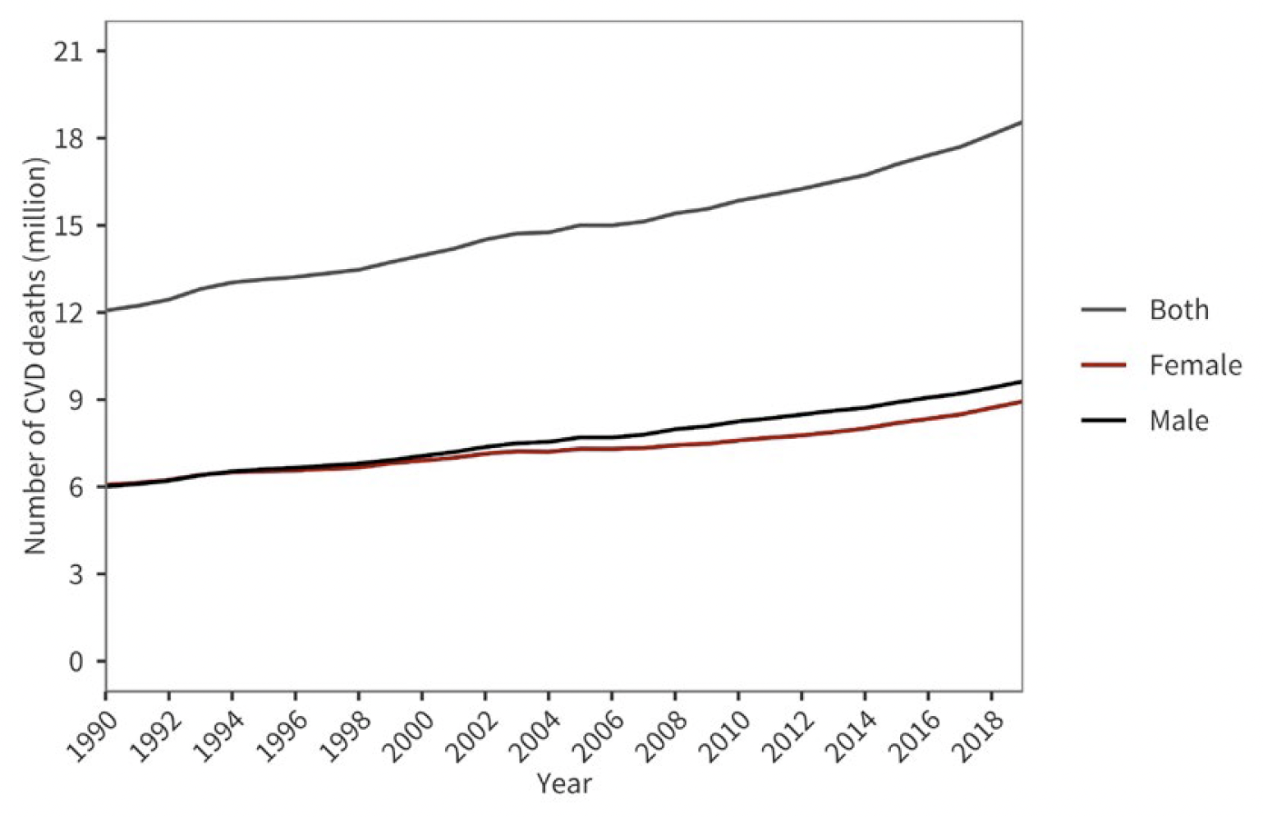
Global trends in deaths due to CVD
18.6 m
=> 1.6 x Belgian population
World heart report 2023. Confronting the world’s nr. one killer

Slide 4
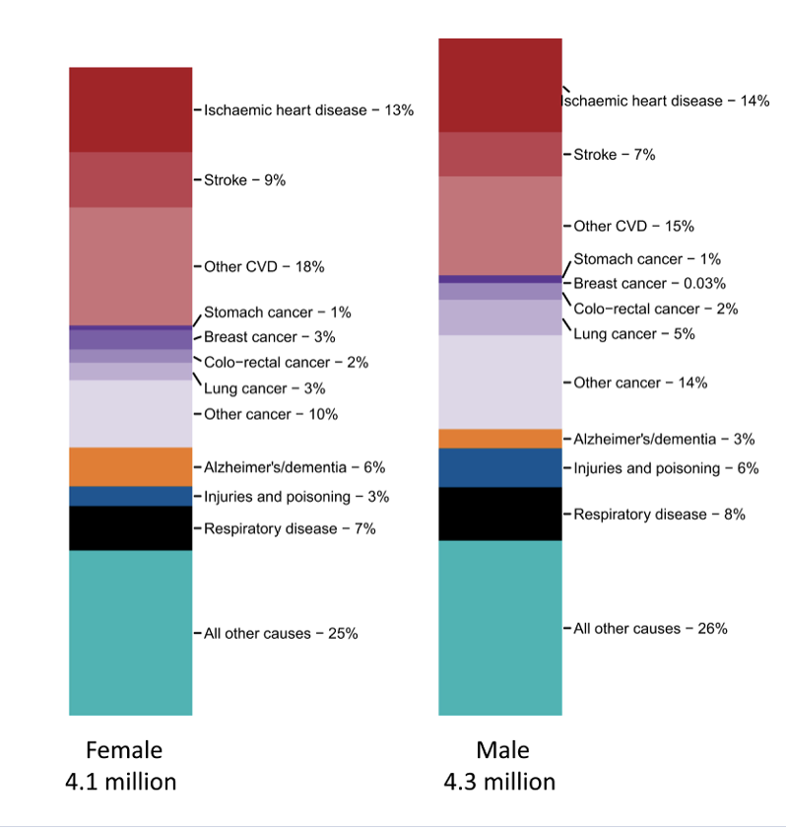
National Causes of Death in Females and Males in EU
CVD caused > 3M deaths
1.6 M in females
Nearly 1.5 M in males
40% of all deaths in females
35% of all deaths in males
Geographic disparities
East European countries have
higher deaths
(52% - 58% women, with
10% less in men)
CVD ⬄ huge toll on health, 62 M impacted in EU
⬄ huge economic burden, 282 BN Euro annual cost
Eur Heart J, Volume 45, Issue 38, 7 October 2024, Pages 4019–4062,
Notes:
These are EU averages with middle income countries having higher mortality , 53% vs 34% in women and 46% vs 30% in men
(Bulgaria and Romania at the higher end. Latvia, Lithuania, Estonia )

Slide 5
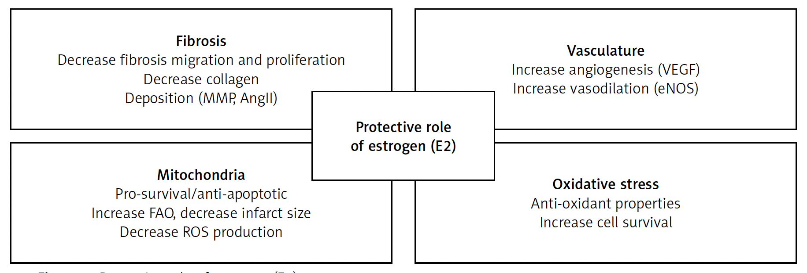
II. Menopause Transition and Physiology
Protective role of estrogen (E2)
Arch Med Sci 2023; 19 (2): 458–466
Notes:
Roughly 51 % of the worlds population is women. MN is an inflection point for CVD

Slide 6
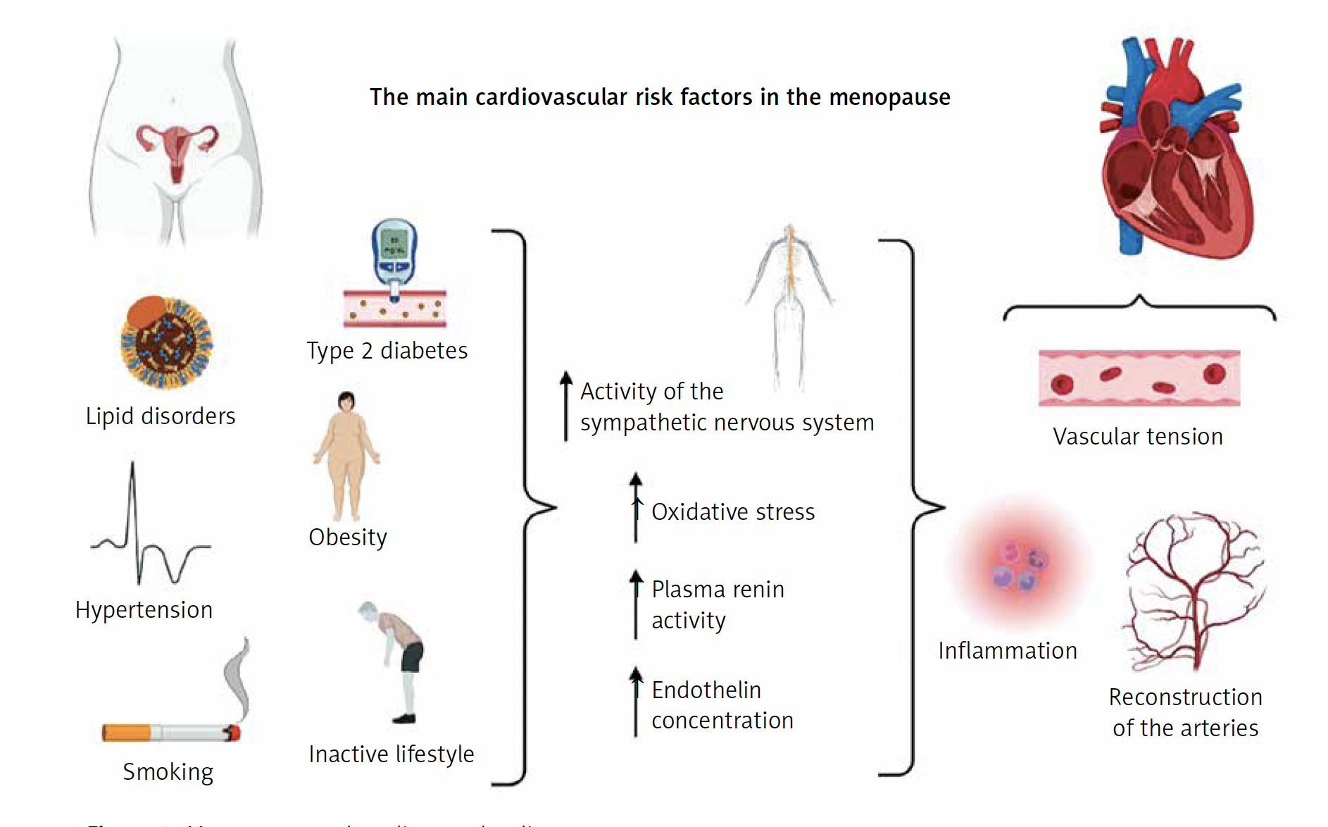
Menopause and Cardiovascular Disease
Ryczkowska et al. Arch Med Sci 2023; 19 (2): 458–466

Slide 7
III. Risk Assessment :Traditional Risk Factors
And Beyond

Slide 8
Traditional RFs have a greater impact
on women, yet CV risk is underestimated
Risk of death from CAD
RF | Men | Women
Smoking + hypertension
DM
Total chol. + LDL
HDL < 50mg/dL
Peri/post-menopausal women =
Oestrogen
Physical functioning
Sarcopenia, Osteoporosis
The WISE Investigators

Slide 9
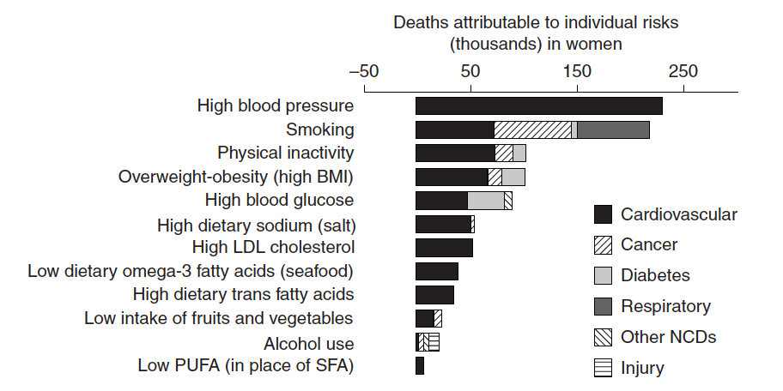
Deaths in women attributable to total effects of individual RF by disease
Data are for all women and do not reflect differences ethnic, racial and socioeconomic groups
Women’s Health Research. 2010

Slide 10
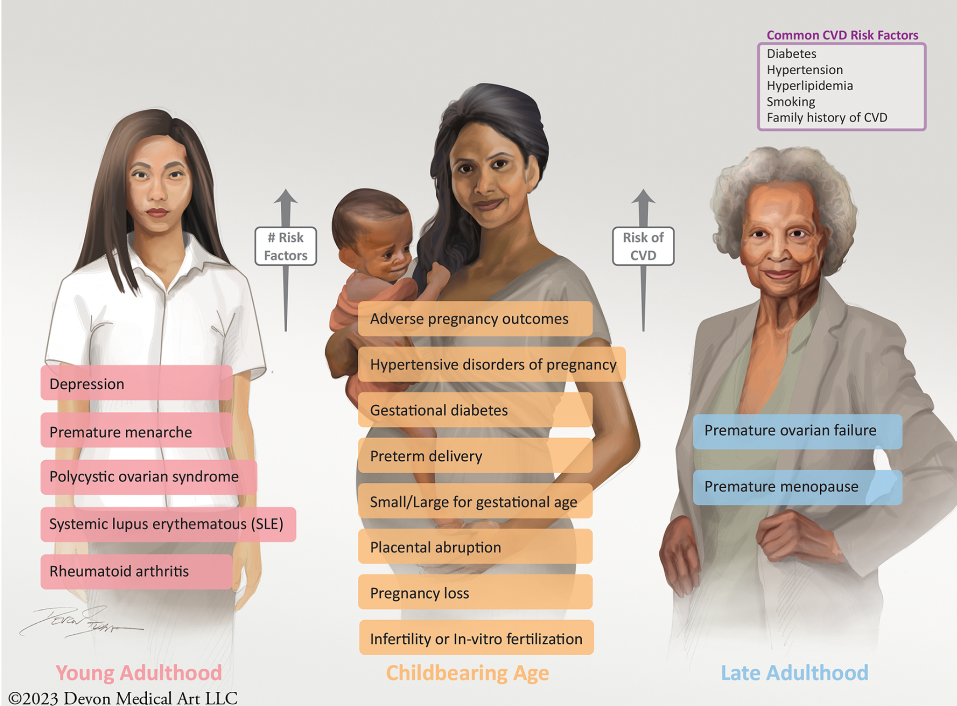
Sex specific/predominant CV risk factors & conditions
Endometriosis
AH Nguyen. Frontiers in CV Medicine. Feb 2024

Slide 11
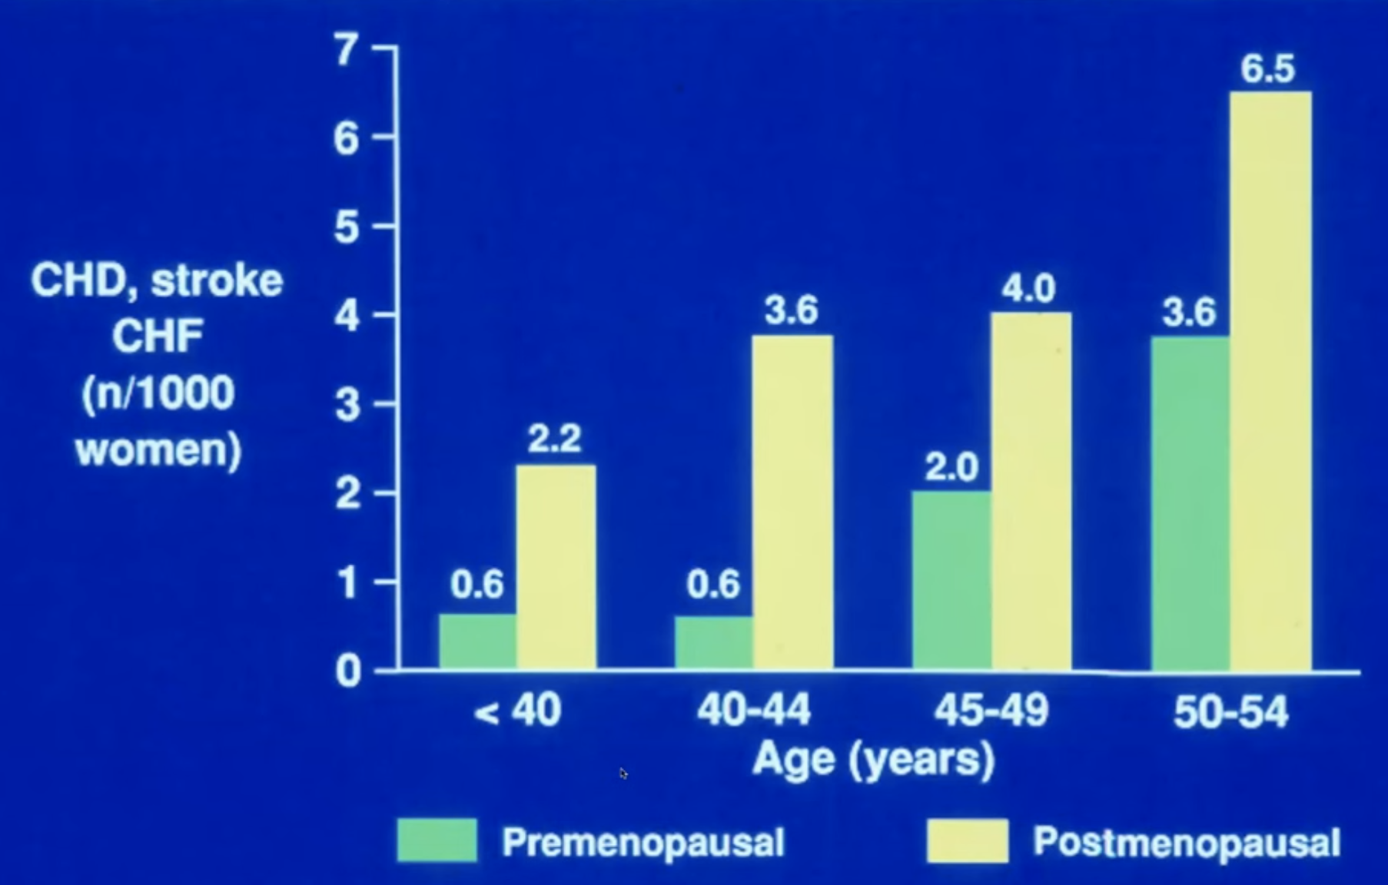
Menopause confers a higher CV risk at every age
Framingham Study : 18 y follow-up (Dhew, 1974, NIH 74-599
Notes:
Doubling risk in women older than 45y, is almost 4 – 6 x higher in younger women.

Slide 12
Early MN => increased CV Risk Factors
Oestrogen drop ⬄ ↑endothelin, angiotensinogen
Parameter | Women with surgical MN age < 40y | Women with natural MN age 40 – 45 y | Women with MN age ≥ 45y | MN hormone therapy (MHT)
Hypertension | ↑↑↑ | ↑↑ | ↑ | ↓
CAD | ↑↑ | ↑ | ↑ | ↓
HF | ↑↑ | ↑ | ↑ | ↓
Lipid disorders | ↑↑ | ↑ | ↑ | ↓
DM-II | ↑↑ | ↑ | ↑ | ↓
Obesity | ↑ | ↑ | ↑ | ↓
Ryczkowska et al. Arch Med Sci 2023; 19 (2): 458–466

Slide 13
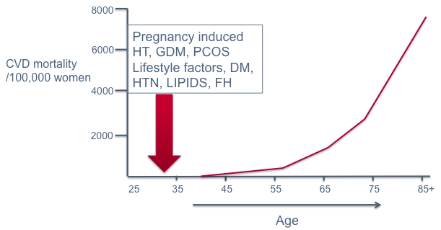
Cumulative causes of increased CV mortality in women during different “life phases”
menopause
Peri-menopause
CMAJ 2017

Slide 14
Women’s health gap⬄ women living in
poor health for 25% more of their lives than men
Conditions that affect life span:
* Ischemic heart disease (> 4 M deaths annually)
* Cervical cancer (350,000 deaths)
* Breast cancer (670,000 deaths)
* Maternal hypertensive disorder (70,000 deaths)
* Postpartum hemorrhage (70,000 deaths)
Conditions that affect health span:
* Menopause (450 M at any point in time; PMN /MN can last up to a decade)
* Premenstrual syndrome (1.8 BN menstruating women every month, 20 – 40% experience PMS)
* Migraine (21% of women)
* Endometriosis (1 in 10 women)
Mckinsey, January 2025. Closing women’s health gap

Slide 15
IV. Role of Cardiovascular Assessment With Imaging in Early Diagnosis

Slide 16
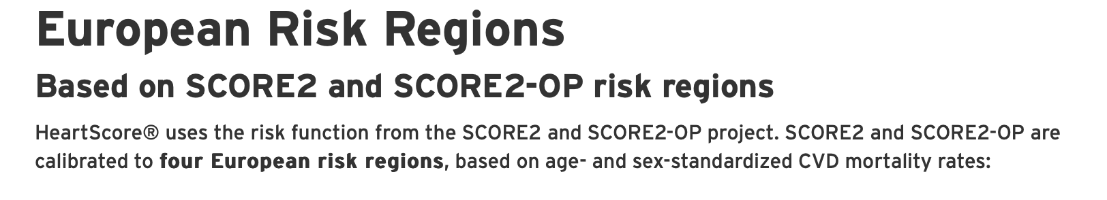
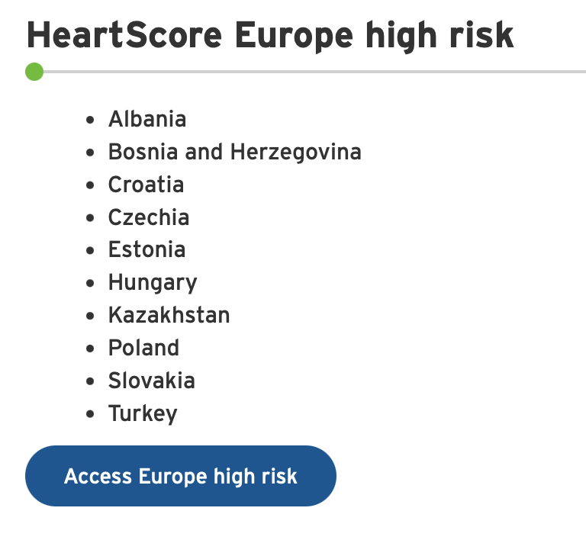
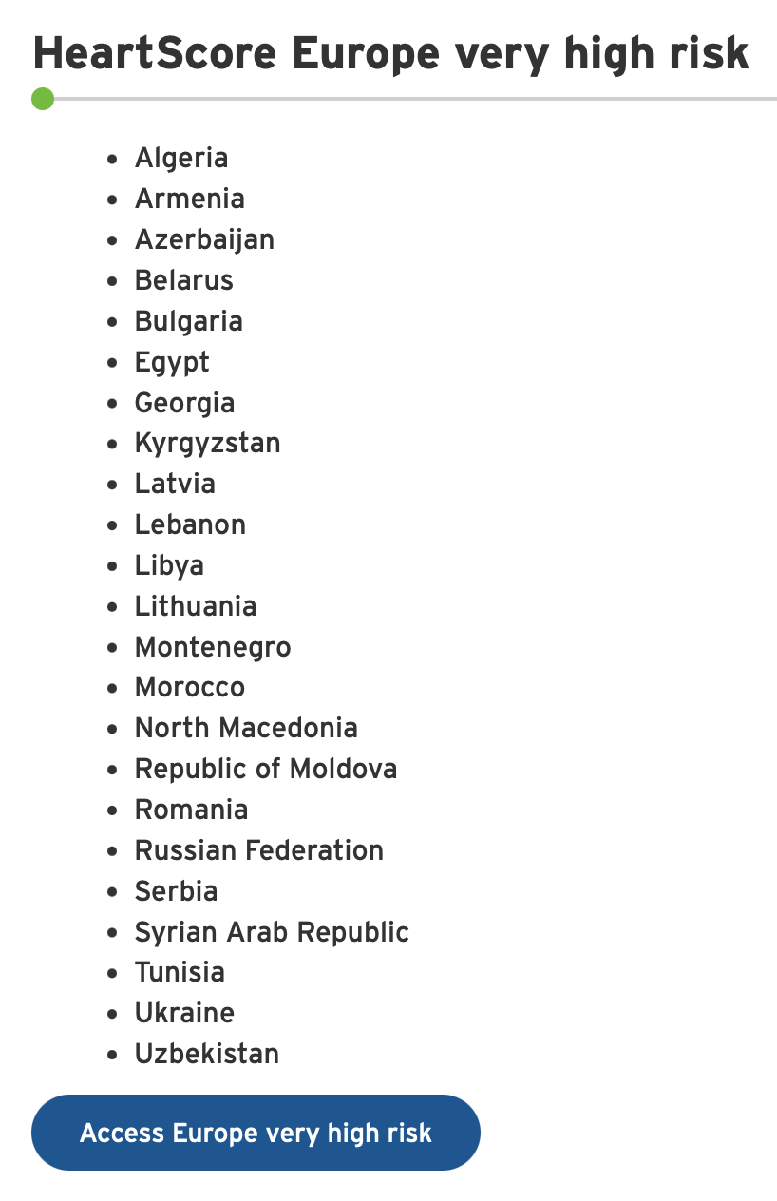
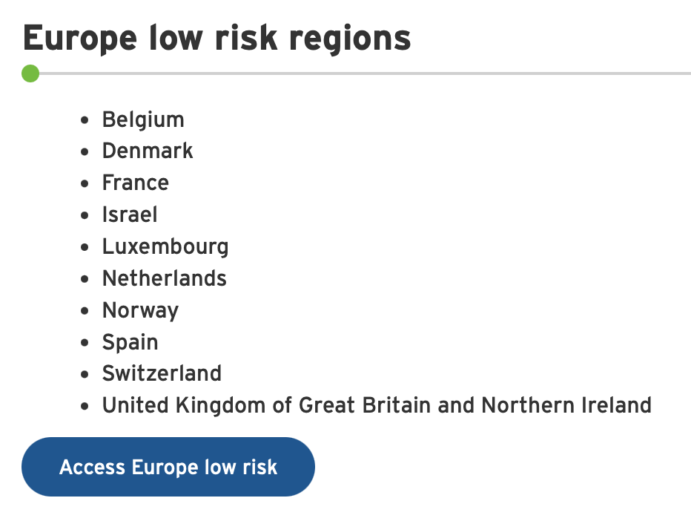
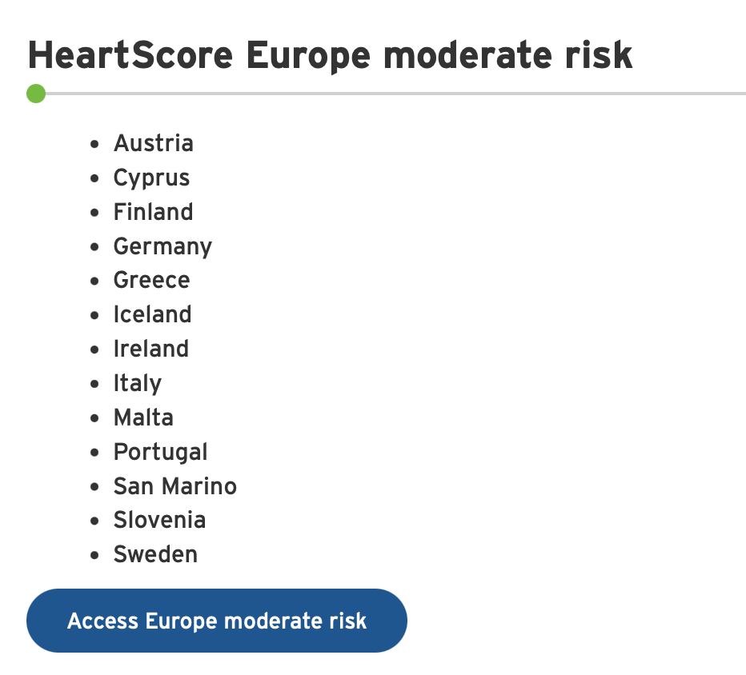

Slide 17
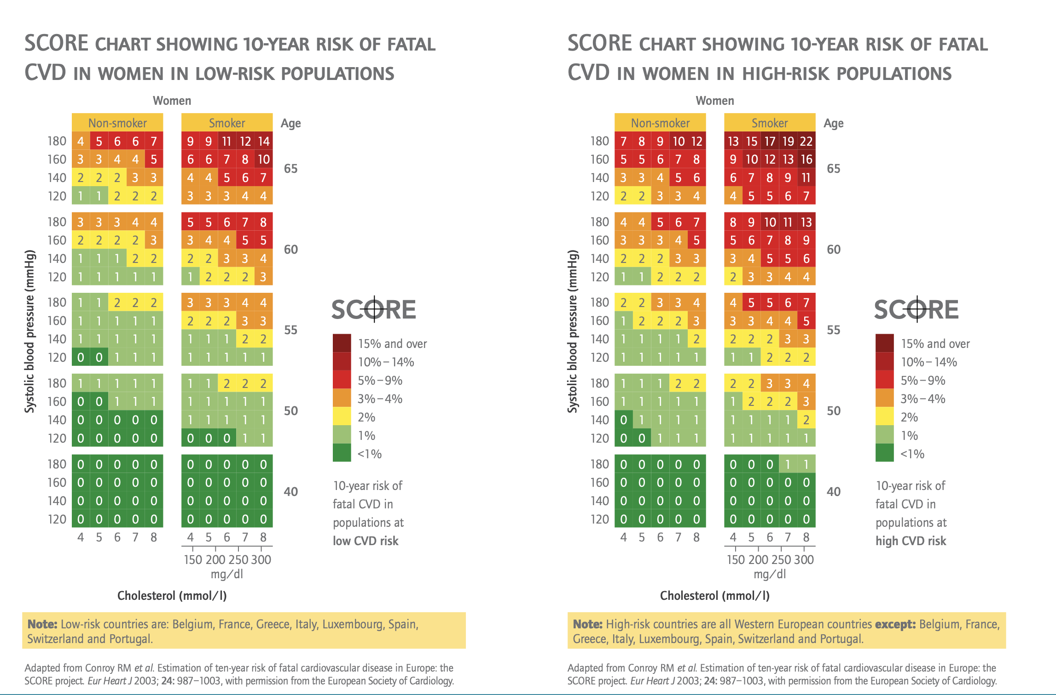
Traditional Risk Score Calculators Always Underestimate Risk in Women
Notes:
Age, gender, SBP, smoking status, cholesterol level, high and low risk countries

Slide 18
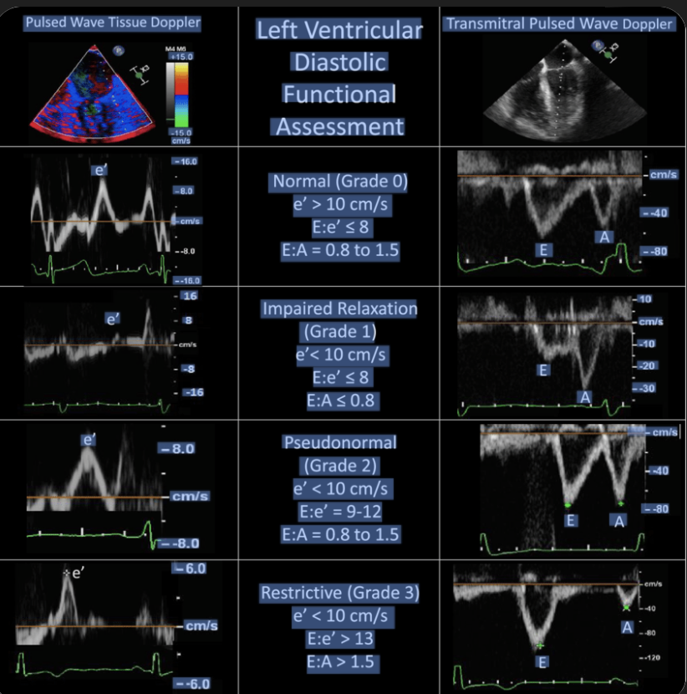
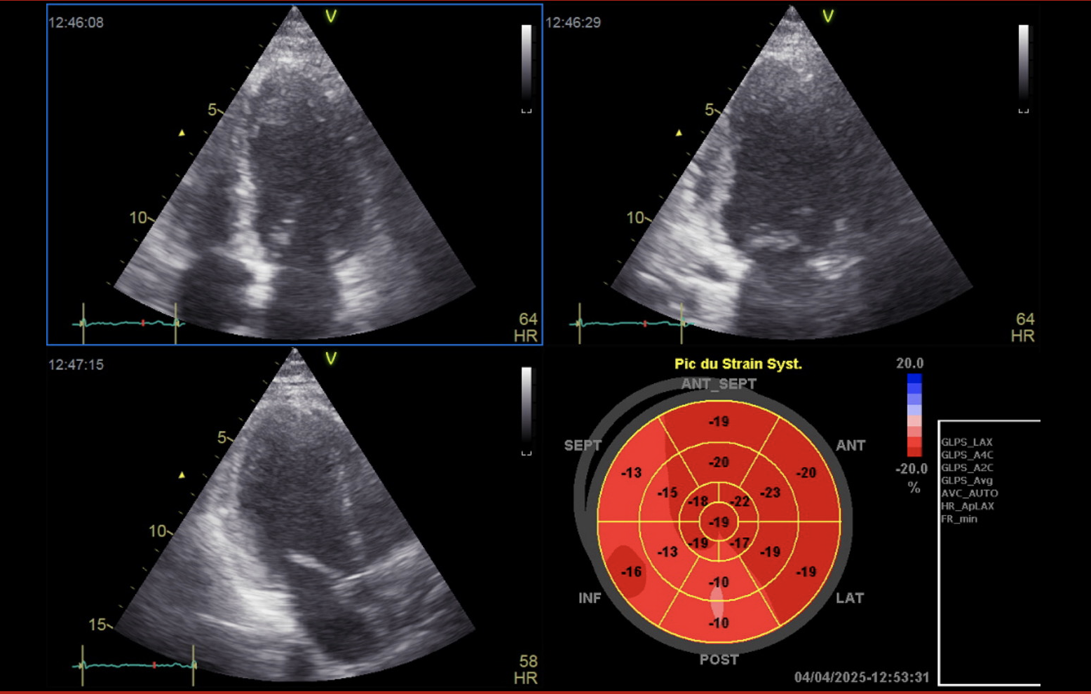
Cardiac Ultrasound in (Peri)Menopause
Diastology
Systolic function:
LVEF, GLS
GLS : -17%
LVEF 46%
Notes:
Subclinical diastolic dysfunction in peri-menopausal woman

Slide 19
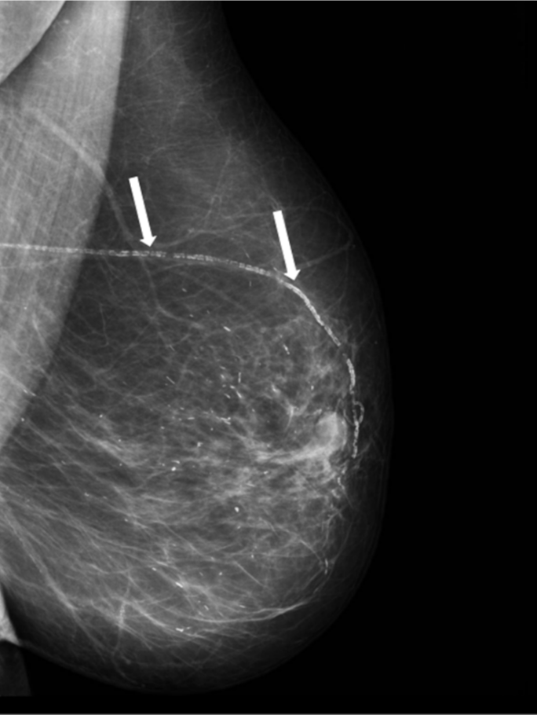
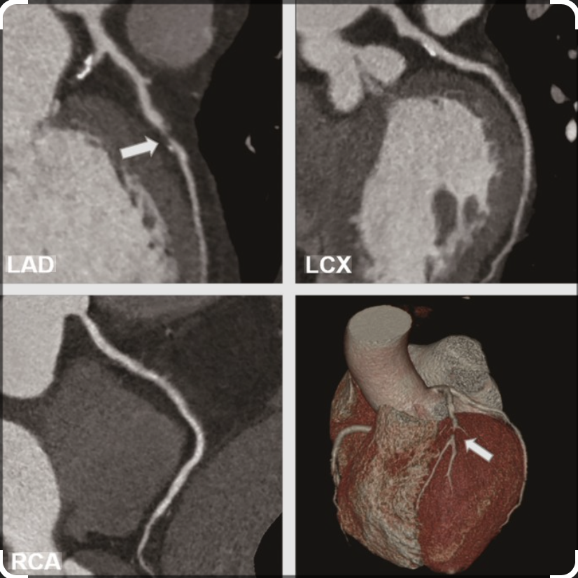
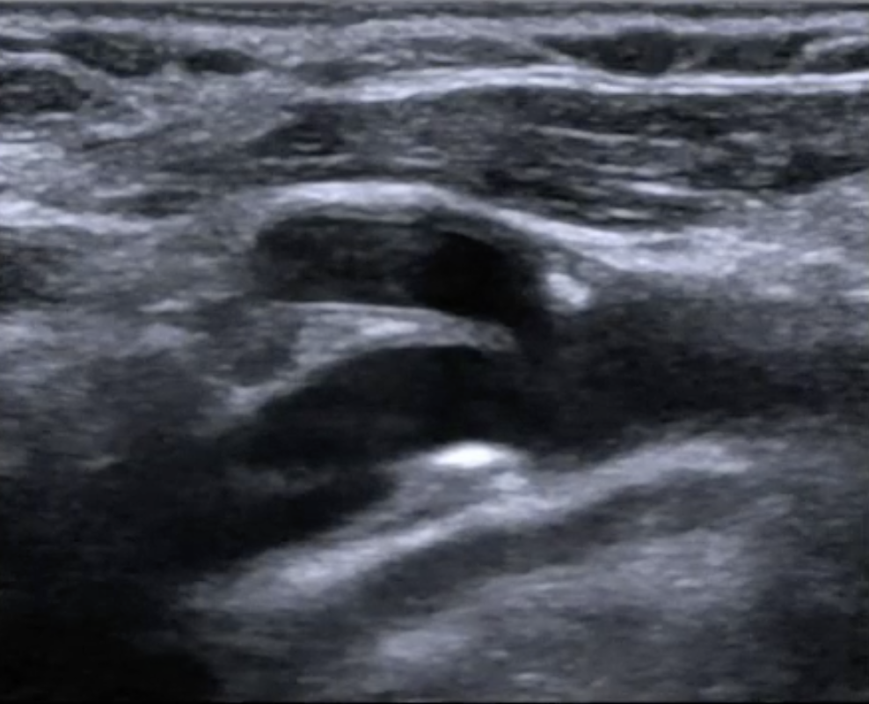
Other Imaging Modalities
Mammogram
Coronary CT Angiography
Carotid
US

Slide 20
V. Menopausal Hormone Therapy and CVD
* MHT is not recommended solely for CVD prevention.
* Early MHT (within 10 yrs) in symptomatic women
may be considered after CV risk evaluation.
* No primary prevention data

Slide 21
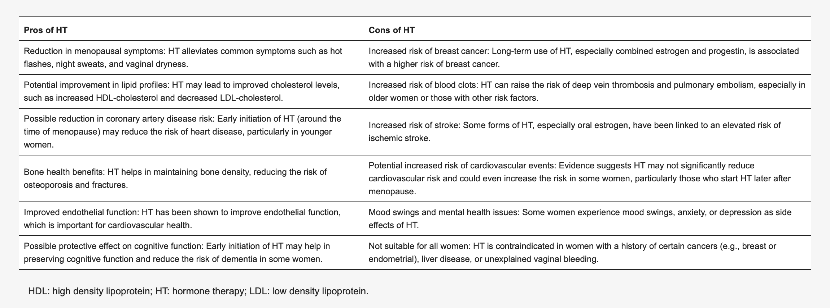
Pros and Cons of HT for CVD prevention in postmenopausal women
Fasero M, Coronado, PJ J. Clin. Med. 2025, 14(11), 3663;

Slide 22
HRT and Heart Attacks
Women taking HRT who sustain a myocardial infarction do not necessarily
have to discontinue it.
Women who have sustained a myocardial infarction and who then require
HRT can be given it.
• The starting dose is very important, needing to be appropriate for the age
of the patient.
• The type of progestogen may be important, with the use of non-androgenic
progestogens being preferred.
• The route of administration of estrogen may be important, with non-oral
administration being preferred in those with any perceived risk of thrombo-embolism.
• The co-administration of a statin may bring further synergistic benefits.
• Supervision from a specialist menopause clinic is recommended
Stevenson J, Collins P, Hodis H. BRITISH MENOPAUSE SOCIETY, Tools for Clinicians, March 2024.

Slide 23
VI. Prevention Strategies : Clinical Translation
* Lifestyle modification: diet, exercise, smoking cessation.
* Blood pressure and lipid control
* Early risk assessment during midlife
* Collaboration between gynaecologists and cardiologists.

Slide 24

AHA’s My Life Check – Life’s Essential 8.
CVD is upto 80% preventable!
AHA 2022, copyright Lloyd-Jones.

Slide 25
Multidisciplinary life course approach
with easy referral patterns
Gynae/Obs
General Practitioner
LIFE
Effective
co-ordination of
Care to provide
specialty care
if needed
APPROACH
Task Shifting
Broadening healthcare roles
Nurses, community healthcare
Workers for simple screening
e.g. blood pressure
Measurements; advice on
Lifestyle…
COURSE
Cardiologist
Bharati Shivalkar, UZA 2017

Slide 26
Checklist for Referral
High Risk
Established ASCVD
DM
CKD
Marked dyslipidemia, LP(a)
Persistent grade II hypertension
AID
Cancer therapy
Risk Enhancers
Menopause timing (early, premature)
Adverse Pregnancy history
Metabolic Syndrome
Sleep apnoea, Chr. Insomnia, shift work
Tobacco/alcohol abuses
Chronic Inflammatory Disease (IBD, HIV, POI)
Significant VM symptoms
Symptoms (ischaemia/HFpEF)
Chest complaints
Dyspnea
Palpitations
Fluid retention
Vital & Labs that trigger referral
BP > 130/80 mmHg repeatedly, home
Lipids (LDL > 150 mg/dL; LP (a)
Glycaemia (HbA1c ≥5.7%, HOMA, Quicki)
Centripetal obesity
Notes:
Marked dyslipidemia = > LDL > 190 mg/dl

Slide 27
VII. Summary & Take Home Messages
*Menopause marks a period of increased
cardiovascular vulnerability.
* Early detection using imaging and clinical risk
assessment enhances prevention.
* Gynaecologists are uniquely positioned to
Identify, evaluate and act on CV risk in routine MN care.
* Multidisciplinary collaboration with Cardiology
optimizes care.

