Slide 1
NK1,3 antagonists 17.01.26 Brussels
Serge Rozenberg, CHU St Pierre Université libre de Bruxelles
Vrije Universiteit Brussel
Belgium serge_rozenberg@stpierre-bru.be serge.rozenberg@skynet.be

Slide 2
Conflict of interest & Disclosure
Conflicts of interest: nil
Disclosure : unrestricted grant to BMS of Astellas
Disclosure SR
Research funding IRIS- King Baudouin Fondation, Vesale research Foundation, Amgen, MSD
Speakers bureau &/or Advisory Boards
Abbot, Pfizer, Will, Gedeon Richter, MSD, Amgen, UCB, Astellas

Slide 3
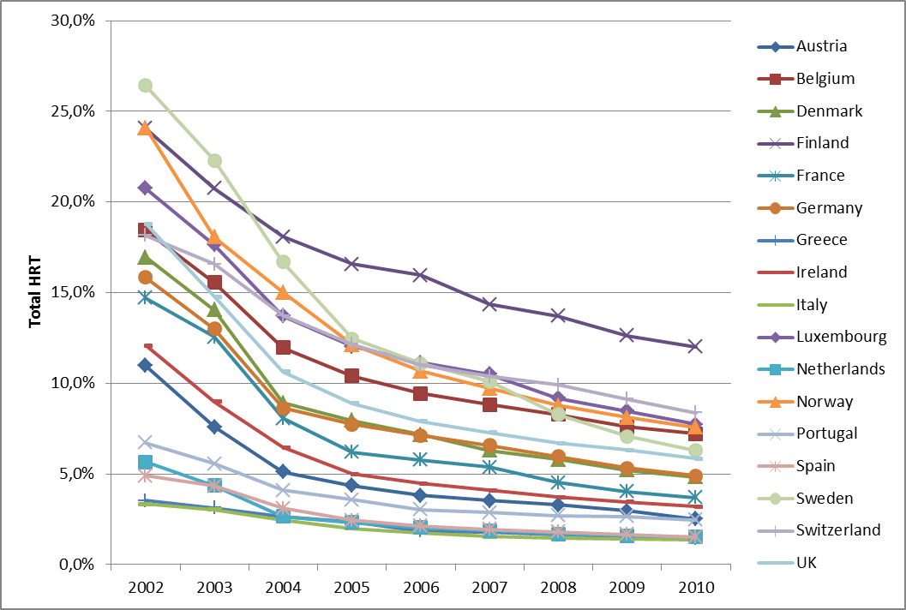
Antoine, Ameye, Paesmans Rozenberg Maturitas 2016
Fig. 1. Changes in estimated proportion of women aged 45–69 years old, using MHT, in 17 European countries.

Slide 4
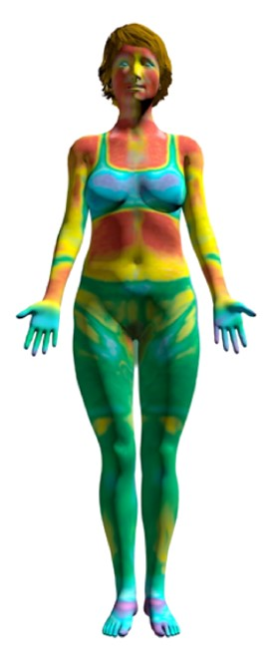






Hot flushes and night sweats (VMS) are often considered the hallmark symptoms of menopause^{1,2}
Clinical definition of severity²
Hot flushes: Episodes of sudden intense sensation of heat in the upper body lasting 1–5 minutes; may be accompanied by sweating, chills, anxiety and heart palpitations.²
SEVERE Sensation of heat with sweating, causing cessation of activity
MODERATE Sensation of heat with sweating, able to continue activity
Night sweats: Hot flushes that occur during sleep.²
MILD Sensation of heat without sweating
VMS, vasomotor symptoms. 1. Monteleone P, et al. Nat Rev Endocrinol. 2018;14(4):199–215; 2. Thurston RC. Vasomotor symptoms. In: Crandall CJ, et al. (Eds). Menopause Practice: A Clinician’s Guide. 6th edn. Pepper Pike, OH: The North American Menopause Society, 2019:43–55.

Slide 5
A large proportion of women with moderate to severe VMS are eligible but averse to MHT¹
Women with moderate to severe VMS in Europe, US and Japan (N=1166)¹
MHT contraindicated
e.g., due to breast or endometrial cancers, deep vein thrombosis and acute liver disease
MHT eligible
MHT caution
Women with underlying medical conditions who warrant an additional risk assessment before prescribing MHT
8% in Japan
9% in the US
12% in Europe
MHT averse
Not currently treated with MHT and not willing to take it
MHT willing
Prescribed HT and willing to take it
79% in Japan
54% in the US
56% in Europe
MHT stopper
MHT continuer
A screening survey was sent to 69,000 women aged 40–65 years in Europe (France, Germany, Italy, Spain and the UK), the US and Japan. 11,771 women were identified as post-menopausal and 3460 completed the full questionnaire.
MHT, menopausal hormone therapy; VMS, vasomotor symptoms. 1. Nappi RE, et al. Menopause. 2021;28(8):875–82.

Slide 6
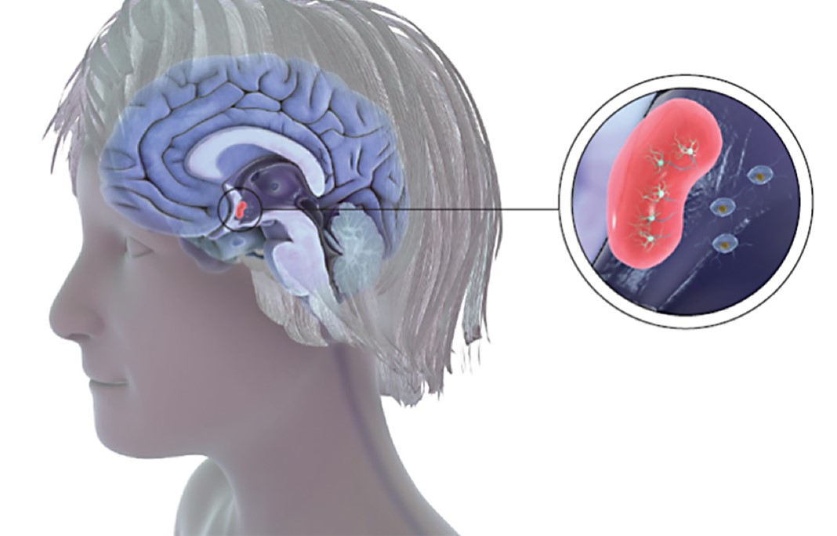
KNDy neurons and thermoregulation
The thermoregulatory center is innervated by KNDy neurons that coordinate various functions, including thermoregulation^{1,2}
Notes:
References
Rance NE, Dacks PA, Mittelman-Smith MA, et al. Modulation of body temperature and LH secretion by hypothalamic KNDy (kisspeptin, neurokinin B and dynorphin) neurons: a novel hypothesis on the mechanism of hot flushes. Front Neuroendocrinol 2013;34(3):211–227.
Mittelman-Smith MA, Williams H, Krajewski-Hall SJ, et al. Role for kisspeptin/neurokinin B/dynorphin (KNDy) neurons in cutaneous vasodilatation and the estrogen modulation of body temperature. Proc Natl Acad Sci U S A 2012;109(48):19846–19851.

Slide 7
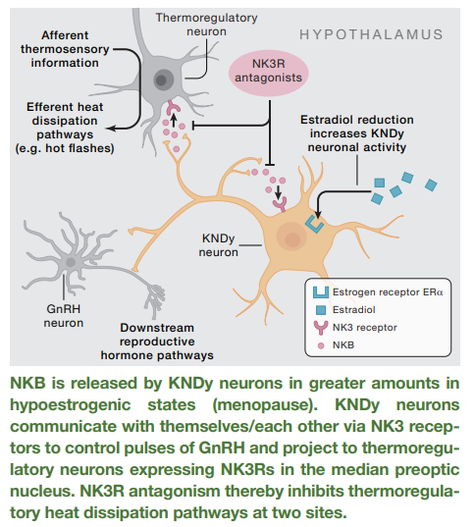
Neurokinin 3 receptor antagonism for menopausal hot flashes
Comninos AN, Dhillo WS. Cell. 2023 Aug 3;186(16):3332-3332.e1. doi: 10.1016/j.cell.2023.07.011. PMID: 37541194.

Slide 8
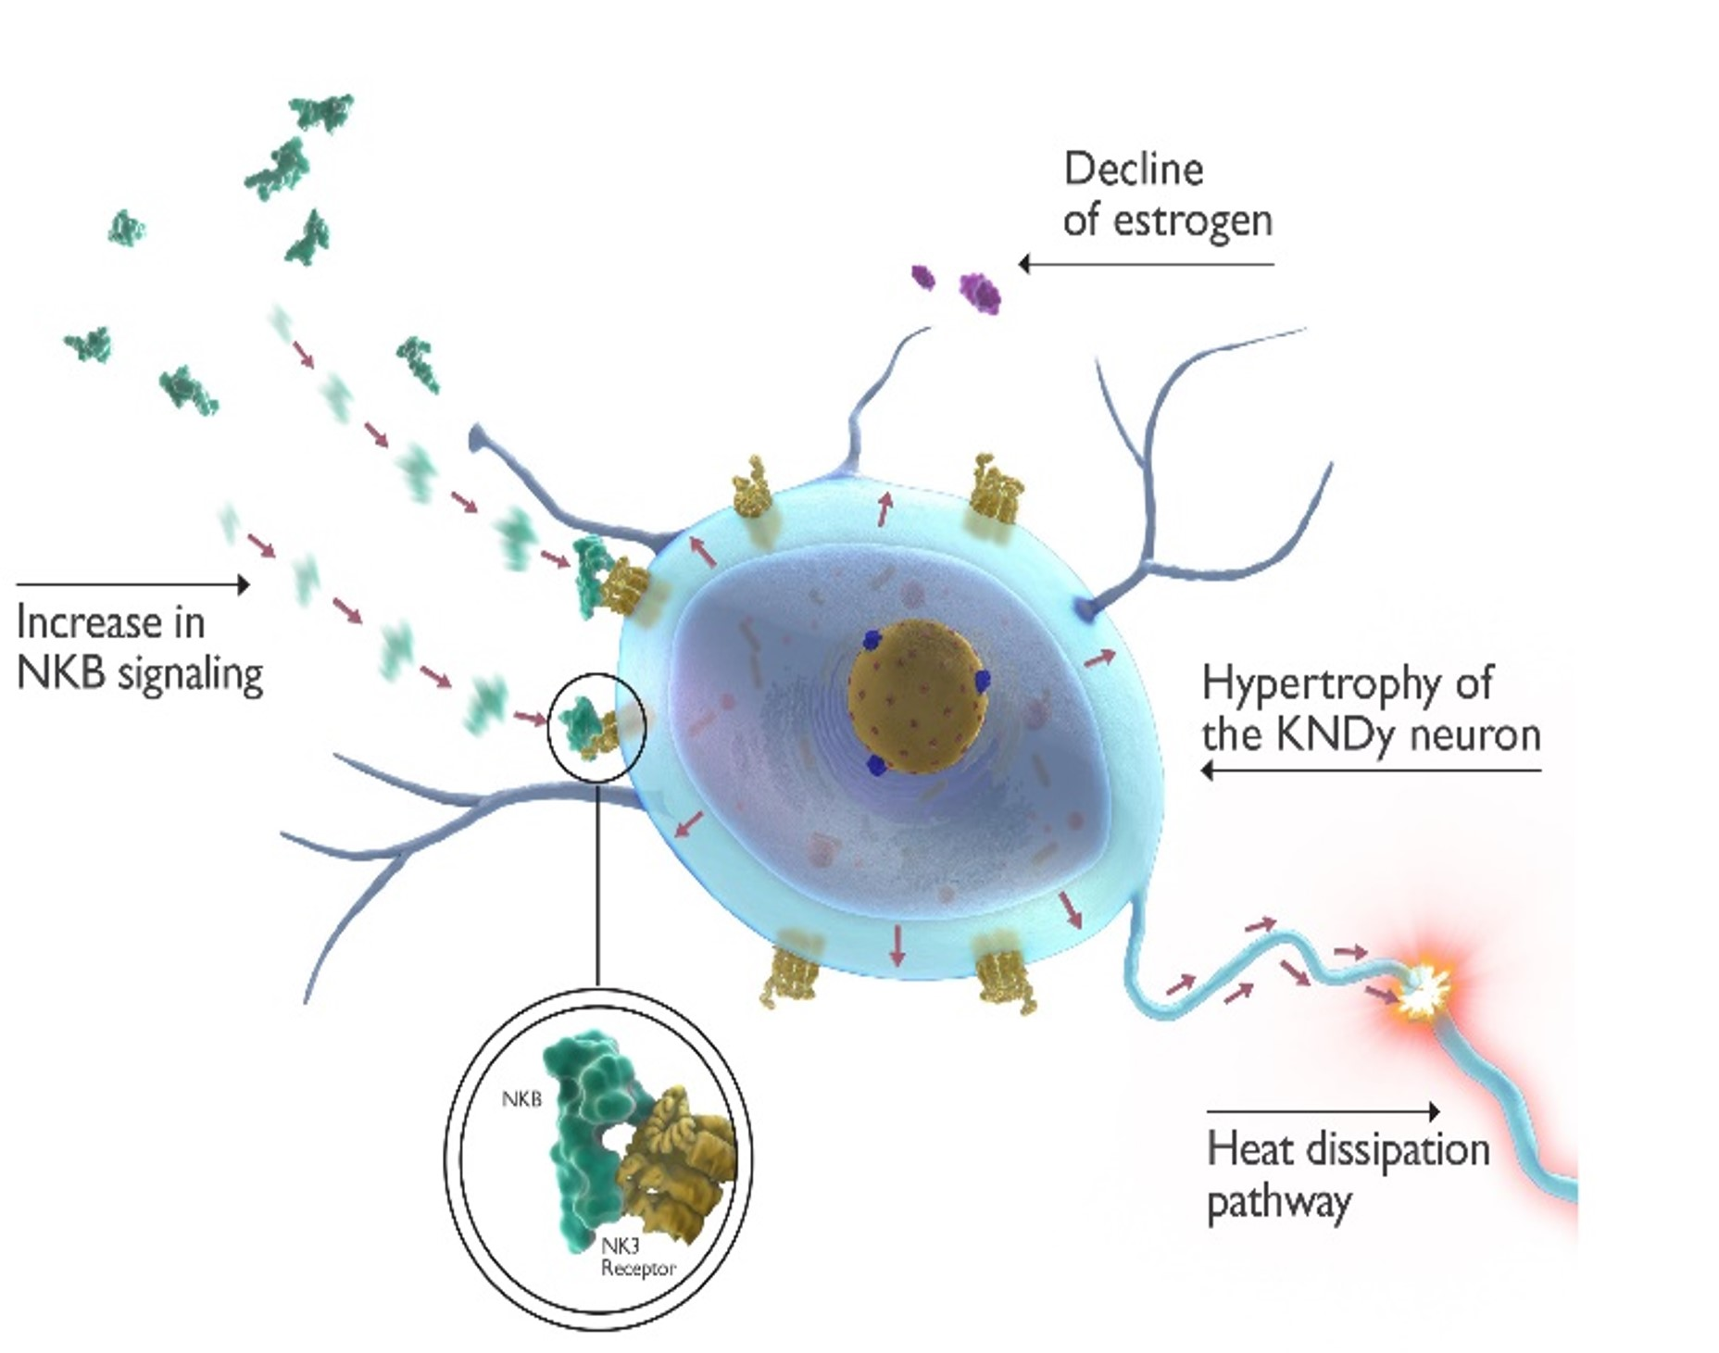
Overstimulation of the thermoregulatory center
During menopause, estrogen levels decline and signaling from NKB increases^{1–4}
No longer counterbalanced by estrogen, the increased NKB signaling overstimulates KNDy neurons to increase activity on the thermoregulatory center (median preoptic nucleus)
The thermoregulatory center becomes hypersensitive to heat-sensitive peripheral sensors, activating heat dissipation effectors, including sweating and vasodilation, experienced as hot flashes
Notes:
References
Rance NE, Dacks PA, Mittelman-Smith MA, et al. Modulation of body temperature and LH secretion by hypothalamic KNDy (kisspeptin, neurokinin B and dynorphin) neurons: a novel hypothesis on the mechanism of hot flushes. Front Neuroendocrinol 2013;34(3):211–227.
Mittelman-Smith MA, Williams H, Krajewski-Hall SJ, et al. Role for kisspeptin/neurokinin B/dynorphin (KNDy) neurons in cutaneous vasodilatation and the estrogen modulation of body temperature. Proc Natl Acad Sci U S A 2012;109(48):19846–19851.
Padilla SL, Johnson CW, Barker FD, et al. A neural circuit underlying the generation of hot flushes. Cell Rep 2018;24(2):271–277.
Jayasena CN, Comninos AN, Stefanopoulou E, et al. Neurokinin B administration induces hot flushes in women. Sci Rep 2015;5:8466.

Slide 9
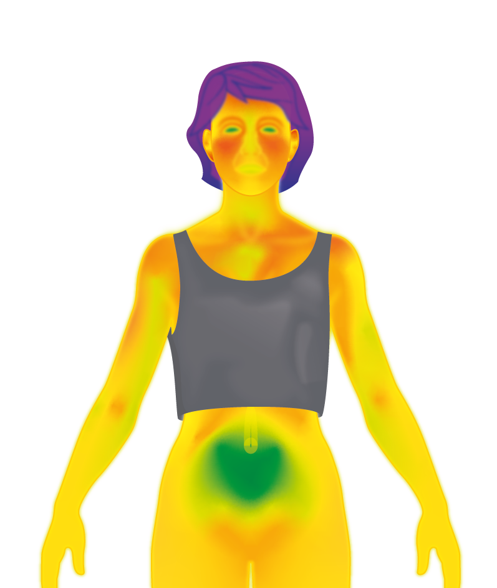
KNDy neurons in thermoregulatory homeostasis¹
Hypothalamus
Periphery
KNDy neuron
Thermoregulatory center
Median preoptic nucleus
Normal cooling
NKB
NKB
NK3R
NK3R
ERα
The thermoregulatory center triggers heat dissipation effectors (characterized by sweating and peripheral vasodilation) in response to changes in temperature
NKB
Estrogenª
Estrogenª
The thermoregulatory center of the hypothalamus is innervated by KNDy neurons^{2,3} which are stimulated by NKB ( ) via NK3R^{4,5} and inhibited by estrogen ( ) in a delicate balance^{6–8,a}
Notes:
References
Depypere H, Lademacher C, Siddiqui E, Fraser GL. Fezolinetant in the treatment of vasomotor symptoms associated with menopause. Expert Opin Investig Drugs 2021;30(7):681–694.
Krajewski SJ, Burke MC, Anderson MJ, et al. Forebrain projections of arcuate neurokinin B neurons demonstrated by anterograde tract-tracing and monosodium glutamate lesions in the rat. Neuroscience 2010;166(2):680–697.
Padilla SL, Johnson CW, Barker FD, et al. A neural circuit underlying the generation of hot flushes. Cell Rep 2018;24(2):271–277.
Dacks PA, Krajewski SJ, Rance NE. Activation of neurokinin 3 receptors in the median preoptic nucleus decreases core temperature in the rat. Endocrinology 2011;152(12):4894–4905.
Jayasena CN, Comninos AN, Stefanopoulou E, et al. Neurokinin B administration induces hot flushes in women. Sci Rep 2015;5:8466.
Krajewski-Hall SJ, Blackmore EM, McMinn JR, Rance NE. Estradiol alters body temperature regulation in the female mouse. Temperature (Austin) 2017;5(1):56–69
Ruka KA, Burger LL, Moenter SM. Both estrogen and androgen modify the response to activation of neurokinin-3 and κ-opioid receptors in arcuate kisspeptin neurons from male mice. Endocrinology 2016;157(2):752–763.
Mittelman-Smith MA, Williams H, Krajewski-Hall SJ, et al. Role for kisspeptin/neurokinin B/dynorphin (KNDy) neurons in cutaneous vasodilatation and the estrogen modulation of body temperature. Proc Natl Acad Sci U S A 2012;109(48):19846–19851.

Slide 10
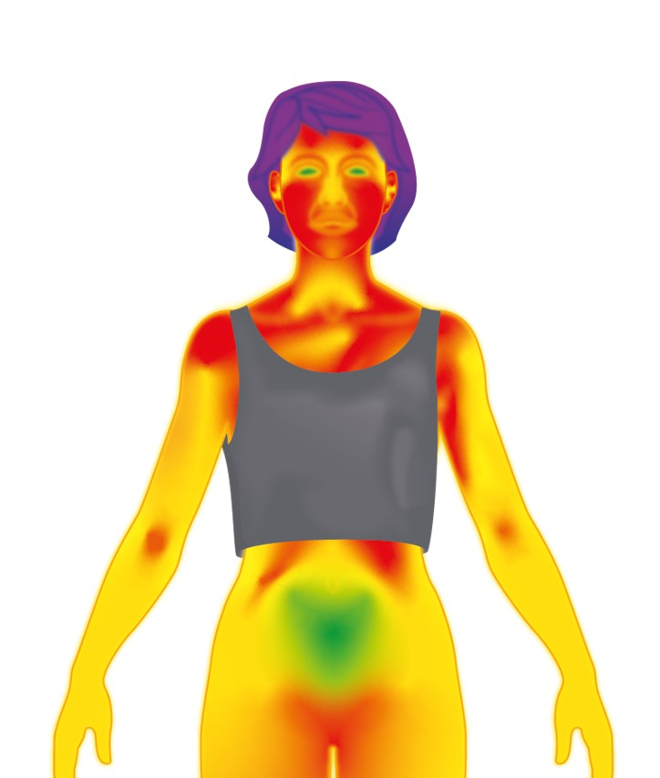
Altered thermoregulatory activity in KNDy neurons¹
Hypothalamus
Periphery
KNDy neuron
Thermoregulatory center
Median preoptic nucleus
Triggered cooling
Disproportionate neuronal activity
NKB
NKB
NK3R
KNDy neurons
hypertrophy
NK3R
ERα
Thermoregulatory center triggers heat dissipation effectors that contribute to the experience of hot flashes and night sweats
NKB
Estrogenª
Estrogenª
Low estrogen levels lead to loss of negative feedback
VMS
With declining estrogen levels, NK3R-mediated activation is unopposed^{2,3}
Unopposed NKB signaling increases neuronal activity, leading to hypertrophy of the KNDy neuron,^{4,5} and alters the activity on the thermoregulatory center⁶⁻¹¹
The thermoregulatory center triggers heat dissipation effectors. Vasodilation in the skin causes heat loss, which is experienced as hot flashes, sweating, and chills^{7,10,11}
Notes:
References
Depypere H, Lademacher C, Siddiqui E, Fraser GL. Fezolinetant in the treatment of vasomotor symptoms associated with menopause. Expert Opin Investig Drugs 2021;30(7):681–694.
Krajewski-Hall SJ, Blackmore EM, McMinn JR, Rance NE. Estradiol alters body temperature regulation in the female mouse. Temperature (Austin) 2017;5(1):56–69.
Mittelman-Smith MA, Williams H, Krajewski-Hall SJ, et al. Role for kisspeptin/neurokinin B/dynorphin (KNDy) neurons in cutaneous vasodilatation and the estrogen modulation of body temperature. Proc Natl Acad Sci U S A 2012;109(48):19846–19851.
Rance NE, McMullen NT, Smialek JE, et al. Postmenopausal hypertrophy of neurons expressing the estrogen receptor gene in the human hypothalamus. J Clin Endocrinol Metab 1990;71(1):79–85.
Rance NE, Young WS 3rd. Hypertrophy and increased gene expression of neurons containing neurokinin-B and substance-P messenger ribonucleic acids in the hypothalami of postmenopausal women. Endocrinology 1991;128(5):2239–2247.
Dacks PA, Krajewski SJ, Rance NE. Activation of neurokinin 3 receptors in the median preoptic nucleus decreases core temperature in the rat. Endocrinology 2011;152(12):4894–4905.
Padilla SL, Johnson CW, Barker FD, et al. A neural circuit underlying the generation of hot flushes. Cell Rep 2018;24(2):271–277.
Mittelman-Smith MA, Krajewski-Hall SJ, McMullen NT, Rance NE. Neurokinin 3 receptor-expressing neurons in the median preoptic nucleus modulate heat-dissipation effectors in the female rat. Endocrinology 2015;156(7):2552–2562.
Rance NE, Dacks PA, Mittelman-Smith MA, et al. Modulation of body temperature and LH secretion by hypothalamic KNDy (kisspeptin, neurokinin B and dynorphin) neurons: a novel hypothesis on the mechanism of hot flushes. Front Neuroendocrinol 2013;34(3):211–227.
Krajewski-Hall SJ, Miranda Dos Santos F, McMullen NT, et al. Glutamatergic neurokinin 3 receptor neurons in the median preoptic nucleus modulate heat-defense pathways in female mice. Endocrinology 2019;160(4):803–816.
Dacks PA, Rance NE. Effects of estradiol on the thermoneutral zone and core temperature in ovariectomized rats. Endocrinology 2010;151(3):1187–1193.

Slide 11
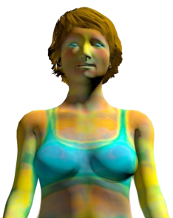
Mechanism of action: fezolinetant moderates neuronal activity to treat VMS
Hypothalamus
Periphery
KNDy neuron
Thermoregulatory Center
Restoration of balance
NKB
Median preoptic nucleus (MnPO)
Estrogenª
NK3R antagonism blocks NKB and reduces KNDy neuron activity
FEZ
FEZ
NK3R
NK3R
ERα
NKB
↓ VMS frequency and severity
Estrogenª
Fezolinetant, a selective NK3R antagonist, blocks NKB signaling and KNDy neuron activity, to moderate neuronal activity in the thermoregulatory center, helping to restore thermoregulatory balance¹⁻³
a Available data support an inhibitory effect of estradiol, specifically, on KNDy neurons.
E2, estradiol; ERα, estrogen receptor alpha; Fez, fezolinetant; KNDy, kisspeptin-neurokinin B-dynorphin; MOA, mechanism of action; NK3R, neurokinin 3 receptors; NKB, neurokinin B; VMS, vasomotor symptoms.
1. Hoveyda HR, et al. ACS Med Chem Lett. 2015;6(7):736-40. 2. Depypere H, et al. J Clin Endocrinol Metab. 2019;104(12):5893-905. 3. Fraser GL, et al. Menopause. 2020;27(4):382-392.
Notes:
Hoveyda 2015 p738
Depypere 2019 p2, 9
Fraser 2020 p4, 6, 10
Astellas preclinical data supports fezolinetant activity on the MnPO neuron, as shown in the graphic: 2693-ph-0001-ncr-en-final-02 p8, p12 Fig 3. (Not referenced on slide because unpublished.)

Slide 12
Fezolinetant efficacy and safety profile were evaluated in two phase 3 pivotal studies^{1,2}
SKYLIGHT 1 & SKYLIGHT 2
12-week, randomised, placebo-controlled, double-blind phase 3 studies, followed by a 40-week extension.* Co-primary endpoint:
Mean change in frequency and severity of moderate to severe VMS from baseline to Weeks 4 and 12
Randomised
12 weeks
40-week extension†
Follow-up visit
Placebo
VEOZA 45 mg
VEOZA 45 mg
VEOZA 45 mg
Day 1
Week 4
Week 12
Week 52
Week 55
Adapted from Lederman S. 2023; Johnson KA. 2023.^{1,2}
Co-primary endpoint
Co-primary endpoint
End of treatment visit
In SKYLIGHT 1 and SKYLIGHT 2, patients were randomised to VEOZA at doses of 30 mg or 45 mg. Data for VEOZA 30 mg is not presented in this deck as it is not an approved dosage. *Assessments after the 12-week, placebo-controlled period were descriptive only.^{1,2} The trials were double-blinded for the first 12 weeks and then blinded to dose for the 40-week extension.^{1–3} Stratification factor: current smoker or non-smoker (former/never);^{1,2} †Women were initially randomised to placebo and were subsequently re-randomised to VEOZA during the extension period.^{1,2} VMS, vasomotor symptoms. 1. Lederman S, et al. Lancet. 2023;401(10382):1091–102; 2. Johnson KA, et al. J Clin Endocrinol Metab. 2023;108(8):1981–97; 3. VEOZA™ (fezolinetant) Summary of Product Characteristics.

Slide 13



Assessing VMS frequency and severity in the fezolinetant phase 3 trials
FREQUENCY^{1,2}
SEVERITY^{1,2}
Women self-reported VMS episodes over a 24-hour period in electronic diaries, providing data on number of VMS episodes each day.
VMS severity was reported in electronic diaries, ranging from a score of 1 (mild) to 3 (severe).
SEVERE Sensation of heat with sweating, causing cessation of activity
3
MODERATE Sensation of heat with sweating, able to continue activity
2
Clinically meaningful change in VMS frequency was defined as a reduction of ≥2 episodes over 24 hours compared with placebo.³
1
MILD Sensation of heat without sweating
VMS, vasomotor symptoms. 1. Lederman S, et al. Lancet. 2023;401(10382):1091–102; 2. Johnson KA, et al. J Clin Endocrinol Metab. 2023;108(8):1981–97; 3. VEOZA™ (fezolinetant) Summary of Product Characteristics.
Notes:
Notes
The frequency and severity of VMS in SKYLIGHT 1 and 2 were self-reported daily by study partcipants^{1,2}
At the start of the study, women received an electronic handheld device, similar to a smart phone, to record their VMS over a 24-hour period^{1,2}
Frequency was measured as a daily mean and analysed as a weekly average^{1,2}
A clinically meaningful change in VMS frequency was defined as a reduction of 2 or more episodes over 24 hours compared with placebo³
Severity of VMS was rated as^{1,2}
Mild, defined as a sensation of heat without sweating, scored in the electronic diary as a 1
Moderate, defined as a sensation of heat with sweating but able to continue activity, scored in the electronic diary as a 2
Severe, defined as a sensation of heat with sweating causing cessation of activity, scored in the electronic diary as a 3
Severity was scored as a daily mean and analysed as a weekly average^{1,2}
References
Lederman S, et al. Lancet. 2023;401(10382):1091–102
Johnson KA, et al. J Clin Endocrinol Metab. 2023;108(8):1981–97
Astellas. Fezolinetant: Summary of Product Characteristics

Slide 14
Fezolinetant significantly reduced both the frequency of moderate to severe VMS and severity of remaining episodes vs placebo¹
Pooled analysis of SKYLIGHT 1 and 2: frequency of moderate to severe VMS per 24 hours
Pooled analysis of SKYLIGHT 1 and 2: severity of VMS episodes per 24 hours
Week 4
Week 12
Week 4
Week 12
Baseline
11.1
11.0
11.1
11.0
2.4
2.4
2.4
2.4
0
0
−5.8
−3.5
−6.9
−4.4
−0.2
−0.53
−0.30
−0.67
−0.42
LS mean change from baseline (SE)
−0.4
−5
LS mean change from baseline (SE)
−0.6
−2.3* (0.32)
P<0.001
−0.8
−0.24 (0.04)
P<0.001
−10
−2.5* (0.35)
P<0.001
−1
−0.24 (0.06)
P<0.001
VEOZA (n=341)
Placebo (n=342)
*VEOZA 45 mg met the clinically meaningful threshold of a reduction of two or more hot flashes per day, compared with placebo. LS, least squares; SE, standard error; VMS, vasomotor symptoms. 1. VEOZA™ (fezolinetant) Summary of Product Characteristics

Slide 15


Fezolinetant reduced the frequency of moderate to severe VMS by 63% from baseline to 12 weeks¹
Frequency of moderate to severe VMS per 24 hours (Pooled analysis of SKYLIGHT 1 and 2)¹
Week 4
Week 12
0
At 12 weeks, ~2 out of every 3 VMS episodes were eliminated (63%).
−20
−40
−32%
−40%
−60
−53%
−63%
−80
VEOZA (n=341)
−100
Placebo (n=342)
Adapted from Summary of Product Characteristics – VEOZATM (fezolinetant).¹
VMS, vasomotor symptoms. 1. VEOZA™ (fezolinetant) Summary of Product Characteristics
Notes:
Speaker notes
This slide shows the mean percent reduction in the daily frequency of moderate to severe VMS at Week 4 and Week 12 in a pooled analysis of SKYLIGHT 1 and 2¹
Women treated with fezolinetant reported a 63% reduction in the frequency of moderate to severe VMS symptoms at Week 12, compared with a 40% reduction reported in women in the placebo group, meaning that about 2 out of every 3 VMS episodes were eliminated by fezolinetant treatment¹
References
1. Astellas. Fezolinetant: Summary of Product Characteristics

Slide 16


The severity of any remaining VMS episodes was reduced from moderate to severe at baseline to mild to moderate by Week 4¹
Severity of remaining VMS episodes
A reduction in VMS severity to mild to moderate means that some women may not experience sweating at all.²
3
Baseline
2
Week 4
Week 12
1
2.4
1.9
1.7
SEVERE sensation of heat with sweating, causing cessation of activity
MODERATE sensation of heat with sweating, able to continue activity
MILD sensation of heat without sweating
VMS, vasomotor symptoms. 1. VEOZA™ (fezolinetant) Summary of Product Characteristics; 2. Lederman S, et al. Lancet. 2023;401(10382):1091–102.
Notes:
Speaker notes
In addition to the reduction in frequency of moderate to severe VMS, there was also a significant reduction in the severity of remaining episodes¹
By Week 4, the severity of those remaining VMS episodes was reduced from a score of 2.4 at baseline to 1.9¹
In real terms, this represents a reduction from moderate to severe symptoms (sensation of heat with sweating, which may cause cessation of activity), to mild to moderate symptoms (where some women may not experience sweating at all)^{2,3}
References
Astellas. Fezolinetant: Summary of Product Characteristics
Lederman S, et al. Lancet. 2023;401(10382):1091–102
Johnson KA, et al. J Clin Endocrinol Metab. 2023;108(8):1981–97

Slide 17
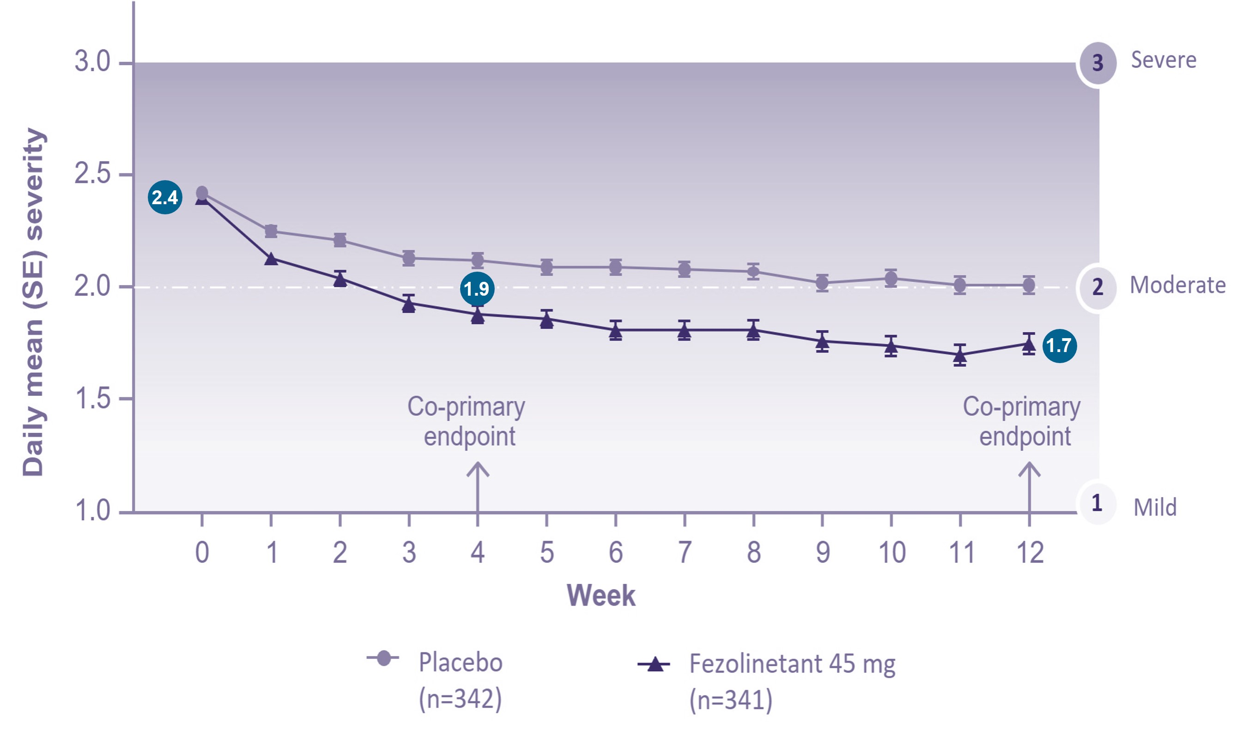
Severity of any remaining VMS episodes was reduced from moderate to severe at baseline to mild to moderate¹⁻³
Changes at each week in co-primary endpoint VMS severity
Change from baseline to week 12 in mean severity
of moderate-to-severe VMS per 24h – pooled FAS
Parameter | Statistic | Placebo (n=342) | Fezolinetant 45 mg (n=341)
Baseline | Mean (SD) | 2.42 (0.34) | 2.40 (0.35)
Change from baseline at week 4 | LS Mean Reduction (SE) Difference vs placebo P-value | -0.30 (0.03) -- -- | -0.53 (0.03) -0.24 (0.04) < 0.001
Change from baseline at week 12 | LS Mean Reduction (SE) Difference vs placebo P-value | -0.42 (0.04) -- -- | -0.67 (0.04) -0.24 (0.06) < 0.001
1. Nappi RE, et al. Treating moderate-to-severe menopausal vasomotor symptoms with fezolinetant: analysis of responders using pooled data from two phase 3 studies (SKYLIGHT 1 and 2). Menopause. 2024 Jun 1;31(6):512-521, 2. SKYLIGHT 1: Lederman S, et al. Fezolinetant for treatment of moderate-to-severe vasomotor symptoms associated with menopause (SKYLIGHT 1): a phase 3 randomised controlled study. Lancet. 2023;401(10382):1091-1102, 3. SKYLIGHT 2: Johnson KA, et al. Efficacy and Safety of Fezolinetant in Moderate-to-Severe Vasomotor Symptoms Associated With Menopause: A Phase 3 RCT. J Clin Endocrinol Metab. 2023;108(8):1981-1997.

Slide 18
The effect of fezolinetant on moderate to severe VMS frequency was sustained through 52 weeks^{1,2}
Reduction in Week 1
SKYLIGHT 1
Reduction in Week 1
Improvement sustained through 52 weeks
Re-randomised to VEOZA 45 mg at Week 12
SKYLIGHT 2
Daily mean frequency (SE)
Weeks
Adapted from Lederman S. 2023;¹ Johnson KA. 2023.²
Mean change in the frequency and severity of moderate to severe VMS from baseline to each visit in the active treatment extension period was an exploratory endpoint. Assessments after the 12-week, placebo-controlled period were descriptive only.^{1,2} SE, standard error; VMS, vasomotor symptoms. 1. Lederman S, et al. Lancet. 2023;401(10382):1091–102; 2. Johnson KA, et al. J Clin Endocrinol Metab. 2023;108(8):1981–97.
Notes:
Speaker notes
The effect of fezolinetant on VMS frequency was observed through 52 weeks treatment in SKYLIGHT 1 and 2^{1,2}
For women initially randomised to fezolinetant, the reduction in frequency seen at Week 12 was observed through Week 52^{1,2}
Women re-randomised from placebo to fezolinetant at Week 12 experienced a reduction in the frequency of VMS consistent with that in women receiving fezolinetant throughout the study^{1,2}
Plateauing of the placebo effect is evident from 4 weeks of treatment^{1,2}
References
Lederman S, et al. Lancet. 2023;401(10382):1091–102
Johnson KA, et al. J Clin Endocrinol Metab. 2023;108(8):1981–97

Slide 19
In the SKYLIGHT 1 & 2 trials and their pooled analysis, a greater decrease in patient-reported sleep disturbance was observed at week 12 with Fezolinetant vs placebo^{1–3,*}
Mean change in PROMIS SD SF 8b total score from baseline to Week 12
SKYLIGHT 1¹
SKYLIGHT 2²
Pooled Analysis of SKYLIGHT 1 and 2^{3,*}
Baseline
n=174
n=175
n=167
n=167
n=341
n=342
27.1
26.4
26.2
27.4
26.7
26.9
LS mean change from baseline (SE)
LS mean change from baseline (SE)
LS mean change from baseline (95% CI)
−1.1
(0.7)
P=0.16†
−1.5
(95% CI: −2.5, −0.5)
VEOZA 45 mg
Placebo
1. Lederman S, et al. Lancet. 2023;401:1091–1102. Supplementary appendix; 2. Johnson KA, et al. J Clin Endocrinol Metab. 2023;108:1981–97; 3. Shapiro C.M. M, et al. Maturitas. 2024:186:107999.

Slide 20
69% of women treated with fezolinetant felt their VMS was much or moderately better at Week 12 vs 40% of women on placebo¹
Proportion of women reporting change on the PGI-C VMS at Week 12: pooled analysis of SKYLIGHT 1 and 2^{1,*}
Adapted from Cano A, et al. 2024.¹
Results were consistent across both the SKYLIGHT 1 and SKYLIGHT 2 trials. Score on the PGI-C VMS was a pre-specified secondary endpoint in the pooled analysis of SKYLIGHT 1 and SKYLIGHT 2. Scores were collected at Weeks 4 and 12 during the double-blind period. *A rating of ‘much better’ or ‘moderately better’ on the PGI-C VMS was considered a positive change. PGI-C, Patient Global Impression of Change; VMS, vasomotor symptoms. 1. Cano A, et al. BJOG 2024 Aug;131(9):1296-1305.
Notes:
Speaker notes
The PGI-C VMS is a patient reported assessment of change in VMS and scores were collected at Week 4 and Week 12 of the double-blind period¹
In a pooled analysis of SKYLIGHT 1 and SKYLIGHT 2, at Week 12, 69% of women treated with fezolinetant felt their VMS was much or moderately better compared with 40% of women on placebo¹
References
1. Cano A, et al. Fezolinetant impact on health-related quality of life for vasomotor symptoms due to the menopause: Pooled data from SKYLIGHT 1 and SKYLIGHT 2 randomised controlled trials. BJOG 2024 Aug;131(9):1296-1305. doi: 10.1111/1471-0528.17773. Epub 2024 Feb 6.

Slide 21
Frequency of TEAEs in SKYLIGHT 1¹
Overview of TEAEs during the 12-week double-blind period (safety analysis set)
Adapted from Lederman S, et al 2023.¹
The 30 mg dose of fezolinetant has been studied in clinical trials, but is not an authorised dose in the UK, EU or in the USA. *Transaminases increased and liver function test increased; †Dry mouth, glossodynia and paraesthesia oral (n=1); dyspepsia and nausea (n=1); nausea, dizziness, headache, migraine, and skin discolouration (n=1); headache (n=2); nausea and abdominal pain upper (n=1); ALT increased (n=1); weight increased (n=1); and diarrhoea and abdominal pain upper (n=1); ‡Dizziness (n=1); myalgia (n=1); fungal infection (n=1); transaminases increased (n=1); endometrial disorder (n=1); dizziness and hepatic pain (n=1); diverticulitis (n=1); aggression, muscle twitching and palpitations (n=1); upper abdominal pain (n=1); and liver function test increased (n=1); §A mass in the distal femur (n=1); dizziness and headache (n=1); abdominal pain upper (n=2). ALT, alanine aminotransferase; TEAE, treatment-emergent adverse event.
1. Lederman S, et al. Lancet. 2023;401(10382):1091–102.

Slide 22
Frequency of TEAEs in SKYLIGHT 2¹
Overview of adverse events: 12-week double-blind period (safety analysis set)*
Adapted from Johnson KA, et al. 2023.¹
The 30 mg dose of fezolinetant has been studied in clinical trials, but is not an authorised dose in the UK, EU or in the USA. *For the double-blind period, data were collected from the first dose of study drug until Week 12; †Atrial fibrillation in one participant, tooth infection in one participant and COVID-19 in one participant; ‡Biliary dyskinesia in one participant and posterior tibial nerve injury in one participant; §Increased appetite and hot flush in one participant; IIFatigue and oropharyngeal pain in one participant and alexithymia in one participant; ¶Arthralgia in one participant; abdominal pain, haematochezia, nausea, vomiting and colitis in one participant; international normalised ratio increased in one participant; nausea in one participant; and alanine aminotransferase increased in one participant. TEAE, treatment-emergent adverse event. 1. Johnson KA, et al. J Clin Endocrinol Metab. 2023;108(8):1981–97.

Slide 23
The safety profile of fezolinetant was assessed in the SKYLIGHT 4 trial¹
52-week treatment period
Informed consent
Screening
Randomised 1:1:1
Placebo
End of treatment visit Day 365
Follow-up visit Day 386
Fezolinetant 30 mg
Fezolinetant 45 mg
Day –35
Day 1
Week 52
Week 55
Adapted from Neal-Perry G, et al. 2023.¹
The 30 mg dose of fezolinetant has been studied in clinical trials, but is not an authorised dose in the UK, EU or in the USA
1. Neal-Perry G, et al. Obstet Gynecol. 2023;141(4):737–47.

Slide 24
SKYLIGHT 4 evaluated the long-term safety profile, tolerability and effect of fezolinetant on endometrial health¹
Co-primary endpoints:¹
Frequency and severity of TEAEs
Percentage of participants with endometrial hyperplasia
Percentage of patients with endometrial malignancy
Secondary endpoints:¹
Change from baseline to 12 months in endometrial thickness
Percentage of participants with disordered proliferative endometrium
Change from baseline to 12 months in bone mineral density and trabecular bone score at the hip and spine, vital signs, clinical laboratory tests, Columbia Suicide Severity Rating Scale score and ECG parameters
ECG, electrocardiogram; TEAE, treatment-emergent adverse event. 1. Neal-Perry G, et al. Obstet Gynecol. 2023;141(4):737–47.

Slide 25
SKYLIGHT 4 included women aged 40–65 years with moderate to severe VMS due to menopause¹
Select inclusion criteria *¹
Born female, aged 40 to 65 years, with VMS due to menopause
Body mass index (BMI) ≥18 kg/m2 and ≤38 kg/m2
Subject must be seeking treatment or relief for VMS associated with menopause and confirmed as postmenopausal per one of the following criteria at screening
Spontaneous amenorrhea for ≥12 consecutive months
Spontaneous amenorrhea for ≥6 months with biochemical criteria of menopause (follicle-stimulating hormone >40 IU/L)
Bilateral oophorectomy ≥6 weeks before the screening visit
Select exclusion criteria*¹
Endometrial biopsy confirming presence of disordered proliferative endometrium, endometrial hyperplasia, endometrial malignancy, or other clinically significant findings at screening
Use of strong or moderate cytochrome P450 1A2 inhibitors, hormone therapy, hormonal contraceptives, or any prescription, over-the-counter, or herbal treatment for VMS precluded participation, unless treatment was discontinued with drug-specific washout periods based on the known half-lives of the medications
* Not including of all inclusion and exclusion criteria. BMI, body mass index; VMS, vasomotor symptoms. 1. Neal-Perry G, et al. Obstet Gynecol. 2023;141(4):737–47.

Slide 26
Frequency of TEAEs in the SKYLIGHT 4 trial¹
 | Placebo (n=610) | Fezolinetant 30 mg (n=611) | Fezolinetant 45 mg (n=609) | Fezolinetant total (N=1,220)
TEAE* | 391 (64.1) | 415 (67.9) | 389 (63.9) | 804 (65.9)
Study drug-related TEAEs | 106 (17.4) | 94 (15.4) | 110 (18.1) | 204 (16.7)
Serious TEAEs | 14 (2.3) | 20 (3.3) | 23 (3.8) | 43 (3.5)
Study drug-related serious TEAEs | 1 (0.2) | 0 | 3 (0.5) | 3 (0.2)
TEAEs leading to withdrawal of treatment | 26 (4.3) | 34 (5.6) | 28 (4.6) | 62 (5.1)
Study drug-related TEAEs leading to withdrawal of treatment | 16 (2.6) | 16 (2.6) | 17 (2.8) | 33 (2.7)
Death† | 0 | 1 (0.2) | 0 | 1 (0.1)
TEAEs occurring in ≥5% of participants Headache COVID-19 | 56 (9.2) 38 (6.2) | 52 (8.5) 38 (6.2) | 55 (9.0) 32 (5.3) | 107 (8.8) 70 (5.7)
TEAEs by severity‡ Mild Moderate Severe | 180 (29.5) 191 (31.3) 20 (3.3) | 215 (35.2) 185 (30.3) 15 (2.5) | 195 (32.0) 171 (28.1) 23 (3.8) | 410 (33.6) 356 (29.2) 38 (3.1)
Adapted from Neal-Perry G, et al. 2023.¹
The 30 mg dose of fezolinetant has been studied in clinical trials, but is not an authorised dose in the UK, EU or in the USA.
Data are n, (%). *Defined as an adverse event observed after administration of study intervention was started and up to 21 days after the last dose of study intervention; †One death reported in the fezolinetant 30 mg group was considered unrelated to study drug. Because all TEAEs are listed, death is noted, as well as the TEAE of cardiac arrest and anoxic brain injury that led to treatment withdrawal; ‡Mild: no disruption of normal daily activities; moderate: affects normal daily activities; severe: inability to perform daily activities. TEAE, treatment-emergent adverse event.
1. Neal-Perry G, et al. Obstet Gynecol. 2023;141(4):737–47.

Slide 27


The safety profile of fezolinetant has been studied in 2,203 women during phase 3 clinical studies¹
Adverse reactions for fezolinetant 45 mg observed during clinical studies and from spontaneous reporting^{1,2}
The most frequent adverse reactions leading to dose discontinuation with fezolinetant 45 mg were ALT increase (0.3%) and insomnia (0.2%)¹
MedDRA system organ class | Frequency category | Adverse reaction
Psychiatric disorders | Common (≥1/100 to <1/10) | Insomnia
GI disorders | Common (≥1/100 to <1/10) | Diarrhoea, abdominal pain
Hepatobiliary disorders | Common (≥1/100 to <1/10) | ALT increased, AST increased
 | Not known | Drug-induced liver injury*
There were no serious adverse reactions reported at an incidence greater than 1% across the total study population¹
* Incidence can’t be estimated – post marketing setting
ALT, alanine aminotransferase; AST, aspartate aminotransferase; GI, gastrointestinal; MedDRA, Medical Dictionary for Regulatory Activities; VMS, vasomotor symptoms. 1. VEOZA™ (fezolinetant): Summary of Product Characteristics, Astellas
Notes:
Fezolinetant EMA Product Information updates (table only)
Section 4.8: addition of hepatobiliary disorders to tabulated list of adverse reactions for fezolinetant 45mg.

Slide 28
Fezolinetant was assessed for hepatic safety profile¹⁻⁴
In a pooled analysis of the phase 3 trials (the hepatic safety profile was assessed in women receiving VEOZA 45 mg (n=1100) and placebo (n=952).¹
In clinical trials:¹
Serious cases with elevations of ALT and/or AST (>10x ULN) with concurrent elevations in bilirubin and/or ALP were reported post marketing¹
In some cases, elevated LFTs were associated with signs and symptoms suggestive of liver injury, such as fatigue, pruritus, jaundice, dark urine, pale faeces, nausea, vomiting, decreased appetite and/or abdominal pain¹
Elevated LFTs and symptoms suggestive of liver injury were generally reversible on discontinuation of therapy¹
2.1%
of women receiving VEOZA experienced elevation in serum ALT levels ≥3x ULN compared with 0.8% of women receiving placebo.
1.0%
of women receiving VEOZA experienced elevation in serum AST levels ≥3x ULN compared with 0.4% of women receiving placebo.
ALT, alanine aminotransferase; AST, aspartate aminotransferase; ULN, upper limit of normal. 1. VEOZA™ (fezolinetant): Summary of Product Characteristics, 2. Lederman S, et al (SKYLIGHT 1). Lancet. 2023;401(10382):1091–102, 3 Johnson KA, et al (SKYLIGHT 2). J Clin Endocrinol Metab. 2023;108(8):1981–97, 4. Neal-Perry G et al (SKYLIGHT 4). Obstet Gynecol 2023;141:737–747.

Slide 29
Recommendations for liver monitoring ¹
Before starting treatment with fezolinetant | After starting treatment with fezolinetant
Measure liver values (ALT, AST, bilirubin, albumin and INR**) Do NOT start if: ALT or AST or total bilirubin ≥ 2 x ULN Liver function disorder Child-Pugh B or C ** Before initiation of fezolinetant, INR (international normalized ratio/prothrombin time) and albumin are measured to assess liver function (Child-Pugh/cirrhosis). This is unchanged from the previous fezolinetant SmPC. | Monitor ALT, AST and bilirubin once a month for the first 3 months and then based on clinical judgement STOP if: • Transaminases ≥ 3 x ULN + symptoms of liver injury Or • Transaminases ≥ 3 x ULN + total bilirubin > 2 x ULN Or • Transaminases > 5 x ULN Monitoring of liver function should be maintained until they have normalized.
Patients should contact their physician immediately when signs and symptoms of liver injury, such as fatigue, pruritus, jaundice, dark urine, pale faeces, nausea, vomiting, decreased appetite, and/or abdominal pain, occur
Abbreviations: ALT: alanine aminotransferase; AST: aspartate aminotransferase; INR: international normalized ratio/prothrombin time; SmPC: Summary of Product Characteristics; ULN: upper limit of normal, LFT, liver function test; ULN, upper limit of normal. 1. VEOZA Product Information (SmPC)

Slide 30

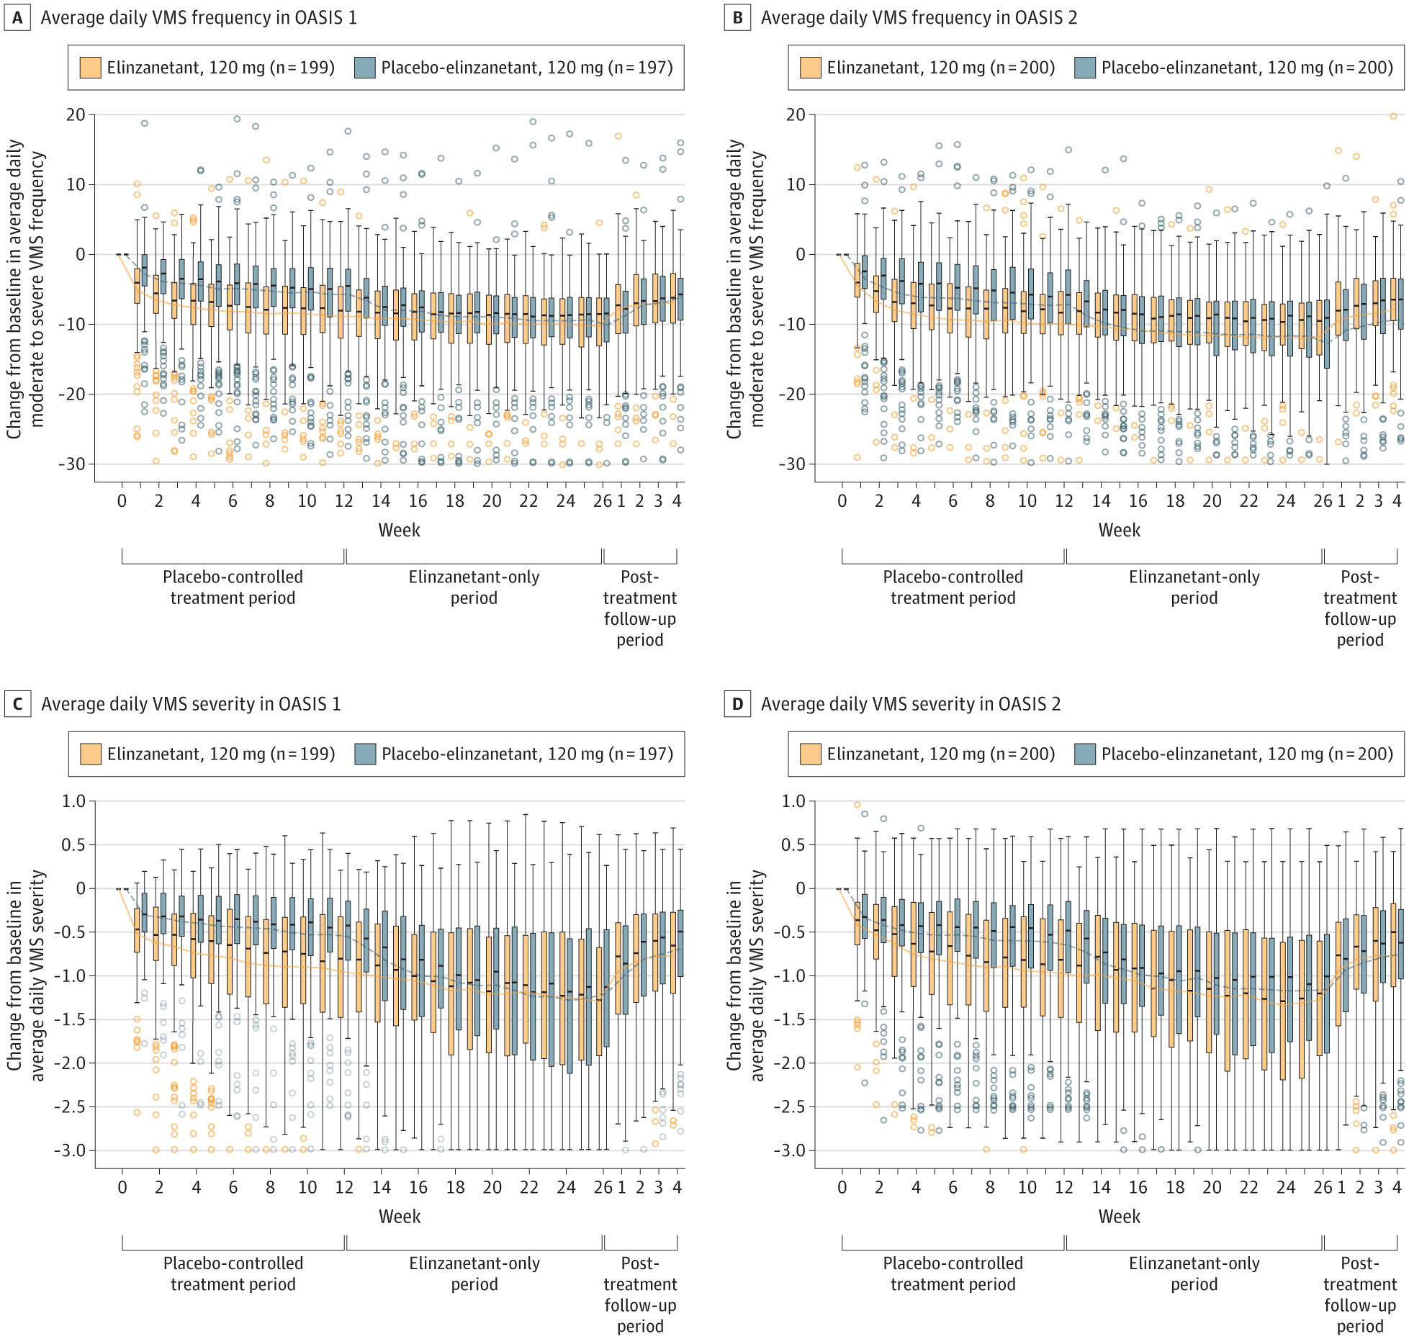
From: Elinzanetant for the Treatment of Vasomotor Symptoms Associated With Menopause: OASIS 1 and 2 Randomized Clinical Trials
JAMA. 2024;332(16):1343-1354. doi:10.1001/jama.2024.14618
Figure Legend:
Change From Baseline in Average Daily Vasomotor Symptom (VMS) Frequency and Severity by Treatment Group and StudyScore range 0-3 (0 indicates no moderate or severe vasomotor symptoms [at baseline] and no mild, moderate, or severe vasomotor symptoms [post baseline]; 1, mild; 2, moderate; and 3, severe symptoms; higher scores indicate greater vasomotor symptom severity). Data shown are means (95% CIs). Zoomed-in presentation along the y-axis for illustration purposes. Only outliers within the displayed scale are visible. Connecting lines over time join arithmetic means by treatment group. A boxplot presentation of the full distribution is provided in eFigure 1 in Supplement 3 and the descriptive summary and data range are available in eTable 5 in Supplement 3. Placebo-elinzanetant, 120 mg, refers to the participants receiving placebo who were switched to receive elinzanetant after week 12. Efficacy analyses were performed on the full analysis set. The circles indicate outside values.

Slide 31
From: Elinzanetant for the Treatment of Vasomotor Symptoms Associated With Menopause: OASIS 1 and 2 Randomized Clinical Trials
JAMA. 2024;332(16):1343-1354. doi:10.1001/jama.2024.14618

Slide 32
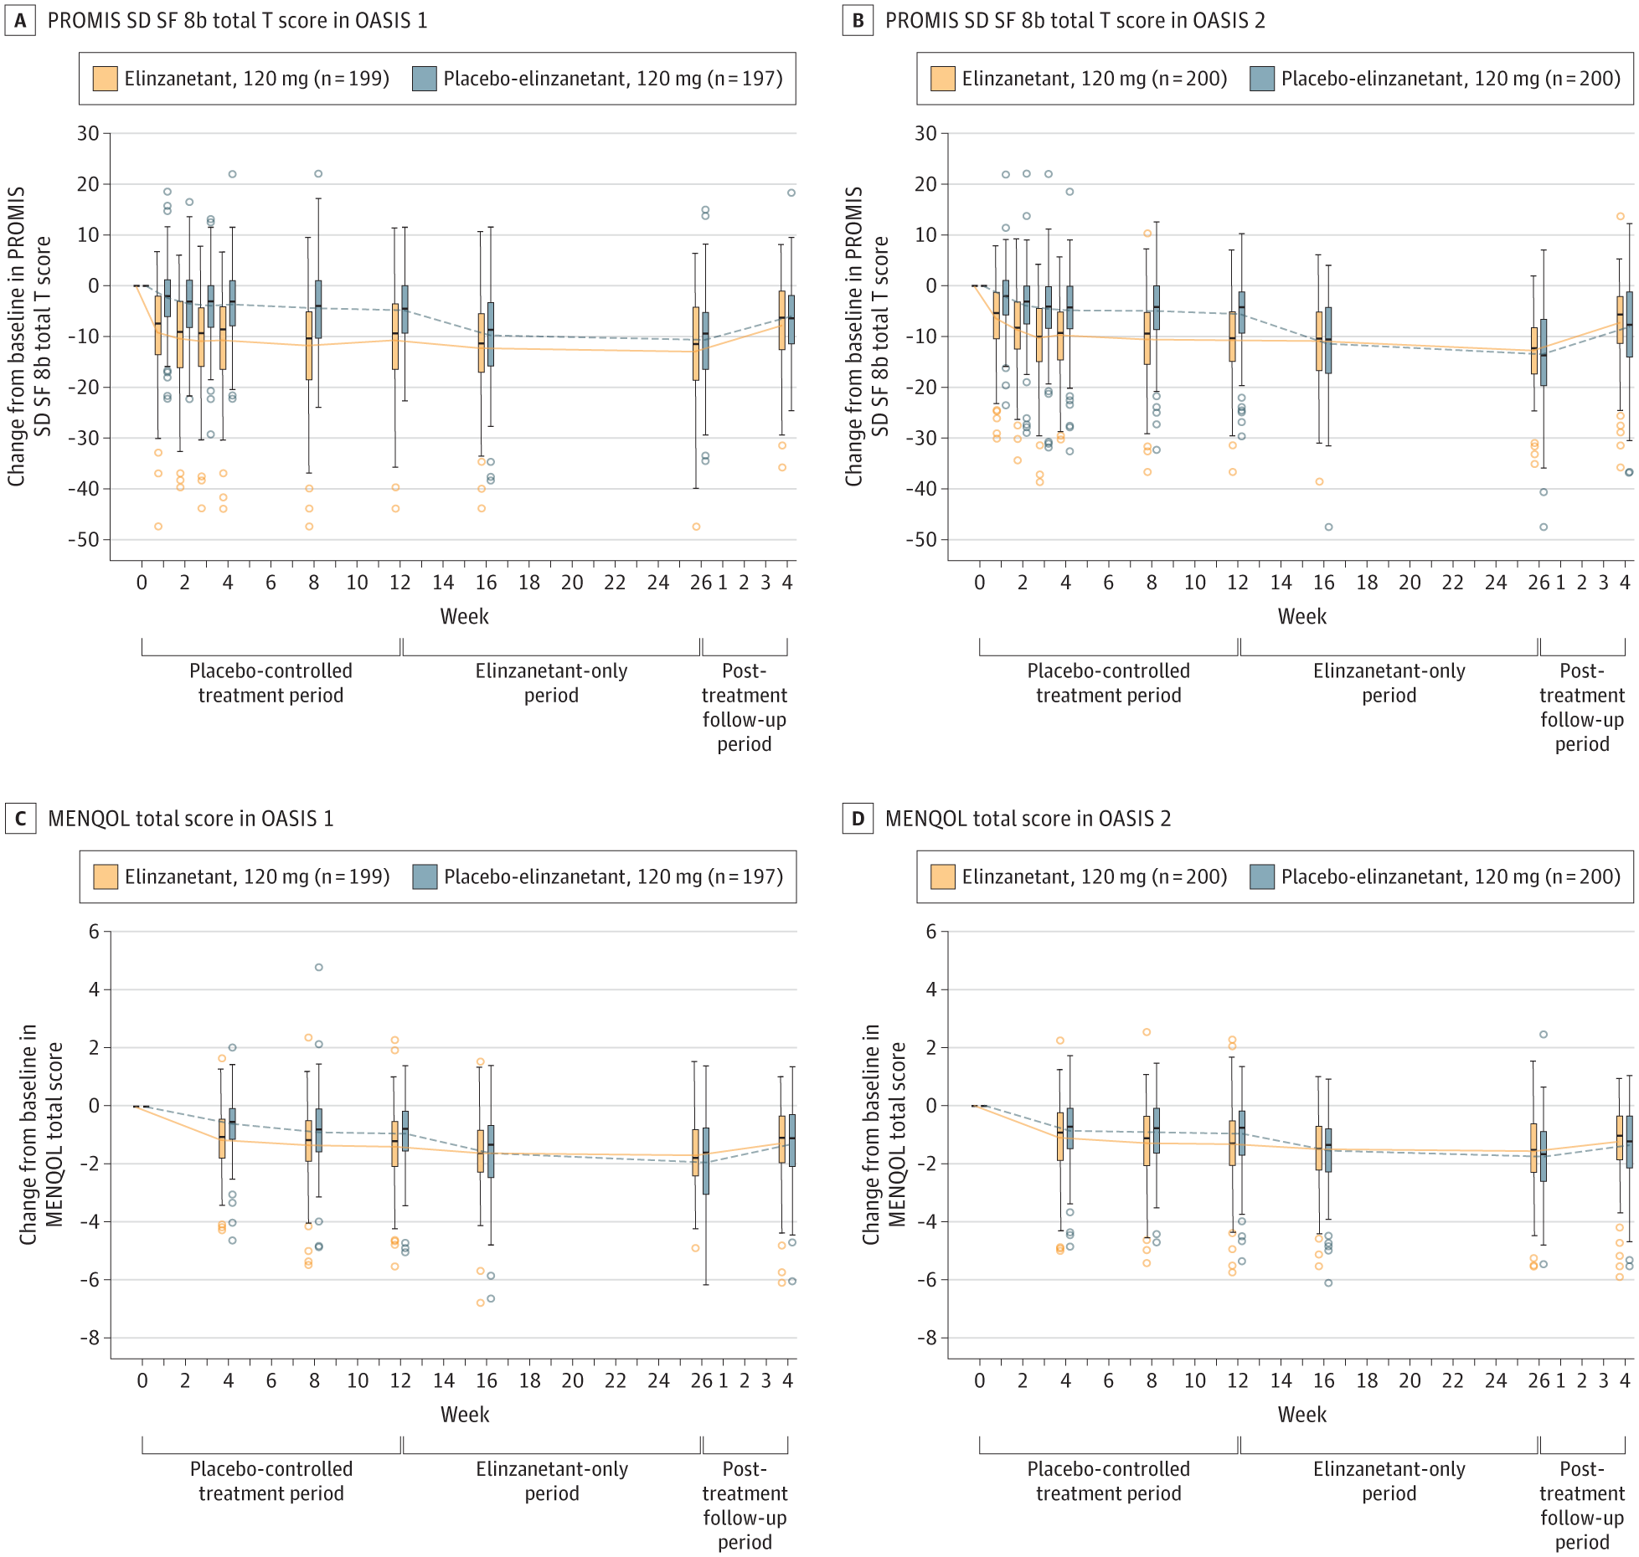
From: Elinzanetant for the Treatment of Vasomotor Symptoms Associated With Menopause: OASIS 1 and 2 Randomized Clinical Trials
JAMA. 2024;332(16):1343-1354. doi:10.1001/jama.2024.14618
Change From Baseline in PROMIS SD SF 8b Total T Scoreª and MENQOL Total Score^{b} by Treatment Group and StudyA reduction in Patient-Reported Outcomes Measurement Information System Sleep Disturbance Short Form 8b (PROMIS SD SF 8b) total T score and Menopause-Specific Quality of Life (MENQOL) questionnaire total score corresponded to an improvement in symptoms. Efficacy analyses were performed on the full analysis set. Connecting lines over time join arithmetic means by treatment group. The circles indicate outside values. ªFor PROMIS SD SF 8b, the score ranges from 28.9 to 76.5 (70, severe sleep disturbance). Higher scores indicate greater severity of sleep disturbance. ^{b}For MENQOL, the score ranges from 1 to 8; higher scores indicate greater bother; and 0.9-point within-patient change represent a clinically meaningful difference.

Slide 33
From: Elinzanetant for the Treatment of Vasomotor Symptoms Associated With Menopause: OASIS 1 and 2 Randomized Clinical Trials
JAMA. 2024;332(16):1343-1354. doi:10.1001/jama.2024.14618

Slide 34
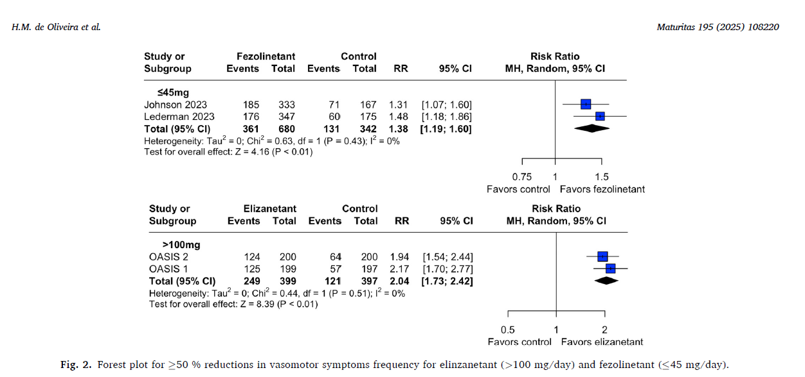

Slide 35
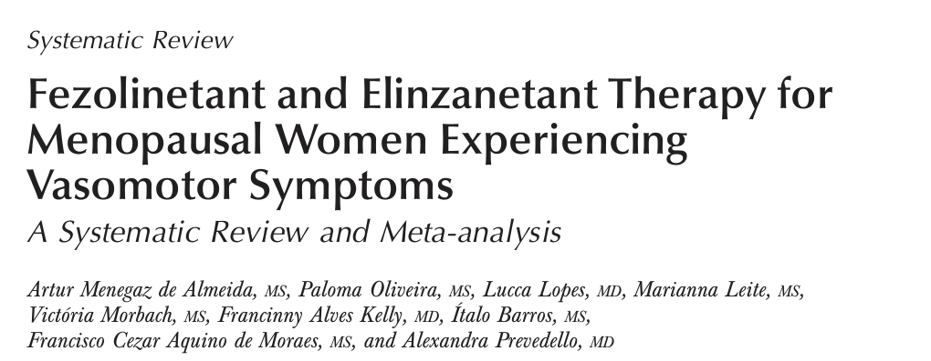
OBSTETRICS & GYNECOLOGY March 2025

Slide 36
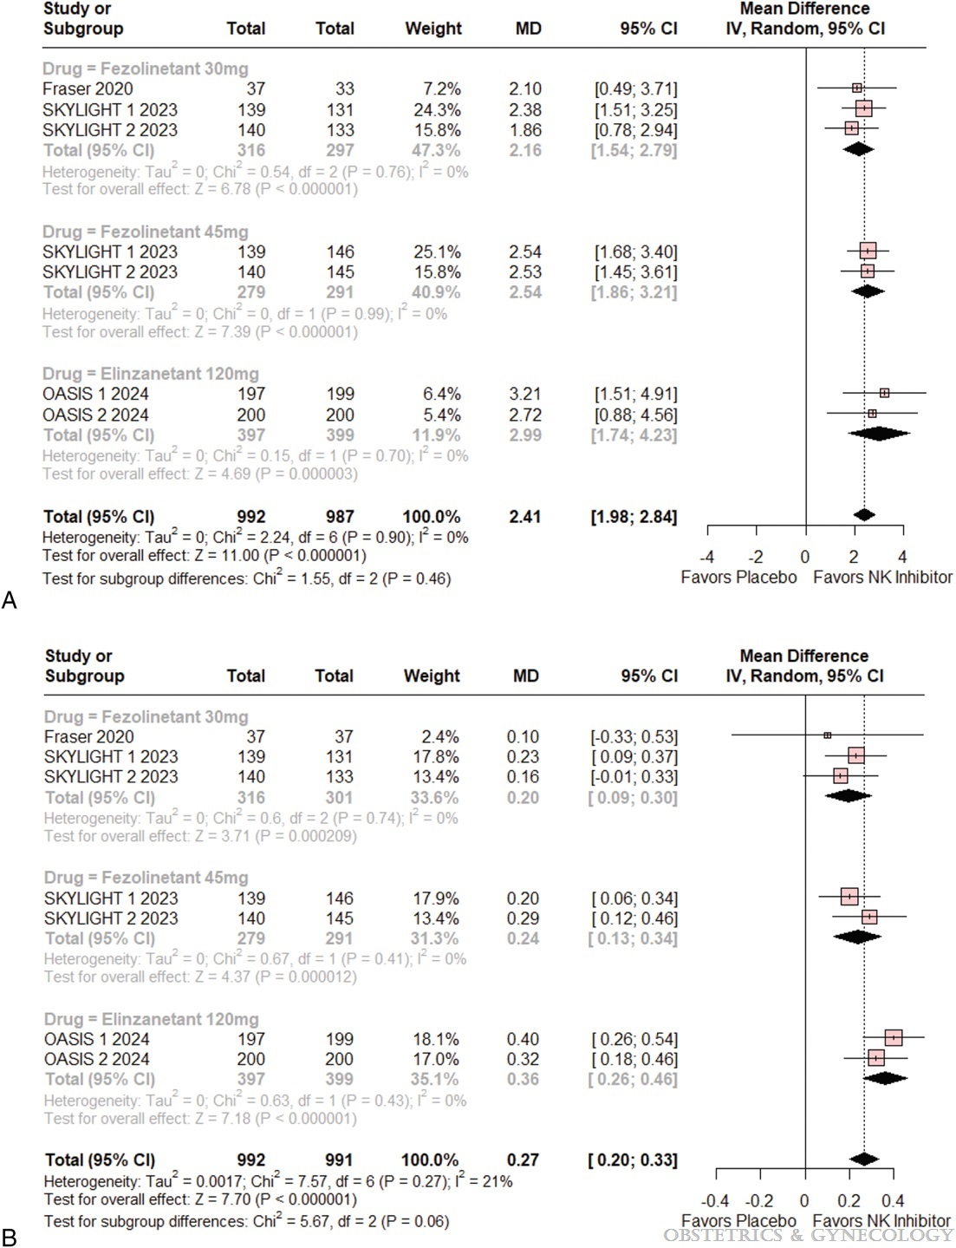

Fig. 2.
Fezolinetant and Elinzanetant Therapy for Menopausal Women Experiencing Vasomotor Symptoms: A Systematic Review and Meta-analysis
Menegaz de Almeida, Artur; Oliveira, Paloma; Lopes, Lucca; Leite, Marianna; Morbach, Victória; Alves Kelly, Francinny; Barros, Ítalo; Aquino de Moraes, Francisco Cezar; Prevedello, Alexandra
Obstetrics & Gynecology145(3):253-261, March 2025.
doi: 10.1097/AOG.0000000000005812
A. Vasomotor symptoms frequency change from baseline. B. Vasomotor symptoms severity change from baseline. MD, mean difference; IV, inverse variance; SKYLIGHT, A Study to Find Out if Fezolinetant Helps Reduce Moderate to Severe Hot Flashes in Women Going Through Menopause; OASIS, A Study to Learn More About How Well Elinzanetant Works and How Safe it is for the Treatment of Vasomotor Symptoms (Hot Flashes) That Are Caused by Hormonal Changes Over 26 Weeks in Women Who Have Been Through the Menopause; df, degrees of freedom; NK, neurokinin.

Slide 37
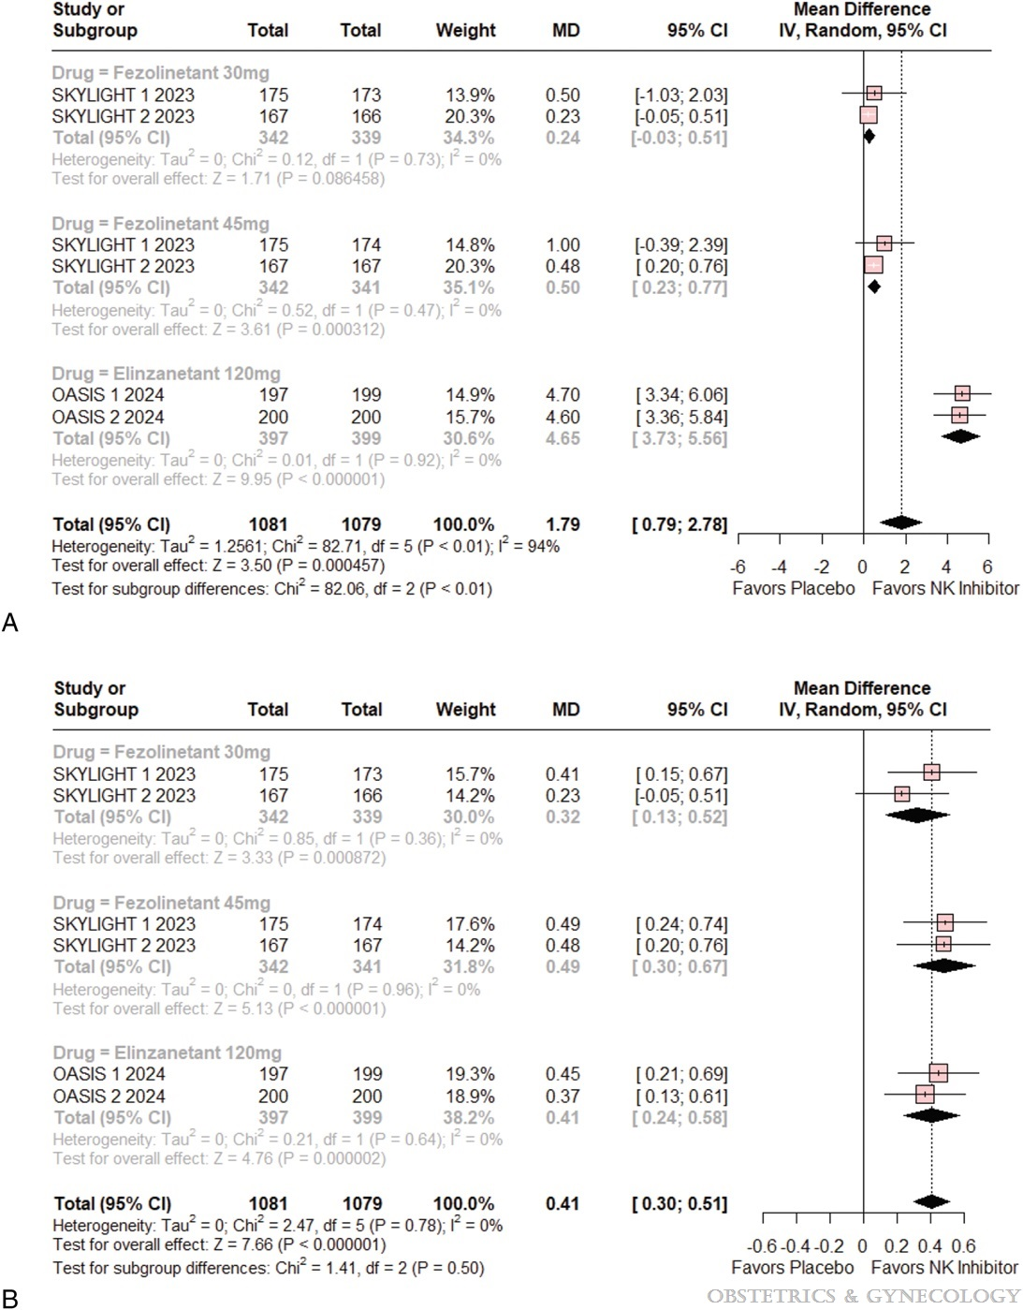
Fig. 3.
Fezolinetant and Elinzanetant Therapy for Menopausal Women Experiencing Vasomotor Symptoms: A Systematic Review and Meta-analysis
Menegaz de Almeida, Artur; Oliveira, Paloma; Lopes, Lucca; Leite, Marianna; Morbach, Victória; Alves Kelly, Francinny; Barros, Ítalo; Aquino de Moraes, Francisco Cezar; Prevedello, Alexandra
Obstetrics & Gynecology145(3):253-261, March 2025.
doi: 10.1097/AOG.0000000000005812
A. PROMIS-SD-SF (Patient-Reported Outcomes Measurement Information System Sleep Disturbance Short Form) score change from baseline. B. MENQOL (Menopause-Specific Quality of Life) score change from baseline. MD, mean difference; IV, inverse variance; SKYLIGHT, A Study to Find Out if Fezolinetant Helps Reduce Moderate to Severe Hot Flashes in Women Going Through Menopause; OASIS, A Study to Learn More About How Well Elinzanetant Works and How Safe it is for the Treatment of Vasomotor Symptoms (Hot Flashes) That Are Caused by Hormonal Changes Over 26 Weeks in Women Who Have Been Through the Menopause; df, degrees of freedom; NK, neurokinin.

Slide 38
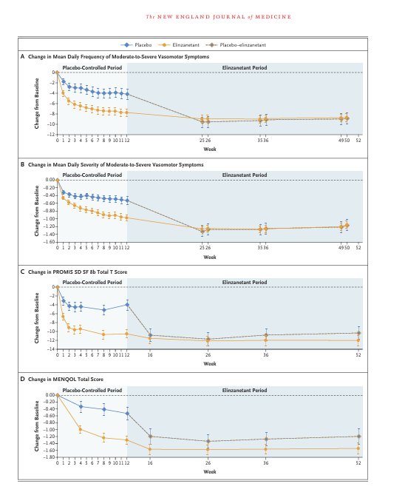
Elinzanetant for Vasomotor Symptoms from Endocrine Therapy for Breast Cancer
Cardoso F, et al Elinzanetant for Vasomotor Symptoms from Endocrine Therapy for Breast Cancer. N Engl J Med. 2025
The daily dose is 120 mg (two 60 mg capsules daily) and baseline liver function tests are recommended as they are for fezolinetant

Slide 39
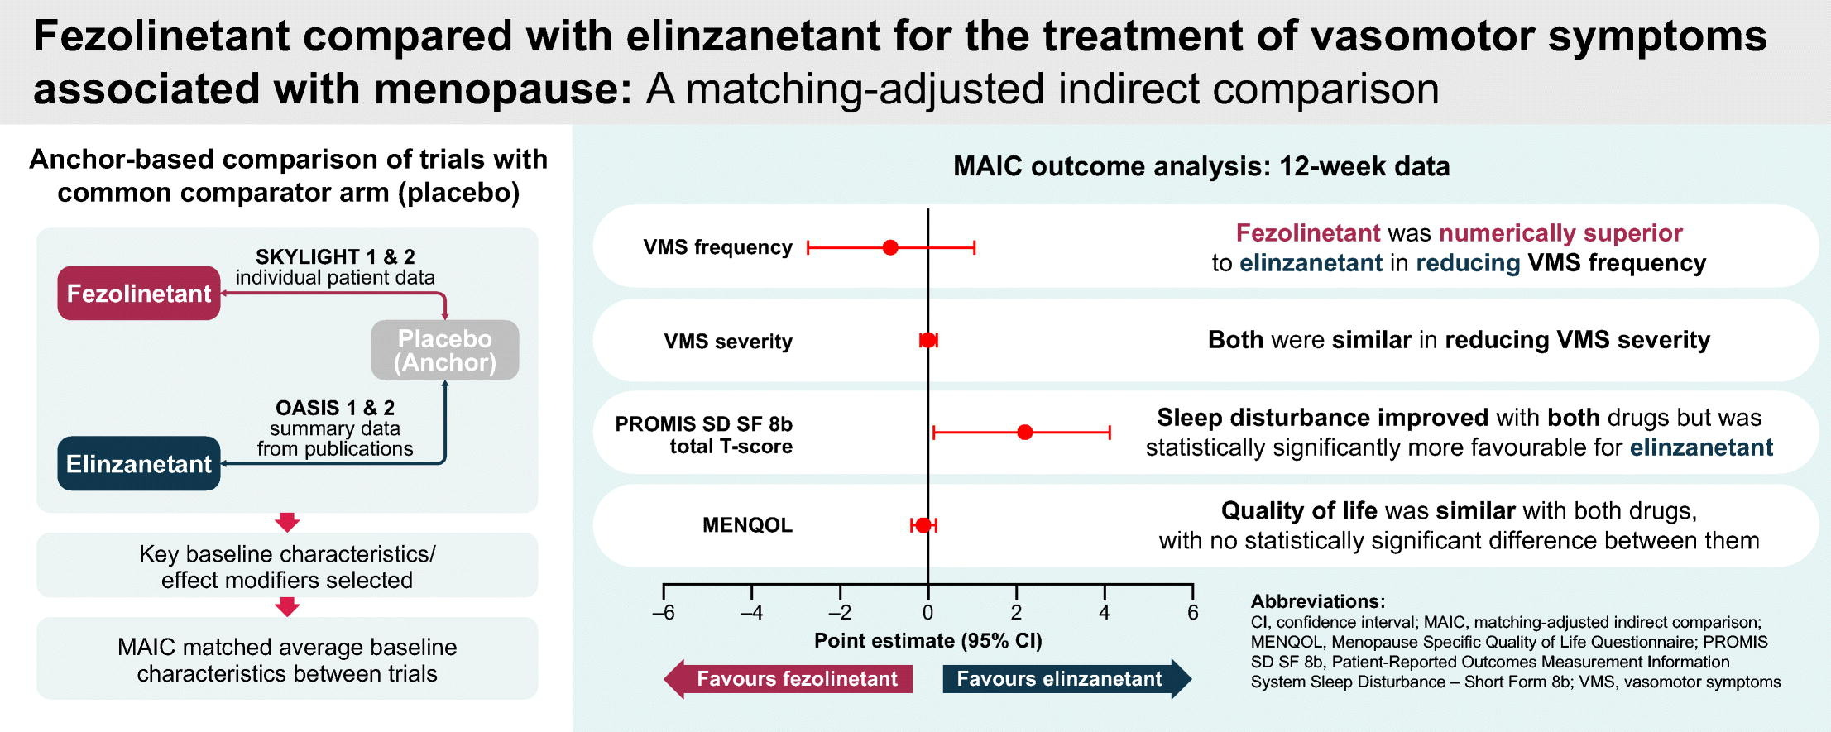
Fezolinetant compared with elinzanetant for the treatment of vasomotor symptoms associated with menopause: A matching-adjusted indirect comparison
Stute P, Shapiro C M M, Morga A, Tai TA, Ajmera M, Muresan B, Martins K, Hua Y, Zhao A, Liu J, Nappi RE. Fezolinetant compared with elinzanetant for the treatment of vasomotor symptoms associated with menopause: A matching-adjusted indirect comparison. Maturitas. 2025 Nov 24;205:108782. doi: 10.1016/j.maturitas.2025.108782. Epub ahead of print. PMID: 41418588.

Slide 40
Conclusions
New medications for patients with :
Contra-indications to MHT
Unwilling to use MHT
Side effects of MHT
NK3 -antagonists Fezolinetant (Veoza) ®
Efficay on VMS
To some extent on sleep
And quality of life
Cave hepatic tests
NK 1,3- antagonists Elinzanetant (not marketed yet)

Slide 41
Notes:
41

