Slide 1
“Update of Postmenopausal Osteoporosis management
17.1.26
BMS course
Serge Rozenberg,
CHU St Pierre Université libre de Bruxelles
Vrije Universiteit Brussel
Belgium
serge_rozenberg@stpierre-bru.be
serge.rozenberg@skynet.be
BE_EN_24832_v1, November 2025

Slide 2
Conflict of interest & Disclosure
Conflicts of interest: nil
Disclosure : unrestricted grant to BMS of Astellas
Disclosure SR
Research funding IRIS- King Baudouin Fondation, Vesale research Foundation, Amgen, MSD
Speakers bureau &/or Advisory Boards
Abbot, Pfizer, Will, Gedeon Richter, MSD, Amgen, UCB, Astellas

Slide 3
Take home messages
Osteoporosis affects essentially postmenopausal women (4 x more women than men)
The burden is immense
Gynecologists have a crucial role in preventing & treating postmenopausal osteoporosis

Slide 4
Agenda
Overview of postmenopausal osteoporosis
Diagnosis
Therapeutic algorithm
Old & New medications

Slide 5
Agenda
Overview of postmenopausal osteoporosis
Diagnosis
Therapeutic algorithm
Old & New medications

Slide 6
Lifetime fracture risk
A 50-year-old white woman has a 15 - 20% risk of hip fracture and a 50% risk of any osteoporotic fracture.
Black & Rosen NEJM 2016

Slide 7
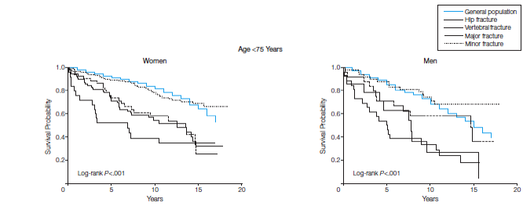
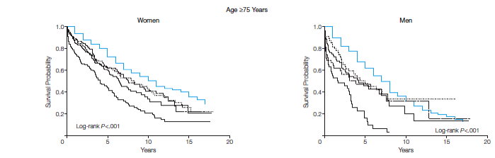
Survival curves according to type of fracture
From Bliuc D et al, JAMA 2009
Notes:
There is also an increased mortality that is due to vertebral fractures as is illustrated on these Kaplan Meyer survival curves. Although hip fracture patients have the lowest survival, patients suffering from other major osteoporotic factures and from vertebral fractures have also a reduced survival in both women and men independently of their age.

Slide 8
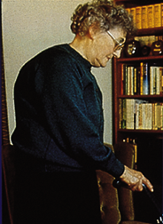
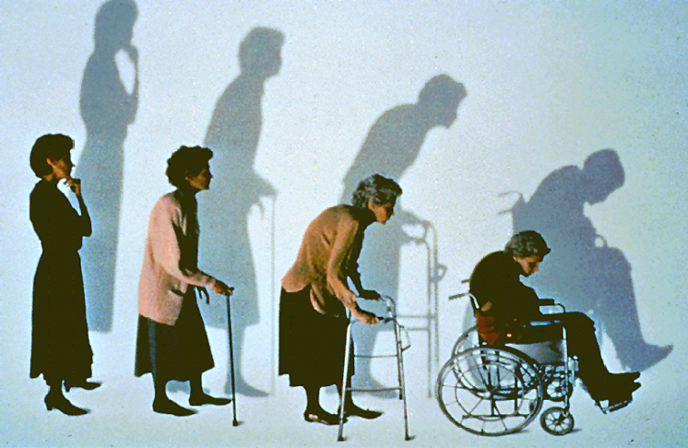
Clinical Consequences
Kyphosis
Loss of height
Bulging abdomen
Acute and chronic pain
Breathing difficulties, reflux and other GI symptoms
Depression
REDUCED QUALITY OF LIFE

Slide 9




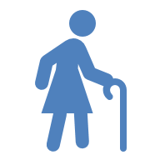
Osteoporosis is a common condition among women
≥50 years; however, there is a large treatment gap^{1–3}
Europe prevalence^{1,2}
Belgium prevalence³
Belgium treatment gap^{3‡}
79.1% women
291 thousand women
remain untreated³
In 2019, there were
681 000
individuals in the Belgium with osteoporosis
20.9%
men
66%
In 2019, 25.5 million women in Europe had osteoporosis^{1,2}*†
The prevalence of osteoporosis in the total population in 2019
was 5.6%^{1,2}
of women do not receive osteoporosis treatment despite exceeding the fracture risk threshold³
22.4%
of women aged ≥50 years
vs
6.6% of men aged
≥50 years
In 2019, the treatment gap‡ in Europe was 71%, with 15 million women remaining untreated^{1,2}
Osteoporosis disproportionately affects women aged 50 years
or more
*Estimates from the International Osteoporosis Foundation scorecard for osteoporosis in Europe (SCOPE) project in 2019.¹ †32 million men and women had osteoporosis in 2019.^{1,2}
‡SCOPE 2021 defined the treatment gap as the rate of women who exceed the intervention threshold but do not receive treatment.²
1. Kanis JA et al. Arch Osteoporos 2021;16:82; 2. Scorecard for Osteoporosis in Europe. SCOPE 2021 Summary Report. Available from: https://www.osteoporosis.foundation/sites/iofbonehealth/files/2022-01/SCOPE%20Summary%20Report.pdf. Accessed March 2025; 3. Scorecard for Osteoporosis in Europe (Belgium). SCOPE 2021 Summary Report. Available from: https://www.osteoporosis.foundation/sites/iofbonehealth/files/scope-2021/Belgium%20report.pdf. Accessed October 2025

Slide 10
In Belgium, fragility fractures have an economic and healthcare burden¹
    Direct cost of incident fractures
€ 1.1 billion
    Ongoing cost resulting from fractures in previous years (long-term disability costs)
€ 766.4 million
    Cost of pharmacological intervention (assessment & treatment)
€ 321.9 million
    Total direct cost
    (excluding the value of QALYs* lost)
      Fragility fractures accounted for 2.4% of total healthcare spending in 2019¹
€ 34.0 million
€ 1.1 billion
Qaly: Quality-Adjusted Life-Year – a multidimensional outcome measure that incorporates both the Quality (health-related) and Quantity (length) of life
Qaly: Quality-Adjusted Life-Year
1. Scorecard for Osteoporosis in Europe (Belgium). SCOPE 2021 Summary Report. Available from: https://www.osteoporosis.foundation/sites/iofbonehealth/files/scope-2021/Belgium%20report.pdf. Accessed October 2025

Slide 11
What should we do ?

Slide 12
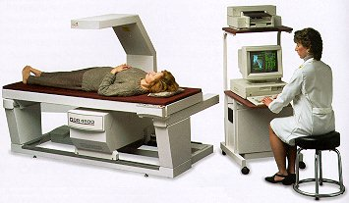
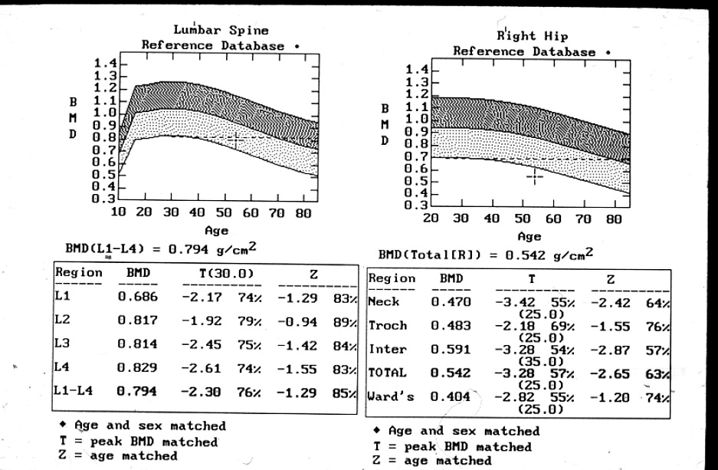
Identify patients at risk

Slide 13
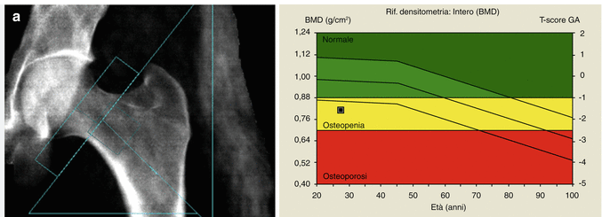
WHO osteoporosis definition
T-score > -1SD of the young adult mean= normal BMD .
T-score between 1 to -2.5 SD below the young adult = osteopenia .
T-score < 2.5 SD young adult mean = osteoporosis.
Severe (established) osteoporosis= <-2.5 + one or more past fractures due to osteoporosis.
The risk for fracture doubles with every SD below normal.
Severe (established) osteoporosis= <-2.5 + one or more past fractures due to osteoporosis.
Z-score : BMD is compared to an age-matched norm.

Slide 14
Who should be screened ?
BMD: Women ≥65 years – We suggest BMD assessment in all women 65 years of age and older (Grade 2B).
BMD: Women <65 years – We suggest BMD assessment in postmenopausal women less than 65 years if one or more risk factors are present (table 2) (Grade 2B).
UPTODATE 2022 Author: EW Yu, Eds CJ Rosen, KE Schmader, K Rubinow,

Slide 15
Osteoporotic fracture and BMD
Fractures/1,000 person-years
Number of fractures
50
Fracture rate
400
40
300
30
20
200
10
100
0
0
1.0
0.5
0.0
-0.5
-1.0
-1.5
-2.0
-2.5
-3.0
-3.5
Siris. Surgeon General’s Workshop on Osteoporosis and Bone Health, December 2002

Slide 16
Osteoporotic fracture and BMD
Fractures/1,000 person-years
Number of fractures
50
Fracture rate
Women with fractures
400
40
300
30
20
200
10
100
0
0
1.0
0.5
0.0
-0.5
-1.0
-1.5
-2.0
-2.5
-3.0
-3.5
Siris. Surgeon General’s Workshop on Osteoporosis and Bone Health, December 2002

Slide 17
FRAX
Treatment should be considered when there is a 10 year hip fracture risk of at least 3% (and less than 70 years) or 5% (and ≥70 years)
or a 20% risk (all ages) of a major osteoporotic fracture (MOF)
Sanchez-Rodriguez D, Bergmann P, Body JJ, Cavalier E, Gielen E, Goemaere S, Lapauw B, Laurent MR, Rozenberg S, Honvo G, Beaudart C, Bruyère O. The Belgian Bone Club 2020 guidelines for the management of osteoporosis in postmenopausal women. Maturitas. 2020

Slide 18
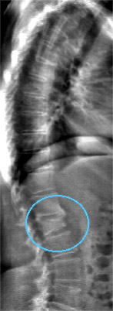
Single Energy Fan-beam DXA Imaging a Potential Alternative to Conventional Radiographs
Single energy imaging
Fast (10 sec) scanning / breath hold
Simple visual evaluation
Low dose (1/100 of radiographs)
Available at point of care

Slide 19
Diagnostic tests in the work-up of secondary osteoporosis.
Complete blood count
Renal and liver function test
Serum calcium and phosphate levels, CTX, P1NP
Serum C-reactive protein
Serum bone-specific or total AP activity
Serum 25-hydroxyvitamin D
Serum levels of basal TSH
Serum free testosterone levels (in men)
Fasting glucose levels
Intact parathyroid hormone
Serum protein electrophoresis, immunofixation
24-h urinary calcium excretion (with creatinine and sodium control)
Anti-tissue transglutaminase antibodies
Anti-HIV antibodies
Morning fasting serum cortisol after dexamethasone suppression
Serum tryptase levels, urinary histamine excretion
COL1A genetic testing

Slide 20
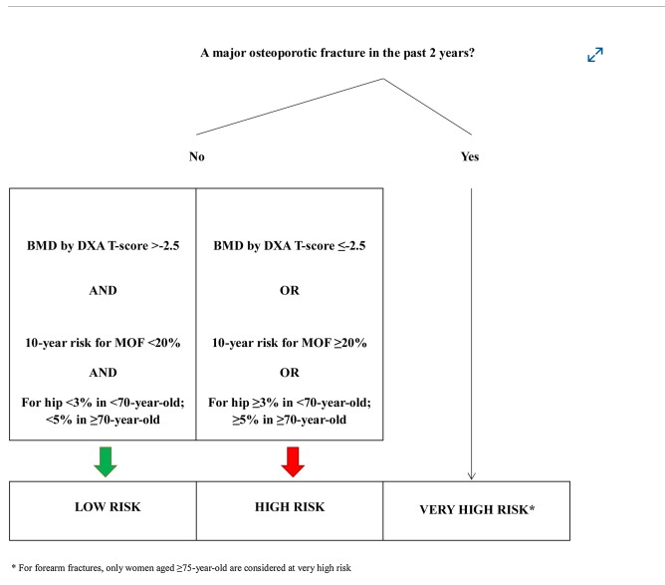
Sanchez-Rodriguez D, Bergmann P, Body JJ, Cavalier E, Gielen E, Goemaere S, Lapauw B, Laurent MR, Rozenberg S, Honvo G, Beaudart C, Bruyère O. The Belgian Bone Club 2020 guidelines for the management of osteoporosis in postmenopausal women. Maturitas. 2020

Slide 21
Different fracture risks require different interventions¹
Adapted from NICE Guidelines Group recommends FRAX® assessment to establish a patient’s 10-year probability of major osteoporotic fracture and to guide treatment decisions¹
10-year probability of major osteoporotic fracture (%)
40
very high risk:
Anabolic agents
High Risk
Bisphosphonates /Denosumab if older .
Very high risk
35
30
High risk
25
Intermediate risk
20
Correct risk factors
+ Ca + Vit D , MHT or SERM
15
Intervention threshold
10
Correct risk factors, calcium, vitamin D
exercise.
5
Low risk
0
50
55
60
65
70
80
90
Age (years)
Adapted from Gregson C et al. 2022.¹

Slide 22
Correct risk factors
Tabacco
Alcohol
Sedentarily
Diabetes
Falling
Sedatives ….

Slide 23
Therapeutic strategies

Slide 24
Calcium and vitamin D supplementation in osteoporosis
Optimal intake : uncertain.
Postmenopausal osteoporosis: 1200 mg calcium /d (total diet plus supplement) and 800 IU vitamin /d
Premenopausal osteoporosis, in males with osteoporosis, 1000 mg calcium (total of diet and supplement) and 600 IU /d
Calcium carbonate (with meals) or citrate (patients taking proton pump inhibitors (PPIs) or H2 blockers or who have achlorhydria)
Safe upper limits : calcium (diet plus supplements) < 2000 mg/day. Vitamin D < 4000 IU/ d.
Side effects Nephrolithiasis
Cardiovascular : debated
Uptodate Rosen 2025

Slide 25
MHT & osteoporosis

Slide 26
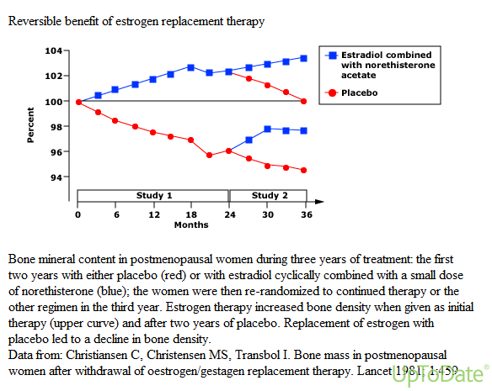

Slide 27
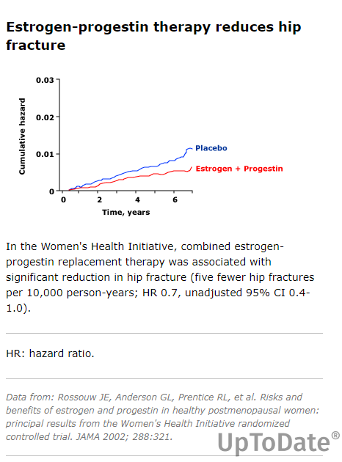

Slide 28
Discontinuation of menopausal hormone therapy and risk of fracture: nested case-control studies using routinely collected primary care data
Nested case-control study using UK
Women > 40 years (199-2023) (n=648 747 ), and with a first record for any fracture, matched at the fracture index date with up to 5 controls (n=2 357 125) with no fracture history,
Vinogradova Y,et al Lancet Healthy Longev. 2025 Jul;6(7):100729. doi: 10.1016/j.lanhl.2025.100729. Epub 2025 Jul 23. PMID: 40713950; PMCID: PMC12316639.

Slide 29
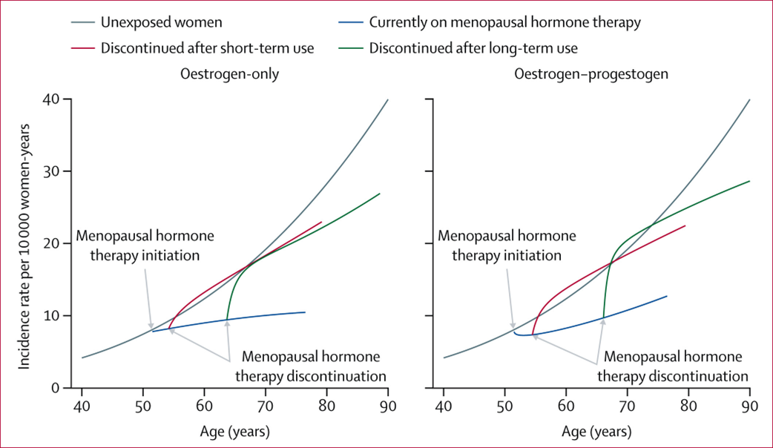
Discontinuation of menopausal hormone therapy and risk of fracture: nested case-control studies using routinely collected primary care data
Vinogradova Y,et al Lancet Healthy Longev. 2025

Slide 30
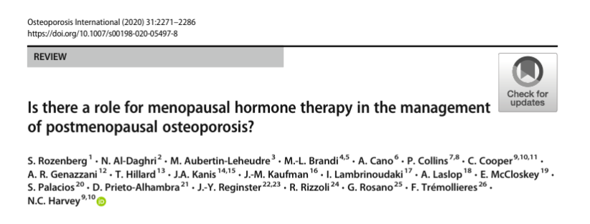
Overall, the benefit-risk profile supports MHT treatment in women who have recently (< 10 years) become menopausal, who have menopausal symptoms and who are less than 60 years old, with a low baseline risk for adverse events. MHT should be considered as an option for the maintenance of skeletal health in women, specifically as an additional benefit in the context of treatment of menopausal symptoms, when commenced at the menopause, or shortly thereafter, in the context of a personalized benefit-risk evaluation.

Slide 31
SERM
Indication for Raloxifene
Younger postmenopausal women with osteoporosis without pronounced vasomotor menopausal symptoms
Risk for vertebral but not hip fractures
No risk factors for VTE venous thrombosis
Additional benefit : Reduces breast cancer risk.
Fuggle NR, Cooper C, Harvey NC, Al-Daghri N, Brandi ML, Bruyere O, Cano A, Dennison EM, Diez-Perez A, Kaufman JM, Palacios S, Prieto-Alhambra D, Rozenberg S, Thomas T, Tremollieres F, Rizzoli R, Kanis JA, Reginster JY. Assessment of Cardiovascular Safety of Anti-Osteoporosis Drugs. Drugs. 2020 Oct;80(15):1537-1552.

Slide 32
Effect of Raloxifene in Women With or Without Existing Fractures
MORE Trial - 3 Years
25
RR 0.70
(95% CI = 0.56, 0.86)
20
30%
Placebo
15
% of Women with
Incident Vertebral Fracture
Raloxifene 60 mg/d
10
RR 0.50%
(95% CI = 0.29, 0.71)
5
50%
0
Without Prevalent
Vertebral Fractures
With Prevalent
Vertebral Fractures
Ettinger et al. JAMA 1999; 282:637-45.

Slide 33
Biphosphonates

Slide 34
Fracture Prevention with Infrequent Zoledronate in Women 50 to 60 Years of Age
10-year, prospective, RCT early postmenopausal women (50 to 60 years of age) with bone mineral density T scores lower than 0 and higher than -2.5 (scores of -1 or higher typically indicate normal bone mineral density) at the lumbar spine, femoral neck, or hip.
zoledronate 5 mg at baseline and at 5 years (zoledronate-zoledronate group), zoledronate 5 mg at baseline and placebo at 5 years (zoledronate-placebo group), or (placebo-placebo group).
Spinal radiographs were obtained at baseline, 5 years, and 10 years.
1054 women with a mean age of 56.0 years at baseline, 1003 (95.2%) completed 10 years of follow-up.
A new morphometric fracture occurred in 22 women (6.3%) in the zoledronate-zoledronate group, in 23 women (6.6%) in the zoledronate-placebo group, and in 39 women (11.1%) in the placebo-placebo group (RR, zoledronate-zoledronate vs. placebo-placebo, 0.56 [95%{CI}, 0.34-0.92; P = 0.04]; and zoledronate-placebo vs. placebo-placebo, 0.59 [95% CI, 0.36 to 0.97; P = 0.08]).
RR of fragility fracture, any fracture, and major osteoporotic fracture was 0.72 (95% CI, 0.55 - 0.93), 0.70 (95% CI, 0.56 - 0.88), and 0.60 (95% CI, 0.42- 0.86), respectively, when zoledronate-zoledronate was compared with placebo-placebo and 0.79 (95% CI, 0.61 - 1.02), 0.77 (95% CI, 0.62 - 0.97), and 0.71 (95% CI, 0.51 - 0.99), respectively, when zoledronate-placebo was compared with placebo-placebo.
Conclusions: Ten years after trial initiation, zoledronate administered at baseline and 5 years was effective in preventing morphometric vertebral fracture in early postmenopausal women.
Bolland MJ, et al . N Engl J Med. 2025 Jan 16;392(3):239-248. doi: 10.1056/NEJMoa2407031. PMID: 39813642.

Slide 35
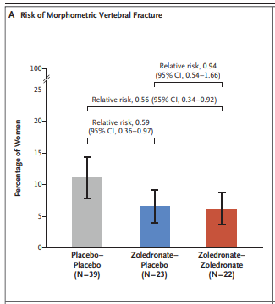
Fracture Prevention with Infrequent Zoledronate in Women 50 to 60 Years of Age
Bolland MJ, et al . N Engl J Med. 2025 Jan 16;392(3):239-248. doi: 10.1056/NEJMoa2407031. PMID: 39813642.

Slide 36
Bisphosphonate adverse events
Acute phase response
Upper GI
Rash
Iritis
Renal impairment
Jaw osteonecrosis
Atypical fracture femur
Oesophagal cancer

Slide 37
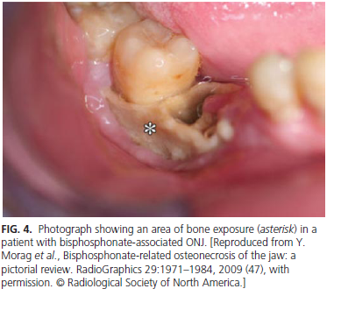
osteonecrosis of the jaw
Incidence: 1/10,000 bisphosphonate users ?
Much higher among patients with cancer
Black DM, Rosen CJ. Clinical Practice. Postmenopausal Osteoporosis. N Engl J Med. 2016 Jan 21;374(3):254-62. doi: 10.1056/NEJMcp1513724. Erratum in: N Engl J Med. ;374(18):1797.

Slide 38
Optimal duration ?
Mildly reduced BMD, no fractures
Likely that discontinuing after 3-5 years, for a temporary drug holiday (1-2 year).
Black DM, Rosen CJ. Clinical Practice. Postmenopausal Osteoporosis. N Engl J Med. 2016 Jan 21;374(3):254-62. doi: 10.1056/NEJMcp1513724. Erratum in: N Engl J Med. ;374(18):1797.

Slide 39
Denosumab Re-treatment and Changes in
Lumbar Spine and Total Hip BMD
Phase 2: Postmenopausal Women With Low BMD
Placebo
30 mg Q3M
Lumbar Spine
Total Hip
14
Discontinued
Treatment
Re-treatment
60 mg Q6M
8
Discontinued
Treatment
Re-treatment
60 mg Q6M
12
6
10
8
4
6
2
Percent Change
(LS Mean ± SE)
Percent Change
(LS Mean ± SE)
4
0
2
0
-2
-2
-4
-4
-6
0
6
12
18
24
36
48
0
6
12
18
24
36
48
Months
Months
Adapted from Miller PD, et al. Bone. 2008;43:222-229.
Notes:
Re-treatment with denosumab was associated with increases in lumbar spine and total hip BMD.
Patients who were re-treated with denosumab 60 mg Q6M at month 36 (following 12 months of discontinued denosumab treatment) demonstrated increases in lumbar spine and total hip BMD that were similar to those seen with initial denosumab treatment.
At 48 months, lumbar spine BMD increased to 9.0% over baseline.
At 48 months, total hip BMD increased to 3.9% over baseline.
Miller PD, et al. Bone. 2008;43:222-229.

Slide 40
Vertebral Fractures After Discontinuation of Denosumab: A Post Hoc Analysis of the Randomized Placebo-Controlled FREEDOM Trial and Its Extension.
Participants received ≥2 doses of denosumab or placebo Q6M, discontinued treatment, and stayed in the study ≥7 months after the last dose.
Of 1001 participants who discontinued denosumab during FREEDOM or Extension, the vertebral fracture rate increased from 1.2 per 100 participant-years during the on-treatmentperiod to 7.1, similar to participants who received and then discontinued placebo (n = 470; 8.5 per 100 participant-years).
Among participants with ≥1 off-treatment vertebral fracture, the proportion with multiple (>1) was larger among those who discontinued denosumab (60.7%) than placebo (38.7%; p = 0.049), corresponding to a 3.4% and 2.2% risk of multiple vertebral fractures, respectively.
Cummings et al J Bone Miner Res. 2018 Feb;33(2):190-198. doi: 10.1002/jbmr.3337. Epub 2017 Nov 22.

Slide 41
The paradigm is changing
The place of anabolic agents ?

Slide 42
NOGG recommended approach for sequential therapy in postmenopausal women at very high fracture risk¹
Particularly in those with vertebral fractures
Developing severe osteoporosis
Bone forming
agent, 1–2 years*
Antiresorptive therapy, ≥3–5 years†
STOP: If low risk
CONTINUE: If high or very high risk
Teriparatide/
abaloparatide/
romosozumab
Alendronate/zoledronate/denosumab
?
Bone strength
(mass + quality)
Time
Adapted from Curtis EM et al. 2022.²
FRACTURE RISK ASSESSMENT
Patient at very high risk of fracture,
particularly those with
vertebral fractures
MONITORING:
Adherence and fracture
risk reassessment
*Based on approved duration of treatment in line with UK Summary of Product Characteristics.
†Plan to prescribe oral bisphosphonates for at least 5 years, or intravenous bisphosphonates for at least 3 years and then re-assess fracture risk.
NOGG, National Osteoporosis Guideline Group.
1. National Osteoporosis Guideline Group. Clinical guideline for the prevention and treatment of osteoporosis 2024. Available at: https://www.nogg.org.uk/full-guideline. Accessed March 2025;
2. Curtis EM et al. Aging Clin Exp Res. 2022;34:695–714.

Slide 43
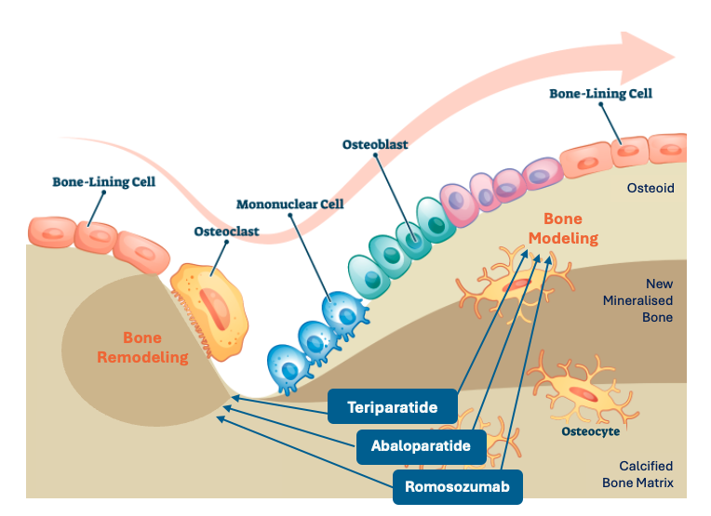
Differential effects of bone forming agents on bone surfaces¹
Teriparatide and abaloparatide act primarily by activating bone formation coupled to bone resorption at remodelling surfaces, and to a lesser extent by activating bone-forming cells at modelling surfaces.¹
Romosozumab acts primarily by activating modelling-based bone formation while inhibiting bone resorption at remodelling surfaces.¹
Adapted from Ferrari 2018.¹
1. Ferrari SL. Nat Rev Rheumatol. 2018;14(3):128.

Slide 44
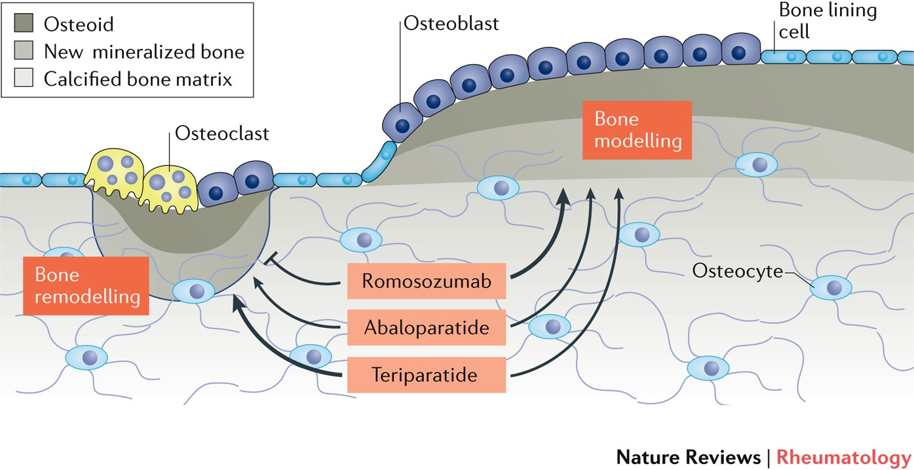
Romosozumab mechanism of action
Romosozumab is a bone-forming agent that binds and inhibits sclerostin, increasing bone formation and decreasing bone resorption¹
In the EU, romosozumab is indicated for the treatment of severe osteoporosis in postmenopausal women with high fracture risk¹
Romosozumab mechanism of action²
Romosozumab
Abaloparatide
Teriparatide
Figure adapted from Ferrari SL. 2018.
Notes:
Objective: To introduce romosozumab’s MoA
MoA, mechanism of action.

Slide 45
FRAME: Subject Incidence of New Vertebral Fracture
Through Month 24
Placebo
Placebo-to-denosumab
Romosozumab
Romosozumab-to-denosumab
RRR = 75%
p < 0.001
RRR = 73%
p < 0.001
Through Month 12
Through Month 24
n/N1 =
59/3322
16/3321
84/3327
21/3325
n/N1 = number of subjects with fractures/number of subjects in the primary analysis set for vertebral fractures; p value based on logistic regression model adjusted for age (<75, ≥75) and prevalent vertebral fracture.
RRR = relative risk reduction.
Adapted from: Cosman F, et al. N Engl J Med 2016;375:1532–43.

Slide 46
ARCH: Serious Adverse Events
Event | Month 12: Double-blind period |  |  | Primary analysis: Double-blind and open-label period*
 | Romosozumab (n = 2040) | Alendronate (n = 2014) |  | Romosozumab to alendronate (n = 2040) | Alendronate to alendronate (n = 2014)
Serious adverse event | 262 (12.8%) | 278 (13.8%) |  | 586 (28.7%) | 605 (30.0%)
Adjudicated serious cardiovascular (CV) event† | 50 (2.5%) | 38 (1.9%) |  | 133 (6.5%) | 122 (6.1%)
Cardiac ischaemic event | 16 (0.8%) | 6 (0.3%) |  | 30 (1.5%) | 20 (1.0%)
Cerebrovascular event | 16 (0.8%) | 7 (0.3%) |  | 45 (2.2%) | 27 (1.3%)
Heart failure | 4 (0.2%) | 8 (0.4%) |  | 12 (0.6%) | 23 (1.1%)
Death | 17 (0.8%) | 12 (0.6%) |  | 58 (2.8%) | 55 (2.7%)
Noncoronary revascularisation | 3 (0.1%) | 5 (0.2%) |  | 6 (0.3%) | 10 (0.5%)
Peripheral vascular ischaemic event not requiring revascularisation | 0 | 2 (<0.1%) |  | 2 (<0.1%) | 5 (0.2%)
Death | 30 (1.5%) | 21 (1.0%)‡ |  | 90 (4.4%) | 90 (4.5%)‡
*Incidence rates at the time of the primary analysis were cumulative and included all events in the double-blind and open-label period (to February 27 2017) in patients who received at least one dose of open-label alendronate.
†Serious CV adverse events were adjudicated by the Duke Clinical Research Institute. CV deaths include fatal events that were adjudicated as being CV-related or undetermined (and, therefore, possibly CV-related).
‡One patient had a non-treatment-related serious adverse event of pneumonia that was incorrectly flagged as death in the primary analysis snapshot and was not included in the analysis of fatal events.
Adapted from: Saag KG, et al. N Engl J Med 2017;377:1417–27.

Slide 47
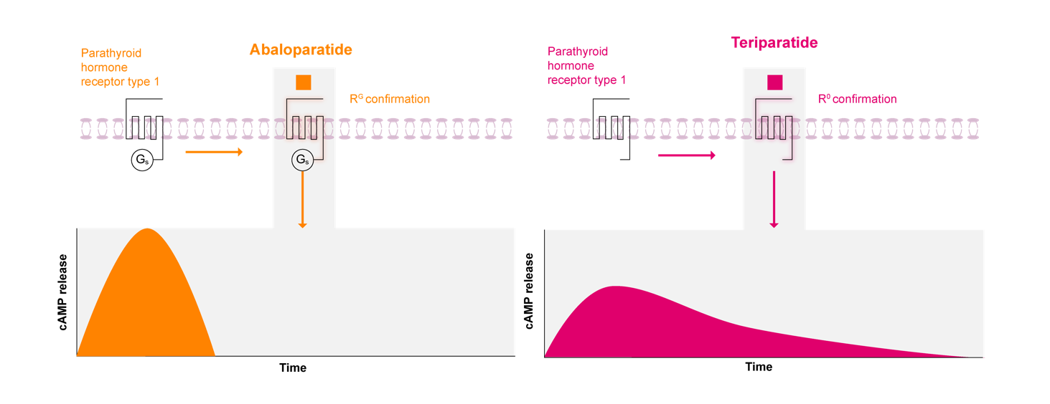
Abaloparatide demonstrates preferential binding to the R^{G} conformation of PTHR1 vs teriparatide¹
Differential effects of abaloparatide vs teriparatide on PTHR1 signalling¹
Abaloparatide binds more selectively to the R^{G} conformation of PTHR1, which induces more transient cAMP signalling vs teriparatide^{1,2}
This results in an increase in bone formation markers with less concomitant bone resorption, and a net anabolic effect on bone^{1,2}
Adapted from Khosla S et al. 2017.¹
cAMP, cyclic adenosine monophosphate; PTHR1, parathyroid hormone type 1 receptor; R^{G}, G protein–dependent conformation.
1. Khosla S et al. Lancet Diabetes Endocrinol. 2017; 5:898–907; 2. Hattersley G et al. Endocrinology. 2016;157:141–9.

Slide 48
ACTIVE and ACTIVExtend study design^{1,2}
STUDY DESIGN
ACTIVE was a phase 3 randomised controlled trial assessing the safety and efficacy of abaloparatide
vs placebo and open-label teriparatide over 18 months^{1,2}
In ACTIVExtend (an open-label extension study), eligible patients received an additional 24 months of alendronate treatment^{1,2}
ACTIVE N=2070¹
ACTIVExtend n=963¹
Randomisation
Double blind
Abaloparatide 80 μg SC daily (n=696)
Alendronate 70 mg weekly (n=469)
Patients from the Abaloparatide group in the ACTIVE trial
Placebo SC daily (n=688)
Alendronate 70 mg weekly (n=494)
Patients from the placebo group in the ACTIVE trial
Open label
Teriparatide 20 μg SC daily (n=686)
0
6
12
18
19
25
43
Months
Adapted from ELADYNOS® EPAR. October 2022.²
Teriparatide patients were not eligible for the ACTIVExtend study.
SC, subcutaneous.
1. ELADYNOS® (abaloparatide) EPAR SmPC. april 2024. Available at: https://www.ema.europa.eu/en/documents/product-information/eladynos-epar-product-information_en.pdf Accessed November 2025;
2. ELADYNOS® (abaloparatide) EPAR; Public assessment report. October 2022. Available at: https://www.ema.europa.eu/en/documents/assessment-report/eladynos-epar-public-assessment-report_en.pdf. Accessed March 2025

Slide 49
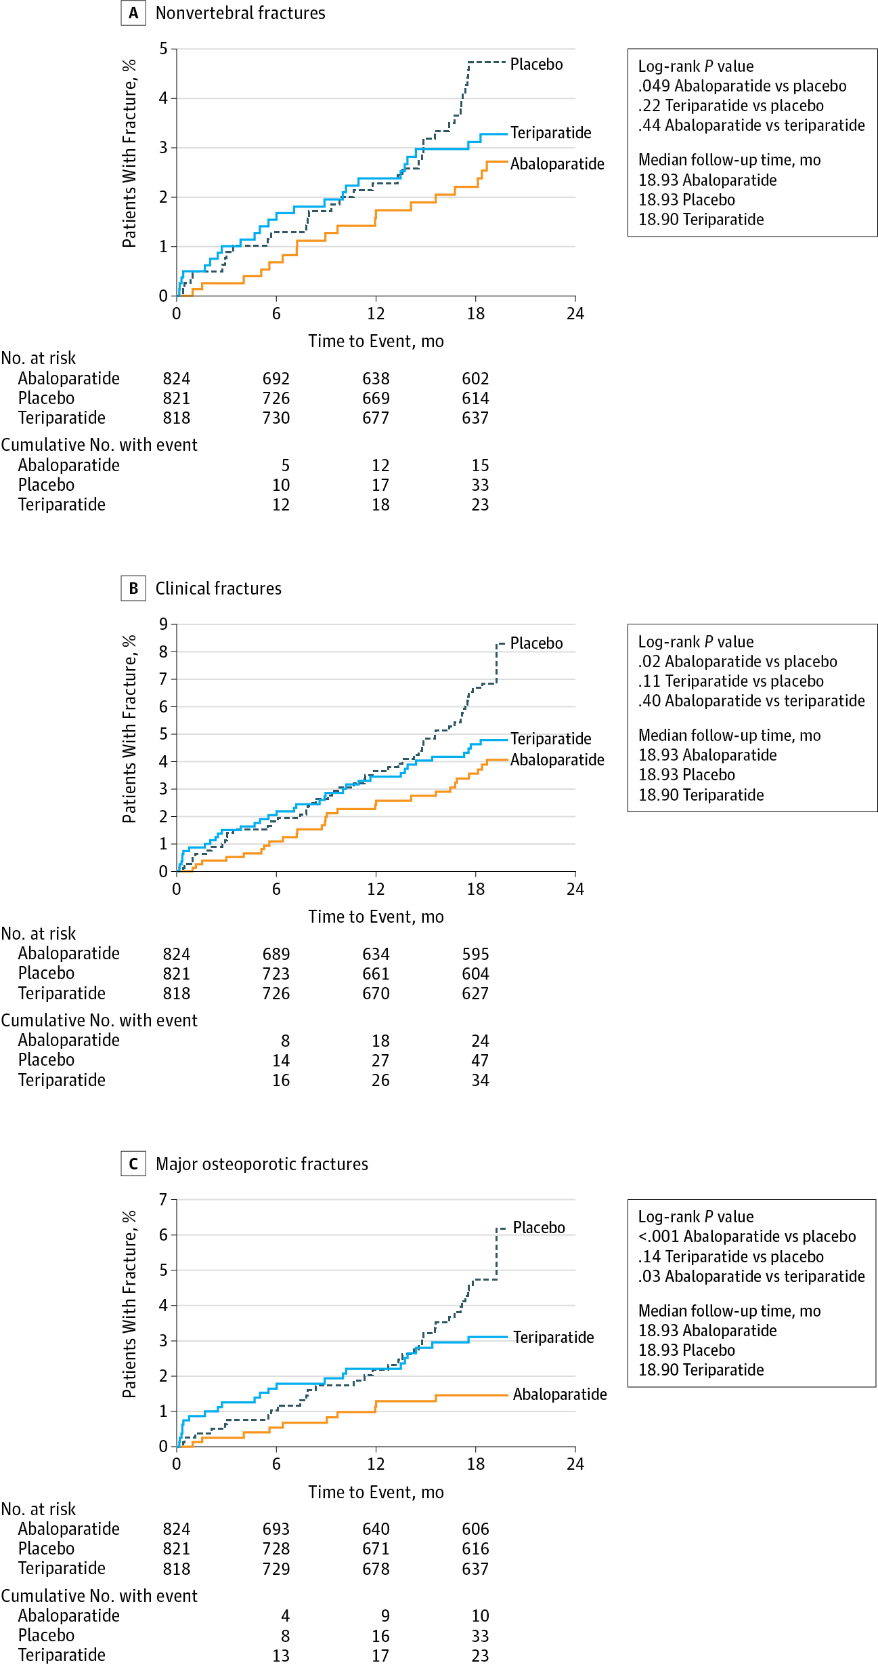
Effect of Abaloparatide vs Placebo on New Vertebral Fractures in Postmenopausal Women With Osteoporosis: RCT
JAMA. 2016;316(7):722-733. doi:10.1001/jama.2016.11136
Time to Event of Nonvertebral, Clinical, and Major Osteoporotic Fractures
A, Kaplan-Meier curves time to the first nonvertebral fracture
Abaloparatide vs placebo: HR 0.57 (95% CI, 0.32-1.00; P = .049)
Teriparatide vs placebo, the HR was 0.72 (95% CI, 0.42-1.22; P = .22).
B, Curves indicate time to the first clinical fracture
Abaloparatide vs placebo, the HR was 0.57 (95% CI, 0.35-0.91; P = .02)
Teriparatide vs placebo, the HR was 0.71 (95% CI, 0.46-1.09; P = .11).

Slide 50
Effect of Abaloparatide vs Placebo on New Vertebral Fractures in Postmenopausal Women With Osteoporosis: RCT
JAMA. 2016;316(7):722-733. doi:10.1001/jama.2016.11136
C, Curves indicate time to the first major osteoporotic fracture
Abaloparatide vs placebo, the HR was 0.30 (95% CI, 0.15-0.61; P < .001)
Teriparatide vs placebo, the HR was 0.67 (95% CI, 0.39-1.14; P = .14).

Slide 51
Abaloparatide significantly reduced new vertebral fractures vs placebo^{1,2}
PRIMARY EFFICACY ENDPOINT
New vertebral fractures in ACTIVE (mITT)^{1,2}
New vertebral fractures in ACTIVExtend (mITT)^{1,2}
88% relative risk reduction
(3.7% absolute risk difference)
(p<0.0001)
84% relative risk reduction
(4.4% absolute risk difference)
(p<0.0001)
Abaloparatide/
alendronate
(n=457)
Abaloparatide
(n=583)
ACTIVE
18 months
ACTIVE + ACTIVExtend
43 months*
Significantly lower risk of vertebral fracture at 18 months with abaloparatide vs placebo^{1,2}
This was sustained when followed with alendronate during ACTIVExtend (Month 19 to 43)^{1,2}
Vertebral fracture defined as fracture of the lumbar or thoracic spine.³
*Sustained efficacy at 25 months (primary endpoint) and at 43 months (exploratory endpoint).²
mITT, modified intent-to-treat.
. ELADYNOS® (abaloparatide) EPAR SmPC. april 2024. Available at: https://www.ema.europa.eu/en/documents/product-information/eladynos-epar-product-information_en.pdf Accessed November 2025;
2. ELADYNOS® (abaloparatide) EPAR; Public assessment report. October 2022. Available at: https://www.ema.europa.eu/en/documents/assessment-report/eladynos-epar-public-assessment-report_en.pdf. Accessed March 2025; 3. Miller PD et al. JAMA. 2016;316:722–33.

Slide 52
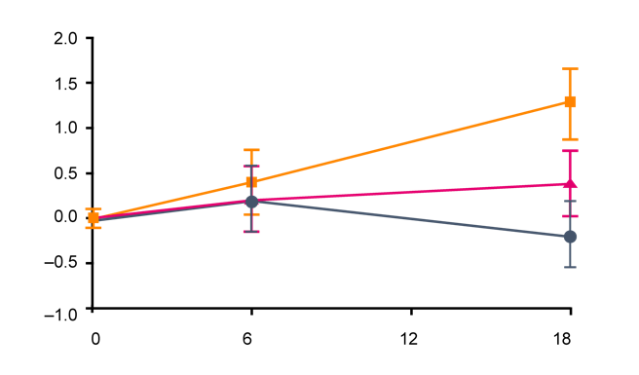










Treatment with abaloparatide in ACTIVE resulted in significant bone building at cortical-rich sites¹
RETROSPECTIVE ANALYSIS
Mean change in hip cortical volumetric BMD vs baseline at 18 months
Abaloparatide
Teriparatide
Change from baseline in hip cortical volumetric BMD
+2
Mean change in BMD (%)
Abaloparatide (n=250)
+1
Mean change in BMD (%)
Teriparatide† (n=250)
0
Placebo (n=250)
1.3%
mean increase from baseline in hip cortical volumetric BMD with abaloparatide (p<0.001) and 0.4% with teriparatide (p=0.13)*
Months
Significant increase in hip BMD at
18 months with abaloparatide vs placebo (p<0.001) and vs teriparatide (p<0.01)
Adapted from Winzenrieth R et al. 2021.¹
Hip DXA images from a subset of randomly selected patients in the ACTIVE trial (n=250 per arm) were retrospectively analysed using three-dimensional modelling methods (3D-SHAPER software) to evaluate changes from baseline at 6 and 18 months.
*p-values vs placebo; †Teriparatide vs placebo: p<0.05.
BMD, bone mineral density; DXA, dual-energy X-ray absorptiometry.
1. Winzenrieth R et al. Osteoporos Int 2021;32:575–583.

Slide 53
Hypercalciuria and dizziness were the two most common adverse events with abaloparatide^{1,2}
ACTIVE: Most commonly reported AEs from baseline to 18 months (≥5% in any treatment group)
Adverse event | Placebo (n=687), n (%) | Abaloparatide (n=694), n (%) | Teriparatide (n=686), n (%)
Hypercalciuria* | 86 (12.5) | 108 (15.6) | 124 (18.1)
Dizziness | 49 (7.1) | 77 (11.1) | 56 (8.2)
Upper respiratory tract infection | 61 (8.9) | 65 (9.4) | 65 (9.5)
Back pain | 69 (10.0) | 60 (8.6) | 52 (7.6)
Nausea | 21 (3.1) | 59 (8.5) | 37 (5.4)
Headache | 40 (5.8) | 59 (8.5) | 49 (7.1)
Arthralgia | 61 (8.9) | 58 (8.4) | 60 (8.7)
Hypertension | 37 (5.4) | 47 (6.8) | 36 (5.2)
Influenza | 21 (3.1) | 43 (6.2) | 23 (3.4)
Nasopharyngitis | 56 (8.2) | 43 (6.2) | 43 (6.3)
Palpitations | 3 (0.4) | 39 (5.6) | 12 (1.7)
Urinary tract infection | 36 (5.2) | 37 (5.3) | 34 (5.0)
Pain in extremity | 40 (5.8) | 34 (4.9) | 39 (5.7)
Constipation | 37 (5.4) | 28 (4.0) | 28 (4.1)
In the ACTIVE study, incidence of injection site reaction was 6.2% in the abaloparatide treatment group¹
*Hypercalciuria, urine calcium increased, urine calcium/creatinine ratio increased.
AE, adverse event.
1 . ELADYNOS® (abaloparatide) EPAR SmPC. april 2024. Available at: https://www.ema.europa.eu/en/documents/product-information/eladynos-epar-product-information_en.pdf Accessed November 2025;
2. ELADYNOS® (abaloparatide) EPAR; Public assessment report. October 2022. Available at: https://www.ema.europa.eu/en/documents/assessment-report/eladynos-epar-public-assessment-report_en.pdf. Accessed March 2025.

Slide 54
Take Home messages
Osteoporosis is a major public health issue
Affecting ½ women after age of 50.
Identify risk factors, use BMD
Correct risk factors
Use Ca + vit D
Sanchez-Rodriguez D, Bergmann P, Body JJ, Cavalier E, Gielen E, Goemaere S, Lapauw B, Laurent MR, Rozenberg S, Honvo G, Beaudart C, Bruyère O. The Belgian Bone Club 2020 guidelines for the management of osteoporosis in postmenopausal women. Maturitas. 2020 Sep;139:69-89. doi: 10.1016/j.maturitas.2020.05.006.
Gregson CL, Armstrong DJ, Avgerinou C, Bowden J, Cooper C, Douglas L, Edwards J, Gittoes NJL, Harvey NC, Kanis JA, Leyland S, Low R, McCloskey E, Moss K, Parker J, Paskins Z, Poole K, Reid DM, Stone M, Tomson J, Vine N, Compston J; National Osteoporosis Guideline Group (NOGG). The 2024 UK clinical guideline for the prevention and treatment of osteoporosis. Arch Osteoporos. 2025

Slide 55
Take Home messages
In moderately affected women (young no fracture) MHT & SERMS
Osteoporosis but not severe : Bisphosphonates or Denosumab. Bisphosphonates can be stopped for a drug holiday in the absence of fractures, but not Denosumab, which needs to be followed by another anti-osteoporotic drug.
Gregson CL, Armstrong DJ, Avgerinou C, Bowden J, Cooper C, Douglas L, Edwards J, Gittoes NJL, Harvey NC, Kanis JA, Leyland S, Low R, McCloskey E, Moss K, Parker J, Paskins Z, Poole K, Reid DM, Stone M, Tomson J, Vine N, Compston J; National Osteoporosis Guideline Group (NOGG). The 2024 UK clinical guideline for the prevention and treatment of osteoporosis. Arch Osteoporos. 2025 Sep 8;20(1):119.

Slide 56
Take Home messages
Paradigm is changing: Major Osteoporotic fractures/severe osteoporosis
Romosozumab/Abaloparatide may be used prior to or after Bisphosphonates or Denosumab
Sanchez-Rodriguez D, Bergmann P, Body JJ, Cavalier E, Gielen E, Goemaere S, Lapauw B, Laurent MR, Rozenberg S, Honvo G, Beaudart C, Bruyère O. The Belgian Bone Club 2020 guidelines for the management of osteoporosis in postmenopausal women. Maturitas. 2020 Sep;139:69-89. doi: 10.1016/j.maturitas.2020.05.006.
Gregson CL, Armstrong DJ, Avgerinou C, Bowden J, Cooper C, Douglas L, Edwards J, Gittoes NJL, Harvey NC, Kanis JA, Leyland S, Low R, McCloskey E, Moss K, Parker J, Paskins Z, Poole K, Reid DM, Stone M, Tomson J, Vine N, Compston J; National Osteoporosis Guideline Group (NOGG). The 2024 UK clinical guideline for the prevention and treatment of osteoporosis. Arch Osteoporos. 2025

Slide 57
Notes:
72

