Slide 1





Physiology: Hormonal changes during menopause, the importance of KNDy, NKB signaling, Neurokinin and antagonists
Axelle Pintiaux, MD, PhD- ULg

Slide 2
Definitions
Perimenopause – Menopause transition
Menopause
Postmenopause

Slide 4
MT begins four to six years before cessation of menses, and a physiologic deterioration of hypothalamic-pituitary-ovarian axis function associated with fluctuating hormone levels

Slide 5
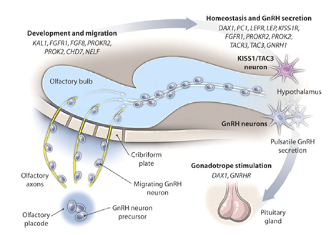

Slide 6
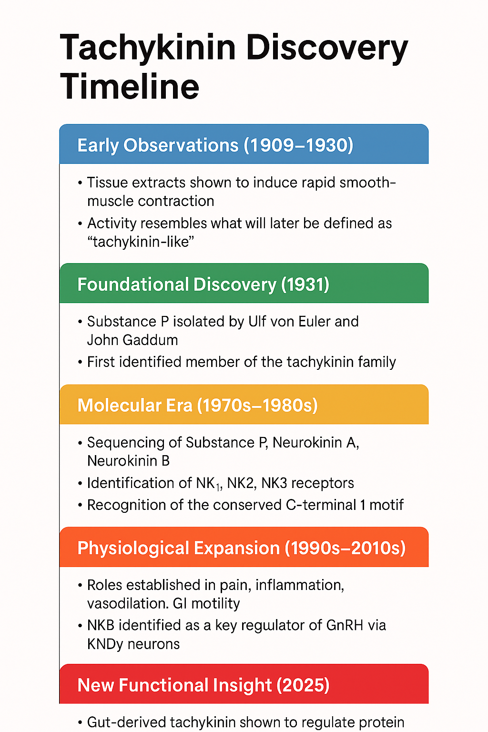
Protein-responsive gut hormone tachykinin directs food choice and impacts lifespan.Ahrentløv N, Kubrak O, Lassen M, Malita A, Koyama T, Frederiksen AS, Sigvardsen CM, John A, Madsen PEH, Halberg KV, Nagy S, Imig C, Richter EA, Texada MJ, Rewitz K.Nat Metab. 2025 Jun;7(6):1223-1245. doi: 10.1038/s42255-025-01267-0. Epub 2025 Apr 14.PMID: 40229448
appetite and longevity

Slide 7
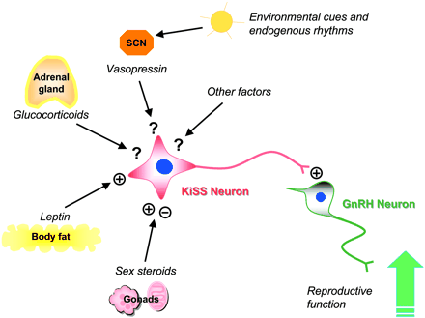
Kiss neuron
CRF
-
Récepteur GPR54
/Ghrelin
/Neuropeptide Y
GnRH R
Pituitary
Kisspeptin, a key factor in the neuroendocrinological regulation of animal reproduction, is a peptide product encoded by kiss genes, which act as the natural ligand of GPR54.

Slide 8
Karolina Skorupskaite, Human Reproduction Update, Vol.20, No.4 pp. 485–500, 2014

Slide 9
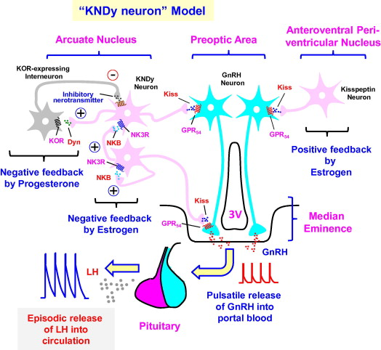
Guangfu Hu,General and Comparative Endocrinology 208 (2014) 94–108

Slide 10
Aleisha M. Moore, Endocrinology, 2024, Vol. 165, No. 2

Slide 11
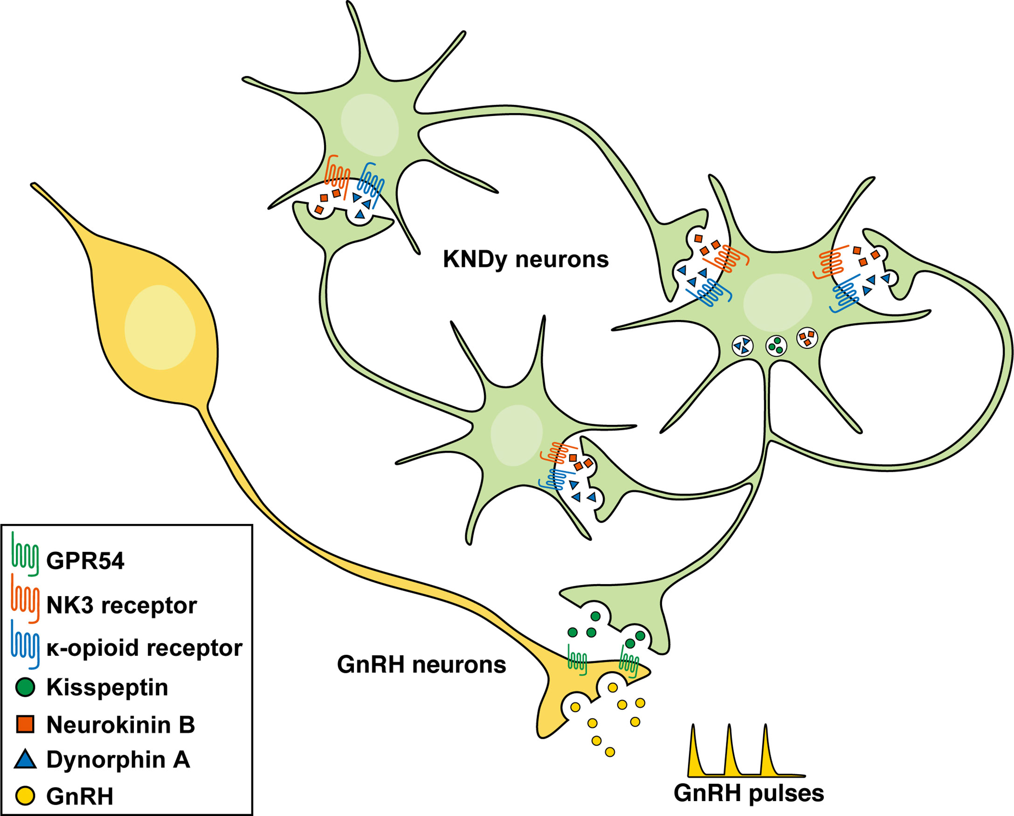

Slide 12
Proposed model for role of ARC Kiss1R neurons in the generation of GnRH pulses in ewes.
Robert L. Goodman,Endocrinology, 2023, Vol. 164, No. 11

Slide 13
Animal (2019), 13:12, pp 2986–2999

Slide 14

Flushes, blushing or hot flushes
Apart from physiological flushes represented by emotional or prudish blushing, post-prandial flushes and menopausal hot flushes, various pathologic flushes exist of various etiologies: endocrine, dysmetabolic, histaminic and iatrogenic.
Their pathogenicity is based mainly on local metabolites secretion provoking vasodilatation.
J F Merlen, J M Coget ,J Mal Vasc. 1987;12(3):285-90

Slide 15

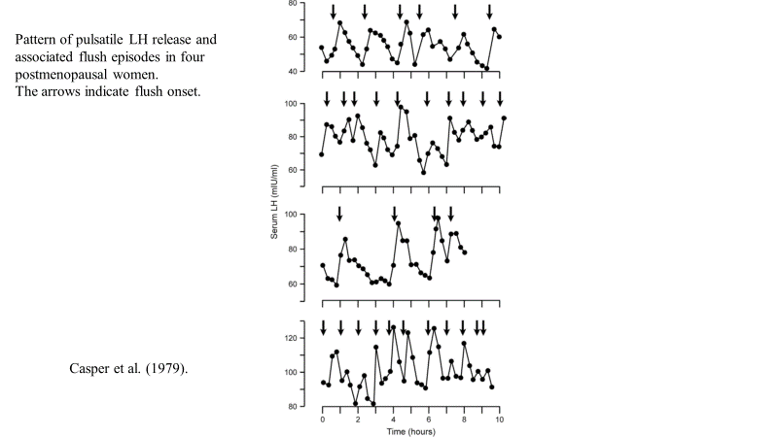
The menopausal hot flush
Although the hot flush is generally recognised by women and the medical profession as the most characteristic and often a very distressing symptom of the climacteric, it remains an enigma
It is probable that the flush is initiated by a supra-pituitary mechanism which is influenced by the hypothalamic factors responsible for pulsatile LH release
David W. Sturdee, Maturitas 60 (2008) 42–49

Slide 16
Modulation of body temperature and LH secretion by hypothalamic KNDy (kisspeptin, neurokinin B and dynorphin) neurons: A novel hypothesis on the mechanism of hot flushes
Based on the marked changes in hypothalamic kisspeptin, neurokinin B and dynorphin (KNDy) neurons in postmenopausal women, we hypothesize that KNDy neurons play a role in the mechanism of flushes.
In the rat, KNDy neurons project to preoptic thermoregulatory areas that express the neurokinin 3 receptor (NK3R), the primary receptor for NKB. Furthermore, activation of NK3R in the median preopticonucleus, part of the heat-defense pathway, reduces body temperature.
Finally, ablation of KNDy neurons reduces cutaneous vasodilatation and partially blocks the effects of estrogen on thermoregulation
A.A. Romanovsky, Editor
https://doi.org/10.1016/B978-0-444-63912-7.00001-1
Naomi E. Rance- Front Neuroendocrinol. 2013 August ; 34(3): doi:10.1016/j.yfrne.2013.07.003.

Slide 17
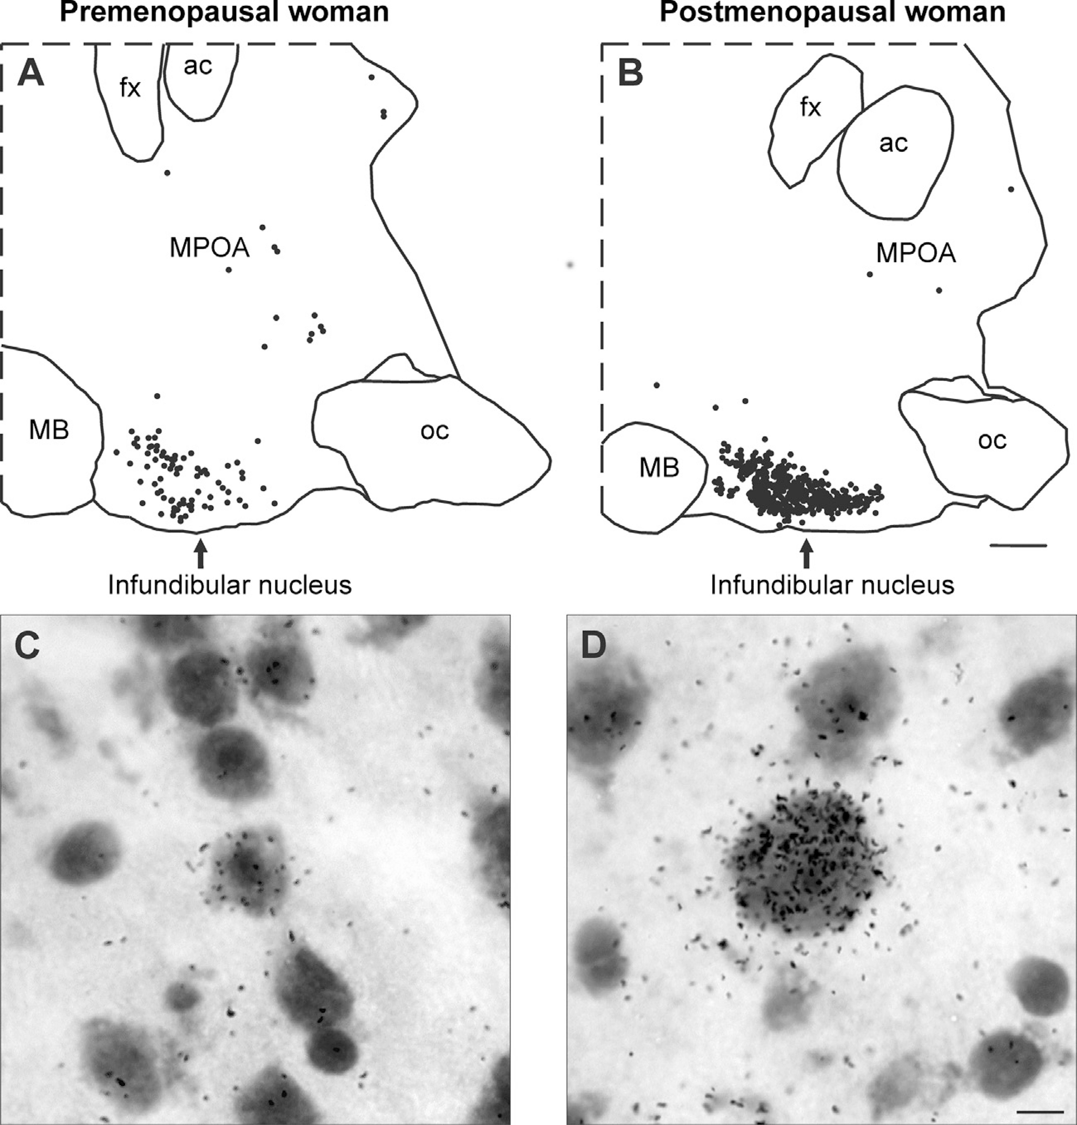
In postmenopausal women, kisspeptin neurons are hypertrophied and display increased numbers of audioradiographic grains, indicative of increased gene expression. Nearly identical changes can be seen in NKB neurons in the infundibular nucleus of postmenopausal women (Rance and Young, 1991).

Slide 18
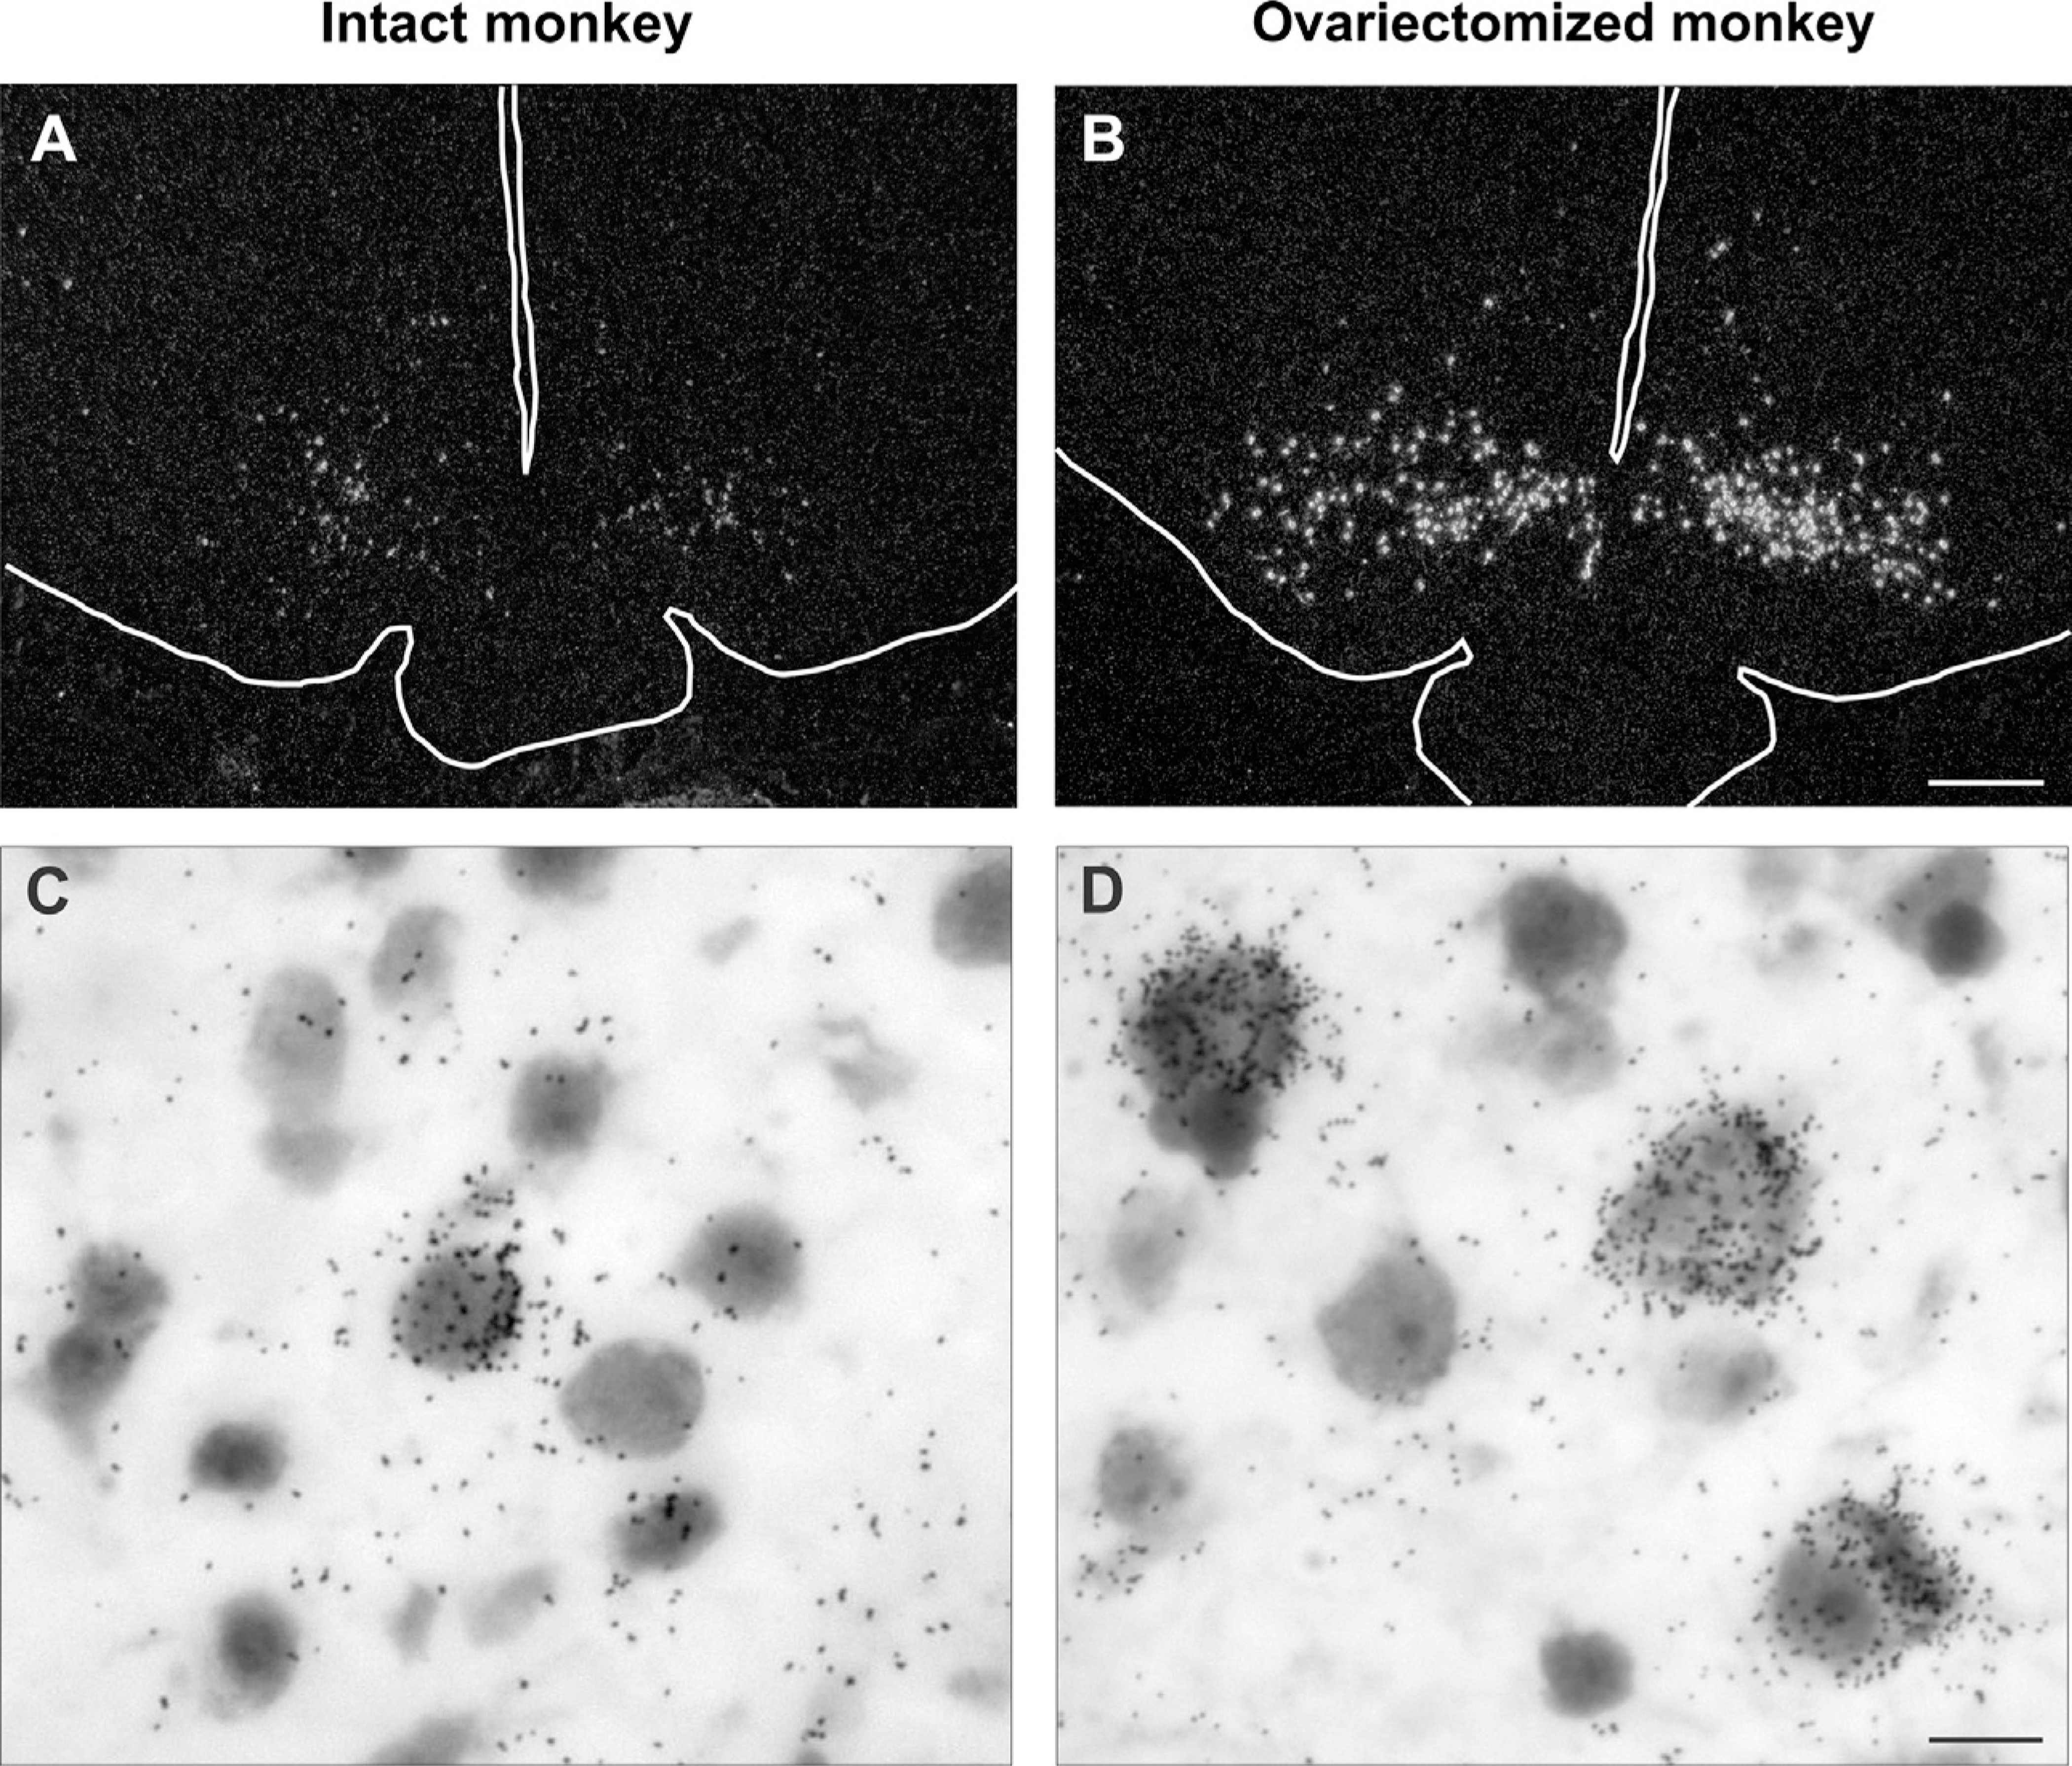
(A and B) Darkfield photomicrogaphs of coronal hypothalamic sections from an intact (A)or ovariectomized (B) cynomolgus monkey hybridized with cDNA probes complimentary to NKB mRNA (Tac3 in the monkey) and visualized using autoradiography
Brightfield photomicrogaphs of neurons expressing NKB mRNA visualized using in situ hybridization in the arcuate nucleus of an intact (C) or ovariectomized (D) cynomolgus monkey

Slide 19
Schematic diagram showing the relationship between KNDy neurons and the neuroendocrine circuits controlling LH secretion in postmenopausal women
Naomi E. Rance,Front Neuroendocrinol. 2013 August ; 34(3): . doi:10.1016/j.yfrne.2013.07.003.

Slide 20
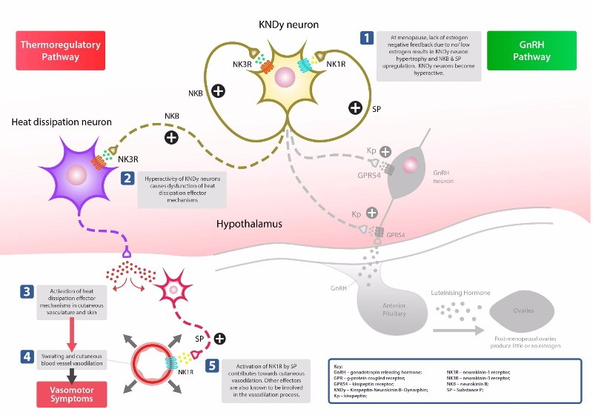
Menopause transition : a neuroendocrine storm

Slide 21
Karolina Skorupskaite, Human Reproduction Update, Vol.20, No.4 pp. 485–500, 2014

Slide 22


Additional effects ??
hypothalamic neurons that express NK3R are implicated in the estrogen modulation of body weight
cardiovascular disease is increased in menopausal women but pre-clinical evidence suggests that manipulation of neuronal signaling in the ventral tegmental area, which highly expresses NK3R, using an NK3R antagonist reduces heart rate and reverses spontaneous hypertension in rats
specific metabolic/cardiovascular endpoints. ??
Noel S, Sorlet C, Hospied S, et al. Suppression of weight gain in ovariectomized high-fat diet rats and in female monkeys by treatment with ESN364 (NK3 antagonist). Endocrine Rev 2017;38:OR19-6
Lessard A, Campos MM, Neugebauer W, Couture R. Implication of nigral tachykinin NK3 receptors in the maintenance of hypertension in spontaneously hypertensive rats: a pharmacologic and autoradiographic study. Br J Pharmacol 2003;138:554–63
De Brito Gariepy H, Couture R. Blockade of tachykinin NK3 receptor reverses hypertension through a dopaminergic mechanism in the ventral tegmental area of spontaneously hypertensive rats. Br J Pharmacol 2010;161:1868–84

Slide 24
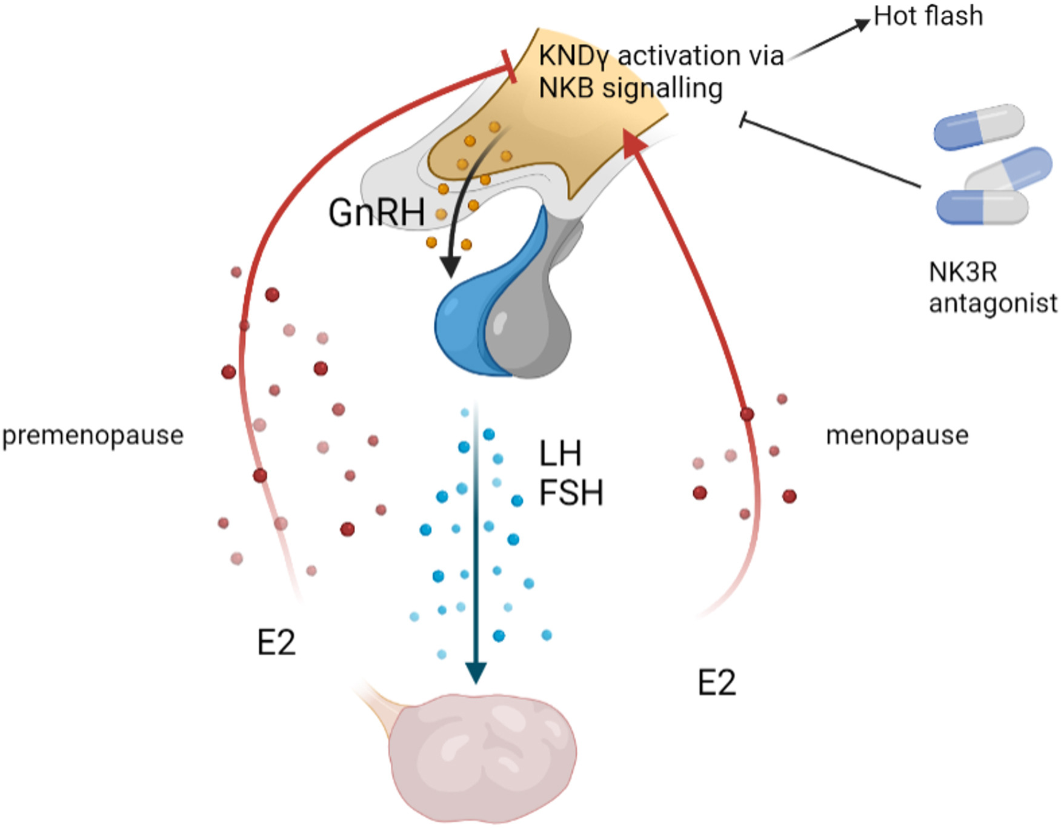

Slide 26


Tailored Care
Delamater and Santoro, Clin Obstet Gynecol. 2018 September ; 61(3): 419–432.

Slide 27






