Slide 1
How to manage a Menopause consultation
Dr.Eveline Markowicz
Delta Hospital, Brussels

Slide 2
How to manage a Menopause consultation
Overcoming barriers
and applying patient-centered interview techniques
to arrive at shared decision-making

Slide 3
What are the issues
The obstacles are :
Patients beliefs about the risks of breast cancer, thrombosis
Caregivers convictions about on the risks faced by patients of breast cancer patients and cardiovascular risk.
Limited access to menopause consultations due to the number of practitioners, gynecologists, general practitioners, and menopause consultants.
A menopause consultation is a very time-consuming process.

Slide 4
How to solve these issues
For patients : There are tools they should use in preparation for their first consultation to identify symptoms
Menoscore
Greenscale
MTT
Meno-check
Brochure
Podcast
For doctors: questionnaires to identify menopausal patients and to offer treatments
Questionnaire MTT (Menopause Treatment Tool)
The 2023 Practitioner’s Toolkit for Managing Menopause

Slide 5
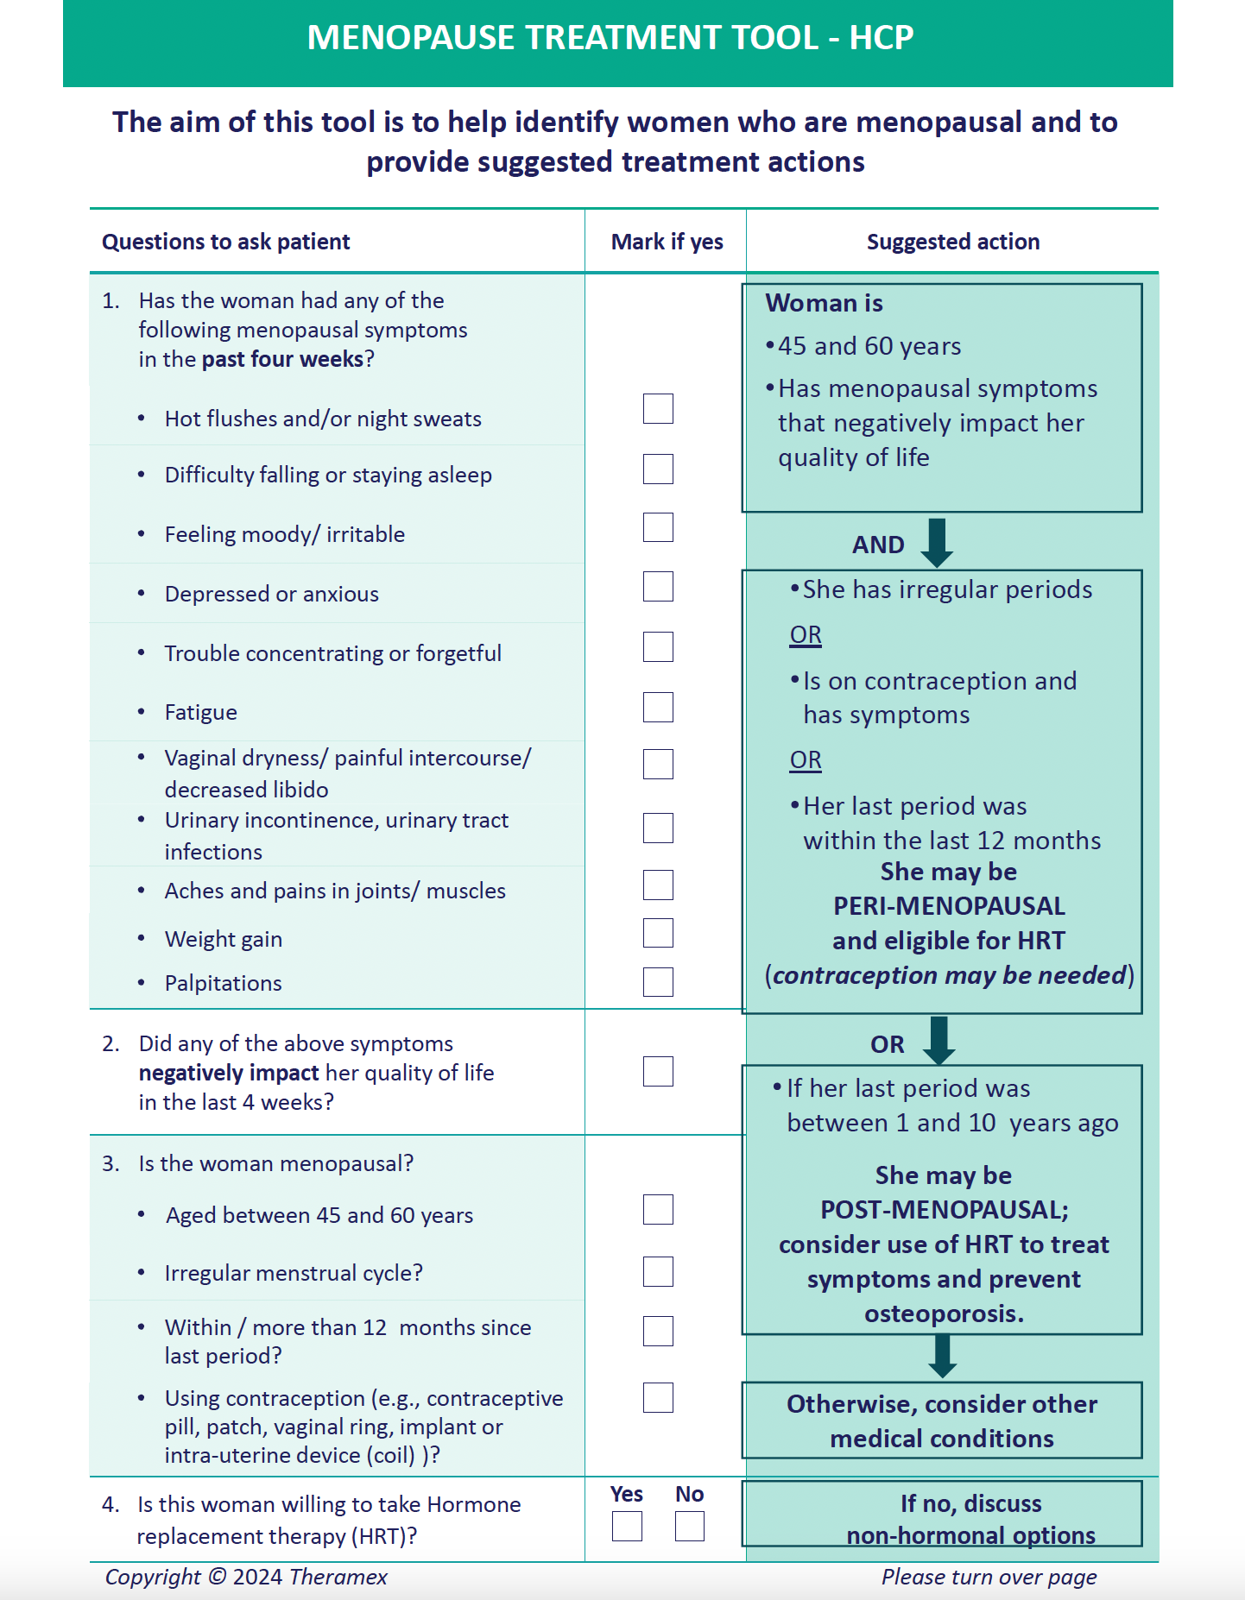
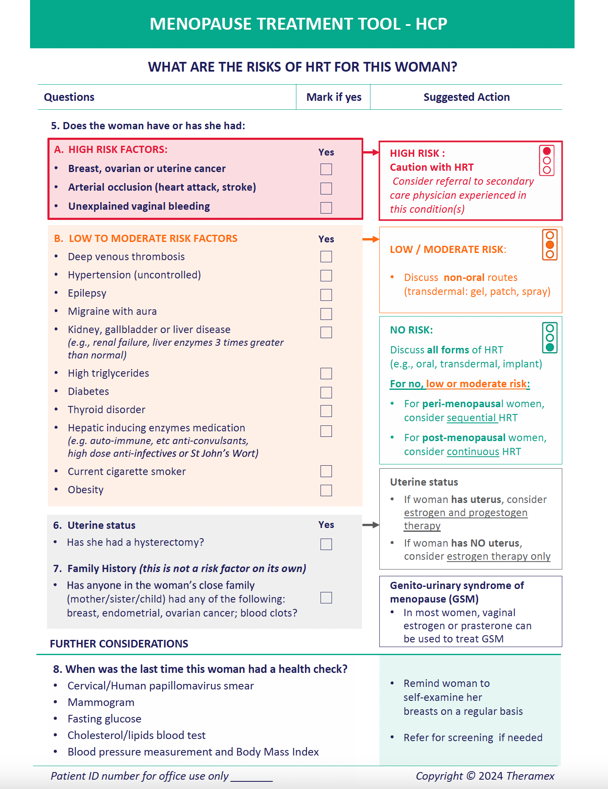
Questionnaire MTT

Slide 6
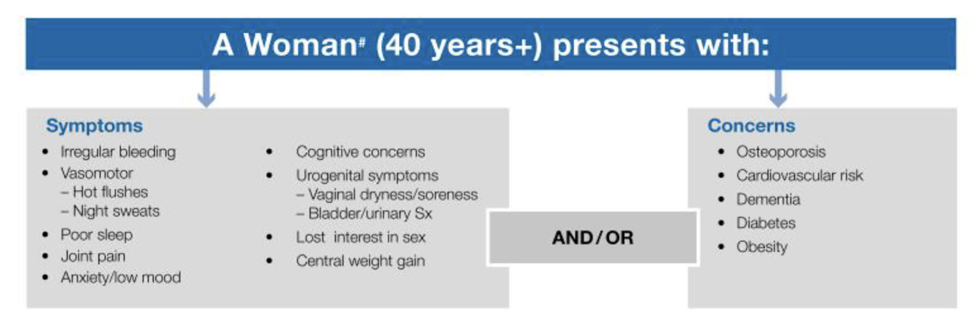
Toolkit (1)
The 2023 Practitioner’s Toolkit for Managing Menopause; S. R. Davis , S. Taylor,C. Hemachandra,K. Magraith,P. R. Ebeling,F. Jane &R. M. Islam

Slide 7
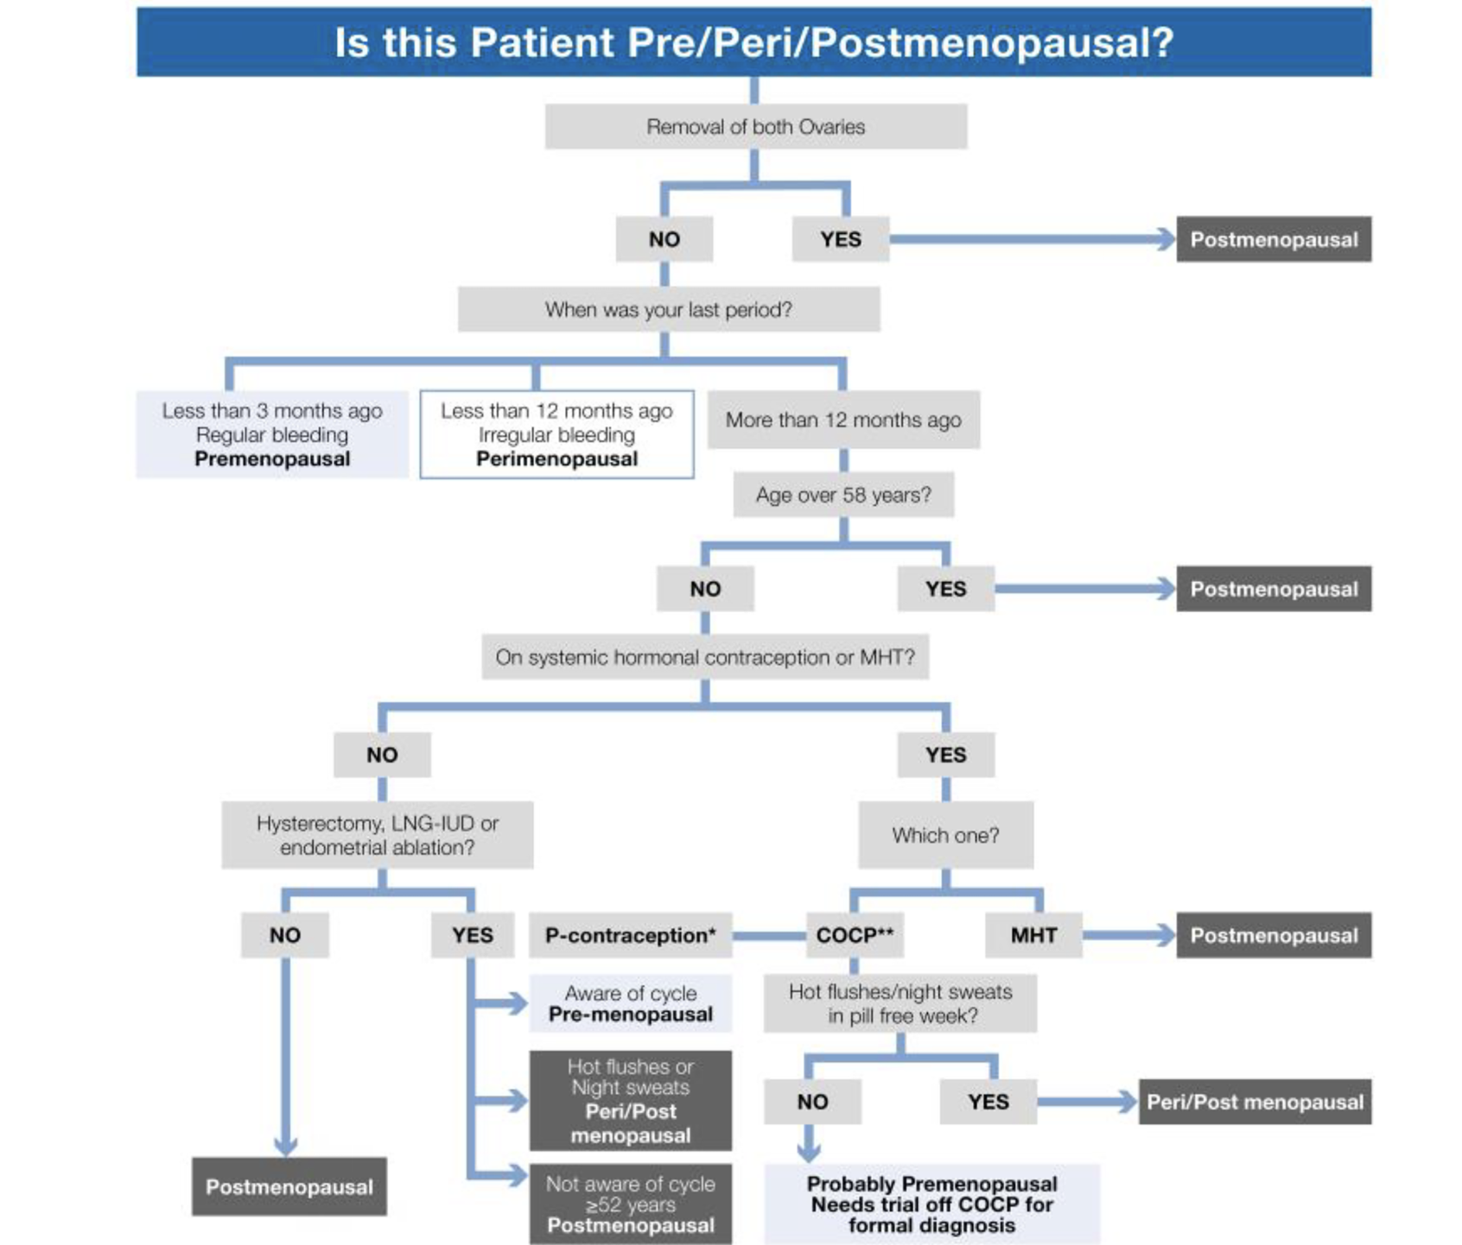
Toolkit (2)
The 2023 Practitioner’s Toolkit for Managing Menopause; S. R. Davis , S. Taylor,C. Hemachandra,K. Magraith,P. R. Ebeling,F. Jane &R. M. Islam

Slide 8
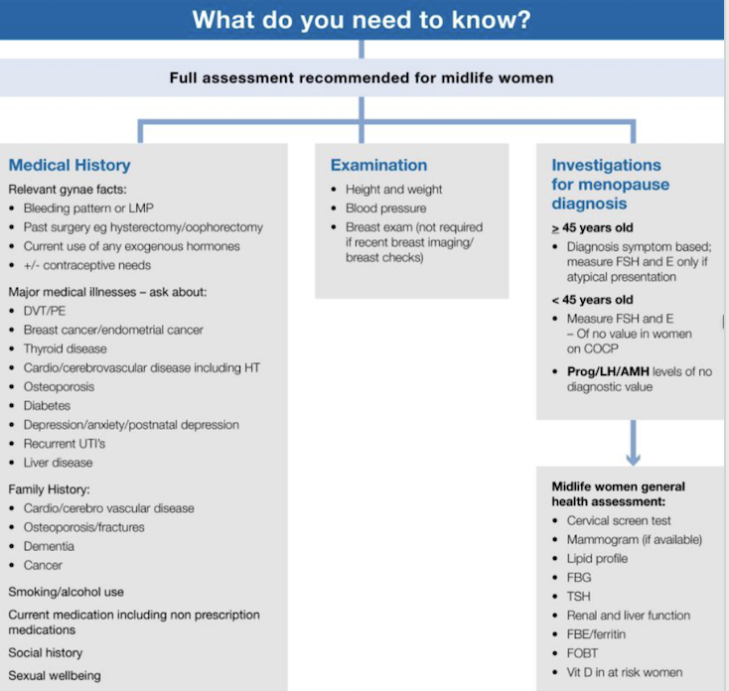
Toolkit (3)
The 2023 Practitioner’s Toolkit for Managing Menopause; S. R. Davis , S. Taylor,C. Hemachandra,K. Magraith,P. R. Ebeling,F. Jane &R. M. Islam

Slide 9
Menopausal Treatment Tool :
Results from an international study. Petra Stute
Results Summary:
Based on feedback questionnaires (160 clinician’s and 156 menopausal women’s)
a. Most (>85%) clinicians and women reported both tools to be convenient and valuable for discussing symptoms and treatment options.
b. Most clinicians (>55%) and women (>70%) reported improved interactions and confidence in treatment decisions.
Menopausal women were positive about MTT-HCP use in their consultation. They reported the MTT-HCP was:
a. easily understood (93%)
b. asked about relevant symptoms (96%)
c. provided clear and structured conversations with their HCPs (93%)
d. reassured (89%) and increased confidence (82%) in their treatment options

Slide 10
Preparation of the first Menopause consultation by the patient
Ideally, each new patient should bring their medical file with them. This should include
cervical smear results,
breast imaging,
blood tests,
colonoscopy results,
cardiology consultation, etc.
The patient should also fill in the MTT questionnaire about their symptoms before the appointment.
As an option, the patient could read a brochure or view a podcast about menopause.

Slide 11
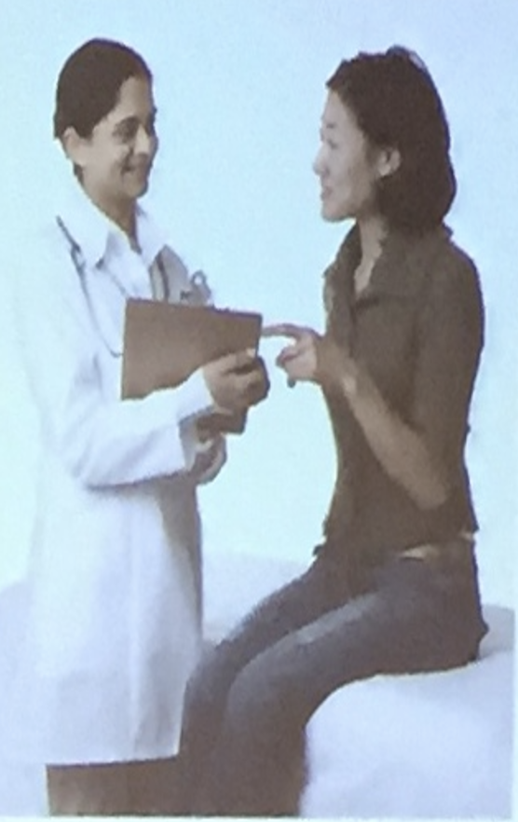
Good patient outcomes depend on successful communication and share decision-making
Clearly presenting evidence and engaging patient on their own medical decision leads to better health outcomes
Improve knowledge of options
More accurate expectations of possible benefits and harms
Choices better aligned with patient values
Greater participation in decision -making
Improved adherence to treatment
Increased patient satisfaction

Slide 12
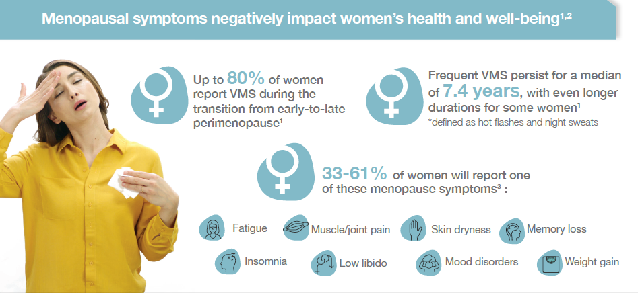
Menopausal symptoms negatively impact women’s health and well-being ^{1,2}
El Khoudarry SR, et al. Menopause: The Journal of The North American Menopause Society 2019; 26(10): 1213–1227.
Makara-Studzińśka MT, et al. Prz Menopauzalny 2014; 13(3): 203–211.
Tremollieres FA, et al. Maturitas 2022; 166: 58–64.

Slide 13
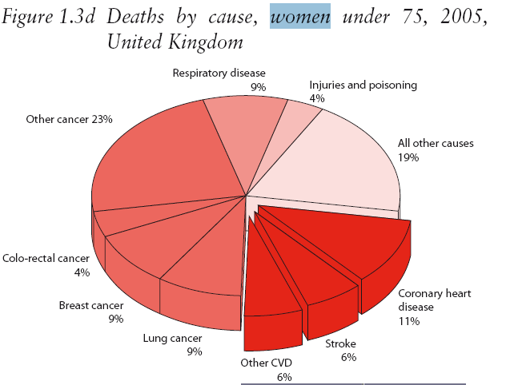
Do women estimate their risk correctly?
Only a minority estimated their own risk correctly
Women’s awareness about risk factors of breast cancer: A survey of 1000 consecutive women attending a breast clinic.
Fabienne Liebens, et al Climacteric 2011
http://www.heartstats.org/

Slide 14
Understanding Patients’Psychological Barriers
Lack of understanding
Fear of adverse events from HT
International Online Survey (2014), 1476 women (> 90%, UK)
53% felt able to make an informed choice about HT
55% felt unable to make an informed choice about alternate (non-HT) therapies
Of 55% of women who used alternate therapies,
39% admitted that they did not know enough to make an informed choice
29% were unaware that alternate therapies could affect the function of other medication when taken together
European Online Survey (2014), 3890 women aged > 45 years
(15% of the 25147 invited participants)
Percentage of women who agreed that hormones are dangerous , by country

Slide 15
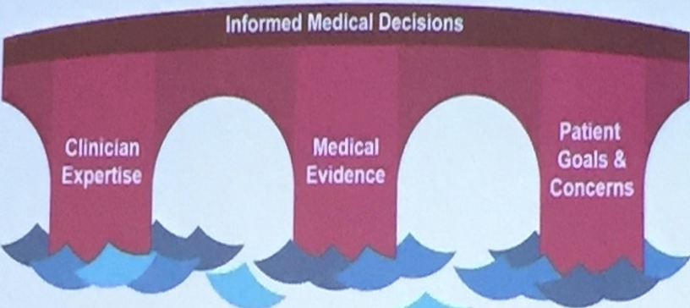
Bridging the Gap: Necessary Components for Achieving High-Quality Medical Decisions
There is no « right » medical decision in an objective sense.
The best decision is the one that is right for the patient

Slide 16
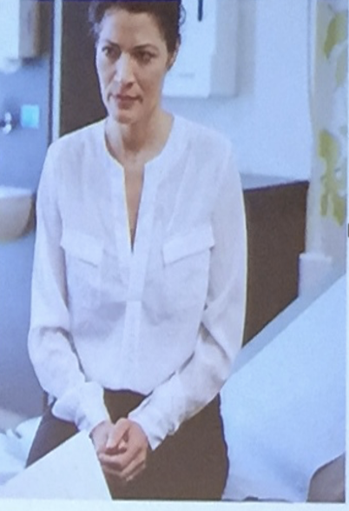
Use of Reflective Listening to Identify and Understand Patients Concerns and Goals
OARS
Open question that encourage further elaboration and consideration
Affirmation that foster positive feelings during the consultation
Reflections that indicate the clinician has heard and accurately understood the patient
Summarises that extent the basic reflections to include additional information

Slide 17
Putting OARS into Practice in the Setting of New Complex Data
O A R S
Open questions
What do you know about the symptoms of menopause?
What do you know about taking hormones at the time of menopause?
Affirmation
Those hot flashes must be very uncomfortable.
Reflections
I understand that you would like to consider treatment options for your symptoms but have some questions.
Summaries
Every woman's experience with menopause is her own. We can tailor HT for your specific needs and work to maximize the potential benefits and minimize the potential risks

Slide 18

The Benefits of Reflective Listening
Allowing the patient to talk while the physician actively listen and reflects back to the patient what he or she has heard
Add no more than 3 minutes to the visit
Helps to better define patient concerns
Decrease “late-ansing concerns “at the end of the patient visits

Slide 19
Framing Conversation about Medical Evidence with Patients
Instead of saying ……
Consider reframing the language by saying…..
Combined HT is associated with increased risk of breast cancer
The most up-to-date medical evidence shows that this is a slight increase in the risk of breast cancer with combined HRT when used for five years or more.
Other medical evidence shows that the risk -for you -may be comparable to the risk of breast cancer associated with consuming two or three more alcoholic drinks per day
The risk of HT is that eight more women in 10,000 per year will develop breast cancer
The relative safety of HT is that 9992 woman in 10,000 will not have that's an increase in breast cancer risk
I recommend HT for you because it's the most effective treatment for hot flashes
HT is considered to be the most effective treatment for hot flashes, but we should talk about whether this is the right option for you

Slide 20
Specific language that can be used to communicate medical evidence
Language that provides confidence to patient regarding evidence relevant to the health care
“What is proven to work best “
“The most up-to-date medical evidence including ,information about the risk and benefits about what works best”
“Best practice in the medical field”
“What medical science shows about each option’s benefits any risk “
“What the research shows”
“Guidelines developed by national medical expert about what work best”

Slide 21
Summary: Communicating With Patient About Medical Evidence
Patients desire deep and meaningful involvement in medical evidence and decision making
The gap between what patient want and what they currently receive should serve as a stimulus for action
Necessary components for achieving high quality medical decision involve a combination of medical evidence, clinician expertise, and patient goals and concerns use of reflective listening can help clinician identify and understand patient goals and concerns
Positive language that focuses on the most up to date medical evidence, including information about risk and benefits, resonate with patients
Putting all these elements together can enhance patient satisfaction and possibly other medical outcomes

Slide 22
Menopause is inevitable, suffering is not.
Not everyone needs to receive a hormone substitution treatment, but everyone should receive accurate information.
Dr. Mary Claire Haver – Podcast/Youtube

