Slide 1


Vaginal dryness and urinary symptoms (GSM)
Silke Vasseur
Perineology clinic, UMC St Pieter, Brussels

Slide 2
Content
Introduction
Pathophysiology
Clinical presentation
Treatments

Slide 3
Content
Introduction
Pathophysiology
Clinical presentation
Treatments

Slide 4
GSM
Genitourinary syndrome of the menopause
Introduced since 2014 in replacement of “vulvovaginal atrophy”
=> much more than vulvovaginal atrophy
Portman DJ; Vulvovaginal Atrophy Terminology Consensus Conference Panel. Genitourinary syndrome of menopause: new terminology for vulvovaginal atrophy from the International Society for the Study of Women's Sexual Health and the North American Menopause Society. Menopause. 2014.

Slide 5
Definition
Collection of symptoms and signs < hypoE2 changes
labia majora/minora, clitoris, introitus, vagina, urethra, bladder
genital symptoms: dryness, burning, irritation
sexual symptoms: lack of lubrication, discomfort/pain, impaired function
urinary symptoms of urgency, dysuria, and recurrent UTI
some or all
Generally occurs in post-menopausal patients
Women of any age with a decrease in E2 (post-partum period, during breast-feeding)

Slide 6
Introduction
GSM affects 50-70% of postmenopausal women
Underdiagnosed < embarrassement / lack of awareness
Consequences on QOL
chronic pain
urinary disorders
sexual dysfunction
psychological distress, reduced self-esteem and depression
Persists and worsens without treatment

Slide 7
Introduction
Urogenital disorders = a frequent problem
rarely mentioned by patients during routine consultations
55% suffers from urinary incontinence at least once a week
70% with vaginal dryness
40% reporting pain during intercourse
➔ impact +++ on quality of life

Slide 8
Content
Introduction
Pathophysiology
Clinical presentation
Treatments

Slide 9
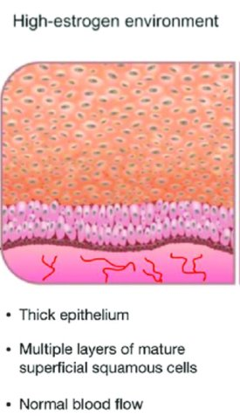
Pathophysiology
ER in vagina, vulva, urethra, and bladder
Maintains collagen content of epithelium
thickness and elasticity
Maintains acid mucopolysaccharides and hyaluronic acid => keeps epithelial surfaces moist
Maintains optimal genital blood flow
Maintains healthy vaginal microbiome
Nonkeratinized stratified squamous epithelium of the vagina in response to E2 is
thick, rugated, and rich in glycogen (> acid)
E2 maintains a well-epithelialized vaginal vault during the
reproductive years

Slide 10
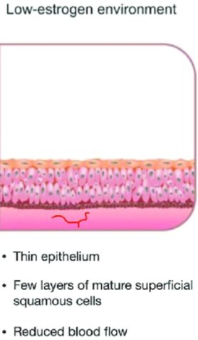
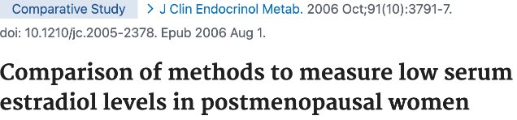
Pathophysiology
At menopause
estrogen (< 5 pg/ml)
Most E2 assays are not sufficiently sensitive
No routine measurement of E2 levels
changes in the mucosa usually develop gradually over a period of years

Slide 11
Pathophysiology
1. Vaginal atrophy
Thinning of the top layer of superficial epithelial cells
increase fragility, inflammation and microabrasions
this layer may be completely absent in patients with severe atrophy
Loss of rugae
Loss of elasticity of the vaginal epithelium
Shortening and narrowing of the vaginal canal, with loss of distensibility
Increased subepithelial connective tissue
Reduction in vaginal secretions from 3 to 4 g/4 hours to 1.7 g/4 hours
less lubrication, worsening vaginal dryness
➔ Dyspareunia

Slide 12
Pathophysiology
2. Alteration of vaginal microbiota
The low glycogen content of the thinned epithelium leads to
lactic acid production by lactobacilli ➔ vaginal pH > 5
These changes encourage predisposing affected patients to infection
by skin and rectal flora
Gardnerella vaginalis, streptococci, staphylococci, coliforms, diphtheroids as well as trichomonas species.
vaginitis and UTIs
Lactobacilli Dominance and Vaginal pH: Why Is the Human Vaginal Microbiome Unique? Miller EA et al. Front Microbiol. 2016

Slide 13
Pathophysiology
3. Urinary tract​
the bladder, urethra, pelvic floor musculature, and endopelvic fascia​ also contain estrogen receptors​
➔ urethral atrophy​
decreased resistance ​
stress urinary incontinence​
hematuria​
➔ weakened bladder support​
Risk of urgency, nocturia, recurrent UTIs and urethral prolapse​
➔ loss of urethral seal​
predisposes to urinary leakage

Slide 14
Recurrent urinary tract infection (UTI)
Discharge and odour
Decrease in blood flow
Decrease in lubrication
Loss of elasticity
Atrophic vaginitis
Pain
Sexual dissatisfaction

Slide 15
Pathophysiology
Emerging data suggest that androgens also play a role ​
AR have been reported in the mucosa, muscularis, and adventitial layers of the vagina ​
Androgens are precursors to the synthesis of estrogens​
indirect effect on this tissue through the aromatization pathway ​
direct effect on this tissue as testosterone​
The role of androgens in the treatment of genitourinary syndrome of menopause (GSM): International Society for the Study of Women's Sexual Health (ISSWSH) expert consensus panel review. Simon JA et al. Menopause. 2018

Slide 16
Pathophysiology
Long-term consequences if untreated​
Progressive worsening of symptoms​
Rarely resolve spontaneously and ​deteriorate if left untreated​
negatively affecting patients confidence and intimacy with their partners​
Increased risk of pelvic organ prolapse​
Recurrent UTIs​
chronic bladder irritation ​
antibiotic overuse​

Slide 17
Etiology – modifying factors
Natural or surgical menopause
Premature ovarian failure
Anti-oestrogen drugs (Tamoxifen, Aromatase inhibitors, GnRH agonist)
Post partum, breastfeeding
Hypothalamic amenorrhoea
Favouring factors
nulliparity
vaginal surgery
abstinence
smoking

Slide 18
Content
Introduction
Pathophysiology
Clinical presentation
Treatments

Slide 19
Clinical presentation
Vaginal symptoms
vaginal lubrication during sexual activity
Dyspareunia, including vulvar or vaginal pain
Vulvar or vaginal bleeding
postcoital bleeding, labial fissures
Vulvovaginal burning, irritation, or itching
Vaginal discharge (leucorrhea)

Slide 20
Clinical presentation
Urinary symptoms
dysuria
urinary urgency and frequency
nocturia
recurrent UTIs
< altered vaginal flora and urethral atrophy
urethral prolapse

Slide 21
Clinical presentation
Sexual dysfunction
Decreased libido
< discomfort, pain and hormonal changes
loss of interest in sexual activity
Arousal difficulties
reduced blood flow and lubrication can impair sexual response

Slide 22
Evaluation
ASK about pelvic floor problems !!
Ask about incontinence, urgency, itching, pain
Ask about sexual difficulties
Ask about quality of life

Slide 23
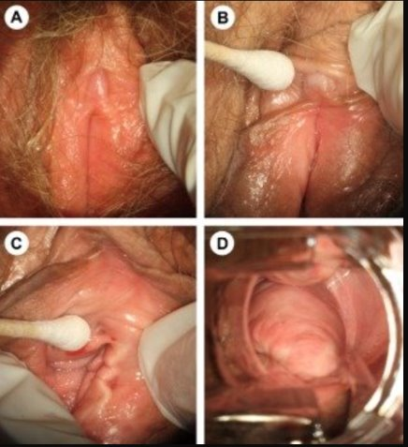
Pelvic examination
Labia minora resorption or fusion​
Tissue fragility/fissures/petechiae​
Introital retraction​
Loss of hymenal remnants​
Prominence of urethral meatus​
Urethral eversion or prolapse​
Vulvovaginal pallor/erythem​a
Loss of vaginal rugae​
Decreased vulvovaginal secretions/lubrication​
Decreased elasticity​
vaginal discharge that is thin, white, and nonodorous​

Slide 24
Differential diagnosis
Vaginitis and vaginosis​
abnormal discharge, intense itching, culture + ​
Vulvar dermatitis in response to environmental agents​
Vulvar lichen sclerosus​
white lesions, intense itching, positive biopsy​
Vulvovaginal lichen planus​
Genital tract ulcers or fissures < herpes lesions or systemic disease​
Genital tract bleeding < trauma, infection, or malignancy​
Vulvodynia​
Other etiologies of frequent urinary tract infection​

Slide 25
Content
Introduction
Pathophysiology
Clinical presentation
Treatments

Slide 26
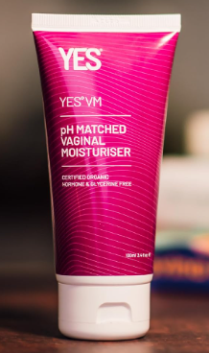
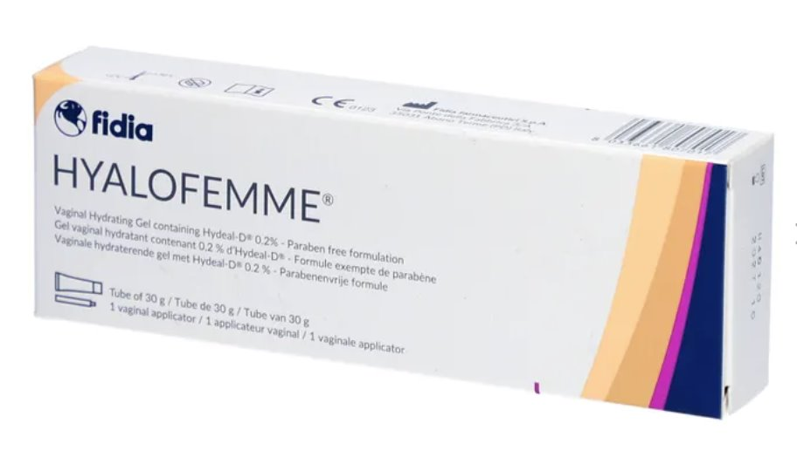
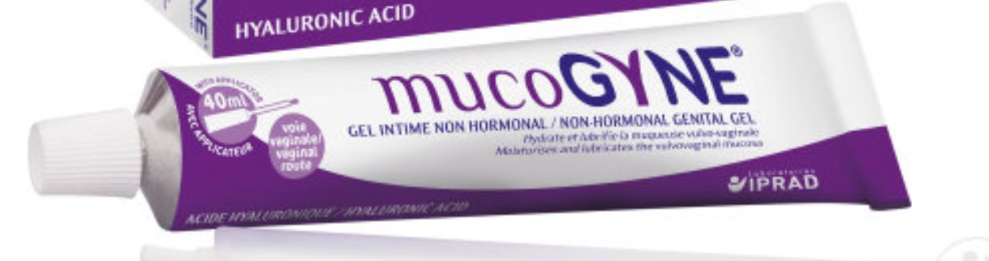
Treatments
Non-hormonal vaginal creams/ovules
Lubricants vs moisturisers
Use of lubricants during intercourse
Moisturisers: 1x/day for 2 weeks, then 1-2x/week.
Impact on tissue limited
Importance of physiological pH
Nappi RE, Martella S, Albani F, Cassani C, Martini E, Landoni F. Hyaluronic Acid: A Valid Therapeutic Option for Early Management of Genitourinary Syndrome of Menopause in Cancer Survivors? Healthcare (Basel). 2022

Slide 27
Treatments
Pelvic floor muscle treatment (PFMT)
If insufficient knowledge about pelvic floor: learning to use PF
If coexistent vaginismus, vulvodynia: relaxation, desensibilisation
Pilot study of PFMT for GSM suggesting improved blood flow, improved vaginale tissue elasticity, better relaxation and muscle strength
Mercier et al. Pelvic floor training: mechanisms of action for the improvement of genitourinary syndrome of menopause. Climacteric 2020

Slide 28
Treatments
Estriol (E3) << Estradiol (E2) vaginal application
Effective in reducing atrophy, urinary urgency, recurrent UTIs
Slight increase in systemic estradiol levels the first weeks (thinner lining), then return to base levels
No increased risk for thrombosis
No increased risk for endometrial cancer
no need for progestogen treatment
No increased risk for breast cancer
Hirschberg, et al. Topical estrogens and non-hormonal preparations for postmenopausal vulvovaginal atrophy: An EMAS clinical guide. Maturitas 2021

Slide 29
Treatments
Estriol/estradiol:
Estriol vaginal cream (Blissel 50µg/dose < Aacifemine 500µg/dose), ovules (Oekolp 30µg < Aacifemine 500µg)
Estradiol tablet (Rewellfem 10µg, Vagifem 10µg)
First 2 weeks: 1x/ day
! can burn, be painful if severe atrophy
➔ First 2 weeks of non-hormonal cream before switch to hormonal cream
Improvement after 2-4 weeks
After 2 weeks of daily application => 2x/week
Maintenance treatment for life

Slide 30
Treatments
DHEA ovules (Intrarosa)
Vaginal dehydroepiandrosterone may improve dryness, dyspareunia, and distress, bother, or interference from genitourinary symptoms
Administration: 1x/day for 2 weeks, then 2x/week
Ospemifene (SERM)
oral ospemifene may improve dryness, dyspareunia. May worsen VMS
60mg 1x/day, available in the Netherlands (Senshio) not for sale in Belgium/France, only studies
Danan et al Hormonal Treatments and Vaginal Moisturizers for Genitourinary Syndrome of Menopause : A Systematic Review​ Ann Intern Med. 2024

Slide 31
Treatments
Vaginal testosterone, systemic DHEA, vaginal oxytocin, and oral raloxifene or bazedoxifene may provide no benefit (low QOE) or had uncertain effects (very low QOE). ​
Not recommended
Menopause hormone therapy (systemic)
Not recommended as treatment for GSM
May worsen stress urinary incontinence
Davis et al. Global Consensus Position Statement on the Use of Testosterone Therapy for Women. 2019 J Clin Endocrinol Metab.

Slide 32
Treatments
Laser or radiofrequency devices
Laser and other energy-based devices (eg, fractional microablative CO2 laser, erbium:YAG [Er:YAG] laser, temperature-controlled radiofrequency [RF] laser) have been marketed for treatment of VVA, but there are limited data regarding the safety and efficacy of these devices. ​
Meta analysis from 2024: improvement of dyspareunia, dryness, burning (in comparison with sham-laser), but low quality of evidence​
Not recommended
Pessoa. Laser therapy for genitourinary syndrome of menopause: systematic review and meta-analysis of randomized controlled trial. Rev Bras Ginecol Obstet. 2024

Slide 33
Special populations
Breast cancer survivors:
Observational data
no increased risk of recurrent breast cancer
No increased risk of breast cancer or overall mortality
In practice:
First line: non hormonal creams/ovules
If not enough improvement, vaginal estriol can be proposed (if consent of patient and oncologist)
Beste et al. Vaginal estrogen use in breast cancer survivors: a systematic review and meta-analysis of recurrence and mortality risks. Am J Obstet Gynecol. 2025

Slide 34
Take home messages
GSM ​is a frequent complication of hypoestrogenism​
Vaginal dryness, dyspareunia, and dysuria​
Quality of life, sexual health and urinary function​
Common but underdiagnosed and worsens over time​
Important to ask patients about symptoms ​!
Differentiating from other conditions is crucial to avoid misdiagnosis
Treatment with nonhormonal or hormonal local therapies​, for life

Slide 35
Thank you! Questions?

