Slide 1




The impact of combined MHT on breast cancer risk (including Mirena®)
Prof. Herman Depypere, MD, PhD
Breast and Menopause Clinic, University Hospital, Ghent, Belgium

Slide 2
No conflict of interest.

Slide 4
5 Y
WHI CEE duration before trial stopped : 7,2 years
Median duration of CEE use: 5,9 years
Median adherent time >80 % of pills: 3,5 years
10 Y
A. Z. LaCroix, R. T. Chlebowski, J. E. Manson et al., “Health outcomes after stopping conjugated equine estrogens among postmenopausal women with prior hysterectomy: a randomized controlled trial,” The Journal of the American Medical Association, vol. 305, no. 13, pp. 1305–1314, 2011.

Slide 5
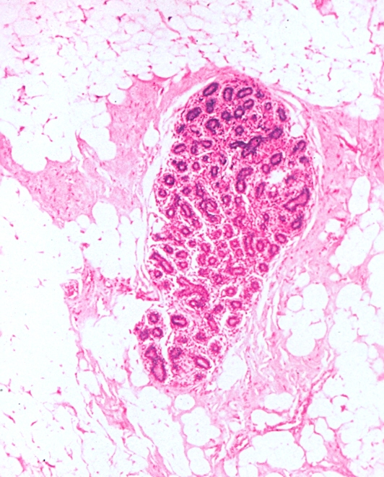
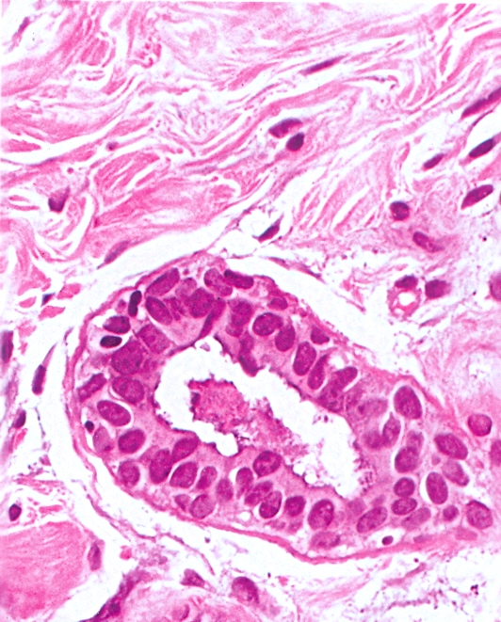

Slide 6
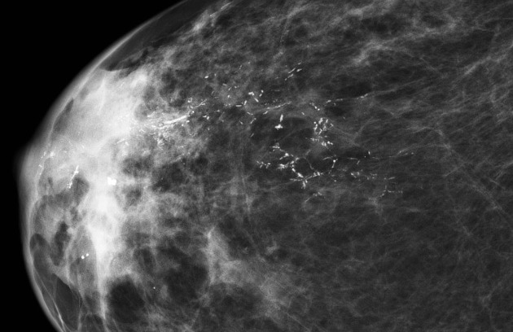
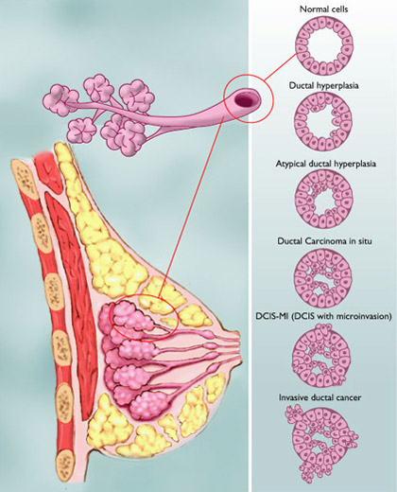
DUCTAL HYPERPLASIA EVOLUTION TO INVASIVE CANCER

Slide 7
Breast cancer incidence
In total population the incidence of breast cancer is in the order of 2,5 per 1000 women per year from the age of 50.
In a low risk population it is as low as 0,5 per 1000 women per year.
In women with dens breast tissue on mammography it may be as high as 10 breast cancers per 1000 women per year.

Slide 8
Known risk factors
Menarche <12 y versus > 14 y 1,2-1,5
Menopause >55 y versus < 55 y 1,5-2,0
Partus >30 versus <20 y 1,3-2,0
Ionizing rays 1,0-8,7
Biopsy (any histological finding) 1,5-1,8
Atypical hyperplasia 4,0-4,4
Smoking at young age (< 20 y) 1,3-1,8
Physical activity 0,68
Hormonal therapy 0,7 tot 1,4
Genetic high penetrance: BRCA 1&2, PTEN, TP 53
Genetic low penetrance: CHEK2, PALP2, ATM, RAD51C

Slide 9
Known risk factors
Menarche <12 y versus > 14 y 1,2-1,5
Menopause >55 y versus < 55 y 1,5-2,0
Partus >30 versus <20 y 1,3-2,0
Ionizing rays 1,0-8,7
Biopsy (any histological finding) 1,5-1,8
Atypical hyperplasia 4,0-4,4
Smoking at young age (< 20 y) 1,3-1,8
Physical activity 0,68
Hormonal therapy 0,7 tot 1,4
Genetic high penetrance: BRCA 1&2, PTEN, TP 53
Genetic low penetrance: CHEK2, PALP2, ATM, RAD51C

Slide 10
Parous women has 80-100 % type 3 lobules
Nulliparous women has 50-60 % type 1 lobules
Puberty
pregnancy
Lactation
Lobule
Type 1
Lobule
Type 2
Lobule
Type 3
Lobule
Type 4
Proliferatie
60
22
4
1

Slide 11
Proliferationrate reduces mutation recovery
Time for DNA repair before duplification
No time for DNA repair before duplification
oncogene
In een cel
In each daughter cell
In each daughter cell

Slide 12
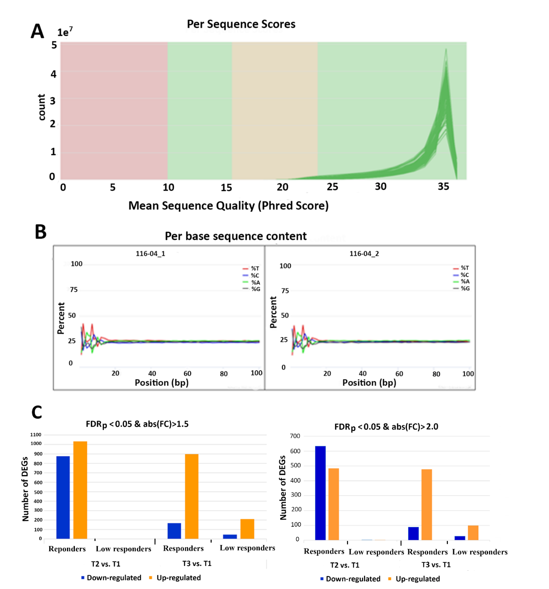
Depypere, Hermanª; Su, Yanrong^{b}; Dang, Nhi^{b}; Poppe, Bruce^{c}; Stanczyk, Frank^{d}; Janssens, Jaak^{e}; Russo, Jose^{b}
Prolonged recombinant pregnancy hormone use in BRCA1 and BRCA2 mutation carriers. European Journal of Cancer Prevention: March 12, 2021 - Volume Publish Ahead of Print - Issue - doi: 10.1097/CEJ.0000000000000664

Slide 13
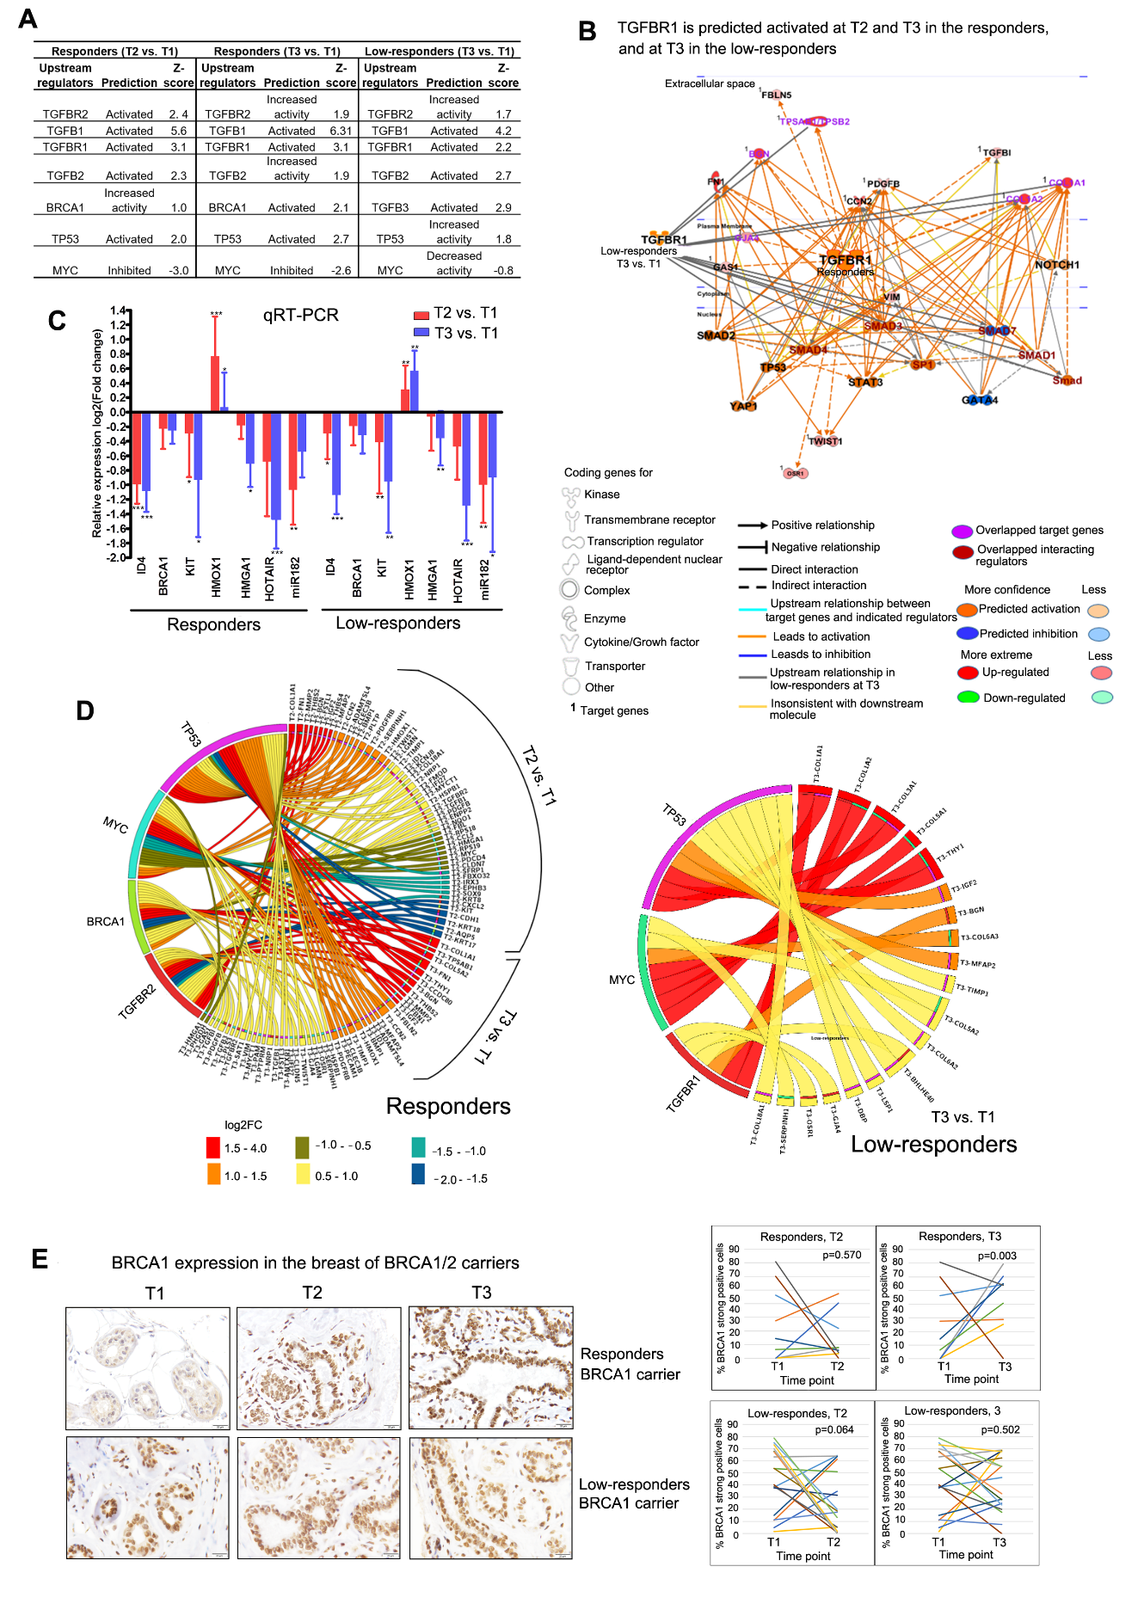
Y Su, N Dang, H Depypere, et al. Recombinant Human chorionic gonadotropin induces signaling pathways towards cancer prevention in the breast of BRCA1/2 mutation carriers. Eur J Cancer Prev. 2023 Mar 1;32(2):126-138.

Slide 14
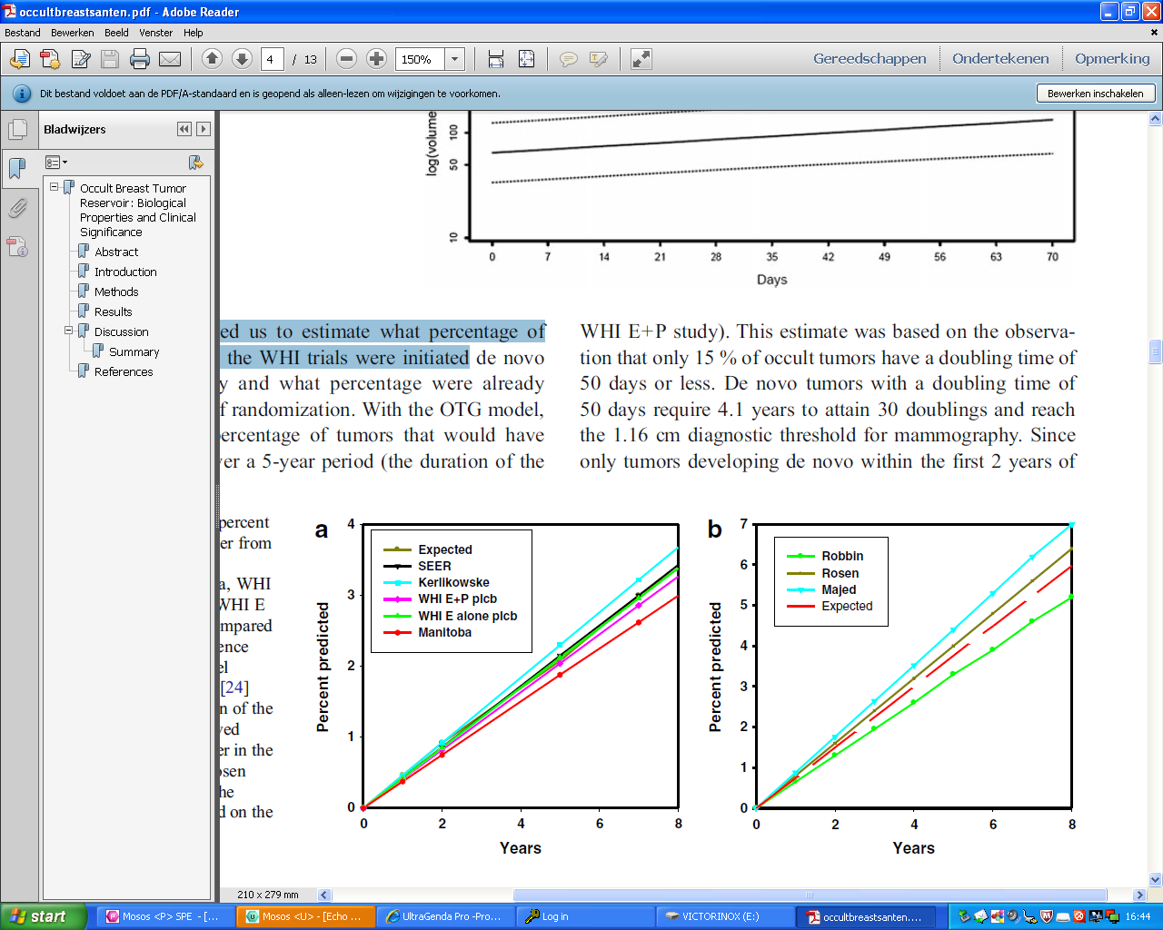
Occult breast cancer reservoir
Santen model (200 days doubling time, 1.16 cm detection, 7 % prevalence)
Santen R et al. Horm canc, 2013; Santen R J of steroid biochemistry and molecular biology 2013.

Slide 15


Apple – metabolic syndrome
–

Slide 16
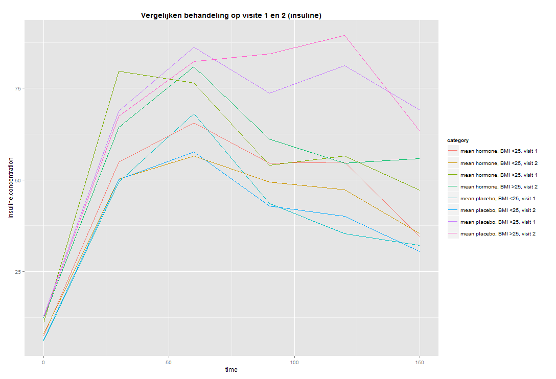
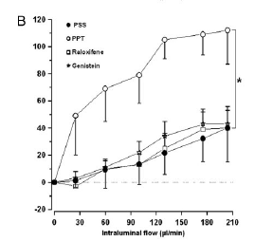
Van de Voorde J, Depypere H. Inflamm res 1999, 48, 100-101.
A randomized trial on the effect of oral combined estradiol and drospirenone on glucose and insulin metabolism in healthy menopausal women with a normal oral glucose tolerance test. Maturitas ( IF 3.630 )
H Depypere,A Dierickx,F Vandevelde,F Stanczyk,L Ottoy,J Delanghe,B Lapauw

Slide 17
Operate studie
Randomisatie:
inspanning met lenzetto en progebel
Lenzetto en progebel
Inspanning, uithouding, spierkracht, homa IR, ctx, P1NP, DNA methylatie, amyloid, P tau, apo
Prof Calders, Prof Lapauw, Prof Kaufman, Prof Depypere

Slide 18
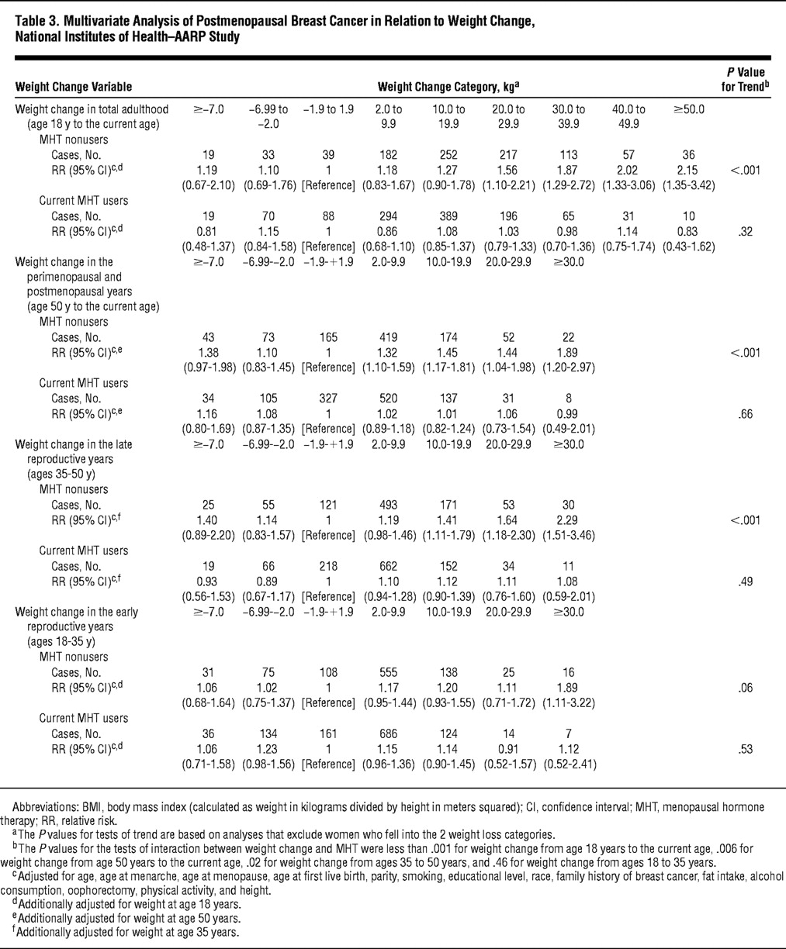
biomedische les hormonen en kanker-2014- Prof Depypere -Prof Bracke
18

Slide 19
Nurses health study
Pepi trial, …..
Hers study
Danish dahors
WHI global study cc
WHI estrogen only
Salpeter
Cohrane
Finnish
WHI long term follow up
DOPS

Slide 20
WHI CEE MPA
Outcome by Age 50-60 years of age at inclusion
Hormone
Therapy Placebo HR (95% CI) P value
All-cause mortality
Pooled trials 70 (0.23) 98 (0.34) 0.69 (0.51-0.94) .01
CEE alone vs placebo 35 (0.28) 50 (0.39) 0.71 (0.46-1.09) .04
CEE plus MPA vs placebo 35 (0.20) 48 (0.30) 0.67 (0.43-1.04) .20
CVD mortality
Pooled trials 18 (0.060) 22 (0.076) 0.79 (0.42-1.47) .85
CEE alone vs placebo 8 (0.063) 10 (0.077) 0.81 (0.32-2.04) .34
CEE plus MPA vs placebo 10 (0.058) 12 (0.075) 0.77 (0.33-1.79) .47
Cancer mortality
Pooled trials 37 (0.12) 48 (0.17) 0.74 (0.48-1.14) .05
CEE alone vs placebo 20 (0.16) 26 (0.20) 0.78 (0.43-1.40) .06
CEE plus MPA vs placebo 17 (0.099) 22 (0.14) 0.71 (0.38-1.33) .37
Menopausal Hormone Therapy and Long-term All-Cause and Cause-Specific Mortality: TheWomen’s Health Initiative Randomized Trials
JoAnn E. Manson, MD, DrPH; Aaron K. Aragaki, MS; Jacques E. Rossouw, MD; Garnet L. Anderson, PhD; Ross L. Prentice, PhD; Andrea Z. LaCroix, PhD;
Rowan T. Chlebowski, MD, PhD; Barbara V. Howard, PhD; Cynthia A. Thomson, PhD; Karen L. Margolis, MD, MPH; Cora E. Lewis, MD, MSPH; JAMA 2017
Marcia L. Stefanick, PhD; Rebecca D. Jackson, MD; Karen C. Johnson,

Slide 21
End Points
Hormone
Therapy Placebo HR (95% CI) P Value
Breast cancer mortality
CEE plus MPA vs placebo 61 (0.043) 40 (0.030) 1.44 (0.97-2.15) .07
CEE alone vs placebo 22 (0.025) 41 (0.046) 0.55 (0.33-0.92) .02

Slide 22
Conjugated equine oestrogen and breast cancer incidence and mortality in postmenopausal women with hysterectomy: extended follow-up of the Women's Health Initiative randomised placebo-controlled trial. Lancet oncol, 2012 Mar 6. [Epub ahead of print]
Anderson GL, Chlebowski RT, Aragaki AK, Kuller LH, Manson JE, Gass M, Bluhm E, Connelly S, Hubbell FA, Lane D, Martin L, Ockene J, Rohan T, Schenken R, Wactawski-Wende J.
22
Notes:
22

Slide 23
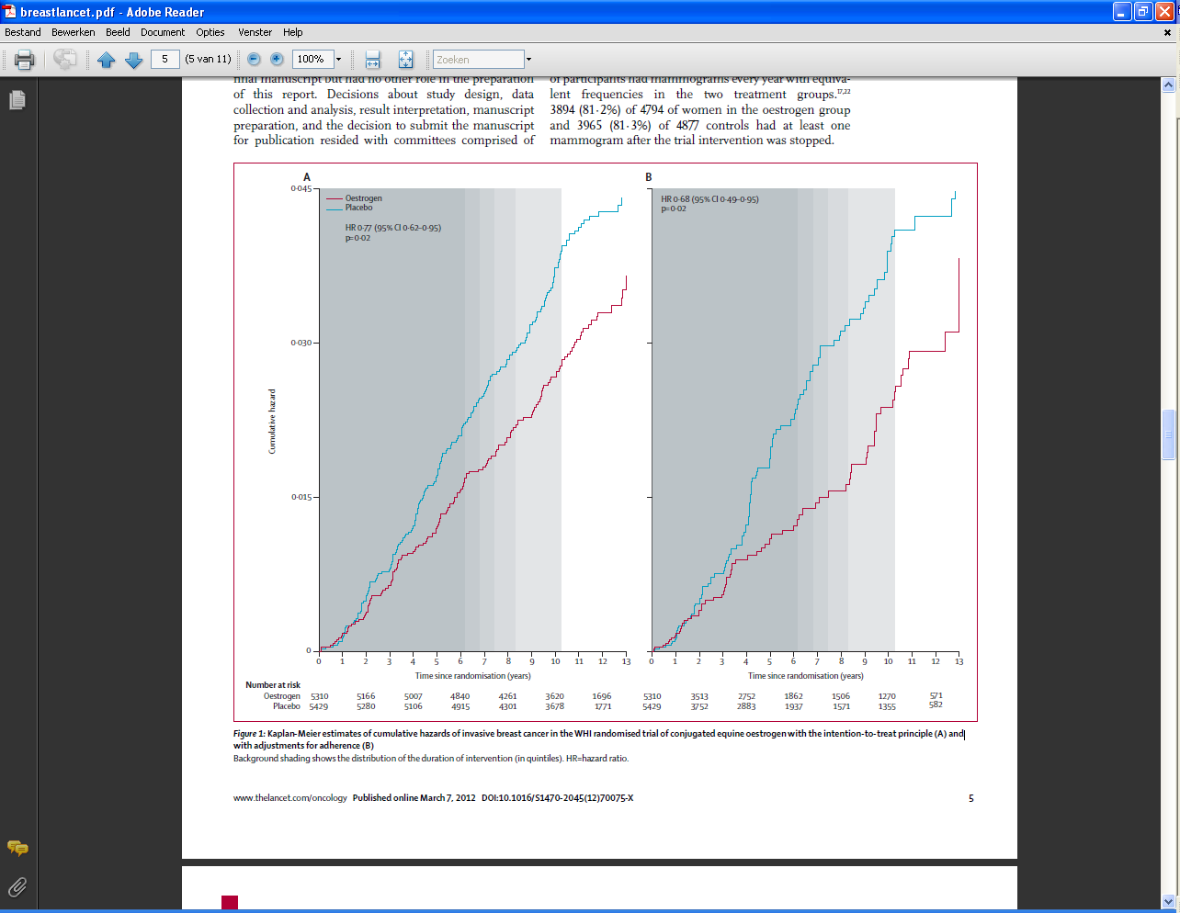
23
Notes:
23

Slide 24
Choice of Progestogen and Breast Cancer Risk: E3N French Cohort Study
Risk of all breast cancer
Risk of breast cancer subtypes with E/D
2.1
2.2
2.2
2.0
2.0
(1.2–3.8)
1.8
1.69
1.8
1.6
(1.50–1.91)
1.6
1.5
1.4
1.16
1.4
1.1
1.1
(0.8–2.7)
1.2
1.00
1.2
Relative risk (95% CI)
1.0
(0.83–1.22)
(0.94–1.43)
1.0
0.8
0.8
(0.8–1.5)
(0.8–1.17)
0.6
0.6
0.4
0.4
0.2
0.2
0
Baseline risk without HRT
Estrogen/ progesterone
Estrogen/ dydrogesterone
Estrogen/other progestogens
0
<5 years
≥5 years
<5 years
≥5 years
Ductal carcinoma
Lobular carcinoma
Not statistically significantly different from risk without HRT
Significantly different from the risk without HRT
N = 80,377 women, for an average treatment duration of 8.1 years
Risk elevation may not be uniform for all progestogens
Fournier A et al. Breast Cancer Res Treat 2008;107:103–11; Fournier A et al. J Clin Oncol. 2008 ;26:1260–1268.
Notes:
In the French E3N cohort study, 2,354 cases of invasive breast cancer occurred among 80,377 postmenopausal women during 8.1 years of follow-up.¹
Compared with HRT never-use, use of E alone was associated with a significant 1.29-fold increased risk of breast cancer (95% CI 1.02–1.65).¹
The risk for all breast cancers associated with combined HRT varied according to progestogen type .¹
1.00 (0.83–1.22) for E/progesterone
1.16 (0.94–1.43) for E/D
1.69 (1.50–1.91) for E/other progestogens
Compared with never-use of HRT, E/D was associated with a significant increase in risk of lobular carcinoma (relative risk [RR] 1.7; 95% CI 1.1 to 2.6), with increased risk with longer duration of treatment.²
E/other progestogens was associated with significant increases in risk of ductal (RR 1.6; 95% CI 1.3 to 1.8) and lobular (RR 2.0; 95% CI 1.5 to 2.7) carcinomas compared with never-use of HRT.²
The authors concluded that the findings suggest that choice of progestogen component for HRT may be an important factor regarding breast cancer risk.
Fournier A et al. Breast Cancer Res Treat 2008;107:103–11.
Fournier A et al. J Clin Oncol. 2008 ;26:1260–1268.
24

Slide 25
Finnish registry on total of 489,105 women who used HT from 1994 to 2009 (3.3 million HT exposure years). Savolainen et al. J Clin Endocrin Metab 2016 101:2794-2801.
In absolute terms, the risk reductions mean 19 fewer CHD deaths and 7 fewer stroke deaths per 1,000 women using any HT for at least 10 years.
Dydrogesterone containing MHT was associated with lower cancer mortality versus MHT containing NETA or MPA.

Slide 26
Danish sex Hormone Register Study DaHoRS
Hormone therapy and breast cancer
Øjvind Lidegaard^{1,} Ellen Løkkegaard²,
Anne Helms Andreasen³, Lisbeth Møller³
Carsten Agger³, Torben Jørgensen³
1) Rigshospitalet, Gynaecologic Clinic, 4232
2) Dept. Obstetrics & Gynaecology, Hilleroed Hospital, DK.
3) Research Centre for Prevention and Health, Glostrup, DK

Slide 27
The impact of progestagen dose Low = 0.5mg NETA or 2.5mg MPA. High = 1mg NETA or 5mg MPA
Adjusted RR, 95% CI
All continuous combined regimens
51-54 55-59 60-64 65-69
DaHoRS/05

Slide 28
Risk of lethal BC with hormones
within five years after diagnosis
Adjusted RR, 95% CI
Women with BC: 12,831
Dead after diagnosis: 2,347 (18%)
Five years follow-up: 1,269
DaHoRS/05

Slide 29
Objective: To investigate the long term effect of hormone replacement therapy on cardiovascular outcomes in recently postmenopausal women.
Design Open label, randomised controlled trial.
Setting Denmark, 1990-93.
Participants: 1006 healthy women aged 45-58 who were recently postmenopausal or had perimenopausal symptoms in combination with recorded postmenopausal serum follicle stimulating hormone values. 502 women were randomly allocated to receive hormone replacement therapy and 504 to receive no treatment (control). Women who had undergone hysterectomy were included if they were aged 45-52 and had recorded values for postmenopausal serum follicle stimulating hormone.
Interventions: In the treatment group, women with an intact uterus were treated with triphasic estradiol and norethisterone acetate and women who had undergone hysterectomy received 2 mg estradiol a day. Intervention was stopped after about 11 years owing to adverse reports from other trials, but participants were followed for death, cardiovascular disease, and cancer for up to 16 years. Sensitivity analyses were carried out on women who took more than 80% of the prescribed treatment for five years.

Slide 30
Main outcome measure The primary endpoint was a composite of death, admission to hospital for heart failure, and myocardial infarction.
Results At inclusion the women on average were aged 50 and had been postmenopausal for seven months. After 10 years of intervention, 16 women in the treatment group experienced the primary composite endpoint compared with 33 in the control group (hazard ratio 0.48, 95% confidence interval 0.26 to 0.87; P=0.015) and 15 died compared with 26 (0.57, 0.30 to 1.08; P=0.084). The reduction in cardiovascular events was not associated with an increase in any cancer (36 in treated group v 39 in control group, 0.92, 0.58 to 1.45; P=0.71) or in breast cancer (10 in treated group v 17 in control group, 0.58, 0.27 to 1.27; P=0.17). The hazard ratio for deep vein thrombosis (2 in treated group v 1 in control group) was 2.01 (0.18 to 22.16) and for stroke (11 in treated group v 14 in control group) was 0.77 (0.35 to 1.70). After 16 years the reduction in the primary composite outcome was still present and not associated with an increase in any cancer.
Conclusions : After 10 years of randomised treatment, women receiving hormone replacement therapy early after menopause had a significantly reduced risk of mortality, heart failure, or myocardial infarction, without any apparent increase in risk of cancer, venous thromboembolism, or stroke.
2 out of 1000 women per year that don’t die

Slide 31
More en core studie
2.0
Total Cases = 77
*P<.001
Placebo
5.3 per 1000
woman-years
RR = 0.38 (95% CI = 0.24-0.58)*
1.0
Raloxifene
1.9 per 1000
woman-years
0.0
0
1
2
3
4
5
Notes:
31

Slide 32
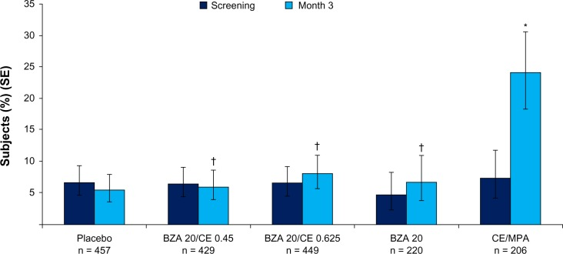
Percentage of women reporting one or more days of breast tenderness at week 12. BZA/CE (both doses), BZA, and placebo demonstrated similar incidences of breast tenderness. CE/MPA showed a significantly higher rates (P < 0.001 versus all other ... Review Mirkin S, Pickar J Intern women health 2013 7 465-75

Slide 33
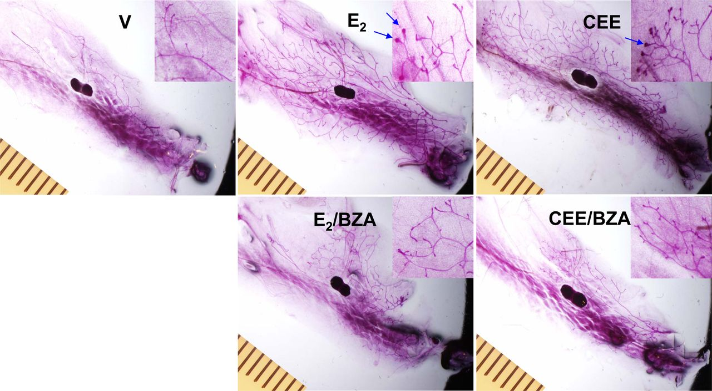

Slide 34
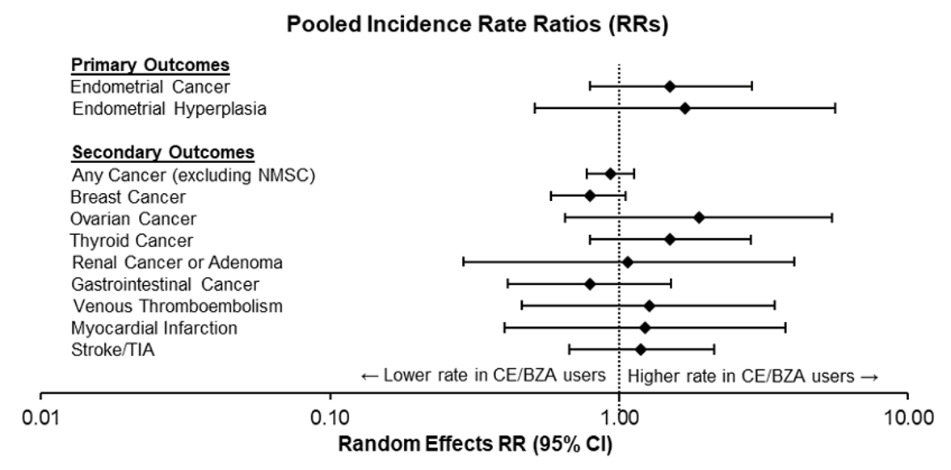
PASS: Pooled Incidence Rate Ratios for all study outcomes
The rate of endometrial
cancer or hyperplasia
was lower than the
rate expected in a
comparable untreated population
The rate of any
cancer or acute CV outcomes
was lower than the
rate expected in a
comparable untreated population
← Lower rate in CE/BZA users
Higher rate in CE/BZA users →
CE/BZA=conjugated estrogens/bazedoxifene; E+P HT=estrogen + progestogen hormone therapy.
1. Pfizer. Post Authorization Safety Study (PASS) of CE/BZA in the US. Final Study Report: https://www.encepp.eu/encepp/openAttachment/documents.otherDocument-1/46639;jsessionid=oVW03JKE9Bw0mPI9WK5mN9y502QlpUYAkyHbb6syIdzMA06I6SZd!-594103221 [Accessed August 2022]
Notes:
Comparable rates of endometrial cancer and endometrial hyperplasia between both interventions
Rate of endometrial Ca less for both than the general population (61 or 43/100,000 vs 81/100,000 wy
No increased risk of breast cancer
Similar rates of acute cardiovascular events and other cancer outcomes
The incidence rate ratio of all these key safety outcomes crosses 1 – in other words, there is no difference between the treatment groups.
Note: From Figure B1 of submitted manuscript
Ref: PASS CSR 26 March 2021, Endometrial Hyperplasia on page 42 (section 10.4.1.1) - 48 cases in 38,770 py (=124 in 100,000 py) and on page 29 (142.9 cases per 100,000 py)

Slide 35
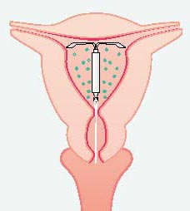
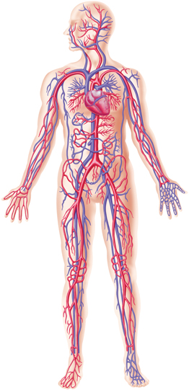
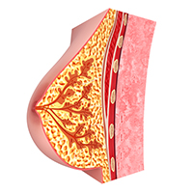
Levonorgestrel concentration
Uterus | Serum | Breast
20 μg/24 uur | 0,18 ng/mL | 0,26 ng/g
Notes:
Maar hier even niet of er een effect is op de incidentie, maar wat de eventuele werkingsmechanismen zijn van LNG op borstcarcinomen.
In een studie (naam) onlangs hier op het UZ op de dienst gynaecologie, werd de relatie tussen mirenaspraal gebruikers en de concentratie LNG in serum en borst weefsel onderzocht.
De resultaten bekomen uit de studie kan u hier zien. Een Mirena IUD is geproduceerd om 20 microgram LNG af te geven per 24 uur. Het principe van een IUD is dat het een lokale werking heft, met lokale vrijgave van zijn product. Wanneer er bij een persoon bloed wordt geprikt dan zien we in het serum een gemiddelde concentratie van 0,18 ng LNG/ ml serum. Bij een punctie naar borstepitheel wordt hier een concentratie van 0,26 ng LNG / gram worstweefsel gevonden.
Deze presentatie kadert in het onderzoek van Prof. Depypere dewelke onderzoekt wat de de concentratie LNG is in borstweefstel bij patiënten met een Mirena spiraal. In deze presentatie worden mogelijke effecten van LNG op borstkankercellijnen weergegeven.

Slide 36
The use of the LNG-IUS to protect the endometrium during menopausal estrogen replacement therapy is well established. Data on breast safety are sparse. A study by Lyytinen and coworkers indicated that an LNG-IUS in combination with estrogens is associated with an increase in breast cancer. However, confounders such as age at menarche, age at menopause, body weight, and socio-economic status were not accounted for in that study.
Depypere H, Inki P. The levonorgestrel-releasing intrauterine system for endometrial protection during estrogen replacement therapy: a clinical review. Climacteric 2015;18:470-82.
Depypere H, et all. A 60-month non-comparative study on bleeding profiles with the levonorgestrel intrauterine system from the late transition period to estrogen supplemented menopause. European journal of obstetrics, gynecology, and reproductive biology. 2010;153:176-80.
Lyytinen HK, Dyba T, Ylikorkala O, Pukkala EI. A case-control study on hormone therapy as a risk factor for breast cancer in Finland: Intrauterine system carries a risk as well. Int J Cancer. 2010;126:483-489.

Slide 39
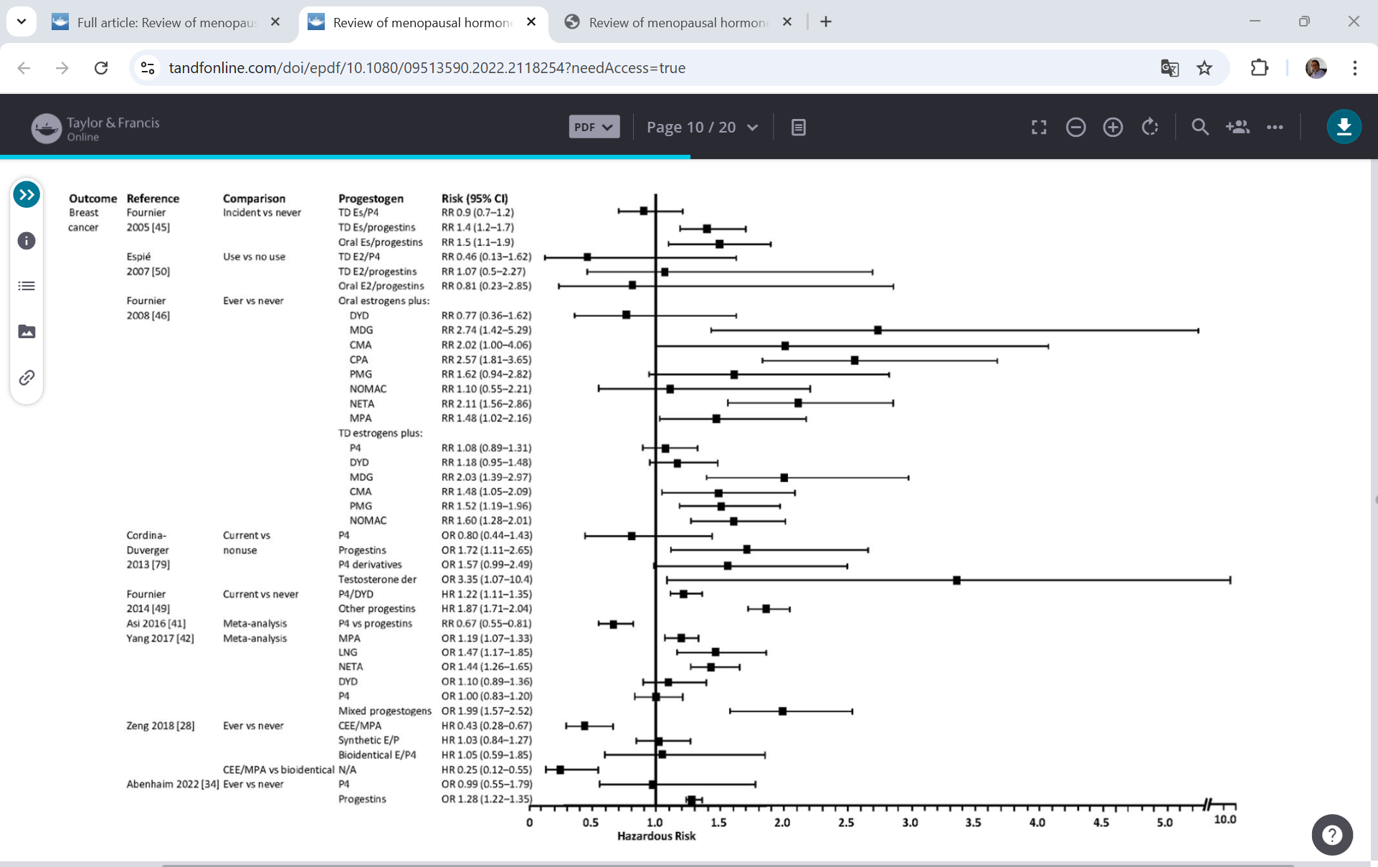
Different estrogens and progestogens

Slide 40
Conclusion:
Small differences
Natural progesterone
Dydrogesterone
Low dose progestogens
Sequential vs continuous
Combination with intra uterine IUS
Follow up TSEC and future studies are needed

