Slide 1
MENOPAUSAL SYMPTOMS AND TREATMENT OPTIONS
BMS –Astellas course 17/1/2026
Ameryckx Linda
Universitair ziekenhuis antwerpen

Slide 2
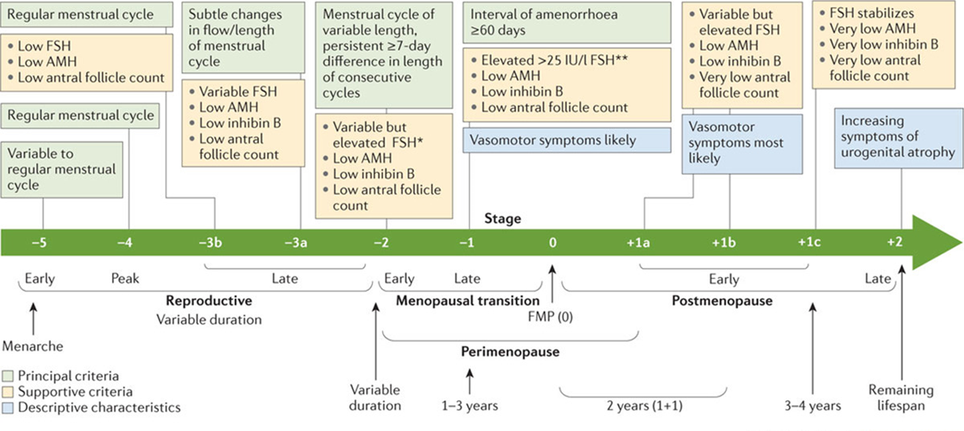
STRAW- staging system : stages of reproductive ageing
female life divided into 3 phases
Notes:
STRAW divided the adult female life into three phases: reproductive, the menopausal transition, and postmenopause.
These three phases included a total of seven stages centered on the FMP (Stage 0) (1–4).
The reproductive phase was divided into Stages –5, –4, and –3 corresponding to early, peak, and late, respectively.
The menopausal transition phase consisted of Stage –2 (early) and Stage –1 (late), and
the postmenopause phase contained Stages +1 (early) and +2 (late).
Late reproductive stage or Stage –3 was characterized by regular menstrual cycles and increasing levels of FSH.
marks the time when fecundability begins to decline and during which a woman may begin to notice subtle changes in her menstrual cycles. endocrine parameters begin to change before overt changes in menstrual cyclicity and that these endocrine changes are important to fertility assessments, subdivided into two substages (-3b and -3a).
In Stage –3b, menstrual cycles remain regular without change in length or early follicular phase FSH levels; however, AMH and antral follicle counts are low. Most but not all studies suggest that inhibin-B is also low.
(inhibin-B: prod by granulosacells, ! Role in regulation of the cycle and hormonebalance: is a neg Feedback regulator on the hypfysis and inhibits FSH secretion. Is an indicator offollicle activity and short term ovarian function; fluctuates during ovarian cycle)
(AMH:prod by granulosacells; also a marker for ovarian reserve)
In Stage -3a, subtle changes in menstrual cycle characteristics, specifically shorter cycles begin. Decrease inhibin B (egg quality -> increase FSH →shorter foll phaseEarly follicular phase (cycle days 2–5) FSH increases and becomes more variable, with the other three markers of ovarian aging being low. Estradiol remains stabel or can even increase because of increased FSH) de luteale phase can shorten and progesterone production decreases (rel E-dominance:more PMS, Painfull breasts because increasing E2 and moodswings, difficulties sleeping in or staying asleep)The lack of standardized AMH assays prevented the development of quantitative recommendations for this biomarker.
Stage –2 or early MP transition was characterized by increased variability in menstrual cycle length, defined as a persistent difference of 7 days or more in the length of consecutive cycles. Persistence is defined as recurrence within 10 cycles of the first variable length cycle. Cycles in the early menopausal transition are also characterized by elevated but variable early follicular phase FSH levels and low AMH levels and AFC
Stage –1 or late MP transition was characterized by onset of skipped cycles or amenorrhea of at least 60 days and continued elevation of FSH.
The late menopausal transition is marked by the occurrence of amenorrhea of 60 days or longer. Menstrual cycles in the late menopausal transition are characterized by increased variability in cycle length, extreme fluctuations in hormonal levels, and increased prevalence of anovulation. In this stage, FSH levels are sometimes elevated into the menopausal range and sometimes within the range characteristic of the earlier reproductive years, particularly in association with high estradiol levels. The development of international standards and the availability of substantive population-based data now permit the definition of quantitative FSH criteria, with levels greater than 25 IU/L in a random blood draw characteristic of being in late transition, based on current international pituitary standards that approximate more than 40 IU/L in the previously used urine-based gonadotropin standards . Empirical analyses should be undertaken to confirm this recommendation, and researchers and clinicians should carefully evaluate the appropriate FSH value, depending on the assay they use. Based on studies of menstrual calendars and on changes in FSH and estradiol, this stage is estimated to last, on average, 1 to 3 years. Symptoms, most notably vasomotor symptoms, are likely to occur during this stage.

Slide 3
STRAW: 3 phases: subdivided in 7 stages centered around the FMP
Notes:
These three phases included a total of seven stages centered on the FMP (Stage 0)
The reproductive phase was divided into Stages –5, –4, and –3 corresponding to early, peak, and late, respectively.
The menopausal transition phase consisted of Stage –2 (early) and Stage –1 (late), and
the postmenopause phase contained Stages +1 (early) and +2 (late).
Late reproductive stage or Stage –3 was characterized by regular menstrual cycles and increasing levels of FSH.
marks the time when fecundability begins to decline and during which a woman may begin to notice subtle changes in her menstrual cycles. endocrine parameters begin to change before overt changes in menstrual cyclicity and that these endocrine changes are important to fertility assessments, subdivided into two substages (-3b and -3a).
In Stage –3b, menstrual cycles remain regular without change in length or early follicular phase FSH levels; however, AMH and antral follicle counts are low. Most but not all studies suggest that inhibin-B is also low.
(inhibin-B: prod by granulosacells, ! Role in regulation of the cycle and hormonebalance: is a neg Feedback regulator on the hypfysis and inhibits FSH secretion. Is an indicator offollicle activity and short term ovarian function; fluctuates during ovarian cycle)
(AMH:prod by granulosacells; also a marker for ovarian reserve)
In Stage -3a, subtle changes in menstrual cycle characteristics, specifically shorter cycles begin. Early follicular phase (cycle days 2–5) FSH increases and becomes more variable, with the other three markers of ovarian aging being low. Estradiol remains stabel or can even increase because of increased FSH) de luteale phase can shorten and progesterone production decreases (more PMS, Painfull breasts because increasing E2 and moodswings, difficulties sleeping in or staying asleep)The lack of standardized AMH assays prevented the development of quantitative recommendations for this biomarker.
Stage –2 or early MP transition was characterized by increased variability in menstrual cycle length, defined as a persistent difference of 7 days or more in the length of consecutive cycles. Persistence is defined as recurrence within 10 cycles of the first variable length cycle. Cycles in the early menopausal transition are also characterized by elevated but variable early follicular phase FSH levels and low AMH levels and AFC
Stage –1 or late MP transition was characterized by onset of skipped cycles or amenorrhea of at least 60 days and continued elevation of FSH.
The late menopausal transition is marked by the occurrence of amenorrhea of 60 days or longer. Menstrual cycles in the late menopausal transition are characterized by increased variability in cycle length, extreme fluctuations in hormonal levels, and increased prevalence of anovulation. In this stage, FSH levels are sometimes elevated into the menopausal range and sometimes within the range characteristic of the earlier reproductive years, particularly in association with high estradiol levels. The development of international standards and the availability of substantive population-based data now permit the definition of quantitative FSH criteria, with levels greater than 25 IU/L in a random blood draw characteristic of being in late transition, based on current international pituitary standards that approximate more than 40 IU/L in the previously used urine-based gonadotropin standards . Empirical analyses should be undertaken to confirm this recommendation, and researchers and clinicians should carefully evaluate the appropriate FSH value, depending on the assay they use. Based on studies of menstrual calendars and on changes in FSH and estradiol, this stage is estimated to last, on average, 1 to 3 years. Symptoms, most notably vasomotor symptoms, are likely to occur during this stage.

Slide 4
Late reproductive phase stage -3b and -3a
Notes:
Late reproductive stage or Stage –3 was characterized by regular menstrual cycles and increasing levels of FSH.
marks the time when fecundability begins to decline and during which a woman may begin to notice subtle changes in her menstrual cycles. endocrine parameters begin to change before overt changes in menstrual cyclicity and that these endocrine changes are important to fertility assessments,
subdivided into two substages (-3b and -3a).
In Stage –3b, menstrual cycles remain regular without change in length or early follicular phase FSH levels; however, AMH and antral follicle counts are low. Most but not all studies suggest that inhibin-B is also low.
(inhibin-B: prod by granulosacells, ! Role in regulation of the cycle and hormonebalance: is a neg Feedback regulator on the hypfysis and inhibits FSH secretion. Is an indicator offollicle activity and short term ovarian function; fluctuates during ovarian cycle)
(AMH:prod by granulosacells; also a marker for ovarian reserve)
In Stage -3a, subtle changes in menstrual cycle characteristics, specifically shorter cycles begin.
Early follicular phase (cycle days 2–5) FSH increases and becomes more variable,
the other three markers of ovarian aging being low.
Estradiol remains stabel or can even increase because of increased FSH)
de luteale phase can shorten and progesterone production decreases (more PMS, Painfull breasts because increasing E2 and moodswings, difficulties sleeping in or staying asleep)The lack of standardized AMH assays prevented the development of quantitative recommendations for this biomarker.
Stage –2 or early MP transition was characterized by increased variability in menstrual cycle length, defined as a persistent difference of 7 days or more in the length of consecutive cycles. Persistence is defined as recurrence within 10 cycles of the first variable length cycle. Cycles in the early menopausal transition are also characterized by elevated but variable early follicular phase FSH levels and low AMH levels and AFC
Stage –1 or late MP transition was characterized by onset of skipped cycles or amenorrhea of at least 60 days and continued elevation of FSH.
The late menopausal transition is marked by the occurrence of amenorrhea of 60 days or longer. Menstrual cycles in the late menopausal transition are characterized by increased variability in cycle length, extreme fluctuations in hormonal levels, and increased prevalence of anovulation. In this stage, FSH levels are sometimes elevated into the menopausal range and sometimes within the range characteristic of the earlier reproductive years, particularly in association with high estradiol levels. The development of international standards and the availability of substantive population-based data now permit the definition of quantitative FSH criteria, with levels greater than 25 IU/L in a random blood draw characteristic of being in late transition, based on current international pituitary standards that approximate more than 40 IU/L in the previously used urine-based gonadotropin standards . Empirical analyses should be undertaken to confirm this recommendation, and researchers and clinicians should carefully evaluate the appropriate FSH value, depending on the assay they use. Based on studies of menstrual calendars and on changes in FSH and estradiol, this stage is estimated to last, on average, 1 to 3 years. Symptoms, most notably vasomotor symptoms, are likely to occur during this stage.

Slide 5
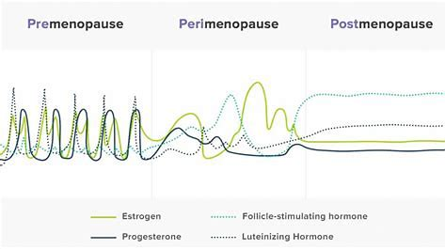
Menopausal transition : stage -2 (Early); stage -1 (Late)
Notes:
Stage –2 or early MP transition was characterized by increased variability in menstrual cycle length, defined as a persistent difference of 7 days or more in the length of consecutive cycles. Persistence is defined as recurrence within 10 cycles of the first variable length cycle. Cycles in the early menopausal transition are also characterized by elevated but variable early follicular phase FSH levels and low AMH levels and AFC
Stage –1 or late MP transition was characterized by onset of skipped cycles or amenorrhea of at least 60 days and continued elevation of FSH.
The late menopausal transition is marked by the occurrence of amenorrhea of 60 days or longer. Menstrual cycles in the late menopausal transition are characterized by increased variability in cycle length, extreme fluctuations in hormonal levels, and increased prevalence of anovulation. In this stage, FSH levels are sometimes elevated into the menopausal range and sometimes within the range characteristic of the earlier reproductive years, particularly in association with high estradiol levels. The development of international standards and the availability of substantive population-based data now permit the definition of quantitative FSH criteria, with levels greater than 25 IU/L in a random blood draw characteristic of being in late transition, based on current international pituitary standards that approximate more than 40 IU/L in the previously used urine-based gonadotropin standards . Empirical analyses should be undertaken to confirm this recommendation, and researchers and clinicians should carefully evaluate the appropriate FSH value, depending on the assay they use. Based on studies of menstrual calendars and on changes in FSH and estradiol, this stage is estimated to last, on average, 1 to 3 years. Symptoms, most notably vasomotor symptoms, are likely to occur during this stage.

Slide 6
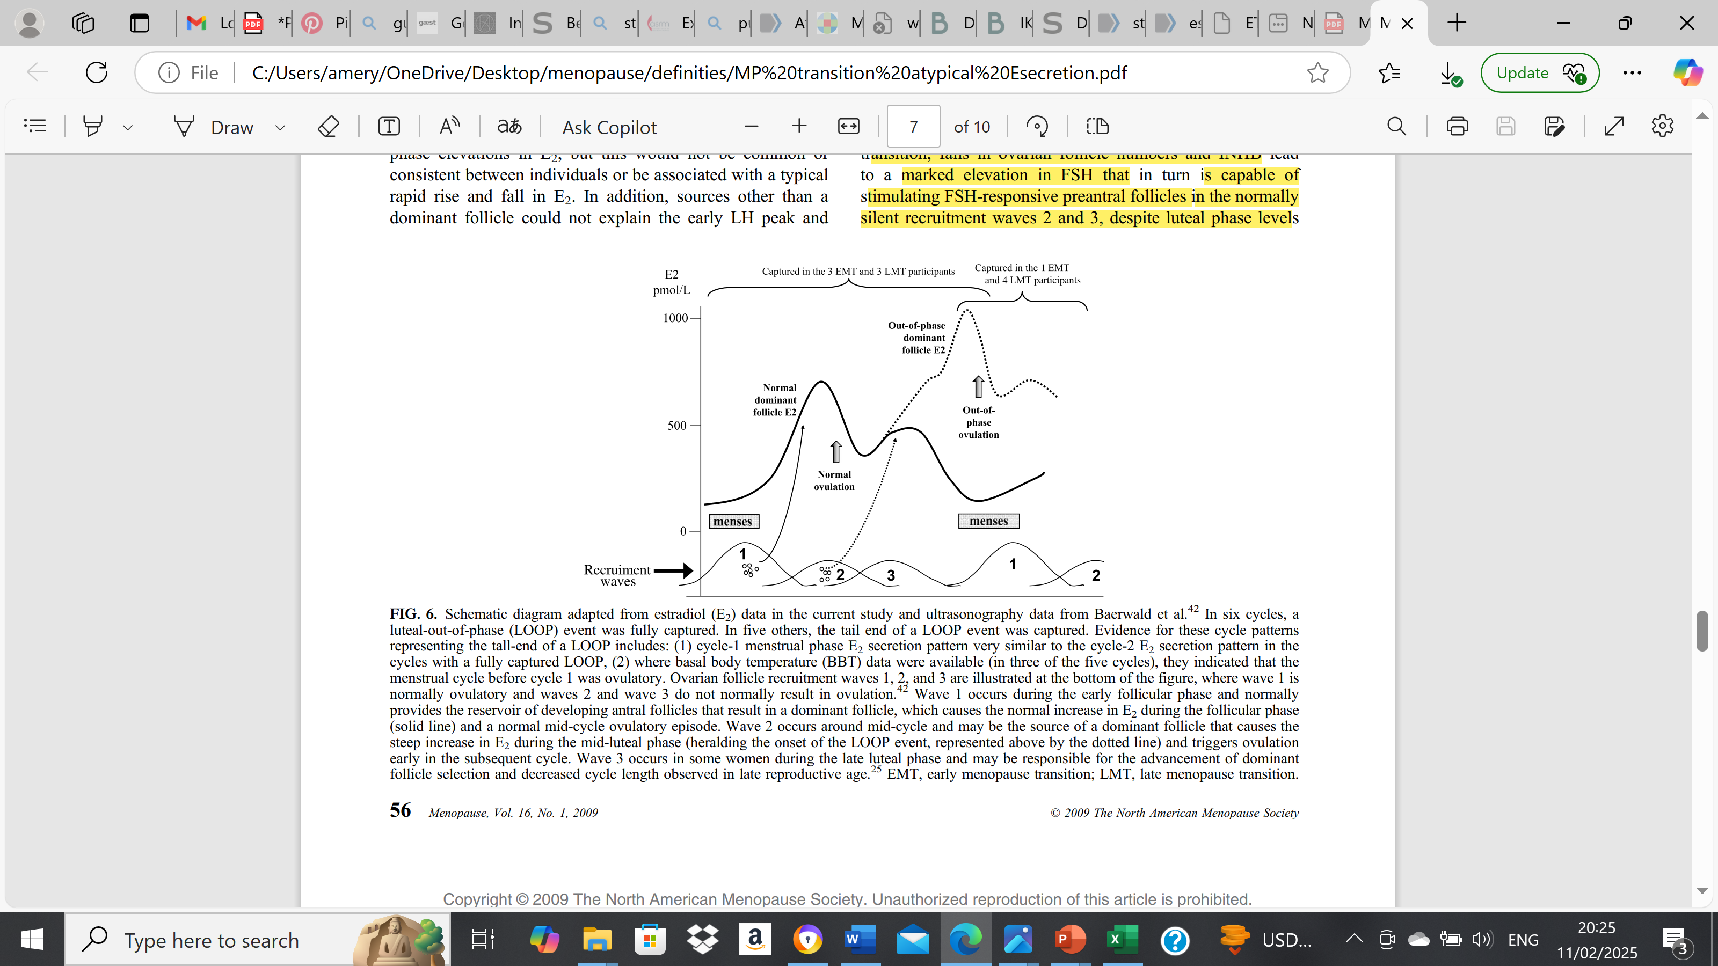
The LOOP cycle: menopause transition
Notes:
In late perimenopause (STRAW stage -1), is characterized by irregular menstrual cycles and unpredictable hormone levels, including dramatic swings in estradiol (E2). An increasing number of studies have found variable high E2 and low luteal phase progesterone occur with progression of Stages
the loop cycle refers to the irregular and unpredictable menstrual cycles caused by declining ovarian function. This phase is characterized by prolonged anovulatory cycles, significant hormonal fluctuations, and extended intervals between periods.
(37%) early and late menstrual transition ovulatory cycles exhibited a specific pattern of E2 secretion that was characterized by a second increase in E2 during the mid- and late luteal phases and that continued to a peak during the subsequent menstrual phase. This second rise and fall in E2 was typical in appearance of a normal follicular phase, except that it was superimposed on an existing ovulatory cycle (specifically during the luteal and menstrual phases). The pattern was therefore referred to as a luteal out-of-phase (LOOP) follicular event. In four of these LOOP cycles, a luteinizing hormone peak and ovulatory episode followed the second E2 peak early in the subsequent cycle. Compared with the typical ovulatory cycles, the cycles with LOOP events exhibited lower luteal phase progesterone, higher early cycle follicle-stimulating hormone, and lower early cycle inhibin B. They were also associated with abnormally short (G21 d) or long (940 d) cycle length.
Key Features of the Loop Cycle in Late Perimenopause
1. Long, irregular cycles (>60 days)
- Ovulation becomes increasingly rare.
- Some cycles may be very short, while others are very long or even absent.
- Periods may skip months before resuming.
2. Persistent High FSH and Fluctuating Estradiol
- FSH (Follicle-Stimulating Hormone) remains elevated as the body attempts to stimulate the ovaries.
- Estradiol (Eâ‚‚) fluctuates widelyâ€”sometimes high due to occasional follicular activity, sometimes very low.
-These fluctuations can cause intense symptoms, such as night sweats and mood swings.
3. Unopposed Estrogen Exposure
- Due to infrequent ovulation, progesterone production is reduced.
-This can lead to heavy, prolonged bleeding (if the endometrium builds up excessively before shedding).
4. Menstrual Patterns Vary
- Some women experience light, infrequent periods.
- Others have heavy, unpredictable bleeding due to endometrial instability.
- The cycle eventually leads to amenorrhea (no periods for 12 months), marking menopause.
Clinical Implications
- Increased risk of endometrial hyperplasia due to irregular shedding.
- Higher risk of symptoms like hot flashes, vaginal dryness, and sleep disturbances due to fluctuating estrogen.
- Hormone therapy (HT) may be considered for symptom relief and cycle regulation

Slide 7
Postmenopause
Notes:
Postmenopause:
FSH continues to increase and E2 continues to decline approximately till 2Y after the FMP. Afterwards levels stabilise
Therefore early PMP is divided in 3 stages
• Early postmenopause lasts approximately 5–8 years and includes the following stages:
Stage +1a lasts 1 year. It marks the end of the 12 month period of amenorrhea required to define that the FMP has occurred and corresponds to the end of the “perimenopause”. FSH increases fast and peaks – E2 is very low- VMS maximal – sleepproblems, changed mood, depressive,cognitive changes – peak bone mass loss
○ Stage +1b lasts 1 year. It includes the remainder of the period of rapid changes in mean FSH and estradiol levels – FSH high/variable
○ Stage +1c is estimated to last 3–4 years. It represents the period of stabilization of high FSH levels and low estradiol values – often decling symptoms
• Late postmenopause (Stage +2) includes the remaining lifespan. It represents the period in which further changes in the reproductive endocrine function are more limited and processes of somatic aging become of paramount concern.

Slide 8

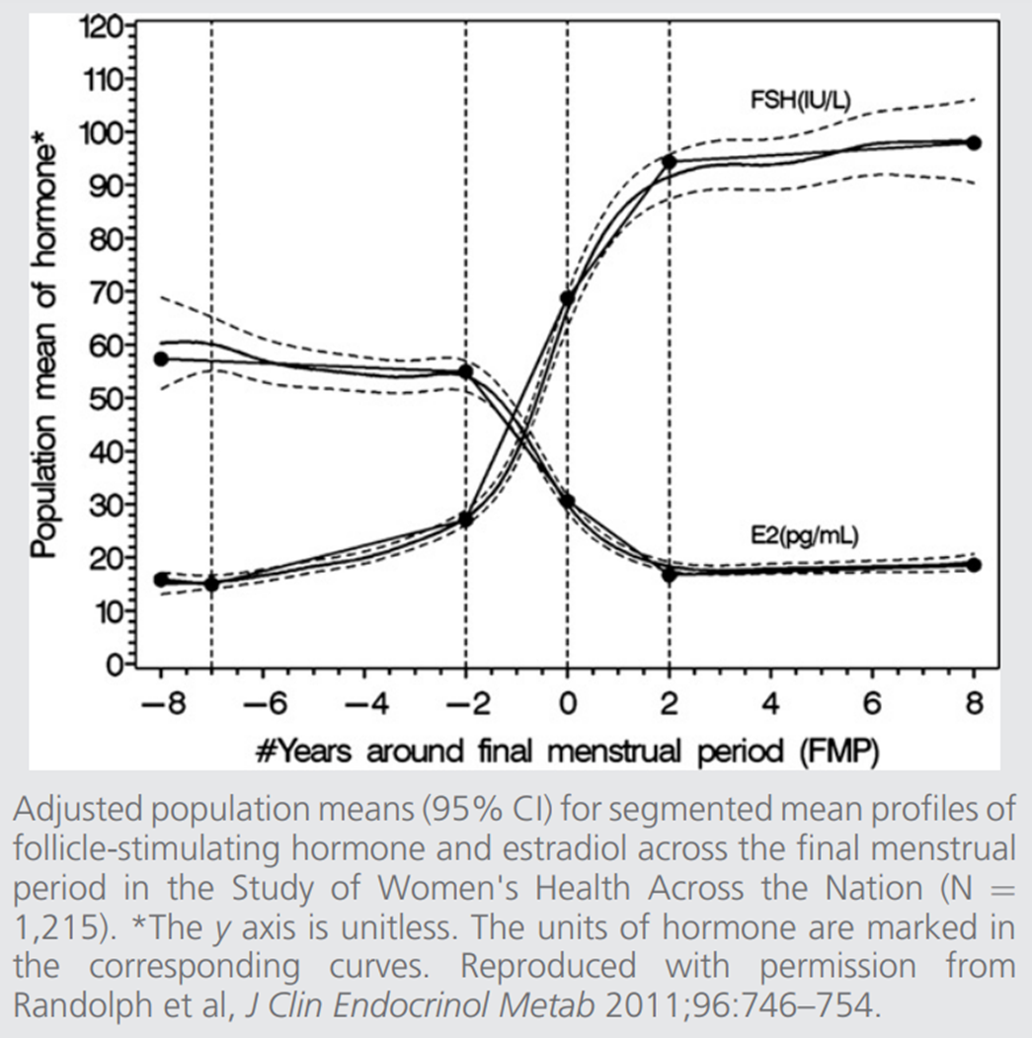



Clinical diagnosis
Women > 45 year – not using contraception
Difficult after hysterectomy or LNG-IUD
FSH – E2
Menopause : FSH consistently > 40 IU/ml or higher // E2 < 25
Peri-menopause: FSH and E2 can vary greatly !
Not systemically indicated in women > 45 years
Not indicated in women on COC / high dose POP
Indication :
women < 45 y with VMS and/or menstrual cycle changes
Women < 40 years : multiple measurements 4-6 weeks apart
Also TSH / T4 – Prolactine - HCG

Slide 9
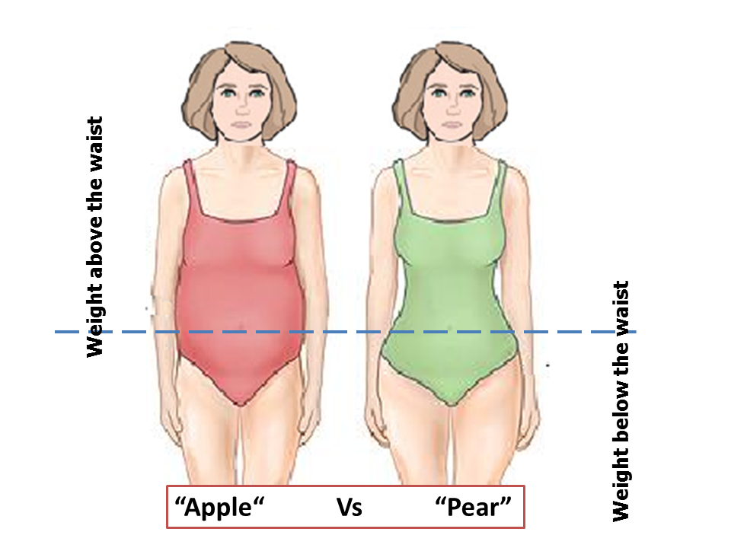
↑ weight
- age related
- ↓ muscle mass
- ↓ energy consumption
- slight ↓ thyroid function
- ↓ metabolism
- ↓ sleep / ↓ E2:
- ↓ leptine: ↓ fatburning ↓ satiety
- ↑ ghereline: ↑ hunger, cravings
- ↑ cortisol (also stress): ↑visceral fat
↑ craving
- ↑ insulin resistance
- ↑ Triglycerides
- ↑ cholesterol (total ; LDL )
Body composition
↓oestradiol (E2): ↑ total fat mass
↓ gluteofemoral fat
↑ central (visceral) fat
↓ lean mass
Waist-to-hip ratio !!
Mid-life weight gain is both pre- and post-menopausal, but pre-menopausal weight gain appears to be more pronounced
Notes:
Gewichtstoename, vetverdeling
Gewichtstoename op middelbare leeftijd, die vaak gepaard gaat met een verminderd energieverbruik, kan grotendeels worden verklaard door veranderingen in de chronologische leeftijd en niet door reproductieve veroudering.
Lichaamssamenstelling: de transitieperiode is onafhankelijk geassocieerd met nadelige veranderingen in lichaamssamenstelling. Een versnelde toename van vetmassa, verlies van vetvrije massa en toename van visceraal vetweefsel.
Decline in muscle mass from the age of 30_40; this results in a lower metabolism
Leptin: produced by fatcells; increase fatburning; makes you feel ‘full’
leptin resistance: less fatburning, lower metabolism; you feel hungry
Gherelin: produced by the stomach before a meal; sends asignal to the brain that you are hungry
increased gherelin due to lower progesterone: hungry++ cravings

Slide 10
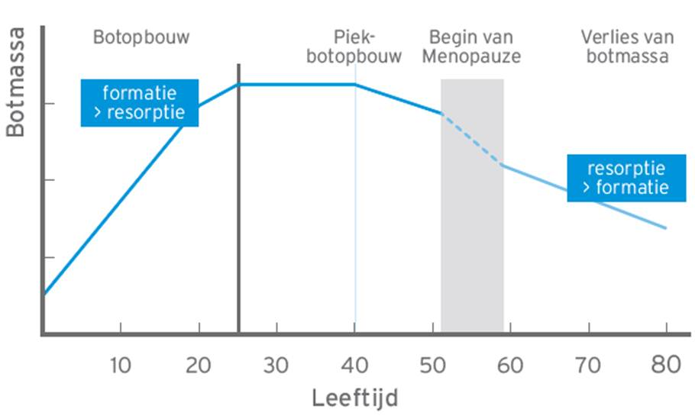
Bonemetabolism
perimenopauze
Afbraak 2-5%/jaar
0,5%/jaar
0,5%/jaar
-12% PBM
-30 % PBM
Notes:
Piekbotmassa wordt bereikt op einde vd adolescentie
Tot de leeftijd v 35-40 ishet procesv botafbraak en opbouw in balans
Vanaf 40j is er reeds afname vd botmassa 0,4%/jaar
Versnelde botafname in periMP: 2%/jaar- begint 1-3j voor de MP- duurt 5-10jaar
Na intrede vd periMP MP is er versnelde resorptie : 2_5%/jaar gedurende de eerste 5-10j
Gem verlies v 10-12% botmassa thv hip and spine over de MP transitie
Nadien 0,5% per jaar
Rond 80 jaar is +/- 30 % vd piek botmassa verloren

Slide 11

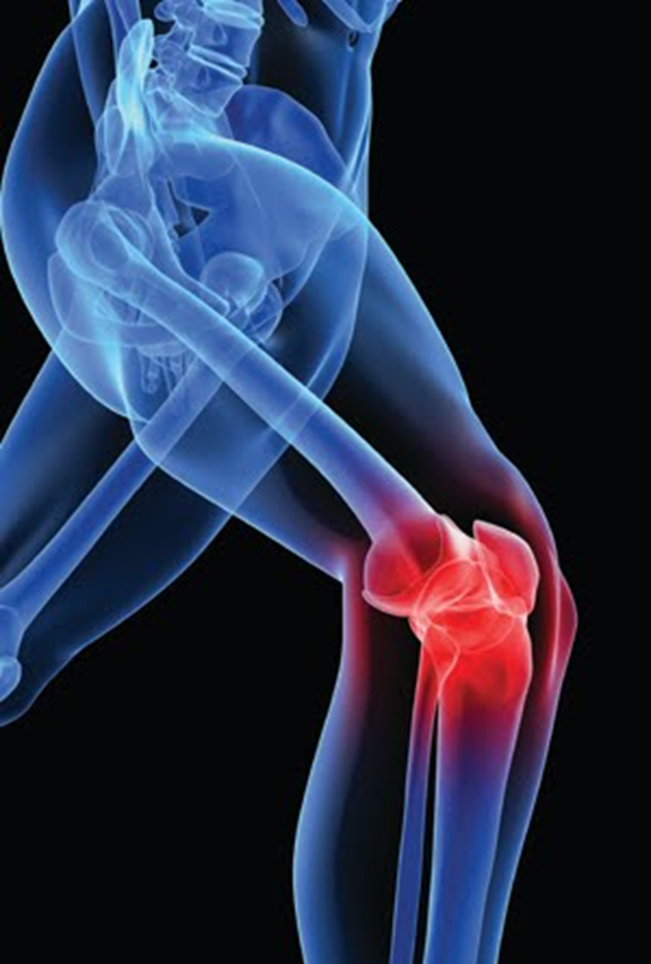
joints
Jointpains (hands, knees, shoulders..)
Morningstiffness
More ligament inflammation

Slide 12

How to handle menopause

Slide 13







life style !!!!!!!!!!!!!!
Aerobic ex
30-90’/d
Volle granen
spierversterking
Low glycemic index
Notes:
We need to stress the importance of a healthy life style with exercise such as regular aerobic ex but also muscle strenghtening ex to increase muscle mass a thus basic metabolic rate. Als a healthy diet with minimal alcohol use is most importnat
De menopauze transitie en postmenopauze brengen veranderingen in het hormonale milieu, het fysisch en psychologisch welzijn alsook heel wat metabole veranderingen t.h.v. o.a. lipiden en suikermetabolisme, hart- en bloedvaten, het botmetabolisme. Deze negatieve veranderingen hebben een impact op ontstaan van chronische aandoening in het latere leven van de vrouw. Het is het ideale moment voor counseling rond preventie hiervan. (11)
Levensstijladvies : aanpak van levensstijlfactoren heeft een positief effect op menopauze symptomen en de algemene gezondheid. Het is een belangrijke hoeksteen van het menopauze beleid!
Nastreven van een gezond gewicht. Vermijden van abdominale obesitas. Viscerale adipositas is geassocieerd met een verhoogd risico op sterfte, zelfs bij mensen met een normale BMI.
Evenwichtig en gezond dieet: de energie inname moet in balans zijn met het energieverbruik.
Het traditionele mediterrane dieet wordt aanzien als evenwichtig en bevat veel groenten, fruit, volle granen, noten, zaden, gezonde onverzadigde vetten (olijfolie), matige inname van vis en gevogelte, lage inname van rood vlees, vleeswaren, zuivelproducten en snoep. (12) Lage consumptie van simpele koolhydraten, alcohol, verzadigde vetten en bewerkte voedingsproducten. implementeren van deze gezonde voedingswijze op ‘lange’ termijn kan
• het cardiovasculaire risico verminderen alsook de incidentie van cardiovasculaire gebeurtenissen en overlijden hierdoor
• leiden tot een gunstiger lichaamssamenstelling
• de botmineraaldichtheid handhaven of verbeteren bij vrouwen met osteoporose
• helpen cognitieve achteruitgang te voorkomen
• het risico op borstkanker te verminderen
• het risico op sterfte door alle oorzaken te verminderen
Op ‘korte’ termijn dat dit voedingspatroon:
• vasomotorische symptomen verbeteren
• Cardiovasculaire risicofactoren zoals bloeddruk, cholesterol en bloedglucosewaarden verbeteren
• de stemming verbeteren en symptomen van depressie
Adequate calcium inname: een totale calciuminname via de voeding van 1.200 mg/dag wordt aanbevolen; bij voorkeur uit voedingsmiddelen en zuivelproducten. Als deze dagelijkse inname niet bereikt wordt door voedselinname, moeten orale supplementen worden overwogen. Hogere calciumdoses kunnen nodig zijn na bariatrische chirurgie en bij patiënten
met achloorhydrie; calciumabsorptie kan worden verminderd door protonpompremmers, in dat geval verkies je calciumcitraat preparaten. (13)
Adequate vitamine D inname: 600-1000 IE vitamine D/d wordt aanbevolen, hetzij door blootstelling aan de zon, hetzij door middel van een dieet of suppletie. Vitamine D zorgt voor een adequate calciumopname uit de darm. Bij vrouwen met een laag fractuurrisico die geen farmacologische behandeling nodig hebben, is een minimaal niveau van 25OHD ≥20 ng/ml (≥50 nmol/l) na te streven, met een bovengrens van ≤50 ng/ml (≤125 nmol/l). (13)
Rookstop
Beperken alcoholconsumptie
Voldoende beweging
minstens 150–300 minuten matige intensiteit aërobe fysieke activiteit; of ten minste 75-150 minuten aërobe fysieke activiteit met hoge intensiteit/week ; of een gelijkwaardige combinatie van matige en krachtige intensiteit activiteit gedurende de week. (14)
Spierversterkende oefeningen bij matige of hogere intensiteit die betrekking heeft op alle belangrijke spiergroepen : 2 of meer dagen per week
.

Slide 14
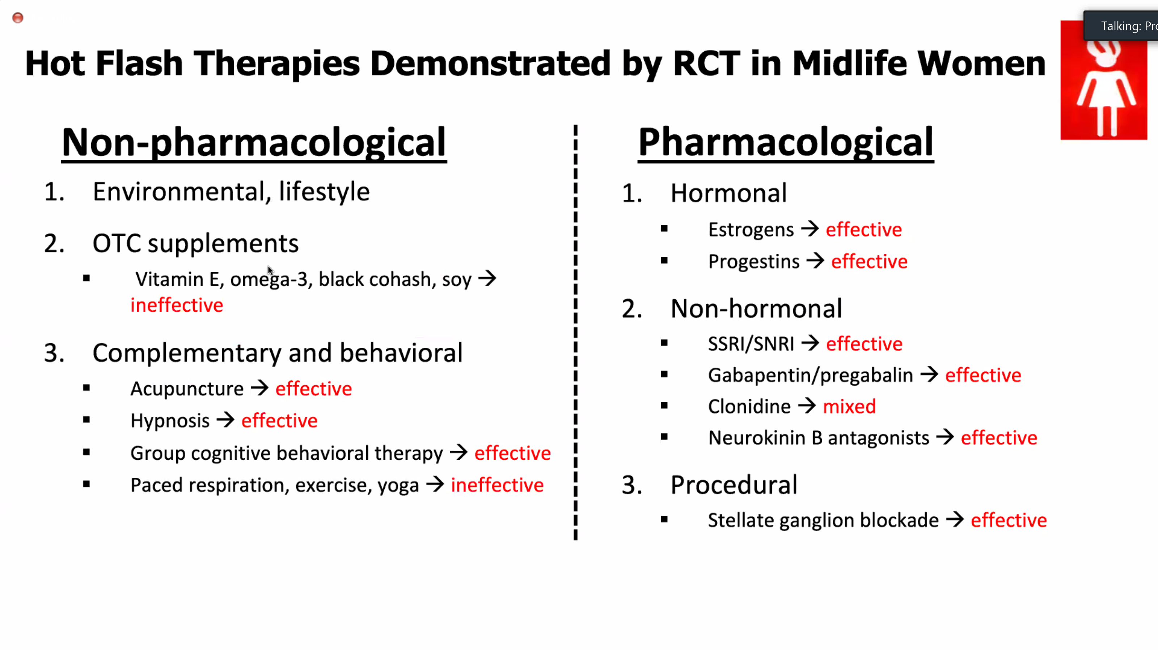

Slide 15






Hormonal substitution

Slide 16
Why?
Using MHT (Menopause Hormone therapy)

Slide 17
MHT = FDA approved for 4 indications:
Moderate – severe Vasomotor symptoms
Treatment hypoestrogenism < 45 years
POI (before 40 years) and early menopause (before 45 years
increased morbidity & mortality :Life expectancy -2 y (compared to MP at 55y)
cardiovascular morbi-mortality (Grade 1C)
neuro-degenerative diseases (Grade IC)
Increased risk for osteoporosis and fractures
Prevention or treatment of osteoporosis
Genito urinary syndrome - Vulvo vaginal atrophy: local
Notes:
Hormone therapy is FDA approved for four indications:
moderate to severe VMS;
prevention of osteoporosis in postmenopausal women;
treatment of hypoestrogenism caused by hypogonadism, BO, or POI; and
treatment of moderate to severe vulvovaginal symptoms.

Slide 18
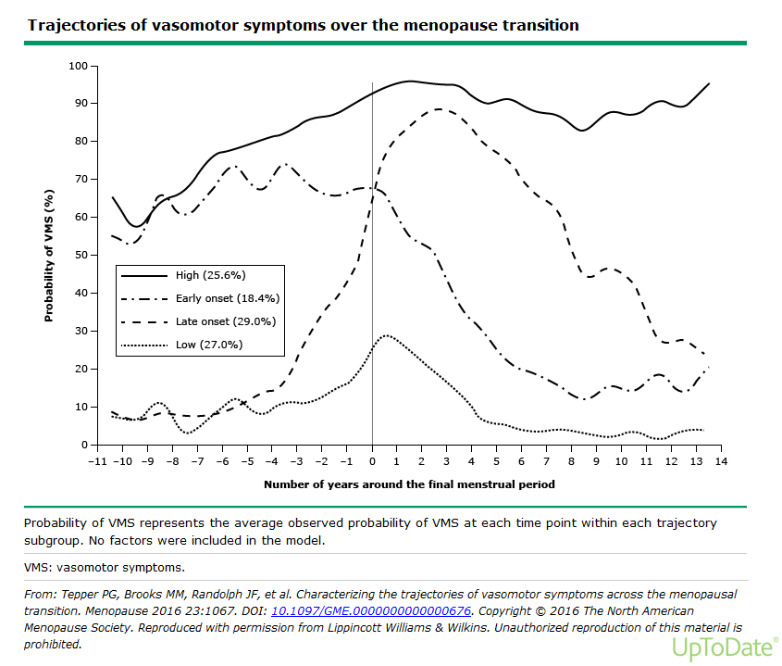
Vasomotor symptoms
Mean 7.4 y
↓ Quality of life
4 categories
Riskfactors:
Smoking
Depressive mood
Obesity
Underlying CVD- CV risk factors
Level of evidence Ia – BMS
Notes:
Moderate to severe symptoms disturb women’s health-related quality of life for variable (short to very long) durations.
In women suffering from such symptoms, MHT is the most effective treatment. In these women, it improves their quality of life.
In asymptomatic women, MHT usually does not ameliorate objectively the overall quality of life.
Since VMS are more often seen with smokers, women who are depressed or obese it is important to also address those factors
It is also important to know that women who are early flushers and esp super flushers are at risk for underlying CVD
So don’t send them home with the message that it is a normal part of midlife or just with an hormone prescription, but look further for signs of metabolic syndrome, chronic inflammation and early signs of AS
Longitudinals studies indicate that women follow distinct patterns of VMS
Both the SWAN study (US° and an Australian study ( Aus Longit Study of women’s health) found that VMS follow 4 trajectories in approx. equal proportions across 4 groups
4 types:
Mild : mild/ no HF
Late onset : start na laatste menstruatie → blijven tot late MP
Early onset : start reeds vroeg in de overgang maar↓ na laatste menses
Super flushers : start vroeg in de overgang → blijven tot late MP
RF voor HF vroege flushers
↑ BMI
Centrale obesitas
↓ slaapkwaliteit
↓ Quality of life

Slide 19
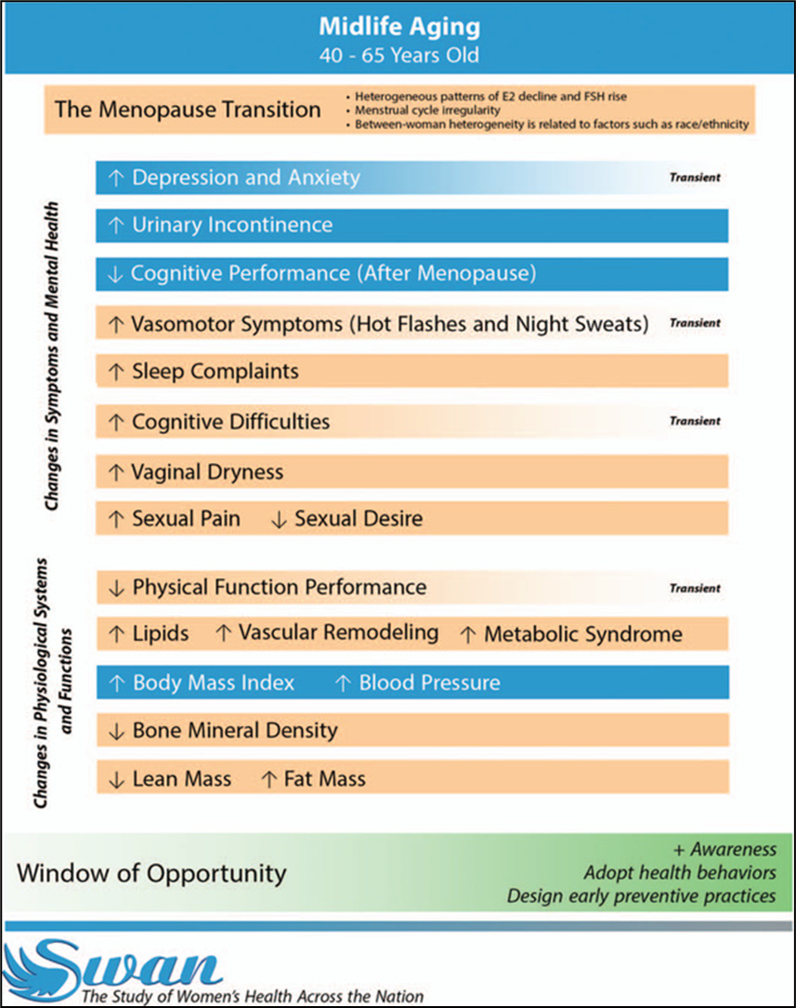
Other indications for HT
sleepdisturbances (15%)
MHT ↓ nighttime VMS
MHT ↑ sleep independent of VMS
Depressive mood
↑ risk depression in vulnerable women (x2-5)
Previous postpartum depression
PMS / PMDD
Treat with MHT first
Anxiety / clinical depression
Not indication for MHT
But MHT may help if // other climacteric symptoms
15%
Notes:
However, apart from those 4 indications, womenexperience other climacteric symptoms such as sleep complaints , depression and anxiety for which MHT may me helpfull as these symptoms disturb women’s health-related quality of life for variable (short to very long) durations.
In women suffering from such symptoms, MHT is the most effective treatment. In these women, it improves their quality of life.
Improves sleep esp in women with nighttime VMS by reducing awakenings
ET or PT may improve chronic insomnia in MP women, independant of VMS
Oral progesterone has mild sedating effects (GABA agonistic effect).
Oral progesterone improves sleep onset latency but not sleep duration efficiency in RCT in post MP ( syst RV, meta analysis)
in periMP and early MP women often experience depressive feelings, moodswings and feelings of anxiety
This period may also increase vulnerability for some women to develop depression
Especcially Women who have experienced previous periods of depression associated with PMS or postpartum, are more susceptible to depression at the menopause.(2-5x) These women should probably be treated with MHT first before using anti-depressant drugs (grade IIC)
Mood disturbances and depression as such are not an indication of MHT. However, it may help women who have mood disturbances associated with climacteric symptoms.
Causes are multifactorial:
Fysical symptoms : VMS, insomnia
Neurotransmitters: serotonine, noradrenaline
Psychosocial stressors
Physical performance: MP but also age causes a reduction in muscle mass. There is a possible role of E2 on muscle mass as well as less fysical activity
Currently however there is limited evidence tha suggests MHT may improve muscle mass and strength
Arthralgia: women often have this complaint esp in small joints and often get relief with MHT
Some symptoms are transient and especially prevalent in periMP en early MP (depressive mood, anxiety, VMS, cognitive diff) and will decline in post MP
Some symptoms /changes are permanent and progressive due to decline of E/P as well as aging .
MT causes significant alterations in cardiometabolic and vascular health parameters are strongly linked to higher CVD risk.
Some specific MP related symptoms seem also to contribute to future CV health or CVD risk such as depression and chronic sleep problems

Slide 20
Candidates for Prevention with MHT
women less than 60 years , with high risk of osteoporosis:
osteopenia T-score < -1/-2.5 and/or
low BMD T-score < 0 and rapid bone loss (MP transition)
or other risk factors for fracture
Candidates for treatment of Osteoporosis with MHT
Women less than 50 years ; due to early hypogonadism
Women less than 60 years WITH OP but low risk of fracture and not suitable yet for Rx
T-score > -2,5 or
FRAX 10y risk MOF < 20%; HIP fracture < 3%
Women older than 60 years WITH OP; other treatments are recommended (Ia)
Notes:
MHT (ET, EPT and Tibolone, TSEC) is efficacious in preventing menopause-related bone loss (level 1a).
HRT has not been demonstrated in RCT’s to reduce fractures in PM women WITH OP (no FDA indication)
NICE and BMS guidelines
some studies have shown that the use of HRT for a few years around the menopause may provide a long-term protective effect many years after stopping HRT.

Slide 21
How ?
Use MHT?

Slide 22
Choice of HMT depends on several factors:
Presence of a uterus
age
Phase of menopause transition and need for contraception
Risk factors
Choice of the patient

Slide 23
1. Presence of a uterus
Uterus present:
ALWAYS combination E + P
tibolone
TSEC + equine estrogens (DUAVIVE) (Tissue selective estrogen complex)
Hysterectomy:
E- alone
except:
ATCD severe endometriosis
E+P
Tibolone, SERM + E
Sleep problems
Notes:
Counsel about possibility of disease recurrence – malignant transformation
AR is unclear – likely to be very low – no robust data
Regular F-up - Seek medical advice if symptomatic – US! – histology if suspicious

Slide 24
2. age
in POI (< 40 j) and early MP(< 45 jaar)
Dosage should be adapted according to symptomatology (Level 3),
aim for physiologic levels
Higher dose E2 might be necessary for adequate osteoporosis treatment (Level 3)
50 -100 ùg E2 -patch
3-4 pumps oestrogel
2 mg HRT
COC with EE
COC with E2 or estradiolvaleraat = prefered
TD testosterone gel may be required : 5 mg/d ~ 1 chickpea 2% androgel on alternate days
Notes:
HRT may be more beneficial in improving bone health compared to the COC according to data of 2 RCT
in improvind CVD risk ( sign lower mean Pd and Ps

Slide 25
3. Late reproductive phase -3b - need for contraception
Symptoms:
Cycle regular - subtle changes in cycle length / flow: shorter luteal phase
More PMS – sleepproblems – breasttension – bloating - migraine – heavy menses – anxiety
Parameters : E2 still normal – progesterone declines: ‘relative Estrogen dominance’
Treatment:
Luteal progesterone
IUD- LNG
POP
COC
Notes:
r In de vroege perimenopause is de cyclus nog aanwezig die onregelmatig of regelmatig kan zijn maar korter of langer dan voorheen. De menstruatie is vaak lichter of net heviger dan voorheen. Skipcycles kunnen voorkomen. Er zijn vaak erge hormonale schommelingen met klachten van oestrogeen tekorten maar ook van oestrogeen overload zoals pijnlijke borsten, meer hoofdpijn en PMS klachten
LATE periMP
Langere periodes v amenorrhoe- vaker VMS

Slide 26
3. Transition phase – need for contraception
EARLY perimenopause: stage -2
Erratic estradiol levels – low progesterone (LOOP cycles)
Irregular bleeding – heavy / mild – cycle > 7 days different
Episodes VMS – sleepproblems – joint pains – brainfog –
moodswings
Rx:
If ONLY complaints of irregular bleeding:
LNG IUD
POP
Cyclic progesterone
COC: stabilize E2 levels; protect endometrium (!)
Notes:
r In de vroege perimenopause is de cyclus nog aanwezig die onregelmatig of regelmatig kan zijn maar korter of langer dan voorheen. De menstruatie is vaak lichter of net heviger dan voorheen. Skipcycles kunnen voorkomen. Er zijn vaak erge hormonale schommelingen met klachten van oestrogeen tekorten maar ook van oestrogeen overload zoals pijnlijke borsten, meer hoofdpijn en PMS klachten
LATE periMP
Langere periodes v amenorrhoe- vaker VMS

Slide 27
3. Transition phase – need for contraception
LATE perimenopause : stage -1
Skipcycles – amenorrhoe > 60 days
Estradiol usually low
However LOOP cycles exist: E2 peaks !
More VMS and other climacteric symptoms
Rx
if ALSO (episodic) complaints of E2-deficienty:
Same +/- TD estradiol
COC (with E2/ E- valerate / E4)
Sequential MHT
Cave symptoms of estrogen overload (bloated, painfull breasts, headaches,…)
Notes:
r In de vroege perimenopause is de cyclus nog aanwezig die onregelmatig of regelmatig kan zijn maar korter of langer dan voorheen. De menstruatie is vaak lichter of net heviger dan voorheen. Skipcycles kunnen voorkomen. Er zijn vaak erge hormonale schommelingen met klachten van oestrogeen tekorten maar ook van oestrogeen overload zoals pijnlijke borsten, meer hoofdpijn en PMS klachten
LATE periMP
Langere periodes v amenorrhoe- vaker VMS

Slide 28
POST menopause
continious combined MHT (goal amenorrhoe)
Tibolone
LNG-IUD + TD E2
TSEC (bazedoxifene + equine estrogens)
SERM (raloxifene : vertebral osteoporosis; ! VMS +)
Start with LOWEST dose
less E/P side effects
less risk VTE/stroke
Less increase breast density
Proven effect on BMD - ? Fracture
choose NEUTRAL progestagen
micronised progesterone
Dydrogesterone
Notes:
1j amenorrhoe
Gemicroniseerd progesterone
Dydrogesterone
Studies tonen
Geen verhoogd risico op trombose in // PO-TD E2
Minimaal-geen effect op BC risico na 5 j gebruik
Minder P-geassoc NE op huid / vochtretentie / borsten itt tot meer androgene prog

Slide 29
Follow up after 3 months
Change dose of Estradiol?
Lower doses are often insufficient to treat symptoms of VVA/GUS
Change Progesterone if P- related side effects
Progesterone: PMS like symptoms, drowsiness
reduce dose 12d/month
vaginally 200 mg/d – 12 d/month (no first pass liver, ↓ allopregnanolone =
neuroactive metabolite)
Dydrogesterone: 0,5 co - 12d:month
LNG-IUD (5y)
Tibolone : weak androgenic effects
Bazedoxifene + equine estrogens (DUAVIVE) (progesterone intolerance / high breast density)
Drosperinone (PMS symptoms, mild AHT, fluid retention)
Notes:
Natural progesterone:
more selective binding on progesterone receptor – less interaction with androgenic or mineralocorticoid receptors
Side effect: PMS like symptoms, sleepiness or drowsyness
oral: reduce the dose: 12d/month or min 7 days/month
vaginally
Dydrogesterone :
Syntetic progestin but Neutral metabolic profile
oral 14 days/month
LNG-IUD ( 5y)
Tibolone: is metabolised in 3 metabolites binding on ER/ PR/ AR- weak effects
Bazedoxifene / Equine estrogens
drosperinone

Slide 30
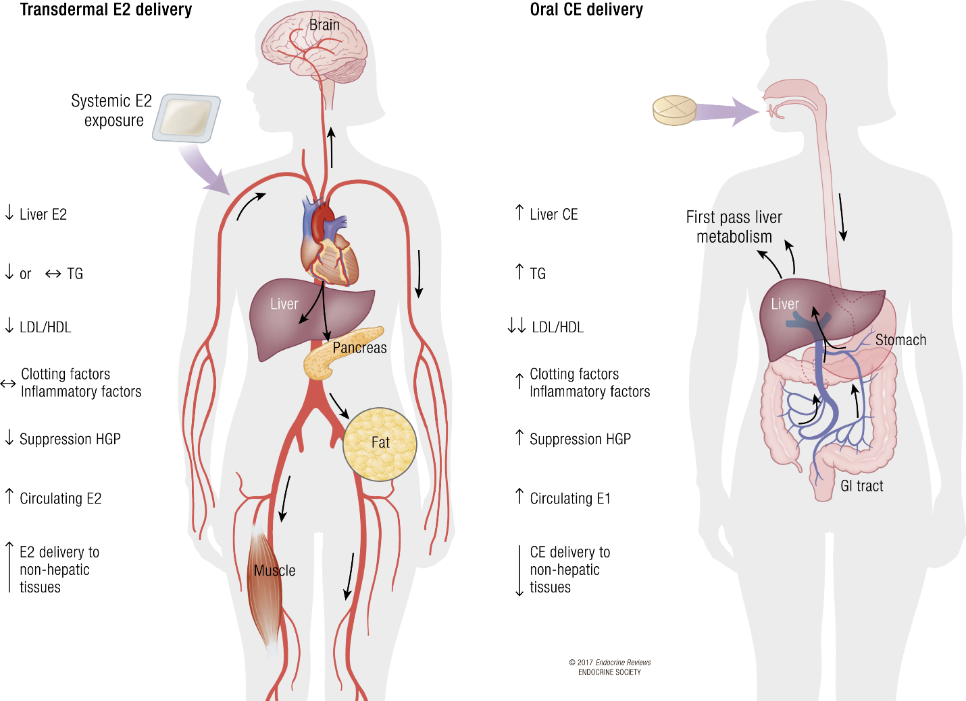
Transdermal estradiol appears to have a neutral effect on lipoproteins, clotting factors and inflammatory factors
Only observational data available,
no ↑ risk of VTE- PE – stroke
for mild and moderate doses (transdermal estradiol ≤50 µg/d)
in a HEALTHY population
BMJ 2010; 340: c2519; Curr Opin Hematol 2010; 17: 457-63; J Thromb Haemost 2012; 10: 2277-86; Menopause 2016; 23: 600-10; Menopause 2018; 25: 1297-1305
Notes:
There is compelling evidence from large observational studies and meta analyses as well as laboratory studies that TD MHT does not increase the risk of VTE above that of non users. However no RCT’s are available
TD admin avoids the first pass effect through the liver and does not alter the coagulation cascade the same way as oral E do.
Lab data show neutral effect on thrombin generation and pro inflamm markers
One possible mechanism for the increased VTE risk is an increase in activated protein C resistance that has been reported with both unopposed estradiol and combined estradiol-progestin therapy

Slide 31
women at moderate risk of VTE
TD oestradiol + progesterone/ dydrogesterone / LNG IUD
In women who have a past history of VTE > 1 year ago ~ triggering factor
exclude thrombophylia
check whether the risk is still present.
If not, MHT may be used (rather transdermal, low dose). (BMS guideline)
women at high risk of VTE / CHD / stroke should not take MHT
Circulation. 2007;115:840-845.
Notes:
MHT should not be prescribed to women at high CHD –stroke of DVT risk (1A-1B).
The stroke and DVT risks may be lower using transdermal estrogens than oral estrogens and using low dose estrogens rather than high dose estrogens and using progesterone or dihydrogesterone rather than androgenic progestins ( 2C)
Migraine without aura
Continuous OAC ( supress endogenous E – production)( prefer natural E2/ E-Val)
POP +/- oestradiol ( TD – lowest effective dose for VMS)
Mirena + oestradiol ( TD – lowest effective dose for VMS)
HRT : continious E2 (TD) + cyclical natural progesterone
E-only (after hysterectomy)
Migraine with aura
POP + TD E2
? Continuous OAC with natural E2 / E-Val (no studies – less impact on VTE – no fluctuations)
SSRI (ecitalopram) – SNRI (venlafaxine) (for migraine and VMS)
Randomized and observational studies reported that MHT increases the risk of VTE (2 to 3 fold) (level 1b evidence). This means that in a cohort of 1000 women using MHT, an additional 2 cases occur per year of use on a typical baseline risk of 1 per 1000 woman-years.
Standard ET doses were associated with a rare, but significant increase in VTE (WHI) (0.8 excess/ 1000 women-year). Major identified risk factors are age, overweight, sedentarity and thrombophilia. The risk is highest during the first year of use.

Slide 32
When?
Use MHT?

Slide 33
Early hypogonadism:
minimal till age of natural Menopause ~ 51 y
longer if need for further OP prevention – symptoms
START HST WITHIN 10 y after initiation of MP and < 60 years
= window period : maximal benefits – minimal risks
Extended use after age 65
In healthy women at low risk of CHD and breast cancer with VMS or increased fracture risk
Use lowest effective dose – prefer transdermal route – neutral progestogen/progesterone
Initiation after age 60 or > 10 years from MP
Re initiation of MHT
Initiation not advised, if so counsell of higher Absolute risk of CHD, VTE, stroke
! New onset VMS > 60 y may be related to underlying medical problem ( OSAS, AHT, hyperthyroidism, carcinoid, lymphoma, TBC, HIV, medication, alcohol,…)
Notes:
Long-term use of hormone therapy, including for women aged older than 60 years, may be considered in healthy women at low risk of CVD and breast cancer with persistent VMS or at elevated risk of fracture for whom other therapies are not appropriate. (Level III) safety data are limited by insufficient evidence regarding safety, risks, and benefits.
• Factors that should be considered include severity of symptoms, effectiveness of alternative nonhormone interventions, and underlying risk for osteoporosis, CHD, cerebrovascular accident, VTE, and breast cancer. (Level III) • Hormone therapy does not need to be routinely discontinued in women aged older than 60 or 65 years. (Level III) • Mitigation of risk through use of the lowest effective dose and potentially with a nonoral route of administration becomes increasingly important as women age and with longer duration of therapy. (Level III) • Longer durations or extended use beyond age 65 should include periodic reevaluation of comorbidities with consideration of periodic trials of lowering or discontinuing hormone therapy. (Level III)
Initiation > 60:older than 60 years or more than 10 or 20 years from menopause onset are at higher absolute risks of CHD, VTE, and stroke than women initiating hormone therapy in early menopause. (Level I)

Slide 34
When not ?
Use MHT?

Slide 35
E/P sensitive malignancies
Breastcancer
CI for systemic MHT
Local estriol may be used with VVA if non hormonal products failed
Endometrial cancer:
Endometrial stromal sarcomas or leiomyosarcomas ( E- sensitive)
High grade advanced stage endometrial cancers (insufficient data)
Ovarian cancer:
Significant improved overall survival and progression free survival with MHT (meta-analyse)
little data for serous borderline tumours, low grade serous tumours
Ovarian germ cell and granulosa cell tumours (no data – theoretical grounds)
BRCA1/ BRCA2 + and risk-reducing BSO: MHT appears safe
NAMS- guidelines 2022; NICE guidelines 2020
Notes:
Breastcancer:
Risk of recurrence of BC with MHT use is inconclusive as number of BC events in studies is too small for definitive conclusions. Two RCTs reported conflicting outcomes of breast cancer recurrence with hormone therapy. One showed an increased RR, the other one didn’t
Meta analysis 2022 showed sign increase in the risk of BC recurrence with the use of HRT was significantly increased in patients with hormone receptor-positive disease
but not in those with hormone receptor-negative tumors
Treatment for gyn malignancies often requires oophorectomy of loss of ovarian function from adjuvant treatment causing sudden premature/early MP wich may require MHT to rx symptoms and to prevent early morbidity/mortality due to early MP
Een meta analyse toonde dat pt behandeld met MHT een sign verbetering hadden v progression free en overall survival
There are theoretical concerns of recurrence risk due to stimulation of Hormone sensitive tumours
There is limited available evidence regarding the use of MHT after gynaecological cancer treatment.
Recommendations are based on old and largely retrospective information and scarce RCTs that are generally underpowered
Endometrial cancer
in women with low-grade, Stage I endometrial cancer after hysterectomy.
Meta-analyses of retrospective studies, with one RCT, do not identify an AE on the risk of recurrence or survival in these cases. A woman’s oncologist should be included in shared decision-making. Systemic hormone therapy is not advised with high-grade, advanced-stage endometrial cancers or with endometrial stromal sarcomas or leiomyosarcomas, because there are insufficient studies assessing safety
Ovarian cancer
Current and recent use of hormone therapy is associated with a small but statistically significant risk of ovarian cancer in observational studies, principally for serous type, although there was no increase in ovarian cancer risk in women randomized to EPT in the WHI.
In women with a history of ovarian cancer, benefits of hormone therapy use generally outweighs risks, especially with bothersome VMS or early menopause;
No evidence that MHT will adversely affect prognosis
Epithelial ovarian cancer: MHT may slightly improve survival (Cochrane RV- 3 RCT’s – 350 women)
use of hormone therapy is not advised in women with hormone-dependent ovarian cancers, including granulosa-cell tumors
low-grade serous carcinoma. Conflicting: 1 case control showed improved progression free interval with anti estrogen therapy (nolvadew/letrozole)(Level II) •
Germ cell tumours: small subset may be hormone sensitive: avoid MHT
Granulosa cell tumours: no data : avoid MHT
Short-term hormone therapy use appears safe in women with BRCA1 and BRCA2 gene mutations who risk-reducing BSO before the average age of menopause. (Level II)- meta analysis
Cervical cancer: evidence suggests no ecc risks with MHT with squamous or adenoca
Vulval/vaginal cancer: no evidence of increased recc risk. Syst and topical can be used

Slide 36
Undiagnosed vaginal bleeding
untreated endometrium hyperplasia
History of / at high risk for VTE / PE /CHD / AMI / stroke
Untreated AHT or atrial fibrillation
liverdisease
Meningioma : avoid progestins
alzheimer
Porphyria cutanea tarda
Secundary prevention CVD (HERS trial)
Primary prevention CVD ?
Notes:
HERS sec prevention trial:Oral HRT transiently increases coronary heart disease in women with established CHD:
High-quality trial: 1380 women on oral CEE+MPA and 1383 on placebo
Age at baseline: mean 66.7 +/- SD 6.7 y, follow-up mean 4.1 y
No significant changes overall, but a transient increase in CHD events in year 1 (1.52, 95%CI 1.01–2.29)
If there are atherosclerosis plaques: MHT can stimulate MMP9 proteasis and make the plaques instable and increase thrombosis risk
matrix metalloproteinase 9 (MMP9) genes expression levels were significantly increased in atherosclerosis coronary artery tissue

Slide 37
Hormone replacement therapy and cardiometabolic mechanisms / clinical endpoints: data from (older) high-quality US-based placebo-controlled randomized controlled trials (RCTs)
Weight gain robust evidence PEPI and WHI trials
Diabetes robust evidence HERS and WHI trials
Blood pressure growing evidence PEPI, EPAT, WHI, etc. trials
Atherosclerosis progression growing evidence EPAT, ELITE, KRONOS and WHI trial
Heart failure robust evidence HERS and WHI trials
Coronary heart disease (CHD) incidence robust evidence HERS and WHI trials
Stroke incidence robust evidence HERS and WHI trials
Long-term CHD and stroke mortality robust evidence WHI trials

Slide 38
MHT is not (yet) recommended for primary prevention
The cardiometabolic benefits / risks of MHT depend on:
mode of administration
Oral MHT: ↑ thrombosis risk VTE: all ages
↑ stroke: from age 60 y
↑ CHD from age 70 y ↔ TD
Oral MHT has proven cardiometabolic benefits:
Slightly lower weight gain
reduced insuline resistance and diabetes incidence (20%)
Anti- atherosclerotic effect in early Menopause
These have yet to be proven for TD MHT !!
Type of pharmacological composition
Many studies have been done with oral Equine estrogens / Medroxyprogesterone acetate
Dosage of MHT: ? Difference with lower doses?
Notes:
Effect op BP
In the PEPI and WHI trials (oral CEE +/- MPA), there was a small increase in systolic BP (+0.9-1.8 mm Hg, E+P > E alone) but not diastolic BP
Transdermal HRT with estradiol and oral HRT combinations containing oral estradiol + drosperinone (DRSP) tend to reduce blood pressure, especially in women with mild-to-moderate hypertension

Slide 39


