Slide 1

Belgian Menopause Society
Complex clinical cases
Brussels 28/3/2026
With the collaboration of
Anne Firquet, Axelle Pintiaux, Linda Amereyckx , Eveline Markowicz, Herman Depypere, and Serge Rozenberg

Slide 2
Case 1 : pt with history of mesenteric thrombosis
Patiënt
58 year, G1P1
Menopause: 53 year
symptoms: mastodynia, hot flashes, sleepproblems, moodswings, jointpain
history
Mesenteric thrombosis at age 25 (etiology unknown)
Barrett-oesofagus
Ex-smoker (quit 2023, 20 sig/d)
Weight? Obesity?
Riskprofile
Prediabetes: blood glucose 110 mg/dL; HbA1c 6.0%
Dyslipidemia: LDL 133 mg/dL (Normal Lp(a) ; homocysteine; triglycerides)
Bloodpressure: 145/70 mmHg
Familial osteoporosis

Slide 3
Key Concern
History of Mesenteric (? venous)Thrombosis
Clot in superior(!)- inferior mesenteric vein
Can be acute; subacute; chronic
Usually related to
Prothrombotic disorder: was thrombophilia excluded?
Factor V Leiden
Protrombine mutation
Antiphospholipid syndrome
proteïne C / antitrombine
Hematological disorder
JAK2 mutation
Pro inflammatory state (inflammation, infection, cancer)
Trauma , surgery , venous stasis
Did she take OAC?
Risk of secondary episode is low : 5-15%

Slide 4
Investigations
Bone density: normal
Lumbar spine (L1–L4): +0.4
Femoral neck: −0.1
Mammography: pending
Clinical Consideration
Indication for HRT?
Symptomatic menopause
Age <60 years <10 years since menopause
→ within the “window of opportunity” for MHT.

Slide 5
HRT and Thrombosis Risk
Low dose Transdermal estradiol/ progesterone
No hepatic first-pass effect
Minimal impact on coagulation
Preferred option in patients with elevated thrombosis risk
However : Before initiation:
Optimize cardiovascular risk factors: cholesterol – Glucose
Specialist Advice : treatment?
Diet instructions - dietician
Reduce weight?
May have positive effect on hot flushes; joint pains; mood; mastalgia
Fysical exercise
May have positive effect on sleep, insulin resistance /pre diabetes ; joint pains and mood, CVD

Slide 6
Case 2 : otosclerosis
51 years
G0
Peri-menopause: very irregular cycles and debilitating hot flashes, disturbed sleep, joint pain, mood swings, aggressiveness
History: otosclerosis
Family history: father AMI at 57y , heavy smoker
BP:120/80
Lab results pending
Mammogram: normal; type B density

Slide 7
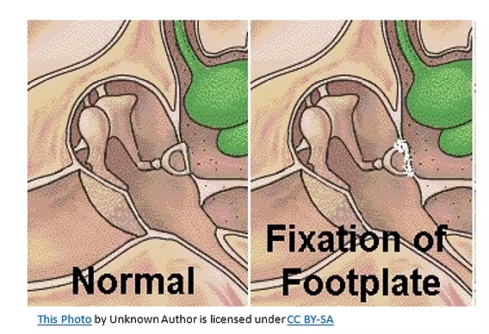
Otosclerosis : Overview & Pathogenesis
Chronic bone remodeling disorder of the ottic capsule in the middle ear
Typically : Stapes fixation → conductive hearing loss
Localized dysregulation : RANKL / OPG system
Early Active phase :↑ RANKL act: ↑ osteoclasts : bone becomes spongiotic +
hypervascular
Late phase:↑ osteoblast → inactive , sclerotic bone deposition
Possible contributors:
Genetic (autosom dom, variable penetrance)
possible viral triggers (measles)
More common in women (20 - 40 yrs)
Notes:
OPG: osteoprotegerin : blocks RANL and inhibits osteoclasts

Slide 8
Female Hormones: What Do We Know?
Ralationship with estradiol is complex and not fully understood
Estrogen & progesterone receptors in otic bone
Possible effects on bone remodeling
E2: ↑OPG ↓ RANKL → ↑ osteoblast ↓ osteoclast activity
BUT: effects in otosclerotic capsule = unclear
Prolactin : may ↓OPG ↑ RANKL
Hypothesis / prolactin : E2 could modulate RANKL/OPG
BUT: evidence = weak / inconsitent
Possible positive effects on ossicular ligament elasticity
Hormones likely modulate, not cause disease

Slide 9
Pregnancy
Controversy wether pregnancy /E2 exposure = causative factor
Historical belief: worsening during pregnancy
Based on surveys : subjective hearing loss around pregnancy
Modern data: no strong link with onset/progression
Likely transient changes in ossicular mechanics
Subjective fluctuation ≠ true disease progression
Hormones probably do not affect ottosclerotic lesion itself

Slide 10
Perimenopause, Menopause & HRT
. 2025
. 2025
. 2025
Estrogen decline → possible ↓ ligament flexibility
No strong evidence menopause accelerates disease
Post - oophorectomy : worse hearing at diagnosis
HRT: so far: no proven benefit or harm
Potential benefit:
E2 could better preserve auditory capacities as it positively impacts the ligaments in the ossicular chain
COC: no proven harm
Do not modify HRT based on otosclerosis alone
Pregnancy, Estrogen Exposure, and the Development of Otosclerosis: A Case-Control Study of 1196 Women. Macielak RJ The effect of female hormone in otosclerosis. A comparative study and speculation about their effect on the ossicular chain based on the clinical results. Ricci G et al.2022

Slide 11
Case 3
50 years
Menopause (LMP 2021)
G0
Symptoms:
VMS: not that bad: I can cope
Sleep problems rx anti histaminicum
Mood swings ++++
Joint and muscle stiffness
Urge
ATCD:
Systemic sclerodermia + Raynaud
Prim biliary cholangitis
Uveitis; iritis
Fam: sister breastca 45y
mother cervical cancer
Rx: ursofalk, nifidipine, asaflow
Previous examinations
Mammogram 9/2025: Nl
DEXA 9/2025:8/2025
LWZ: -0.8
hip: +0.3 nek: +0.2
Blood: hypercholesterolemia

Slide 12
Systemic Sclerosis (SSc)
Autoimmune connective tissue disease
Affects microvasculature + connective tissue
👉 Core mechanisms
Vasculopathy + fibrosis
Endothelial damage → ischemia
Fibroblast activation → collagen deposition
👉 Clinical involvement
Skin, lungs, GI tract, heart, kidneys
Raynaud’s phenomenon (hallmark)
👉 Immunology
ANA (>90%)
Anti-centromere / Anti-Scl-70
B-cell activation
👉 Epidemiology
Female predominance (>80%)
2 types: limited cutaneous type
diffuse type + organ involvement
Primary Biliary Cholangitis (PBC)
Autoimmune cholestatic liver disease
Targets small intrahepatic bile ducts
👉 Core mechanisms
Bile duct destruction → cholestasis
Bile accumulation → hepatocellular injury
Progressive liver fibrosis
👉 Clinical features
Liver involvement
Pruritus (key symptom)
Fatigue
👉 Immunology
AMA (anti-mitochondrial antibodies)
B-cell activation
👉 Epidemiology
Strong female predominance (>90%)
Notes:
Vasculopathy : Micro vascular damage
Endothelial dysfunction (endothelial injury, ↓ NO, ↑ endothelin-1)
Vasoconstriction
Ishemia
Capillary loss
Raynaud’s phenomenon (vasospasm small vessels triggered bij cold/stress = often 1st symptom
Autoimmunity: deregulation innate and adaptive Immune system
B-cel activation : Autoantibodies (anti-centromere, anti-SCl-70) 15_30% of diffuse SSc has SCL_70 Ab :and only in 10-15%of CREST
anti SCL-70type of antinuclear autoantibody that target the enzyme DNA topoisomerase I, which is involved in DNA replication and repair.
Fibrosis : excessive collagen production
progressive fibrosis skin
Potential organ dysfunction ( lungs, GI tract, kidneys, heart) in diffuse SSc type
2 types:
Limited cutaneous type (CREST), slow progression
Diffuse SSc: widespread skin and more often organ involvement, rapid progression
often anti SCL-70 + (men)

Slide 13
SSc pathogenesis and hormones
Complex, multifactorial , incompletely understood
Relevance of sex hormones on the Immune system + inflammation = complex
Immune modulatory and fibrotic potential ~ concentration, receptor subtype, target tissue, disease state
Few studies of varying quality evaluated the role of sex hormones in SSc
Possible profibrotic effects
Vasodilatory effects
Hormonal changes may influence progression and expression of SSc
SSc diagnosis in MP : ↑ pulmonary hypertension (HT = protective?)
↓ skin fibrosis
Early MP often // more severe disease: more vascular involvement + fibrosis
Exogenous HRT linked to ↑ risk SSc if started several years before disease onset
Notes:
Biological sex has been variably correlated to the incidence, severity, and progression of autoim mune diseases, such as systemic sclerosis (SSc), however pathogenesis is often complex and multifactorial with lifestyle, genetic,X chrom linked genetic factors, epigenetic factors hormonal, and envi ronmental factors.1,2
Sexual hormones exert com plex effects on the immune system, although their relationship is not completely understood.
3 Menopause represents a time of meaningful hor monal change, which might interact with an underlying autoimmune disease.
4 Despite the high prevalence of autoimmune disorders among female individuals,5,6 relevant data on the impact of menopause on the course of certain autoim mune rheumatic diseases are scarce. It has been suggested that menopause may affect both the onset and the activity of these conditions, acting both directly on the disease itself and indirectly on the comorbidity burden,
relevant data on the impact of menopause on the course of certain autoim mune rheumatic diseases are scarce. It has been suggested that menopause may affect both the onset and the activity of these conditions, acting both directly on the disease itself and indirectly on the comorbidity burden
data have shown that estrogens can modulate the arterial tone through endothelial-dependent mechanisms,33 the meno pause-related loss of estrogen has been suggested to trigger the pathogenic mechanisms that lead to vascular damage and, consequently, to disease related vascular manifestations, including the increased risk of developing new-onset PAH in SSc patients.17 As a consequence, hormonal replacement therapy was hypothesized to protect against the development of isolated PAH
we might hypothesize that menopause affects not only the disease expression but also the disease activity and associated comor bidities.
data suggest that both menopausal status and age at menopause may impact SSc clinical features, being associated with disease character istics such as vascular, pulmonary, and gastroin testinal manifestations.

Slide 14
HRT
Immune effects
↑ B-cell activation → potential trigger (SLE > SSc)
No clear evidence of disease worsening in stable SSc/PBC
Vascular
↑ NO → potential benefit (Raynaud, endothelial function)
Possible ↓ risk pulmonary hypertension
Liver (PBC)
Dose-dependent cholestasis risk (especially oral)
↑ E2: worsens bile secretion problem: cholestasis
↓ E2 : worsens bile flow problems : cholestasis
Generally safe if NO liver decompensation
Prefer transdermal route
Other
↓ uveitis flares (anti-inflammatory effect)
↓ osteoporosis risk (important in PBC)
Avoid / caution if:
Active autoimmune disease
Abnormal LFTs / cholestasis
Severe vascular disease
👉 Strategy:
Low dose
Transdermal preferred
Individualized risk assessment
EASC guidelines 2017
Notes:
MP: lower balbladder contractility : less bile flow: stasis, galstones

Slide 15
COMPARATIVE SUMMARY
Feature | HRT | Fezolinetant | SSRI/SNRI
Autoimmunity | ⚠️ possible trigger | Neutral | Neutral
Fibrosis (SSc) | ⚠️ possible ↑ | No effect | No effect
Vascular (Raynaud) | 🟢 possible benefit | Neutral | Neutral
Liver (PBC) | ⚠️ cholestasis risk | ⚠️ LFT ↑ | 🟡 generally safe
Bone health | 🟢 protective | No effect | No effect
Vasomotor symptoms | ⭐ most effective | ⭐ effective | ⭐ moderate
Musculosceletal pain effective No effect No effect
Notes:
PBC estrogen: may reduce bile flow

Slide 16
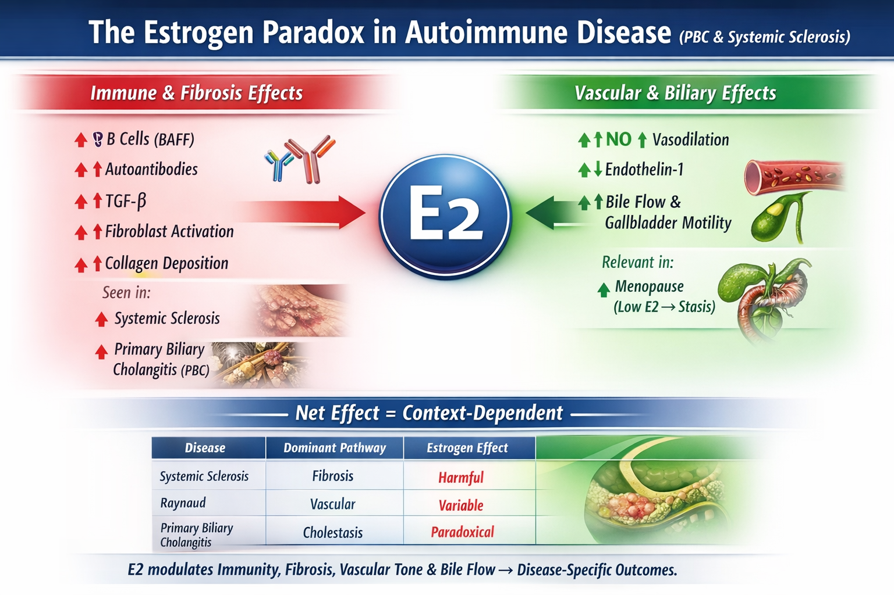

Slide 17
Lifestyle optimization
Sleep optimization
Breastcancer: 1st relative < 50
Lifetime risk x2 x3 : 25-35% lifetime risk
consider genetic counseling
annual mammogram
HRT is no CI but adds small absolute risk
First choice
SSRI

Slide 18
references
Menopause in systemic sclerosis: the impact on clinical presentation in a multicenter cross-sectional analysis from the National Registry of the Italian Society for Rheumatology (SPRING-SIR).ther advances in musc skeletal disease 2025
Sex differences in systemic sclerosis: from pathogenesis to clinical manifestations and treatment Melpomeni Toito ther advances in musculoscletal disease 2025

Slide 19
Case 4 How to manage a symtomatic patient after 10 years of neglected menopause?
Mrs A 58 years old
Hot flushes night and day since the menopause - work difficulties –fatigue-new job 1 hour drive to work
Menopause at 48
Fear about HT but now she would like benefit from the MHT
Has been on racemosa cimifuga, red clover ,soy , oxybutinine and venlafaxine without sufficient effectiveness
BMD trabecular osteopenia ( Tsc -2,1), vaginal dryness, SA lichen, breast screening N , breast low density ,treated dyslipidemia, mild HTA, quit smoking 20 years ago- familial history myocardial infarction in the father (no smoker) at 59, stroke GM at 62
On calcium 1 g , vit D 25000 /15D , metformine 850 2x/D, Suvezen10/10, Amlodipine

Slide 20
How to manage a symtomatic patient after 10 years of neglected menopause?
What informations do you need to know ?

Slide 21
Effect of HT on CHD: Timing of Initiation
Years Since
Menopause
Absolute Risk per 10,000 Women per Year of HT Use
WHI-E+P
0.88
<10
10-19
>20
P for trend=0.05
-4
7
30
1.23
1.66
WHI-E
0.48
<10
10-19
>20
P for trend=0.15
-14
-1
7
0.96
1.12
WHI-Combined
0.76
<10
10-19
>20
P for trend=0.02
-6
4
16
1.10
1.28
0
0.5
1.0
1.5
2.0
2.5
Hazard Ratio (95% Confidence Interval)
Rossouw JE, JAMA 2007;297:1465-1477.

Slide 22



Cardiovascular health after menopause transition, pregnancy disorders, and other gynaecologic conditions: a consensus document from European cardiologists, gynaecologists, and endocrinologists
• MHT is indicated to alleviate menopausal symptoms
• MHT may be of potential prophylactic benefit in depression
• Doses and types of MHT regimens, and age at initiation are crucial for its safety
• Before starting MHT, assessment of cardiovascular risk factors should be performed
• Consider measuring CAC with CT when there is uncertainty on individual cardiovascular risk
• MHT is not recommended in women at high cardiovascular risk and after a CVD event
• Initiation of MHT is generally not advised in asymptomatic women
A.H.E.M. Maas et al. European Heart Journal (2021) 42, 967–984

Slide 23
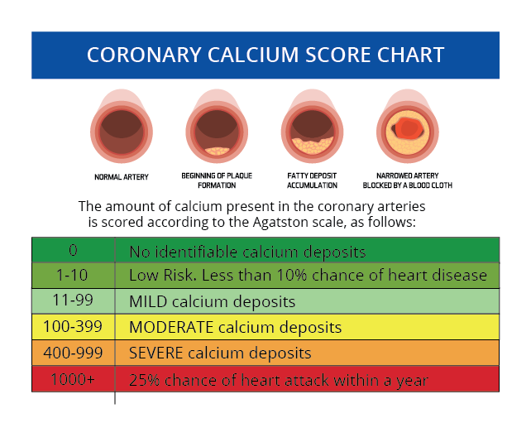

Slide 24
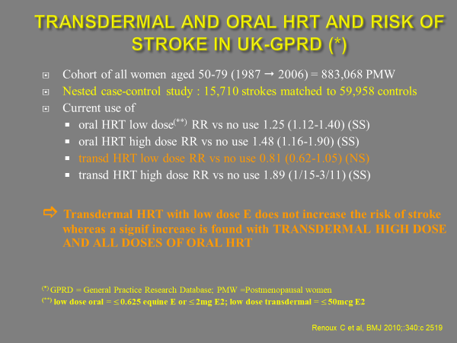
Transdermal and oral hormone replacement therapy and the risk of stroke: a nested case-control study
WHAT IS ALREADY KNOWN ON THIS TOPIC
Oestrogen replacement therapy with or without progestogen is associated with an increased
risk of stroke in postmenopausal women
WHAT THIS STUDY ADDS
The use of transdermal hormone replacement therapy containing low doses of oestrogen was not associated with an increased risk of stroke, in contrast to the oral route of oestrogen alone or combined with a progestogen
Transdermal administration of hormone replacement therapy may be a safer alternative to the oral route of administration
Renoux C et al, BMJ 2010

Slide 25
Cardiovascular diseases : CHD
Some studies reported that severe vasomotors symptoms, repeated miscarriages, or hypertensive disorders in pregnancy, increase cardiovascular risk.
Experimental and observational studies reported in the past reduced risk of atherosclerosis and CHD in MHT users (level 2, 3 of evidence).
Observational (NHS) and randomised (WHI) data reported a reduced risk in early menopause (at least before the age of 60 and or less than 10 years after menopause) (level 1a). Women older than 60 years can continue using.
On the other hand, benefit of treatment seems to be lost on CHD risk in women in whom the treatment has been initiated at older age (above the age of 70) (WHI) (level 1a of evidence).

Slide 26
Cardiovascular diseases : CHD
Standard ET doses, used during an average period of 6.8 years, lowered the incidence of CHD in women less than 10 years after menopause (WHI) (level 1a of evidence).
A reduced risk of atherosclerosis has been reported in women starting ET at an early age or soon after menopause (level 1a)
Whether MHT should currently be used for this indication only is currently still debated .

Slide 27
Cardiovascular diseases : CHD
Standard ET doses, used during an average period of 6.8 years, lowers the incidence of CHD in women 50-59 years of age (WHI) (level 1a of evidence).
Some progestins may reduce the beneficial effects of ET (proven for MPA) (level 1b of evidence).
On the other hand, other risk factors should be considered, such as hypertension, lipids and cholesterol, …. In complex situations, Score systems may be used to calculate the patient’s risk (SCORE 2). Coronary Artery Calcium Score (CAC) can be measured also.
In women with a 10 year risk higher than 10%, MHT is not indicated.

Slide 28
Cerebrovascular diseases : Stroke
Cerebrovascular disease are prevalent in elderly women.
Prevention should be aimed controlling risk factors. MHT treated women at young age, may develop less atherosclerosis, although it has not been proved that they have a decreased risk of developing cardio & cerebrovascular disease at old age.
MHT (EPT, ET and Tibolone) and SERMS, initiated at old age increase the risk of stroke (level 1b of evidence).
In the absence of risk factors, the attributable risks are however negligible in women before the age of 60 years.
At standard dose after 60, there is an excess of 8 to 11 cases /10 000 women- year on a baseline incidence of 26/10 000 women -year.
Observational studies suggest that low doses MHT confer a lower risk of stroke (level 2a of evidence).
MHT is contraindicated in women with a past history of transient ischemic attack or stroke.
Individual cardio-vascular risk can be evaluated by risks models.

Slide 29
Case 6 How to manage menopause after bilateral ovariectomy for ovarian borderline tumors in a 30 years old patient ?
Mrs Julie 30 years old , MD
No personal history before
Abdominal pain, large ovarian tumors observed on ultrasound, CA 125 elevated, ascite
Oocyte cryopreservation
Bilateral salpingo oophorectomy and cytoreduction ( pelvic and abdominal extension) : ovarian serous borderline tumors micropapillary variant
Familial history : GM breast cancer at 80, mother depression
On calcium and vit D
Hot flushes, sleep troubles, oxybutinine tested but not efficient on warm sensation

Slide 30
Case 7 How to manage menopause after a low grade serous ovarian cancer in a young patient ?
Mrs Hue 25 y old
Adressed to the oncologic department after surgery for low grade serous ovarian cancer (cytoreductive surgery)
on aromatase inhibitor
Hot flushes, sleep troubles
Rare subtype: ~2–5% of epithelial ovarian cancers and <10% of serous ovarian cancers.
Slow-growing with low proliferation rates and less aggressive cellular features.
Often hormone‑receptor positive (ER/PR).
Common genetic alterations: MAPK pathway mutations (KRAS, BRAF), PI3K changes.
Frequently diagnosed at advanced stages (III–IV) in ~80% of cases.

Slide 32
Take home message
BOT is NOT explicitly listed as a contraindication to MHT. BUT caution is warranted, especially in serous BOT with high-risk features (implants, microinvasion),BOT treated in patients with strong family history or genetic risk, situations where transformation to LGSC is a concern.
Borderline tumors, especially serous BOT, share molecular pathways with low‑grade serous carcinoma (LGSC), a known hormonally sensitive tumor.
Do NOT use systemic MHT in:
Low‑grade serous ovarian cancer (LGSOC)
Granulosa cell tumors (estrogen‑dependent)
MHT may be considered (case‑by‑case) in:
Most epithelial ovarian cancers except LGSOC
No clear overall increased recurrence risk with MHT in ovarian cancer as a group,
but subtype-specific sensitivity varies.
Vaginal estrogen is generally safe, with minimal systemic absorption, for most gynecologic cancer survivors.
General non-cancer contraindications include history of breast cancer, cardiovascular disease, stroke, blood clots, or liver disease.

Slide 34

Szabo RA, Marino JL, Hickey M.Climacteric. 2019 Dec;22(6):572-578. doi: 10.1080/13697137.2019.1646718. Epub 2019 Aug 21.

Slide 35
Case 8 How to manage menopause after an endometrial cancer ?

Slide 36
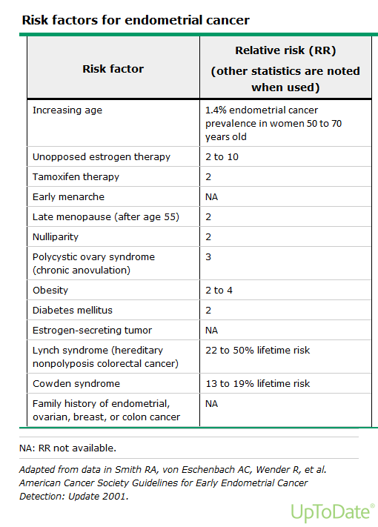

Slide 37
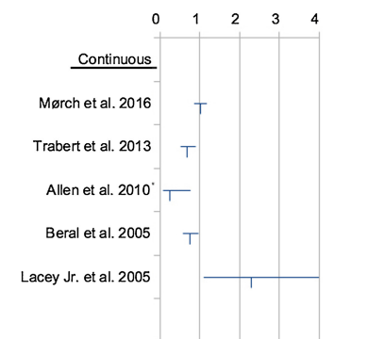
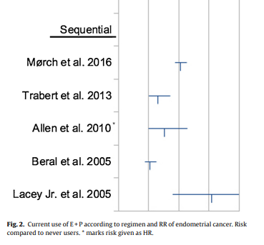
MHT and the risk of endometrial cancer: A systematic review
0 1 2 3 4
Sjögren LL, Mørch LS, Løkkegaard E. Hormone replacement therapy and the risk of endometrial cancer: A systematic review. Maturitas. 2016

Slide 38
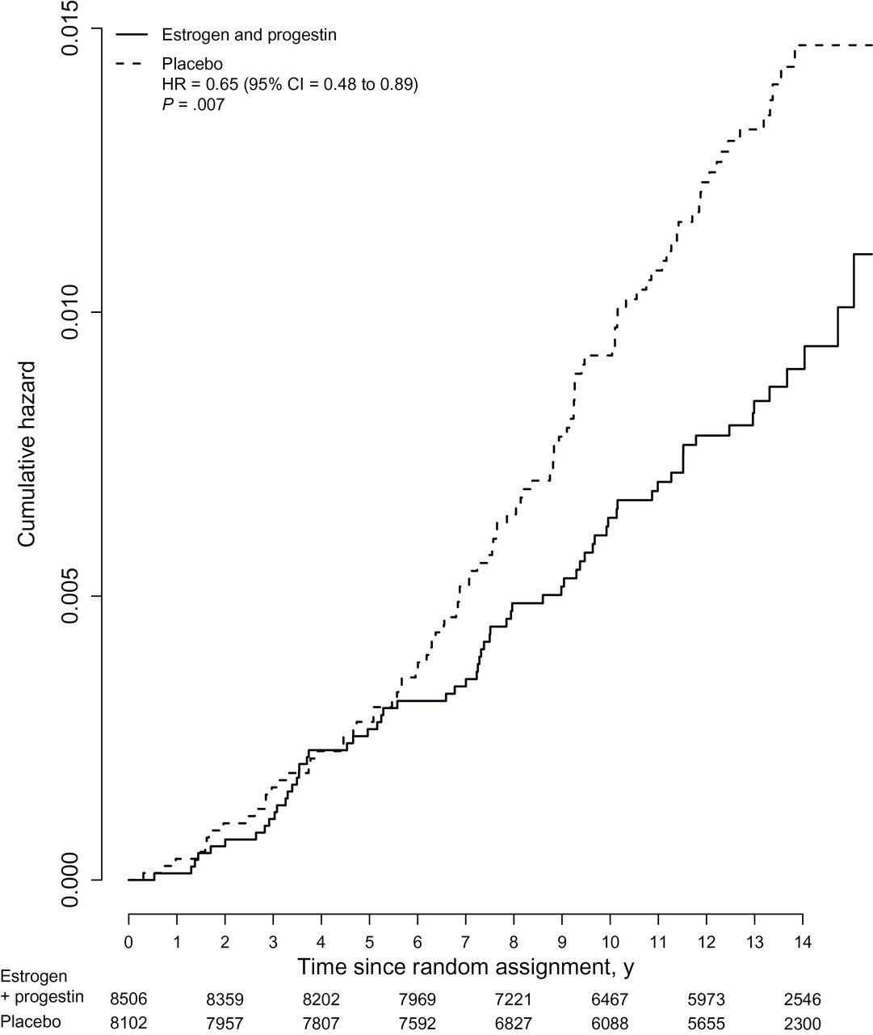

Figure 2. Kaplan-Meier estimates of cumulative hazards of endometrial cancer in the Women’s Health Initiative ...
Continuous
E+P
Notes:
Figure 2. Kaplan-Meier estimates of cumulative hazards of endometrial cancer in the Women’s Health Initiative randomized trial of continuous combined estrogen plus progestin with the intent-to-treat principle. Hazard ratio (estrogen plus progestin vs placebo) with 95% confidence intervals and P values is from Cox regression models stratified by age and random assignment in the dietary modification trial. Estrogen indicates conjugated equine estrogens, and progesterone indicates medroxyprogesterone acetate. All statistical tests were two-sided. CI = confidence interval; HR = hazard ratio.
Unless provided in the caption above, the following copyright applies to the content of this slide: © The Author 2015. Published by Oxford University Press. All rights reserved. For Permissions, please e-mail: journals.permissions@oup.com.

Slide 39
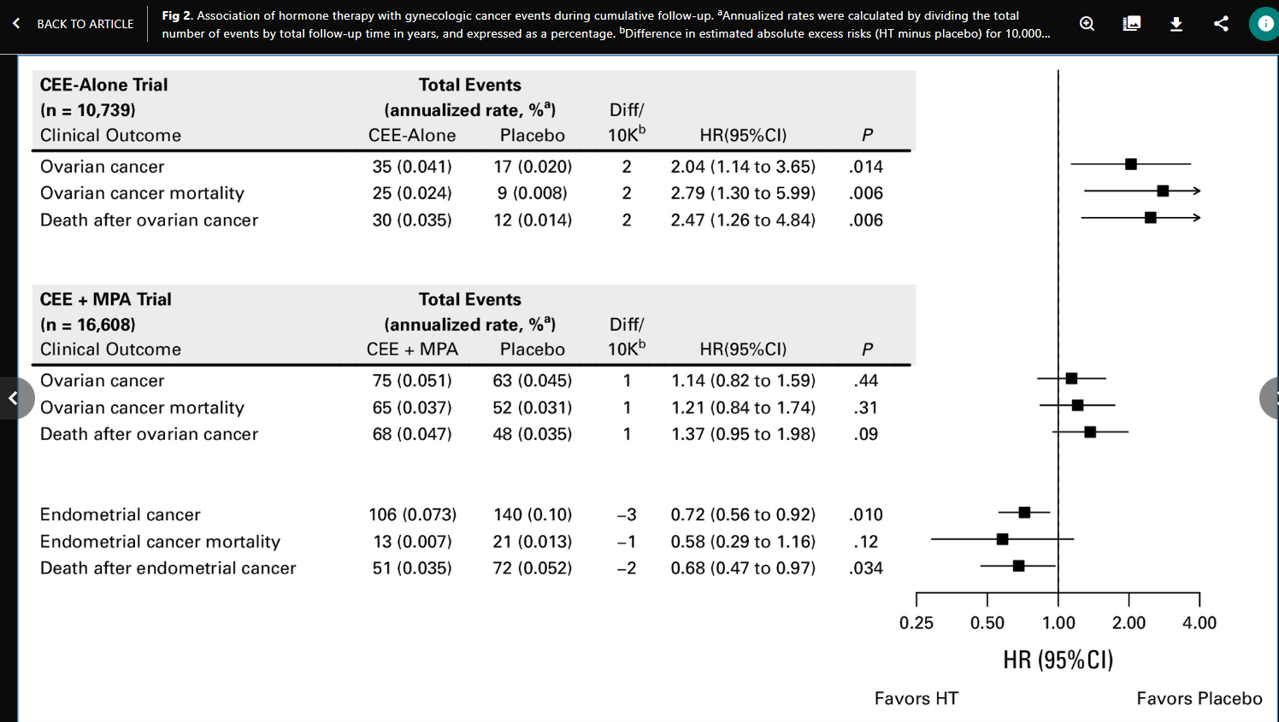
MHT and Ovarian and Endometrial Cancers: Long-Term Follow-Up of the WHI-RCT.
Chlebowski et al J Clin Oncol. 2024

Slide 40
Endometrium Ca
Approach to younger patients — (age ≤40 comprise < 7% of endometrial cancers),
surgery includes oophorectomy
low-risk disease,
ET should be administered as first line therapy .
National Comprehensive Cancer Network. NCCN Clinical Practice Guidelines in Oncology. Uterine cancer. https://www.nccn.org/professionals/physician_gls/pdf/uterine.pdf (Accessed on August 22, 2023).

Slide 41
Endometrium Ca
Patients with intermediate- or high-risk disease-> nonhormonal interventions: NK-antagonists
Vaginal rather than systemic E-therapy consistent with guidelines
But no prospective data to inform the safety
Progestin is not necessary
Committee on Gynecologic Practice. ACOG committee opinion. Hormone replacement therapy in women treated for endometrial cancer. Number 234, May 2000 (replaces number 126, August 1993). Int J Gynaecol Obstet. 2001

Slide 42
Case 9 How to manage a Turner syndrome ?

Slide 43

Case 9
Ms. GC, Sonia
G0 P0 43 years old Portuguese
Diagnosed with TS at age 15
11/4/2025
Climen (2 mg E2 valerate + 1 mg cyproterone acetate) for 20 years
Microgynon 20 for 8 years → regular cycle of 3 days
L-thyroxine 25
145 cm 50 kg 140/80 mmHg
Cardiac evaluation: normal
ENT evaluation: chronic sinusitis; normal hearing
Hot flashes ++ , Night sweats ++ ; Hair loss , sleep disorder
Oestrogel 2 doses + Progebel 100
30/01/2026
Improved sleeping
Improved mood
Improved concentration
Increased weight
Suggestion : increase Oestrogel + Progebel

Slide 44

What is Turner Syndrome?
25-50 per 100 000 female individuals
Sex chromosome disorder in phenotypic females
Complete or partial absence of the second sex chromosome
Most common karyotypes (Table 1):
45,X: 40–50 %
45,X/46,XX mosaicism: 15–25 %
45,X/46,XY mosaicism: 10–12 %
Isochromosome Xq: 15 %
Main features: short stature, ovarian insufficiency, congenital heart defects, renal/skeletal anomalies, early hearing loss, neurocognitive profile
Turner Syndrome – 2024 International Clinical Practice Guidelines Clinical practice guidelines for the care of girls and women with Turner syndrome

Slide 45
Growth Hormone (GH) Treatment
Offer GH early (as young as 2 years) if growth failure, short stature, or risk of short stature
Continue until little growth potential remains (bone age ≥14 years or height velocity <2 cm/year)
Average adult height gain: +5 to +8 cm (up to +15–17 cm with early high-dose protocols)
Best results with: young age at start, high dose, long duration, tall parental height
No physiological reason to continue GH after epiphyseal closure
Turner Syndrome – 2024 International Clinical Practice Guidelines Clinical practice guidelines for the care of girls and women with Turner syndrome

Slide 46
Puberty and Ovarian Function Markers
Measure LH, FSH, and AMH at 8–9 years and yearly until 11–12 years
1/3 of girls show spontaneous pubertal signs (twice as common in non-45,X)
Spontaneous menarche in only ≈20 %
AMH <4 pmol/L predicts absence of spontaneous puberty
Turner Syndrome – 2024 International Clinical Practice Guidelines Clinical practice guidelines for the care of girls and women with Turner syndrome

Slide 47
Pubertal Induction – Estrogen Therapy
Start low-dose 17β-estradiol (E2) between 11 and 12 years if FSH is elevated on two measurements
In late diagnosis (>12 years) with remaining growth potential: start low-dose E2 together with GH
Prefer transdermal (TD) E2 route; oral E2 is second choice
Goal: mimic normal physiology, preserve linear growth, and achieve normal timing of puberty
Turner Syndrome – 2024 International Clinical Practice Guidelines Clinical practice guidelines for the care of girls and women with Turner syndrome

Slide 48
Monitoring and Adult Hormone Replacement Therapy
Assess breast development, height, uterine ultrasound, bone density, and serum E2 (target adult level 350–500 pmol/L / 100–150 pg/mL)
Continue cyclic E2 + progesterone until age ≈50–55 years (natural menopause)
Individualize regimen (dose, route, formulation) according to patient preference to maximize long-term adherence
DXA + pQCT at end of pediatric care (≈18 years) and repeat around age 21 years
Turner Syndrome – 2024 International Clinical Practice Guidelines Clinical practice guidelines for the care of girls and women with Turner syndrome

Slide 49
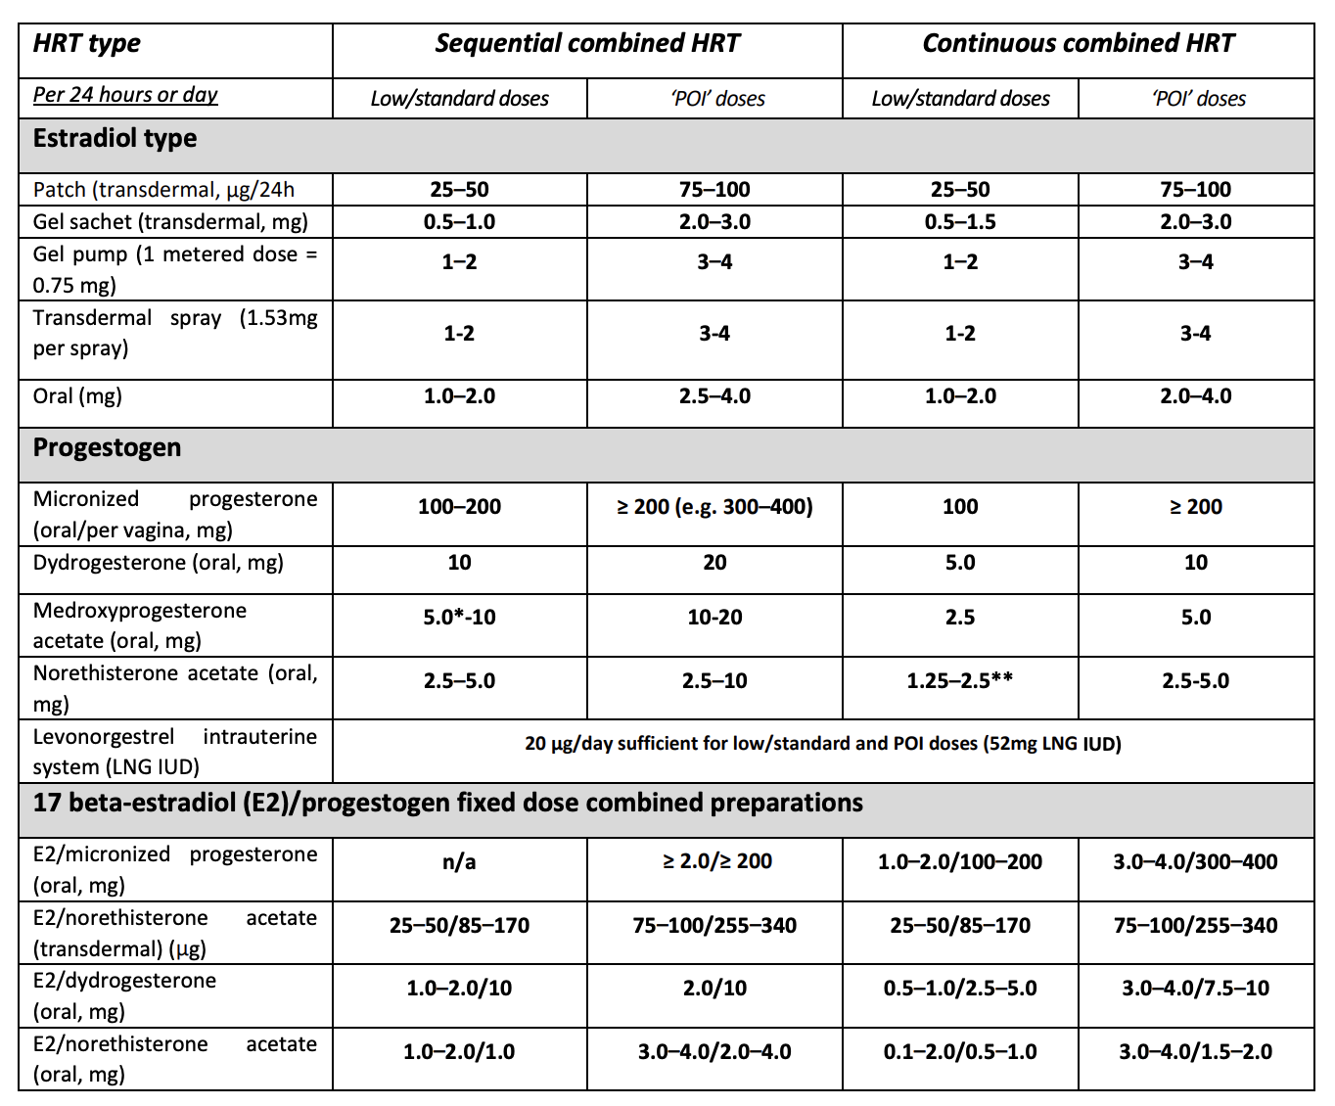
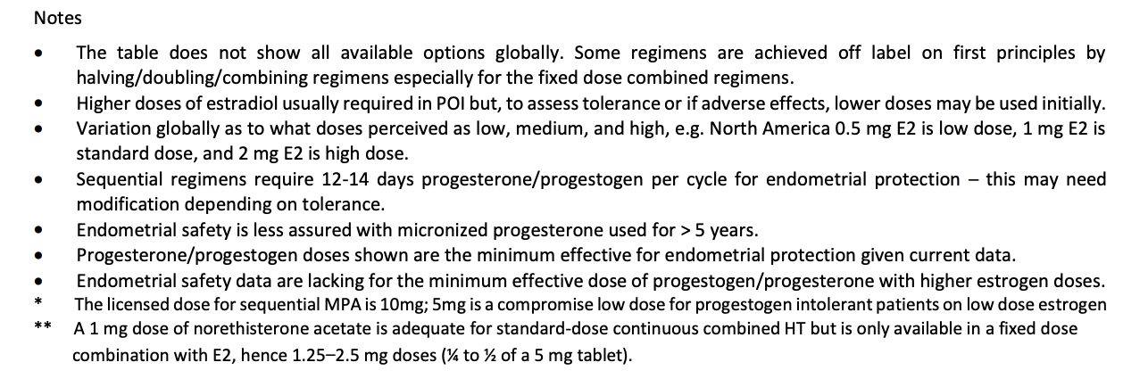
Summary of HRT options: Standard and POI regimens modified with permission from Panay, N et al. 2020
Source : IMS recommendations

Slide 50
/ Case 10 LM (GMC)
31 years old G1P1: Personal history: Bilateral pulmonary embolism with
pulmonary infarction (May 2025). Negative coagulation test. Used a vaginal contraceptive ring from January 2025 to May 2025. Family history: Mother's breast cancer at age 55 and recurrence at age 57. Mother went through menopause at age 50. Smoker: 0 Ongoing treatment: Eliquis and L-thyroxine

Slide 51
First consultation in July 2025 for hot flashes. Normal examination Amenorrhea since June 28, 2025. Blood tests July 2025: AMH 0.03, FSH 109 - LH 51, E2 < 25, Normal androgens, Normal PRL, breast ultrasound not yet done, will schedule appointment TSH elevated at 5, positive TPO antibodies at 86 —> start levothyroxine 25 and endocrinologist appointment Low vitamin D --> supplement Menstrual period from September 1 to 6, 2025. Feeled much better in terms of muscle soreness. Seen twice in the ER for chest discomfort, had a CT scan which was negative. Did not start L-thyroxine. Exhausted, difficulty concentrating. Period from September 20th to 26th Period from October 18th to 24th

Slide 52
Blood test results 10/16/25: TSH 6, AMH 0.02, FSH 27 - LH 19 - E2 98, PRL negative —> Diagnosis of autoimmune hypothyroidism and prescription of L-thyroxine 50 Hematologist contraindicates any hormonal treatment. Given the probable onset of POI, the patient was referred to another hematologist for further consultation. Endocrinologist appointment 12/09. TSH completely unbalanced, L-thyroxine increased by 1 tablet of 25 plus every other day with blood test follow-up in 1 month. Questions:

Slide 53
To discuss - Is POI confirmed? - Should genetic testing be performed despite resumption of menstrual cycles? - What about prescribing HRT with transdermal estrogen + LNG IUD in cases of confirmed POI despite normalization of thyroid function?

Slide 54


Slide 55
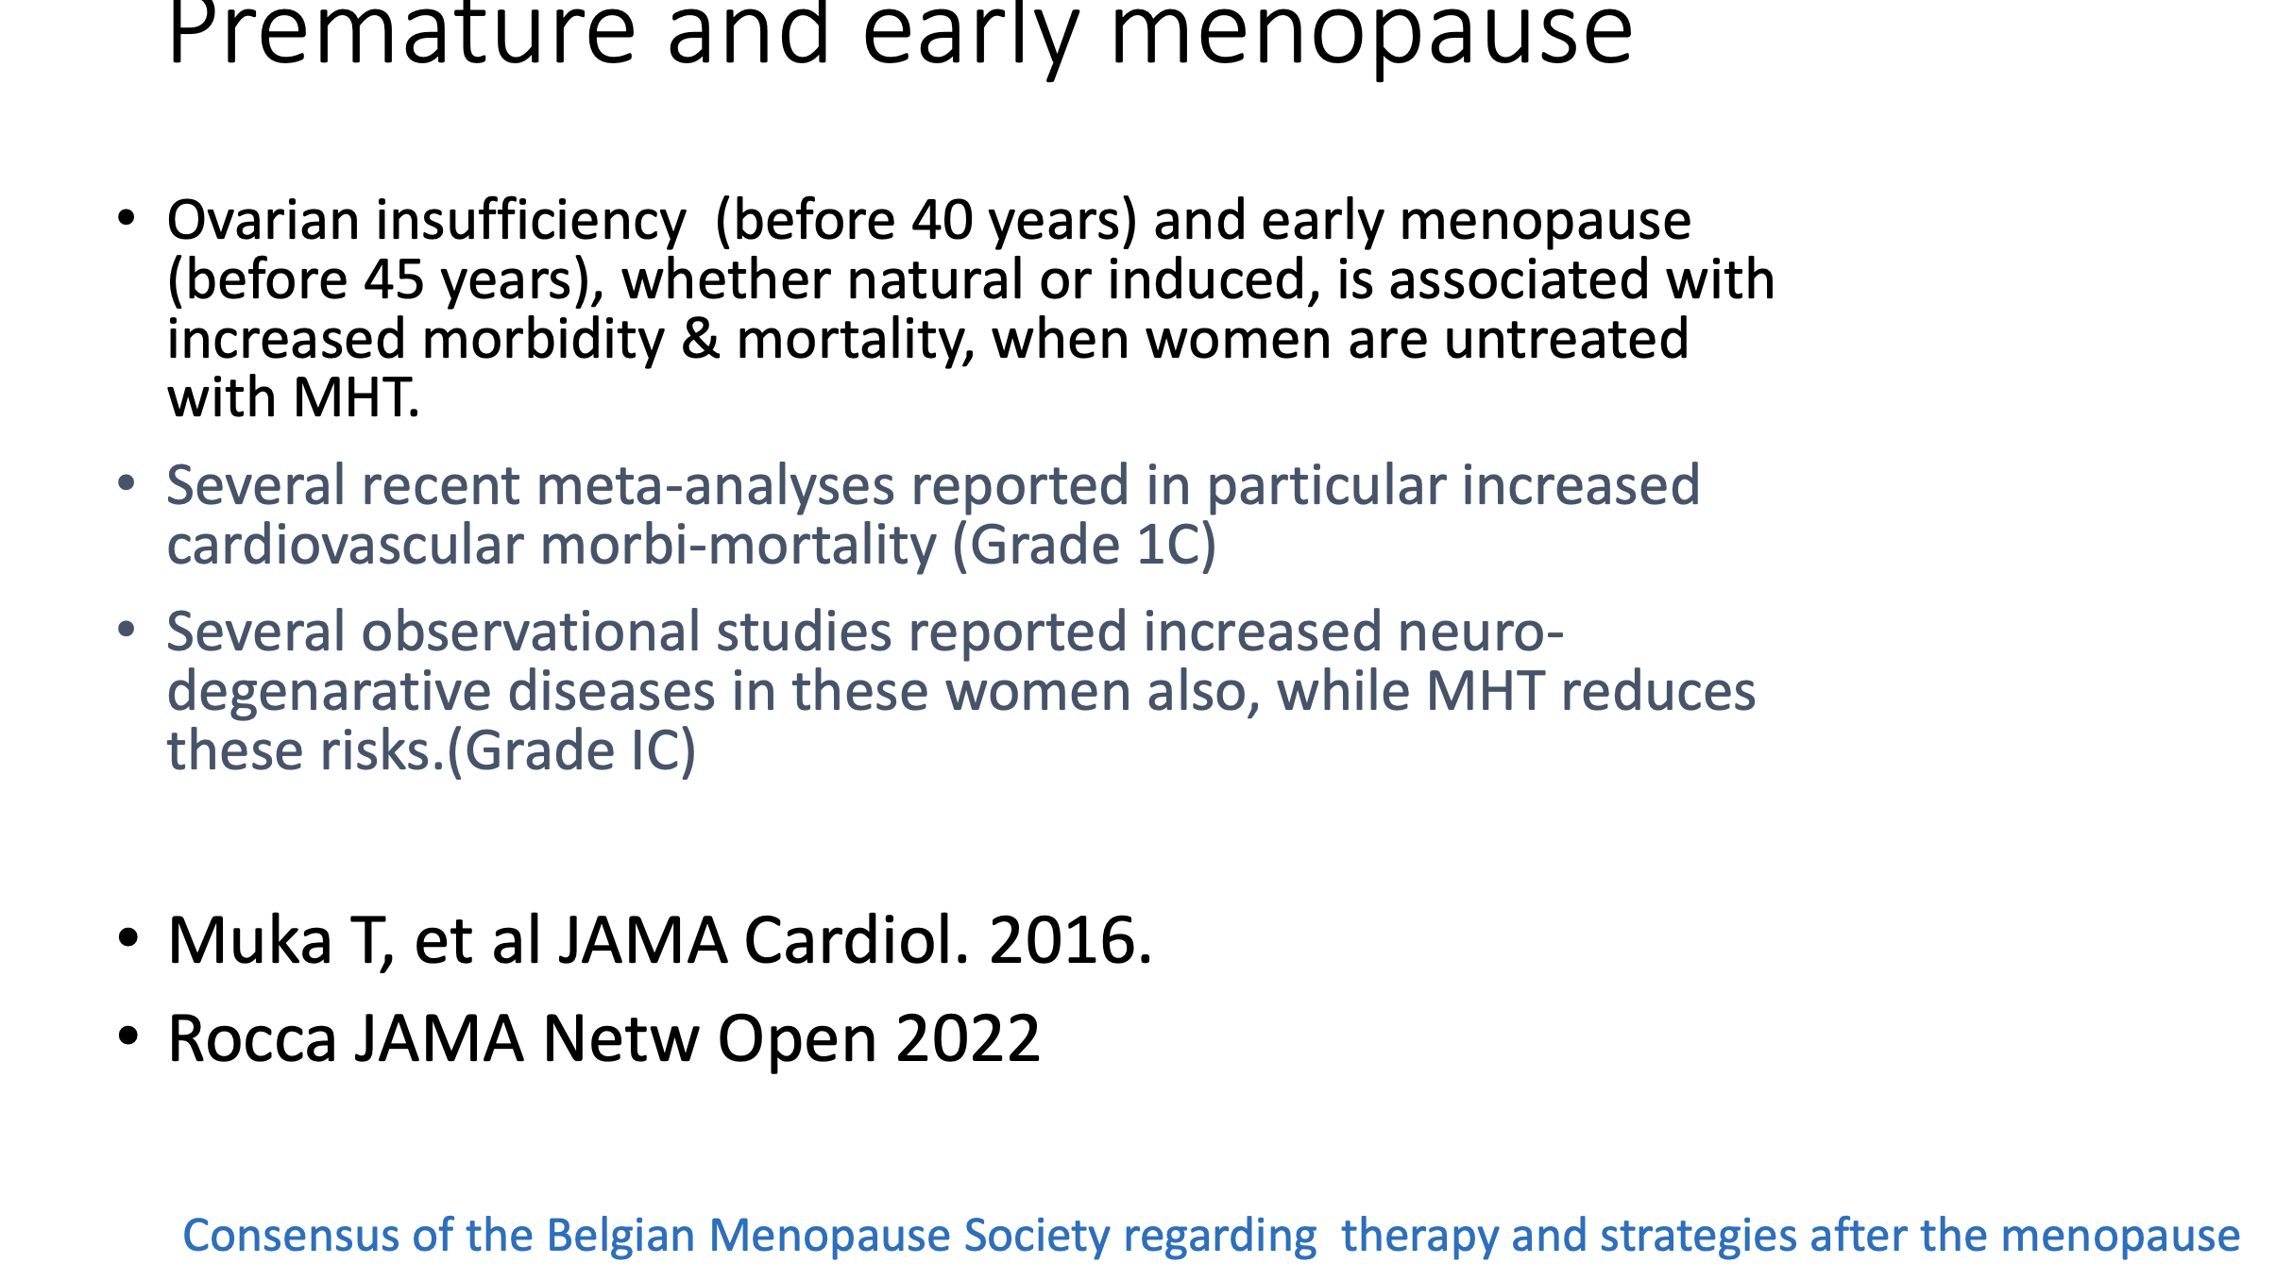

Slide 56
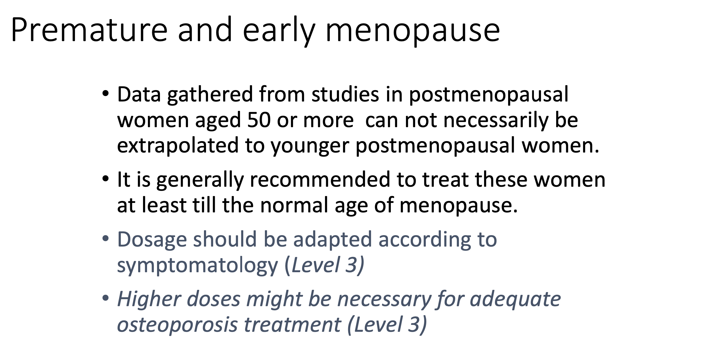

Slide 57
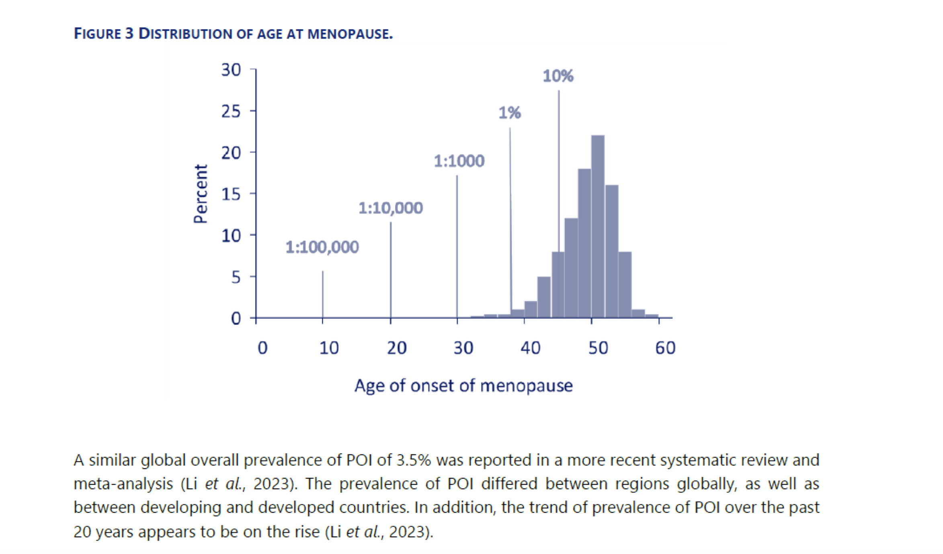

Slide 58
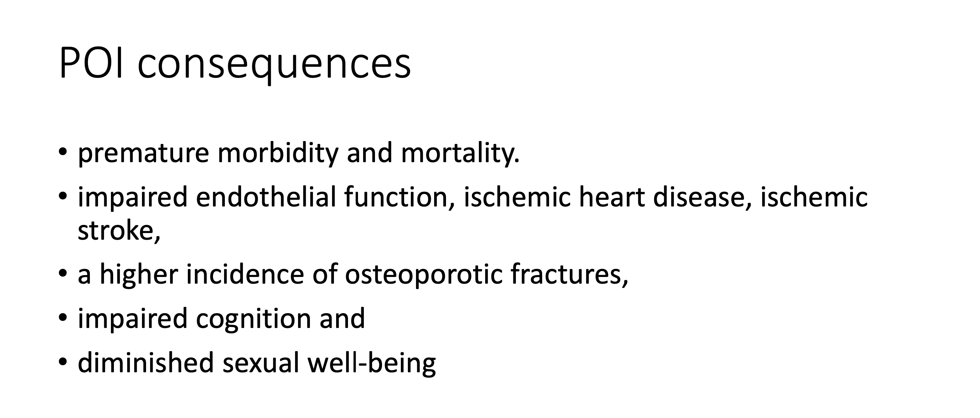

Slide 59
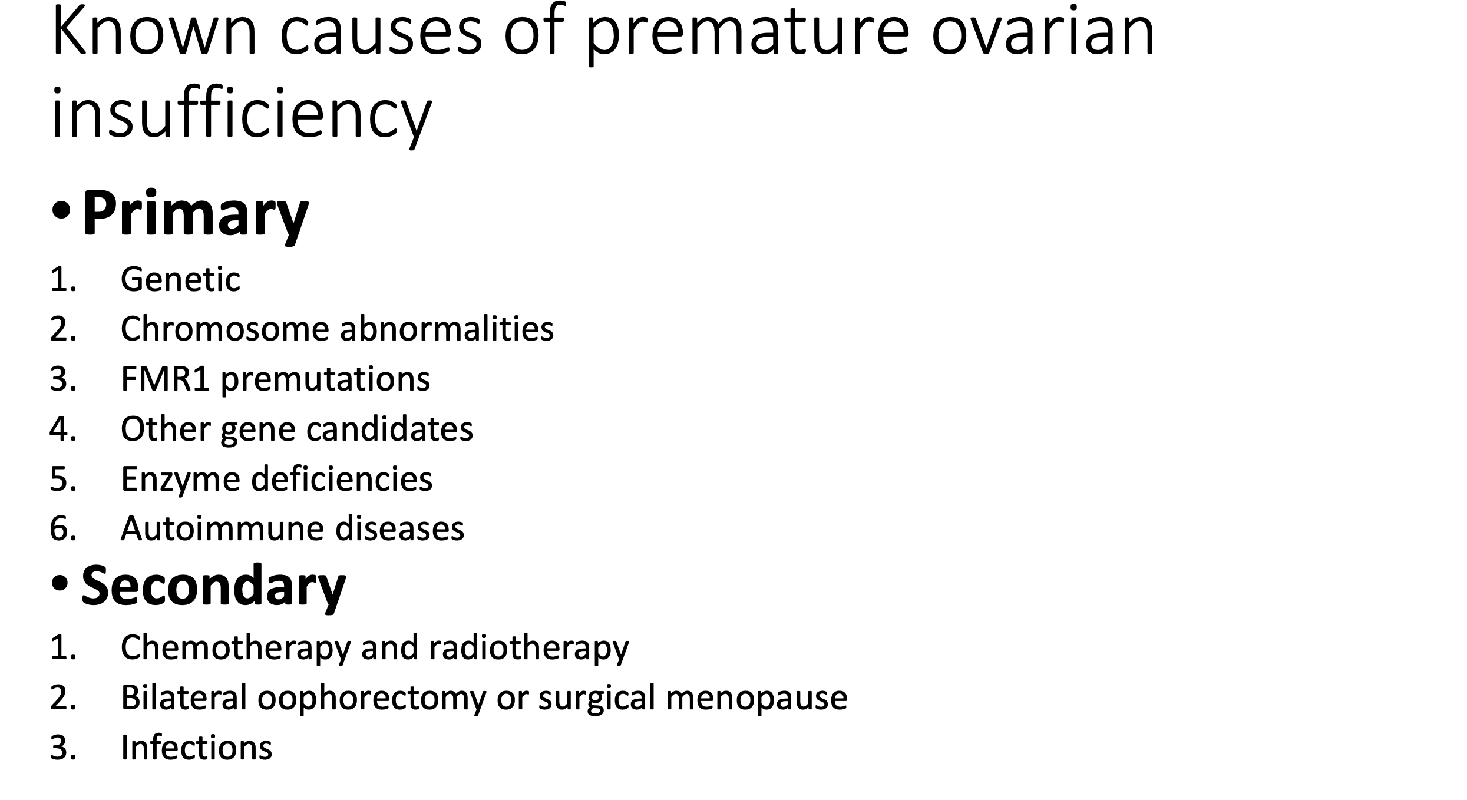

Slide 60
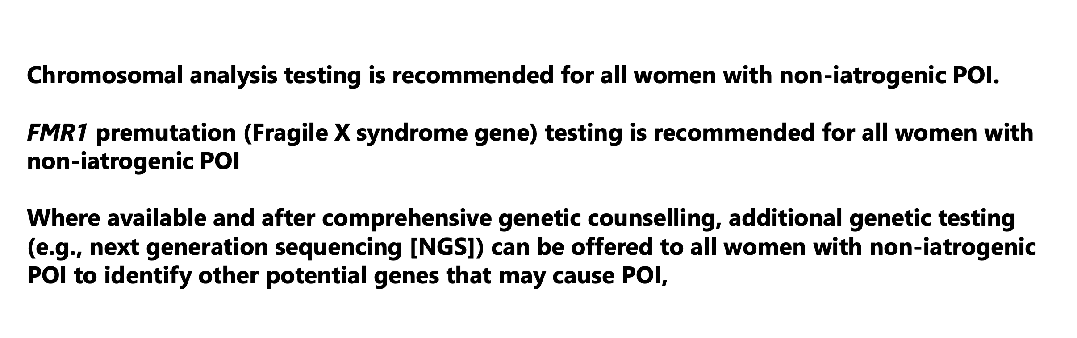

Slide 61
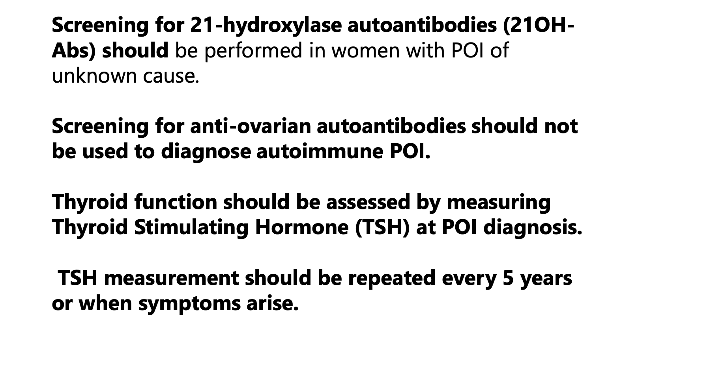

Slide 62
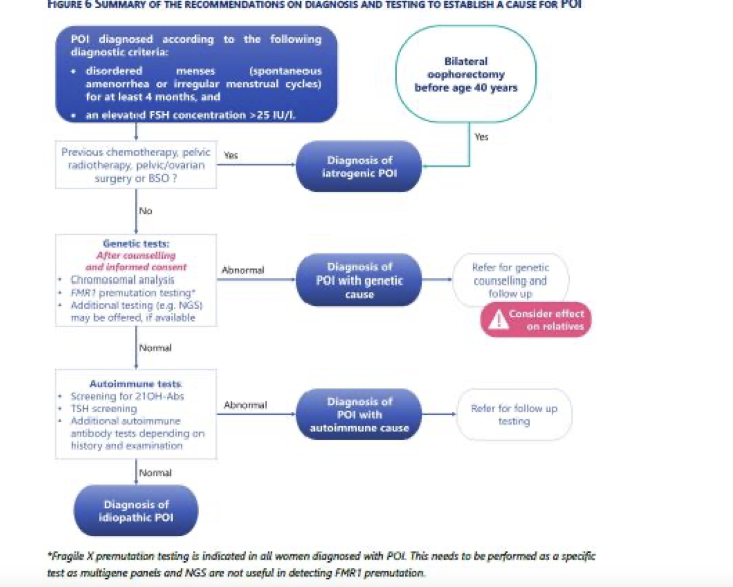

Slide 63
Case 11
Mrs VAP 56 years old G2P2 Personal Medical History: - CIN 2 conization in 1994, RCC ok - Wrist fracture in 2024 (fall playing padel) -Hypertension resolved Family History: No history of neo-gynecological surgery, 1 brother who had a TIA (Transient Ischemic Attack) Smoking: 0 Chronic Treatment: Lormetazepam, Urolina, Ursofalk, Atozet Breast Examination up to date 2023 MRI: Stable severe osteopenia (? DEXA) STOPPED taking the birth control pill and switched to Microgynon 30 at age 53 (?)

Slide 64
First consultation in 09/2024: Increasingly debilitating hot flashes, Sleep disturbances, irritability, Total loss of libido, starting to cause problems in the relationship Context of enzymatic cholestasis, on Ursofalk. Liver parameters normalized Also, annual liver ultrasound for probable FNH (Focal Nodular Hyperplasia) Follow-up with Dr. D (gastroeneterologist) to confirm agreement to initiate HRT.Who agrees with liver enzyme follow-up at 3 and 6 months —> Normal blood work at 3 months of treatment and marked improvement in the patient's symptoms 04/2025: Patient has 2 episodes of TIA, contraindication to resuming hormonal treatment by the hematologist? Currently taking clopidogrel. Thrombophilia screening negative. Normal cholesterol. Normal AST/ALT/LDH/GGT.Elevated alkaline phosphatase at 129 U/L (normal range 46-116).

Slide 65
Clonidine trial —> no effect. Rheumatologist seen in September 2025: suggests starting treatment with Bonviva 150mg/month.

Slide 66
To discuss Question: - Veoza trial? —> Dr. D (gastro) opinion requested for approval, subject to monitoring of liver enzymes. - What about other complaints besides hot flashes?

Slide 67
Case 12
51 year old lady with significant complaints – vasomotor symptoms, stiffness, brain fog.
Dens breasts: birads 4
Mother breast cancer at the age of 68 years of age
Two childeren
No medication
Last menstruation 8 months ago
Diagnosis
Treatment possibilities?

Slide 68
Hormone therapy - oral versus transdermal
Duavive
Veoza
E4 based hormonal therapy

Slide 69
Nurses health study
Pepi trial, …..
Hers study
Danish dahors
WHI global study cc
WHI estrogen only
Salpeter
Cohrane
Finnish
WHI long term follow up
DOPS

Slide 70
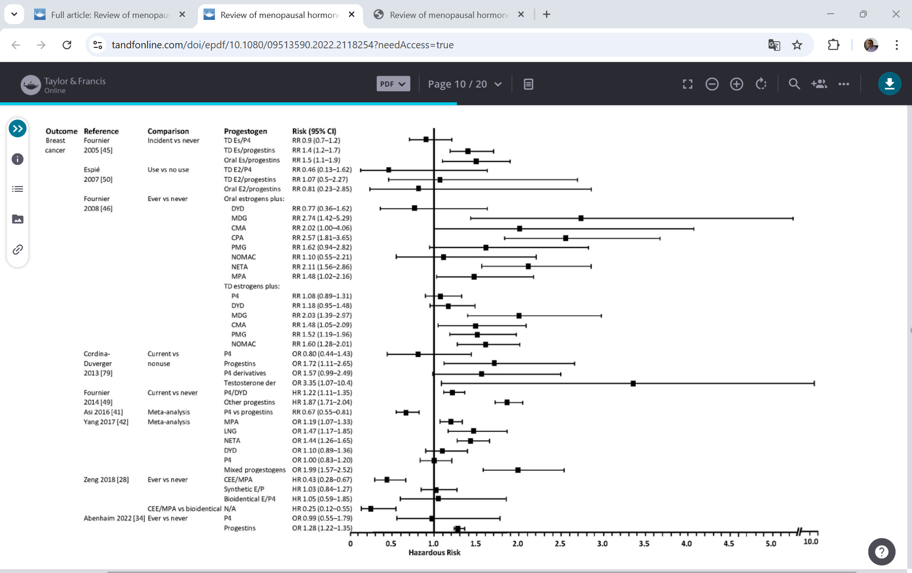
Different estrogens and progestogens

Slide 71
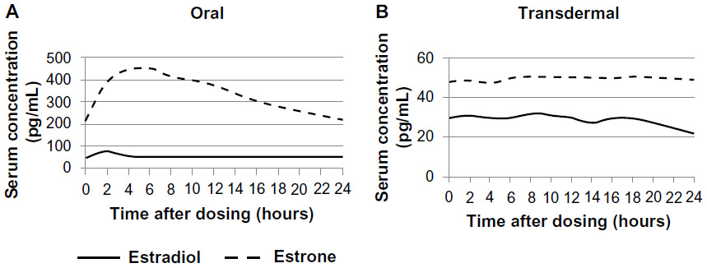

Slide 72
The dominant post-menopausal estrogen, estrone, cooperates with nuclear factor κB (NF-κB) to stimulate inflammation, while pre-menopausal 17β-estradiol opposes NF-κB.
Estrone, but not 17β-estradiol, activates epithelial-to-mesenchymal transition (EMT) genes to stimulate breast cancer metastasis.
HSD17B14, which converts 17β-estradiol to estrone, is higher in cancer than normal breast tissue and in metastatic than primary cancers and associates with earlier metastasis.
Treatment with estrone, but not 17β-estradiol, and HSD17B14 overexpression both stimulate an EMT, matrigel invasion, and lung, bone, and liver metastasis in estrogen-receptor-positive (ER+) breast cancer models, while HSD17B14 knockdown reverses the EMT.
Estrone:ERα recruits CBP/p300 to the SNAI2 promoter to induce SNAI2 and stimulate an EMT, while 17β-estradiol:ERα recruits co-repressors HDAC1 and NCOR1 to this site. Present work reveals novel differences in gene regulation by these estrogens and the importance of estrone to ER+ breast cancer progression.
Domenico Ribatti et al. Translational Oncology 13 2020
Maiko Sho et al. Nature review endocrinology 22 2026 166-176

Slide 73
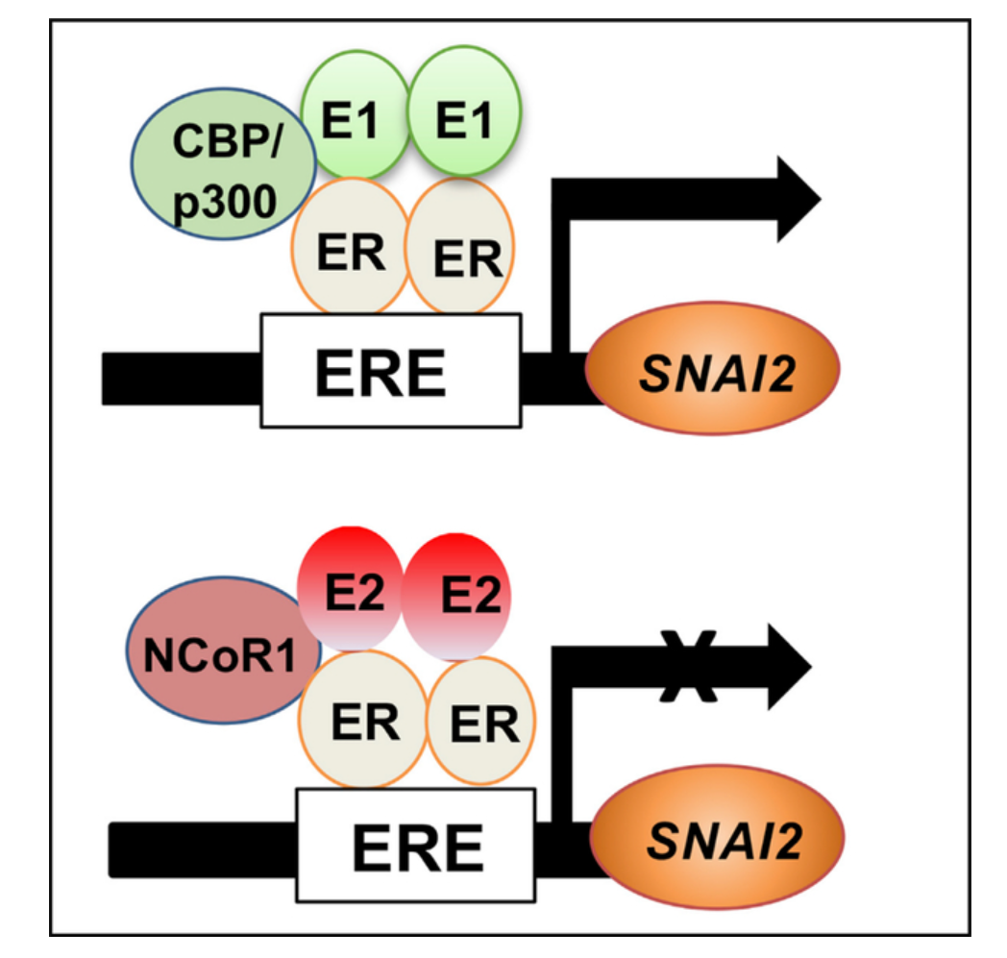

Slide 74
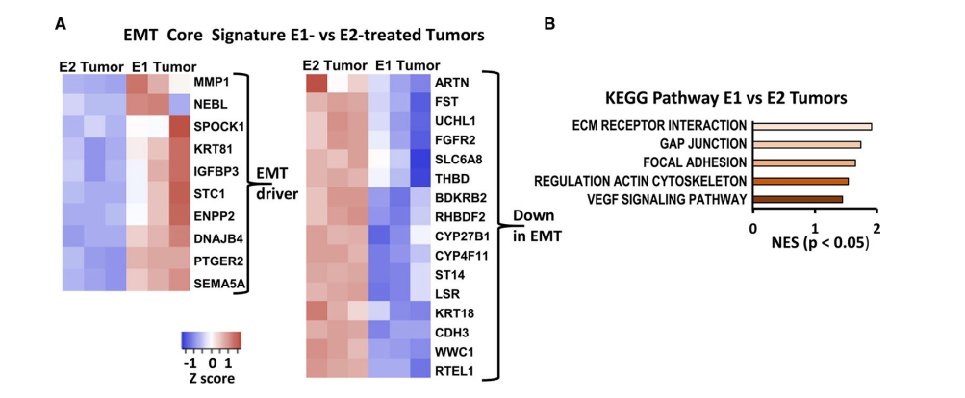

Slide 75
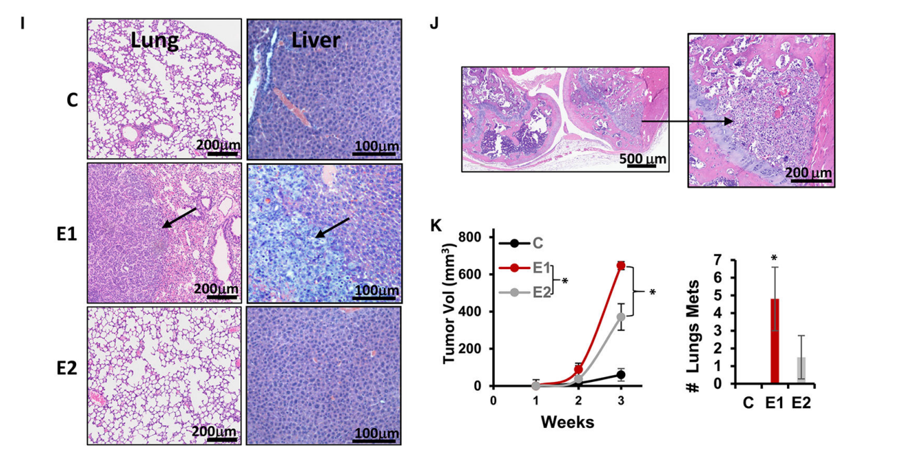

Slide 76
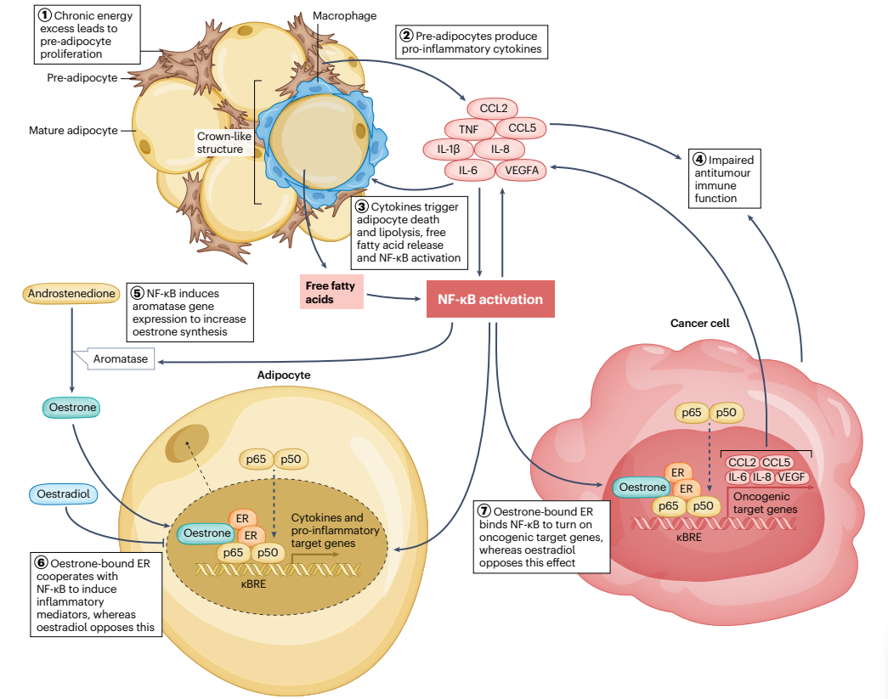

Slide 77
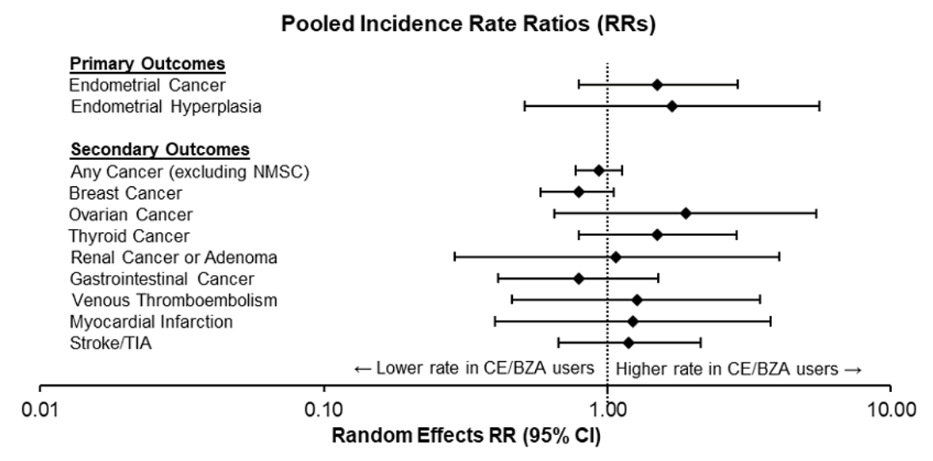
Duavive: PASS: Pooled Incidence Rate Ratios for all study outcomes
The rate of endometrial
cancer or hyperplasia
was lower than the
rate expected in a
comparable untreated population
The rate of any
cancer or acute CV outcomes
was lower than the
rate expected in a
comparable untreated population
← Lower rate in CE/BZA users
Higher rate in CE/BZA users →
CE/BZA=conjugated estrogens/bazedoxifene; E+P HT=estrogen + progestogen hormone therapy.
1. Pfizer. Post Authorization Safety Study (PASS) of CE/BZA in the US. Final Study Report: https://www.encepp.eu/encepp/openAttachment/documents.otherDocument-1/46639;jsessionid=oVW03JKE9Bw0mPI9WK5mN9y502QlpUYAkyHbb6syIdzMA06I6SZd!-594103221 [Accessed August 2022]
Notes:
Comparable rates of endometrial cancer and endometrial hyperplasia between both interventions
Rate of endometrial Ca less for both than the general population (61 or 43/100,000 vs 81/100,000 wy
No increased risk of breast cancer
Similar rates of acute cardiovascular events and other cancer outcomes
The incidence rate ratio of all these key safety outcomes crosses 1 – in other words, there is no difference between the treatment groups.
Note: From Figure B1 of submitted manuscript
Ref: PASS CSR 26 March 2021, Endometrial Hyperplasia on page 42 (section 10.4.1.1) - 48 cases in 38,770 py (=124 in 100,000 py) and on page 29 (142.9 cases per 100,000 py)

Slide 78
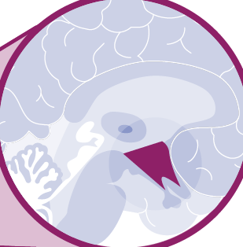
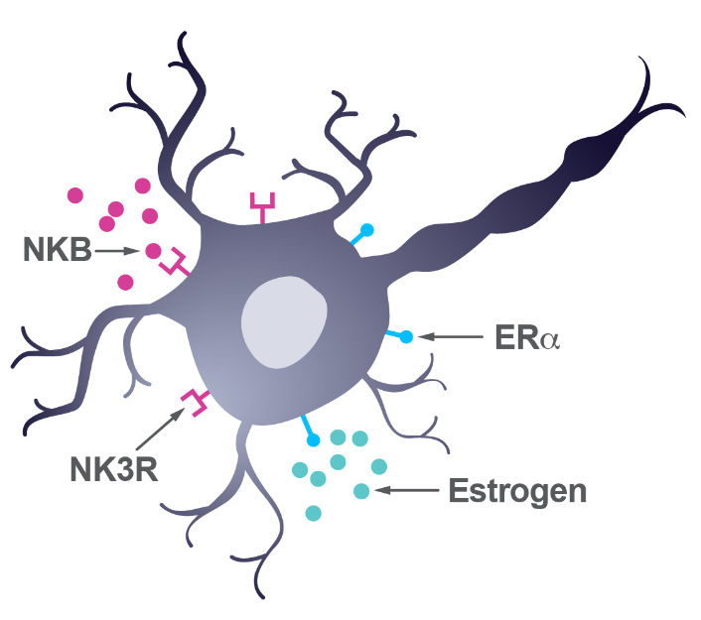
Veoza: KNDy neurons: where are they and what do they express?^{1,2}
The link between oestrogen withdrawal and hot flushes are KNDy neurons, neurons in the human infundibular nucleus (arcuate nucleus in rodents) of the hypothalamus that co-express:
Kisspeptin
Neurokinin B
Dynorphin
Also contain oestrogen receptors
Hypothalamus
KNDy neuron
NKB
ERα
NK3R
Oestrogen
Oestrogen
Adapted from Depypere H, et al. 2021.²

Slide 79
The effect of fezolinetant on moderate to severe VMS frequency was sustained through 52 weeks^{1,2}
Reduction in Week 1
SKYLIGHT 1
Improvement sustained through 52 weeks
Re-randomized to Fezolinetant 45 mg at week 12
SKYLIGHT 2
Re-randomised to VEOZA 45 mg at Week 12
Daily mean frequency (SE)
Weeks
Adapted from Lederman S. 2023;¹ Johnson KA. 2023.²
Mean change in the frequency and severity of moderate to severe VMS from baseline to each visit in the active treatment extension period was an exploratory endpoint. Assessments after the 12-week, placebo-controlled period were descriptive only.^{1,2} SE, standard error; VMS, vasomotor symptoms. 1. Lederman S, et al. Lancet. 2023;401(10382):1091–102; 2. Johnson KA, et al. J Clin Endocrinol Metab. 2023;108(8):1981–97.
Notes:
Speaker notes
The effect of fezolinetant on VMS frequency was observed through 52 weeks treatment in SKYLIGHT 1 and 2^{1,2}
For women initially randomised to fezolinetant, the reduction in frequency seen at Week 12 was observed through Week 52^{1,2}
Women re-randomised from placebo to fezolinetant at Week 12 experienced a reduction in the frequency of VMS consistent with that in women receiving fezolinetant throughout the study^{1,2}
Plateauing of the placebo effect is evident from 4 weeks of treatment^{1,2}
References
Lederman S, et al. Lancet. 2023;401(10382):1091–102
Johnson KA, et al. J Clin Endocrinol Metab. 2023;108(8):1981–97

Slide 80
Estetrol based
Nuclear estrogen receptor modulator
Membrane receptor inhibitor

Slide 81
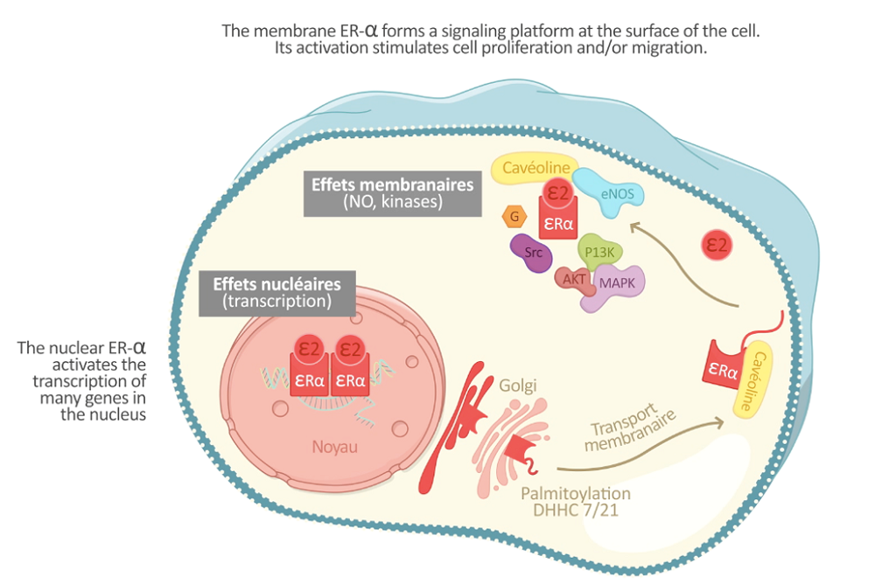





E4 – a Natural Estrogen with Selective action in Tissues supported by a unique mode of action
E4 acts differently depending on the tissue
Antagonist on the membrane ERα
E4 blocks the membrane estrogen receptor¹⁻³
E4 has a neutral effect on the liver unlike other estrogens¹⁻³
E4 has a low impact on normal and malignant breast⁴⁻⁷
Membrane effects
(NO, kinases)
caveolins
E4
E4
Nuclear effects
(transcription)
E4
E4
E4
Agonist on the nuclear ERα
Golgi
caveolins
Membrane transport
E4 activates the nuclear estrogen receptor^{1,2,3}
E4 has important estrogenic activity on the vagina, endometrium, bone, and cardiovascular system to provide beneficial effects¹⁻³
Nucleus
Palmitoylation
DHHC 7/21
ER: estrogen receptor; E4: estetrol; NO: nitric oxide; G: glucose, Src: tyrosine-protein kinase; eNOS: endothelial nitric oxide synthase; PI3K: phosphatidylinositol 3-kinase; AKT: protein kinase B; MAPK: mitogen-activated protein kinase; DHHC 7/21: palmitoylacyltranferases for sex steroid receptors
¹ Abot et al. EMBO Mol Med 2014 | ²Foidart JM et al. In: Brinton RD et al. (eds.) 2019. Sex Steroids’ Effects on Brain, Heart and Vessels. ISGE Series |³Arnal JF et al. Physiol Rev 2017 | ⁴Giretti et al. Front Endocrinol (Lausanne) 2014 | ⁵Gérard et al. J Endocrinol 2015 | ⁶Singer CF et al. Carcinogenesis 2014 | ⁷Visser M et al. Horm Mol Biol Clin Invest 2012

Slide 82
Case 13
47 year old lady with significant complaints – vasomotor symptoms, stiffness, brain fog.
Was treated with surgery/radiotherapy/chemotherapy for triple negative breastcancer
Mother breast cancer at the age of 68 years of age
Two childeren
Last menstruation 8 months ago stopped during secund chemotherapy administration
Treatment possibilities?

Slide 83
Treatment possibilities?
Veoza
Livial
Hormone therapy

Slide 84
Case 14
52 year old lady with significant complaints – vasomotor symptoms, stiffness, brain fog.
Was treated with surgery/radiotherapy for DCIS at the age of 45.
Regular cycles from 45 y until 50 years of age.
Two childeren
Now complaints started 8 months ago. Bloodtest confirms menopause.
Treatment possibilities?

Slide 85
Case 15 Mme BO (DN1974) 51 years
Medical and surgical history: - Intra-parenchymal hemorrhagic stroke 2023 ,related to secondary hypertension due to primary hyperaldosteronism (low renin, high aldosterone without evidence of adenoma or adrenal hyperplasia on dedicated CT scan)
- Hypertension - Dyslipidemia
Resection of a cerebellar tumor in childhood.
G2P2 no gestational diabetes/hypertension
2018: endometriosis with several surgical interventions, including a hysterectomy with post-hysterectomy hemorrhagic shock.

Slide 86
Chronic treatment: - Aldactone 50 mg once daily - Myrosor 10 mg daily Lifestyle: Smoking: 0 Alcohol: 0
Sequelae of stroke (left hemiplegia + sometimes memory impairment) BMI 25 Blood test: 2025: TSH normal, cholesterol normal, fasting plasma glucose normal Cardiology consultation: 09/25 in order Last neurological assessment in 11/2025, normal blood pressure 125/85 Aldactone, which normalized blood pressure

Slide 87
Clinical presentation: Hemorrhagic stroke due to secondary hypertension primary hyperaldosteronism in 2023.
Was taking oestrogen gel and Progesteron --> stopped following the stroke.
Restarted gel a month ago (on her own) because she couldn't stand not sleeping anymore.
Especially nocturnal dysmorphic disorder and rumination.
Arthralgia in her hands.
Since restarting gel, her sleep has improved significantly.
Gynecological exam unremarkable. Heart rate and sleep studies normal.

Slide 88
Discussion Treatment post stroke ?
Agreement to resume her estrogel alone, given that her hypertension was resolved by treatment of her primary hyperaldosteronism? - If estrogen gel is not an option, what treatment should be offered to the patient?

Slide 89
Discussion
Relation MHT – Stroke (before & after stroke)
Endometriosis & menopause & MHT

Slide 90
Postmenopausal hormone therapy and risk of stroke: The Heart and Estrogen-progestin Replacement Study (HERS)
Secondary coronary heart disease prevention trial.
Methods and results: Postmenopausal women (n=2763) randomised to CEE +MPA or placebo.
1ary outcomes: stroke incidence & stroke death during a mean follow-up of 4.1 years.
149 women (5%) had 1 or more strokes, 85% of which were ischemic, resulting in 26 deaths.
HT was not significantly associated with risk of nonfatal stroke : RH 1.18; 95% CI 0.83 - 1.66), or fatal stroke (RH 1.61; 95% CI 0.73 to 3.55), or transient ischemic attack (RH 0.90; 95% CI 0.57 to 1.42).
Independent predictors of stroke events: increasing age, hypertension, diabetes, current cigarette smoking, and atrial fibrillation. Black women were at increased risk compared with white women, and unexpectedly, body mass index was inversely associated with stroke risk.
Conclusions: HT (CEE + MPA) had no significant effect on the risk for stroke among postmenopausal women with coronary disease.
Simon JA, et al Postmenopausal hormone therapy and risk of stroke: The Heart and Estrogen-progestin Replacement Study (HERS). Circulation. 2001 Feb 6;103(5):638-42. doi: 10.1161/01.cir.103.5.638. PMID: 11156873.

Slide 91
A Clinical Trial of Estrogen-Replacement Therapy after Ischemic Stroke
RCT double-blind, placebo-controlled trial of estrogen therapy (1 mg of estradiol-17β per day) in 664 postmenopausal women (mean age, 71 years) who had recently had an ischemic stroke or transient ischemic attack. Women were recruited from 21 hospitals in the United States and were followed for the occurrence of stroke or death.
Results
Mean follow-up period of 2.8 years, there were 99 strokes or deaths among the women in the estradiol group, and 93 among those in the placebo group (RR estradiol group, 1.1; 95%CI 0.8 to 1.4).
Estrogen therapy did not reduce the risk of death alone (RR, 1.2; 95 %CI 0.8 to 1.8) or the risk of nonfatal stroke (RR, 1.0; 95 %CI , 0.7 to 1.4). The women who were randomly assigned to receive estrogen therapy had a higher risk of fatal stroke (relative risk, 2.9; 95 %CI, 0.9 to 9.0), and their nonfatal strokes were associated with slightly worse neurologic and functional deficits.
Conclusions
Estradiol does not reduce mortality or the recurrence of stroke in postmenopausal women with cerebrovascular disease. This therapy should not be prescribed for the secondary prevention of cerebrovascular disease.
Viscoli et al N Engl J Med 2001;345:1243-1249

Slide 92
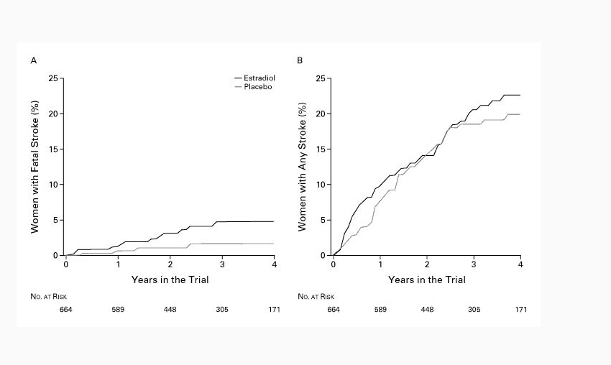
A Clinical Trial of Estrogen-Replacement Therapy after Ischemic Stroke
Viscoli et al N Engl J Med 2001;345:1243-1249

Slide 93
Effect of estrogen plus progestin on stroke in postmenopausal women: the WHI RCT
151 patients (1.8%) in the E+P and 107 (1.3%) in the placebo groups had strokes.
Overall 79.8% of strokes were ischemic. For combined ischemic and hemorrhagic strokes, the ITT HR for E+P vs placebo was 1.31 (95% CI, 1.02-1.68); with adj for adherence, the HR was 1.50 (95% CI, 1.08-2.08).
The HR for ischemic stroke was 1.44 (95% CI, 1.09-1.90) and for hemorrhagic stroke, 0.82 (95% CI, 0.43-1.56).
Point estimates of the HRs indicate that excess risk of all stroke was apparent in all age groups, in all categories of baseline stroke risk, and in women with and without hypertension, prior history of CVD, use of hormones, statins, or aspirin.
Other risk factors for stroke, including smoking, blood pressure, diabetes, lower use of vitamin C supplements, blood-based biomarkers of inflammation, higher white blood cell count, and higher hematocrit levels did not modify the effect of estrogen plus progestin on stroke risk.
Conclusions: E+P increases the risk of ischemic stroke in generally healthy postmenopausal women.
Wassertheil-Smoller S,et al . Effect of estrogen plus progestin on stroke in postmenopausal women: the Women's Health Initiative: a randomized trial. JAMA. 2003 May 28;289(20):2673-84. doi: 10.1001/jama.289.20.2673. PMID: 12771114.

Slide 94

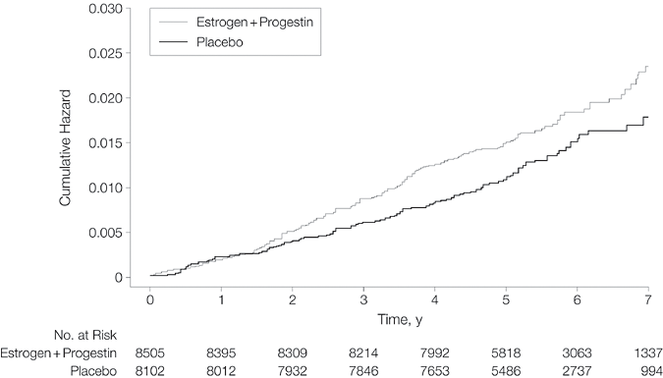
From: Effect of Estrogen Plus Progestin on Stroke in Postmenopausal Women: The Women's Health Initiative: A Randomized Trial
JAMA. 2003;289(20):2673-2684. doi:10.1001/jama.289.20.2673

Slide 95
Transdermal and oral HRT and the risk of stroke: a nested case-control study
Population based nested case-control study.
Setting About 400 GP UK database
Women 50-79 years between 1 January 1987 and 31 October 2006
For each case of stroke occurring during follow-up, up to 4 controls selected from cohort members in the risk sets defined by the case.
Exposure to HRT: (oestrogens only, oestrogens plus progestogen, progestogen only, and tibolone, oral v transdermal and dose (high v low).
Main outcome measures Rate ratio of stroke associated with current use of oral and transdermal HRT compared with no use. Current use was considered as a prescription whose duration included the index date.
Renoux C, et al Transdermal and oral hormone replacement therapy and the risk of stroke: a nestedcase-control study. BMJ. 2010 Jun 3;340:c2519. doi: 10.1136/bmj.c2519. PMID: 20525678.

Slide 96
Transdermal and oral hormone replacement therapy and the risk of stroke: a nested case-control study
Results: There were 15,710 cases of stroke matched to 59 958 controls.
The rate of stroke in the cohort was 2.85 per 1000 per year.
The adjusted rate ratio of stroke associated with current use of transdermal HRT was 0.95 (95% CI 0.75 to 1.20) relative to no use.
The risk of stroke was not increased with use of low oestrogen dose patches (rate ratio 0.81(0.62 to 1.05)) compared with no use, whereas the risk was increased with high dose patches (rate ratio 1.89 (1.15 to 3.11)).
Current users of oral HRT had a higher rate of stroke than non-users (rate ratio 1.28 (1.15 to 1.42)) with both low dose and high dose.
Conclusions: The use of transdermal HRT containing low doses of oestrogen does not seem to increase the risk of stroke. The presence of residual confounding, however, cannot be entirely excluded in the interpretation of this finding.
Renoux C, et al Transdermal and oral hormone replacement therapy and the risk of stroke: a nested case-control study. BMJ. 2010 Jun 3;340:c2519. doi: 10.1136/bmj.c2519. PMID: 20525678.

Slide 97
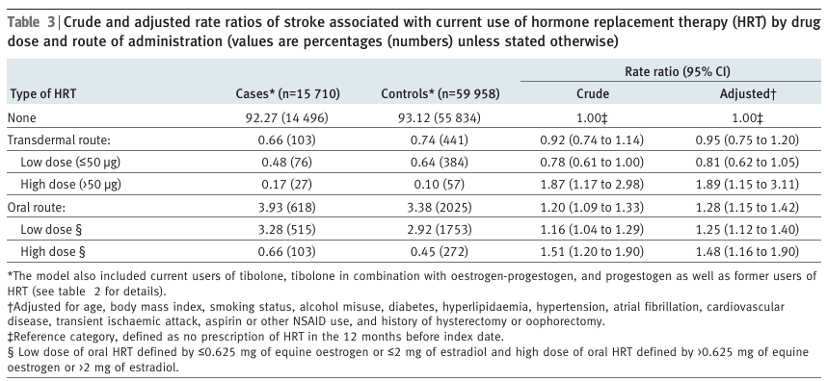
Renoux C, et al Transdermal and oral hormone replacement therapy and the risk of stroke: anestedcase-control study. BMJ. 2010 Jun 3;340:c2519. doi: 10.1136/bmj.c2519. PMID: 20525678.

Slide 98
Renoux C, et al Transdermal and oral hormone replacement therapy and the risk of stroke: anestedcase-control study. BMJ. 2010 Jun 3;340:c2519. doi: 10.1136/bmj.c2519. PMID: 20525678.

Slide 99
PMHT and Risk of Stroke: Impact of the Route of Estrogen Administration and Type of Progestogen
Nested case-control study of ischemic stroke (IS) within French women aged 51- 62 years between 2009 and 2011 without personal history of cardiovascular disease or contraindication to hormone therapy.
Participants were identified using the French National Health Insurance database, which includes complete drug claims for the past 3 years and French National hospital data.
Identified 3144 hospitalized IS cases who were matched for age and zip code to 12 158 controls.
Conditional logistic regression was used to estimate odds ratios (OR) and 95% confidence intervals (95% CI).
Canonico M, et al . Stroke. 2016 Jul;47(7):1734-41.

Slide 100
PMHT and Risk of Stroke: Impact of the Route of Estrogen Administration and Type of Progestogen
Results: Compared with nonusers, the adjusted ORs of IS were1.58 (95% CI, 1.01-2.49) in oral estrogen users and 0.83 (0.56-1.24) in transdermal estrogens users (P<0.01). There was no association of IS with use of progesterone (OR, 0.78; 95% CI, 0.49-1.26), pregnanes (OR, 1.00; 95% CI, 0.60-1.67), and nortestosterones (OR, 1.26; 95% CI, 0.62-2.58), whereas norpregnanes increased IS risk (OR, 2.25; 95% CI, 1.05-4.81).
Conclusions: Both route of estrogen administration and progestogens were important determinants of IS. Our findings suggest that transdermal estrogens might be the safest option for short-term hormone therapy use.
Canonico M, et al . Stroke. 2016 Jul;47(7):1734-41.

Slide 101
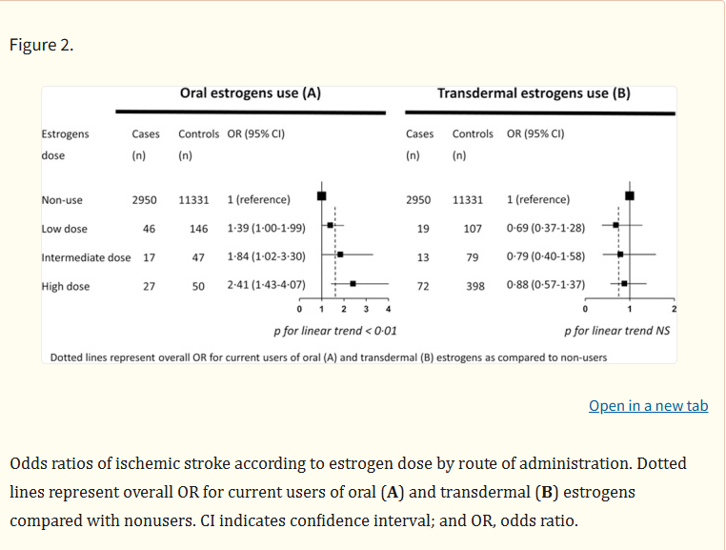
Canonico M, et al Postmenopausal Hormone Therapy and Risk of Stroke: Impact of the Route of Estrogen Administration and Type of Progestogen. Stroke. 2016 Jul;47(7):1734-41. doi: 10.1161/STROKEAHA.116.013052. Epub 2016 Jun 2. PMID: 27256671; PMCID: PMC4927222.

Slide 102
Canonico M, et al Postmenopausal Hormone Therapy and Risk of Stroke: Impact of the Route of Estrogen Administration and Type of Progestogen. Stroke. 2016 Jul;47(7):1734-41. doi: 10.1161/STROKEAHA.116.013052. Epub 2016 Jun 2. PMID: 27256671; PMCID: PMC4927222.

Slide 103
Endometriosis and Menopause
Endometriosis after menopause : 2%of patients
Severely symptomatic endometriosis : uncommon
lesions established during the reproductive years ? Or de novo?
Both on and off HT
Study of 72 women with symptomatic postmenopausal endometriosis: only two were using HT (Morotti et al Arch Gynecol Obstet. 2012)
Postmenopausal estrogen production: extra-ovarian source (eg, skin, fat tissue) (Attar E, Hum Reprod Update. 2006 Jan-Feb;12(1):49-56.)

Slide 104
Ovarian Cancer & menopause status
Risk of malignant transformation of endometriosis : 1 % for premenopausal females
1-2.5 % percent for postmenopausal females
Van Gorp T et al . Endometriosis and the development of malignant tumours of the pelvis. A review of literature. Best Pract Res Clin Obstet Gynaecol. 2004 Apr;18(2):349-71.

Slide 105
Hormone therapy for menopause symptoms & endometriosis
Debated question
The RR and benefits of HT may depend on the size of the endometriotic implants.
Women with peritoneal disease >3 cm at the time of surgical resection had an increased risk of symptom recurrence when treated with ET compared with women whose disease was less than 3 cm (9 vs 1%)
Matorras R, et al Recurrence of endometriosis in women with bilateral adnexectomy (with or without total hysterectomy) who received hormone replacement therapy. Fertil Steril. 2002 Feb;77(2):303-8.
For women with significant residual endometriosis + moderate or severe symptoms or < 45 years , the benefit may outweigh the risks
Rozenberg S, et al Should we abstain from treating women with endometriosis using menopausal hormone therapy, for fear of an increased ovarian cancer risk? Climacteric. 2015;18(4):448-52.

Slide 106
For this patient
Rather NK antagonist ?
So certainly, no oral E2
If any : low dose transdermal

Slide 107
Case 16 Mme BV- 54 ans
Gynecological and obstetric history: G2P1 cesarean section, postpartum preeclampsia
Medical history: - History of left pontine ischemic stroke at age 44, persistent right-sided hemiparesthesia - Discovery of heterozygous mutation of Factor V Leiden. - Hypertension treated with Diovane - Hypercholesterolemia, no treatment - Preventive clips for cerebral aneurysms (diagnosed following aneurysm rupture in her father) - Gilbert's syndrome

Slide 108
Treatment: - Asaflow 80 - Diovane TA 11/8 BMI 27
Smoking Stopped 2009 Not a migraine sufferer Bio 2025: 297, LDL 211, GGT 36 - GPT 56 - PAL 126 - Bili 1.9 Bio 06/01: (1 month after starting Veoza) GPT 41 - GPT 63 - GGT 134 - PAL 126 - Bili 1.3 Bio 07/02: (2 months after starting Veoza) GPT 36 - GPT 53 - GGT 115

Slide 109
Cardiac assessment 11/25: 1- Satisfactory cardiac status with good cardiac function and no signs of myocardial ischemia on exertion.
2- Good blood pressure profile under antihypertensive treatment.
3- Suboptimal lipid profile (target LDLc value < 100 mg%) without documented atherosclerotic arterial disease.
The theoretical risk of a cardiovascular event (fatal and non-fatal) over 10 years is estimated at 2.5% (low if < 5%) according to Heartscore-2.
No formal indication for lipid-lowering medication, but an indication to reinforce lifestyle modifications.
Cardiac assessment 02/26: ECG + Echocardiogram + Stress Test.

Slide 110
Coronary CT scan and ABPM planned. Clinical history: Perimenopause, LMP 08/2025 (before January).
Daily and primarily nighttime heart palpitations for years. Gynecologists no longer want to prescribe HRT, but it's very complicated for the patient, who is at her wit's end.
Appointment rescheduled with Dr. C in October 2025. She contraindicated HRT...
Appointment with hematologist Dr. AT also contraindicated resuming estrogen treatment.
She is depressed and can't take this situation anymore. She's not sleeping, consequently exhausted, not eating, gaining weight... etc. Nutritional follow-up.

Slide 111
CAT: - Veoza trial with 3-month liver enzyme monitoring - Marked improvement in the patient's hot flashes - Onset of lower back pain while taking Veoza. When she stops taking Veoza, she complains of reactive hypertensive spikes.

Slide 112
Discussion calculate cardiac and stroke risk postpartum preeclampsia
History of left pontine ischemic stroke at age 44, persistent right-sided hemiparesthesia - Discovery of heterozygous mutation of Factor V Leiden
Questions: - What treatment options can be offered to the patient for her debilitating hot flashes? - Non-typical lower back pain while taking Veoza, OK to continue treatment

Slide 113
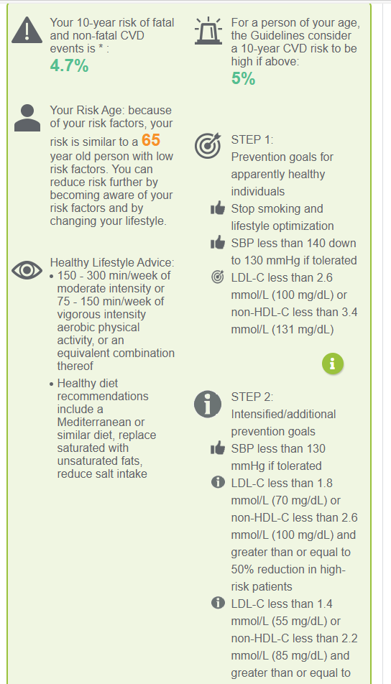
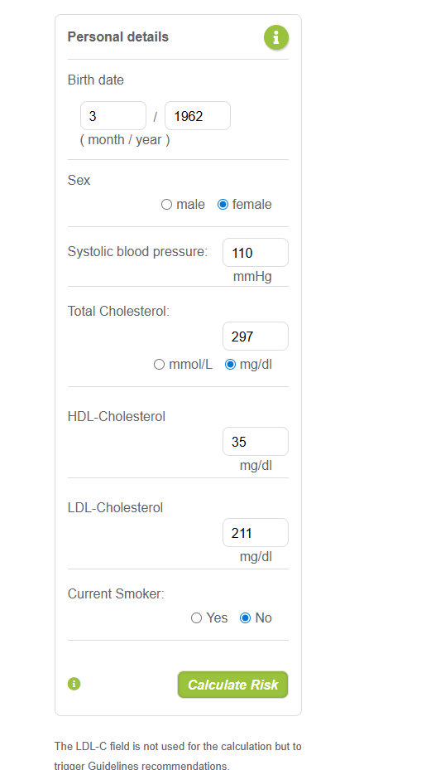
HeartScore Risk

Slide 114
Interpret CAC score
0 → may downgrade risk if no other high-risk features.
1–99 → mild plaque burden, moderate risk.
100–399 → significant plaque, higher risk.
≥400 → very high risk, aggressive prevention advised.

Slide 115
Pre-eclampsia and risk of cardiovascular disease and cancer in later life: systematic review and meta-analysis
Prospective and retrospective cohort studies: dataset of 3,488,160 women, with 198,252 affected by pre-eclampsia (exposure group) and 29,495 episodes of cardiovascular disease(study outcomes).
After pre-eclampsia increased risk of vascular disease. RR95%CI for Hypertension 3.70 (2.70 to 5.05) after 14.1 years , for ischaemic heart disease 2.16 (1.86 to 2.52) after 11.7 years, for stroke 1.81 (1.45 to 2.27) after 10.4 years, and for venous thromboembolism 1.79 (1.37 to 2.33) after 4.7 years. Overall mortality after pre-eclampsia was increased: 1.49 (1.05 to 2.14) after 14.5 years.
Bellamy L,et al . Pre-eclampsia and risk of cardiovascular disease and cancer in later life: systematic review and meta-analysis. BMJ. 2007 Nov 10;335(7627):974.

Slide 116
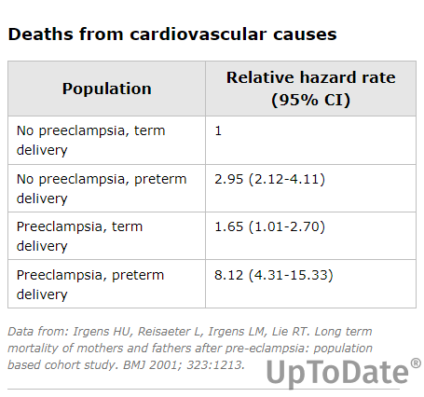

Slide 117
Pre-eclampsia and risk of cardiovascular disease and cancer in later life: systematic review and meta-analysis
Prospective and retrospective cohort studies: dataset of 3,488,160 women, with 198,252 affected by pre-eclampsia (exposure group) and 29,495 episodes of cardiovascular disease(study outcomes).
After pre-eclampsia increased risk of vascular disease. RR95%CI for Hypertension 3.70 (2.70 to 5.05) after 14.1 years , for ischaemic heart disease 2.16 (1.86 to 2.52) after 11.7 years, for stroke 1.81 (1.45 to 2.27) after 10.4 years, and for venous thromboembolism 1.79 (1.37 to 2.33) after 4.7 years. Overall mortality after pre-eclampsia was increased: 1.49 (1.05 to 2.14) after 14.5 years.
Bellamy L,et al . Pre-eclampsia and risk of cardiovascular disease and cancer in later life: systematic review and meta-analysis. BMJ. 2007 Nov 10;335(7627):974.

Slide 118
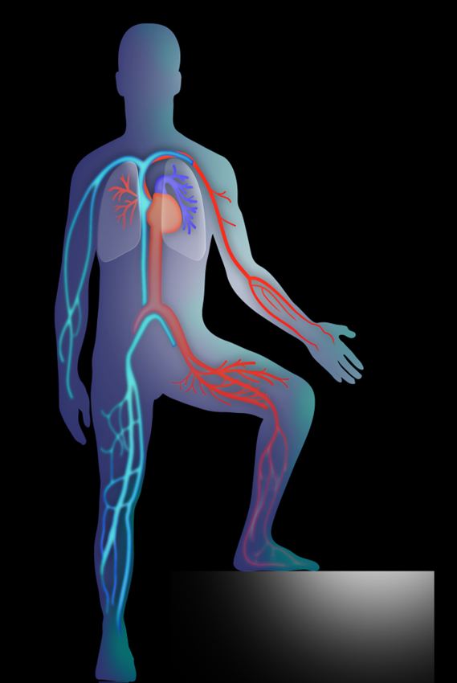
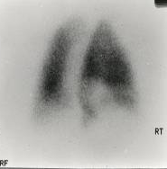
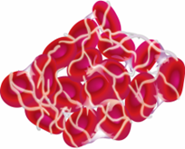

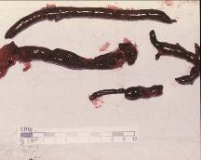

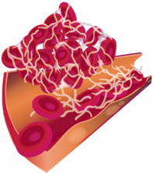
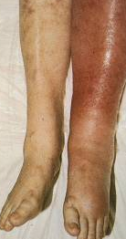
VTE: Deep Vein Thrombosis and Pulmonary Embolism
Migration
PE
Embolus
Thrombus
DVT
Notes:
VTE: deep vein thrombosis and pulmonary embolism
There is a very strong association between PE and DVT.¹
90% of pulmonary emboli are the result of DVT^{2,3}
82% of patients with acute PE have detectable DVT at the time PE is diagnosed¹
Approximately 50% of patients with proven proximal DVT have an associated PE, which is asymptomatic in >50% of cases¹
[This slide contains animations]
References
1. Girard P et al. Chest 1999;116:903–908
2. Anderson FA, Jr, Audet A-M. Available at: http://www.outcomes- umassmed.org/dvt/best_practice/. Accessed August 2011
3. Hull D et al. Chest 1986;89;374S–383S

Slide 119
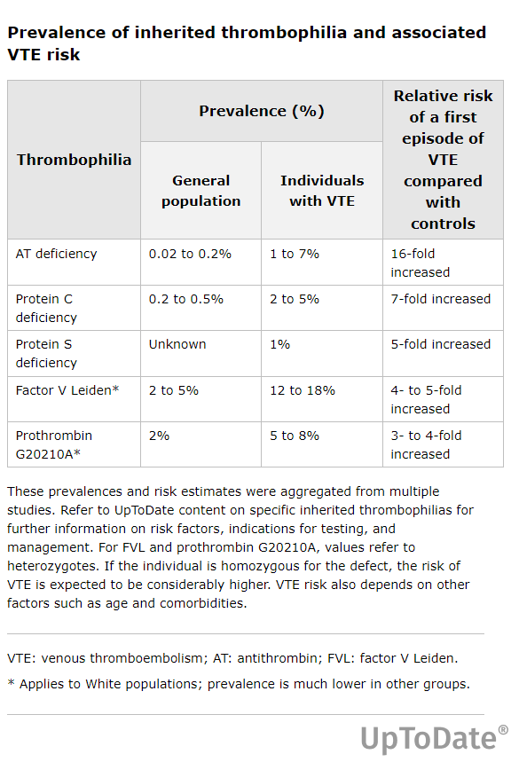

Slide 120
Modeling the risk of venous thrombosis
Immobilization
Threshold for DVT/PE
Pregnancy
Factor V Leiden
Thrombotic Risk
Pill
Basal level
Age
Adapted from Rosendaal FR: Lancet 353: 1167, 1999.

Slide 121
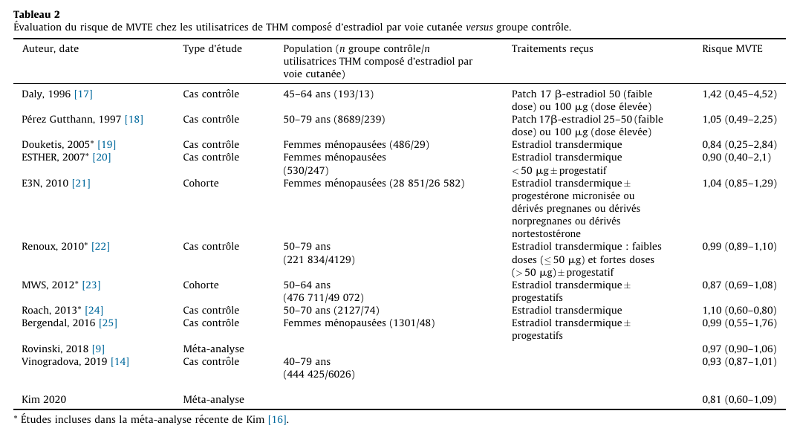
HRT and risks of venous thrombosis
Transdermal
treatment

Slide 122
No risk of thrombosis with
topical vaginal oestrogen

Slide 123
Case 17
Mrs AR, The patient was referred to me for advice and a request to continue MHT. 60-year-old G2P2, primipara at age 30 Eclampsia before her first pregnancy (1996) and pre-eclampsia before her second (2003). Menopause at age 45 and taking transdermal estrogen & Didrogesterone continuously; discontinued in December 2025 by neurologist. The lady has had 3 episodes of vertigo, intense headache, and nausea. The last episode involved a very intense and brutal headache with vomiting, for which an emergency consultation was required (November 2025). CT angioplasty: negative ENT examination: normal, ENT specialist requests brain MRI Brain MRI (26/11/25): ‘several hyperintense FLAIR foci at the level of the peripheral-parietal white substance, rather of vascular origin’ Neurologist discontinues MHT and starts Asaflow 80 and Myrosor 20mg/10mg (cf. ‘for sign of micro AVC in the MRI’: according to the patient)

Slide 124
Case 17
Possible diagnosis of her episodes of brutal vertigo: right vestibular neuritis? Follow-up MRI scheduled for June 26. Other examinations: Ophthalmological examination: normal Cardiological examination: mild insufficiency of the 4 valves and mild atherosclerosis at the thoracic aorta Echo-mammogram (August 2025) ACR BIRADS 2, type B fibroglandular tissue Bosseous densitometry: Osteopenia L1-L4 Patient requests to start MHT. Since stopping MHT: patient complains of intermittent, crampoidal, lower abdominal pain, no digestive or urinary complaints. Gynecological examination normal.

