Slide 1
BMS MENOPAUSE COURSE 17.1.26
Introduction and epidemiology
Serge Rozenberg,
CHU St Pierre Université libre de Bruxelles
Vrije Universiteit Brussel
Belgium
serge_rozenberg@stpierre-bru.be
serge.rozenberg@skynet.be

Slide 2
Conflict of interest & Disclosure
Conflicts of interest: nil
Disclosure : unrestricted grant to BMS of Astellas
Disclosure SR
Research funding IRIS- King Baudouin Fondation, Vesale research Foundation, Amgen, MSD
Speakers bureau &/or Advisory Boards
Abbot, Pfizer, Will, Gedeon Richter, MSD, Amgen, UCB, Astellas

Slide 3
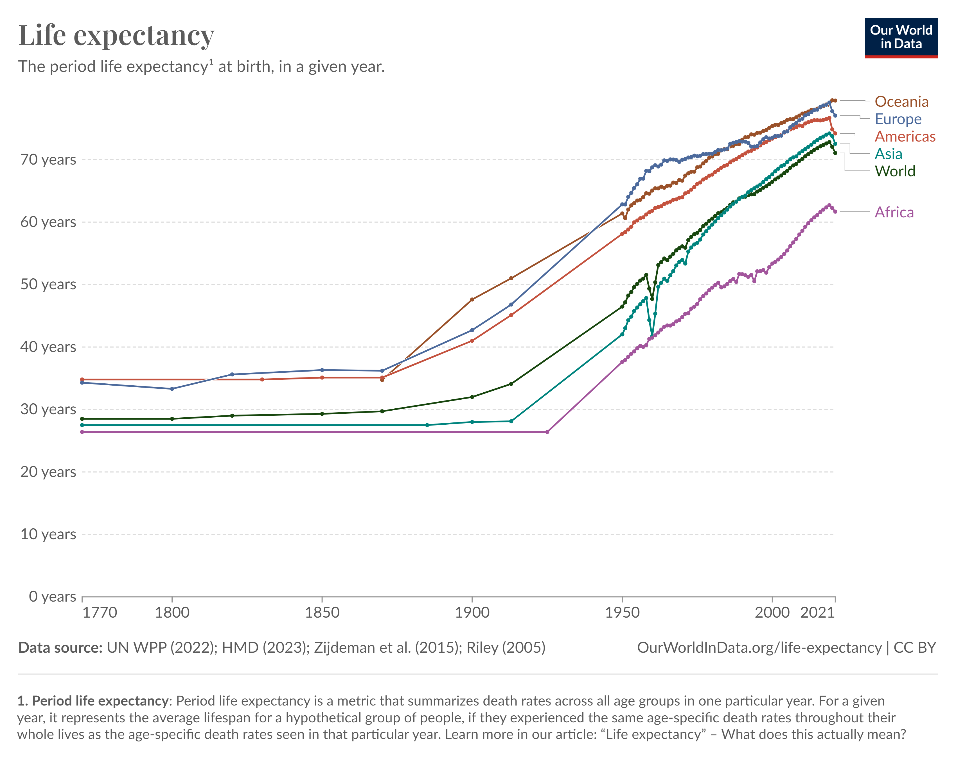
Average age = 51 Years

Slide 4
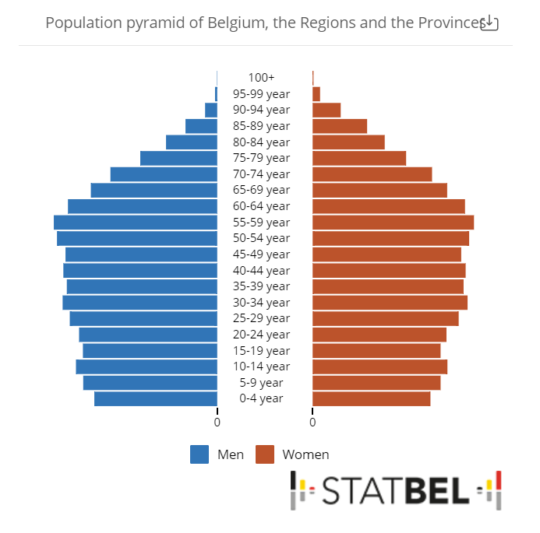
1.5 Million women aged 45-60 yrs

Slide 5

Definition and stages (Straw, reproduction, late reproduction, Perimenopause, Menopause, Postmenopause),
Physiology: Hormonal changes during menopause, the importance of KNDy, NKB signaling, Neurokinin and antagonists) (Axelle Pintiaux ULiège)
Menopausal symptoms and treatment options (Linda Ameryckx UZA)

Slide 6
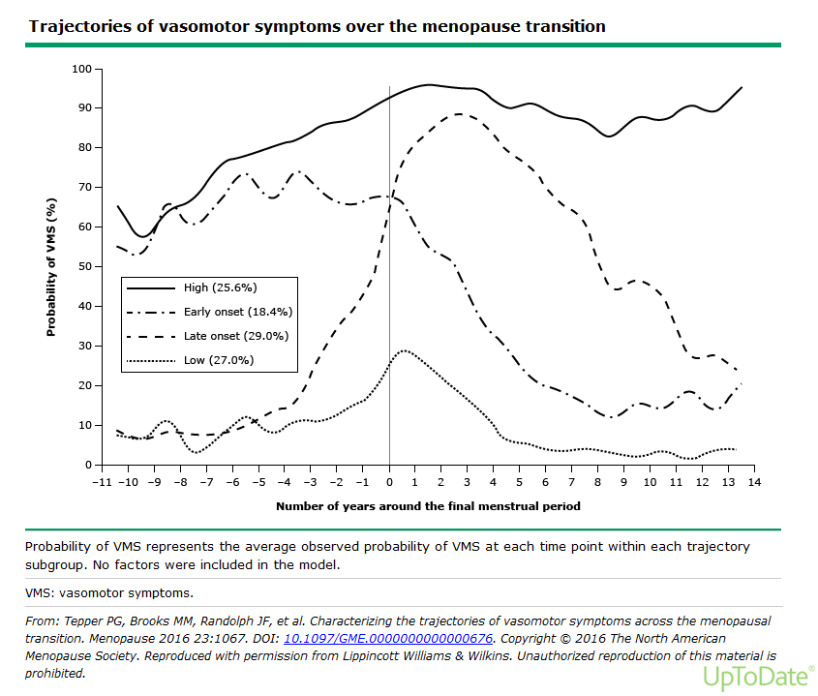

Slide 7
Age of menopause
5% < 45 (early)
< 40 = Ovarian Insufficiency

Slide 8
Factors affecting menopause
Genetics: Family history of early menopause
Genes regulating DNA repair, FMR1 premutation,
Turner syndrome (Sullivan et al Hum Reprod. 2005, Ruth et al
Nature. 2021;596(7872):393. Epub 2021)
Ethnicity : earlier among Hispanic women and later in Japanese American women when compared with White women.( Henderson Am J Epidemiol. 2008 )
Night shift work: increased risk of earlier menopause compared with women without night shift work (Stock et al Hum Reprod. 2019 )
Smoking : approximately one to two years earlier than average (McKinlay et al Ann Intern Med. 1985 )
Hysterectomy with ovarian conservation possibly due to impairment of the ovarian blood supply or other yet unknown mechanisms.

Slide 9
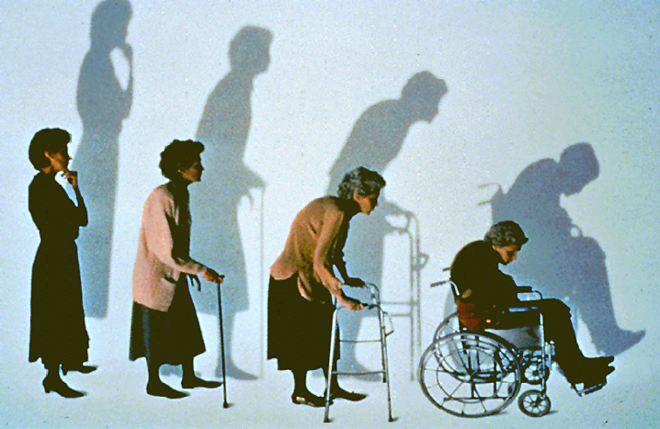
Early menopause increases
Osteoporosis risk (Serge Rozenberg ULB)

Slide 10





Osteoporosis is a common condition among women
≥50 years; however, there is a large treatment gap^{1–3}
Europe prevalence^{1,2}
Belgium prevalence³
Belgium treatment gap^{3‡}
79.1% women
291 thousand women
remain untreated³
In 2019, there were
681 000
individuals in the Belgium with osteoporosis
20.9%
men
66%
In 2019, 25.5 million women in Europe had osteoporosis^{1,2}*†
The prevalence of osteoporosis in the total population in 2019
was 5.6%^{1,2}
of women do not receive osteoporosis treatment despite exceeding the fracture risk threshold³
22.4%
of women aged ≥50 years
vs
6.6% of men aged
≥50 years
In 2019, the treatment gap‡ in Europe was 71%, with 15 million women remaining untreated^{1,2}
Osteoporosis disproportionately affects women aged 50 years
or more
*Estimates from the International Osteoporosis Foundation scorecard for osteoporosis in Europe (SCOPE) project in 2019.¹ †32 million men and women had osteoporosis in 2019.^{1,2}
‡SCOPE 2021 defined the treatment gap as the rate of women who exceed the intervention threshold but do not receive treatment.²
1. Kanis JA et al. Arch Osteoporos 2021;16:82; 2. Scorecard for Osteoporosis in Europe. SCOPE 2021 Summary Report. Available from: https://www.osteoporosis.foundation/sites/iofbonehealth/files/2022-01/SCOPE%20Summary%20Report.pdf. Accessed March 2025; 3. Scorecard for Osteoporosis in Europe (Belgium). SCOPE 2021 Summary Report. Available from: https://www.osteoporosis.foundation/sites/iofbonehealth/files/scope-2021/Belgium%20report.pdf. Accessed October 2025

Slide 11
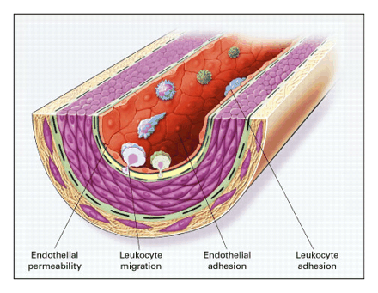
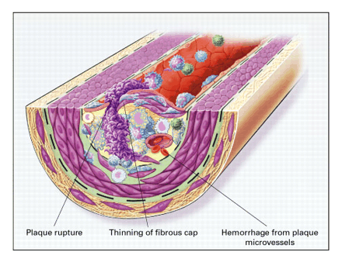
Early menopause increases Atherosclerosis¹
Cardiovascular risk, menopause and MHT Shivalkar Bharati
Ross. N Engl J Med 1999; 340:115-126
Notes:
11

Slide 12
Early menopause & CVD meta-analysis
Menopause before age 45 have a 50% higher risk of coronary heart disease, cardiovascular mortality, and overall mortality compared with women who experienced menopause after age 50
T. Muka, et al.Association of age at onset of menopause and time since onset of menopause with cardiovascular outcomes, intermediate vascular traits, and all-cause mortality: a systematic review and meta-analysis JAMA Cardiol (2016)

Slide 13
Timing hypothesis & window of opportunity

Slide 14
Early menopause increases
Cognitive function ?(Herman Depypere UGent)

Slide 15
Estrogen and cognitive function
Epidemiologic evidence
Effect of endogenous estrogen:
Women greater risk than men for eventual age-related dementia and memory impairment,
During perimenopause, some "brain fog".
However, in a cross-sectional study (n>200 males and females 45 - 55 yrs), women outperformed age-matched males in detailed memory tasks .
Sex differences were attenuated in the postmenopausal years.
Higher serum estradiol concentrations in females, associated with better performance.
Rentz et al Sex differences in episodic memory in early midlife: impact of reproductive aging. Menopause. 2017

Slide 16
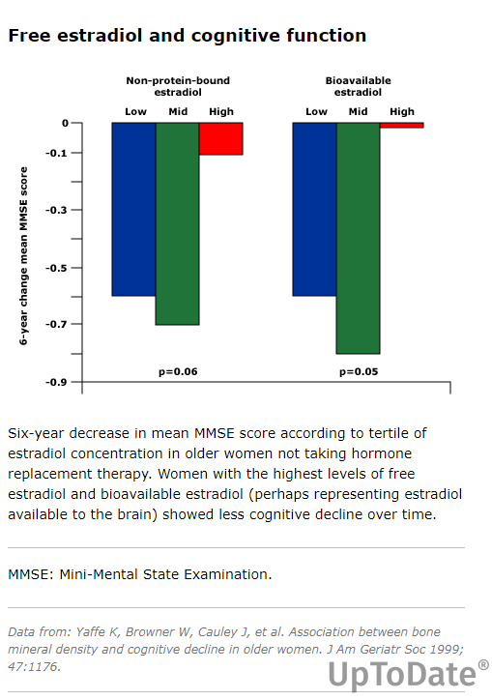

Slide 17
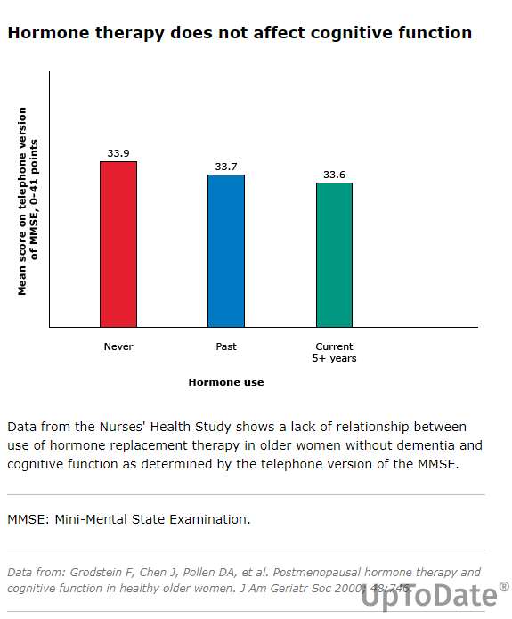

Slide 18
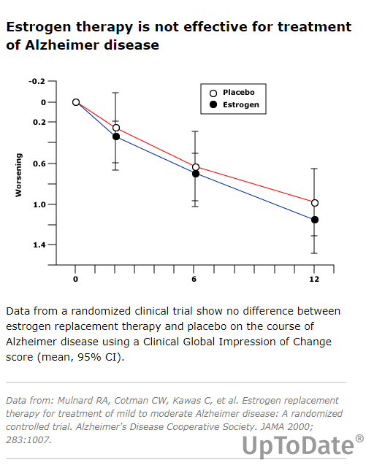

Slide 19
menopause & cognitive function
Cognitive function ?(Herman Depypere UGent)

Slide 20
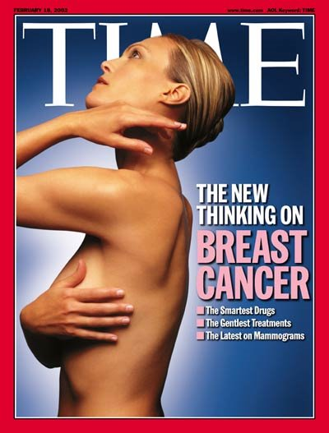
Late menopause increases
Breast Cancer risk (Meriem Sy (ULB)

Slide 21
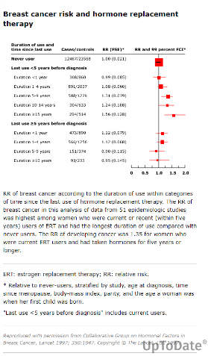
MHT & Breast cancer (Herman Depypere)

Slide 22

Genito Urinary Syndrome ofMenopause
VVA affects up to 70% of women after the menopause
Silke Vasseur (VUB)

Slide 23
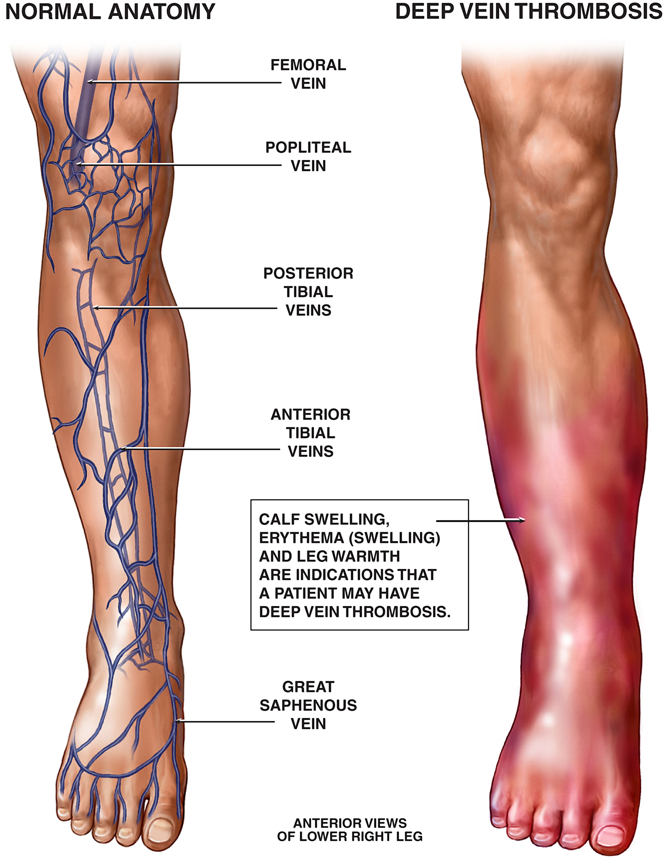
MHT related complications
Revisiting Hormonal Treatments and Thrombosis Risks: New Insights and Perspectives (Cidric Hermans UCL)

Slide 24
Non-hormonal therapy
NK1,3 antagonists
  Serge Rozenberg (ULB)

Slide 25
Practical issues
How to manage a menopause consultation
  Eveline Markowicz (Delta Brussels)
Case discussions
  Anne Firquet (ULiège)
Wrapping up and end of the meeting
  Serge Rozenberg (ULB)

Slide 26
GSM
VVA affects up to 70% of women after the menopause

Slide 27
Ready for a menopause consultation ?
How to manage a menopause consultation : (Eveline Markowicz, Delta Brussels)

Slide 28
Take home messages
Most women are likely to spend 1/3 of their life after menopause
Up to 40% of them will suffer moderate –severe VMS
Many can be helped using MHT
Others using other therapies, such as NK1, 3 antagonists
25% will suffer from osteoporosis
MHT decreases bone loss, but other osteoporosis therapy should be used later
Our goal is to help all our patients !

Slide 29
Notes:
63

