Slide 1


Contraception Need and Perimenopause
A Pintiaux- CHU Liège

Slide 2
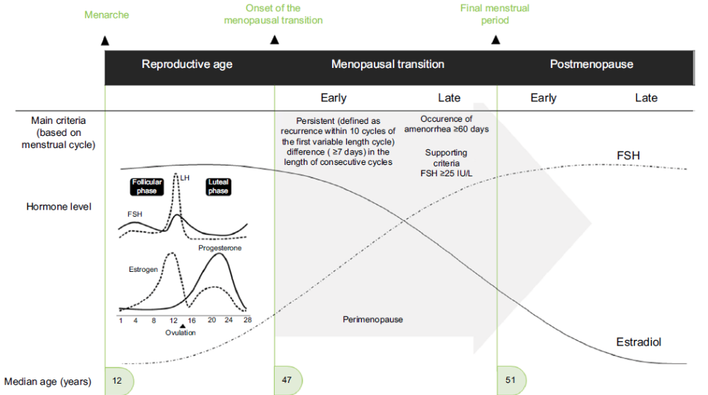

What is perimenopause?
Transition phase before menopause characterized by fluctuating hormones, irregular cycles, hot flushes, sleep disturbance, mood changes and vaginal symptoms.
MT begins four to six years before cessation of menses, and a physiologic deterioration of hypothalamic-pituitary-ovarian axis function associated with fluctuating hormone levels

Slide 3
Perimenopause care
Hormonal Management of Perimenopausal Bleeding, Contraception, and Symptom Control
Perimenopause presents complex needs:
  Frequent unscheduled bleeding
  Persistent risk of unplanned pregnancy
  Sometimes severe climacteric symptoms
Age-related risks (VTE, cardiovascular disease, obesity, cancers) must guide therapeutic choices.

Slide 4

Contraception and Perimenopause
Practical guidance for women aged 40+
Key topics
• Fertility during perimenopause
• Contraceptive options
• Benefits and risks : age-related risks (VTE, cardiovascular disease, obesity, cancers) must guide therapeutic choices
• When contraception can be stopped ?

Slide 5

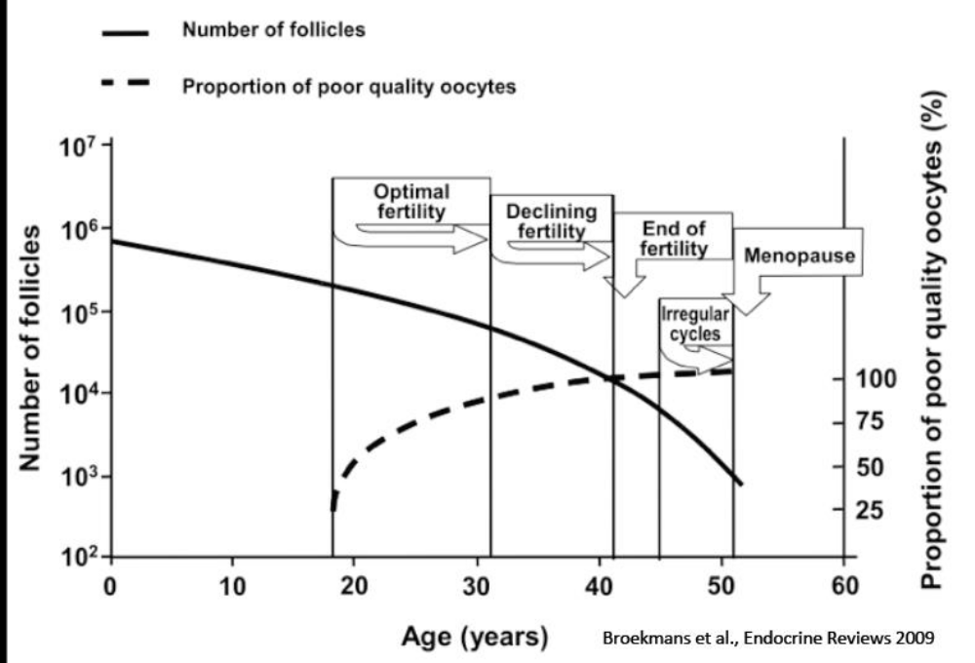
Why contraception still matters
• Fertility declines but pregnancy remains possible until menopause.
• Unintended pregnancy rates remain significant in women over 40.
• Pregnancies at older reproductive ages carry higher maternal and fetal risks.
Many hormone replacement therapy regimens do not provide contraception.
College of Sexual & Reproductive Healthcare. Contraception for women over 40 years; 2010 [cited 2025 Dec]. Available from: FSRH Clinical Guideline: Contraception for Women Aged over 40 Years (August 2017, amended July 2023)

Slide 6
Contraception and age related risks
Copper IUD and LNG-IUD remain first-line options. Progestin-only methods are generally preferred in women with VTE and CV risk factors. Combined hormonal contraception may be used in healthy, non-smoking women over 40 without contraindications. Avoid estrogen-containing contraceptives in women with major cardiovascular risk factors, previous VTE, migraine with aura, or significant hypertension
Higher Baseline VTE and CV Risk Migraine Dyslipidemia Diabetes Arterial hypertension Obesity Lifestyle smoking, sedentary, nutrition

Slide 7
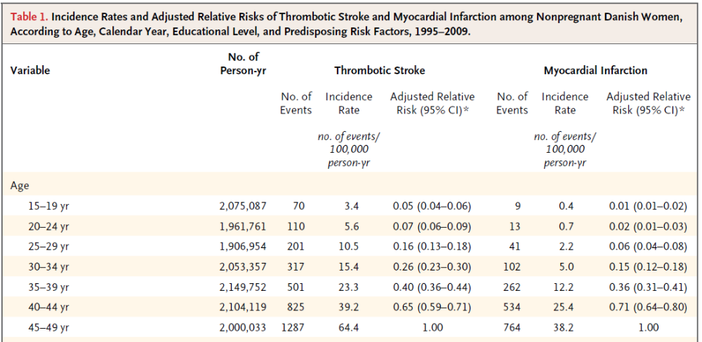
Age-related risks
Lidegaard, O.; Lokkegaard, E.; Jensen, A.; Skovlund, C.W.; Keiding, N. Thrombotic stroke and myocardial infarction with hormonal contraception. N. Engl. J. Med. 2012, 366, 2257–2266

Slide 8
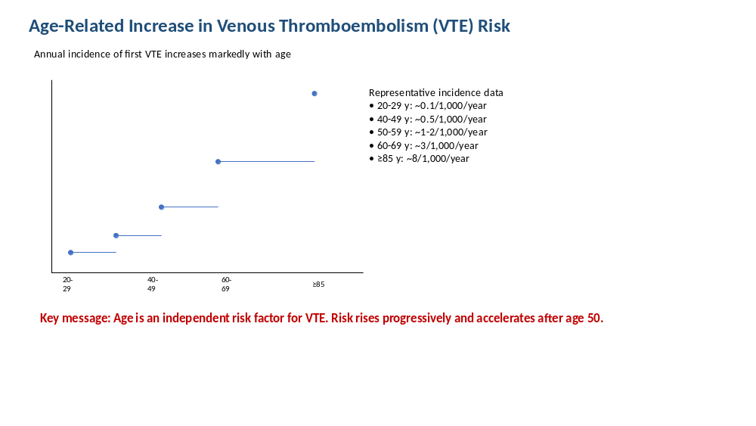
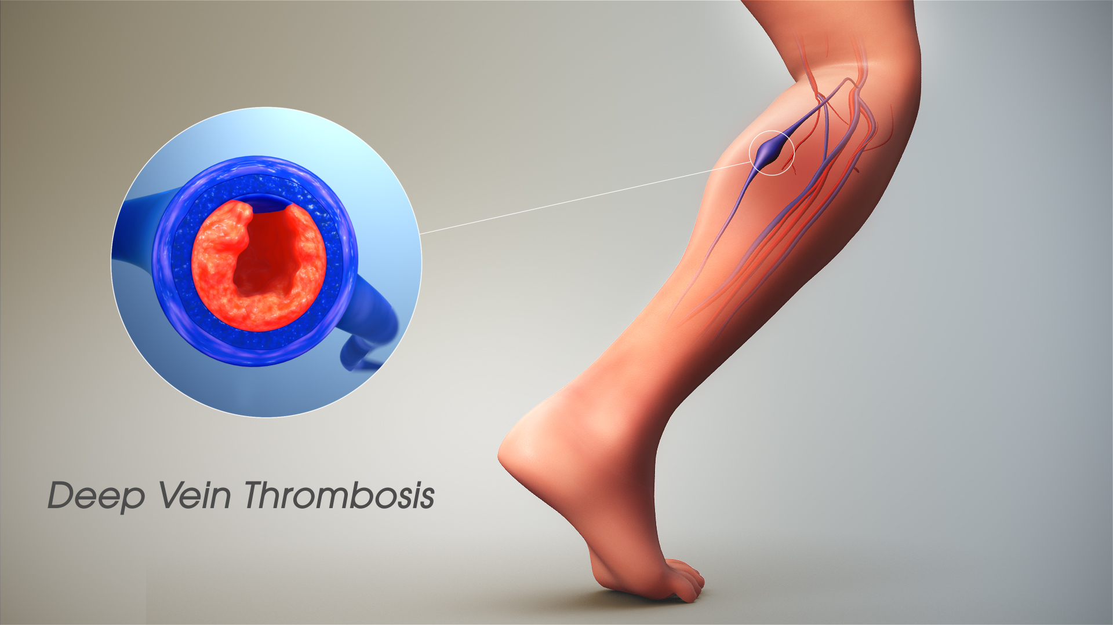
Heit JA et al., summarized in Epidemiology of Venous Thromboembolism. Risk approximately doubles with each decade after age 40. Lutsey PL, Zakai NA. Epidemiology and Prevention of Venous Thromboembolism. Nature Reviews Cardiology, 2022. Age is among the strongest established VTE risk factors. [nature.com]

Slide 9
Age is an independent risk factor for venous thromboembolism (VTE). The risk of VTE increases progressively throughout adulthood. The increase becomes more pronounced after age 50. Aging is associated with: Changes in coagulation and fibrinolysis Increased prevalence of obesity and comorbidities Reduced mobility Greater exposure to medical and hormonal therapies

Slide 10
The VTE risk lower with LNG-based oral contraceptives
Lidegaard et al. BMJ

Slide 11
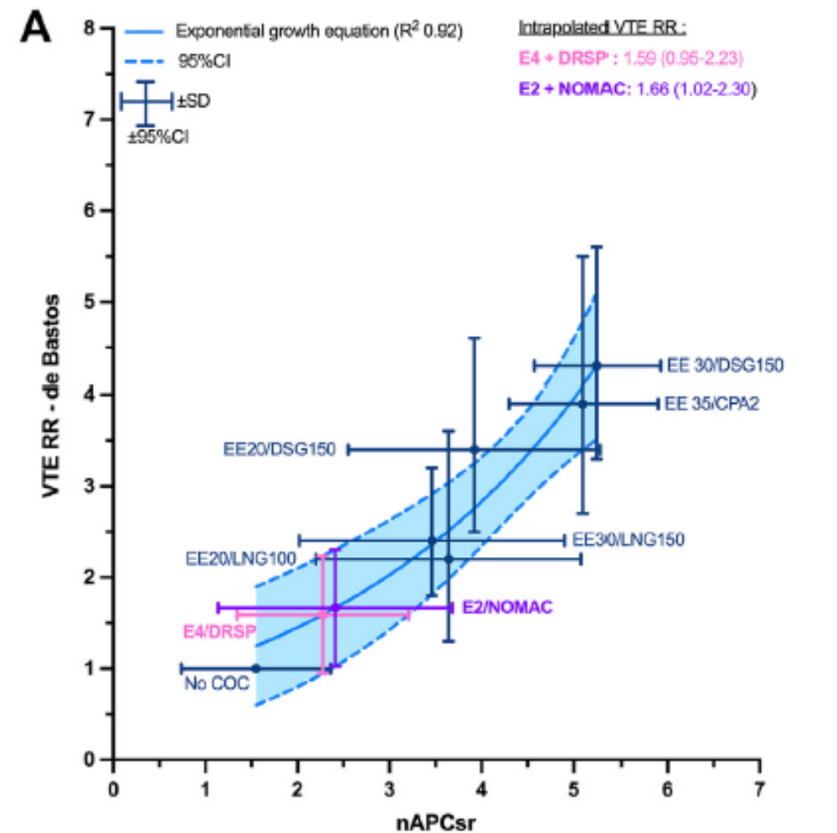
Normalized Activated Protein C Sensitivity Ratio
Morimont, L., Dogné J-M., and Douxfils J. Thrombosis Research 2020

Slide 12
When bleeding still matters
Women in the perimenopause need individualised advice to meet their specific health needs.
Health needs may include the management of unscheduled bleeding, perimenopausal symptom control, and provision of contraception
The 52 mg LNG-IUD remains the reference for:
  Up to 90% reduction in menstrual blood loss over 12 months
  Highly effective contraception
  Endometrial protection during HRT
Limitations: insertion pain, patient refusal, or contraindications
Alternative :
Progestin alone : drospirenone , dienogest , nomegestrol acetate
If vasomotors symptoms and non CI
  LNG –IUD + E2
  Drovelis (estetrol + drospirenone) ,Zoely or Qlaira
  : COC with potentially more favorable metabolic and hemostatic profile than EE-containing COCs
  E2 +Dienogest 2 mg

Slide 13
Climateric symptoms during menopause transition
1.Menopausal Hormone Therapy (MHT): Estrogen alone or combined with progestogen (antigonadotropic) to relieve hot flashes, night sweats, and vaginal symptoms. Combined Oral Contraceptives (COCs): Suitable for healthy women requiring both symptom control and contraception. Levonorgestrel-Releasing Intrauterine System (LNG-IUS): Provides contraception and endometrial protection when used with estrogen therapy. 2. Non-Hormonal Treatments SSRIs/SNRIs (e.g., escitalopram, venlafaxine): May reduce vasomotor symptoms. Gabapentin: Effective for hot flashes, particularly at night. Fezolinetant: Neurokinin-3 receptor antagonist approved for moderate to severe vasomotor symptoms. 3. Management of Genitourinary Symptoms Vaginal moisturizers and lubricants. Low-dose vaginal estrogen therapy. Vaginal dehydroepiandrosterone (DHEA) or ospemifene in selected patients. 4. Lifestyle Interventions Regular physical activity. Healthy diet and weight management. Smoking cessation and moderation of alcohol intake. Stress reduction techniques and adequate sleep.

Slide 14
Benefits beyond contraception
More predictable bleeding
Reduction in heavy menstrual bleeding
Possible improvement of vasomotor symptoms with combined hormonal methods
Protection against endometrial hyperplasia with some progestogen-containing methods
Combined hormonal contraception may also help preserve bone mineral density during the menopausal transition and reduce the risk of endometrial and ovarian cancer.

Slide 15


When can contraception be stopped?
“General guidance”:
• Under 50: continue for 2 years after the last natural menstrual period.
• Age 50 or older: continue for 1 year after the last natural menstrual period.
• Most women can stop contraception at age 55 because spontaneous conception is exceptionally rare.
FSRH Clinical Guideline: Contraception for Women Aged over 40 Years (August2017, amended July 2023)
determining menopausal status can sometimes be challenging
Is it a good guidance ??

Slide 16

Choosing the right method
Consider:
• Smoking status
• Hypertension and cardiovascular risk
• Migraine history
• Obesity
• Personal preference and adherence
• Need for symptom control

Slide 17

Key takeaways
✓ Perimenopause does not eliminate pregnancy risk.
✓ Contraception should be individualized.
✓ Hormonal methods may offer symptom benefits.
✓ Review risks regularly and plan transition to menopause care.
Perimenopausal care requires an individualized, multidisciplinary approach that addresses symptom relief, contraception, preventive health, and long-term cardiometabolic and bone health.

