Slide 1




Progestins and progesterone, routes of adminstration
PROF. DR. H. DEPYPERE
Borst en Menopauze kliniek, Universitair Ziekenhuis, Gent.

Slide 2
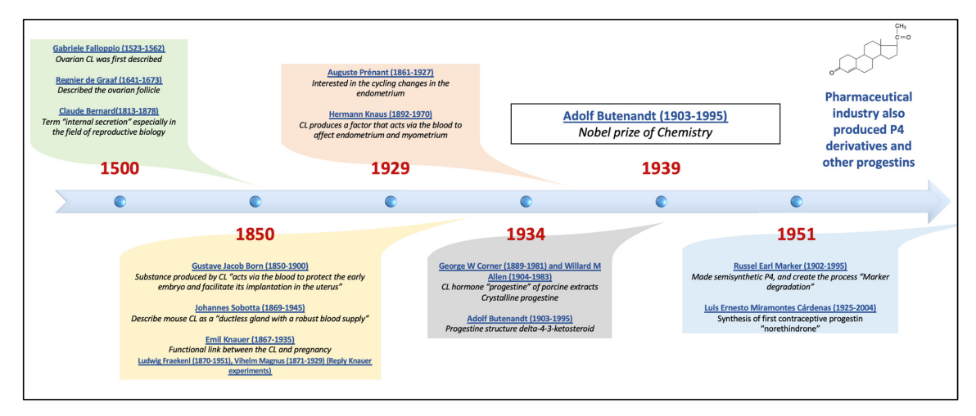

Slide 3
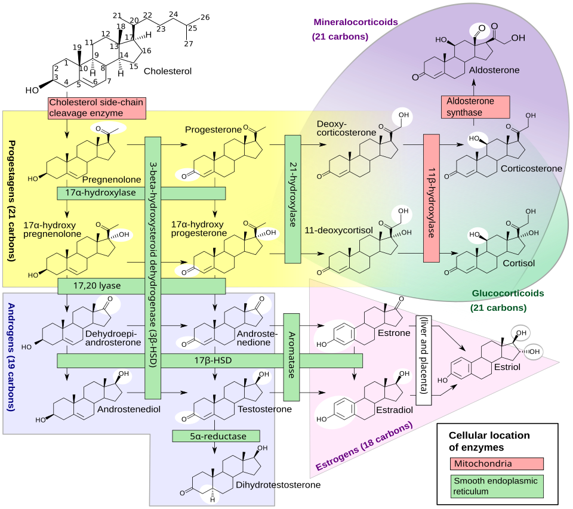

Slide 4
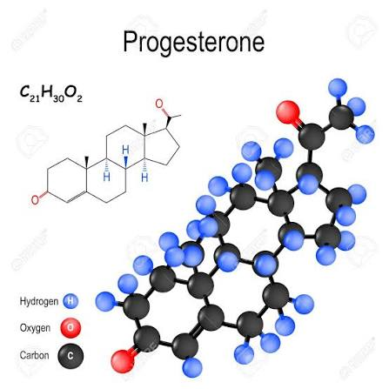
4
Notes:
4

Slide 5
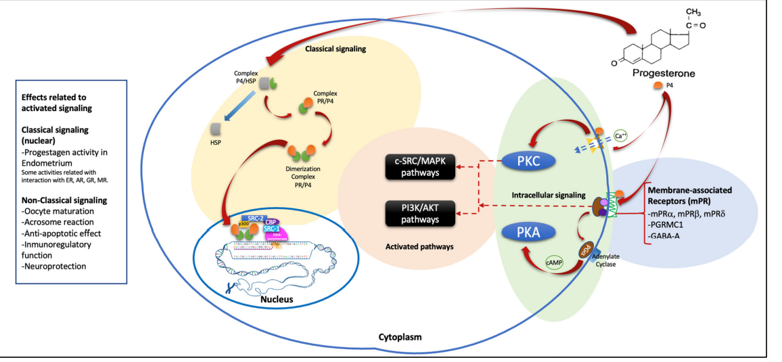
PrA regulator/inhibitor PrB – PrB activator of endometrium and breast – PrC – 5 membrane PR variants – partial Pr membrane components (anti apoptotic)

Slide 6
Reproductive Effects
Uterine lining: Thickens the endometrium during the second half of the cycle so a fertilized egg can attach.
Pregnancy support: Stops ovulation and prevents early labor once a pregnancy is established.
Menstrual regulation: Works with estrogen to time the menstrual cycle and shed the lining cleanly.
Breast tissue: Prepares the breasts for milk production.
Inducer of LH surge; acrosoom reaction
Brain, Sleep, and Mood
Calming effect: Binds to GABA receptors in the brain to reduce anxiety and promote relaxation.
Sleep support: Helps the central nervous system wind down, making it easier to fall and stay asleep.
Mood shifts: Acts as a natural stabilizer, though fluctuations or drops can trigger mood swings or low mood in some people.
Physical and Metabolic Effects
Bone health: Stimulates bone-building cells to support overall bone density.
Hormone balance: Acts as a counterpart to estrogen, preventing estrogen dominance.
Other systems: Influences thyroid function, fat utilization for energy, and fluid balance.

Slide 7
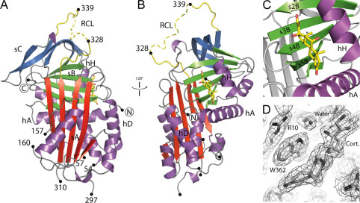
17 % is bound with high affinity to corticosteroid-binding globulin.
80 % is bound with low affinity to albumin.
3 % free circulating progesterone.

Slide 8
𝑇1/2𝛼 (Alpha half-life) = The distribution phase of progesterone is 6 min.
This is the distribution half-life. It indicates how quickly the drug is distributed from the bloodstream (the central compartment) to the surrounding tissues (the peripheral compartment).
Characteristics: This phase is usually very rapid (often taking minutes). As a result, the blood concentration drops sharply at the beginning, because the drug is simply "moving" into the tissues and is not yet being directly eliminated from the body.
𝑇1/2𝛽 (Beta half-life) = The elimination phase of progesterone is 42 min.
This is the biological or elimination half-life. It indicates how quickly the drug is actually removed from the body via the liver (metabolism) and the kidneys (excretion).
8
Notes:
8

Slide 9
With oral intake of natural progesterone
Even before progesterone reaches the liver, conversions already take place in the gut:
Gut bacteria: The microbiota in the gut possess enzymes (such as 5β-reductase) that immediately begin to break down progesterone.
Gut wall (Mucosa): The cells in the intestinal wall contain active enzymes (such as 5α-reductase and CYP3A4). These already convert a significant portion of the progesterone into metabolites during absorption.
Hepatic first-pass effect
All blood that absorbs nutrients and medication from the intestines flows via the portal vein directly to the liver first. The liver filters and processes this immediately through an aggressive metabolic network: 5α-reductase, 5β-reductase, and hydroxylases rapidly break down the remaining progesterone.

Slide 10
With oral intake of natural progesterone: 30 metabolites
5 alfa pregnanolone of allopregnanolone (3α,5α-tetrahydroprogesterone) and 5 beta pregnanolone (3α,5β-tetrahydroprogesterone):
Neurosteroids produced via 5α- and 5β-reduction. These bind to GABA-A receptors in the brain, causing the characteristic sedative, calming, or sleep-promoting side effects of oral progesterone.
20α-Dihydroprogesterone: A biologically active metabolite with weak progestogenic activity (25-50 %) that shows more sustained plasma elevation than progesterone itself after ingestion.
Pregnanediol-3α-glucuronide: A major conjugated urinary and circulating metabolite that shows the highest overall increase in plasma concentrations following oral treatment.
11-Deoxycorticosterone (DOC): Increases markedly in circulation shortly after oral administration. Potent mineralocorticoid.
17α-Hydroxyprogesterone: Typically exhibits the least pronounced increase among studied plasma metabolites.

Slide 11
100 mg oral intake
Peak level of 1.5 – 2.2 ng/ml after 2 hours (MS)
Rapid decrease to baseline within 4-6 hours (MS)
RIA peak of 19,4 ng/ml
200 mg higher incidence of drowsiness and dizzines even when drugs were taken at bedtime.
300 to 1200 mg increase of fatigue.
Case report of hypnotic state that lasted 2 h after 400 mg ingestion. Very high levels of 5 alfa and beta pregnanolone were recorded.

Slide 12
With vaginal intake of natural progesterone
Much less metabolization: less sedative
Higher levels of progesterone
Slow elimination – direct vagina to uterus transport – with high storage of progesterone in the uterus (10 times higher in the endometrium than serum levels) and subsequent delayed release.

Slide 13
With vaginal intake of natural progesterone
100 or 200 mg:
5 ng/ml at 6-12 h and remained at this level for 24 hours, and still detected levels at 72 h.
400 mg 16 ng/ml.

Slide 14
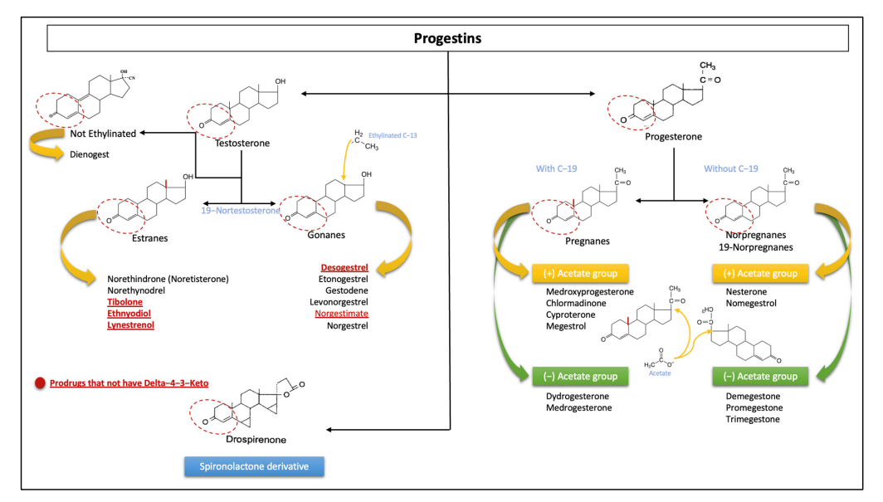
v
v
v

Slide 15
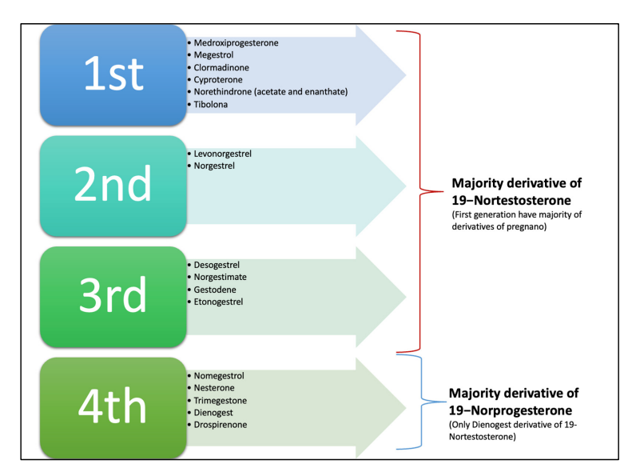

Slide 16
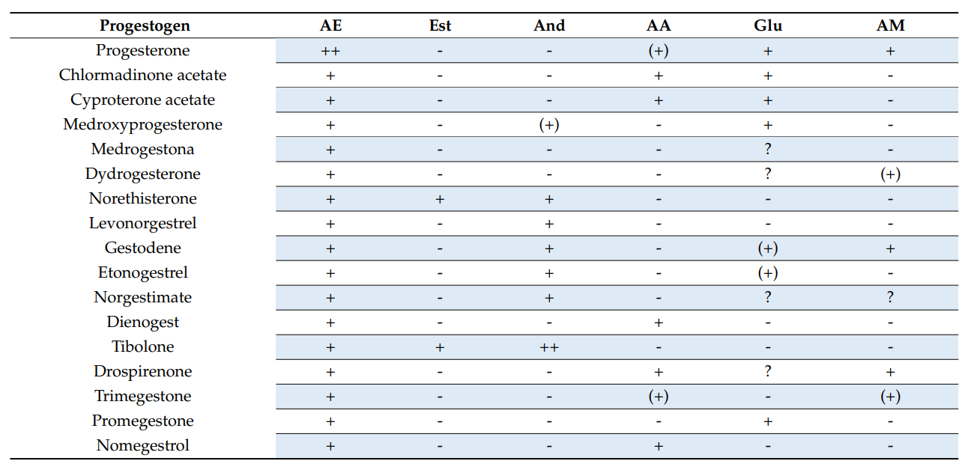

Slide 17
progestogen | Transformation dose (mg/cycle) | Ovulation inhibition dose (mg/day) | Dose in available preparations (mg/day)
progesterone | 4200 | 300
MPA | 50
Chlormadione acetate | 50 | 1,7 | 2,0
Cyproterone acetate | 20 | 1,0 | 2,0
dienogest | 6 | 1,0 | 2,0-3,0
Norethisterone acetate | 50 | 0,5 | 0,6
levonorgestrel | 5 | 0,06 | 0,1-0,15
desogestrel | 2 | 0,06 | 0,15
drosperinone | 50 | 2,0 | 3,0
gestodene | 3 | 0,04 | 0,06-0,075
Nomegestrol acetate | 100 | 1,25 | 2,5

Slide 18
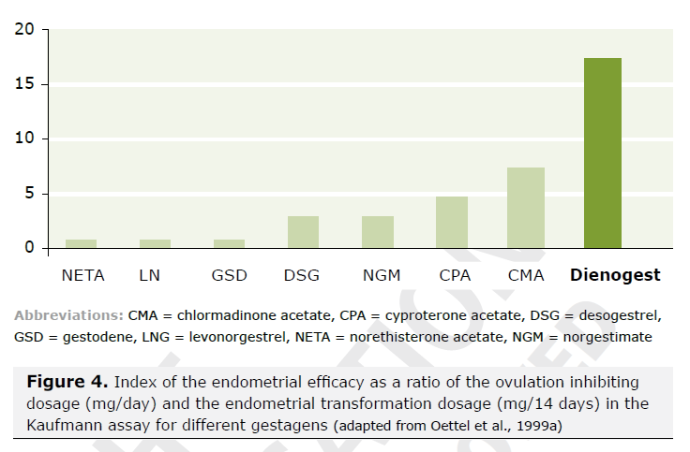
DNG, the most uterotropic progestin
IU= dose needed to inhibit ovulation / dose needed to transform the endometrium
Significant antiproliferative effect => persistent secretory transformation that results in endometrial atrophy
Antiproliferative action related to the PK profile:
  high bioavailability
  high plasma concentration in free form (no binding to SHBG),
  significant intracellular concentration.
Gräser T. Drugs of Today 1996,32 (Suppl H) . 43-55 – Bartsch V J med Drug Rev 2015, 5: 1-31

Slide 19
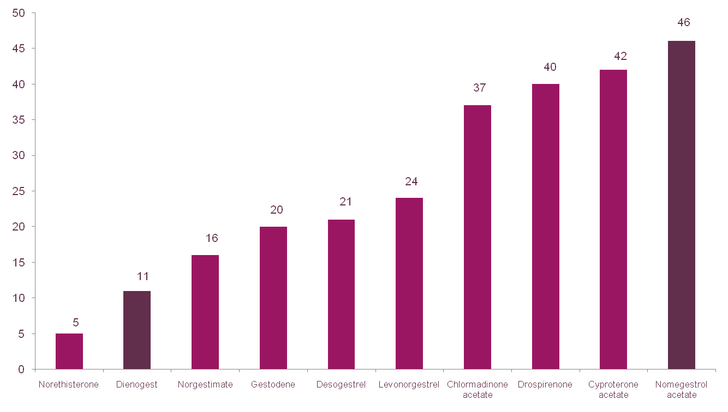
Half life

Slide 20
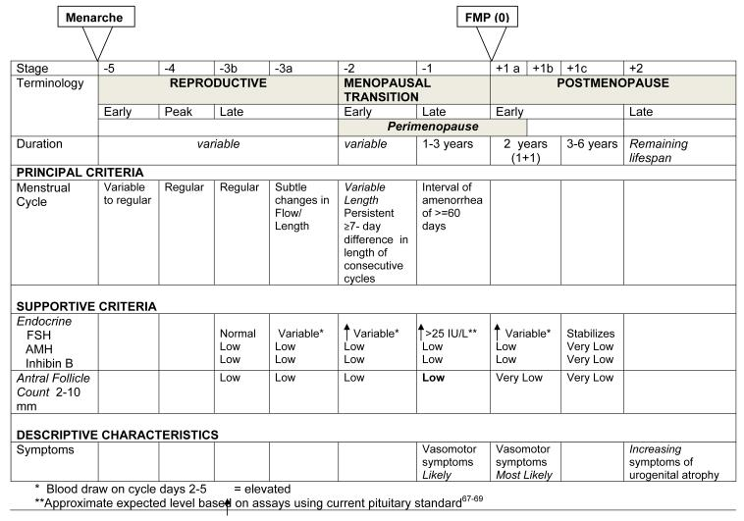
Straw+10 criteria
20
Harlow et al, climacteric, 2012
Notes:
20

Slide 21
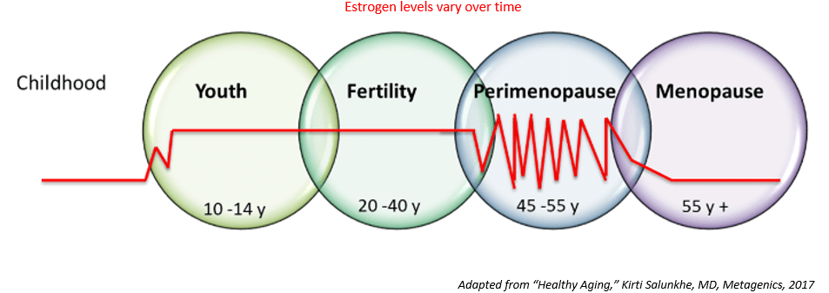
Estradiol levels
21
Notes:
21

Slide 22
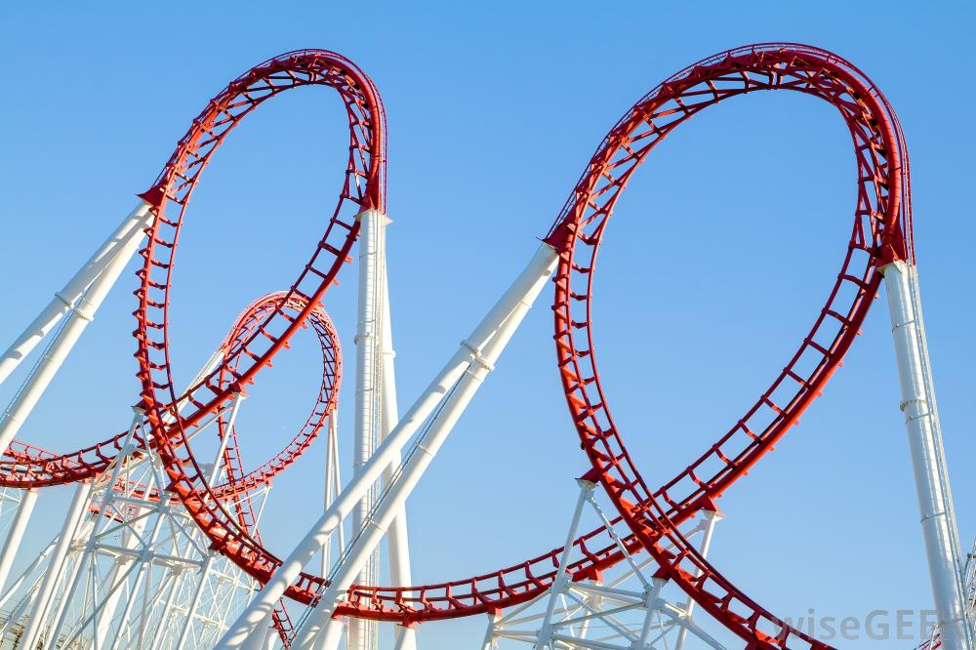
22
Notes:
22

Slide 23



“typical use” Pearl index in real life.
“Perfect use” Pearl index in instances of perfect use.
In transition there is still a need for contraception

Slide 24
Treatment options
Early transition: where no contraception is needed
Still a cycle, but with ovulatory disfunction
Cyclic natural progesteron: avoids hyperplasia and bleeding problems
24
Notes:
24

Slide 25
Treatment options
Late transition:
Disappearance of the cycle with occasional ovulation. More than 60 % are anovulatory *
Cyclic natural progesteron: avoids hyperplasia and bleeding problems, but can increase to disrupt ovulation.
* O'Connor KA, Ferrell R, Brindle E, Trumble B, Shofer J, Holman DJ, Weinstein M. Progesterone and ovulation across stages of the transition to menopause. Menopause. 2009 Nov-Dec;16(6):1178-87.
25
Notes:
25

Slide 26
Treatment options
Late transition:
Inhibit ovulation with a progestin and combine it with estrogen add back.
Avoids bleeding
Avoids hyperplasia
Avoids common complaints of emotional and physical fluctuation
Is contraceptive
26
Notes:
26

Slide 27
Treatment options
Late transition:
Inhibit ovulation with a progestin and combine it with estrogen add back.
Transdermal estrogens (gel, spray, patch), minimizes risk of trombosis.
27
Notes:
27

Slide 28
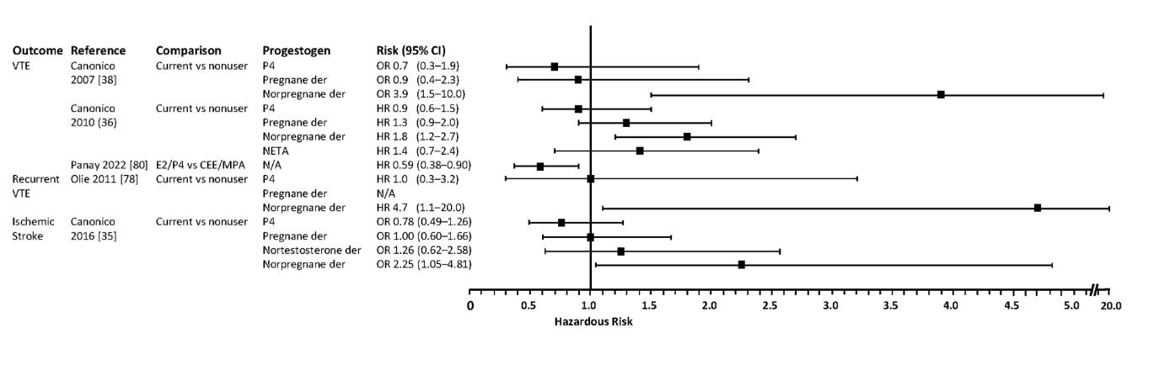
Cardiovascular outcome
Graham et al., Gyn endocrinology 2022; 38: 11 891-910.
28
Notes:
28

Slide 29
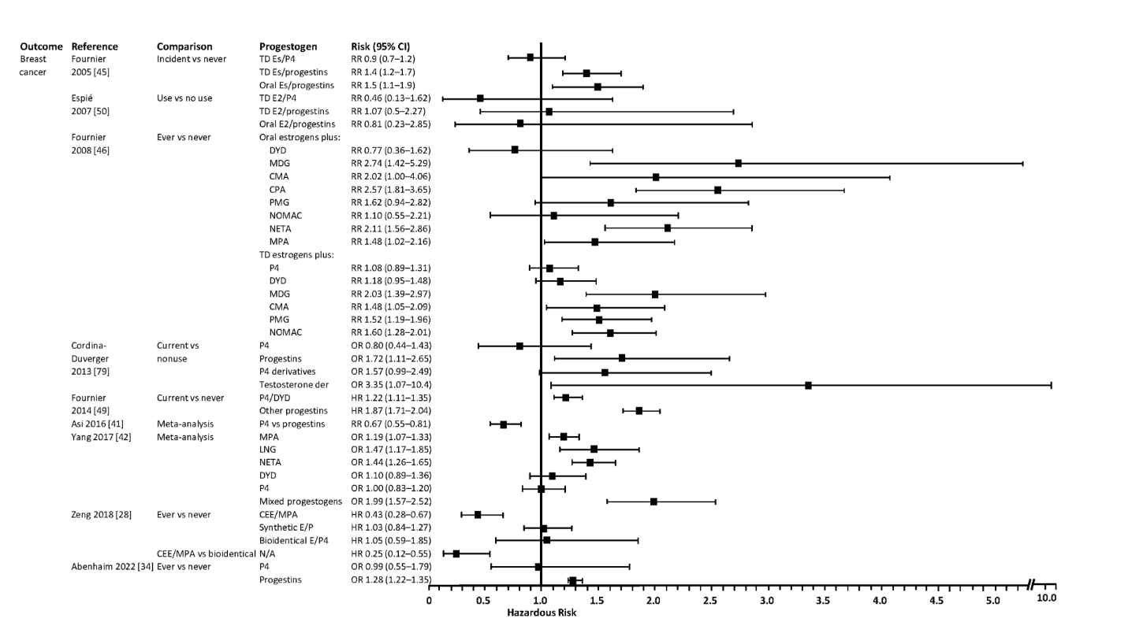
Breast cancer risk
29
Notes:
29

Slide 30
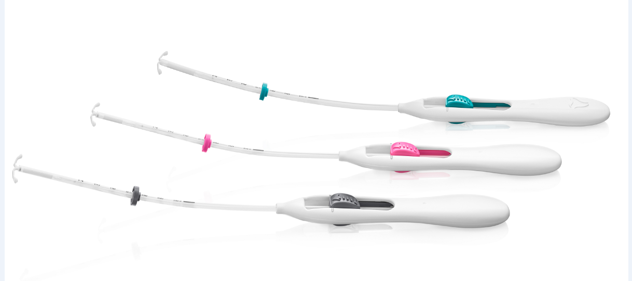

Slide 31
A 60-month non-comparative study on bleeding profiles with LNG IUS in transition from reproductive age contraception to menopausal age endometrial protection during ERT
Depypere H et al. European J Obstet Gynecol and Reprod Biol 2010,153:176-180
Screening failures
n=95
Screened
n=489
Started treatment
n=394
Completed contraception
n=336 (85.3%)
Continued to HRT
n=168 (42.6%)
Completed HRT
n=141 (83.9%)
Prematurely
discontinued
n=58 (14.7%)
Adverse event (9.4%)
Lost to follow-up (2.5%)
Other reason (2.3%)
Protocol deviation (0.5%)
Prematurely
discontinued
n=27 (16.1%)
Adverse event (10.7%)
Lost to follow-up (2.4%)
Other (1.8%)
Protocol deviation (1.2%)

Slide 32
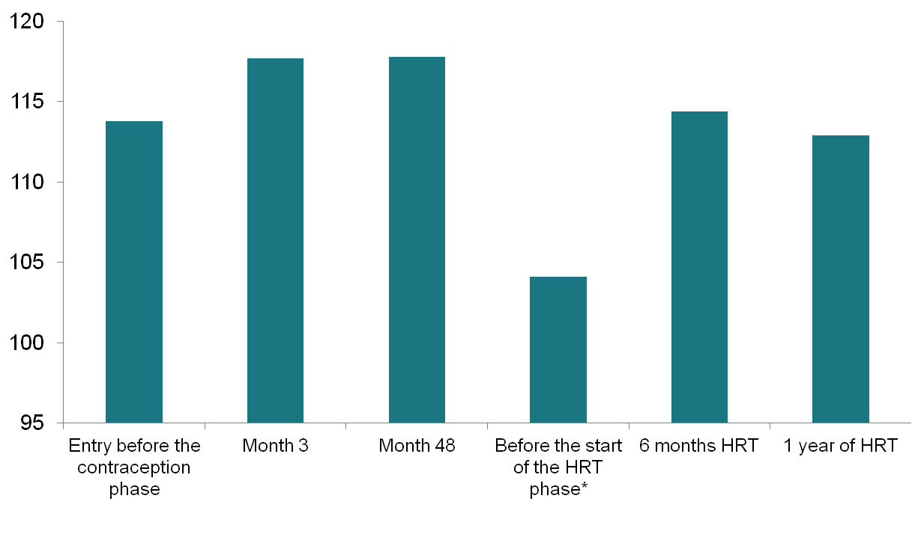
WHQ – Quality of Life Total Score
Total Score
* For the subjects entering the HRT phase

Slide 33
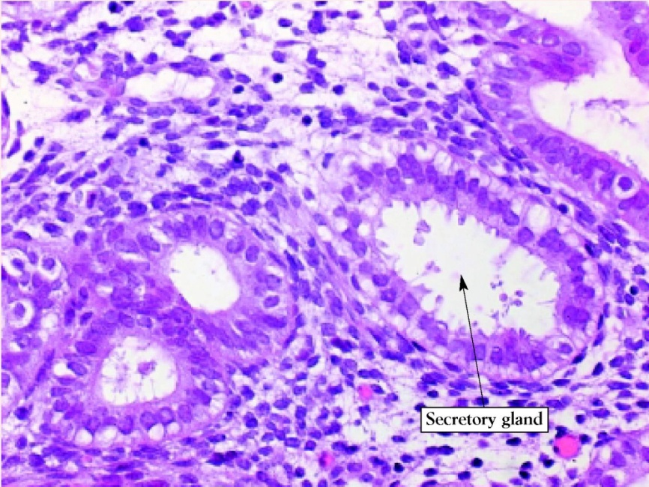

Endometrial Histology
Before and After LNG- IUS Insertion
Before
After
Notes:
33
33
33

Slide 34
Summary of Clinical Studies on LNG-IUS vs Endometrial Ablation/Resection for HMB
Study | Study design | Result
Barrington et al, 2003 | Prospective 6 months LNG-IUS vs TBA | Equal/LNG-IUS slightly better
Busfield et al, 2006 | Prospective 24 months comparative LNG-IUS vs TBA | LNG-IUS better
Crosignani et al, 1997 | Prospective 12 months comparative LNG-IUS vs TCRE | TCRE better
Henshaw et al, 2002 | Retrospective comparative LNG-IUS vs Microwave EA | Equal
Istre and Trolle, 2001 | Prospective 12 months comparative LNG-IUS vs TCRE | Equal/ TCRE slightly better
Rauramo et al, 2004 | Prospective 36 months comparative LNG-IUS vs TCRE | Equal
Shaw et al, 2007 | Prospective 12 months comparative LNG-IUS vs TBA | Equal
TBA = Thermal balloon ablation; TCRE = Transcervical resection of the endometrium. Barrington et al. Eur J Obstet Gynecol Reprod Biol. 2003;108:72–74; Busfield et al. BJOG. 2006;113:257–263; Crosignani et al. Obstet Gynecol. 1997;90:257–263; Henshaw et al. Aust N Z J Obstet Gynaecol. 2002;42:205–209; Istre & Trolle. Fertil Steril. 2001;76:304–309; Rauramo et al. Obstet Gynecol. 2004;104:1314–1321; Shaw et al. Aust N Z J Obstet Gynaecol. 2007;47:335–340.

Slide 35
Women with intermittent vasomotor complaints
Natural estrogen containing pil
Qlaira®
Zoely®
laclimella®
Drovelis ®/Lydisilka®
Velbienne®, laclimella®
35
Notes:
35

Slide 36
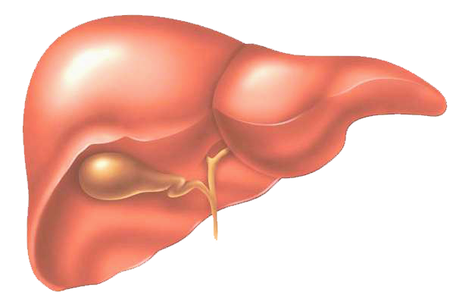
17β -E2 vs ethinylestradiol: different hepatic impact
Because of its ethinyl radical,
EE induces several hepatic passes^{(1, 2)}
The effects of EE on some hepatic proteins are up to 500 to
600 times greater than
those of E2⁽³⁾
EE
EE
EE
EE
Relative potency of estrogens
Estrogen | FSH | SHBG | CBG | Angiotensinogen
17β-E2 | 1 | 1 | 1 | 1
EE | 120 | 600 | 500 | 350
17β-E2 is used as reference
1 - Guengerich FP. Metabolism of 17 alpha-ethynylestradiol in humans. Life Sci 1990;47:1981-8
2 - Lobo RA & Stanczyk FZ. New knowledge in the physiology of hormonal contraceptives. Am J Obstet Gynecol 1994;170:1499-507
3 - Mashchak CA et al. Comparison of pharmacodynamic properties of various estrogen formulations. Am J Obstet Gynecol 1982;144:511-8

Slide 37
E4 15 mg/LNG
E4 15 mg /DRSP
E4 20
mg/LNG
E
4 20
mg/DRSP
E
2
V/DNG
E
4 15
mg/LNG
E
2
V/DNG
E4 20 mg/LNG
E
2
V/DNG
E4
15
mg/DRSP
E2V/DNG
E4
20
mg/DRSP
0.1
0.2
0.3
0.4
0.6
1.0
1.6
2.5
4.0
Odds ratios (95% confidence intervals) comparing the overall outcome based on scores in 4 domains: General feeling, Mood, Sexual life, Premenstrual complaints and Overall effect at cycles 1 to 6
37
Notes:
37

Slide 38
Estetrol (E4): Negligable effect on liver enzymes
Negligable effect of the following the P450 enzymes (<10%)
Estrogen at 10 μmol/L | % of P450 enzymes
 | CYP1A2 | CYP2C9 | CYP2C19 | CYP2D6 | CYP3A4
EE | <10 | <10 | 82 | <10 | 45
E2 | 19 | <10 | 63 | <10 | <10
E4 | <10 | <10 | <10 | <10 | <10
Visser M, et al. Climacteric 2008;11(Suppl.1):64–68

Slide 39
ETP: endogenous thrombin potential |VTE: venous thrombo embolism Normalized Activated Protein C Sensitivity Ratio
39
Notes:
39

Slide 40
relugolix
-Progestativa. De progestativa worden voornamelijk gebruikt om menstruatiestoornissen ten gevolge van myomen te bestrijden om bijvoorbeeld perimenopauzale vrouwen deze periode symptoomloos te laten overbruggen.
Hoewel progestativa in wezen de delingssnelheid van het myoom stimuleren, zullen zij in een hogere dosis door het negatieve feedbackmechanisme op de hypothalamus de GnRH-productie onderdrukken, waardoor een hypo-oestrogene toestand ontstaat.

Slide 41
Among premenopausal women over the age of 45 with abnormal bleeding, the risk for endometrial hyperplasia or cancer is increased three fold (OR 3,1 CI 1,5-6,1) and the overal prevalence is 7,9 % (22 out of 280 patients) Farqubar et al. Am J Ob Gyn 1999 181; 525-9.
Irregular bleeding : discomfort, medical problems, social impact

Slide 42

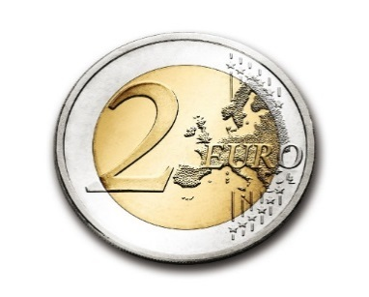
Abnormaal uterien bloedverlies – het stappenplan -
Stap 1: Definiëren van normaal uterine bloedverlies en abnormaal uterien bloedverlies
Frequentie van menses (dagen): | Afwezig (amenorroe) | Frequent (< 21 dagen) | Normaal (21 tot 35 dagen) | Niet frequent (> 35 d)
Duur bloedverlies (dagen): | Verlengd (> 8 dagen) | Normaal (4 tot 8 dagen) | Verkort (< 4 dagen)
Regelmatigheid van de menses: het verschil tussen de langste en de kortste cyclus: | Normaal (variatie < 9 d) | Onregelmatig (variatie > 9 dagen)
Volume maandelijks bloedverlies (ml): | Hevig (> 80) | Normaal (5-80) | Licht (< 5)
Intermenstrueel bloedverlies (IMB): bloedverlies tussen regelmatige menstruaties: | Normaal: Geen IMB | Willekeurig | Cyclisch (begin, halverwege of einde)
Niet geplande bloedingen onder hormonale medicatie: | Normaal: geen | Abnormaal: niet geplande bloedingen | Niet van toepasssing: patiënte neemt geen hormonale medicatie
Stap 2: De PALM-COEIN classificatie systeem van het abnormaal bloedverlies tijdens de reproductieve jaren.
P = Poliep A = Adenomyosis L = Leiomyoom M = Maligniteit of hyperplasie | C = Coagulopathie (systemische aandoeningen van de hemostase) O = Ovariële aandoeningen E = Endometriale oorzaken (primair en secundair) I = Iatrogeen* N = Nog niet geklassifieerd (zeldzame of onduidelijk gedefinieerde pathologiën) *IUD; direct effect op endometrium: bijv alle orale of systemische progestagenen; Medicatie die interfereert met de stolling of de ovulatie
Stap 3: De gestructureerde benadering voor de beoordeling van AUB- anamnese en klinisch onderzoek.

Slide 43
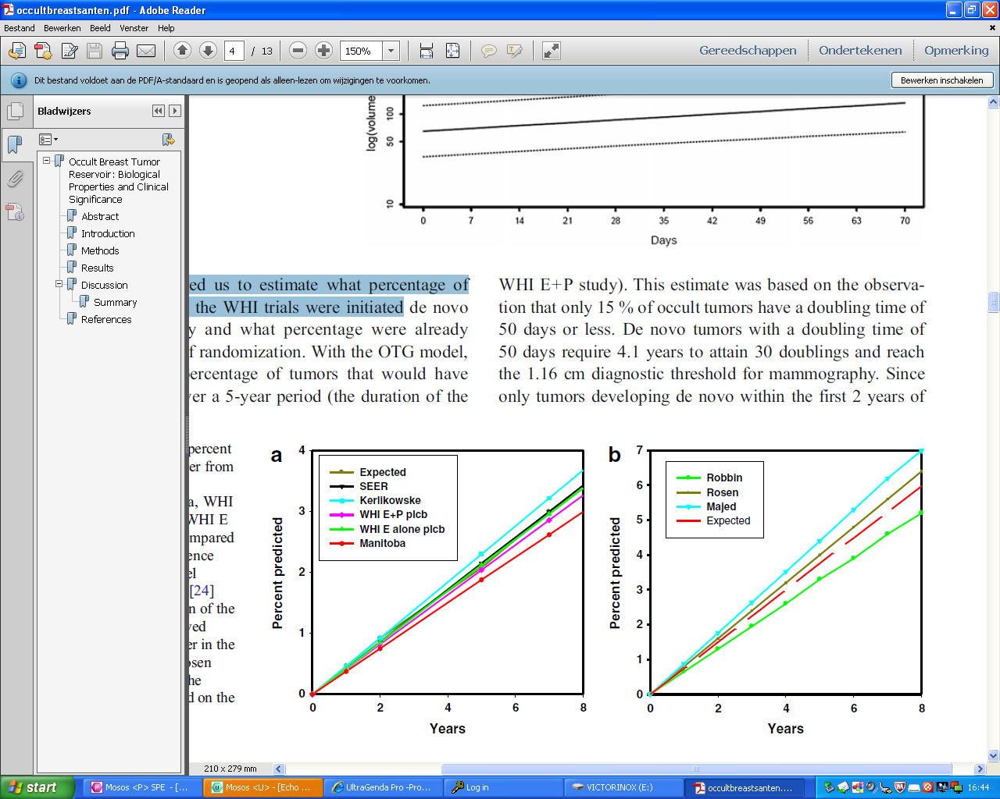
Occult breast cancer reservoir
Santen model (200 days doubling time, 1.16 cm detection, 7 % prevalence)
It takes 29 binary cell divisions to have a tumor of 1 cm size
What about premalignant lesions ?
Santen R et al. Horm canc, 2013; Santen R J of steroid biochemistry and molecular biology 2013.

Slide 44
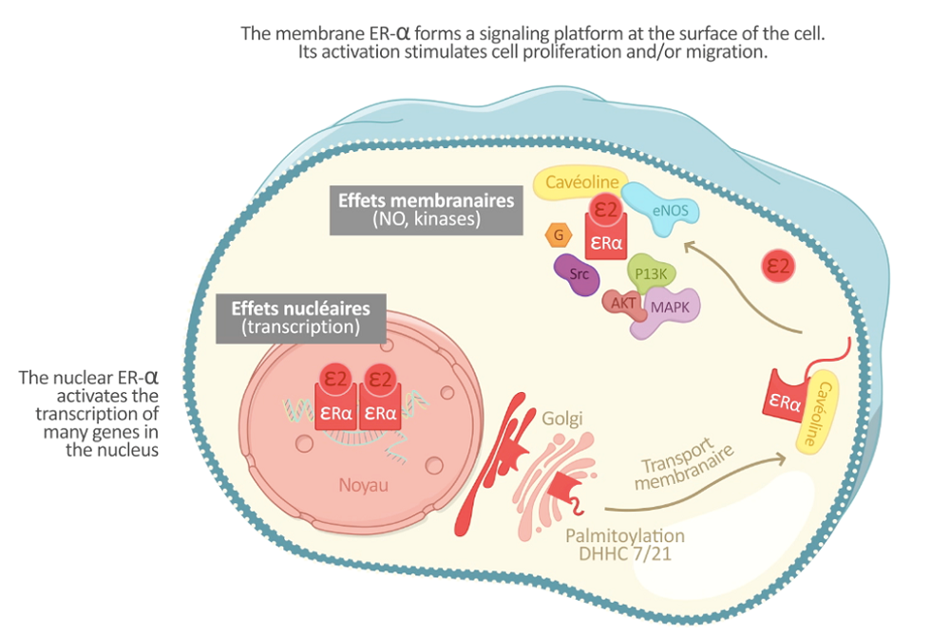
  E4 blocks the membrane estrogen receptor¹⁻³
  E4 has a neutral effect on the liver unlike other estrogens¹⁻³
  E4 has a low impact on normal and malignant breast⁴⁻⁷
44
Notes:
44

Slide 45
Conclusion
Every woman is unique
Every progestogen is unique
Metabolisation in different women is unique
45
Notes:
45

